Slide 1
CPP 4201 | ADVANCED PYTHON PROGRAMMING
Predicting University
Dropout
DATA
ETL
An ETL and machine-learning decision-support prototype
MODEL
KCA UNIVERSITY • KENYA
REVIEW
Tony Kenga · 24/03652
Baraka Blessings · 24/04272
Linet Maina · 24/00632
SUPPORT
Prototype • Human review required
Notes:
We present a reproducible Python workflow that extracts and validates a public dataset, trains and evaluates classifiers, and exposes results through a Streamlit app with a separate Kenyan-campus support prototype. The project is decision support for a class demonstration, not a deployed student-risk service.
Screenshot / audience focus: The visual links data engineering, prediction, review and student support as connected but distinct components.
Advanced Python concept: Modular Python design connects ETL, model and application modules; no single component makes a consequential student decision.
Source evidence: Repository structure: src/dropout_pipeline/ modules; Streamlit entry point support_app.py.
Design choice: The simple native diagram previews the real system stages without implying an external integration.
Transition: First, we will explain the student-support problem and where a careful early-warning prototype might fit.

Slide 2
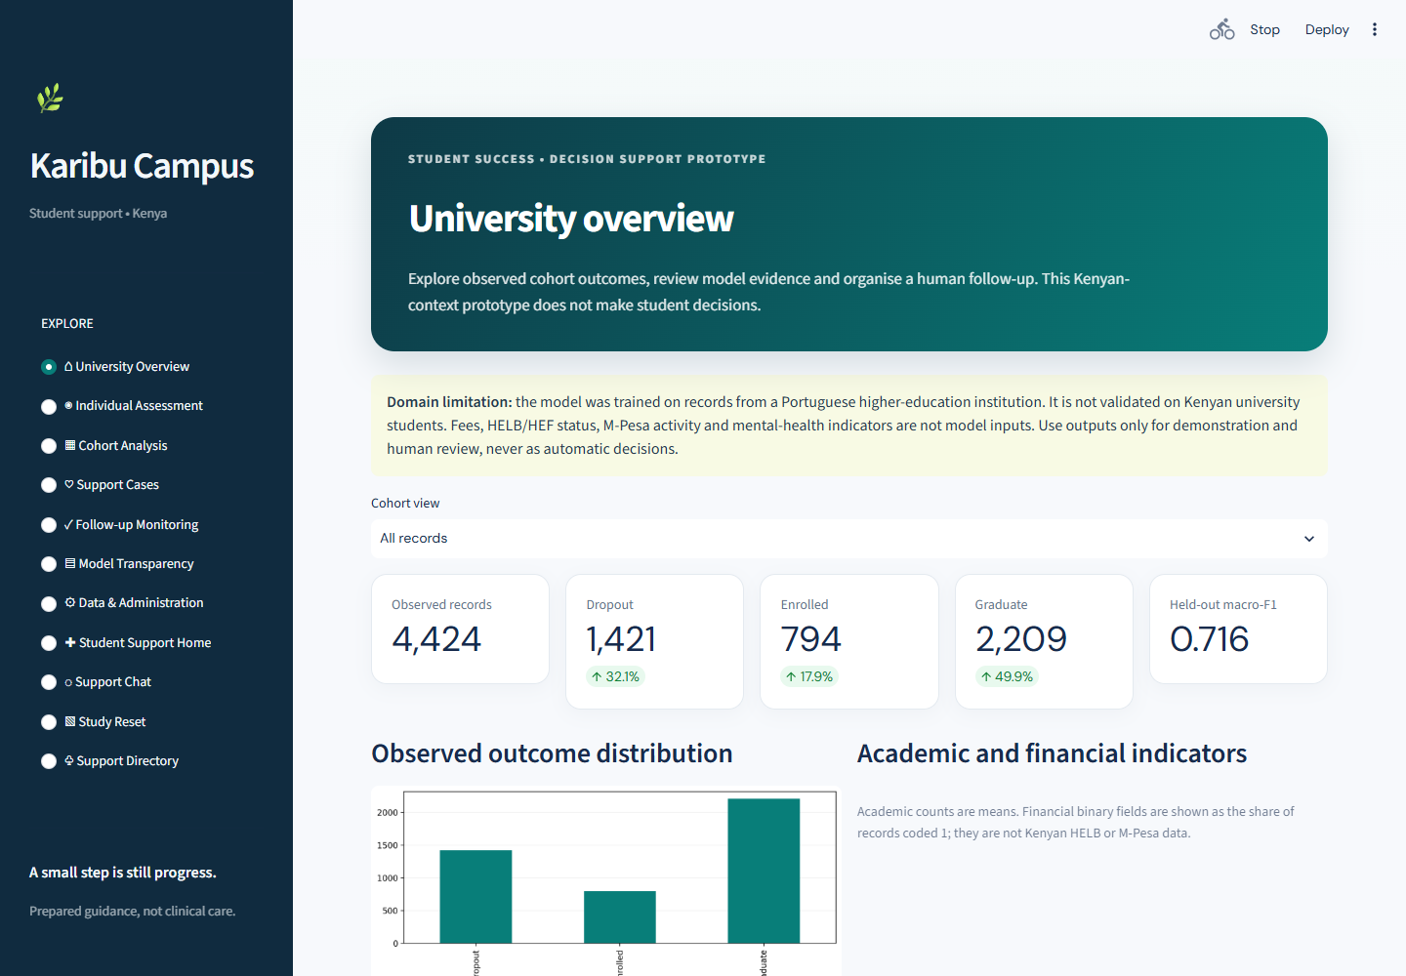
PROJECT PRESENTATION
A campus challenge—and a careful use case
From signal to supportive conversation
A Kenyan campus may see a student juggling CATs, rent, food, transport, fee clearance or homesickness. An adviser could notice a concern, listen, and offer a relevant human referral.
PREDICTION ≠ DECISION
Observed data → staff review → student-led next step
The model is trained on Portugal’s UCI cohort. Its probabilities are not validated for Kenyan students.
LIVE APP • University overview with cohort counts and held-out metric
ADVANCED PYTHON CONNECTION
Modular boundaries keep data processing, inference, and human support workflows separate.
KCA University • CPP 4201 • Advanced Python Programming
02 / 10
Notes:
Student withdrawal and interrupted progression can affect students, families and institutions. A possible campus use case is to help authorised advisers organise timely check-ins. It would not decide who receives aid, enrolment access or disciplinary action.
Screenshot / audience focus: Notice the dashboard itself calls out the Portuguese source cohort and says the model is not validated in Kenya.
Advanced Python concept: Separation of concerns: cohort view, model and support workflow are implemented in distinct functions/modules.
Source evidence: src/dropout_pipeline/support_app.py: _render_home and main; project README dataset/domain limitations.
Design choice: The Kenyan scenario is explicitly proposed context; the screenshot stays anchored to the actual UCI-based app.
Transition: Now we will trace how those components are connected in the implemented architecture.

Slide 3
PROJECT PRESENTATION
System architecture: a reproducible path from data to review
01
EXTRACT
02
VALIDATE
03
TRANSFORM
UCI ZIP → CSV
Schema • rows • labels
Split • preprocess
extract.py
validate.py
transform.py
06
SUPPORT
05
SERVE
04
TRAIN + EVALUATE
Chat • cases • follow-up
Streamlit views
3 models • CV • holdout
support_chatbot.py
support_app.py
model.py • evaluate.py
ARCHITECTURE PRINCIPLE
Reproducible model pipeline and Kenyan-campus student-support hub share one application shell, but the support chatbot does not call the dropout model.
KCA University • CPP 4201 • Advanced Python Programming
03 / 10
Notes:
This is the implemented flow. Extraction and validation feed training. Training compares three classifiers with stratified cross-validation on training rows; the selected estimator is evaluated on a held-out test set. Streamlit presents both analytical pages and a separate Kenyan-campus support experience.
Screenshot / audience focus: Follow the arrows: the wellbeing chatbot is a prepared-intent module and is not a generative AI interface or model inference endpoint.
Advanced Python concept: Python modules and typed interfaces; the model evaluation stage writes structured artifacts used by the app.
Source evidence: src/dropout_pipeline/extract.py, validate.py, transform.py, model.py, evaluate.py, support_app.py, support_chatbot.py.
Design choice: The architecture separates reproducible retrospective modelling from student-facing signposting.
Transition: The next slides look closely at data extraction and validation, then the leakage-safe preprocessing path.

Slide 4
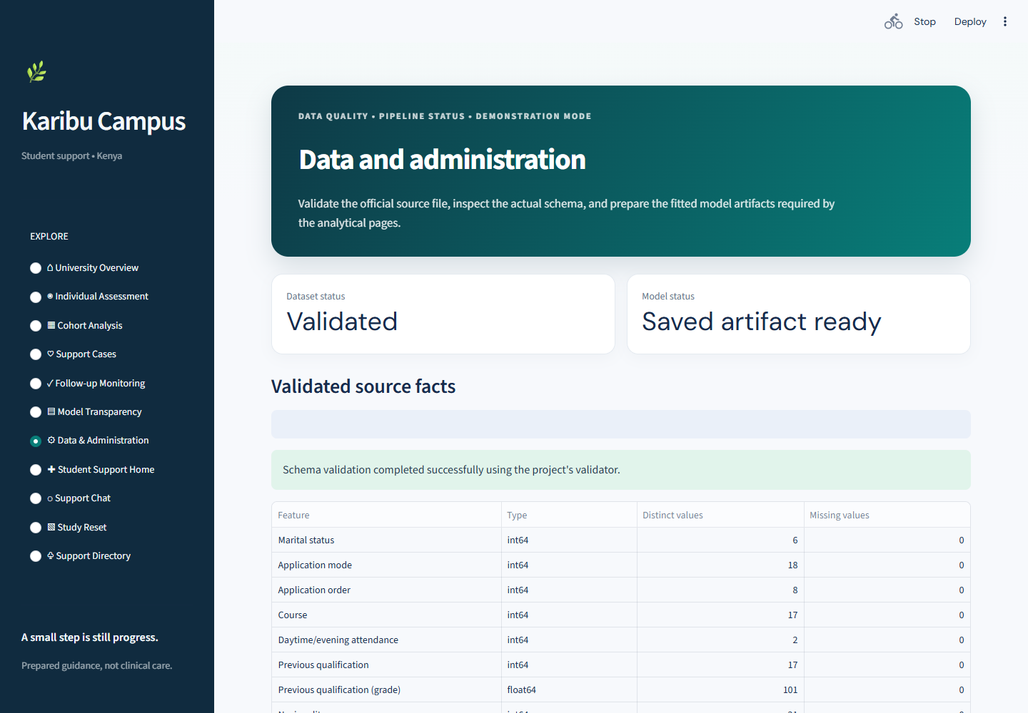
PROJECT PRESENTATION
Extraction and validation protect the data contract
ADVANCED PYTHON CONNECTION
Protocols, generators & domain errors
FrameValidator Protocol in validate.py defines the validation contract. iter_nonempty_lines() streams numbered CSV lines; load_and_validate() checks 37 fields, labels, missing values and numeric predictors. SchemaError and ValidationError name failure types.
WHY IT HELPS
Invalid structure stops the pipeline with a useful, traceable error. Lazy iteration and bounded findings avoid building duplicate intermediate line lists.
KCA University • CPP 4201 • Advanced Python Programming
04 / 10
Notes:
The data page shows the current dataset state and administrative controls. The loader expects the UCI semicolon-delimited file and checks its schema before modelling. It checks targets Dropout, Enrolled and Graduate and numeric predictor columns.
Screenshot / audience focus: Look at the validated row/column facts and data-quality panel. The screen is generated by the actual validation path.
Advanced Python concept: Protocol supports interchangeable validators; generator yields each non-empty source line with a line number; custom exceptions distinguish schema from content errors.
Source evidence: src/dropout_pipeline/validate.py: FrameValidator, ValidationFinding, _width_findings, load_and_validate; extract.py: iter_nonempty_lines; exceptions.py.
Design choice: A Protocol and generator make the contract and streaming behavior explicit without requiring an elaborate validation framework.
Transition: With a validated frame, the next question is how preprocessing avoids learning from held-out rows.

Slide 5
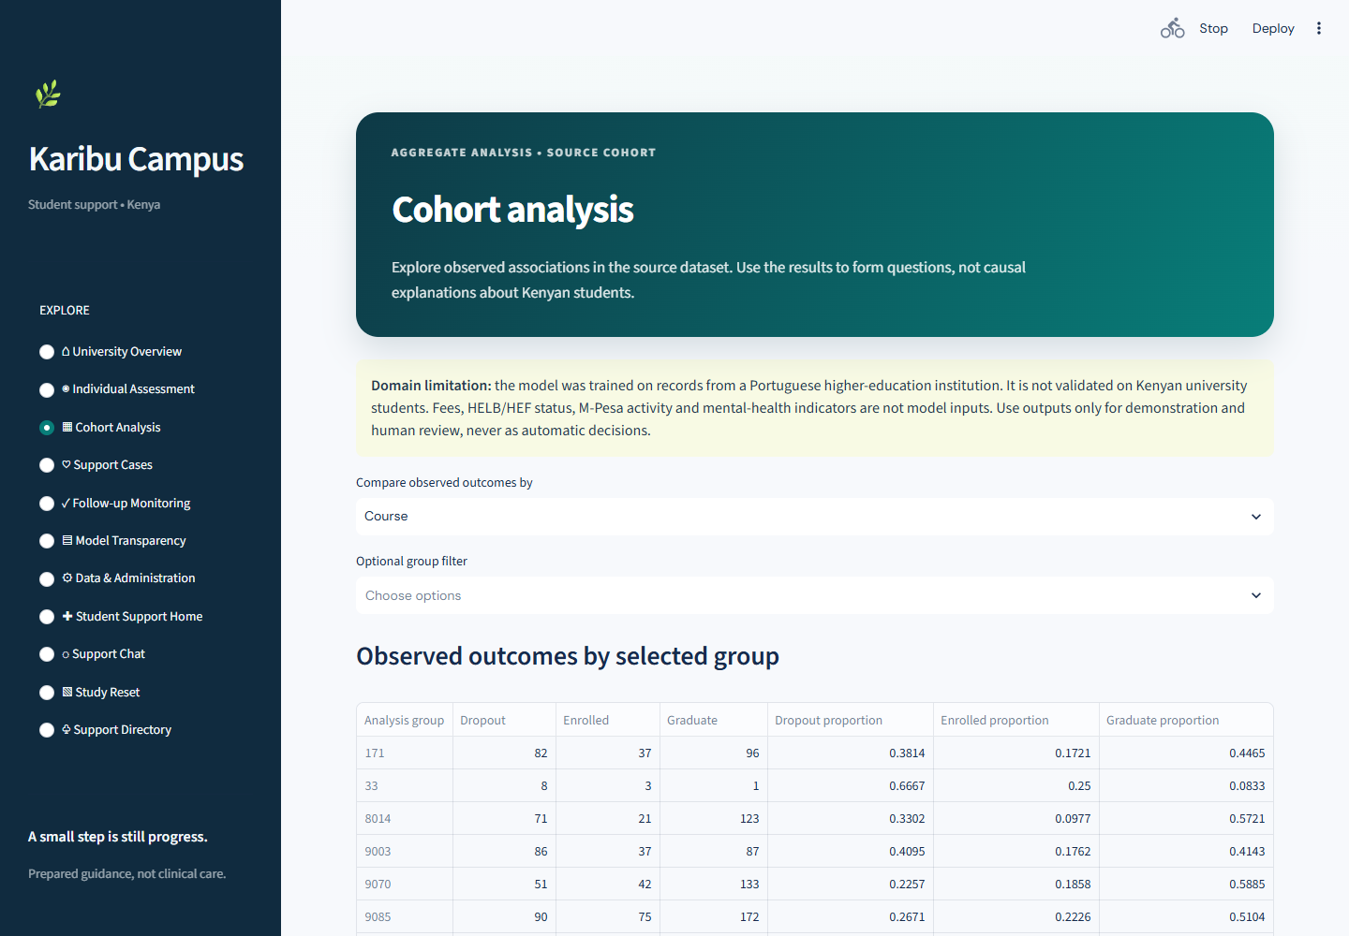
PROJECT PRESENTATION
Transformation keeps preprocessing inside the training folds
ADVANCED PYTHON CONNECTION
Composition with scikit-learn Pipeline
make_preprocessor() builds the project transformer; model.py composes it with each classifier in a scikit-learn Pipeline. StratifiedKFold and cross_validate operate on training partitions.
WHY IT HELPS
Each fold fits preprocessing only on that fold’s training data. This reduces leakage and makes candidate comparisons more reproducible.
KCA University • CPP 4201 • Advanced Python Programming
05 / 10
Notes:
The cohort page summarizes observed source-data patterns; it is descriptive rather than causal. For modelling, feature handling is composed with the estimator as a scikit-learn Pipeline, and cross-validation happens within training data. The final test partition remains for evaluation.
Screenshot / audience focus: The cohort page shows the real outcome distribution. The transformation design is shown alongside it, not claimed as a UI control on this view.
Advanced Python concept: Reusable functions plus scikit-learn Pipeline composition; stratified cross-validation, with preprocessing fitted within each training fold.
Source evidence: src/dropout_pipeline/transform.py: make_preprocessor and split_dataset; model.py: compare_models.
Design choice: A scikit-learn Pipeline is a machine-learning composition pattern, not a Python language feature.
Transition: Once candidates are compared fairly, we can inspect inference and the result the interface displays.

Slide 6
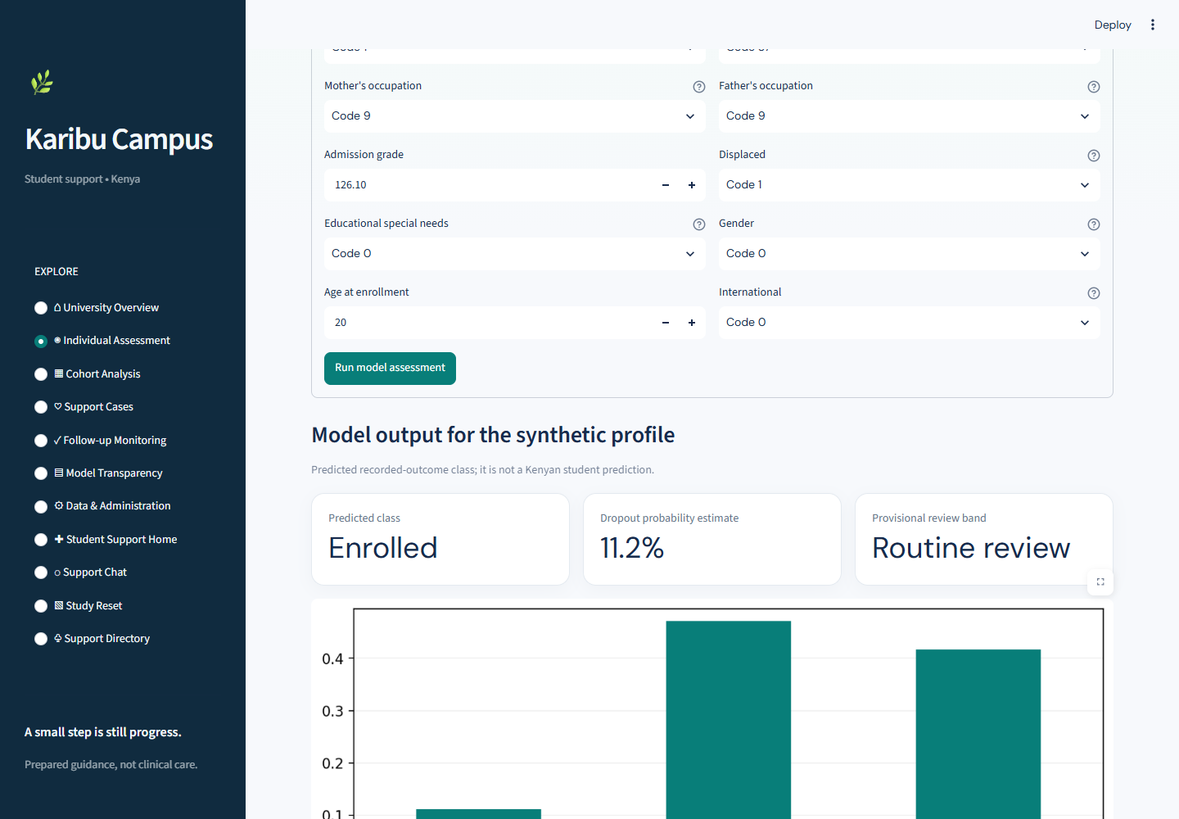
PROJECT PRESENTATION
Prediction is a model output for human review
ADVANCED PYTHON CONNECTION
Typed result objects & explicit categories
inference.py returns an Assessment with predicted class, class probabilities and a review band. ReviewBand is a StrEnum. The app checks that feature names/order and model classes match saved metadata.
WHY IT HELPS
A structured result keeps score, label and provisional review wording together; input/model mismatch fails clearly instead of silently relabelling outputs.
Synthetic demonstration profile • not Kenyan evidence
KCA University • CPP 4201 • Advanced Python Programming
06 / 10
Notes:
The assessment page uses a synthetic profile, and its displayed result comes from the saved model artifact. The model predicts one of the dataset outcome classes—Dropout, Enrolled or Graduate—then returns class probabilities and a provisional review band.
Screenshot / audience focus: The screenshot visibly labels the profile synthetic and includes the scope warning. Do not describe its output as a Kenyan student prediction.
Advanced Python concept: Frozen dataclass Assessment groups inference outputs; ReviewBand StrEnum constrains review labels; validation checks model feature ordering.
Source evidence: src/dropout_pipeline/inference.py: Assessment, ReviewBand, assess_student; support_app.py: _render_assessment.
Design choice: Structured return data is easier to test and render than loosely coupled positional values.
Transition: A prediction needs evaluation context, especially class-level performance and the source domain.

Slide 7
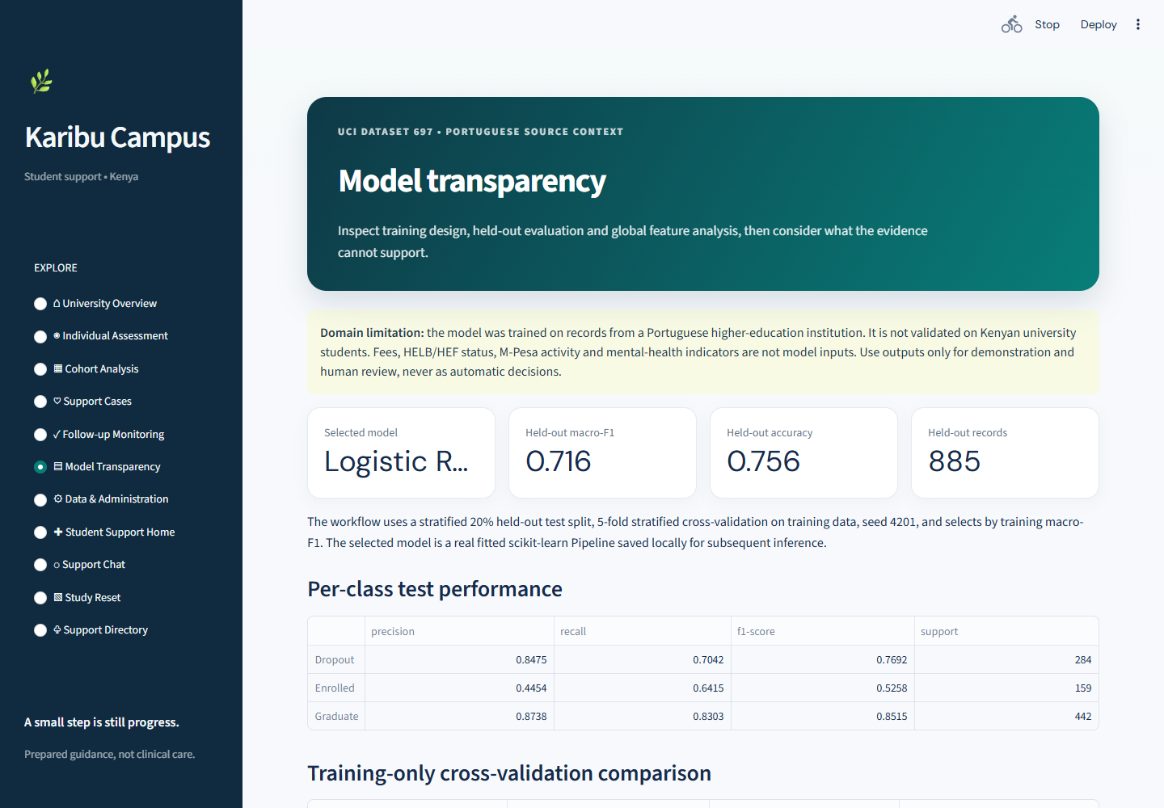
PROJECT PRESENTATION
Evaluation is measurable—and bounded by its source cohort
ADVANCED PYTHON CONNECTION
Reusable evaluation & pattern matching
evaluate_selected() writes metrics.json, a classification report, confusion matrix and permutation importance. _interpret_outcome() uses match/case. Logistic Regression was selected from three candidates.
WHY IT HELPS
Macro-F1 gives each class equal weight. Per-class precision and recall make weaker Enrolled detection visible instead of hiding it inside accuracy.
KCA University • CPP 4201 • Advanced Python Programming
07 / 10
Notes:
On the 885-row held-out test partition, the selected Logistic Regression pipeline achieved macro-F1 0.7155 and accuracy 0.7559, displayed rounded to 0.716 and 0.756. Enrolled is the weaker class in the per-class results, so aggregate performance is not enough. The test partition is from the Portuguese UCI cohort.
Screenshot / audience focus: The transparency page provides the real metrics and per-class report. The confusion matrix is also preserved as a standalone evidence asset in the deck assets.
Advanced Python concept: Reusable evaluation function writes machine-readable results; match/case maps target labels to readable display names.
Source evidence: src/dropout_pipeline/evaluate.py: evaluate_selected, _interpret_outcome; outputs/metrics.json and confusion_matrix.png.
Design choice: Macro averaging helps reveal uneven class performance; the slide avoids presenting accuracy as proof of real-world effectiveness.
Transition: We now move from retrospective prediction to a human-owned support and follow-up process.

Slide 8
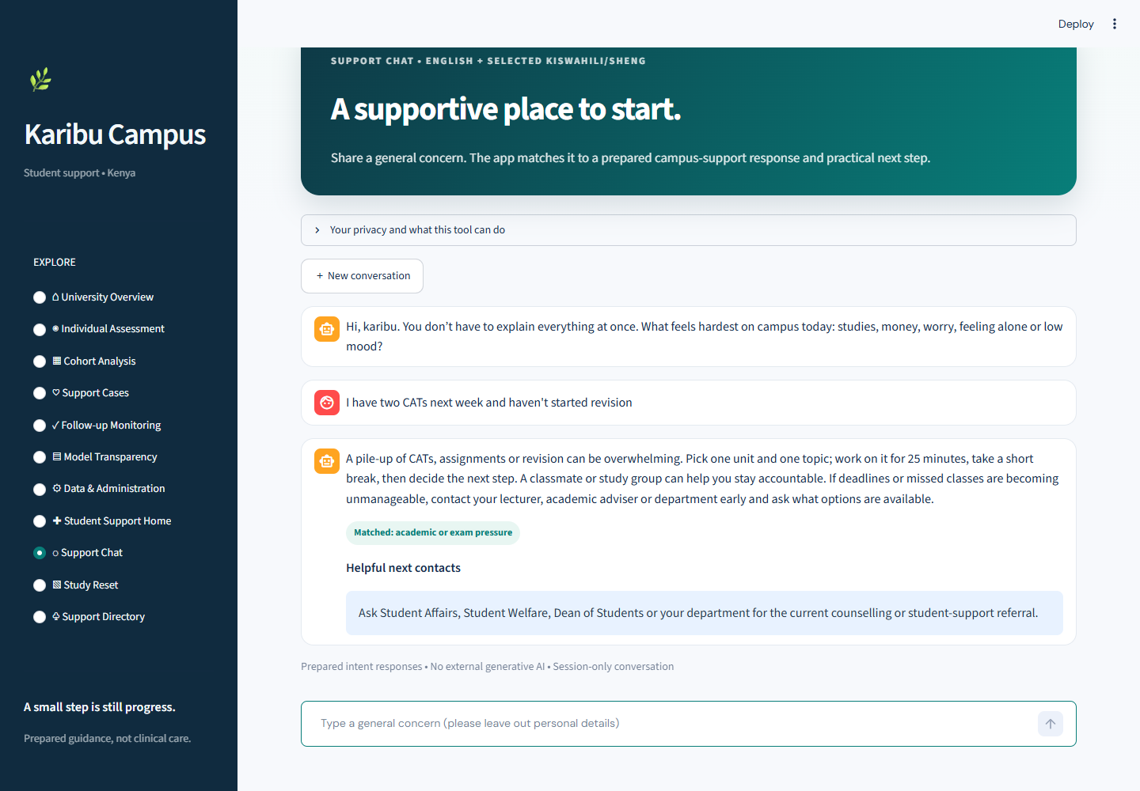
PROJECT PRESENTATION
Kenyan campus support: intent routing and accountable follow-up
ADVANCED PYTHON CONNECTION
Regex intent routing + SupportIntent enum
support_chatbot.py checks safety-first patterns, then routes exam pressure, fees/HELB, anxiety, low mood or loneliness to a prepared SupportReply. The CAT example suggests a 25-minute reset and a human academic referral.
WHY IT HELPS
Transparent rules need no remote generative-AI service and messages are session-only. The separate Support Cases page uses a validated dataclass and status enum for human-owned follow-up.
KCA University • CPP 4201 • Advanced Python Programming
08 / 10
Notes:
The screenshot demonstrates the deterministic chatbot using a realistic student message about two CATs and revision. It returns a short study step and points the student toward an academic adviser or student-affairs referral. Other routed concerns include fees/HELB, anxiety, low mood, loneliness and immediate safety. The rules are transparent but may miss context; the chatbot is not a counsellor or diagnostic system. A separate Support Cases view allows a staff member to record and track pseudonymous follow-up, but local JSON has no authentication or production security.
Screenshot / audience focus: The captured reply labels the matched intent as academic or exam pressure and shows the prepared next step and contact route. The app states there is no external generative AI and the conversation is session-only.
Advanced Python concept: SupportIntent StrEnum, ordered regular-expression patterns and frozen SupportReply dataclass; case tracking separately uses SupportCase and CaseStatus.
Source evidence: src/dropout_pipeline/support_chatbot.py: SupportIntent, SupportReply, _PATTERNS, classify_intent, reply_to; case_management.py: SupportCase, CaseStatus, upsert_case.
Design choice: Intent rules are explicit and inspectable. Kenyan examples use CATs, HELB, fare, hostel, selected Sheng and Kiswahili phrases in the matching patterns; responses direct students to human support.
Transition: The next slide shows the language-level Python techniques supporting these workflows.

Slide 9
PROJECT PRESENTATION
Advanced Python: evidence in the implementation
01
Protocol + type hints
02
Dataclass + StrEnum
03
Context managers
validate.py • FrameValidator
config.py • PipelineConfig / RunStage
extract.py • _fetch / ZIP read
validate(frame) → None
@dataclass(frozen=True)
with urlopen(...) as response
Defines an interchangeable validation contract.
Typed, stable run configuration and stages.
Closes network/archive resources reliably.
04
Decorator + ParamSpec
05
Generator + iterator
06
match / case
extract.py • bounded_retry
extract.py • iter_nonempty_lines
evaluate.py • _interpret_outcome
@wraps(function)
yield number, line
match label: case "Dropout":
Retries transient I/O while preserving signature.
Streams diagnostic lines on demand.
Maps labels to display text exhaustively.
scikit-learn Pipeline is a model-composition pattern; it is not itself a Python language feature.
KCA University • CPP 4201 • Advanced Python Programming
09 / 10
Notes:
These examples are mapped to real source code. A Protocol describes the validation interface; frozen dataclasses and StrEnums give stable typed records and states; context managers close resources; the retry decorator wraps I/O operations; the generator streams lines; and match/case selects display labels. The Python examples are in the source, with tests elsewhere in the repository.
Screenshot / audience focus: Each panel gives a path, symbol and small excerpt so the concepts can be checked against the repository.
Advanced Python concept: Structural typing, dataclasses, enumerations, context managers, decorators/ParamSpec, generators and structural pattern matching.
Source evidence: validate.py: FrameValidator; config.py: PipelineConfig/RunStage; extract.py: _fetch/bounded_retry/iter_nonempty_lines; evaluate.py: _interpret_outcome.
Design choice: Six verified concepts provide meaningful evidence without claiming absent abstractions.
Transition: We will close with the short demonstration path and the work required before any Kenyan operational use.

Slide 10
PROJECT PRESENTATION
What the prototype demonstrates—and what comes next
LIVE DEMO • 3 MIN
ENGINEERING LESSONS
BEFORE KENYAN DEPLOYMENT
1 University overview
2 Model transparency
3 Support Chat: “I’m overwhelmed by CATs and revision.”
4 Support Directory and Study Reset
5 Pseudonymous case workflow
• Keep ETL, model, UI and support modules distinct
• Validate inputs and preserve reproducible outputs
• Inspect per-class metrics, not accuracy alone
• Build human review into the workflow
• Collect lawful, locally representative data
• Validate across institutions and student groups
• Assess fairness, privacy and security
• Co-design referral pathways with campus teams
A useful early-warning prototype should open a supportive conversation—not make a decision about a student.
Repository checks previously verified: 34 pytest tests • Ruff check/format • mypy src/
KCA University • CPP 4201 • Advanced Python Programming
10 / 10
Notes:
Our demonstration sequence is dashboard, model transparency, support chat, then the resources/study reset and pseudonymous follow-up screens if time allows. The app and model tests passed in the repository verification run: 34 pytest tests, Ruff lint and formatting checks, and mypy for 15 source files. Those are software checks, not evidence of Kenyan predictive validity.
Screenshot / audience focus: The live demo highlights the actual app pages and keeps support tools separate from the historical prediction model.
Advanced Python concept: Test fixtures and module boundaries make behaviors easier to verify; the inference and case workflows remain distinct.
Source evidence: Repository tests under tests/; development checks in README.md; application entry point src/dropout_pipeline/support_app.py.
Design choice: The conclusion distinguishes software correctness from population validity and operational readiness.
Transition: Thank you. We welcome questions about the model, Python implementation and Kenyan adaptation requirements.

