Slide 1
Phishing Awareness Simulation Using Social Engineering Techniques
Name: Tony Bush
Internship Domain: Cybersecurity
Organization: Naviotech Solution
Project Type: Awareness-Based Security Simulation

Slide 2
Introduction
Phishing is one of the most prevalent cyber threats affecting individuals and organizations globally.
It relies on social engineering rather than exploiting technical vulnerabilities.
Attackers impersonate trusted entities to manipulate users into revealing sensitive information.
Understanding phishing techniques is critical to strengthening human-centric cybersecurity.

Slide 3
Problem Statement
Users frequently fail to differentiate between legitimate and malicious websites.
Sophisticated phishing pages closely resemble real authentication portals.
Lack of awareness results in credential theft, identity fraud, and data breaches.
Organizations continue to suffer losses due to human error in security.

Slide 4
Objectives of the Project
To study phishing attacks and social engineering techniques used by attackers.
To design and simulate a phishing login page using HTML and CSS.
To demonstrate how visual design influences user trust.
To highlight the importance of awareness in preventing phishing attacks.

Slide 5
Phishing Techniques Studied
Email-based phishing using spoofed messages.
Fake login pages mimicking legitimate services.
Impersonation of trusted brands and platforms.
Urgency and fear-based messaging to manipulate users.

Slide 6
Tools and Technologies Used
HTML for structuring the phishing login interface.
CSS for styling and enhancing the realism of the page.
Web browsers for executing and testing the simulation.
Local system environment to ensure ethical execution.

Slide 7
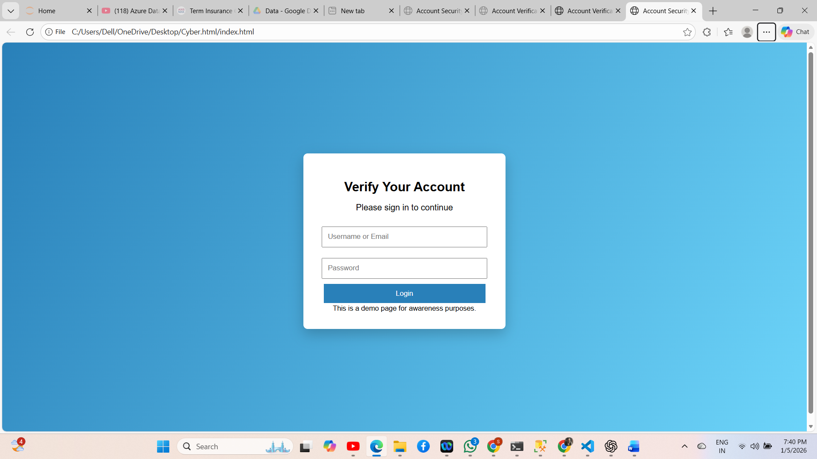

Simulation Design
A basic phishing login page was initially created using HTML.
The page was enhanced using CSS to appear professional and trustworthy.
No backend processing or data storage was implemented.
The simulation was executed locally for ethical and educational purposes.

Slide 8
Results and Analysis
Even simple phishing designs can deceive unsuspecting users.
Enhanced visual styling significantly increases perceived legitimacy.
Phishing attacks exploit human trust more than technical flaws.
User awareness remains the weakest yet most important security factor.

Slide 9
Preventive Measures
Conduct regular cybersecurity awareness and phishing training.
Encourage users to verify URLs before entering credentials.
Implement Multi-Factor Authentication (MFA) for critical systems.
Use advanced email filtering and spam detection tools.

Slide 10
Conclusion
Phishing attacks are primarily driven by social engineering techniques.
Attackers can easily create convincing fake websites using basic tools.
Awareness and education are the strongest defenses against phishing.
Ethical simulations are effective in improving user cybersecurity knowledge.

