Slide 1
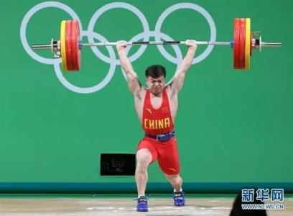

The tutorial of
Raise
a pie?
REST API
Zhen Zhang
Ying Ming
2016.12.07

Slide 2

The Introduction of REST
What is the REST?

Slide 3
The Introduction of REST
Representational State Transfer
design style not a stander
Explain resource and give a example

Slide 4

The Introduction of REST
2. Where do we use REST?
Stateless
client-server
HTTP
REST is more easy and simple to develop between
XML-RPC and SOAP.
Explain “HTTP”

Slide 5
The Introduction of REST
3.URI
4.The pros and cons

Slide 6
The Introduction of REST
Roy Fielding
Manipulation
example
GET, POST, PUT, and DELETE methods
Main advantage with Example
Bad way

Slide 7
Youtube learn
https://www.youtube.com/watch?v=ZHw-cA9U78g
https://www.youtube.com/watch?v=YCcAE2SCQ6k

