Slide 1
Handgun detection using Mask-RCNN
Tony Ou – Software engineering u2

Slide 2
What is a convolutional neural network (cnn)?
Series of layers that extract features from an image and classifies the image using these features
Convolutional layer, Pooling layer, Fully connected layer

Slide 3

Convolutional layer

Slide 4
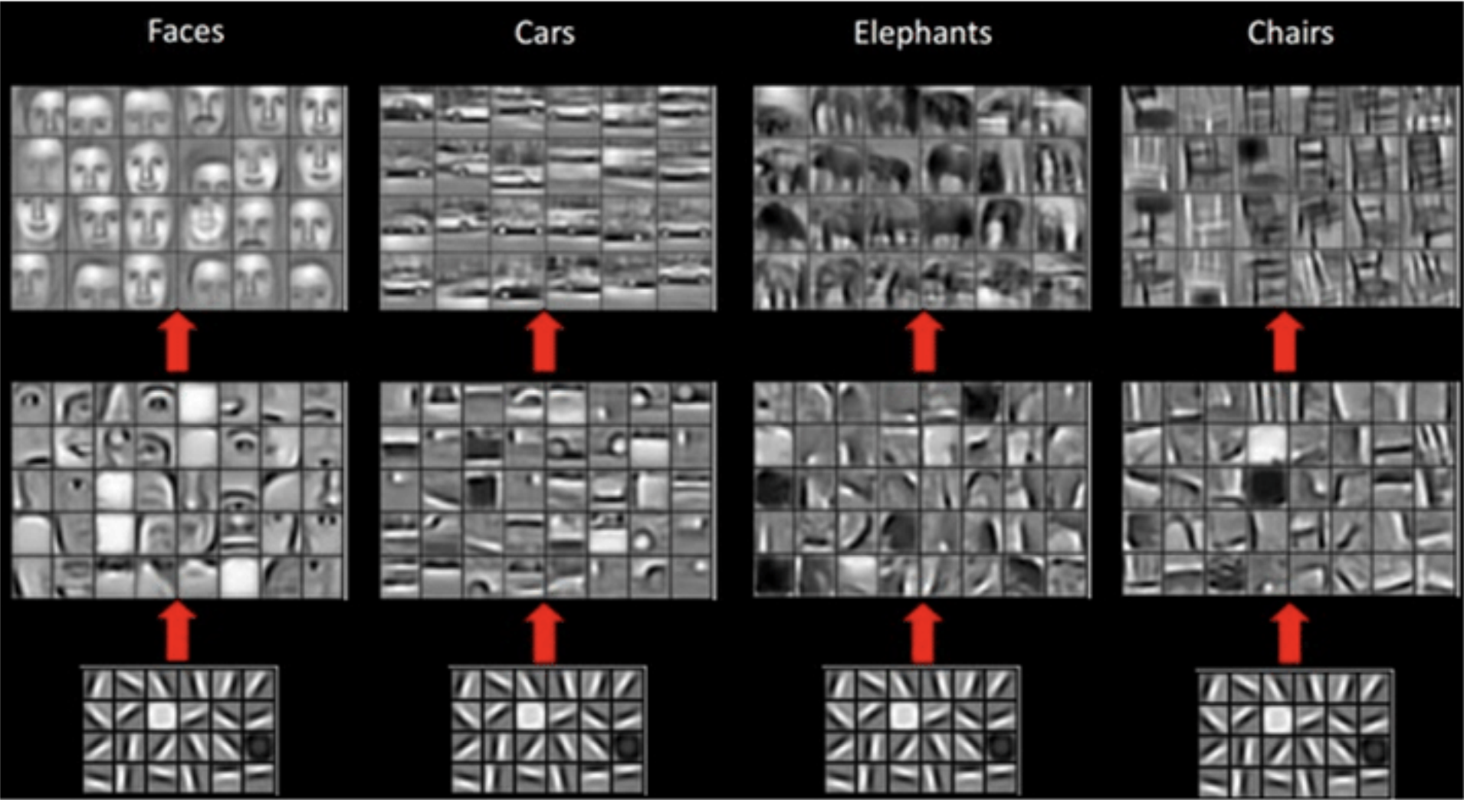

Slide 5
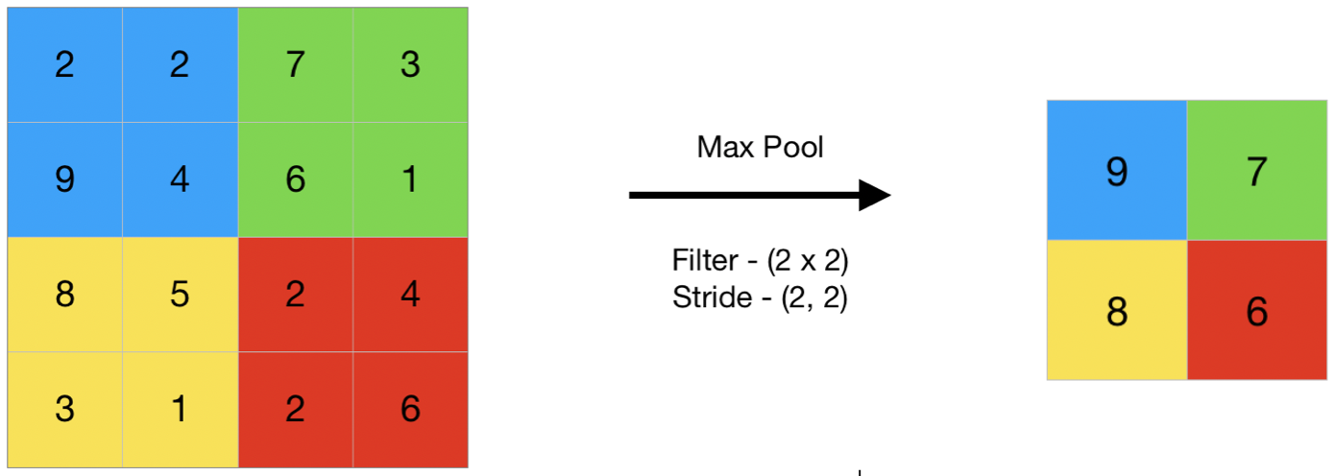
Pooling layer

Slide 6
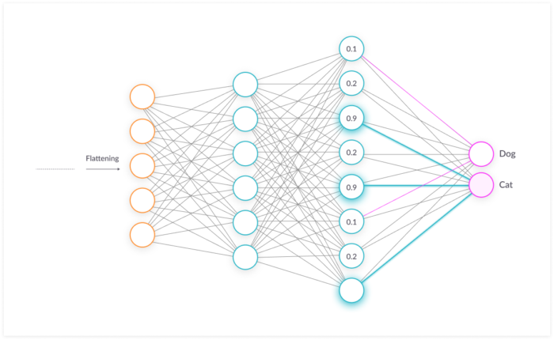
Fully connected (Dense) layer

Slide 7
CNN
Cannot use standard CNN to detect images because the length of the output layer is variable (number of occurrences of an object is not fixed)
One solution would be to select regions and detect presence of the object within the region
Not feasible, might have different spatial locations within the image and different aspect ratios, number of regions will computationally blow up

Slide 8
Solution 1: R-CNN
Extract 2000 regions from the image as region proposals
Instead of classifying huge number of regions, only 2000
Problems:
Huge training time (classify 2000 regions per image)
Region selection is a fixed algorithm = no learning. Could generate bad regions

Slide 9
Solution 2: Fast/Faster R-CNN
Author of R-CNN improved the algorithm so it is faster
Instead of passing regions to the CNN, we directly pass the image to the CNN to generate a convolutional feature map
We then identify the regions using the feature map and predict the class of each region
Faster because convolution operation only done once, not 2000 times

Slide 10

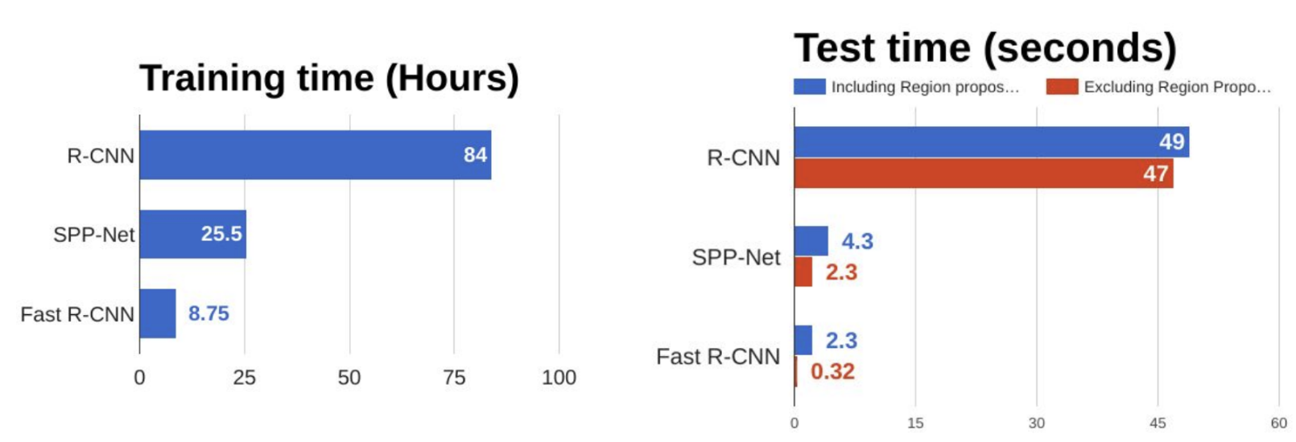

Slide 11
What is mask-rcnn?
Object detection model using instance segmentation developed by the Facebook AI Research team (FAIR)
Combines advantages of both methods (FastRCNN & Fully Convolutional Network (FCN))
2 stages:
Region proposals
Classify, bounding boxes & masks

Slide 12
What is instance segmentation ?
Detect individual instances and also generate a mask on each instances, extremely challenging
Object detection + Semantic segmentation = Instance segmentation
2 families of instance segmentation methods:
FCN driven: full image semantic segmentation result then cut the result image into individual instances
R-CNN driven: generates proposal regions and classifies them individually

Slide 13
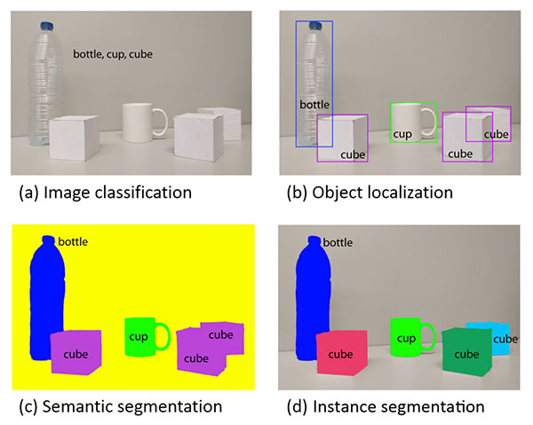

Slide 14
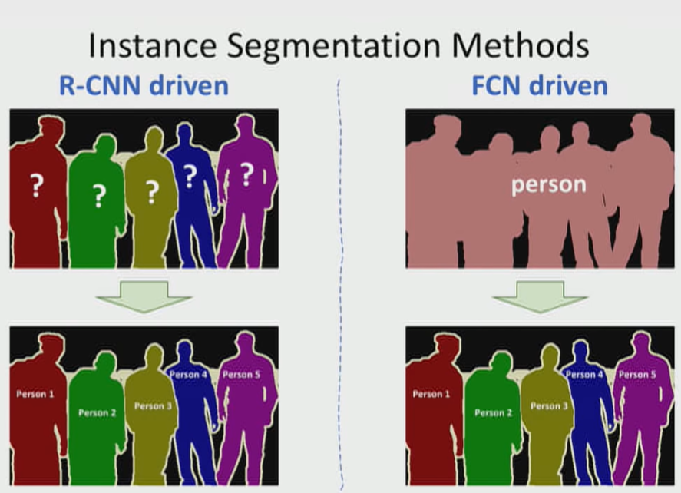

Slide 15
Steps
Use backbone network to generate a feature map (Feature Pyramid Network FPN)
Use the Region Proposal Network (RPN) to propose regions that may contain the object using the FPN (ROI)
Use parallel heads to generate the class, bounding box and mask

Slide 16
Important feature: RoI align
RoI Pooling:
Stride is quantized and data is lost
Also leads to misalignment in the image
RoI Align:
Stride is not quantized, no data is lost
Preserves spatial orientation
Each cell divided into subcells (bins)
Subcells are pooled through bilinear interpolation
Final cell computed using either average or maximum

Slide 17
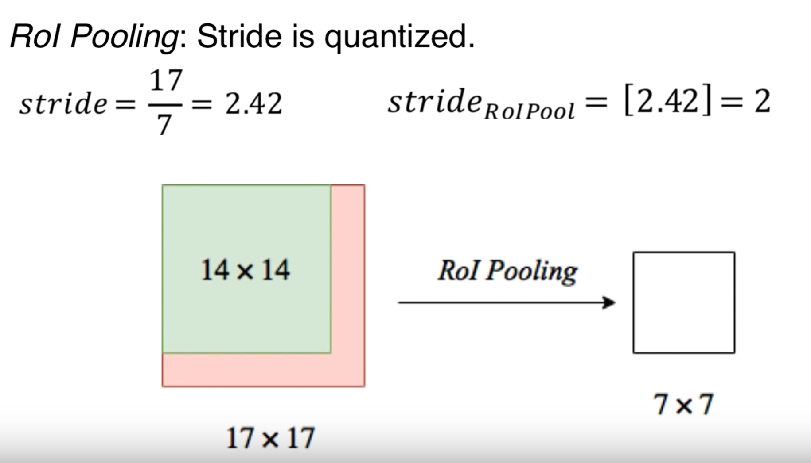

Slide 18
