Slide 1
FoundingBuddies.com
Where Ideas Meet Talents

Slide 2
Elevator Pitch
Ideators
FoundingBuddies
University
Student Project
Start-Up
Experts
Notes:
EXPLANATION:
There is no real way right now to find cofounders and experts in their field for an idea if it‘s still in the Idea or Concept phase. On the other side it‘s also very hard to find an early phase startup to work at, if you are interested in entrepreneurship but are lacking the million dollar idea. We try to solve these problems by connecting students on campus. The website is already online and fully functional at foundingbuddies.com. The backend and server structure is completely scalable to basically any realistic size.
Since universities are interested in high founding rates now more than ever before, there could be an opportunity for a revenue stream.

Slide 3
The Team
Student Bachelor in Technology Management at the TUM
Experienced in consulting through an internship at Accenture
Knowledge in Python, Java, Javascript, HTML 5 and CSS
Jonas Gorlo
Student Engineering Science at the TUM
Experienced in freelancing for CAD modeling tasks
Knowledge in Python, C, Javascript, HTML 5 and CSS
Nicholas Poggendorf

Slide 4
SPS – What problems do We solve?
Students have ideas but can‘t find talent to cofound
There is no platform for students to find future founders
On Campus team aquisition requires luck and a huge network
Students have ideas but can‘t find talent to cofound
There is no platform for students to find future founders
On Campus team acquisition requires luck and a huge network
Situation
IPR protection near impossible if you have to search for cofounders everywhere
Many great ideas get lost because experts are missing
Startups are founded with very homogenous founding teams
Problemation
IPR protection near impossible if you have to search for cofounders everywhere
Many great ideas get lost because experts are missing
Startups are founded with very homogenous founding teams
A platform to connect
future founders and interested students
Including a messaging system potentially including digital NDA contracts
Marketed through universities to boost their founding rates
Solution

Slide 5
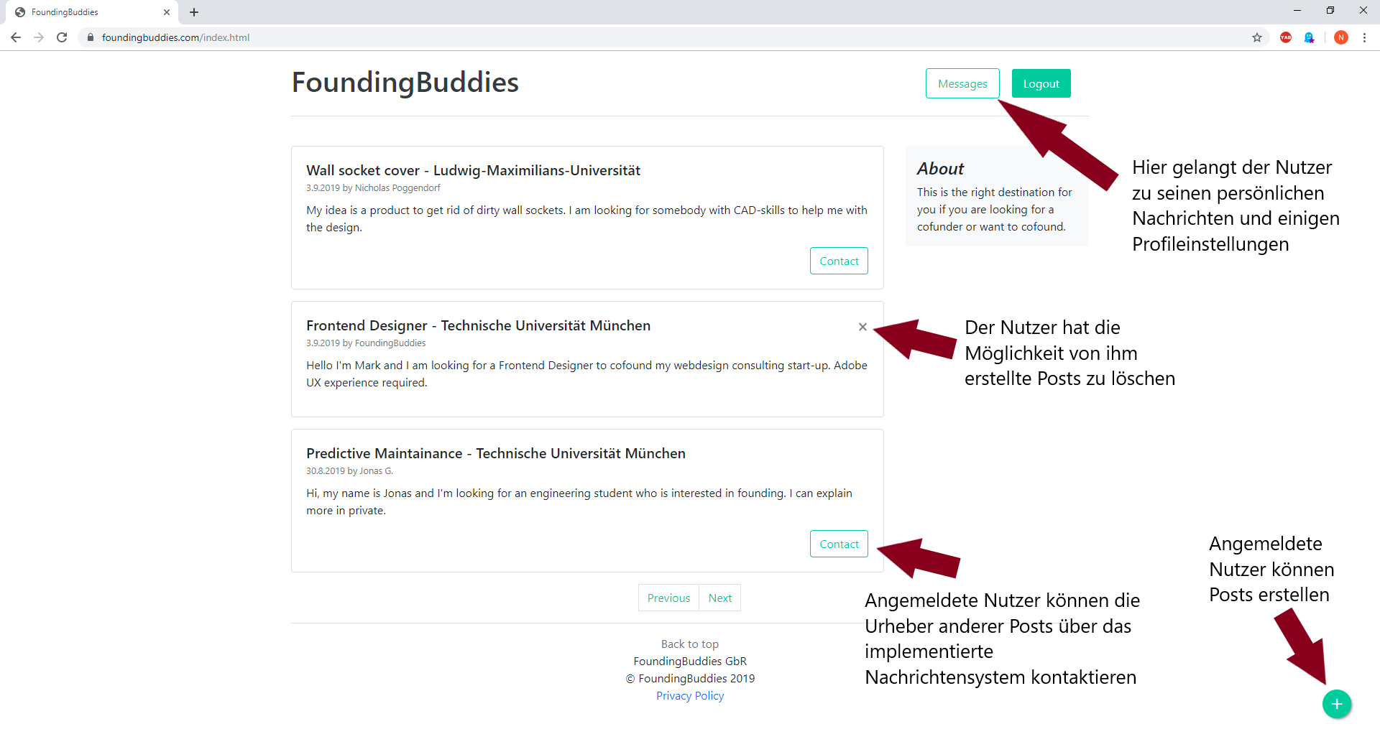
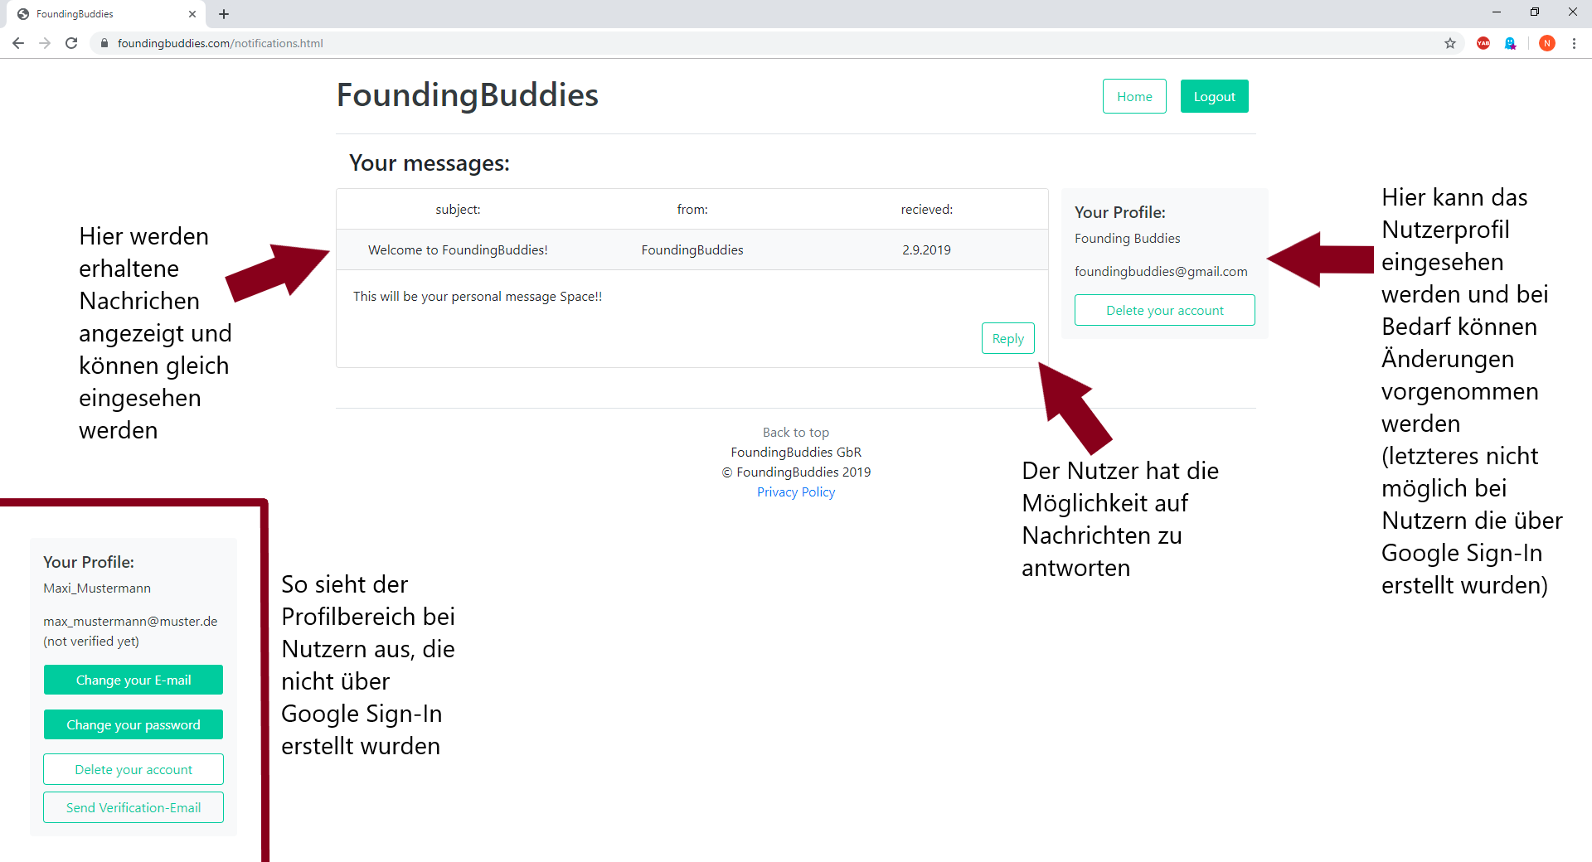
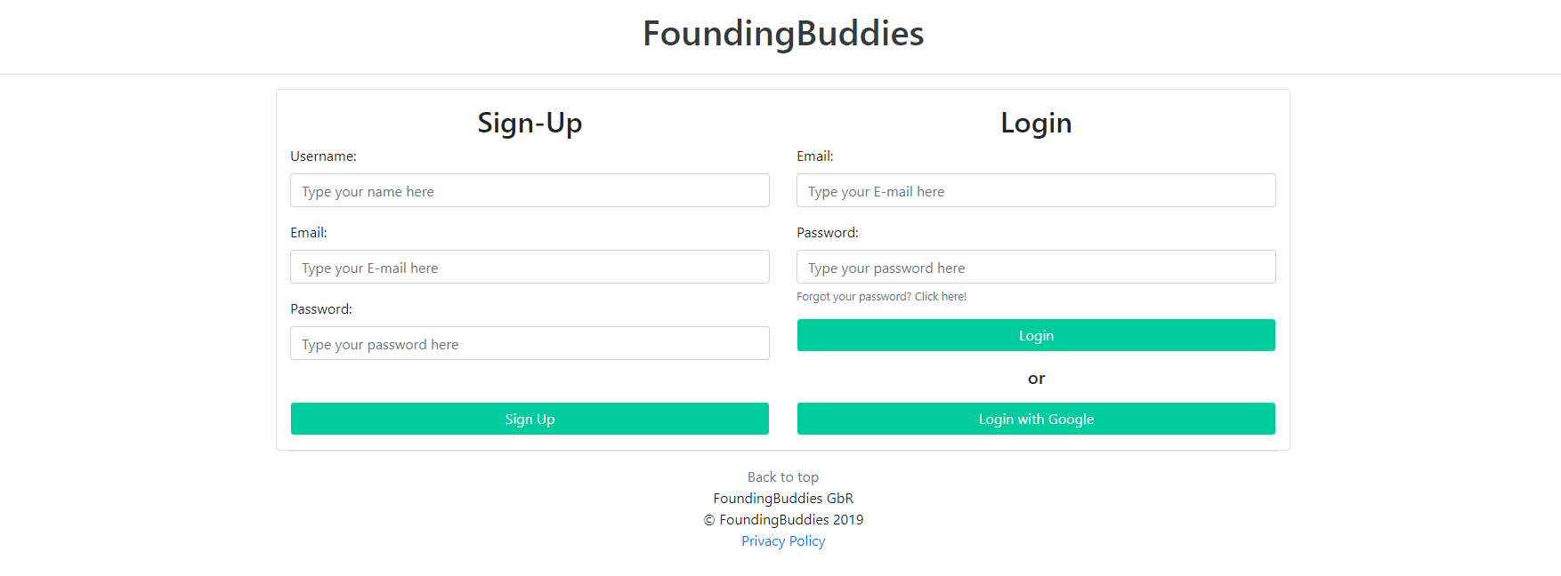
Our Service
Already online at FoundingBuddies.com!

Slide 6
Value Streams - Market/Customers
Usage Fee
FoundingBuddies
Universities
Higher Founding Rate
Content
Free Service
Diverse Start-Ups
Students

Slide 7
Competition Analysis
 | FoundingBuddies | founderio | StartUpHR (UnternehmerTUM) | CoFoundersLab | founder2be
Target Group | Students of cooperating Universities | Cofoundes, Mentors, Business Angels | TUM Students | All Potential Founders | All Potential Founders
Supported Stages | Idea | Idea-Fundraising/Cooperations | Complete Consultation | Idea | Idea
No Sign-In required | ü | ü | û | û | û
Type | Platform | Platform | Service | Platform | Platform
Mentionable Websites: Angel List, CodeArmy, FounderDating, LeanStartupMachine, LetsLunch, Meetup, StartupWeekend, YouNoodle, Startup Sucht, FoundersNation

Slide 8
Unique Selling Propositions
Accessibility
Focus on students
Free usage for students
Strong cooperation with universities
Easy to use online solution with university concentrated target groups

Slide 9
Status Quo : Fully Functional Website
Essential functionality
Additional Features
Already online and running
Basic functionality implemented
Scalable Back-End
Messaging system
Profile editor
Google Sign-in
E-Mail verification

Slide 10
Next Steps
Partnering with universities for user aquisition
Implementation of monetarization
Inclusion of a digital NDA system to protect the IPR of the students durimg chat conversations
Fundraising
Continuously refining the product

Slide 11
User Aquisition within the first Year
120 000
students in Munich
10%
12 000
are interested in (co-)founding a startup
50%
6 000
are activly looking for startups
50%
3 000
will use our service
Notes:
120.000 Studenten (Quelle: muenchen.de)
Unternehmertum bildet jedes Jahr 1000 Leute weiter (Quelle: Unternehmertum Handbuch S.33)
In Munich: 20.000 new students every year -> 500 new user

Slide 12
Further Expansion
2 863 609
Students in Germany
2.5%
75 000
Users of FoundingBuddies.com

Slide 13
Business Plan
2 customer groups
Universities
Students
We sell our website as a service
Including marketing at the campus and in selected lectures
Strong cooperation with the universities
Pricing model: Subscription
We charge no signing fee
Complete functionality is free
Some revenue stream through virtual shares could be possible
Also see Business Model Canvas

