Slide 1

Angular + Jasmine
Behavior Driving Your Angular Development

Slide 2
Tony Curtis
A.K.A Spartacus, Chewbacca, and the StayPuft Marshmallow Man
Consultant Software Engineer / Supervisor at Intermountain Healthcare
Passionate about unit testing, code craft, continuous improvement, and addictive development tools
Love to spend time with family, play euro games, read / watch / write sci-fi and fantasy, listen to music from the 50’s, 60’s, 70’s, 80’s, …, and watch anything even remotely linked to Monty Python’s Flying Circus.

Slide 3
Dogs
User Friendly, simple design, lots of interactions

Slide 4
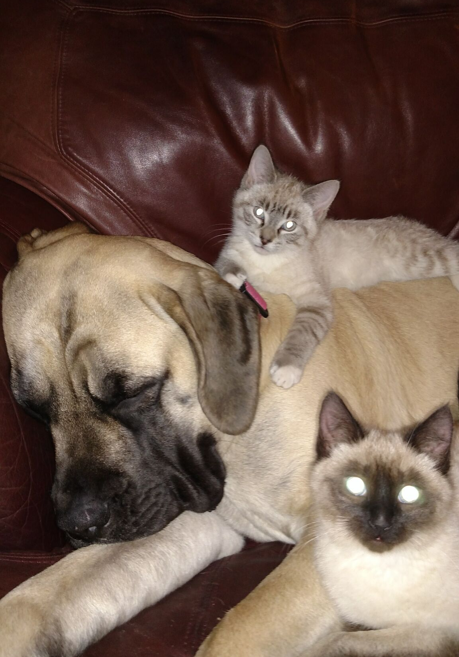
Dogs & Cats
It doesn’t have to be chaotic

Slide 5
Why Unit Test?
Encourages separation of concerns
Allows documentation of applications with verification of that documentation
Gives development the confidence to refactor
Transforms black box to gray box
Saves Development, QA, Deployment, Service Desk, and Users a lot of time and frustration

Slide 6
What to Unit Test?
Any code with logic
Critical path code (high risk)
Complex logic higher priority (cyclomatic complexity) but may be difficult to test
Problematic areas of the application
Easy to test code (low hanging fruit)

Slide 7
How to Unit Test
Tests should be simple (maintainable)
One assertion per test (expose truth)
Isolate the unit under test
Favor loose mocking over strict mocking
Favor state over behavior testing
AAA (Arrange, Act, Assert)

Slide 8
How to Unit Test -
Good test naming (Jasmine excels)
Test the positive signal (red light, green light)
Tests should be robust (beware over-specification, what not how)
General coding best practices (SOLID)
Use code coverage results
Try hard not to ignore, never ever comment!

Slide 9
What’s the worst that could happen?
Chaos!

Slide 10
Demo
*This demo contains no rabbits

