Slide 1
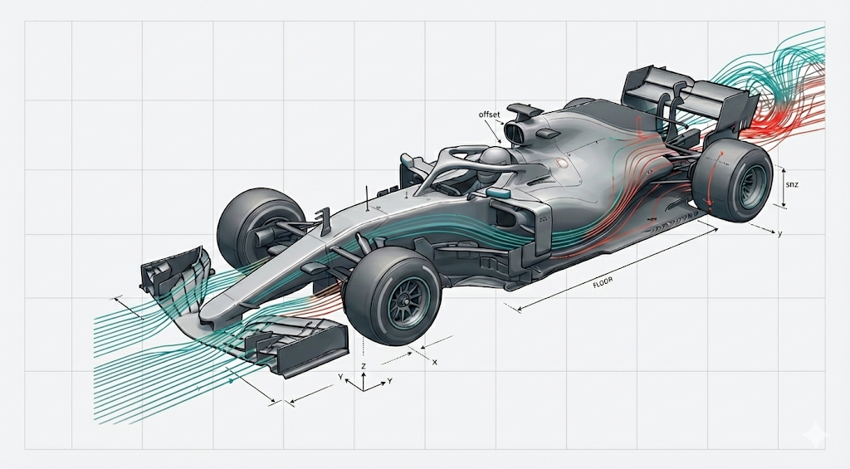
F1 Data Management Project
How did ground effect regulations and budget cap change car performance?
Pre vs Post 2022

Slide 2
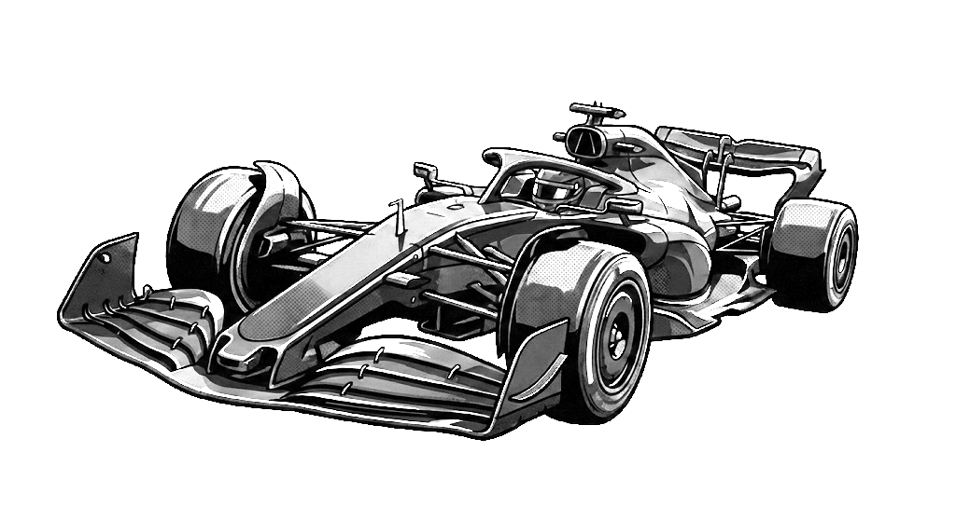
Research Question
How did ground effect regulations and budget cap
change car performance in Formula 1?
▸ Analysis Period: 2017-2025
• Pre-2022: Traditional high - downforce aero
• Post-2022: Ground effect + Budget Cap
▸ Focus: Qualifying lap times on 6 stable circuits

Slide 3
Agenda
01
Data Sources
API, Entity Resolution, LLM, ATR
02
Data Analysis
Preparation, Integration, Quality
03
Data storage and conclusion
Field Spread by Era, Storage, Performance Impact

Slide 4
01
Data Sources

Slide 5
Data Sources Overview
▸ Jolpica API - Qualifying results (3,853 records)
▸ Entity Resolution - Team name mapping
▸ OpenAI GPT-5-mini - FIA Regulations (46 entries)
▸ FIA ATR - Wind tunnel/CFD allocations
all_results = []
offset = 0
limit = 100
while True:
url = f"https://api.jolpi.ca/ergast/f1/{year}/qualifying.json?limit={limit}&offset={offset}"
response = requests.get(url)
data = response.json()
races = data['MRData']['RaceTable']['Races']
if not races:
break

Slide 6
Source 1: Qualifying Data
▸ API: api.jolpi.ca/ergast/f1/{year}/qualifying
▸ Data Collected (2017-2025):
• 2017: 20 races
• 2020: 17 races
• 2024-2025: 24 races
✓ Total: 3,853 qualifying results

Slide 7




Source 2: Entity Resolution
▸ Problem: Team names changed over years
▸ Mappings Applied:
• Toro Rosso → AlphaTauri → RB F1 Team
• Sauber → Alfa Romeo → Sauber
• Force India → Racing Point → Aston Martin
• Renault → Alpine F1 Team
Result: Consistent Team_Entity column
TEAM_ENTITY_MAP = {
'Force India': 'Aston Martin',
'Racing Point': 'Aston Martin',
'Aston Martin': 'Aston Martin',
}
df_qualifying['Team_Entity'] = df_qualifying['Team'].apply(resolve_team_entity)

Slide 8
Source 3: LLM Regulations Extraction
def get_regulations_from_openai(year):
prompt = f'''For {year} F1 season, list main regulation changes.
Return JSON array: [{{"Year": {year}, "Type": "Aero/Financial/Safety/Engine", "Description": "...", "Impact": "Major/Minor/Revolutionary", "Source": "FIA {year}"}}].
Only JSON.'''
response = openai.chat.completions.create(
model=OPENAI_MODEL,
messages=[{'role': 'user', 'content': prompt}],
)
return response.choices[0].message.content
▸ Model: OpenAI GPT-5-mini
▸ Method: Prompt-based JSON extraction
• Fields: Year, Type, Description, Impact
• Types: Aero / Financial / Safety / Engine
✓ Output: 46 regulations entries
• 2017: 6 entries | 2022: 8 entries

Slide 9
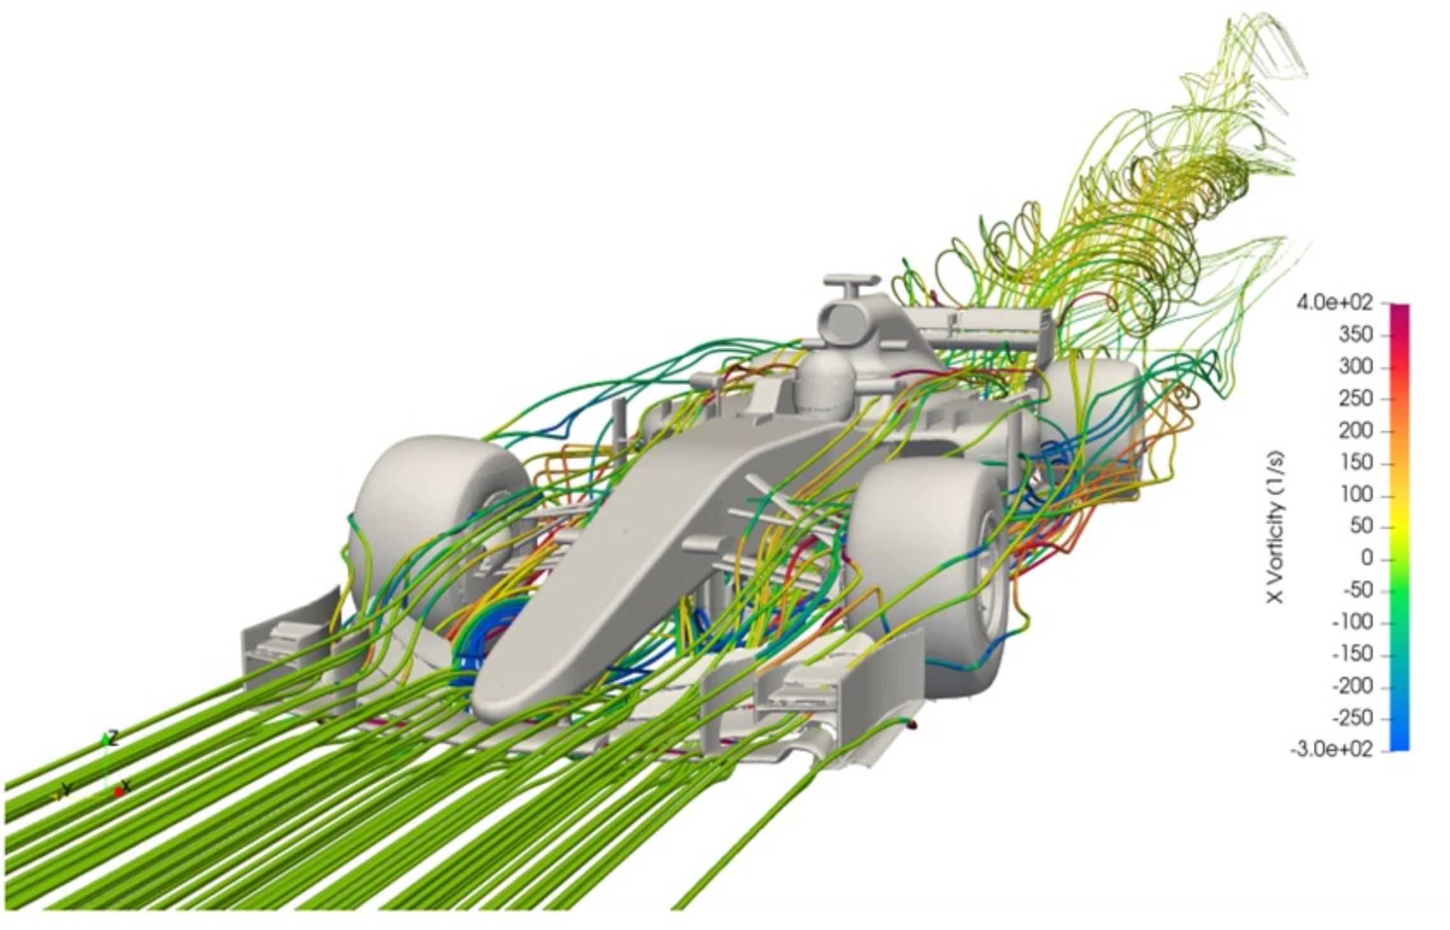
Sources 4: Aerodynamic Testing Restrictions
▸ Wind Tunnel: recreate controlled airflow, test models and measure to see the aerodynamic forces, drag, and downforce
▸ CFD (Computational Fluid Dynamics): replicate the same phenomena through complex mathematical calculations
Output:
2022 >ART 70% - 115%
>WT 224 - 368 hours /y → 100% 320h
>CFD 1400 - 2300 hours /y → 100% 2000h
atr_percentages = {
1: 0.70, 2: 0.75, 3: 0.80, 4: 0.85, 5: 0.90, 6: 0.95, 7: 1.00, 8: 1.05, 9: 1.10, 10: 1.15}

Slide 10
02
Data Analysis

Slide 11
Data Analysis Overview
▸ Data Preparation & Data Integration – Time, Pole Position, GAP, Era labeling, Linking all data together
▸ Data Quality - Completness
▸ Analysis Methodology - Fastest Lap Comparison
▸ Fastest Lap Comparison

Slide 12
Analysis 1: Data Preparation & Data Integration
Preparation
Integration
• Time Parsing
Ex: "1:22.456" into total seconds 82.456
• Pole Position Classification
Ex: Australia 2023 pole is 79.215s, is repeated for every driver to compare it to his best time on qualifying
• Gap Calculation
Ex: Pole sitter gets 0.000, P2 might get +0.215 (0.215s slower)
• Era Labeling
Ex: before 2022 as 'Pre-2022' and after 2022 as 'Post-2022'
• Aggregated regulations by year
Ex: how many regulation changes for each year
• Merged regulations with qualifying data
df_qualifying = df_qualifying.merge(reg_summary, on='Year', how='left')
• Merged ATR data by year and team
df_qualifying = df_qualifying.merge(
df_atr[['Year', 'Team', 'ATR_Percentage', 'WT_RunsAnnual','CFD_ItemsAnnual']],
on=['Year', 'Team'],
how='left'
)

Slide 13
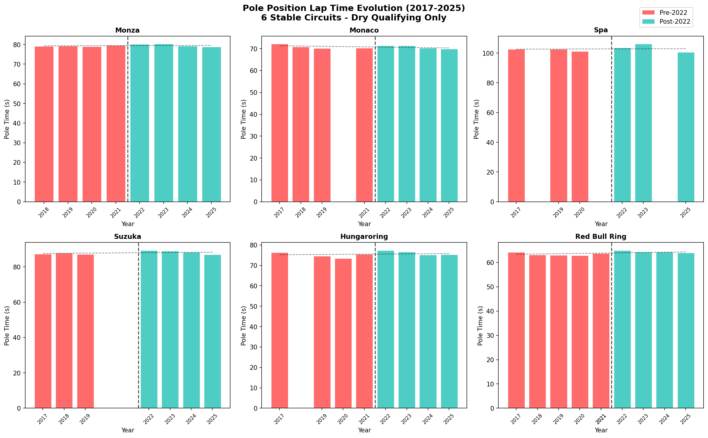
Circuit Performance Pre vs Post 2022
Dry conditions only — 6 stable circuits

Slide 14
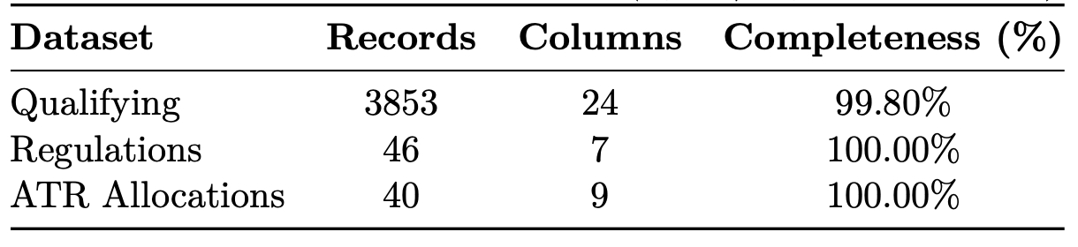
Analysis 2: Data Quality
Results:
Q1: 100.0%
Q2: 74.1% (expected)
Q3: 49.3% (expected)
ATR_Percentage: 45.2% (expected)
WT_RunsAnnual: 45.2% (expected)
CFD_ItemsAnnual: 45.2% (expected)

Slide 15
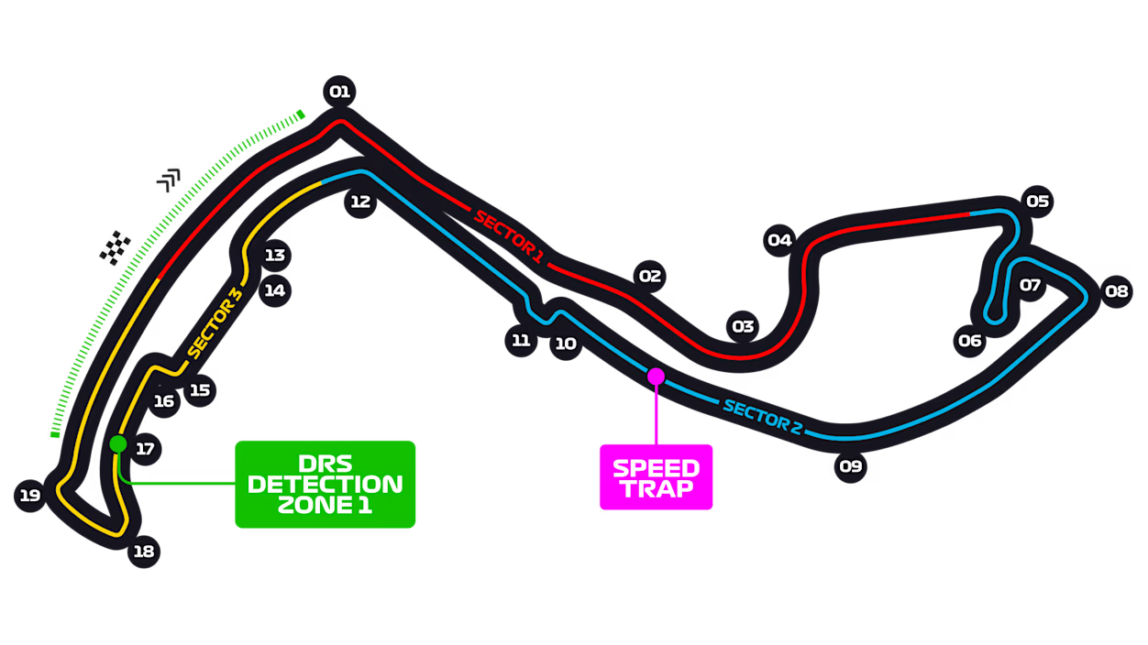
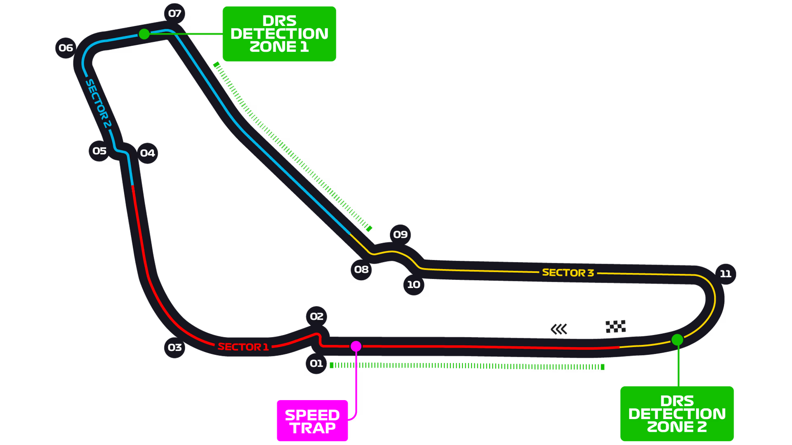
Analysis 3: Analysis Methodology
▸ Stable Circuits (unchanged layout):
Monaco
Monza • Monaco • Spa
Red Bull Ring • Suzuka • Hungaroring
▸ Metric: Delta = Post_2022 − Pre_2022
• Positive → Slower | Negative → Faster
Comparison: Best qualifying lap times
Monza

Slide 16
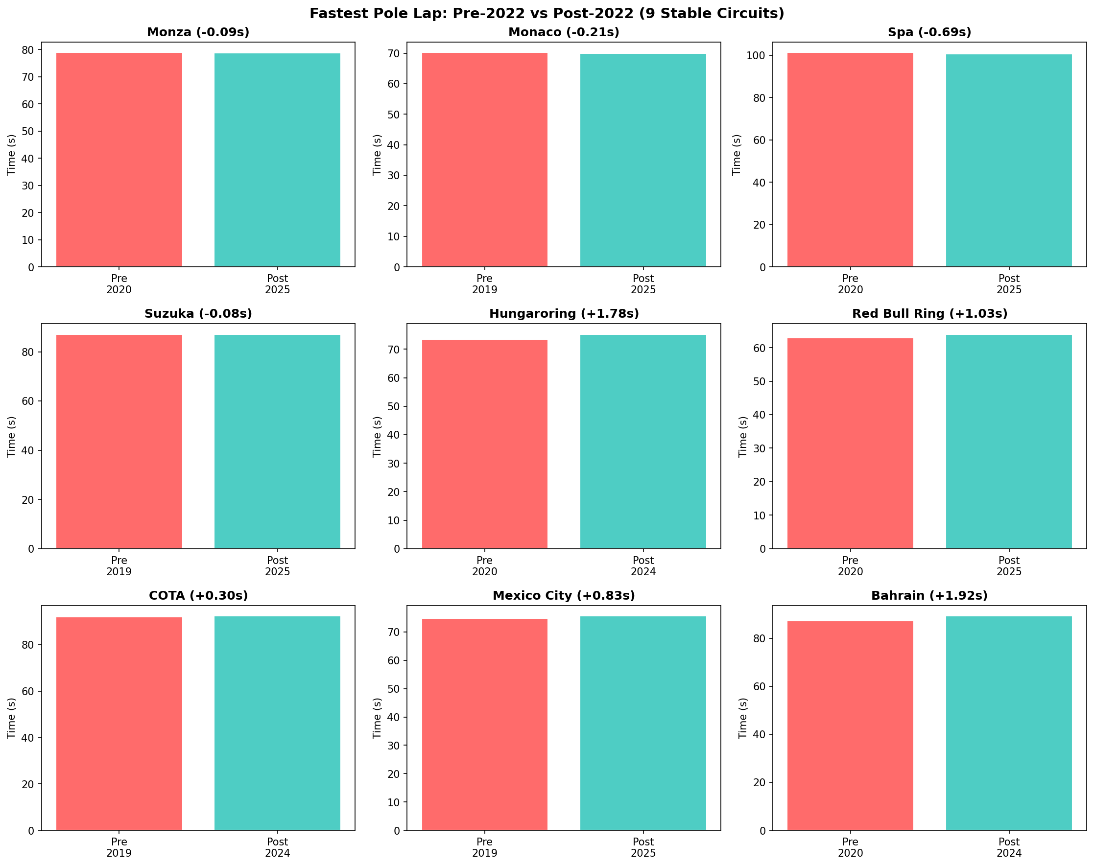
Fastest Lap Comparison
Detailed lap time delta analysis
6

Slide 17
03
Data storage and conclusion

Slide 18
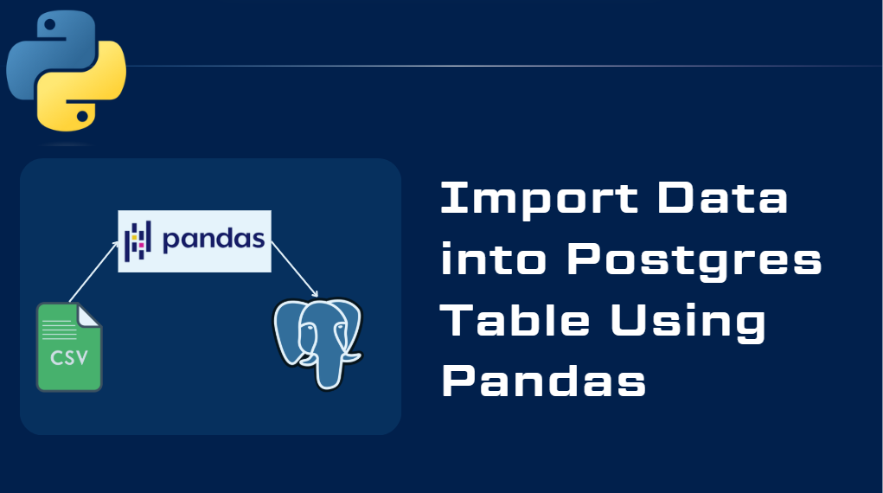
Data Storage Overview
▸ SQLite - Final data storage
▸ WDC/WCC Champions Winners (Jopica API)
▸ Performance Impact
▸ Conclusion

Slide 19
Data Storage: SQLite
▸ Database: f1_data_management.db
▸ Tables:
• seasons (9), record (~90), drivers (~180)
• events (~190 with pole positions)
• regulations (46 LLM-extracted)
• circuit_performance (6 stable circuits)
df_teams = pd.DataFrame(teams_list)
df_teams.to_sql('teams', conn, index=False, if_exists='replace')
print(f"teams: {len(df_teams)} records")

Slide 20
Data Storage: WDC/WCC Champions Winners
▸ The implementation uses two Jolpica API endpoints:
/driverstandings/1.json
/constructorstandings/1.json
def get_driver_standings_winner(year):
url = f"https://api.jolpi.ca/ergast/f1/{year}/driverstandings/1.json"
response = requests.get(url)
data = response.json()['MRData']['StandingsTable']['StandingsLists']
if data and data[0].get('DriverStandings'):
ds = data[0]['DriverStandings'][0]
return {
'name': f"{ds['Driver']['givenName']} {ds['Driver']['familyName']}",
'team': ds['Constructors'][0]['name'] if ds.get('Constructors') else None
}
return None
▸ This data serves for critical analytical purposes:
Regulatory Impact Assessment

Slide 21
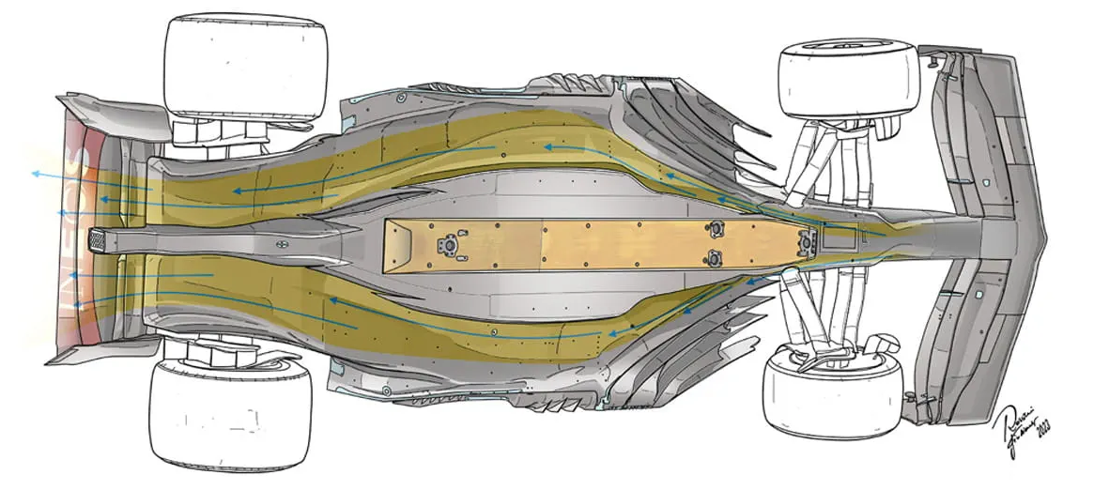
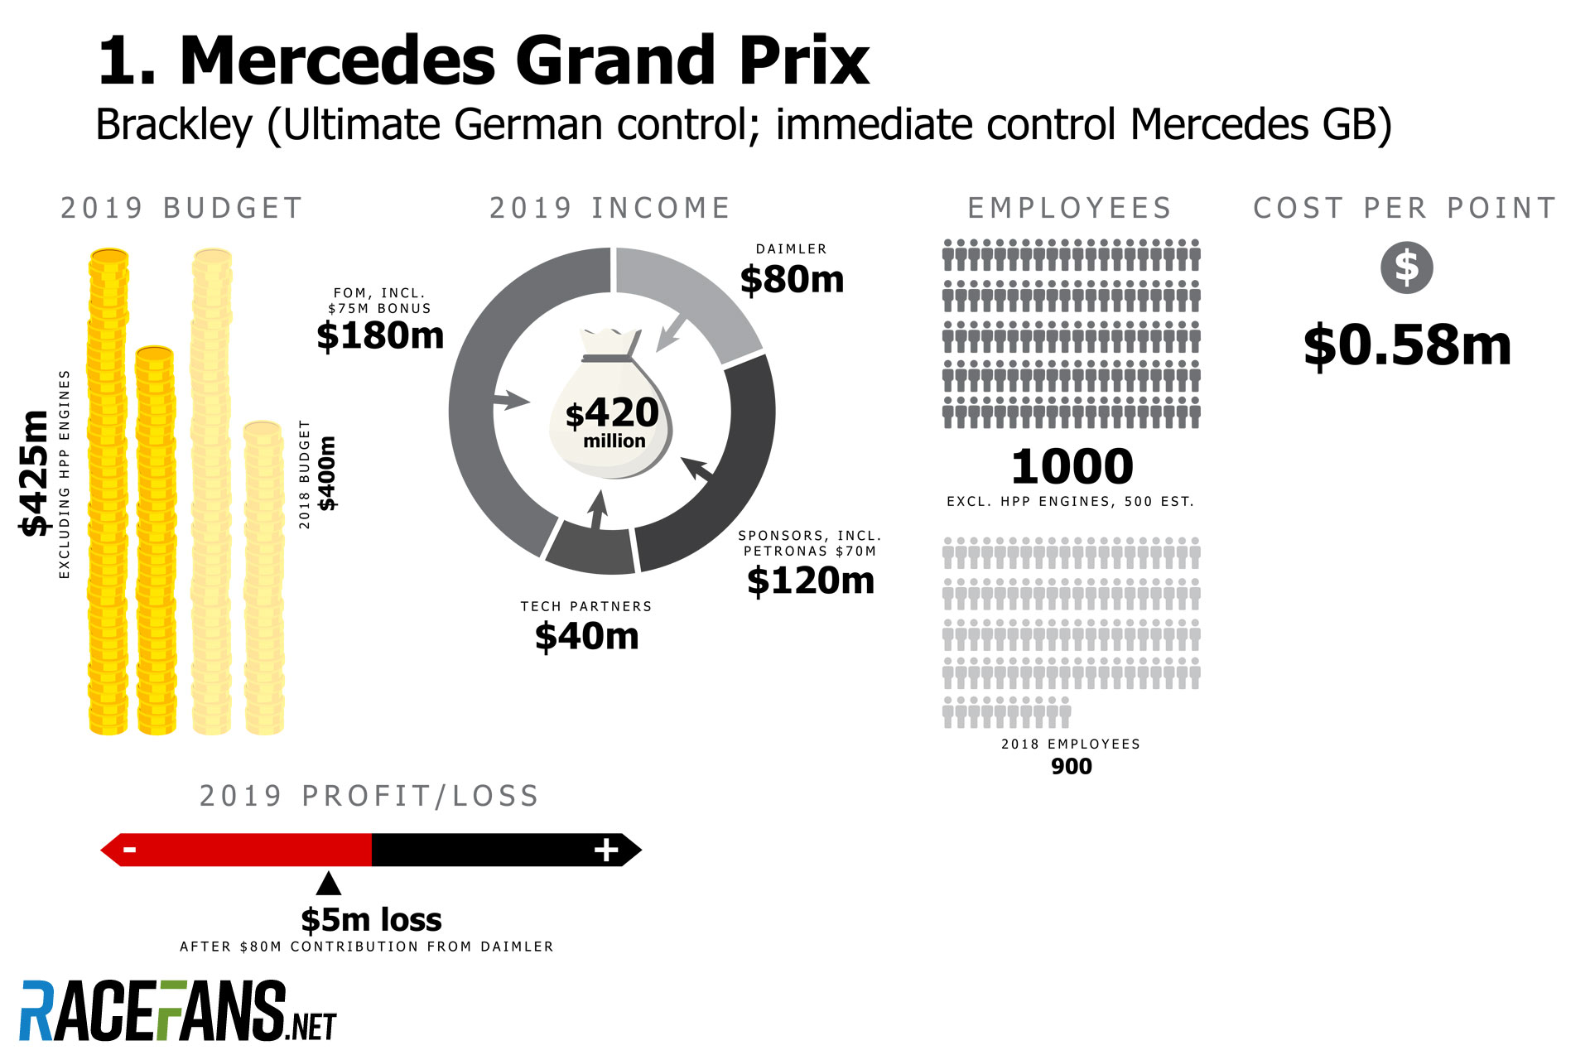
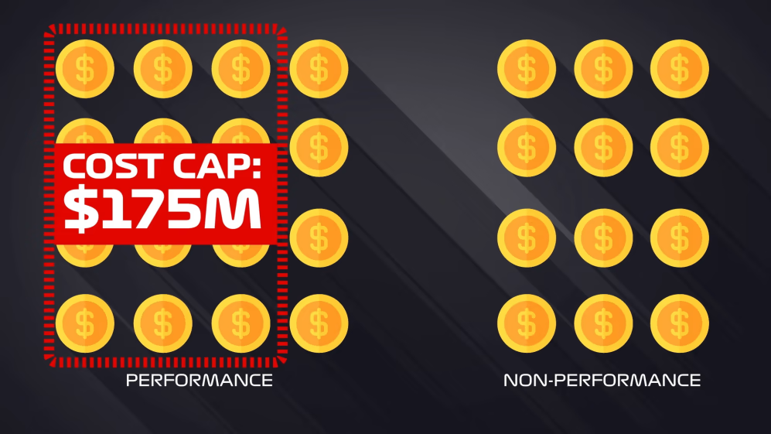
Performance Impact
▸ 2022 Ground Effect Regulations:
• +40kg minimum weight
• Venturi tunnels for downforce
• 18-inch wheels, reduced complex aero
▸ Budget Cap Impact ($145M → lower):
• Equalized development resources
• ATR allocations favor lower-ranked teams
for covid it was reduced to 145M

Slide 22
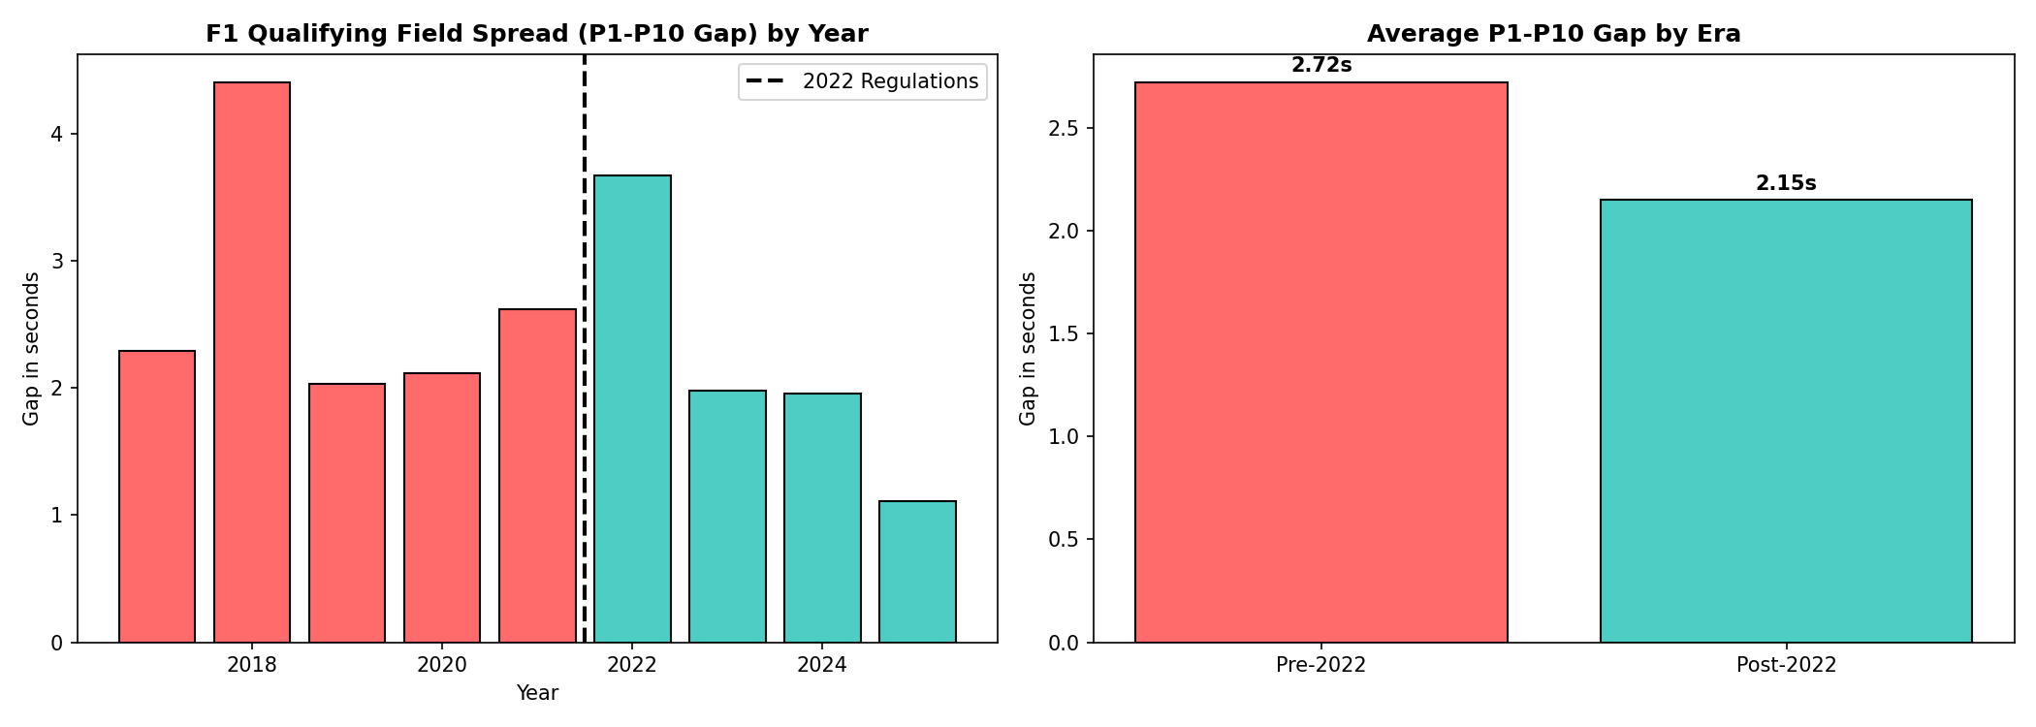
Conclusion
3,853 qualifying results from Jolpica API
Entity resolution for 16 team variants
46 regulations extracted via LLM
SQLite database with 6 normalized tables
Quantitative analysis on 6 circuits
21% narrower

Slide 23
Thank You

