Slide 1



THE C# ORM BATTLE
Code It Up Online Vol. 3

Slide 2
For questions
https://sli.do #battle
The YouTube Live Chat Is Not Monitored
Presentation & Code https://github.com/ivaylokenov/CSharp-ORM-Battle

Slide 3

The Presenter
Ivaylo Kenov – Quality Code Advocate
Various job titles at the same time:
Organizer & Speaker @ Code It Up
CTO @ SoftUni
Full Stack Technical Trainer @ Everywhere
Code General @ https://MyTestedASP.NET
Meme Copy Machine @ Daily Programming Fun
{Insert Job Title Here}
Contacts
https://github.com/ivaylokenov
https://facebook.com/ivaylo.kenov
https://linkedin.com/in/kenov
https://www.instagram.com/ivaylokenov/
YouTube
https://youtube.com/MyTestedASPNETTV

Slide 4
What Are We Going To COVER
About Code It Up
Why This Battle?
Popular C# Data Access Technologies
How To Choose an ORM?
The Anatomy of a Query
Query Optimizations
The Actual Battle!
Data Layer Best Practices
Do You Need the Repository Pattern?

Slide 5
ABOUT CODE IT UP

Slide 6
Code it up
The Code It Up initiative:
Aims to provide detailed knowledge on advanced .NET topics
Aimed at people with at least 1 year of C# experience
Code It Up Online
Free live-streamed online events
Code It Up Networking
Free on-sight events with live streaming
Guest speakers from the industry
Networking part (with pizza and beer)
Code It Up Workshop
Paid events containing practical exercises for the attendees

Slide 7
Upcoming Code it up Events
Events with set dates:
May 30-31 – DDD & Clean Architecture With ASP.NET Core Workshop
Events with no specific order or dates:
Automate Your Process with CI/CD
The Limits of the C# Runtime
API Scenarios - REST, GraphQL & gRPC
Serverless Real-Time C# Applications On AWS? Yes, It’s Possible & Easy!
C# On Rocket Fuel – Writing High Performance .NET
Software Engineering – Patterns & Anti-Patterns
Plus many more! For example Microservices Details?
The SoftUni course for microservices is now published!

Slide 8
Thankful if you share a story
You can be extremely helpful to the initiative
Just share a story on Facebook or Instagram during the lecture
Make sure you tag me so that I can reshare your post - @ivaylokenov
Bonus – add the #codeitup hashtag
Thank you! You rock!

Slide 9
WHY this battle?

Slide 10
WHY this battle?
Developers are often biased and opinionated about database access
Some of them don’t like ORMs and prefer stored procedures for performance
Some of them don’t like stored procedures and prefer ORMs because it is easier
Some of the ORM supporters do not like LINQ and prefer to write SQL queries in their code
Some of the ORM supporters do not like magic SQL strings and prefer LINQ
Some think Entity Framework is slow and inefficient, others love it
And all developers have their valid reasons for thinking their way
Truth is – there is no “one size fits all” solution – it depends on the context
Would you use LINQ, if you have millions of queries per minute?
Would you use stored procedures, if you have thousand queries per day?

Slide 11
Popular C# data access TECHNOLOGIES

Slide 12
ORM vs Micro ORM
It is important to realize the difference
Micro ORM:
Provides basic mapping between SQL and objects
Minimal API for working with the database
Superior performance because of simplicity
ORM:
Advanced features like identity tracking, transaction, lazy-loading, complex mapping system
Usually slower because of the extra layers
Both are not mutually exclusive
Both can be used in the same code-base, depending on needs

Slide 13
Popular C# data access TECHNOLOGIES
We are now going to compare all the popular data access technologies:
Stored procedures & ADO.NET – low-level data access
Nhibernate – the first ORM for C#, popular, still updated
LINQ to DB – fast performance, bridges the gap between ORMs and Micro ORMs
RepoDB – kind of a new player, super-fast performance
Entity Framework 6 – super popular even though kind of outdated
Entity Framework Core – the latest ORM technology from Microsoft
Dapper – popular, comes from StackOverflow

Slide 14
Popular C# data access TECHNOLOGIES
Others were not included because of various reasons:
LINQ to SQL – it was popular, but kind of dead already
PetaPoco – slower than EF and Dapper
Npoco – slower than EF and Dapper
SQLProvider – not very popular
DevExpress XPO – more boilerplate code to write, not a lot of downloads lately
LLBLGen – paid product, but very good
Tortuga Chain – seems fast, but not widely used
ServiceStack OrmLite – paid product, popular, comes from ServiceStack
And many others…
Performance compared with:
https://github.com/FransBouma/RawDataAccessBencher/

Slide 15
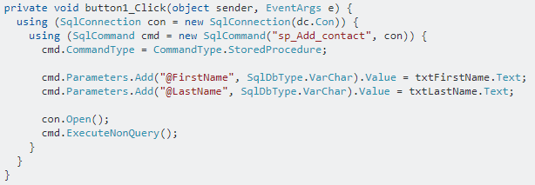
Stored procedures & ADO.NET
The fastest way to query the database in terms of performance
Pros:
Performance-wise is the best
Cons:
Adding business logic to the data layer brings development complexity
Parsing data by hand
No LINQ
Every operation is pretty much handmade

Slide 16
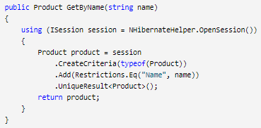
NHibernate
The first C# ORM
Pros:
Lots of features (more than EF)
Lots of database providers
LINQ support
Cons:
More difficult to learn than other ORMs
Default mapping is done through XML
There are third-party fluent configurations
Not supported by professional developers
Development is slow
Most tutorials are from the previous century…

Slide 17
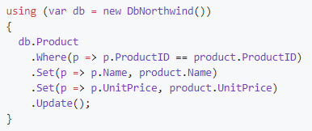
LINQ to DB
A fast C# ORM without advanced features
Pros:
Lots of database providers
LINQ support
Fluent CRUD features
Superior performance
Cons:
Missing advanced features like change tracking
No table generation or code first
Developers must manually write database logic

Slide 18
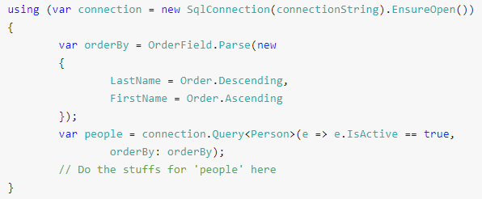
RepoDB
A very fast Hybrid ORM (tries to beat Dapper)
Pros:
Custom “LINQ” support
Fluent CRUD features
Nice customizations
Superior performance
Cons:
Very new, it did not have tests until recently
Not backed by a huge company
No table generation or code first
No default LINQ
Custom API, you need to learn it

Slide 19
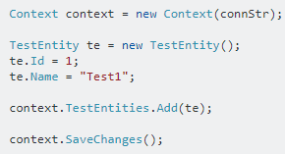
Entity Framework 6
The old-school ORM by Microsoft (still supported, but not developed)
Pros:
LINQ Support
Very easy to use by developers
Stable and mature
Cons:
Getting old now
Not suitable for Domain-Driven Design
Not as performant as micro ORMs
EF Core is catching up:
https://docs.microsoft.com/en-gb/ef/efcore-and-ef6/
Some features are missing without third-party tools:
https://entityframework-plus.net/

Slide 20
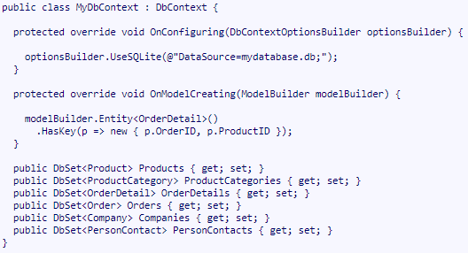
Entity Framework Core
The official ORM by Microsoft
Pros:
LINQ Support
Very easy to use by developers
Suitable for Domain-Driven Design
Advanced features, table generation
Supported by a big company
Supports native SQL (with limitations)
Cons:
Still relatively new
Not as performant as micro ORMs (but it is close enough)
Some features are missing without third-party tools:
https://entityframework-plus.net/
https://docs.microsoft.com/en-us/ef/core/extensions/

Slide 21
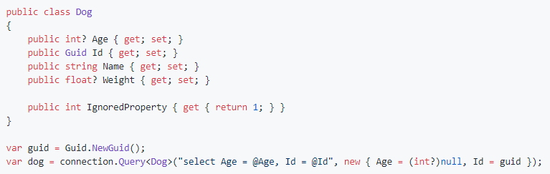
Dapper
Micro ORM by StackOverflow
Pros:
Lightning fast
Full control over the queries
Easy basic operations
Supported by a big company
Cons:
Very low level of usage
No table generation or code first
No LINQ
No advanced features
Developers need to handwrite advanced queries manually

Slide 22
BEFORE WE CONTINUE…

Slide 23

INDEAVR – The EVENT’s DIAMOND SPONSOR
They provide technology services focused on the Digital, Data, Cloud and Advanced Software Engineering expertise.
They are always in search for creative and passionate people with the combination of a sharp strategic mind, emotional maturity, entrepreneurial instincts, and the ability to deliver results.
https://www.indeavr.com/en/technology/application-services
https://www.indeavr.com/en/careers

Slide 24
How to choose an orm?

Slide 25
How to choose an orm?
This is advice is my own opinion based on experience! Feel free to disagree!
Long-term project - more than 1 year of development
Choose a big company’s product
Remember Massive? Yeah, me neither! But some developers do!
Entity Framework Core as a first-class citizen (developers cost more than hardware)
Dapper for low-level optimizations where Entity Framework Core fails to perform well
Short-term project - less than 1 year of development
Need to deliver it fast? Choose the most familiar tool!
Otherwise, feel free to experiment with LINQ to DB or RepoDB
LINQ to DB, if you like LINQ and want familiar syntax
RepoDB, if you want better performance
Need superior performance? ADO.NET is for you (with careful stored procedures)!

Slide 26
The Anatomy of a Query

Slide 27
MICro ORM SQL Query
Let’s first see how a Micro ORM translates a query
It construct a SQL from your hand-written query and the parameters you provide
Executes a SQL command against the database by using ADO.NET
Parses the results for you and maps them to the provided class
It caches the class property setters as delegates so that they perform faster the second time

Slide 28
ORM EXPRESSION Query
The LINQ query is translated to an object tree, ready to be used by the DB provider
The translation is expensive, so it is cached
The result is passed to the database provider
It identifies which parts of the query can be evaluated by the database
These parts are translated to the database language – SQL, for example
A query is sent to the database, and results are returned in raw form
In tracked queries - each item in the set is checked whether it is tracked or not
If it is tracked – it is used from the change tracker
If it is not tracked – a new entity is created and returned
Not tracked queries – new entities are always created
NOTE: Tracking depends on the ORM being used!

Slide 29
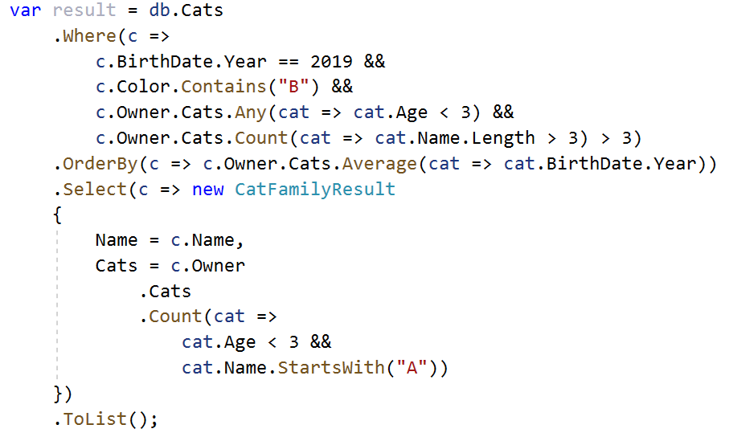
ORM EXPRESSION Query
It is obvious that a normal ORM has much more overhead!
And hidden details which developers may not know!
It is not easy to evaluate how this query is going to perform:

Slide 30
Query Optimizations

Slide 31
Too many queries
Be careful about the famous N + 1 problem
Easily mistaken with lazy loading enabled (EF 6 enables it by default)
One possible solution is Include
You will fix the N + 1, but you may fetch data, which is not needed
In EF Core 5.0 you can filter in the Include statement
The best approach:
Do not use the database objects in your business or UI logic directly
Use DTOs, ViewModels, ResponseModels, you name it
Always use Select projections at the end of your queries
You may use AutoMapper, if mapping objects is getting too heavy

Slide 32
Too many Columns
When you don’t use Select, you fetch all table columns for every row
This behavior may be fine for now, but what about the future?
Someone may add a heavy column to the model and your query will start fetch it unnecessarily
It may seem insignificant, but fetching more columns can make a huge difference in terms of performance
It is a good idea to always project your queries to a different DTO, ViewModel, ResponseModel, you name it
Using Select saves you so much trouble (or AutoMapper, if you are lazy)

Slide 33
Incorrect data loading
With LINQ queries – data is loaded when it is used (materialized)
You may chain multiple Where, Select, OrderBy, and other statements
But no database call will be made until the data objects are needed
Methods like ToList, ToDictionary, Count, Any make the actual data call
Methods which need to construct an actual result of a scalar value or object(s)
As a developer – you need to be careful whether you are executing queries against the database or in memory
Database queries are preferred because it is more optimized for such work
But sometimes an in-memory calculation will be more performant
Measurement is the key here

Slide 34
INNER QUERIES
ORMs with advanced features support inner multiple queries
These provide a very easy solution for otherwise cumbersome joins
But this is where “this ORM is slow” part kicks in
Some of these LINQ expressions are difficult to translate into a good SQL operation
For this reason – sometimes you should write queries as “SQL-native” as possible
And sometimes it is better to query an easier to fetch data
And then calculate the results in memory

Slide 35
BEFORE WE CONTINUE…

Slide 36

Huge THANKS for your support & TRUST!
Everyone who got a paid ticket – 97 people in total! Rewards are coming!
Top supporter – a company this time - €100! Thank you, TSD services!
Personal thanks to – Georgi, Antoniya, Vladimir, Nazif, Valentin, Борислав, Atanas, Iliya, Mihail, Maria, Desislava, Radoslav, Viktor, Viktor, Konstantin Svetoslav, Yulian, Stoyan, Darin, Stefan,
Thanks also to – Pavel, Miroslava, Красимир, Petar, Petko, Dragomir, Ilina Атанас, Plamen, Rumen, Orlin, Николай, Ivan, Kristian, Ivo, Simona, Simeon Kalina, Teodor, Ivaylo, Svetlin, Radoslav, Nikolay, Dobromir, Diana, Stoyan Yordan, Димитър, Nikolay, Georgi, Anna, Emil, Мариян, Dimitar, Hristo, Dimitar, Dimitar, Stoyan, Pirin, Radoslav, Todor, Andrey, Hristo, Ivaylo, Daniela, Bojidar, Lachezar, Илиян, Kostadin, Paketservice, Volen, EMIL, Svilen, Aleksandar, Yavor, Иво, Tihomir, Veselin, Svetlozar, Dimitar, Martin, Antoan, Денислав, Dobromir, Angel, Valentin, Zhivko, Pavel, Iliyan, Dimcho, Silviya, Alexander, Mincho, Plamen, Hristina, Angel, Mira, Grigoris

Slide 37
These events are not Exactly free
I prefer to call them “Pay what you want”
Depending on how much you value the provided knowledge
It takes me a considerable amount of free time to prepare these lectures
And I want them to be perfect and complete!
I put my soul in them!
For this reason I will be extremely thankful, if you decide to support me and my projects!
It is never expected, but always appreciated!
The easiest way is via
PayPal: http://paypal.me/ivaylokenov
Revolut: @ivaylowrlt

Slide 38
Mentorship program ON Patreon
These events are part of my new mentoring program!
Target – junior to regular programmers with 0 to 2 years practical work
Help with:
Becoming better software developers
Code improvement in terms of quality and logic
Career choices and advancement
Interview preparation
And more
Approach – private groups, exclusive lessons, workshops, one-on-one meetings
More information on Patreon: https://www.patreon.com/ivaylokenov

Slide 39
DELETE OPTIMIZATIONS
Deleting multiple elements:
In EF Core single element – do not fetch the data before deleting it, if you have the Id
In EF Core multiple elements
Use native SQL to make query deletion
Use Entity Framework Plus to make query deletion
LINQ to DB
Use the built-in query deletion

Slide 40
COLD And WARM QUERIES
As we already discussed – an ORM needs a lot of heavy preprocessing before calling the database
So the first query is usually slower – it is “cold”
Then a lot of these preprocessed objects are cached for secondary usage
So all queries after the first one are generally faster – they are “warm”
A good technique is to use compiled queries, if the ORM supports them
Some people prefer to “warm up” all their heavy queries at application start time
This technique may work well, if you do not deploy super often
And have lots of other caching going on
It depends, and as always – you should measure

Slide 41
Change tracking
ORMs with change tracking have an overhead in every read query
Especially if the result contains lots of objects
If you will not use the tracked entities in an update or delete scenario – you do not need that feature
In such scenarios – it is a good idea to disable change tracking
You can do it on a context or on a query level
Using Select saves you yet another time, because entity tracking does not cover it
But make sure you use DTOs, ViewModels, ResponseModels, you name it

Slide 42
Miscellaneous Optimizations
Database Indexing for tables with lots of reads on some columns
Be careful with client functions in some ORMs
Be careful with database hierarchies/design generated by ORMs
Use async/await extension methods
Dispose the database context frequently enough
Enable multiple result sets
Use native SQL where needed
Use caching techniques for frequently used queries
Sometimes – it is the database design and not the ORM
Analyze the query execution plan

Slide 43
BEFORE WE CONTINUE…

Slide 44
C# Multithreading Workshop
Held on May 2
Threads, Race Condition, Dead Lock, Thread Pool, Synchronisation and Optimization
Tasks include – Folder Synchronization, Parallel Sorting, Own Cache Implementation
3 hours lecture, 5 hours hands-on experience
Step-by-step guidebook about multithreading (20+ pages)
Lifetime support & Money-back guarantee
Recording – just shoot me a message, and I will give you more details!

Slide 45
ASP.NET Clean Architecture Workshop
Held on May 30-31
Create a fully working ASP.NET Core application with DDD
4+ hours lecture, 12+ hours hands-on experience
Step-by-step guidebook about building “clean” apps (20+ pages)
Lifetime support & Money-back guarantee
2 types of attendance
Online
Recording
http://bit.ly/ciu-ddd

Slide 46
SOFTUNI ASP.NET MICROSERVICES COURSES
I will teach a module with 3 courses for ASP.NET Microservices:
The Architecture of ASP.NET Core Microservices Applications
Architecture choices and microservices with ASP.NET Core
Best practices with ASP.NET Core microservices
Design and Processes in Microservice ASP.NET Core Applications
Design considerations when using microservices with ASP.NET Core
Containers, clusters, teamwork, deployment, configuration
Development of Microservice ASP.NET Core Applications
Domain-driven design with ASP.NET Core microservices
Clean and practical code for the microservice approach
Each Code It Up attendee can use the following discount codes:
https://bit.ly/su-microservices
CODEITUP-onsite & CODEITUP-online

Slide 47
Data Layer Best Practices

Slide 48
Data layer best practices
Data layer separation of concern best practices have lots of options
The most popular ones are:
Repository pattern (with UoW) – injecting data repositories in your presentation layer
Service layer – separating business logic from your presentation layer
Query objects – separating queries from the service layer
Queries contains hidden business logic
Command Query Responsibility Segregation – separating different kinds of queries
We are not going to see these solutions one by one!

Slide 49
Do You Need the Repository Pattern?

Slide 50
The repository pattern
The repository pattern emerged while Entity Framework 6 was the cool kid in town
It was difficult to test the data layer back in the day
It required expression shenanigans to mock the DbContext directly
With Entity Framework Core things are a bit different
With the repository pattern we are essentially creating an abstraction over an abstraction
The ORMs already implement the repository pattern (DbSet) and unit of work (DbContext)
Still – repository pattern is OK, if it encapsulates the business logic
The data services in the service layer are essentially a correct implementation of the pattern
Classic Violations:
Returning IQueryable breaking the abstraction
Delegating calls to the ORM and not doing anything else

Slide 51
The repository pattern
Pros
Isolating queries – it is better to use CQRS
In DDD – repositories for each aggregate root provide encapsulation
Hiding complex SQL queries – only if you use native queries, but the services pattern is still better
Cons
Too generic – hiding the ORM and essentially “disabling” its advanced features
Performance issues – by being too generic, the repository may not perform at best performance
Good reasons to use it
DDD and aggregate roots
Bad reasons to use it
Potential change of the database
To abstract the data layer

Slide 52
The repository pattern
What do the experts think?
Jimmy Bogard
“I am over repositories, and definitely over abstracting the data layer!”
Steve Smith
“No you do not need a repository. But there are certain benefits which you should consider!”
John Smith
“No, the repository/unit-of-work pattern is not useful with EF Core!”
Personally, I use it only with aggregate roots in DDD.
Now let’s see whether we really need it!

Slide 53
FINAL WORDS

Slide 54
Summary
About Code It Up
Why This Battle?
Popular C# Data Access Technologies
How To Choose an ORM?
The Anatomy of a Query
Query Optimizations
The Actual Battle!
Data Layer Best Practices
Do You Need the Repository Pattern?

Slide 55
Upcoming Code it up Events
Events with set dates:
May 30-31 – DDD & Clean Architecture With ASP.NET Core Workshop
Events with no specific order or dates:
Automate Your Process with CI/CD
The Limits of the C# Runtime
API Scenarios - REST, GraphQL & gRPC
Serverless Real-Time C# Applications On AWS? Yes, It’s Possible & Easy!
C# On Rocket Fuel – Writing High Performance .NET
Software Engineering – Patterns & Anti-Patterns
Plus many more!
A SoftUni course about microservices
https://bit.ly/su-microservices

Slide 56
ANY QUESTIONS?
You can support me and my projects:
Via PayPal: http://paypal.me/ivaylokenov
Via Revolut: @ivaylowrlt
On Patreon: https://www.patreon.com/ivaylokenov
On Open Collective: https://opencollective.com/mytestedaspnet
Via Buy Me A Coffee: http://buymeacoff.ee/ivaylokenov
Crypto: http://bit.ly/ik-sponsors
Never expected, always appreciated!

Slide 57
Thank You!
presentation available here: https://github.com/ivaylokenov/CSharp-ORM-Battle

