Slide 1
alation & tableau workshop

Slide 2















Auto Dashboard Work flow
Data Clean Data Summary Table Chart Sharing

Slide 3
Auto Dashboard Work flow
Data Clean Data Summary Table Chart Sharing

Slide 4
Comparison
Data manipulation
Tool | Pro | Con
Sql assistant | easy to use | hard to share
alation | easy to use easy to share and search easy to schedule and view running log | does not show which line cause the error Hard to use version control It share your code to all teammate
SAS base | easy to schedule | UI not friendly
Python pandas |  | learning cost
R dplyr |  | learning cost
Plotting
Tool | Pro | Con
excel | easy to use | hard to schedule and reproduce
tableau | easy to schedule | hard to reproduce and slow ,less personalized
SAS |  | Need additional module
Python matplotlib |  | learning cost
R ggplot |  | learning cost
Sharing
Tool | Pro | Con
excel |  | hard to share
tableau | easy to share
SAS VIYA |  | Need additional module
Python dash |  | learning cost
R shinyapp |  | learning cost

Slide 5
Alation

Slide 6
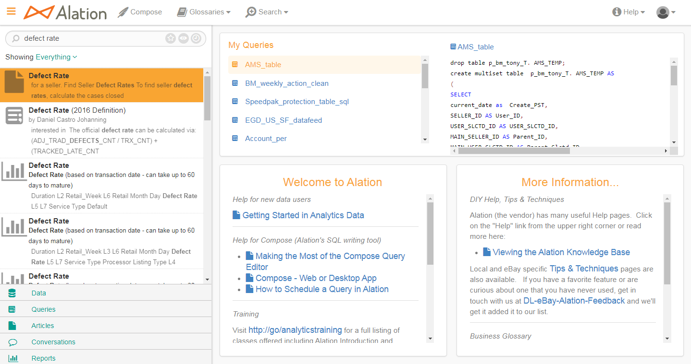
Alation
https://alation.corp.ebay.com/

Slide 7
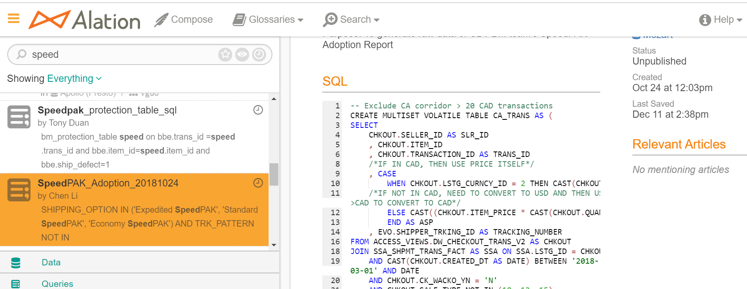
Alation Search

Slide 8
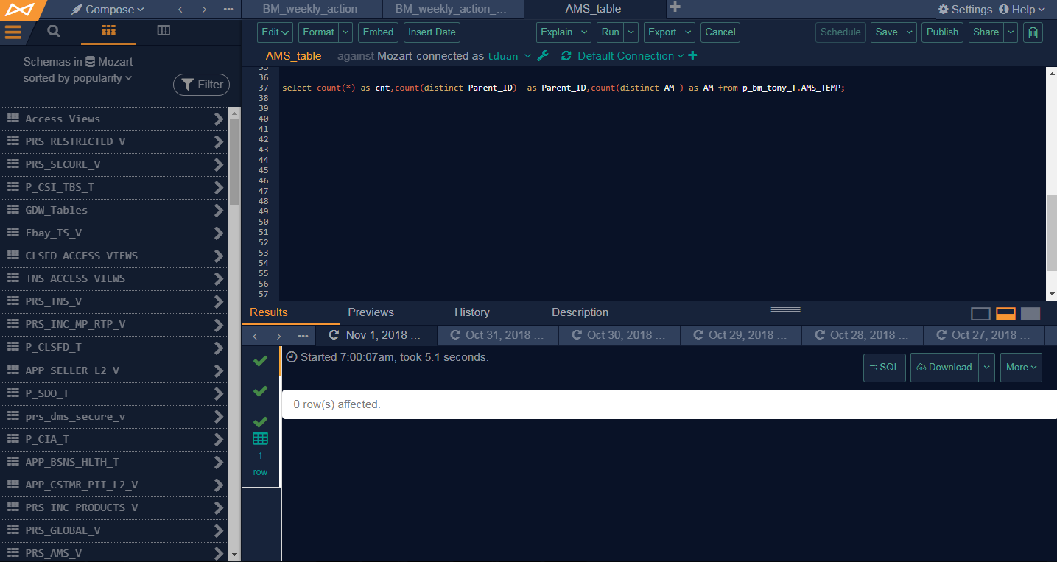
Alation Save & Share
https://alation.corp.ebay.com/compose/query/4593710/
Save
Publish
Save out the link

Slide 9
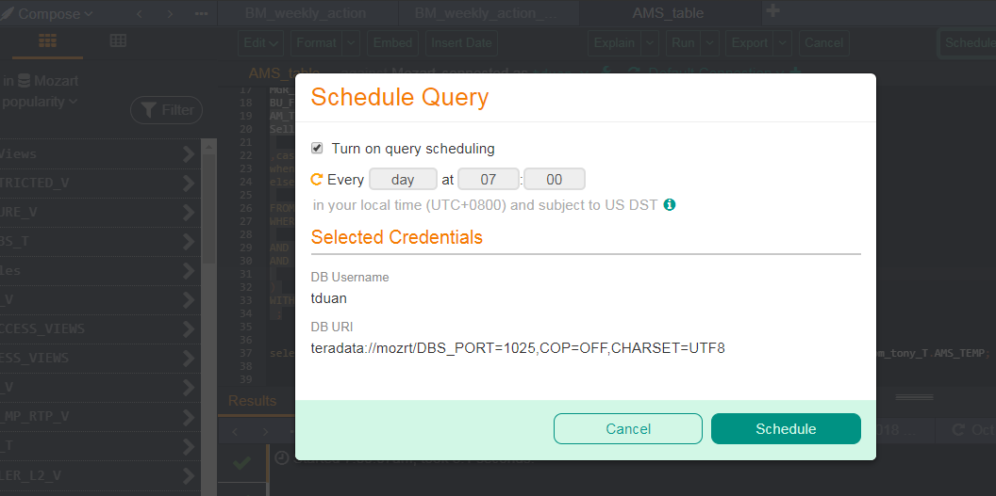
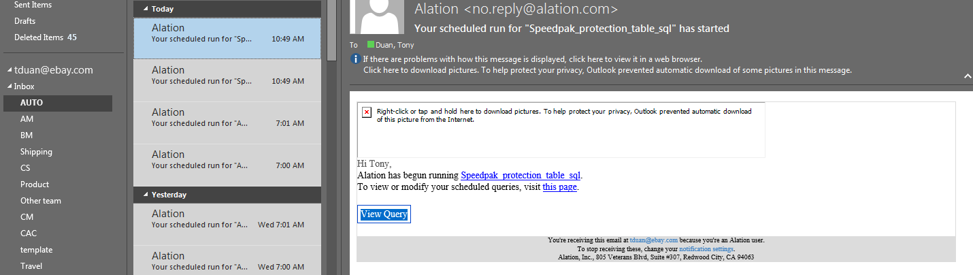
Alation Schedule

Slide 10
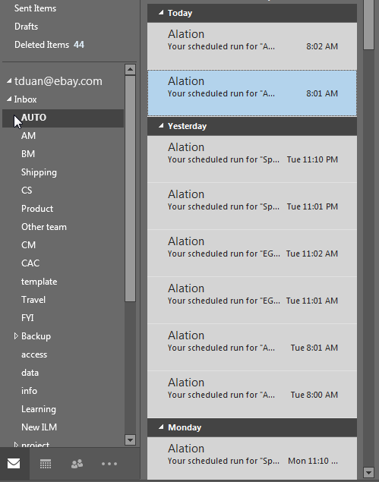
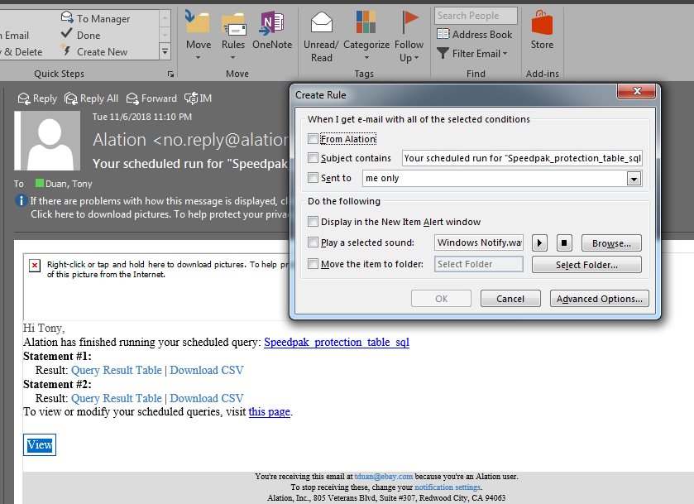
Alation schedule log email

Slide 11
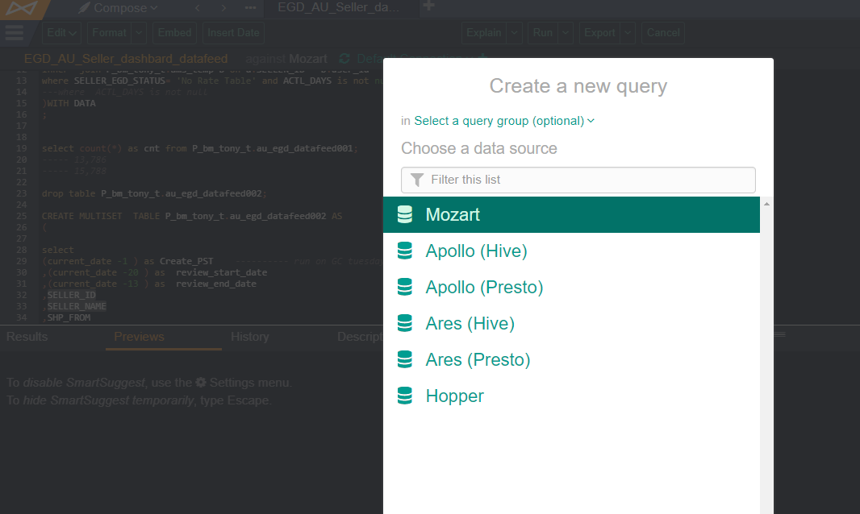
Alation cross Datawarehouse

Slide 12
Tableau

Slide 13
Tableau Structure Big picture
Purpose
Tool
Elements
1.Make dashboard
2.Data from Teradata to Tableau
3.Auto Refresh Teradata
4.Download from Tableau
5.Auto Send email from Tableau
Tableau Desktop
1.Data source
csv/excel/Teradata
…..
2. Worksheet
Table/chart/number
….
3.Dashboard
Worksheet A
Worksheet B
….
4.Story
Dashboard A
Dashboard B
…
5.Workbook
1.Data source / 2. Worksheet / 3.Dashboard / 4.Story ….
Tableau Server
6.Project
Workbook A / Workbook B / Workbook C …..

Slide 14
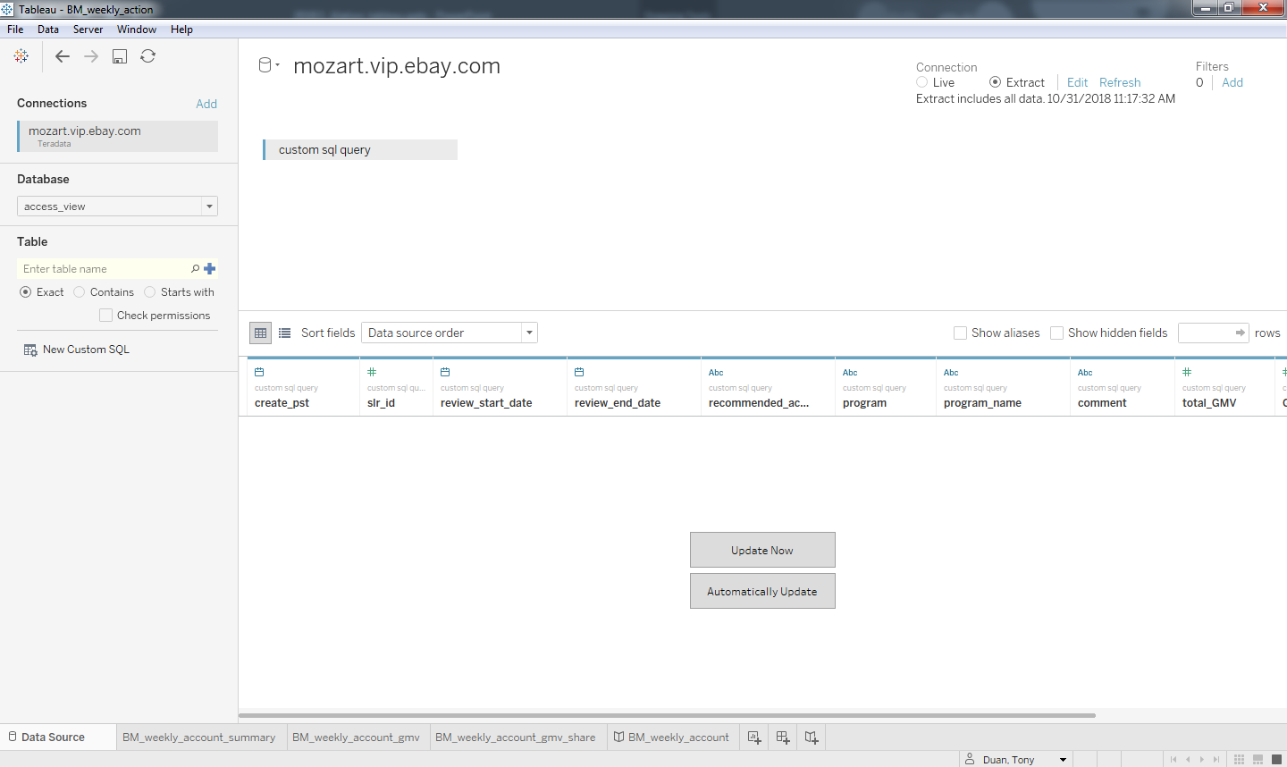
Tableau desktop
Tableau desktop
workbook
1.Data source
2.Worksheet [table/chart]
3.Dashboard
4.story

Slide 15
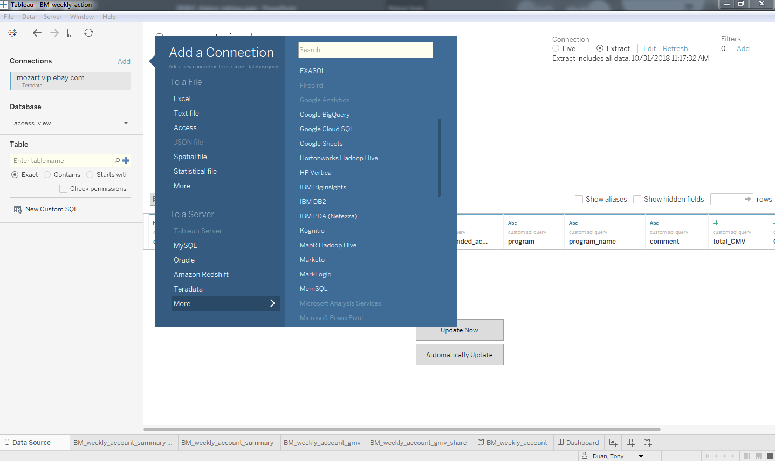
Tableau desktop
1.Data source

Slide 16
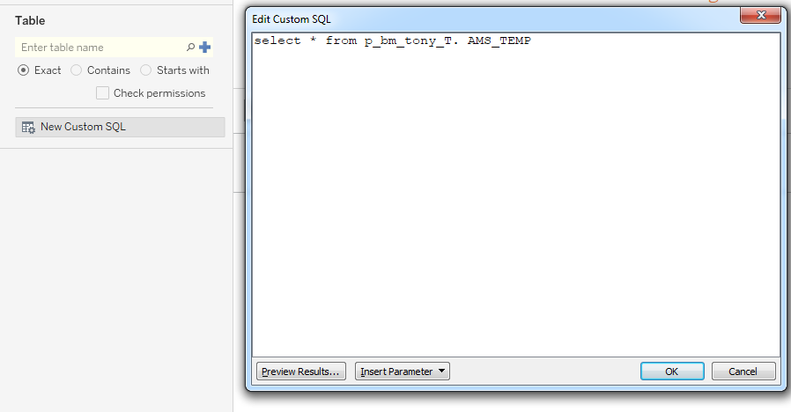
Tableau desktop
1.Data source

Slide 17
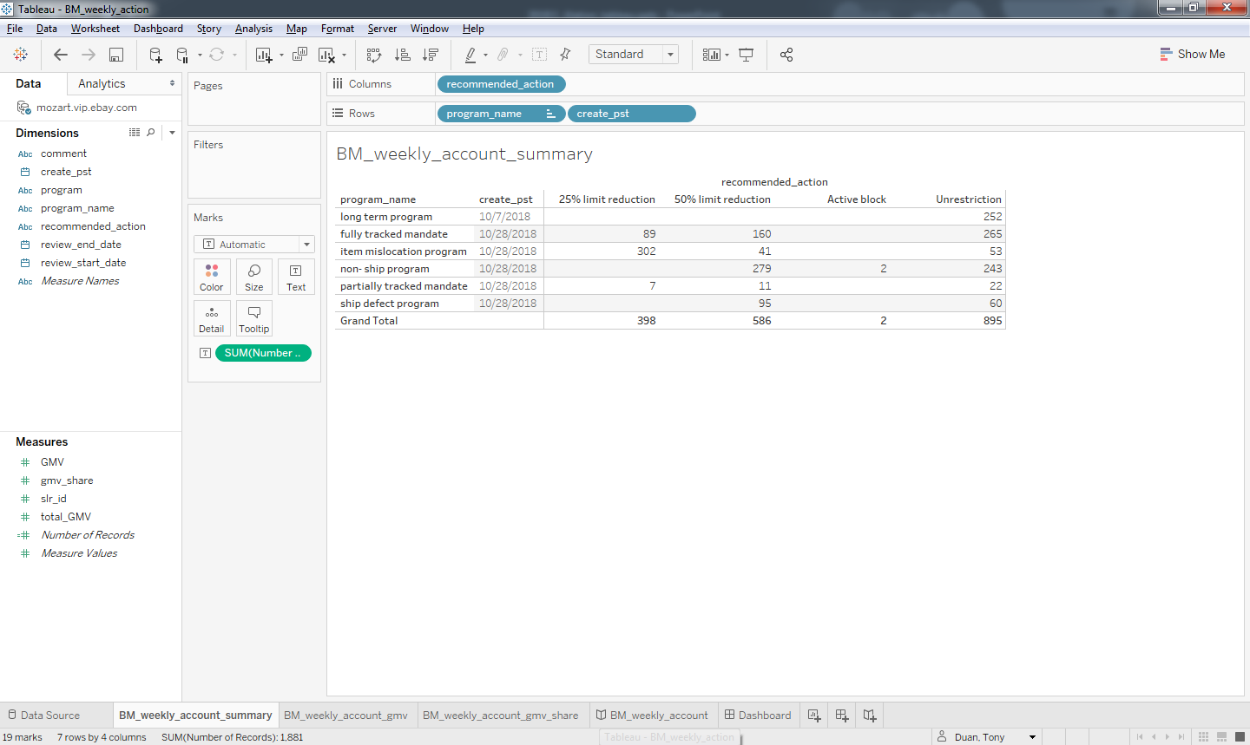
Tableau desktop
2.Worksheet
[Table]

Slide 18
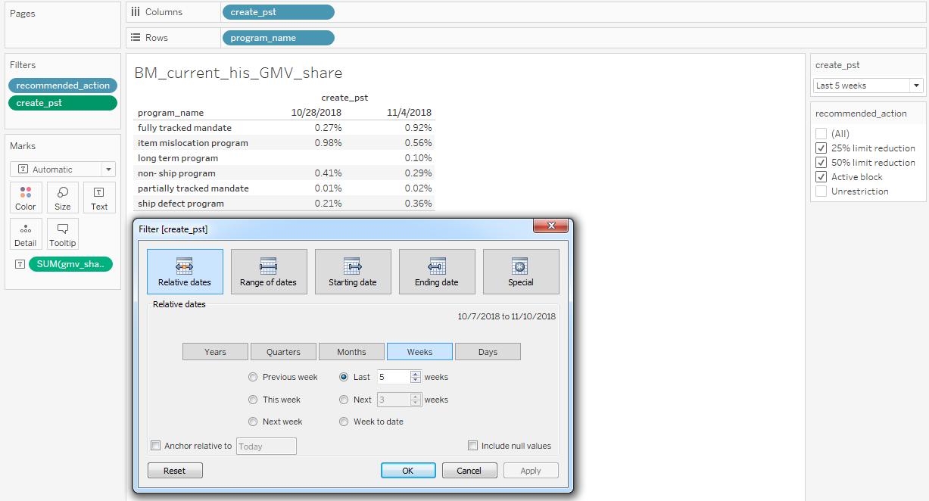
Tableau desktop
2.Worksheet
[Table]
date filter

Slide 19
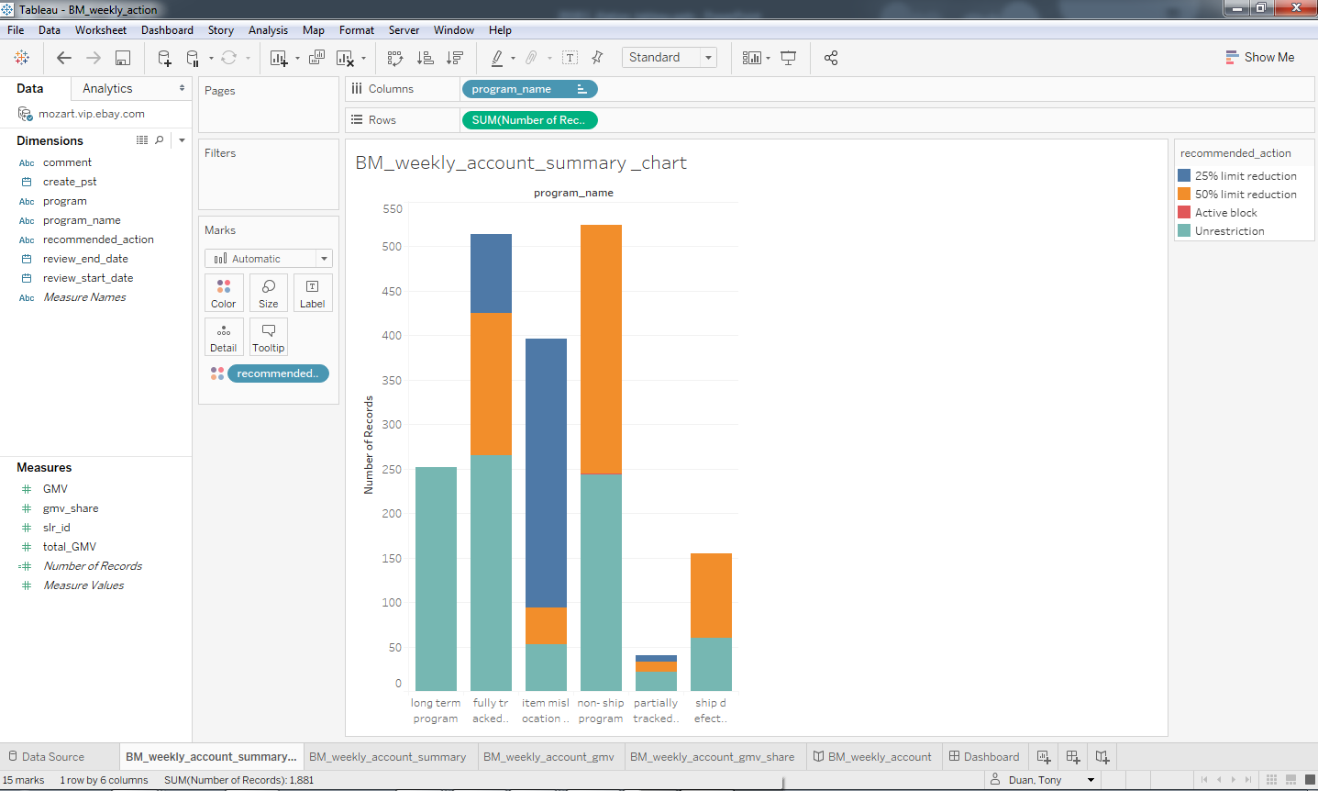
Tableau desktop
2.Worksheet
Chart
gg=ggplot(BM_action, aes(x = pogram_name,y=account, color=recommend_acton)) + geom_col()

Slide 20
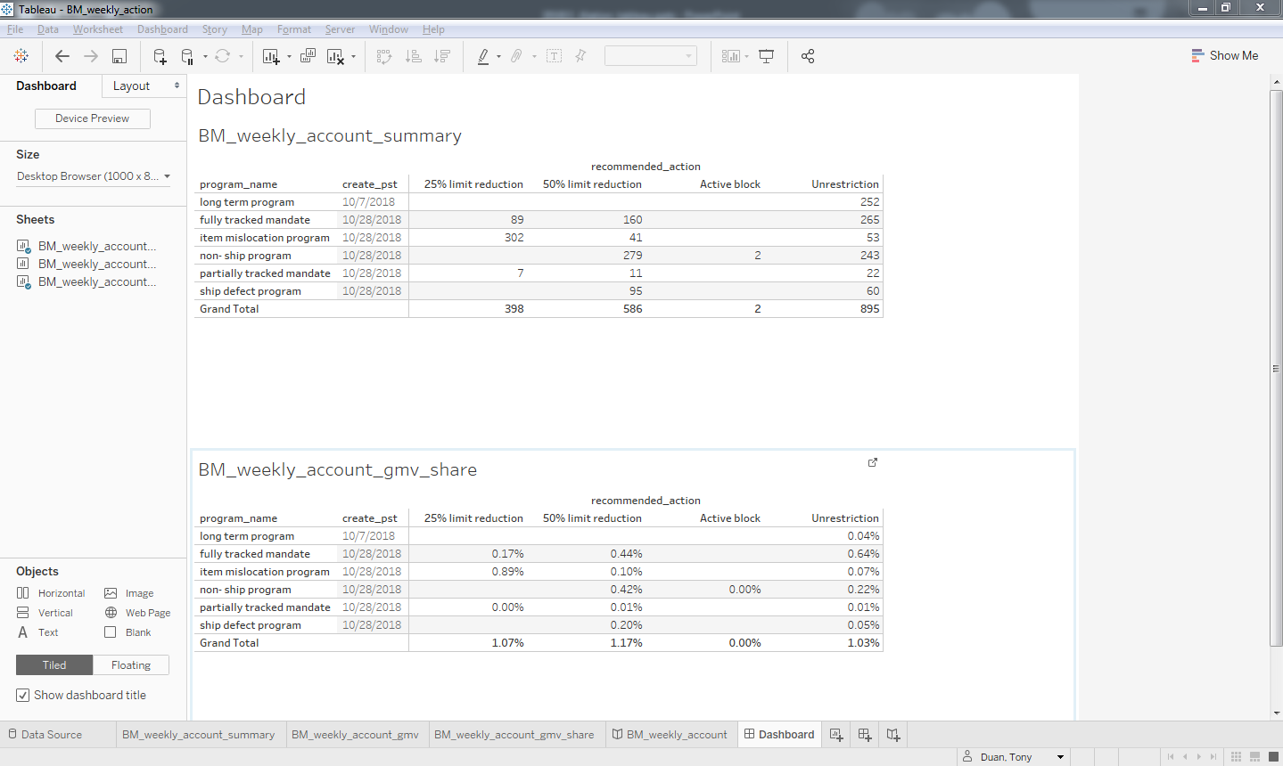
Tableau desktop
3.Dashboard

Slide 21
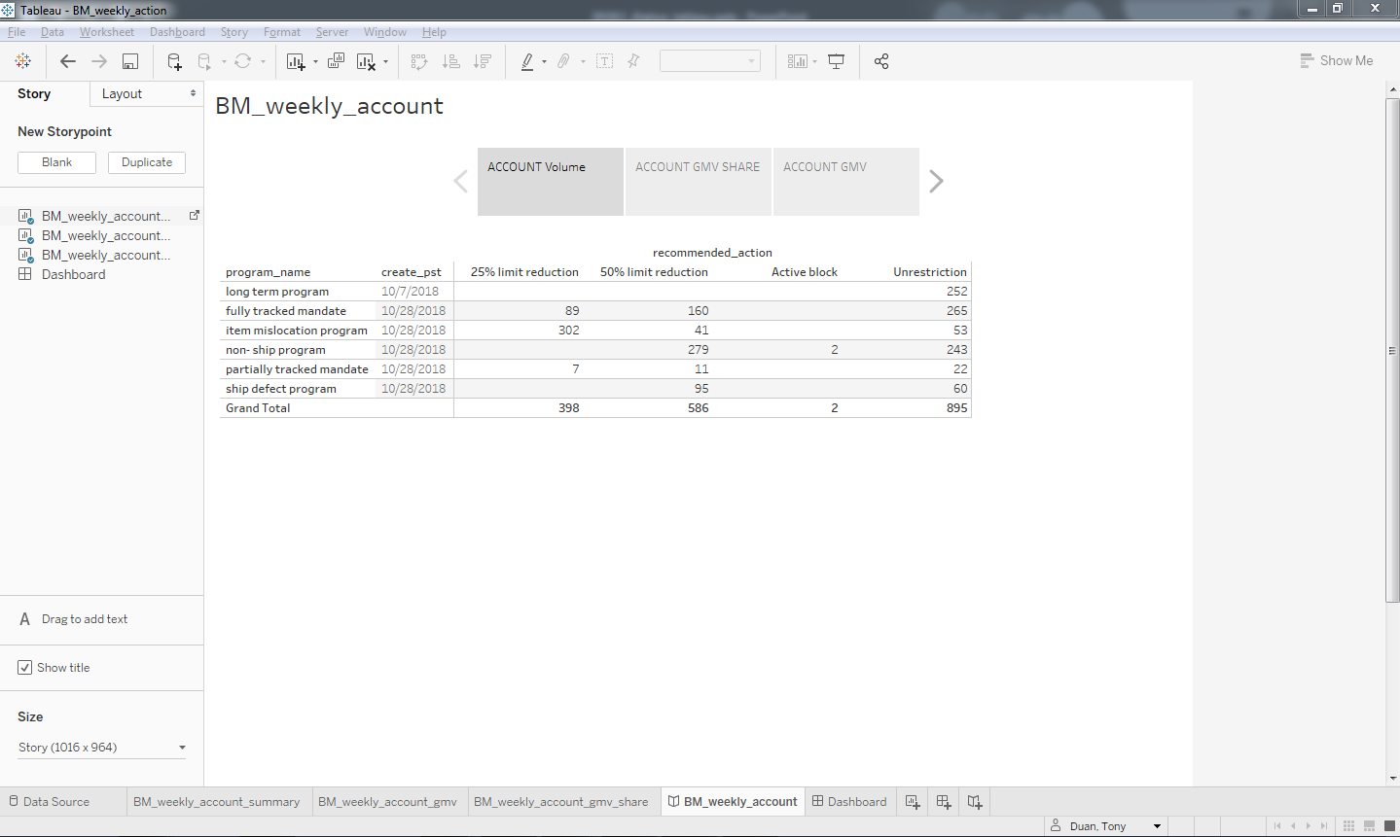
Tableau desktop
4.Story

Slide 22
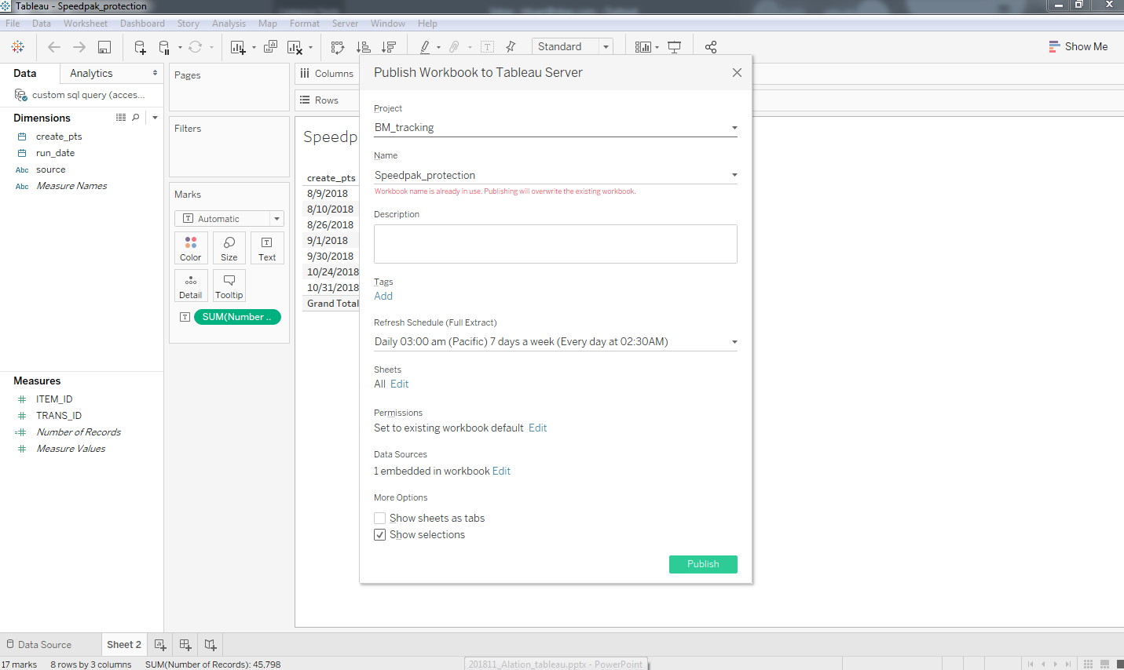
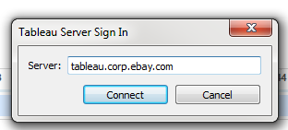
Tableau upload to server and set up auto refresh
menu bar->publish workbook->connect to database->login
5.Workbook

Slide 23
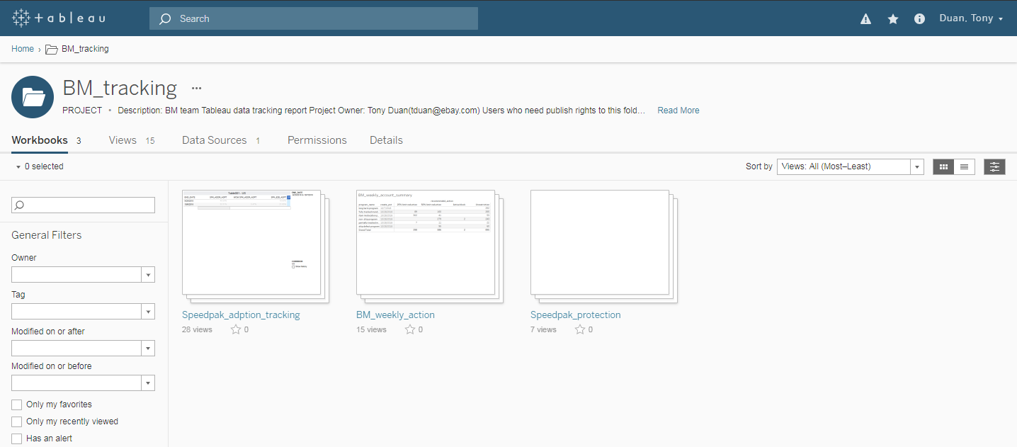
Tableau server
6.Project
5.Workbook
1.Data source
2.Worksheet
3.Dashboard
4.story

Slide 24
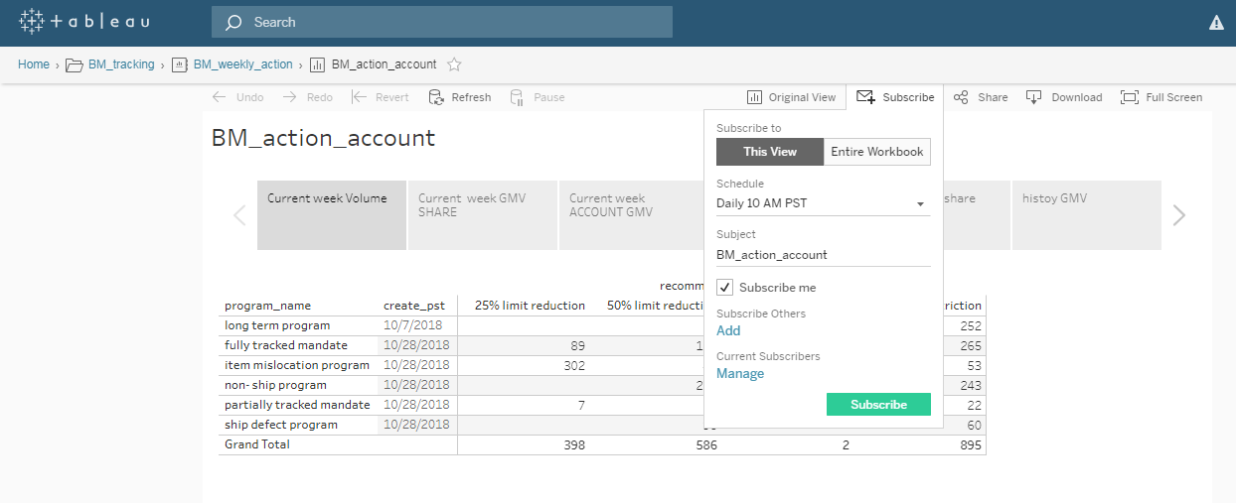
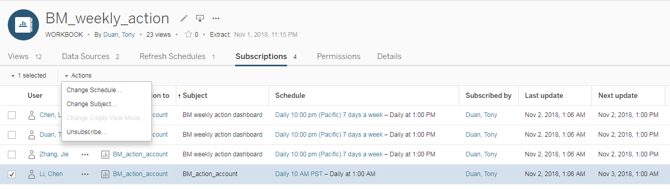
Tableau server send out report

Slide 25
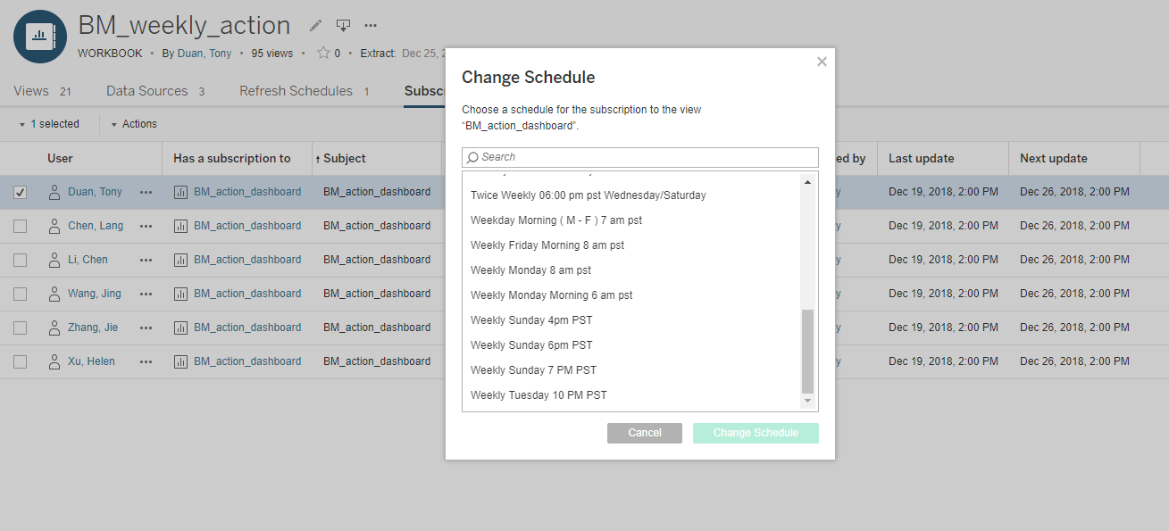
Tableau server send out report

Slide 26
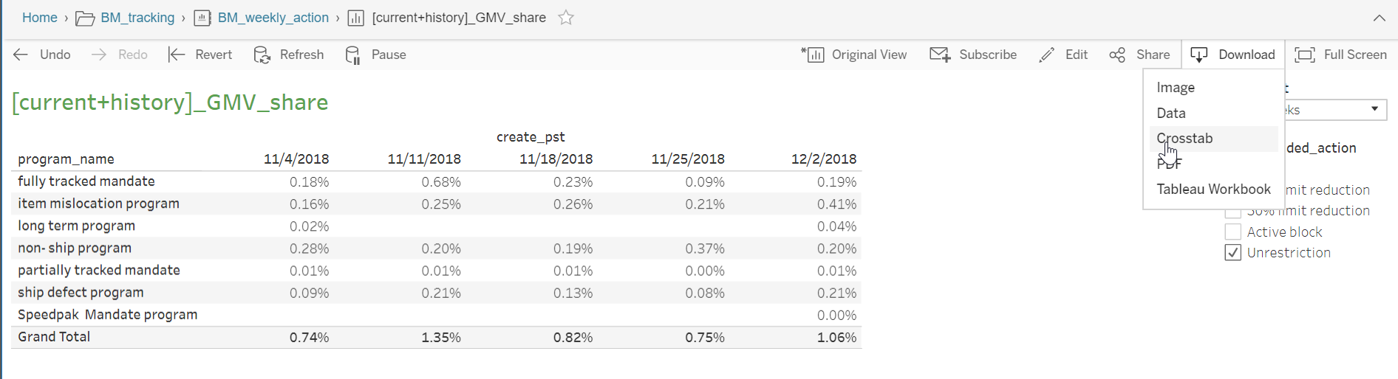
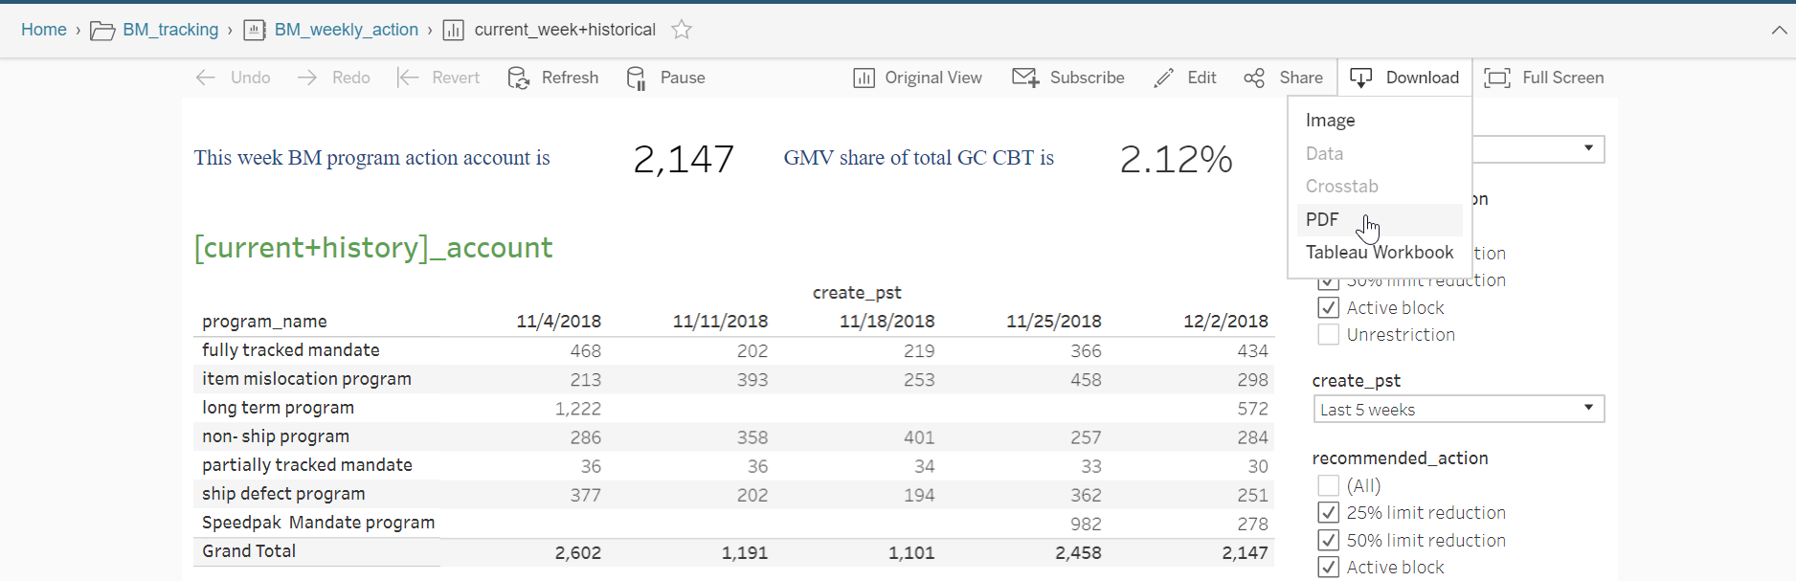
Tableau server download data
2.Worksheet
(table)
Download data
3.Dashboard
4.Story
Download pdf

Slide 27
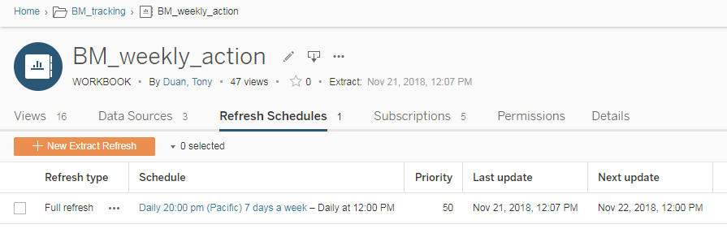
Tableau desktop refresh Automatically

Slide 28
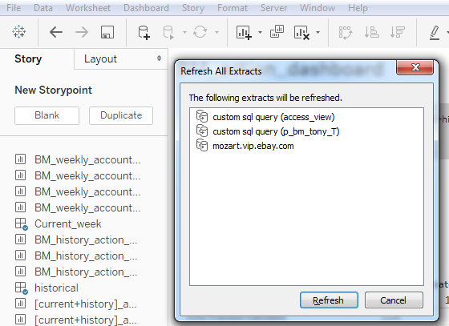
Tableau desktop refresh manually
Data->Refresh All Extracts

Slide 29
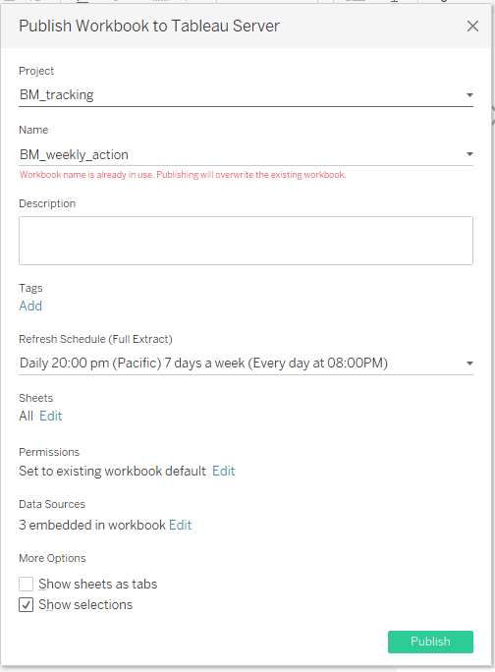
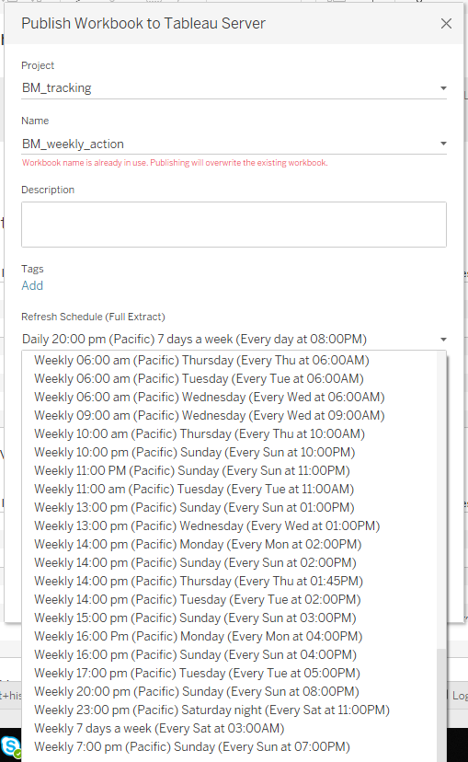
Tableau server refresh
Server-> Public workbook

Slide 30
Tableau access
1.Download Tableau (Software center)
2. apply for Tableau Desktop License in AAP
https://wiki.vip.corp.ebay.com/display/Tableau/KB+-+General+-+How+to+apply+for+Tableau+Desktop+License+in+AAP
3. get publish access to Tableau Server(new project)
https://wiki.vip.corp.ebay.com/display/Tableau/KB+-+General+-+How+to+get+publish+access+to+Tableau+Server
4. get publish access to Tableau Server(existing project)
https://wiki.vip.corp.ebay.com/display/Tableau/KB+-+General+-+How+to+get+publish+access+to+existing+project+on+Tableau+Server
5. Tableau server link:
https://tableau.corp.ebay.com

Slide 31
Reference
Mr. Pavan Lalwani
https://www.youtube.com/playlist?list=PLWPirh4EWFpGXTBu8ldLZGJCUeTMBpJFK
Tableau Tutorial for Beginners@Udemy
https://www.udemy.com/tableau-tutorial-for-beginners/
Tableau official tutorial document:
https://onlinehelp.tableau.com/current/guides/get-started-tutorial/en-us/get-started-tutorial-home.htm
Tableau official tutorial video
https://www.tableau.com/learn/training/archive?version=tableau_desktop_2018_3+tableau_prep_2018_2_1

Slide 32
Video
What is Alation
https://www.youtube.com/watch?v=PZIn3R_0QgA
Ebay + Alation
https://www.youtube.com/watch?v=yxyfUKD21nA
Tableau
https://www.youtube.com/watch?v=npmT7NLVt2s&list=PL4CiwQysIcFHzB0hCIOyu7QuhLPIpIu2e

