Slide 1
R Sharing episode 3
1 Why use R/R studio server PRO/R shiny PRO (pros and cons)
R studio server PRO: multi-section ;project sharing; version control
R shiny PRO: Account summary; Account info; Account performance
2 How to apply R studio server PRO/R shiny PRO Account

Slide 2
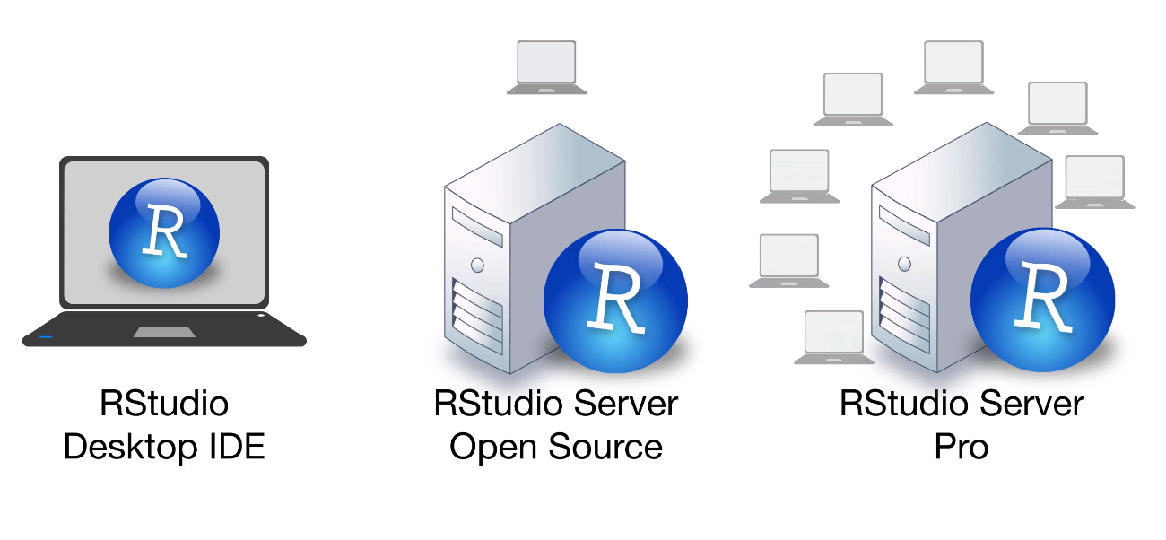


Why use R/R studio server PRO/R shiny PRO
R language
R shiny server pro
Free
Free
Free
$9,995 a year
$9,995 +$150 per users a year

Slide 3
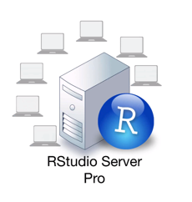
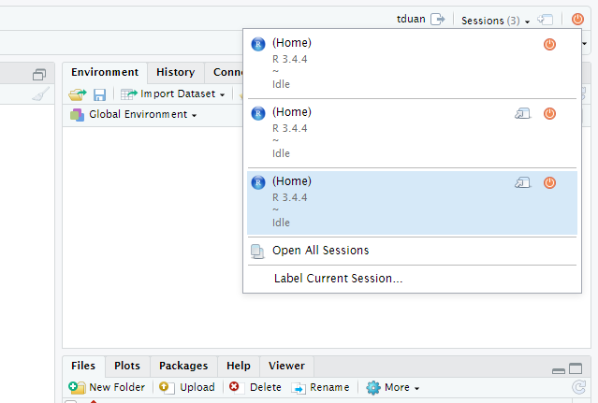
Why use R/R studio server PRO/R shiny PRO
1.Multi section

Slide 4
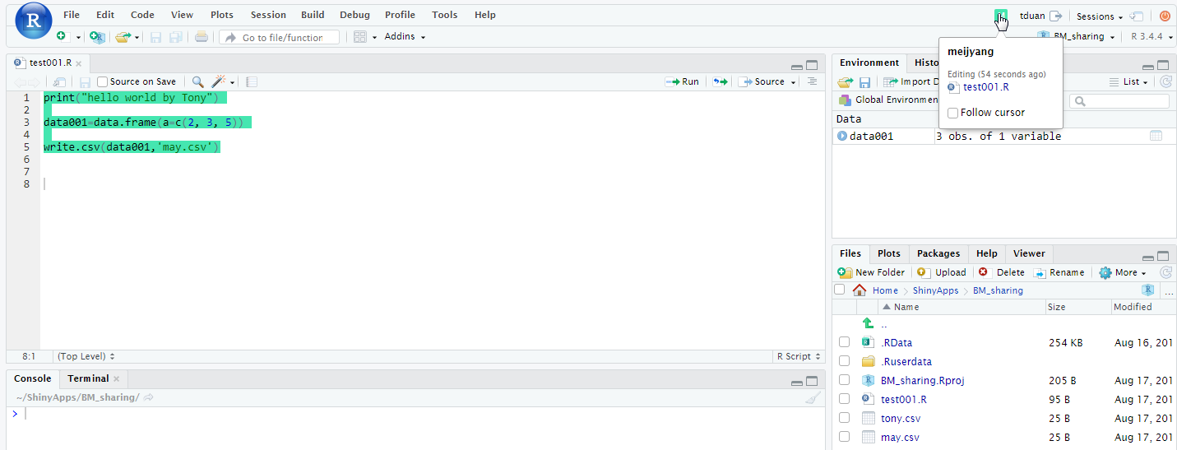
Why use R/R studio server PRO/R shiny PRO
2. Project sharing

Slide 5
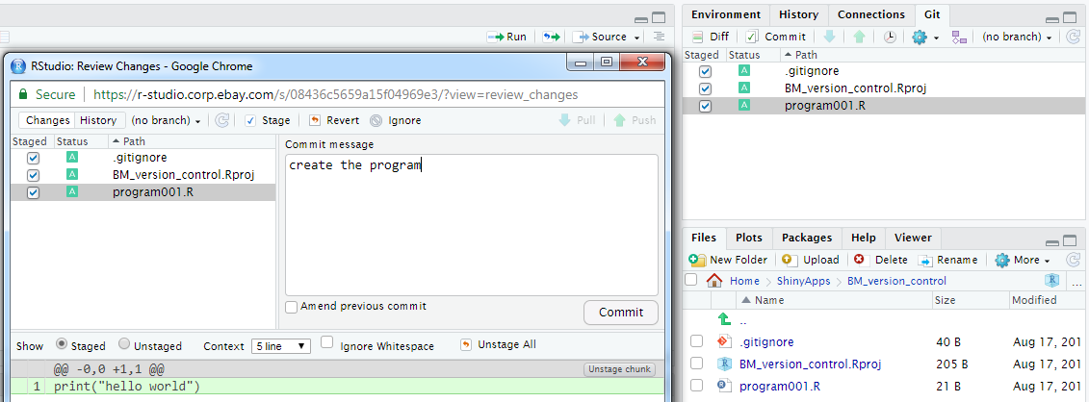
Why use R/R studio server PRO/R shiny PRO
3. Version control

Slide 6
Why use R/R studio server PRO/R shiny PRO
3. Version control
15:00
Code: transaction count >0 listing
Data: list001.xlsx
16:00
Code: transaction >0 listing +AM name
Data: list001.xlsx
17:00
Code: transaction count >10 listing
Data: list001.xlsx
18:00
Code: transaction count >10 listing+AM name
Data: list001.xlsx

Slide 7

Why use R/R studio server PRO/R shiny PRO
3. Version control
15:00
Code: transaction count >0 listing
Data: list001.xlsx(100G)
001
16:00
Code: transaction >0 listing +AM name
Data: list002.xlsx (110G)
002
17:00
Code: transaction count >10 listing
Data: list003.xlsx (50G)
003
18:00
Code: transaction count >10 listing+AM name
Data: list004.xlsx (55G)
004

Slide 8

Why use R/R studio server PRO/R shiny PRO
3. Version control
15:00
Code: transaction count >0 listing
Data: list001.xlsx(100G)
Commit ID:001
git log
git check out 002
16:00
Code: transaction >0 listing +AM name
Data: list002.xlsx (110G)
Commit ID:002
17:00
Code: transaction count >10 listing
Data: list003.xlsx (50G)
Commit ID:003
18:00
Code: transaction count >10 listing+AM name
Data: list004.xlsx (55G)
Commit ID:004

Slide 9
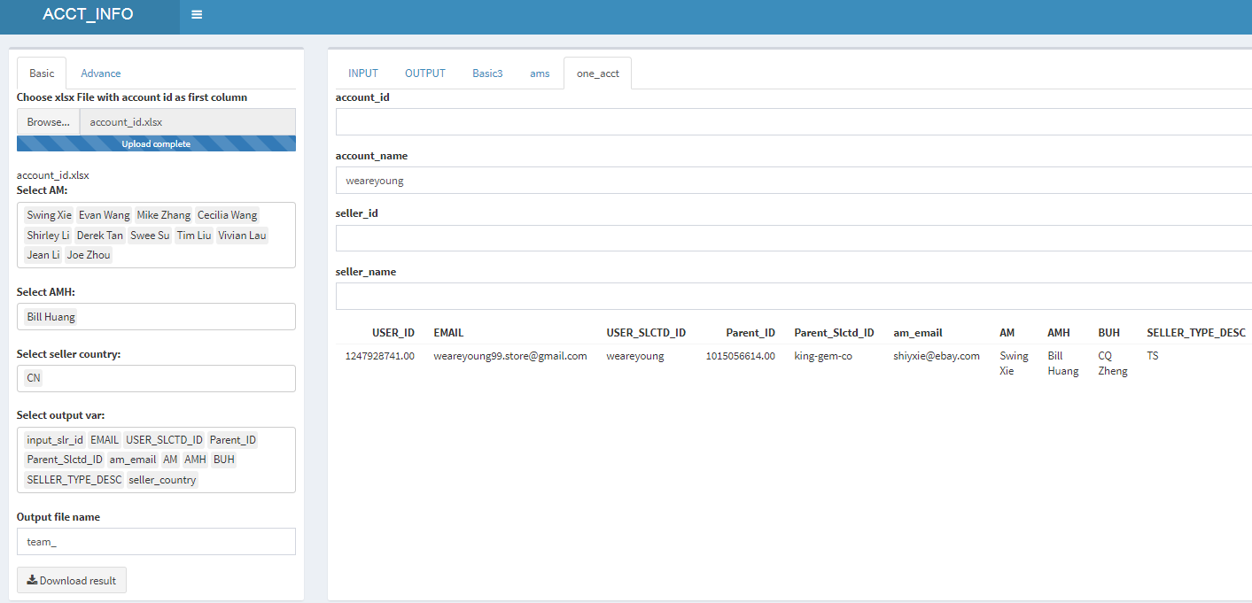
Why use R/R studio server PRO/R shiny PRO
报告。。
R shiny server pro

Slide 10
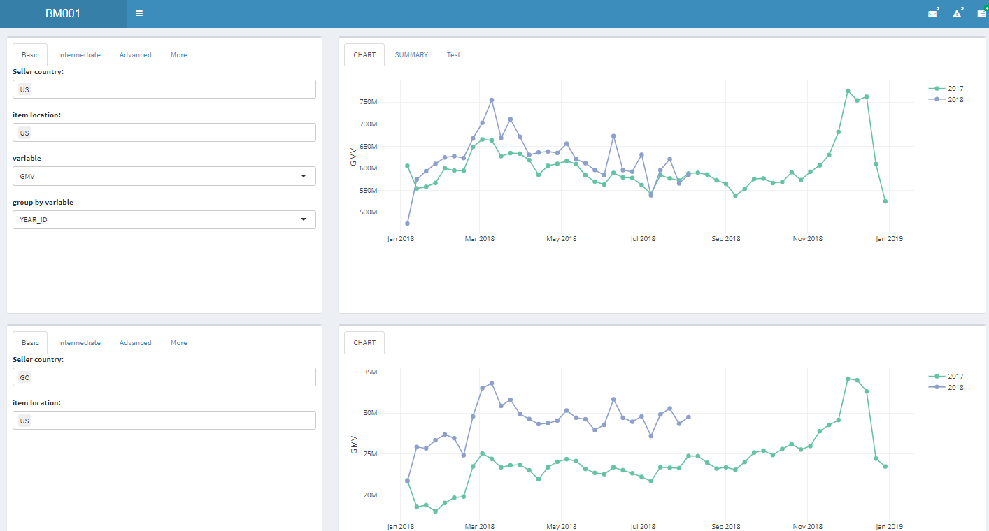
Why use R/R studio server PRO/R shiny PRO
报告。。
R shiny server pro

Slide 11
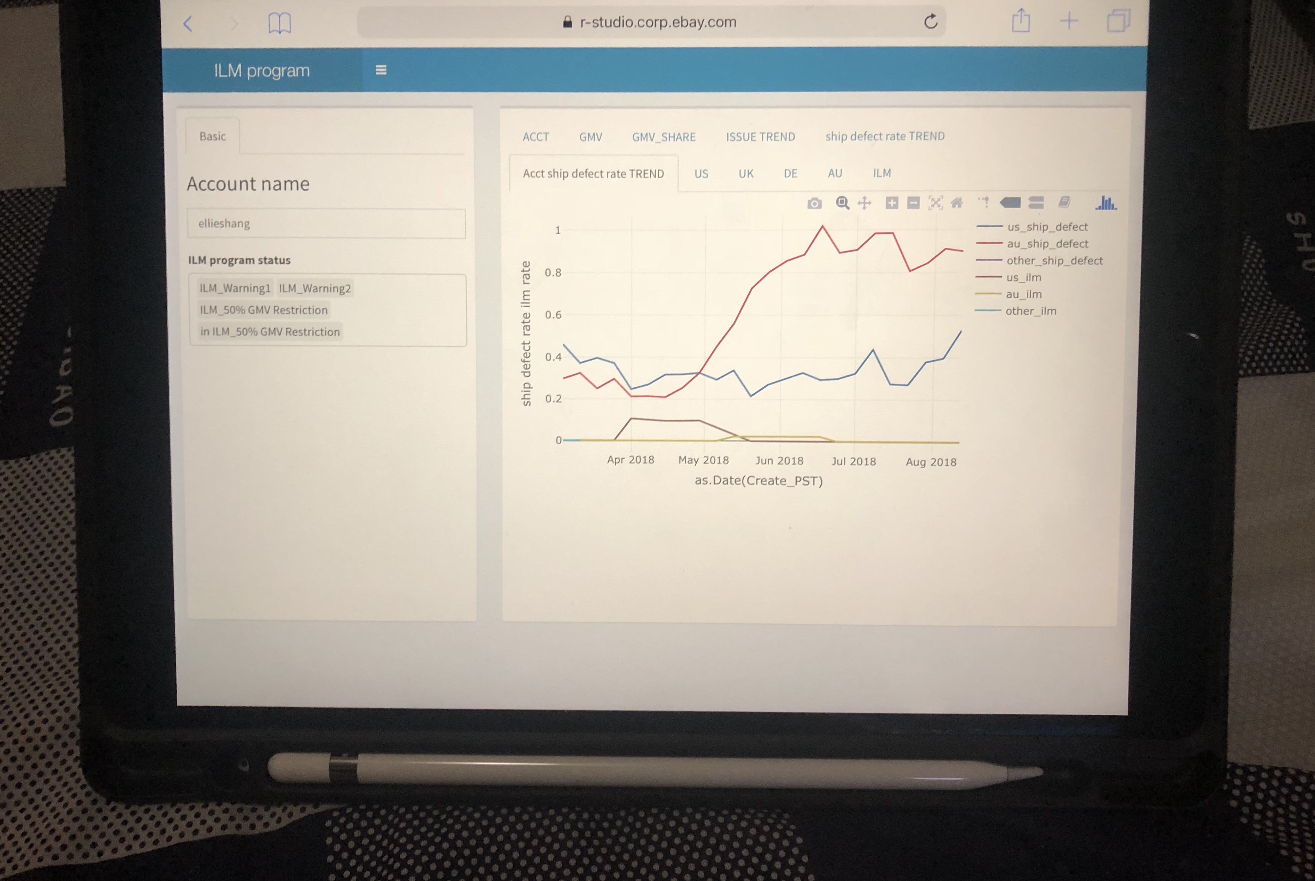
Why use R/R studio server PRO/R shiny PRO
R shiny server pro

Slide 12
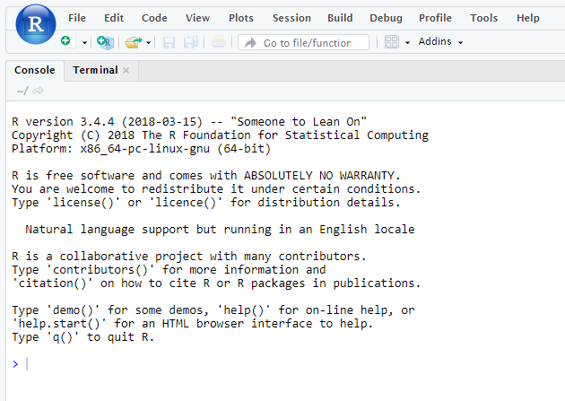
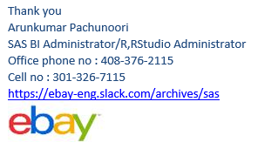
Cons
1. Learning curve:
R language: Get Clean visualization Model
R shiny: R language + data + UI + server
报告。。
2. Everything is Changing quick : R language/R package R studio/R sever

Slide 13
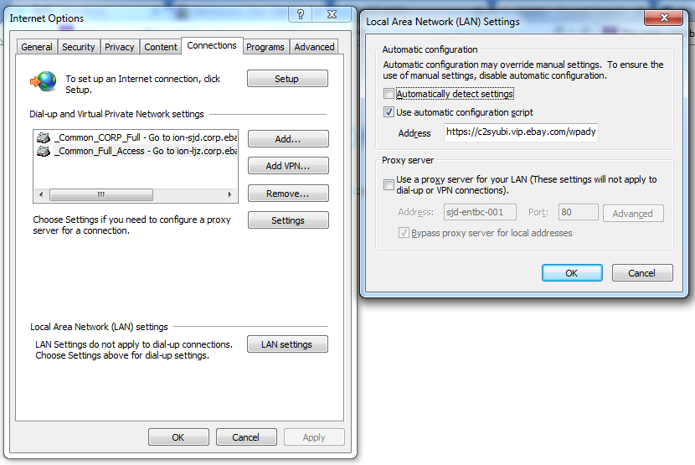
How to apply R studio server PRO/R shiny PRO Account
1.Apply for PET ACCOUNT(which is for our putty account most of us should already have)
Link: https://wiki.vip.corp.ebay.com/display/sas/How+to+approve+the+users+PET+access+requests
2.Apply for R-studio server pro and R shiny pro Account
1) set Internet option
Address https://c2syubi.vip.ebay.com/wpadyubi.pac

Slide 14
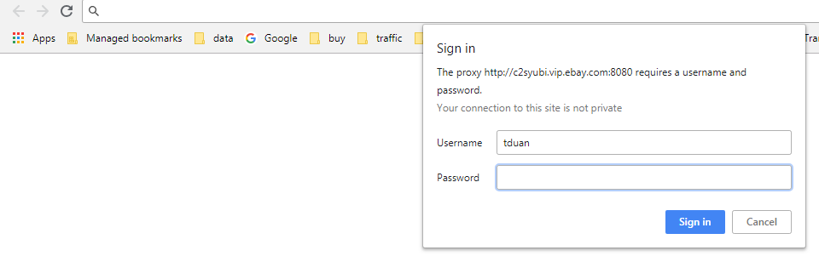
How to apply R studio server PRO/R shiny PRO Account
2) enter your username(for example tduan ) and youbikey for password
Link: https://pet.vip.ebay.com/ups/production/approval-center/request/43984/

Slide 15
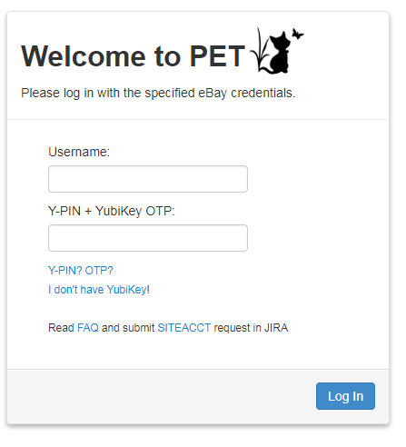
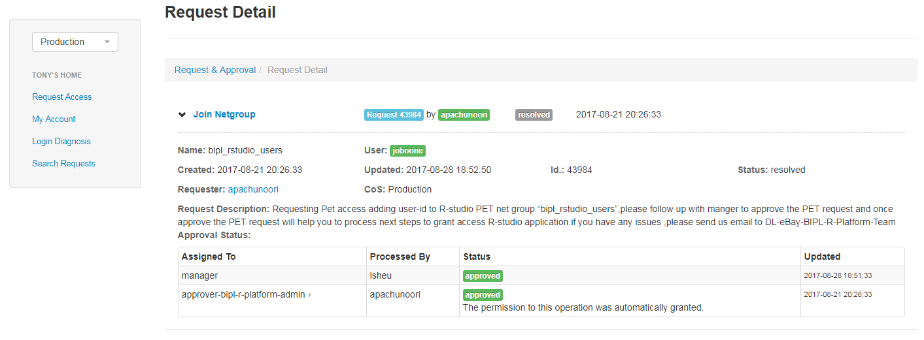
How to apply R studio server PRO/R shiny PRO Account
3) enter username (for example tduan)
Y-Pin + youbikey
4) Apply for R-studio server access
5) Your line manager will get a email and your line manager approve the email

Slide 16
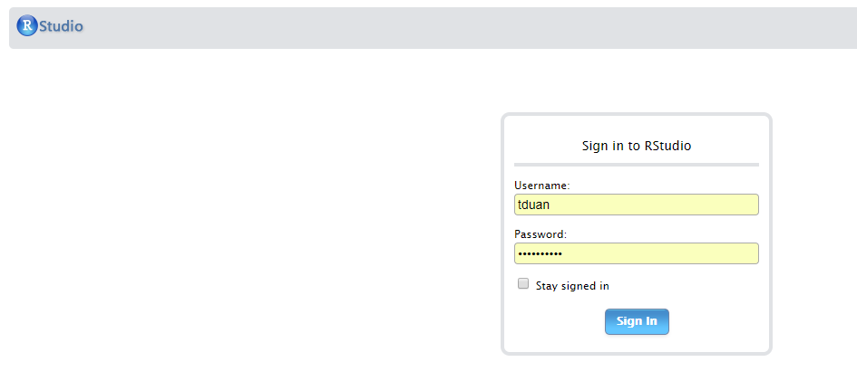
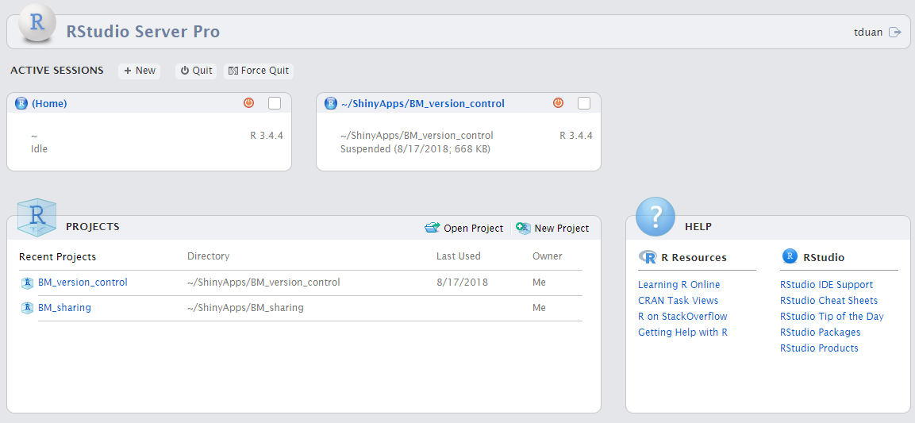
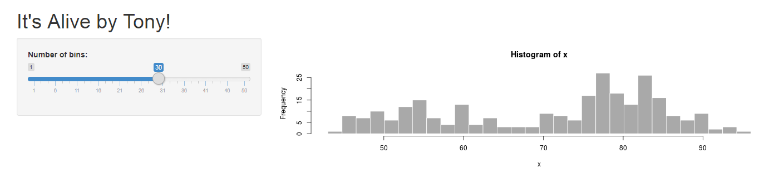
How to apply R studio server PRO/R shiny PRO Account
3.Log in R studio server pro
Link: https://r-studio.corp.ebay.com/s/57ea13c286bd33c286bd3/workspaces/
Enter PET username and password
4. open your R shiny server pro ,replace tduan with your username
Link:https://r-studio.corp.ebay.com/shiny/tduan/hello/

