Slide 1
R & shiny workshop
Get
Clean
Visualize
Shiny

Slide 2
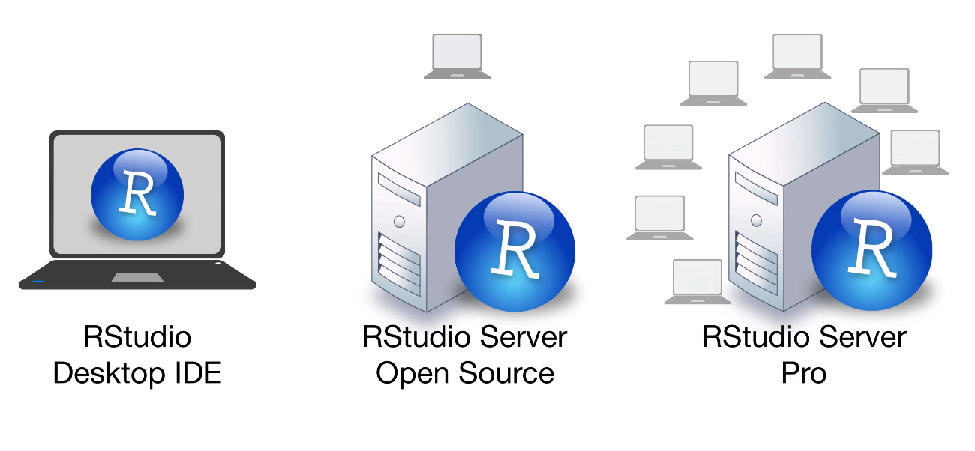


R & Shiny Workshop
R language
R shiny server pro
Free
Free
Free
$9,995 a year
$9,995 +$150 per users a year

Slide 3












Data Analytic Framework
Output:
Trend: what
Segment: why
Action: how
Get
Clean
Data type
Date
String
Outlier
…
Visualize
Line chart
Bar chart
Histogram
Map
Shiny
….
Model
Regression
Tree base
Tensorflow
GBS
K-MEAN
Hierarchical
Pipeline:
Package!!!

Slide 4

Book

Slide 5

STAT -> ML-> AI

Slide 6
R language: Get|Clean|Visualize|Model
1.Get
1) connect with csv
2) connect with excel
3) connect with Teradata
……
2.Clean
Data type
Date
String
Missing value
Outlier
……..

Slide 7
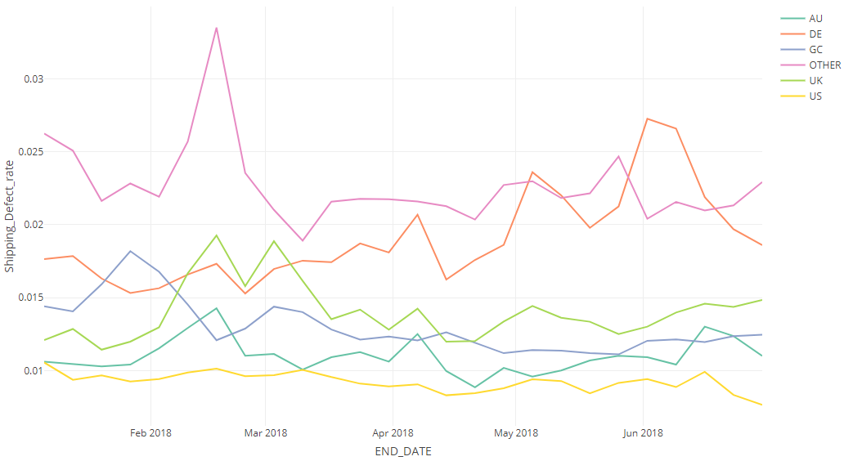
R language: Get|Clean|Visualize|Model
3. Visualize
*2018H1 GC managed seller

Slide 8
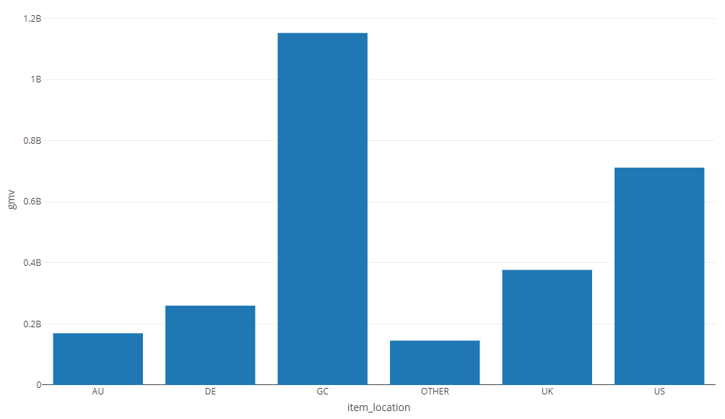
R language: Get|Clean|Visualize|Model
3. Visualize
*2018H1 GC managed seller

Slide 9
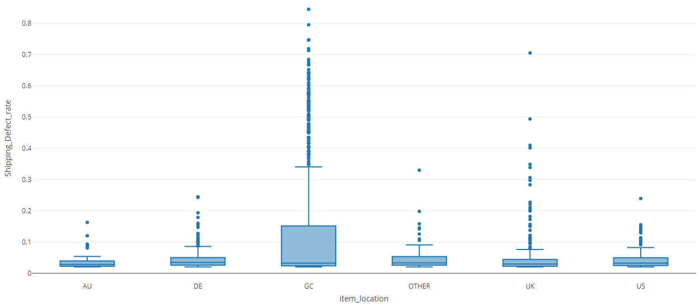
R language: Get|Clean|Visualize|Model
3. Visualize
*2018H1 GC managed seller & Shipping Defect_cnt>30 & Shipping_Defect_rate>0.02

Slide 10


R shiny server pro
Dashboard:

Slide 11
R shiny server pro:3 branch
flexdashboard: Just a document that looks like a dashboard. Also contains some specific widgets designed to work in a dashboard layout. Can only run interactive code clientside (in embedded JavaScript).
Shiny: Needs a server behind it to execute R code on user input. Can implement any layout. Can run interactive code either by processing serverside (in R) or clientside (in embedded JavaScript).
Shinydashboard:Needs a server behind it to execute R code on user input. Can implement a dashboard layout. Contains some specific widgets designed to work in a dashboard layout. Can run interactive code either by processing serverside (in R) or clientside (in embedded JavaScript).

Slide 12
Shinydashboard: work flow
1.User group and propose
2. Prepare data
3. Design and develop dashboard
4. Test your dashboard
5. Schedule data feed update

Slide 13
Shinydashboard Structure on shiny server pro
1. create folder(folder name must be Home/ShinyApps/xxx)
Home/ShinyApps/ACCT_performance001
Shinyapp Link:
https://r-studio.corp.ebay.com/shiny/tduan/ACCT_performance001/
2. create file
dev.R [for data preparation]
ui.R [for frontend user interface,file name must be ui.R]
server.R [for backend function,file name must be server.R]
Datafeed.R [for datafeed update.optional]

Slide 14
Shinydashboard Structure on shiny server pro
dev.R

Slide 15
Shinydashboard Structure on shiny server pro
ui.R
library(shinydashboard)
library(plotly)
shinyUI(function(request) {
dashboardPage(
dashboardHeader(title = "ACCT_performance ")
,dashboardSidebar(collapsed = TRUE)
,dashboardBody()
)
})

Slide 16
Shinydashboard Structure on shiny server pro
server.R
library(shinydashboard)
library(plotly)
shinyServer(function(input, output,session) {})

Slide 17
Shinydashboard Structure on shiny server pro
4) Datafeed.R
-------------------------------------- set up cron job on R server --------------------------------
show job: crontab -e
Add cron job(run on 05 AM US time each Monday):
05 * * * 1 /usr/local/lib/R/bin/Rscript "/home/tduan/ShinyApps/ACCT_performance001/Datafeed.R "
Save:Ctrl+O
Quit:Ctrl+x

Slide 18
Appendix

Slide 19
Shinydashboard Structure on local
dev.R [for data preparation]
shinyApp(ui = ui, server = server)
ui.R [for frontend user interface,file name must be ui.R]
ui=shinyUI(…
server.R [for backend function,file name must be server.R]
server=shinyServer(…

Slide 20
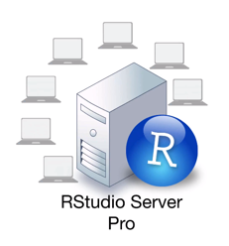
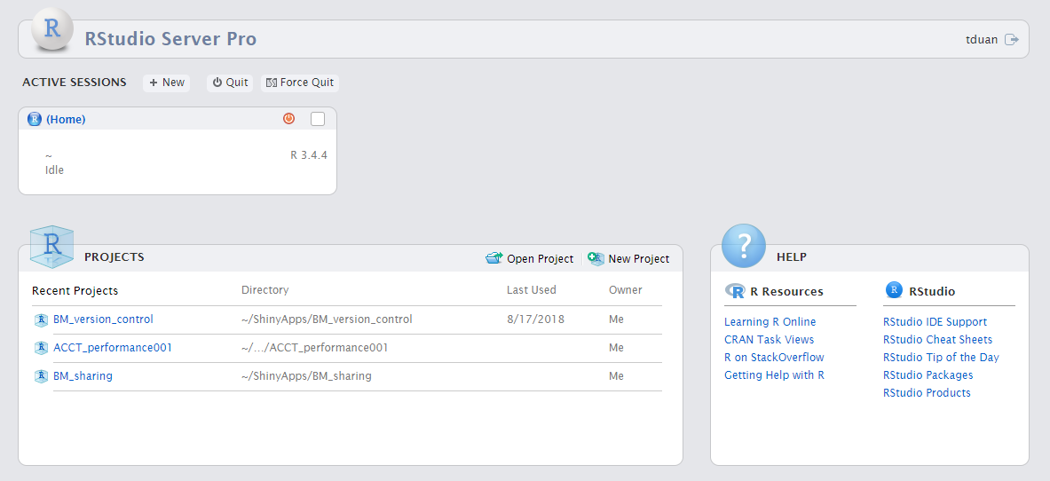
Rstudio server pro
workspaces
https://r-studio.corp.ebay.com/s/57ea13c286bd33c286bd3/workspaces/

Slide 21

Version control
cd ShinyApps/ACCT_performance001
git log
1. create 3 base R file
git checkout b92460da12e37
2. make 3 file template
git checkout 28692d36b45
3. make data
git checkout 23711a1bbf
4.make shiny server.R and ui.R
git checkout b4fd8cd4

