Slide 1
EEG&EOG-based Sleep Staging
CS 182 Project
Hu Gangfeng
Teng Zhihao
Qin Chao

Slide 2
Content
Research Background
Status-of-art about Sleep-staging
Database
Classification Models
Research Pipeline
Evaluation
Improvement and innovation

Slide 3
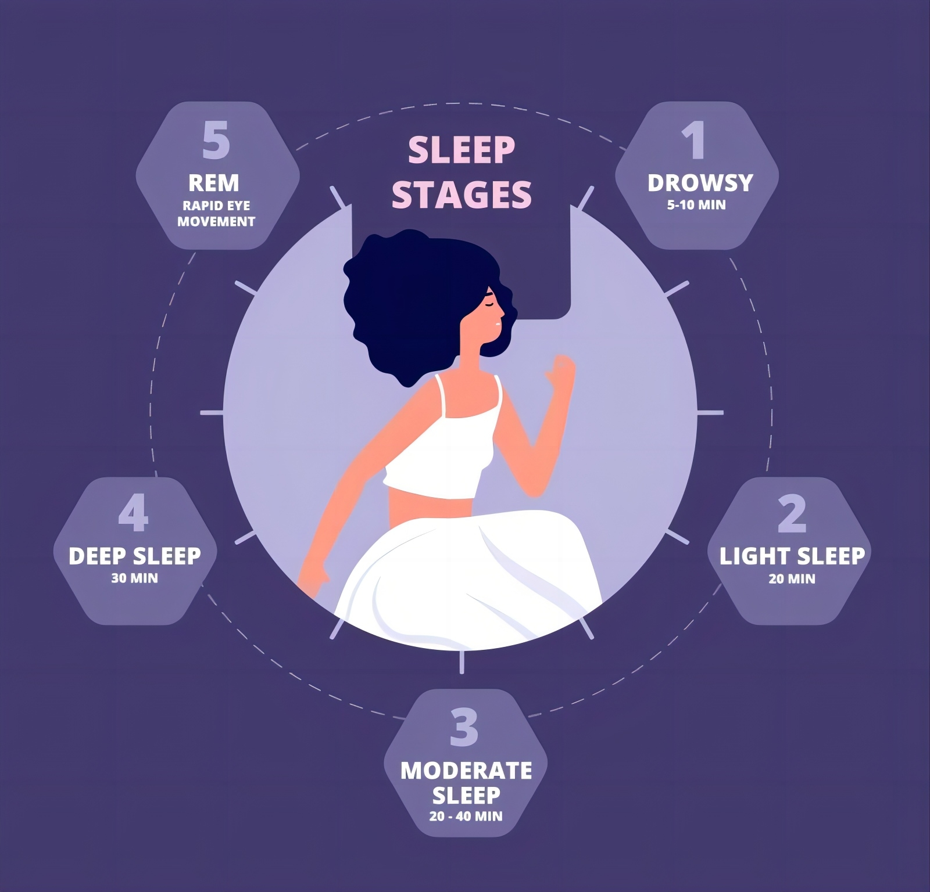
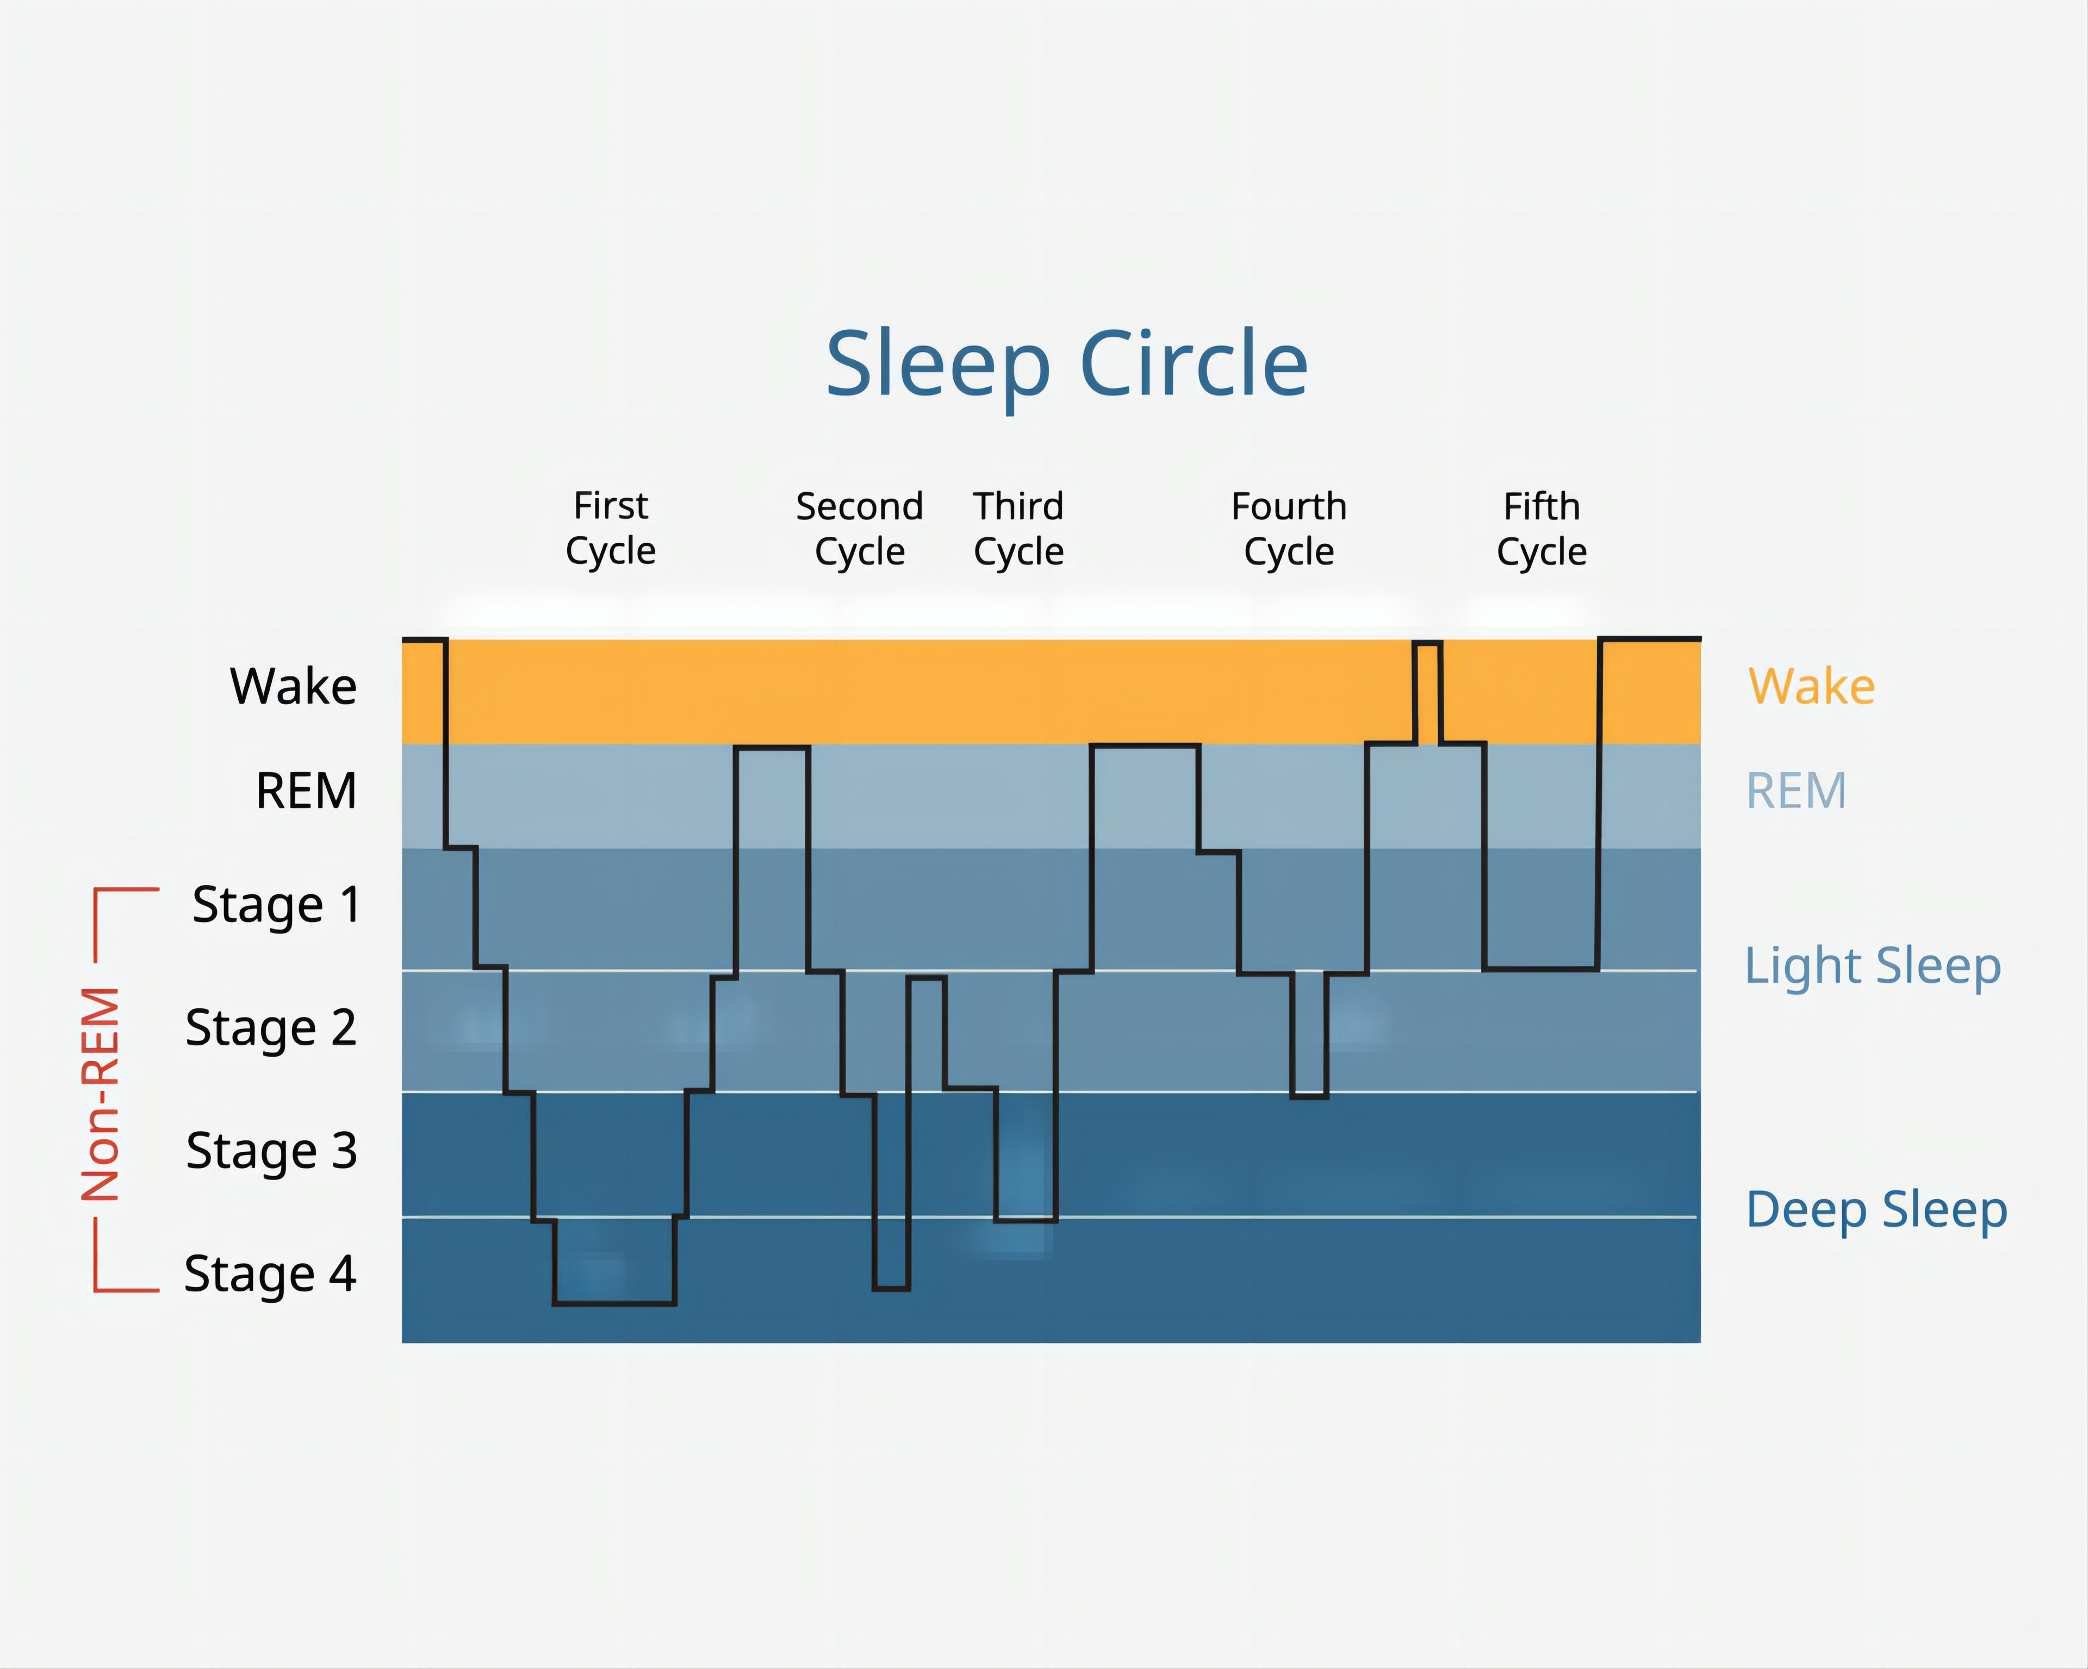
Research Background
Crucial for understanding sleep patterns and overall health.
Sleep Stages: non-rapid eye movement (NREM) sleep, divided into four stages (N1, N2, N3, N4), and rapid eye movement (REM) sleep

Slide 4
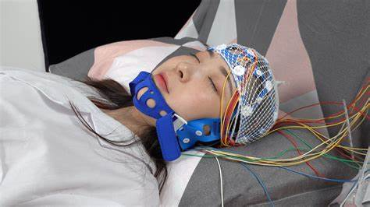
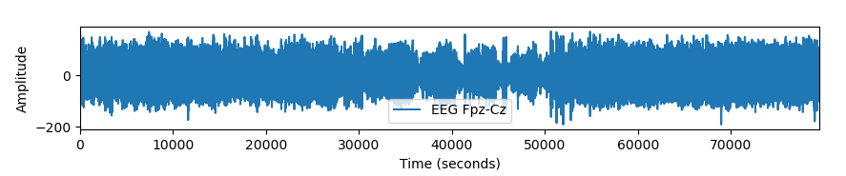
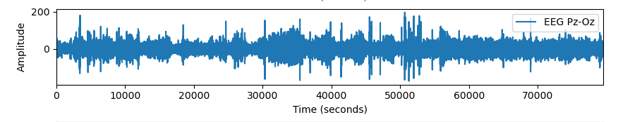
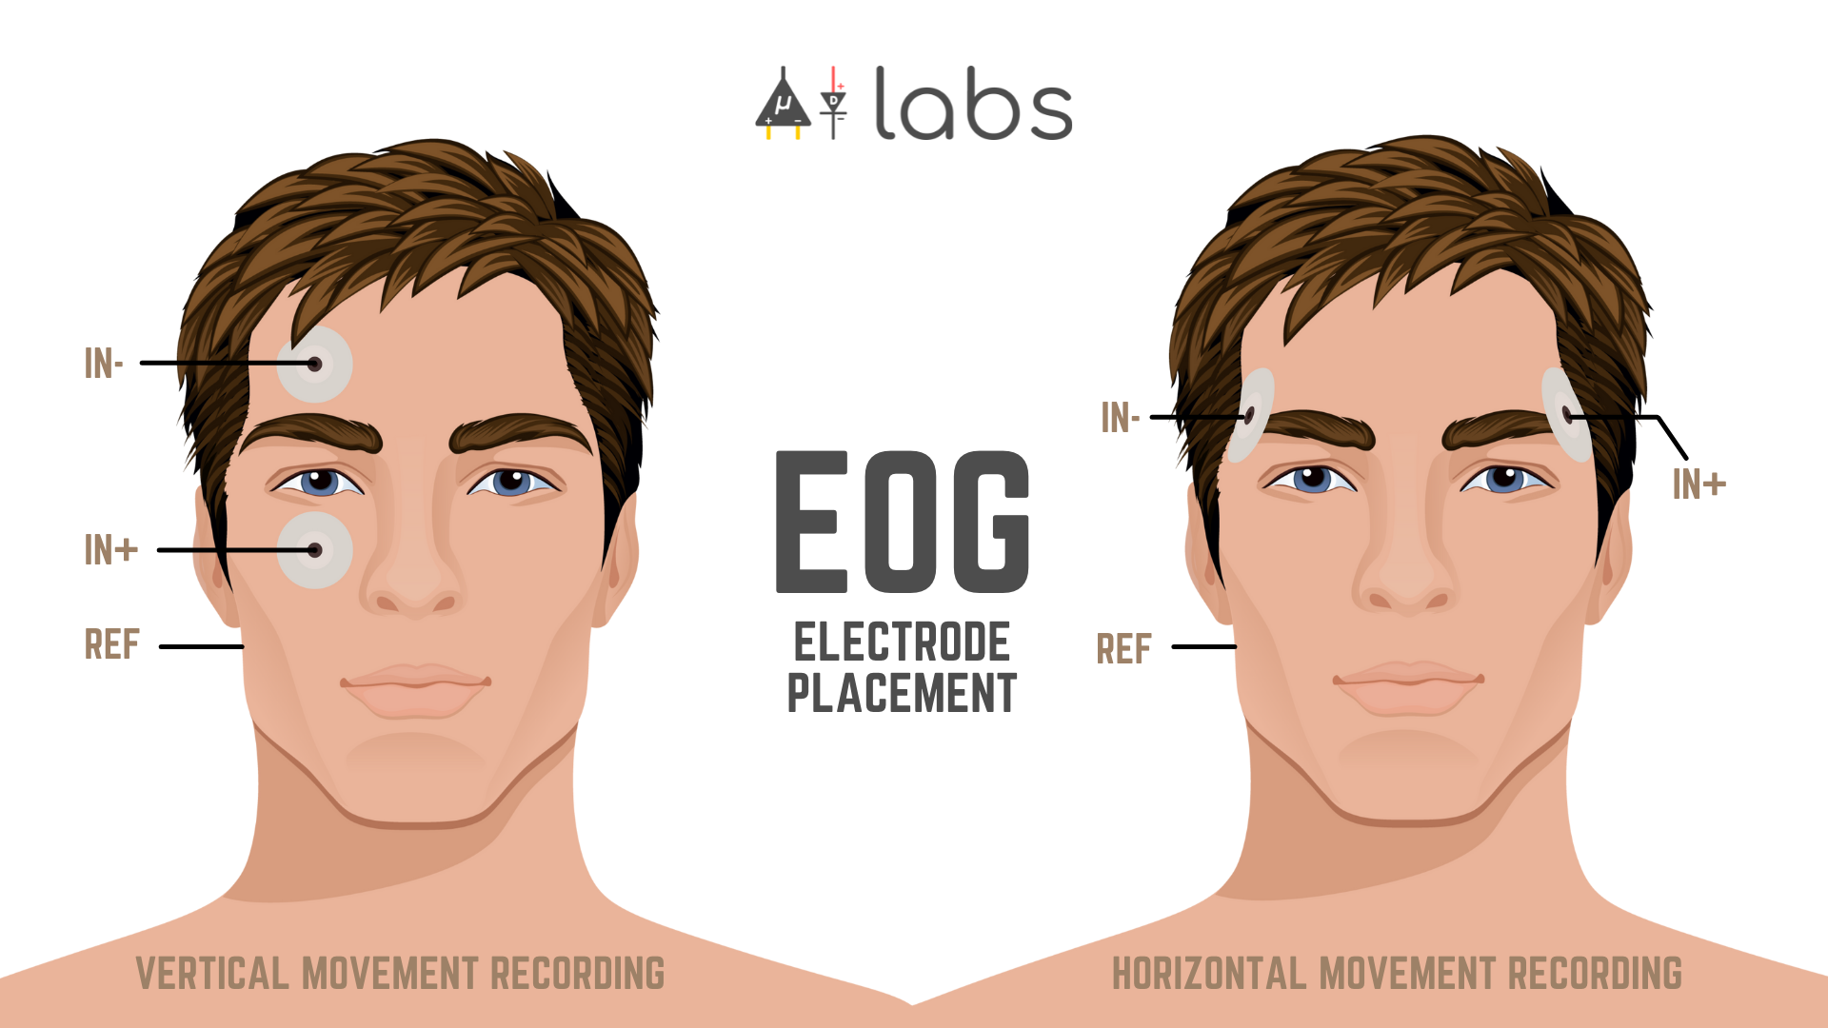
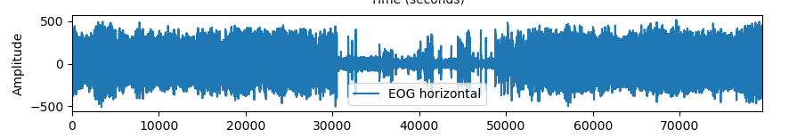
Research Background
EEG (Electroencephalogram): measuring brain activities
EOG (Electrooculography): measuring eye movements
Sleep stage can be classified by EEG + EOG signals.
Frontopolar + Central zero
Parietal + Occipital
Fig. 1 A subject undergoing EEG monitoring
Fig. 2 Explanation to EOG

Slide 5
Status-of-art about Sleep-staging
Mainly focused on developing increasingly complex deep learning architectures^{[1]}
limited in their real-world applicability
not widely adopted in a clinical context
lack interpretability and transparency
[1] Jeroen Van Der Donckt, Jonas Van Der Donckt, Emiel Deprost, Nicolas Vandenbussche, Michael Rademaker, Gilles Vandewiele, Sofie Van Hoecke: Do not sleep on traditional machine learning: Simple and interpretable techniques are competitive to deep learning for sleep scoring

Slide 6
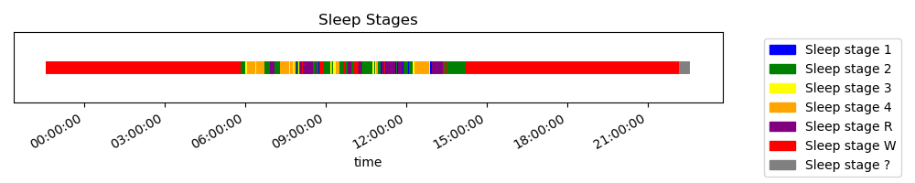
Database
Public Data Set^{[2]}: 152 patients, continuous sleep signals
provide EEG, EOG and EMG signals during patients’ sleeping
provide sleep stages at each time
Fig. 1 EOG signal in dataset
Fig. 2 EEG signal in dataset
[2] https://www.physionet.org/content/sleep-edfx/1.0.0/

Slide 7
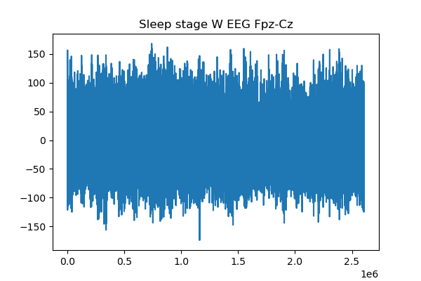
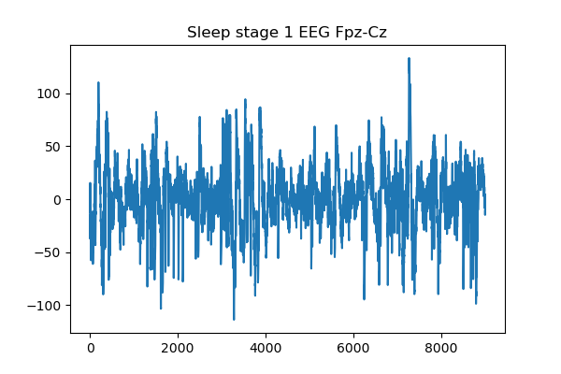
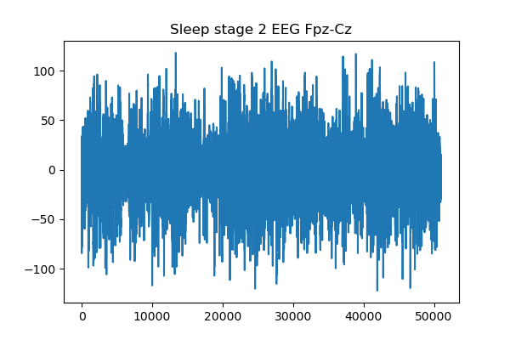
Database
Firstly, we splited signals by sleep stages
...

Slide 8
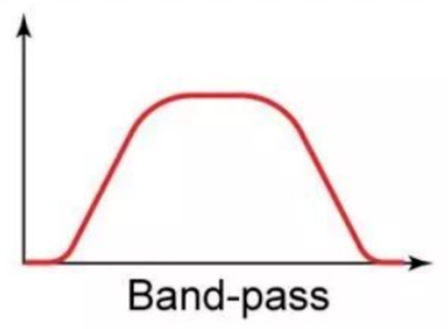
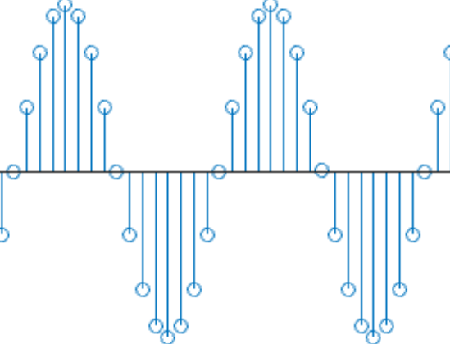
Research Pipeline
Preprocessing
Signal-spliting
Dataset
Feature
Extraction
Model Evaluation
Classification based on ML/DL

Slide 9
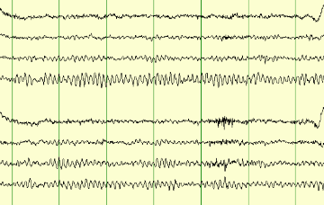
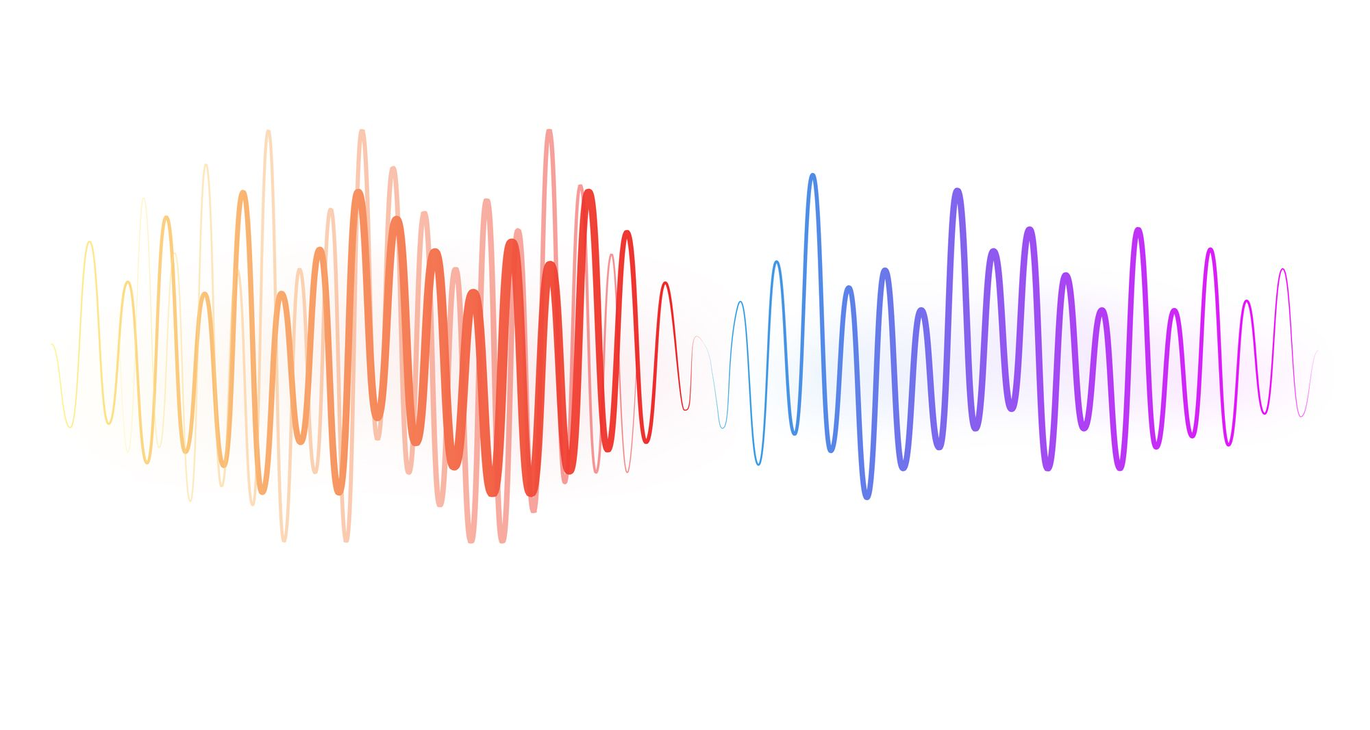
Preprocessing
0.4~30 Hz
removing artifacts or noise
Signal without Noise
This band-pass range is clinically supported to capture the meaningful frequencies of sleep-wave patterns.^{[3]}
[3] Malhotra, A., Younes, M., Kuna, S.T., Benca, R., Kushida, C.A., Walsh, J.Hanlon, A., Staley, B., Pack, A.I., Pien, G.W.: Performance of an automated polysomnography scoring system versus computer-assisted manual scoring. Sleep 36(4), 573–582 (2013)

Slide 10
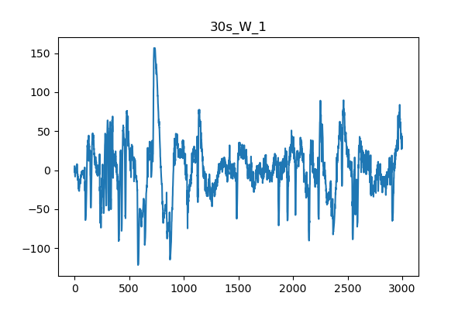
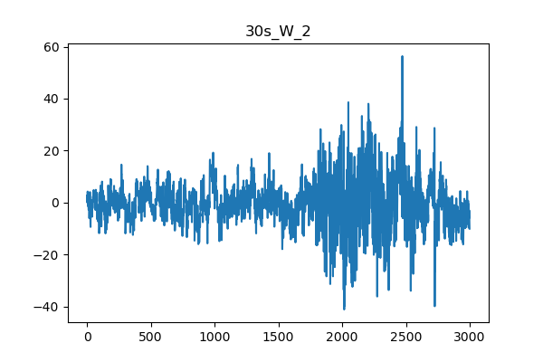
signal spliting
We prefer to identify signals with same length
splited the raw signal by 30s.
...
Fs=100 Hz

Slide 11
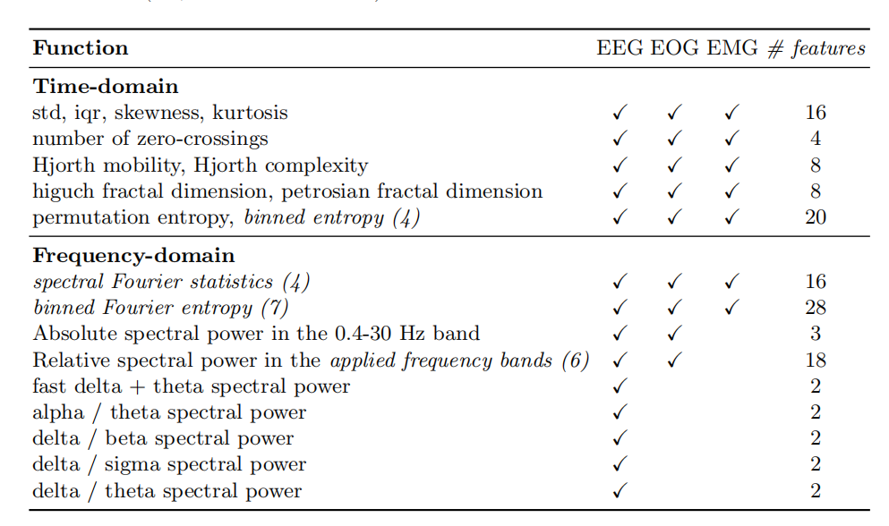
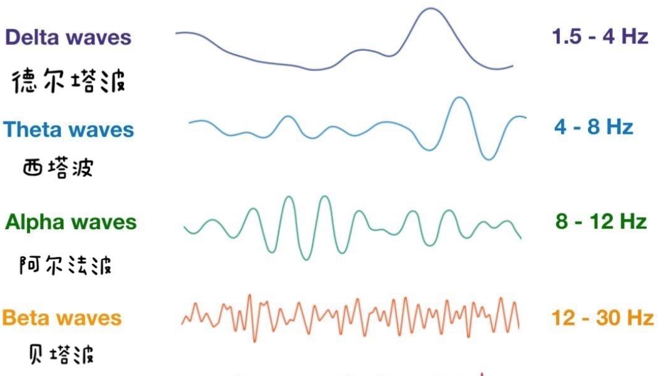
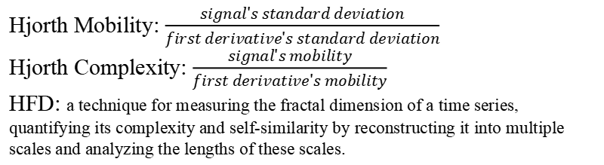
Feature Extraction
Multi-domain features:
Time-domain features
Frequency-domain features
EEG Charateristic
EEG Charateristic
Hjorth Mobility: $\frac{signal's standard deviation}{first derivative's standard deviation}$
Hjorth Complexity: $\frac{signal's mobility}{first derivative's mobility}$
HFD: a technique for measuring the fractal dimension of a time series, quantifying its complexity and self-similarity by reconstructing it into multiple scales and analyzing the lengths of these scales.

Slide 12
Feature Extraction
We used PCA to reduce the dimension:393345×82
Retaining
393345
×46
393345×105
Retaining
393345 × 105
393345×82
393345 × 82
99.9%
Variance
95%
Variance
Feature Matrix
Matrices after PCA

Slide 13
Classification Model
Based on Machine Learning and Deep Learning:
Method | Accuracy in Paper | Accuracy We Get
SVM | not mentioned | 0.78
Logistic regr. | 0.863 | 0.878
Catboost | 0.864 | Under Construction
BP Network | not mentioned | Under Construction
CNN | 0.840 | Under Construction

Slide 14
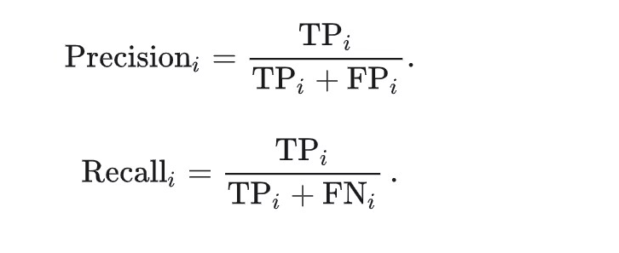
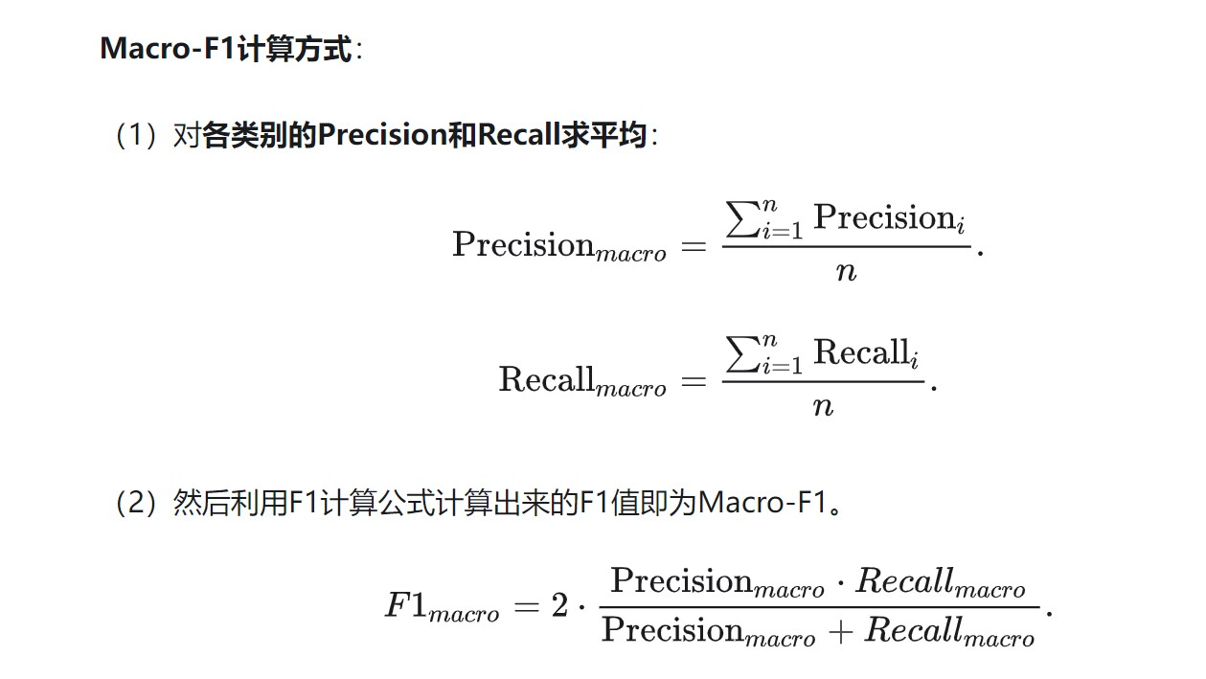
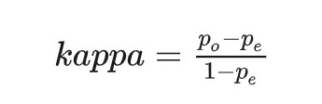
Model Evaluation
Strategy: Cross-Validation (10-folder validation)
Metric: ACC, Macro-F1, κ

Slide 15
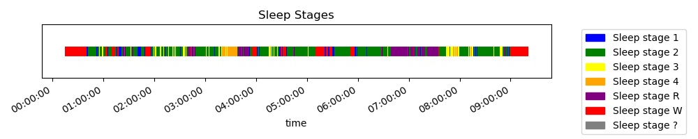
Improvement and innovation
Consider the characteristic of sleep stages:
Notice that “Sleep stage 3” appears more esaily after “Sleep stage 2”, while “Sleep stage 1” appears more esaily after “Sleep stage W”...
Probabilistic graphical model or Markov Model can be used to help detect sleep stages in continuous sleeping signals.
RNN may be good to solve continuous sleeping signals.

