Slide 1
EEG&EOG-based Sleep Staging by ML
CS 182 Project
Hu Gangfeng
Teng Zhihao
Qin Chao

Slide 2
Content
Research Background
Status-of-art about Sleep-staging
Classification Method by Machine Learning
Research Pipeline
Evaluation
Current Progress

Slide 3
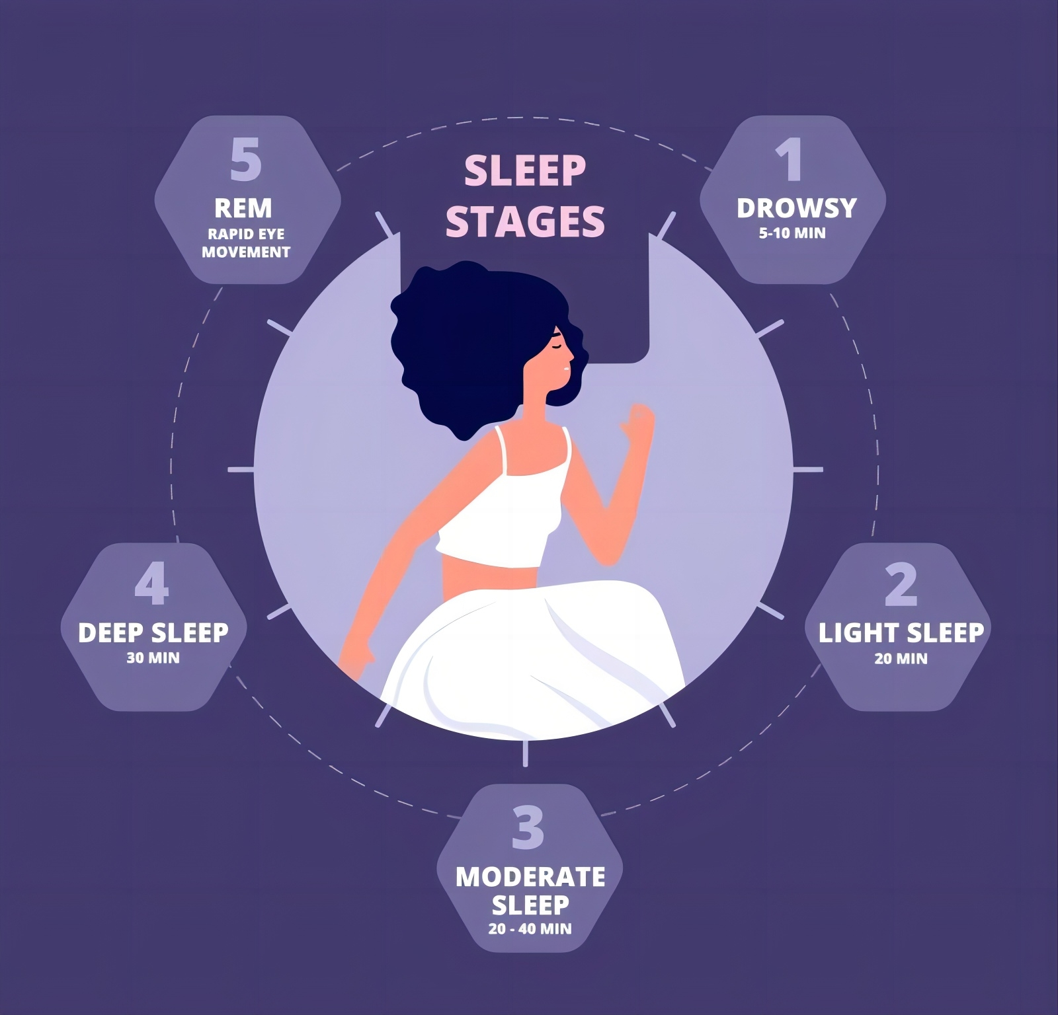
Research Background
Sleep stage analysis is crucial for understanding sleep patterns and overall health.
Sleep Stages: non-rapid eye movement (NREM) sleep, divided into four stages (N1, N2, N3, N4), and rapid eye movement (REM) sleep

Slide 4
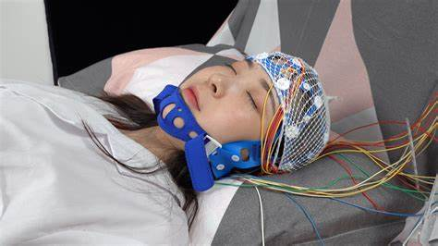
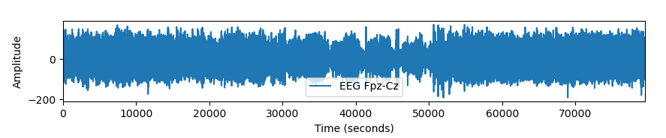
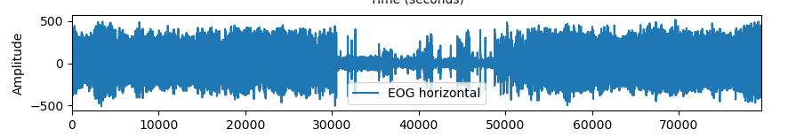
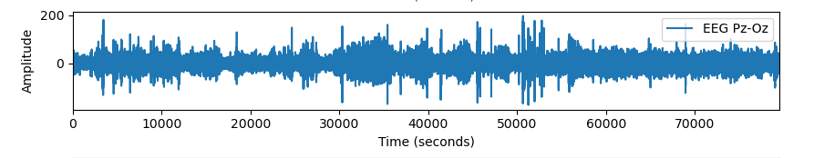
Research Background
Electroencephalogram (EEG) is a medical test used to measure and record the electrical activity in the brain.
Sleep stage can be classified by EEG signals.

Slide 5
Research Status about Sleep-stage Analysis
Current research status:
mainly focused on developing increasingly complex deep learning architectures
automatic sleep staging solutions are not widely adopted in a clinical context yet
most deep learning solutions for sleep scoring are limited in their real-world applicability as they are hard to train, deploy, and reproduce.
lack interpretability and transparency

Slide 6
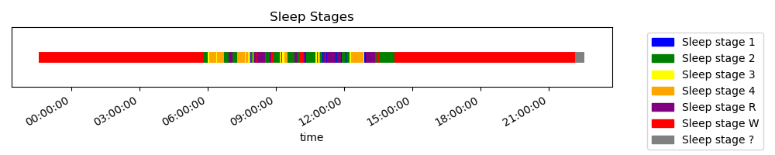
Database
Public Data Set: https://www.physionet.org/content/sleep-edfx/1.0.0/
provide EEG, EOG and EMG signals during patients’ sleeping
provide sleep stages at each time

Slide 7
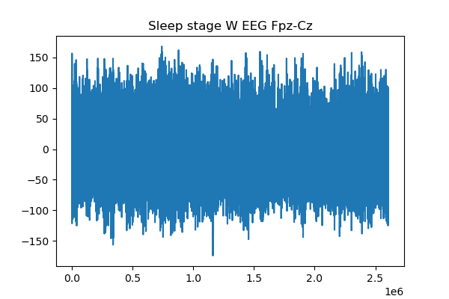
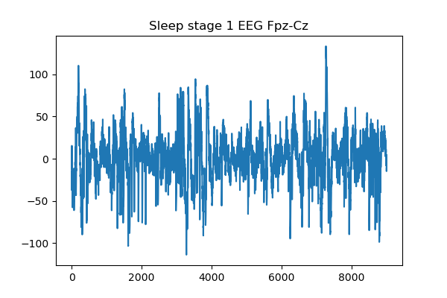
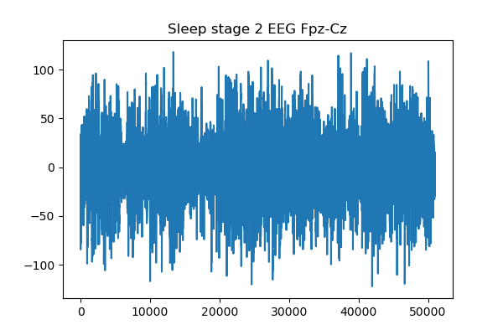
Database
...

Slide 8
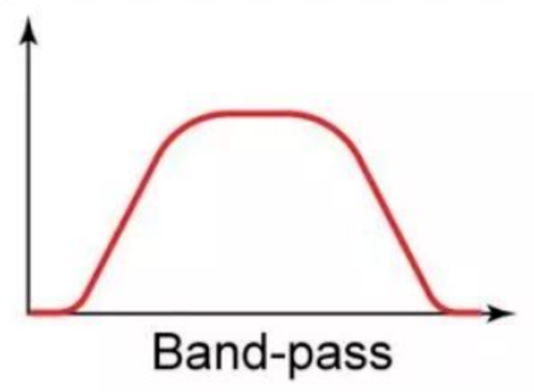
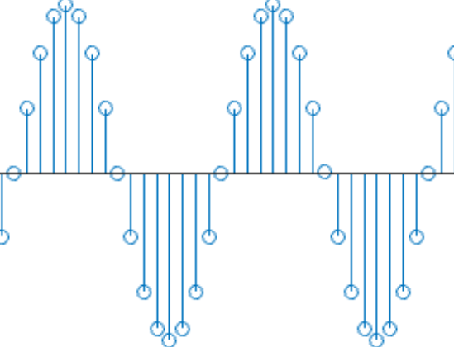
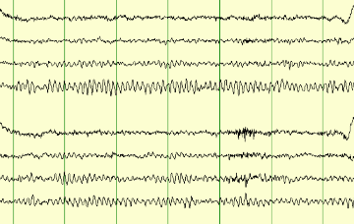
Analysis Method by ML - flow chart
feature extraction
preprocessing
signal-spliting
每个框框画点图
Classification based on ML/DL
Model Evaluation

Slide 9
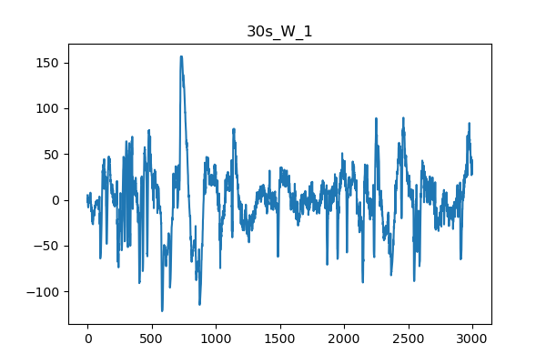
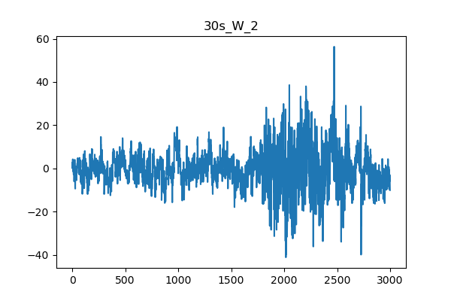
Analysis Method by ML - signal spliting
We prefer to identify signals with same length
splited the raw signal by 30s.
...
Fs=100 Hz

Slide 10
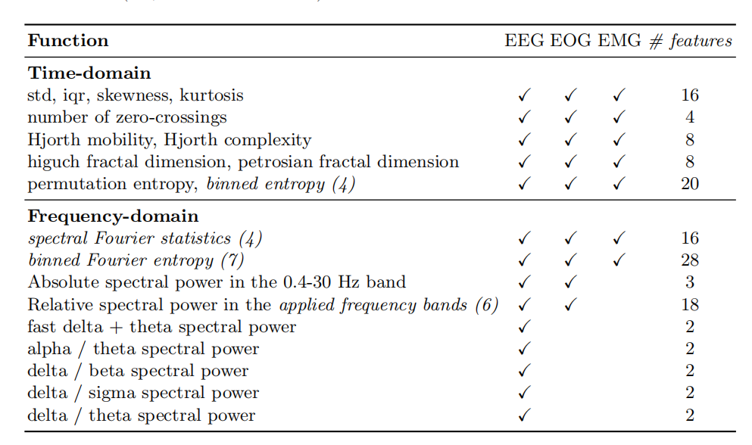
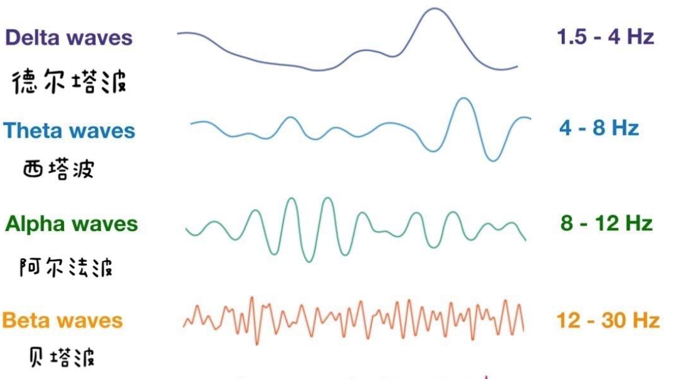
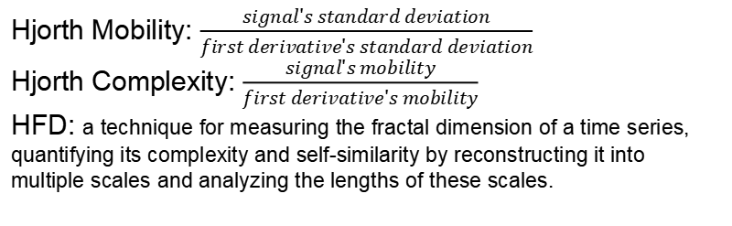
feature extraction
131 features:
Time-domain features
Frequency-domain features
EEG Charateristic
EEG Charateristic
Hjorth Mobility: $\frac{signal's standard deviation}{first derivative's standard deviation}$
Hjorth Complexity: $\frac{signal's mobility}{first derivative's mobility}$
HFD: a technique for measuring the fractal dimension of a time series, quantifying its complexity and self-similarity by reconstructing it into multiple scales and analyzing the lengths of these scales.

Slide 11
Analysis Method by ML - feature extraction

