Slide 1
EEG-based Sleep Stage Analysis by ML
CS 182 Project
Teng Zhihao
Qin Chao
Hu Gangfeng

Slide 2
Content
Research Background
Research Status about Sleep-stage Analysis
Analysis Method by Machine Learning
Research Procedure
Estimation
Current Progress

Slide 3
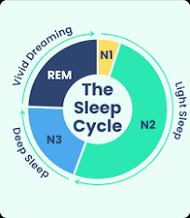

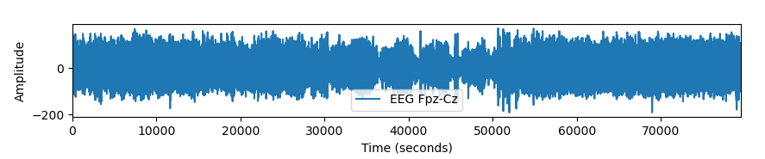
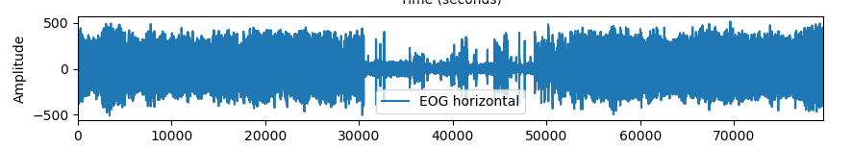
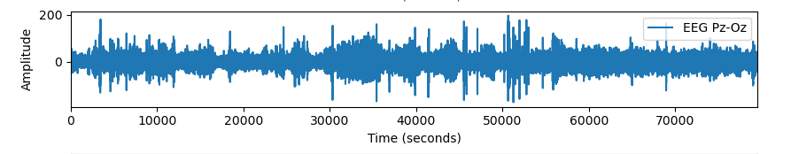
Research Background
Sleep stage analysis is crucial for understanding sleep patterns and overall health.
Sleep Stages: non-rapid eye movement (NREM) sleep, divided into three stages (N1, N2, N3), and rapid eye movement (REM) sleep
Electroencephalogram (EEG) is a medical test used to measure and record the electrical activity in the brain.
Sleep stage can be classified by EEG signals.

Slide 4
Research Status about Sleep-stage Analysis
Current research status:
mainly focused on developing increasingly complex deep learning architectures
automatic sleep staging solutions are not widely adopted in a clinical context yet
most deep learning solutions for sleep scoring are limited in their real-world applicability as they are hard to train, deploy, and reproduce.
lack interpretability and transparency

Slide 5
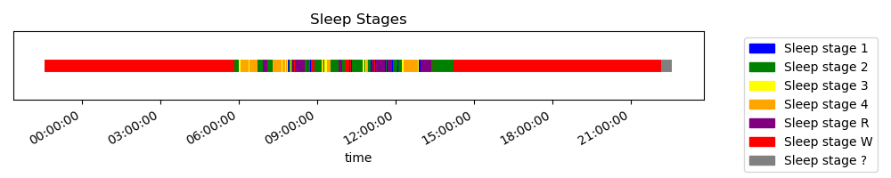
Analysis Method by ML - Database
Public Data Set: https://www.physionet.org/content/sleep-edfx/1.0.0/
provide EEG, EOG and EMG signals during patients’ sleeping
provide sleep stages at each time

Slide 6
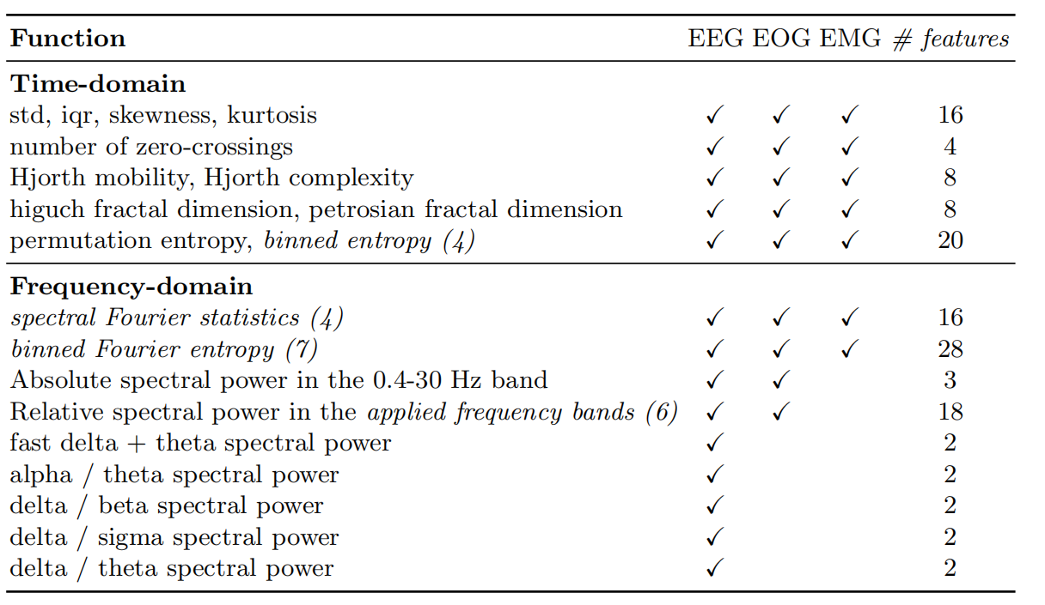
Analysis Method by ML - feature extraction
In the paper, they calculated a set of 131 features per window, these features are
multi-domain (extracted from time and frequency domain) and multi-resolution (calculated on multiple window sizes).

Slide 7
Analysis Method by ML - feature extraction

