Slide 1
Dartford: Local Primary Schools and Nearby Venues
Please refer to the interactive map which you have been emailed recently. If you click on (laptop) or touch (smart phone) a blue spot, then the details of the school at that locaton will pop up in a tool tip for your reference.
You have also been emailed with all the documents you need from this presenatation to conduct your investigations into primary schools and their environs.

Slide 2
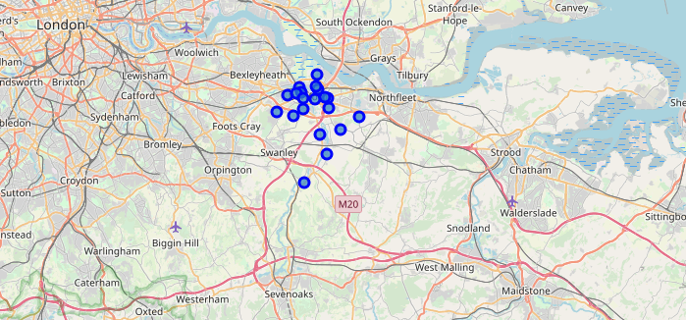
Dartford: Local Primary Schools and Nearby Venues

Slide 3
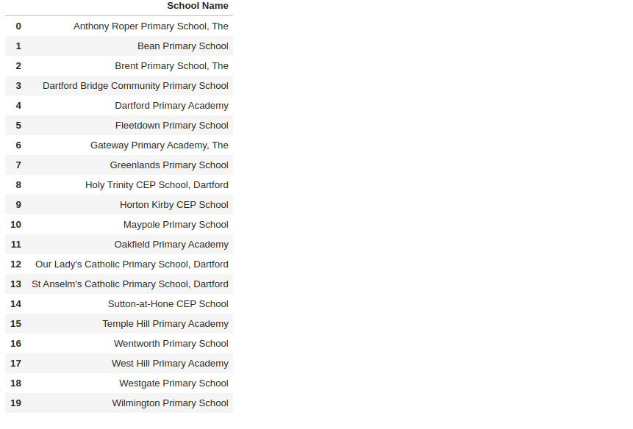
Dartford: Local Primary Schools and Nearby Venues
Here are the names of all the primary schools

Slide 4
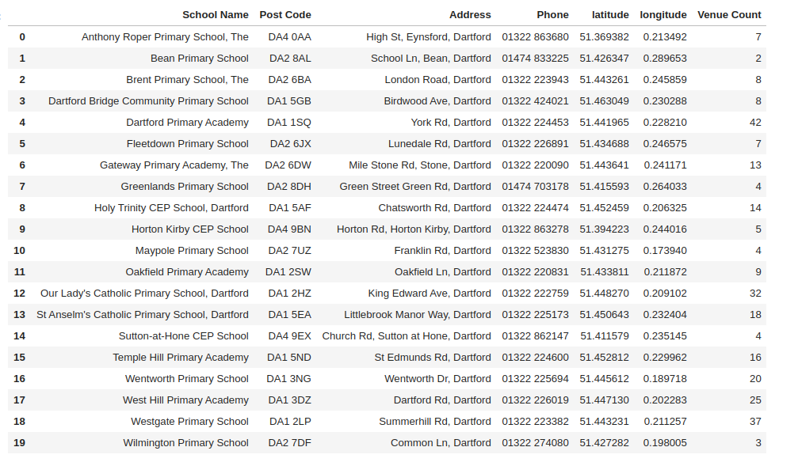
Dartford: Local Primary Schools and Nearby Venues
This table shows how many venues are in the immediate neighbourhood of each school

Slide 5
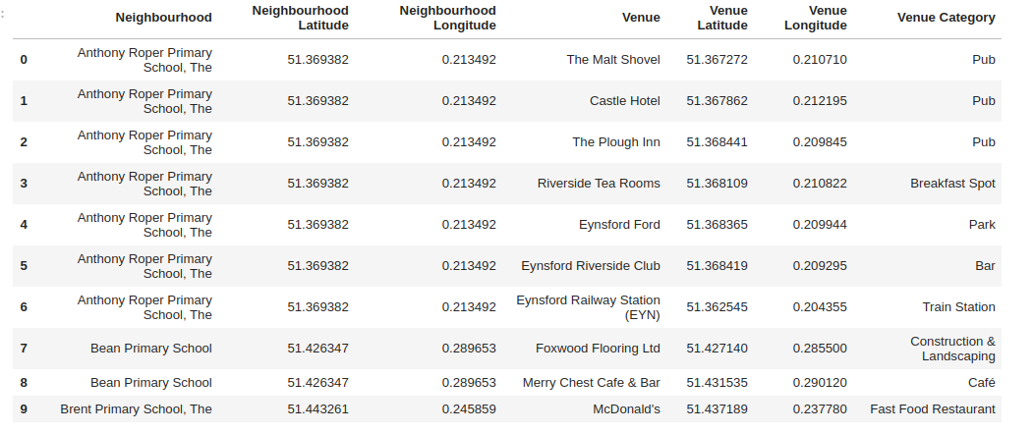
Dartford: Local Primary Schools and Nearby Venues
You have also been emailed the following document, of which this is a sample.

Slide 6
Dartford: Local Primary Schools and Nearby Venues
Cluster 1: A good mix of venues near a bus station

Slide 7
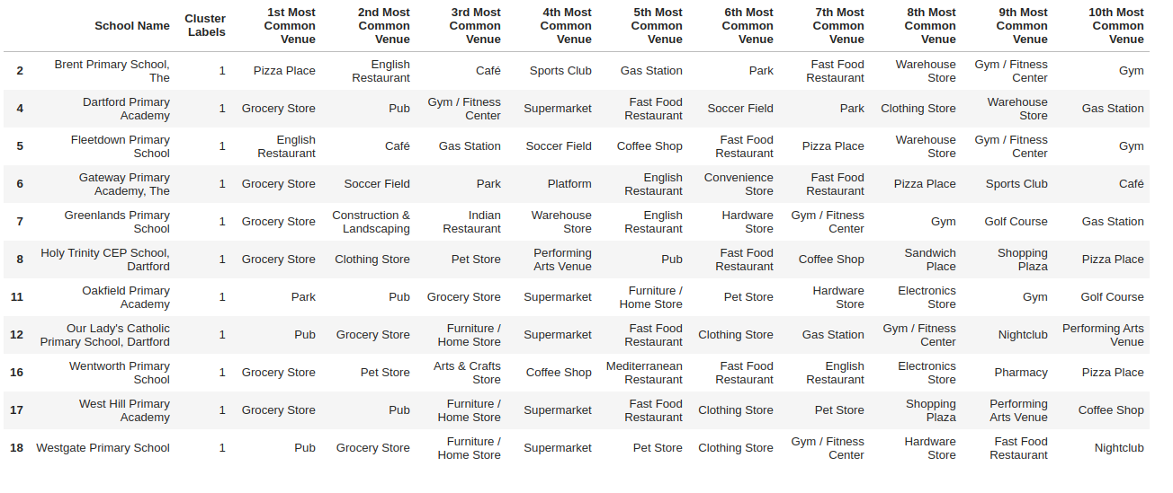
Dartford: Local Primary Schools and Nearby Venues
Cluster 2: Food, drink and shopping

Slide 8
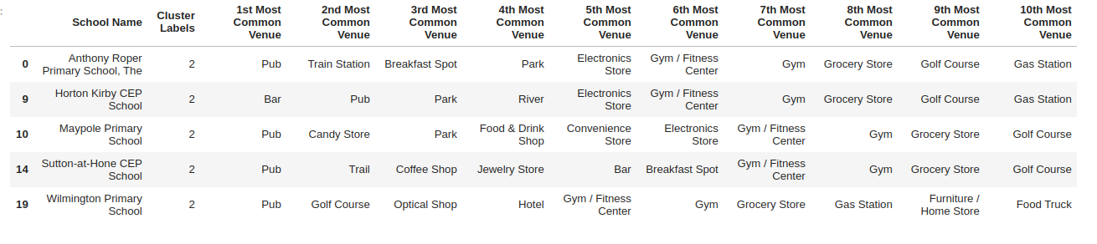
Dartford: Local Primary Schools and Nearby Venues
Cluster 3: Pubs and bars

Slide 9
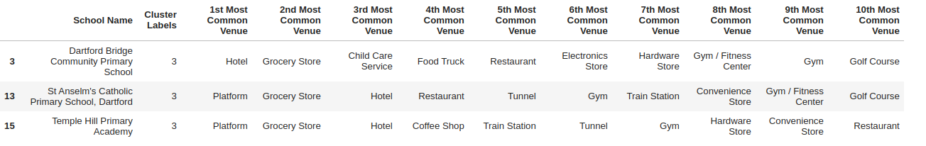
Dartford: Local Primary Schools and Nearby Venues
Shopping and two near a train station (Platform)

Slide 10
Dartford: Local Primary Schools and Nearby Venues
Thank you. Good luck in your searches.

