Slide 1
255 Scope: Blocks, Buffers, Transactions & Locks
It’s Not Just For Minty Fresh Breath
Tom Bascom, White Star Software
Tuesday 2:15pm
Abstract: The interactions between Blocks, Buffers, Transactions, and Record Locks can sometimes seem arcane and mysterious. But there are actually just a few simple rules that govern these interactions and which control the most fundamental aspects of your applications.
Perhaps your code is plagued with errors (214), (243), (244) and so forth. Or maybe you frequently suffer from “<table> in use by <user> on <device>. Wait or press CTRL-C to stop. (121)”. Or sudden bi file growth due to “long transactions”. These are all problems that usually occur because of a mismatch in scopes.
Even if none of that is a problem for you come to this session to learn (or, for old hands, refresh your memory) about how these concepts work together to deliver scalable and robust solutions that will withstand the tests of time!

Slide 2

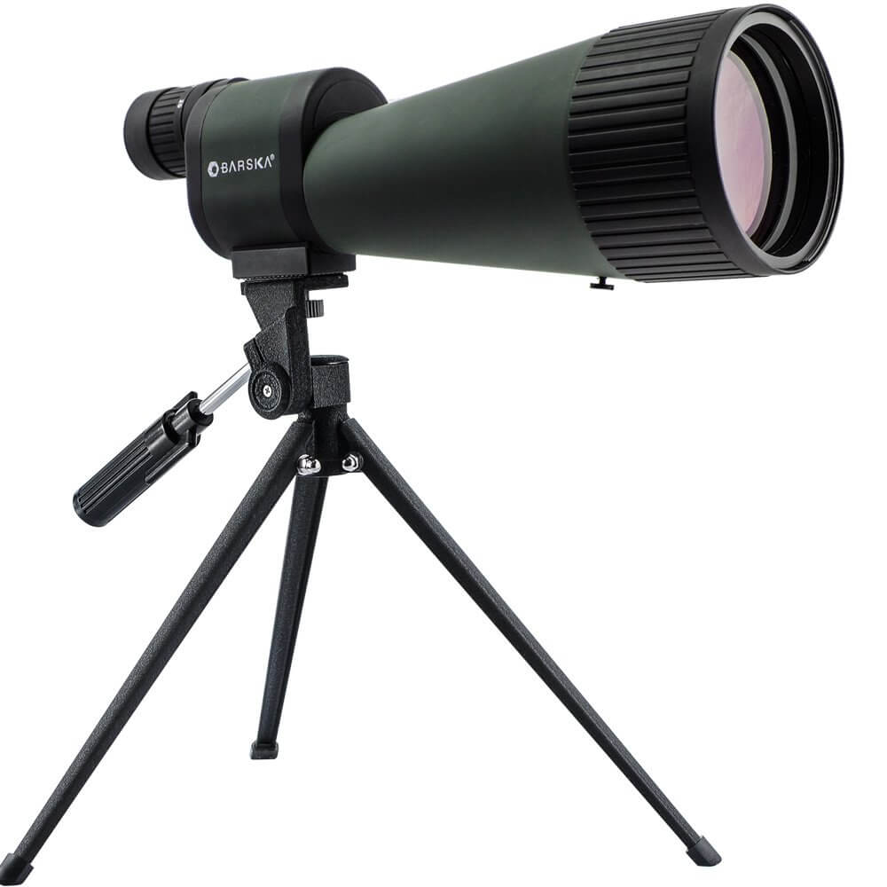
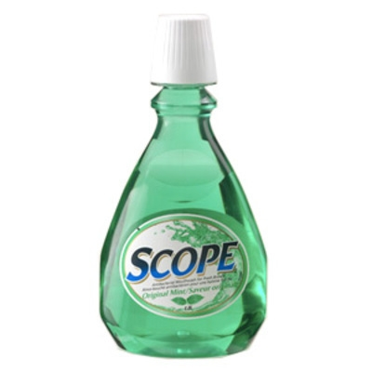
Scope: Blocks, Buffers, Transactions & Locks!
Tom Bascom, White Star Software tom@wss.com
It isn’t just for Minty Fresh Breath!

Slide 3
What is “scope” anyway?
The smallest block that encompasses all possible references to something.
… or “when and where a resource is available or used"
Scope applies to lots of things – today we’re worrying about record buffers, transactions & locks.

Slide 4
Why is scope important?
Scope controls:
When data is written to the database.
How much data is rolled back if a transaction fails.
Whether or not a record can be referenced.
What sorts of locks are held and for how long.
Common scope related error messages:
Illegal nested block statement… (243)
Reference to table XYZ conflicts with block statement reference ( 244)
WARNING – TRANSACTION… (214)

Slide 5
Blocks

Slide 6
Types of Blocks
Procedure blocks
Procedure, Class
Internal Procedure, User Defined Function, Method, Trigger
Control blocks
DO, FOR EACH, REPEAT
Blocks can have sub-blocks
Include files are not blocks

Slide 7
Properties of Blocks
Grouping
Looping
Frame Scoping
Buffer Scoping
Transaction Scoping
Exception Handling

Slide 8


Important (for our talk) Block Scoping Properties
Block | Buffer | Transaction
DO | No | No
DO FOR | Strong | No
DO TRANSACTION | No | Yes
DO FOR TRANSACTION | Strong | Yes
FOR EACH | Weak | Implied
REPEAT | Weak | Implied
REPEAT FOR | Strong | Yes
Internal Procedure / UDF / Method / Trigger | No | Implied
Notes:
DO, FOR EACH & REPEAT are “control blocks”, IP, UDF & Trigger are “procedure blocks” (so are classes)
“Implied” means that if a TRX trigger occurs within the block then that block will contain the transaction.
CREATE, INSERT, DELETE, UPDATE, ASSIGN statements and EXCLUSIVE-LOCK or the TRANSACTION keyword will trigger an implied transaction.

Slide 9
Blocks Do Not Have Locks
Record locks are not a block property.
Record locks are a feature of the database.
Record locks can exist after your session crashes or is killed!
(but not after a clean exit)

Slide 10
Buffers

Slide 11
Buffers vs Records
A buffer name is what you type in your 4GL code
A buffer is a pointer to an instance of a database record.
The default buffer name for every table is the plain old table name.
Named buffers are: define buffer bufferName for tableName.
Within a session:
Multiple buffers can be simultaneously defined for a table.
Each buffer can point to a different instances of records in that table.
Multiple buffers can point to the same instance of a record –
but there is only ever one instance of a particular record.
a particular record can only have ONE lock state.

Slide 12
Best Practice: Buffer Naming Convention
To ensure that you can always easily search for references to table names and table.field, name buffers by using a prefix + the complete table name:
define buffer updCustomer for customer.

Slide 13
Types of Buffer Scope
Free Reference
FIND bufferName, CREATE, INSERT, DELETE, RELEASE
WEAK Scope Block
FOR EACH bufferName
PRESELECT EACH bufferName
Internal Procedures, User-defined functions, Methods of a Class
Can be silently raised by free references outside of a block. The compiler will NOT complain.
STRONG Scope Block
DO FOR bufferName
REPEAT FOR bufferName
Can NOT be raised by references outside of the block – such references will result in compile errors.
Notes:
It’s actually a lot more complicated than this…
RELEASE is vile and does not do what any programmer thinks it does. In particular it has NOTHING to do with locks.

Slide 14
Borrowed Buffer Scope Considered Harmful
procedure b:
find last customer no-lock.
message “b” customer.custnum.
pause.
end.
find first customer no-lock.
message “start:” customer.custnum.
pause.
run b.
message “end:” customer.custnum. /* nasty side-effect ☹ */
pause.

Slide 15
Borrowed Buffer Scope – Prevented!
procedure b:
define buffer customer for customer. /* this is perfectly legal */
find last customer no-lock.
message “b” customer.custnum.
pause.
end.
find first customer no-lock.
message “start:” customer.custnum.
pause.
run b.
message “end:” customer.custnum. /* no nasty side-effect! */
pause.

Slide 16
Best Practices - Buffers
Use named buffers for updates.
Create same-name buffers in internal procedures and UDFs to prevent accidental buffer borrowing.

Slide 17
Transactions

Slide 18
Database Transactions
A database TRANSACTION is an all or nothing unit of work that is committed to the database.
There can only be one db transaction active per session.
But a transaction can contain sub-transactions.
Notes:
“Commit” <> “written” – performance considerations prevent that… but order is preserved across sessions.

Slide 19
OpenEdge Transactions
There is no “commit” keyword for the Progress 4gl.
OpenEdge transactions are committed automatically – at the end of the block that the transaction is scoped to.
Transactions in the Progress 4gl are scoped to the nearest block with the TRANSACTION property unless an outer block explicitly starts a transaction.
The transaction property can be implied by the block type (REPEAT, FOR EACH)
… or it can be explicitly declared by adding the TRANSACTION keyword to a block.
Transactions do NOT cross app-server boundaries.
An app-server call is its own session and has its own transaction scope.
App-server transactions are independent from the session that called them.
If you have an active TRX, call an app-server, commit data in the app server call, return and undo the caller – the app-server transaction will NOT be undone.

Slide 20
Transaction Rollback
OpenEdge Database Transactions are “Rolled Back” if:
There is a system crash before the transaction is complete.
There is an unhandled code execution error.
An explicit UNDO statement is executed or an exception is thrown.
A user interrupts processing with the STOP, ERROR or END key.
The user’s session is aborted or killed.

Slide 21
Business Transactions
A business transaction and a database transaction are not necessarily the same thing.
Thinking that they are, or should be, the same leads to a lot of grief.
Business transactions can often be undone “later” and out of order.
Thus business transactions are often re-startable or have corresponding “reversing transactions”.
Notes:
This time discontinuity also leads to transactions that span user-interface events… “are you sure?”
Business transactions often have much more relaxed rules about the order in which they are executed. Especially with respect to other business transactions.

Slide 22
Transactions at Run-Time
When a sub-program is run a transaction may already be active. The compiler cannot see this in advance.
If a sub-program has:
Substantial processing
Transactions of its own
Blocks for user input or other external events
… then that sub-program may cause problems or behave in unexpected ways.
It is especially easy to accidentally start a transaction and then run a substantial sub-program when performing ad-hoc maintenance such as “data fix programs”. This can be disastrous.
Notes:
Ad-hoc accidental transactions are very common. Maybe some little quick and dirty setup that also just happens to set a value in a db table and then you run your “routine” update…
find controlTable exclusive-lock where activity = 1234.
controlTable.inuse = yes.
run myUpdate.p. /* myUpdate updates a few million rows… */
Oops! That whole thing is one big TRX ☹

Slide 23
Ad-Hoc Accidents
It’s just quick and dirty code… No need to follow best practices!
find controlTable where activity = 1234.
controlTable.inuse = yes.
run myUpdate.p. /* myUpdate.p updates a few million rows… */

Slide 24

Preventing Ad-Hoc Accidents
It’s just quick and dirty code… No need to follow best practices!
do for controlTable transaction:
find controlTable exclusive-lock where activity = 1234.
controlTable.inuse = yes.
end.
run myUpdate.p. /* myUpdate.p updates a few million rows… */

Slide 25
Long Lasting Transactions Considered Harmful
Long transactions mean long lasting record locks.
More users will experience waits for record locks.
The lock table will need to be larger.
Long transactions prevent bi clusters from being reused.
If the bi file fills the available disk space the database will crash.
Crash recovery requires at least 2x to 3x the size of the crashed bi file – so you must add substantial disk space to recover!
Usually this is the result of either:
A transaction that spans user-interaction.
A sub-program run from within an active transaction.
A large business transaction inappropriately implemented as a database transaction.
A mistake with regards to buffer or transaction scope.

Slide 26
Interactive Transaction Scope Test Code
message “main block” transaction available( customer ).
do /* for customer *//* TRANSACTION */:
find next customer /* exclusive-lock */.
message “inside block” transaction.
pause.
leave.
end.
message “end” transaction available( customer).
There are two different usages of “transaction” in this code snippet; the transaction function is being used in the message statements. The TRANSACTION keyword is an attribute of the DO block.
In the MPX user-interface the time shown in the upper right will turn green if a transaction is active. The Control-F hotkey will also indicate an active transaction!
Notes:
Many, many variations possible…

Slide 27
“Chunking” Transactions
define variable i as integer no-undo.
outer: do for customer transaction while true:
inner: do while true:
i = i + 1.
find next customer exclusive-lock.
if not available customer then leave outer.
discount = 0.
if i modulo 100 = 0 then next outer.
end.
end.
The performance of “chunked” updates can be substantially better than one record at time updates. This is generally true for UPDATES and CREATE but not for DELETE operations.
Chunk sizes of more than a few hundred have rapidly diminishing returns.

Slide 28
Finding Transaction Scope With COMPILE
Use the LISTING option to check TRANSACTION and BUFFER scope: COMPILE ./trx1.p LISTING trx1.lis

Slide 29
trx1.lis
./trx1.p 12/18/2018 11:49:14 PROGRESS(R) Page 1
{} Line Blk
-- ---- ---
1 find customer exclusive-lock where custNum = 1 no-error.
2 custNum = 12345.
3 discount = 9.
File Name Line Blk. Type Tran Blk. Label
-------------------- ---- ----------- ---- --------------------------------
./trx1.p 0 Procedure Yes
Buffers: s2k.Customer
The Transaction and the buffer are both scoped to the procedure block. They are the same scope, which is good, but scoping transactions to the procedure block is almost always a bad thing.
Notes:
Transaction IS scoped to the PROCEDURE block – BAD BAD BAD!!!

Slide 30
trx2.lis
./trx2.p 12/18/2018 11:49:19 PROGRESS(R) Page 1 {} Line Blk
-- ---- ---
1 1 do transaction:
2 1 find customer exclusive-lock where custNum = 1 no-error.
3 1 custNum = 12345.
4 1 discount = 9.
5 end.
File Name Line Blk. Type Tran Blk. Label
-------------------- ---- ----------- ---- --------------------------------
./trx2.p 0 Procedure No
Buffers: s2k.Customer
./trx2.p 1 Do Yes
The Transaction is now scoped to a DO block rather than the procedure block. This is an improvement but the buffer is scoped to the procedure block – this sort of mismatch in scopes leads to unexpected SHARE-LOCKs.
Notes:
Better – but the buffer scope and TRX scope do not match ☹

Slide 31
trx3.lis
./trx3.p 12/18/2018 11:49:27 PROGRESS(R) Page 1 {} Line Blk
-- ---- ---
1 define buffer updCustomer for customer.
2
3 1 do for updCustomer transaction:
4 1 find updCustomer exclusive-lock where custNum = 1 no-error.
5 1 custNum = 12345.
6 1 discount = 9.
7 end.
File Name Line Blk. Type Tran Blk. Label
-------------------- ---- ----------- ---- --------------------------------
./trx3.p 0 Procedure No
./trx3.p 3 Do Yes
Buffers: s2k.updCustomer
The Transaction and the buffer are both scoped to the DO block. The DO block is a small and well contained block of update code. This is proper scoping.
Notes:
Perfect – no procedure level transaction and the transaction and buffer are both scoped to the DO FOR

Slide 32
Best Practices – Transactions
Keep transactions small in terms of time and impacted data.
Use strong scoped blocks to update data.
This means that you will need a named buffer!
Do NOT EVER allow a transaction to be active while waiting for a user.
Be very careful calling sub-routines while a transaction is active.
“Chunk” transactions when large quantities of data are being updated.
Verify your transaction and buffer scope ideas with COMPILE LISTING.

Slide 33
Record Locks

Slide 34
Record Locks
NO-LOCK
Reads data without locking out other users or honoring their locks.
Always returns a correctly formed record.
But you might get a “dirty” read.
IOW – some fields may not be up to date or values may change if the transaction is rolled back.
SHARE-LOCK
The default when no specific lock-type is coded.
Can be upgraded to an exclusive-lock if nobody else has a share-lock.
EXCLUSIVE-LOCK
Prevents anyone else from locking the record with either a share-lock or an exclusive-lock.
Does NOT prevent no-lock reads.
Implies a TRANSACTION.
Will be downgraded to a share-lock at the end of transaction scope!

Slide 35
Share-lock Considered Harmful
Most applications are built on an “optimistic” locking strategy.
Share-locks are a “pessimistic” locking technique (lock it just in case).
Share-locks sneak into code:
By forgetting to explicitly specify a lock.
By being unaware of record, lock, and transaction scoping rules.
When buffer scope and transaction scope do not match!
There are no simple ways to statically examine code for unintended share-locks.
But you can apply tools such as ProLint or SonarQube to the problem.

Slide 36
RELEASE Statement
From the documentation:
Verifies that a record complies with mandatory field and unique index definitions. It clears the record from the buffer and unites it to the database if it has been changed.
Notes:
Notice that this says *nothing* about locks or transactions…

Slide 37
RELEASE Statement
From the documentation:
Verifies that a record complies with mandatory field and unique index definitions. It clears the record from the buffer and unites it to the database if it has been changed.
Not One Word About Record Locks!
Notes:
Notice that this says *nothing* about locks or transactions…

Slide 38
RELEASE Is Not About Locks
Validates MANDATORY fields.
Verifies UNIQUE key constraints.
Disassociates the buffer from the record (buffer is no longer AVAILABLE).
Writes the record to the database if it has been changed.
Does NOT terminate buffer or transaction scope.
If the TRANSACTION is not yet committed the write may yet be undone.
Will expand buffer scope (RELEASE is a “free reference”) when used outside a transaction.

Slide 39
RELEASE and Record Locks
message "before find".
pause.
find customer exclusive-lock where cust-num = 2.
display cust-num name discount.
message "before update".
pause.
update discount.
message "before release customer".
pause.
release customer.
message "after release customer".
pause.
RECID Table Flags Usr
------ ----------- -------- ---------
386 2 X 6
386 2 X 6
386 2 X L 6
Notes:
FIND CURRENT NO-LOCK will not free the lock either.

Slide 40
FIND CURRENT Does Not Free Locks Either
message "before find".
pause.
find customer exclusive-lock where cust-num = 2.
display cust-num name discount.
message "before update".
pause.
update discount.
message "before find current customer".
pause.
find current customer no-lock.
message "after find current customer".
pause.
RECID Table Flags Usr
------ ----------- -------- ---------
386 2 X 6
386 2 X 6
386 2 X L 6
Notes:
FIND CURRENT NO-LOCK will not free the lock either.

Slide 41
Best Practices – Record Locks
Always explicitly specify a lock type.
Do not use share-locks.
Do not permit share-locks to be accidentally created!
Do not lock records that you are not going to update immediately.
Do NOT EVER allow an exclusive-lock to be active while waiting for UI.
Be very careful calling sub-routines while an exclusive-lock is active.
Ensure that all exclusive-locks are within strongly scoped transaction blocks so that they do not get down-graded to share-locks when the transaction ends.

Slide 42
Mixology
(Scope Mismatches)

Slide 43
Buffers, Transactions and Locks
Scope is not automatically aligned.
Mismatches lead to problems:
TRX > Buffer = the record (not the buffer) stays locked until TRX end even though the buffer is no longer available.
Buffer > TRX = SHARE-LOCK after TRX end.

Slide 44
Buffer > Transaction
If there are weakly scoped blocks then free references will raise buffer scope silently ☹
find customer no-lock where custNum = 1 no-error.
do TRANSACTION:
find customer exclusive-lock where custNum = 1 no-error.
discount = 10.
end.
/* customer record gets downgraded to SHARE-LOCK */
pause. /* check PROMON to see SHARE-LOCK */
/* in real code lots of stuff could happen here */

Slide 45
Transaction > Buffer
RELEASE and FIND CURRENT do not free up locks:
do TRANSACTION:
find customer exclusive-lock where custNum = 1 no-error.
discount = 8.
release customer.
message available( customer ).
pause. /* check PROMON to see EXCLUSIVE-LOCK is still there */
/* in real code lots of stuff could happen here */
end.
pause. /* check PROMON again … */

Slide 46
Strong Scope – Error
If there is a strong scoped block somewhere in the procedure then a free reference outside the strong scoped block will result in a compile error.
find customer no-lock where custNum = 1 no-error.
do for customer TRANSACTION:
find customer exclusive-lock where custNum = 1 no-error.
discount = 10.
end.
** Illegal nested block statement reference to table Customer. (243)
Notes:
It does not matter if the free reference is before or after – what matters is that it is *outside* the DO FOR

Slide 47
Proper Strong Scoped Update
To have both a free reference and strong scoped references to a table you must have two distinct buffers:
define buffer updCustomer for customer.
find customer no-lock where custNum = 1 no-error.
do for updCustomer TRANSACTION:
find updCustomer exclusive-lock where custNum = 1 no-error.
discount = 10.
end.
/* updCustomer record is not in scope */
pause. /* check PROMON to see that there is no SHARE-LOCK */
Notes:
It does not matter if the free reference is before or after – what matters is that it is *outside* the DO FOR

Slide 48
Questions?
Notes:
And now we have some time for questions…

Slide 49
Thank You!

Slide 51
Not Covered
Dynamic Queries

