Slide 1


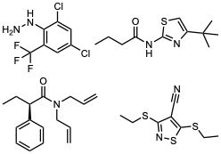
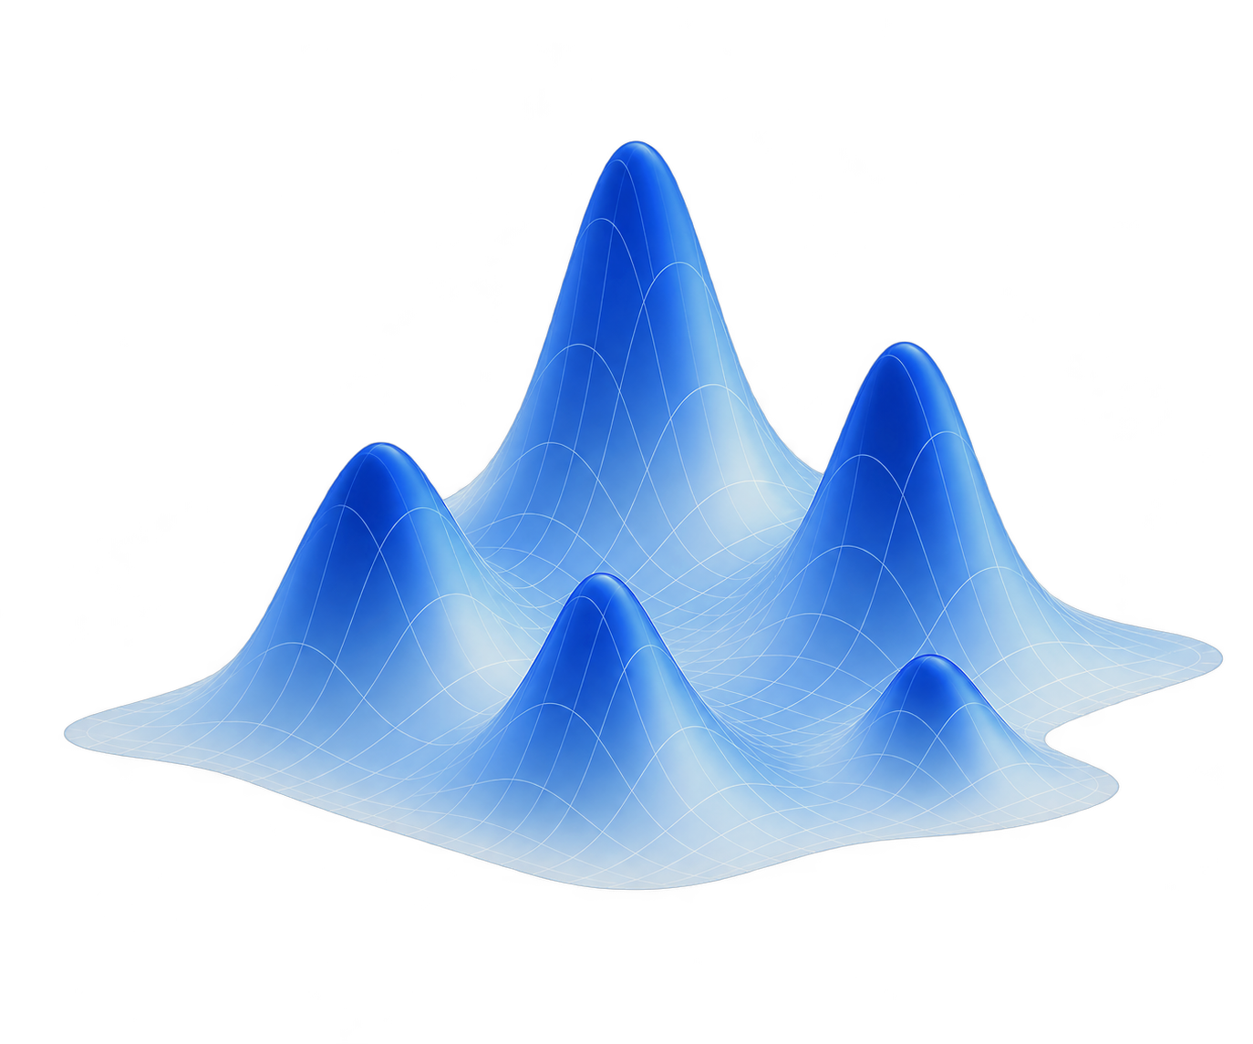

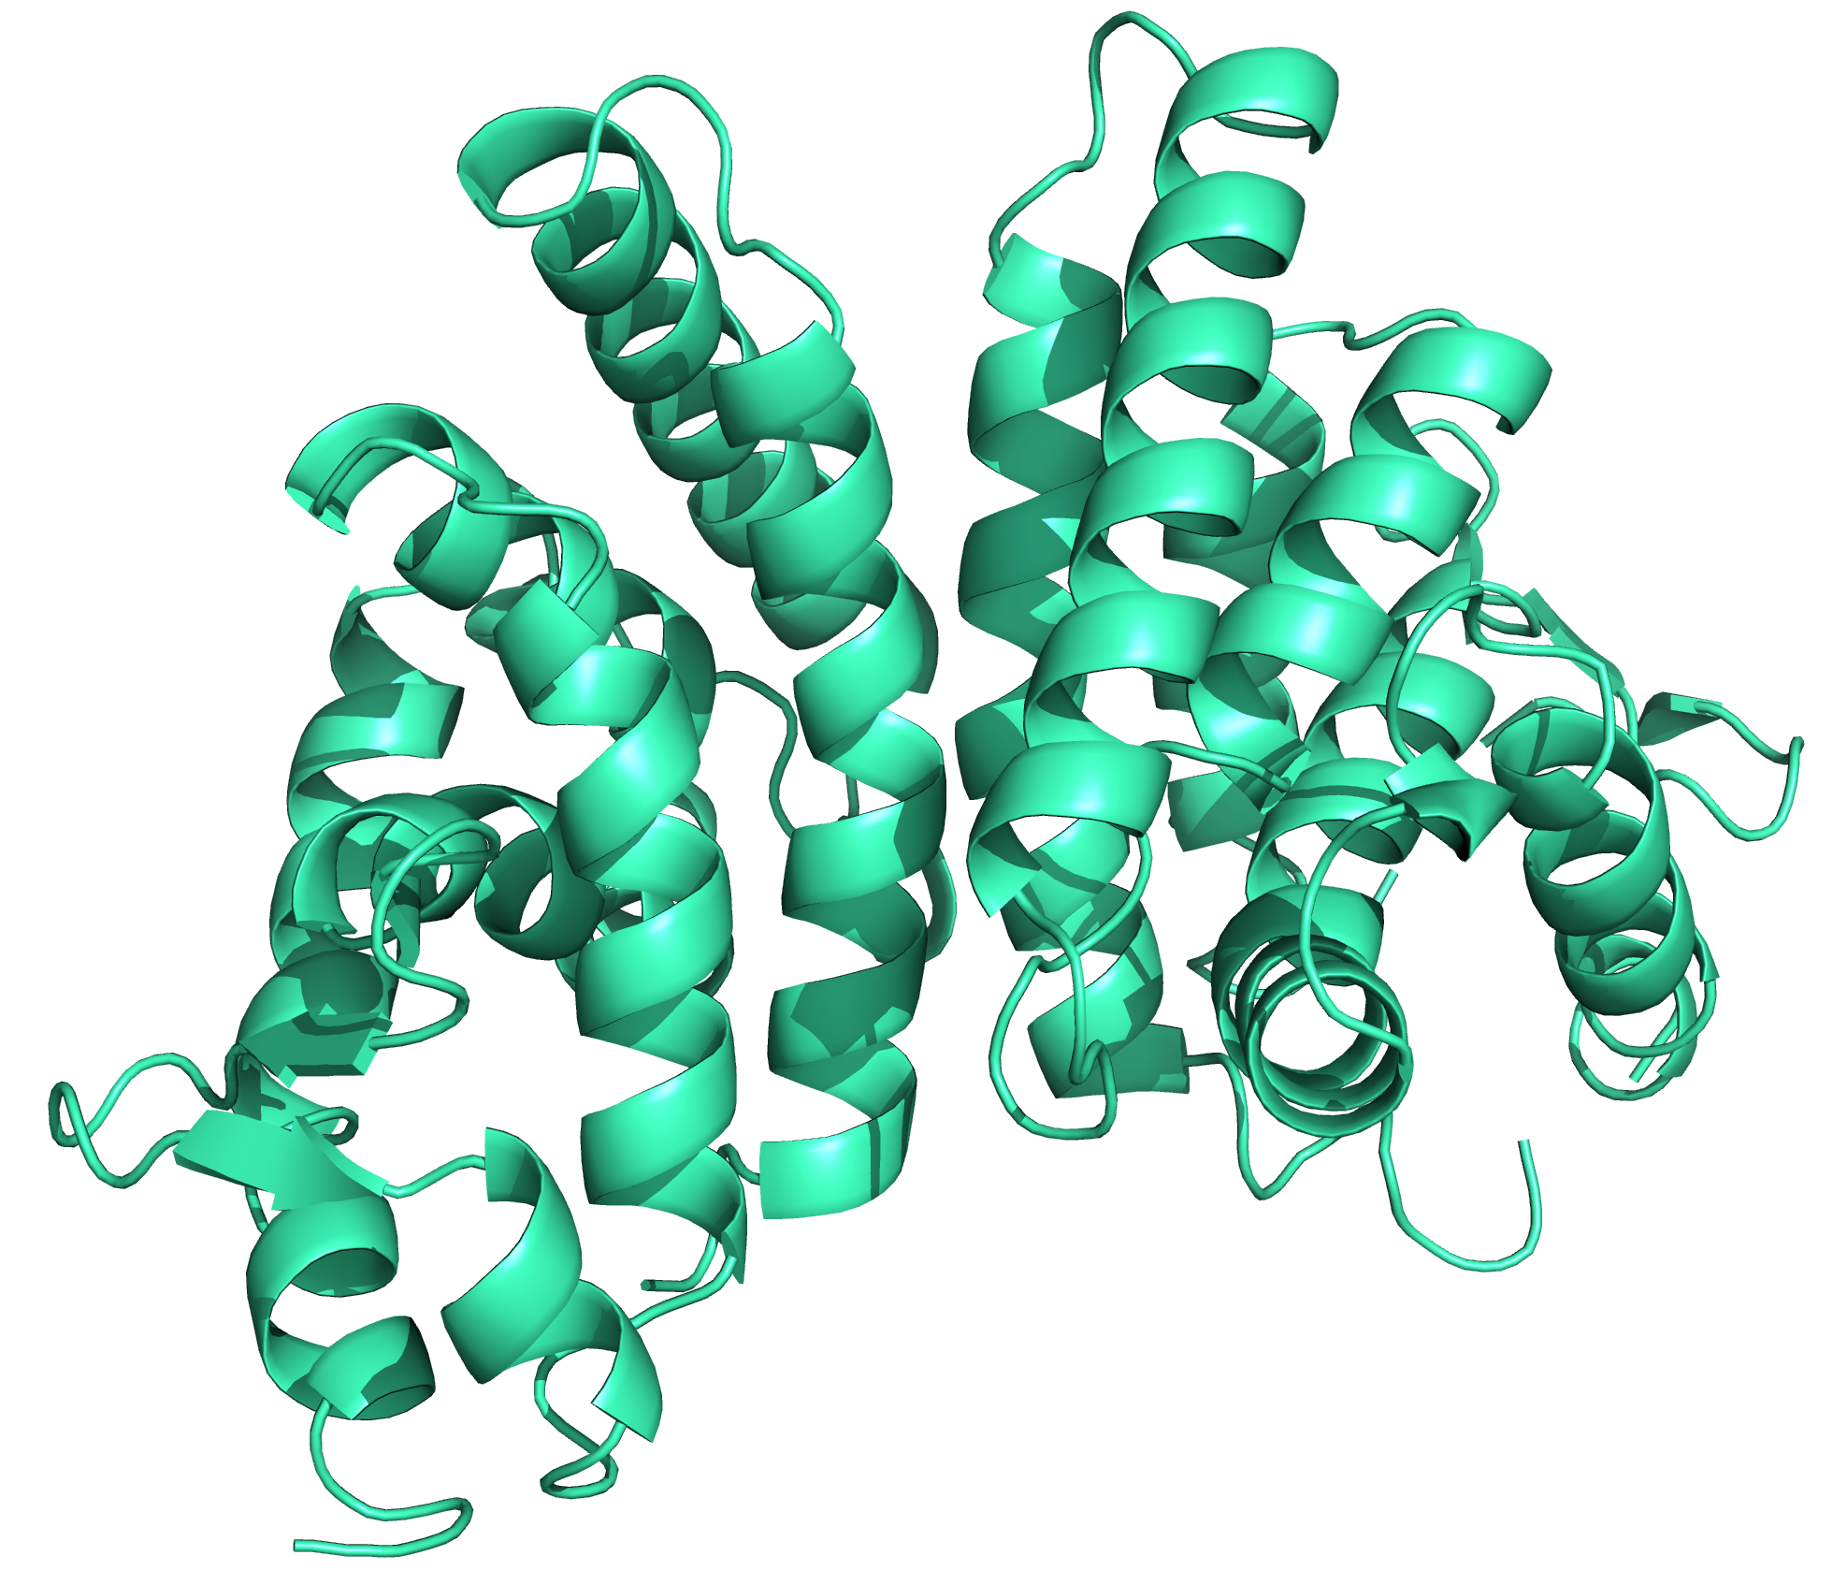
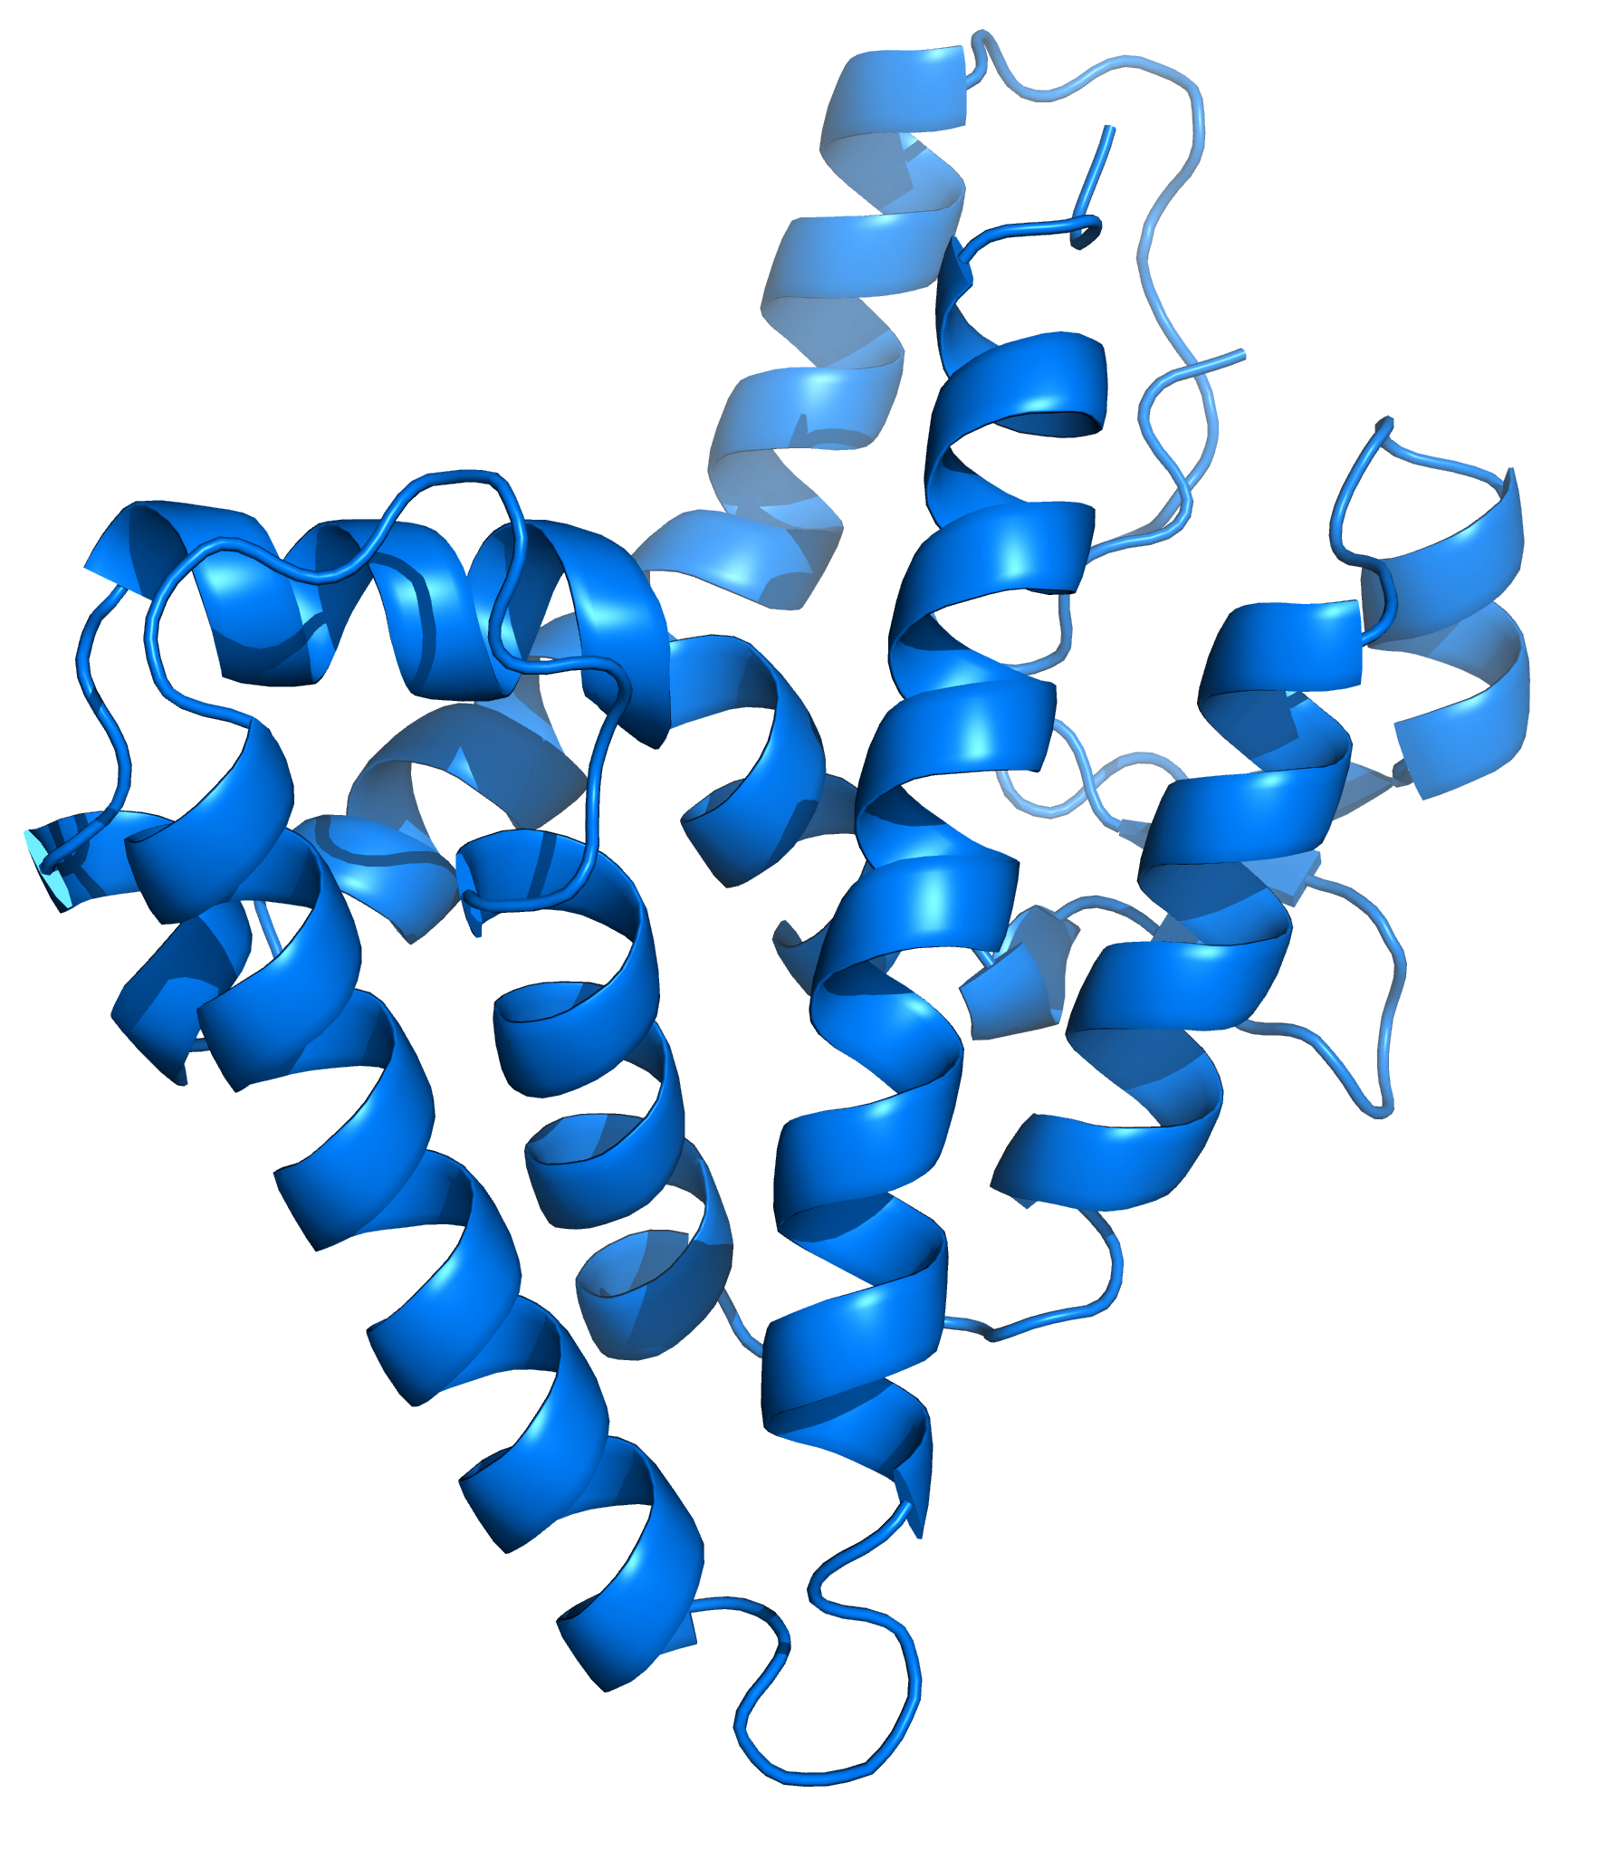
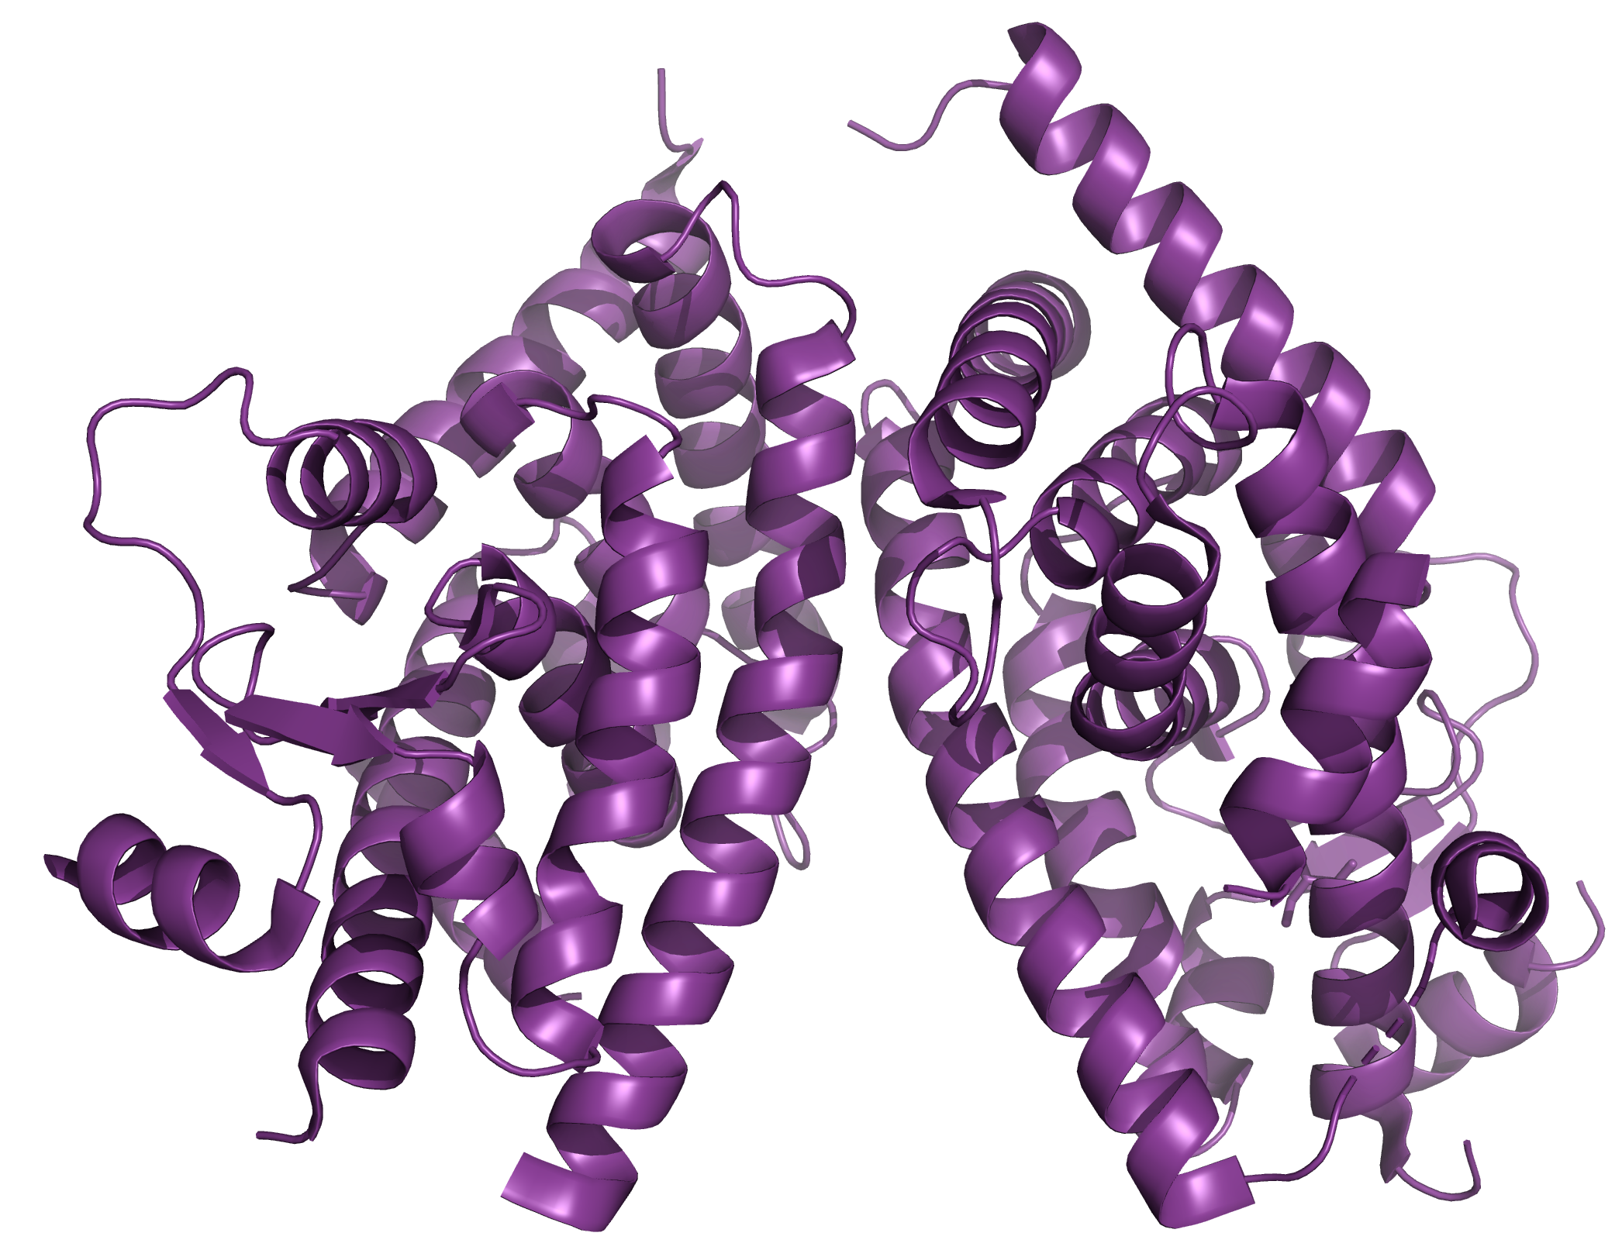
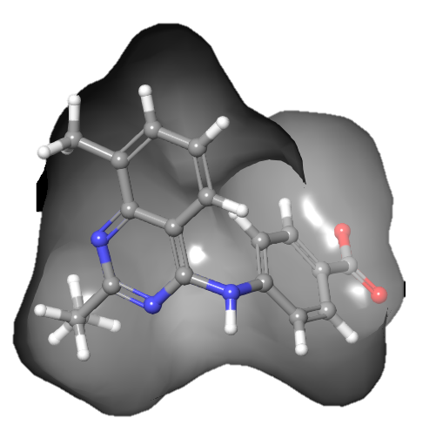

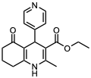


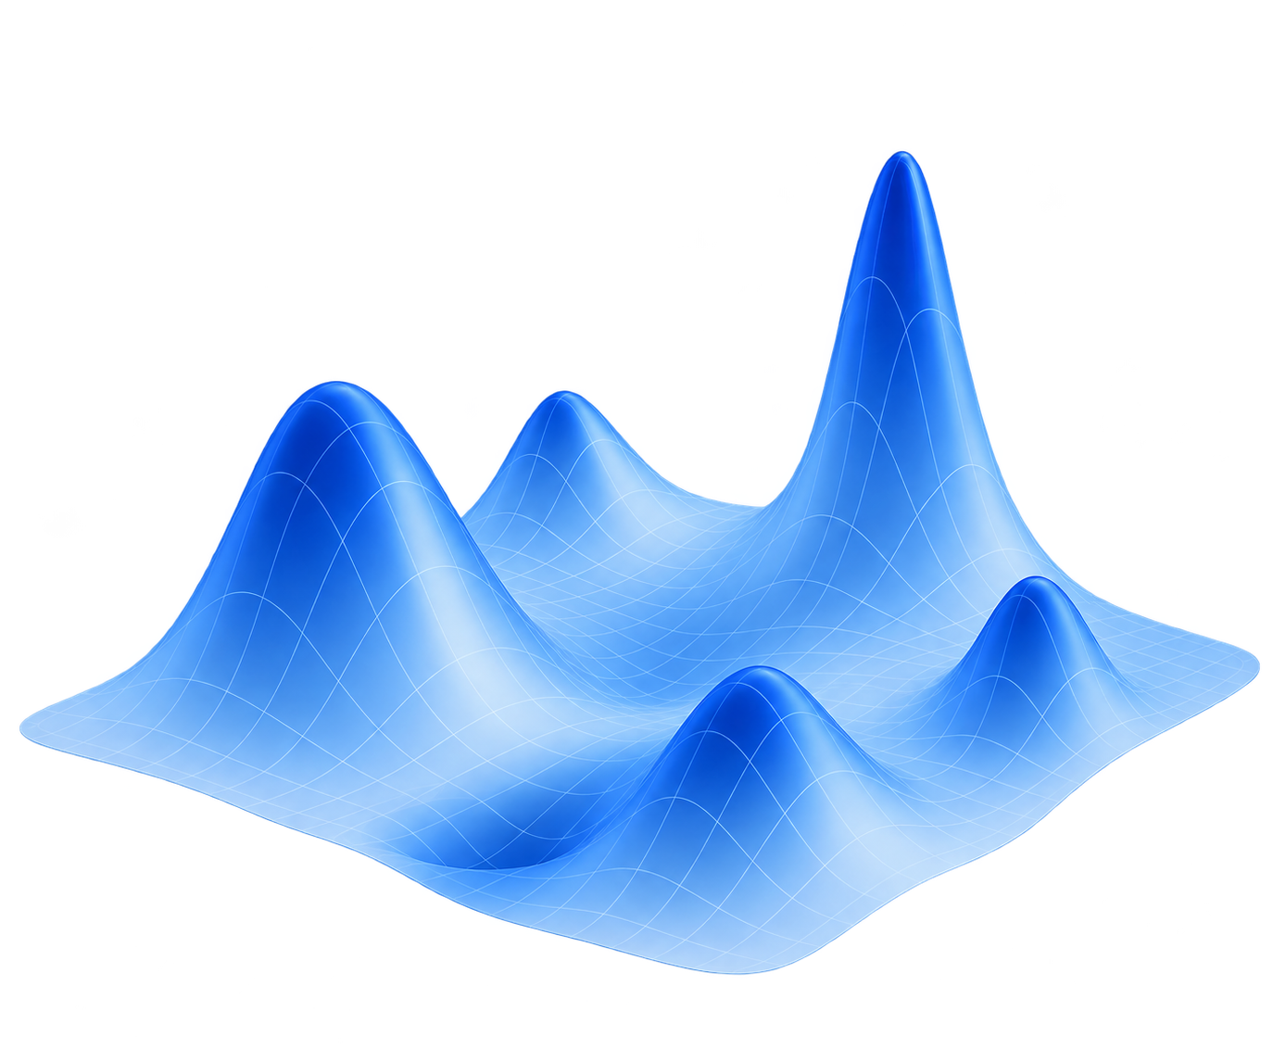

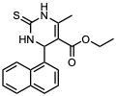








A. Molecular Pre-training
[BOS]
C
C
S
C
1
…
1
C
#
N
[EOS]
GPT decoder × 8 Layers
SMILES Tokenizer
~9.5M ZINC molecules
Next token prediction
Pre-trained molecular generative model
Cross-attention
B. Target-set-conditioned Finetuning
Open-source dataset
Target set encoder
…
SMILES
Next token prediction
SPRi data matrices
Target-set-conditioned generative model
Target set - Active molecules pairs
C. Target Set Encoder
D. SPRi-enhanced Chemical Space Exploration
K Targets
Frozen ESM-C 6B
Dim reduction
Pre-trained generative chemical space
$${\text{l}}_{\text{1}}\text{×}\text{D}$$
$${\text{l}}_{\text{2}}\text{×}\text{D}$$
$${\text{l}}_{\text{3}}\text{×}\text{D}$$
Trained Query Vectors
K^{T}
V
K^{T}
V
K^{T}
V
Cross-attention
$$\text{n}\text{×}\text{D}$$
$$\text{n}\text{×}\text{D}$$
$$\text{n}\text{×}\text{D}$$
$$\text{n}\text{×}\text{D}$$
Trained Info- integration Vectors
Concat.
…
Data-rich condition enables broad exploration
$$\text{m}\text{×}\text{D}$$
Multi-layer
self-attention
One-way Information Integration
Two-way Information Exchange
$$\text{(}\text{K}\text{n+m}\text{)}\text{×}\text{D}$$
Cross-attention
Multi-layer
GPT decoder
Data-sparse condition restricts exploration range
SPRi supplement restores conditional exploration range
(in A. above)
Notes:
SPRi到底写啥名字待定 UHTS

Slide 2

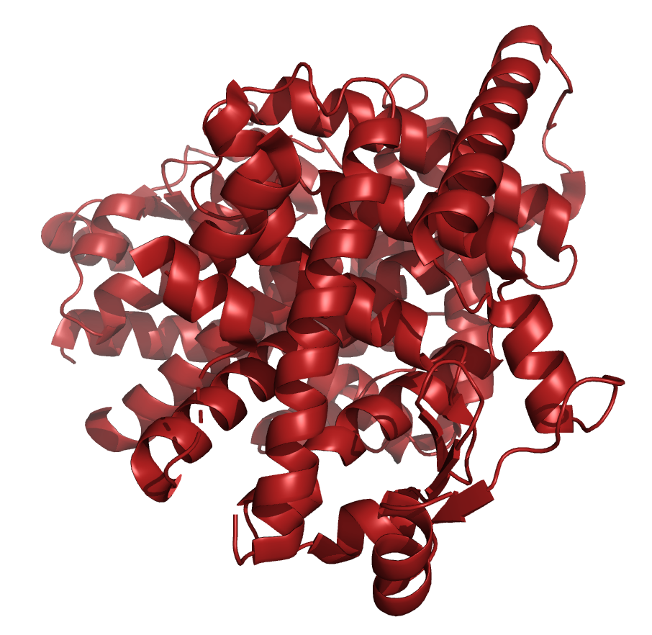
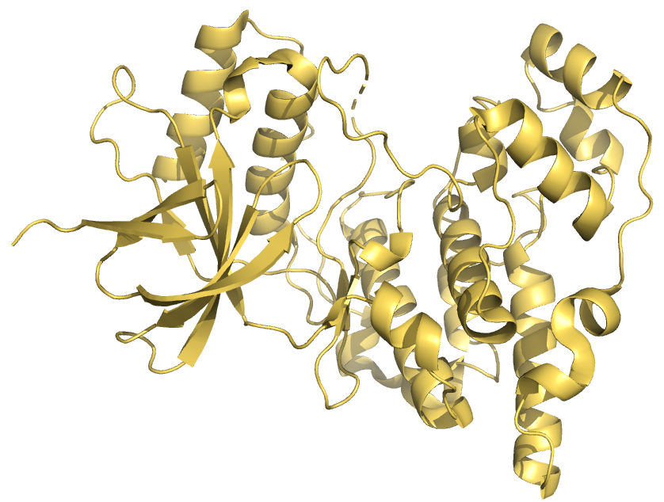



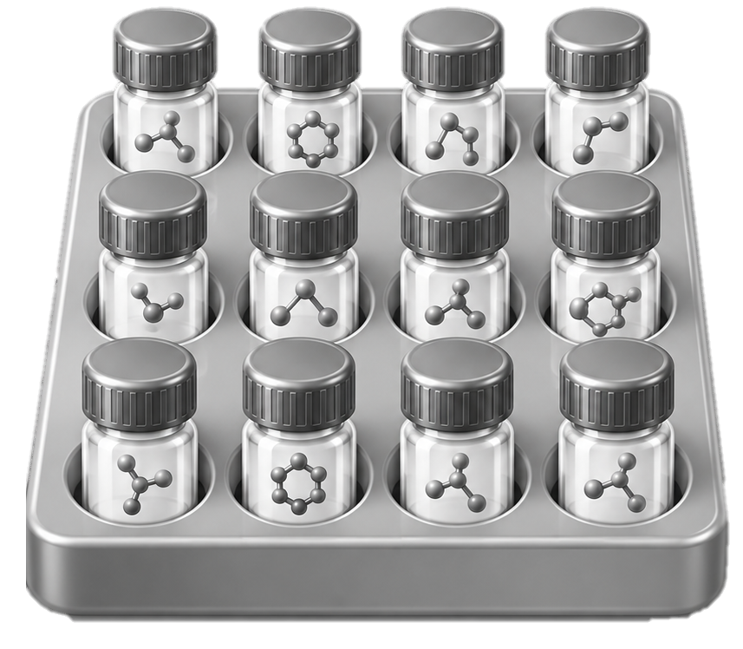







A. Molecular Pre-training
[BOS]
C
C
S
C
1
…
1
C
#
N
[EOS]
GPT decoder × 8 Layers
SMILES Tokenizer
~9.5M ZINC molecules
Next token prediction
Pre-trained generative chemical space
B. Open-source Data Finetuning
Cross-attention
D. Target Set Encoder
Next token prediction
K Targets
Target set - Active molecules pairs
Target set encoder
Frozen ESM-C 6B
Open-source dataset
…
Dim reduction
SMILES
Data-rich condition enables broad exploration
C. SPRi-enhanced Finetuning
$${\text{l}}_{\text{1}}\text{×}\text{D}$$
$${\text{l}}_{\text{2}}\text{×}\text{D}$$
$${\text{l}}_{\text{3}}\text{×}\text{D}$$
Trained Query Vectors
K^{T}
V
K^{T}
V
K^{T}
V
Cross-attention
Finetuning
$$\text{n}\text{×}\text{D}$$
$$\text{n}\text{×}\text{D}$$
$$\text{n}\text{×}\text{D}$$
$$\text{n}\text{×}\text{D}$$
Data-sparse condition restricts exploration range
Trained Info- integration Vectors
Concat.
Target set with few active molecule records
$$\text{m}\text{×}\text{D}$$
Multi-layer
self-attention
Combining
One-way Information Integration
Two-way Information Exchange
$$\text{(}\text{K}\text{n+m}\text{)}\text{×}\text{D}$$
Cross-attention
Finetuning
Multi-layer
GPT decoder
In-house compound library
SPRi data matrices
SPRi supplement restores conditional exploration range
(in A. above)
Notes:
SPRi到底写啥名字待定 UHTS

