Slide 1

Frontend Development

Slide 2
Agenda
Project setup
Intro to HTML
Intro to CSS
Intro to JavaScript
Intro to React (optional)

Slide 3
What is Frontend Development?
Develop what users can see and interact with directly
Runs entirely within the browser for web apps
Connects user actions with application logic
GOAL: Build accessible, responsive, and functional user interfaces

Slide 4
Project Setup
You need:
- A functional web browser like Chrome or Firefox
- Code editor (VSCode or Cursor preferred). Get these extensions if possible: ESLint, Prettier, HTML CSS Support
Node.js (install here https://nodejs.org/en)
Git – to clone the project repository here: https://github.com/TonyLiu0226/toDoListTutorial.git
Run the following command in a terminal or use vsCode’s Source control tab:
git clone https://github.com/TonyLiu0226/toDoListTutorial.git

Slide 5
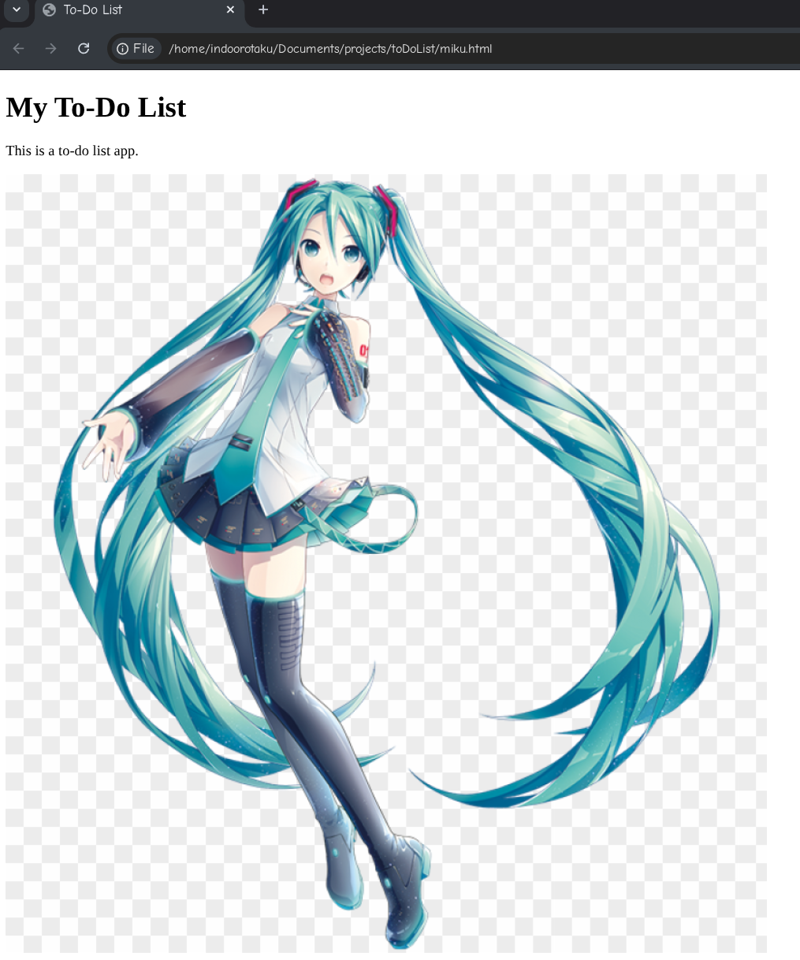
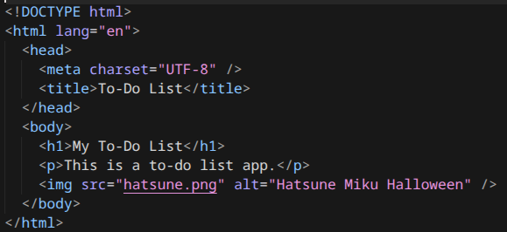
HTML
Standard markup language that controls structure of web pages
Series of elements that tells browser how to display content

Slide 6
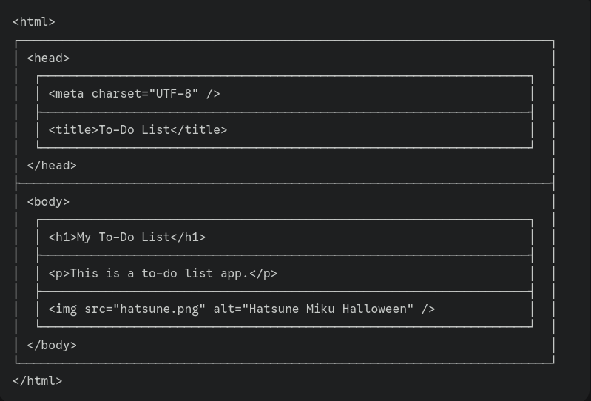
HTML Elements walkthrough
<!DOCTYPE html>
<html lang="en">
<head>
<meta charset="UTF-8" />
<title>To-Do List</title>
</head>
<body>
<h1>My To-Do List</h1>
<p>This is a to-do list app.</p>
<img src="hatsune.png" alt="Hatsune Miku Halloween" />
</body>
</html>
<!DOCTYPE html> — tells the browser to use modern HTML5 rules
<html lang="en"> — wraps the entire page and declares the language
<head> — contains metadata and settings that are not visible on the page
<meta charset="UTF-8"> — ensures text and emojis display correctly
<title> — sets the browser tab name
<body> — holds all visible content
<h1> — main page heading. Other smaller subheadings can also be used, with the tags <h2>, <h3>, <h4>, <h5>, and <h6>.
<p> — paragraph text
<img> — displays an image (src = file, alt = accessibility text)
All tags must have a correponding closing tag, or be self closing Eg:<title></title> or <img src=”x” />

Slide 7
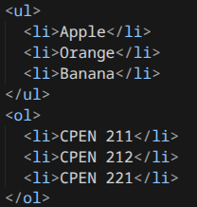
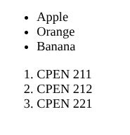
Lists
<ul> is for unordered bulleted lists
<ol> is for numbered lists
In both cases, use an <li> for each item

Slide 8
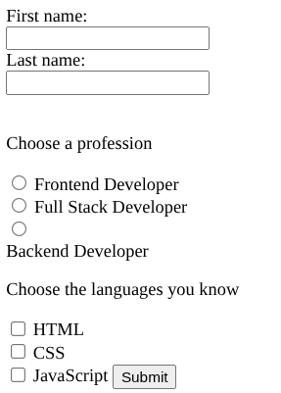
Inputs and forms
<form action="localhost:3000/submit">
<label for="fname">First name:</label><br>
<input type="text" id="fname" name="fname" value=""><br>
<label for="lname">Last name:</label><br>
<input type="text" id="lname" name="lname" value=""><br><br>
<p>Choose a profession</p>
<input type="radio" id="html" name="profession" value="HTML">
<label for="html">Frontend Developer</label><br>
<input type="radio" id="css" name="profession" value="CSS">
<label for="css">Full Stack Developer</label><br>
<input type="radio" id="javascript" name="profession" value="JavaScript">
<label for="javascript">Backend Developer</label><br>
<p>Choose the languages you know</p>
<input type="checkbox" id="language1" name="language1" value="HTML">
<label for="language1">HTML</label><br>
<input type="checkbox" id="language2" name="language2" value="CSS">
<label for="language2">CSS</label><br>
<input type="checkbox" id="language3" name="language3" value="JavaScript">
<label for="language3">JavaScript</label><br><br>
<input type="submit" value="Submit">
</form>
<form> groups all controls together, action attribute defines a URL where form submissions go
<input> defines input field, can have varying types.
id is to match with labels, and helpful attribute for JavaScript. name is the key the field that is sent on submission
Checkboxes: use type=”checkbox”, and different names for each input. Users choose 0 or more.
Radio buttons: use type=”radio”, and the same name for each input in a group of buttons. Users choose exactly 1

Slide 9
Task
Implement To-Do List HTML
Add a place for users to enter tasks (input and button).
Display a list of sample tasks. Each task should have a delete button.
https://www.w3schools.com/html/

Slide 10

CSS
Inline CSS
Inline CSS
<body>
<h1 style="color: blue; text-align: center;">This is a heading</h1>
<p style="color: red; font-size: 16px;">This is a paragraph.</p>
</body>
If HTML controls structure, then CSS controls appearance
Controls:
Spacing
Color
Layout
Font
and more...
Internal CSS
<style>
body {
background-color: linen;
}
</style>
External CSS

Slide 11
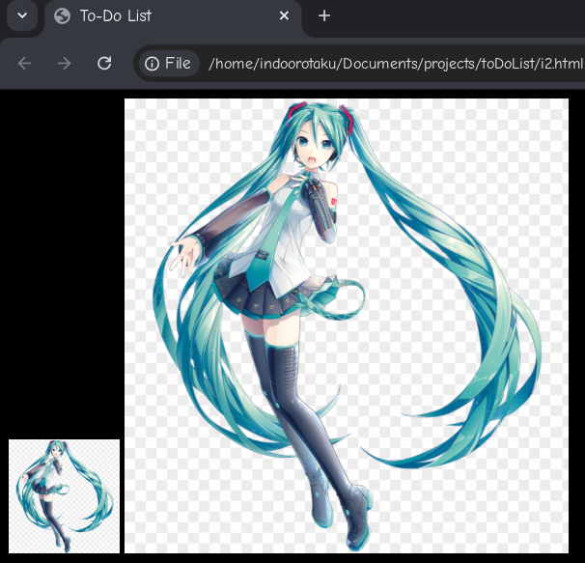
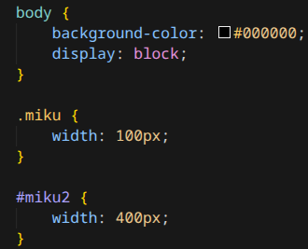
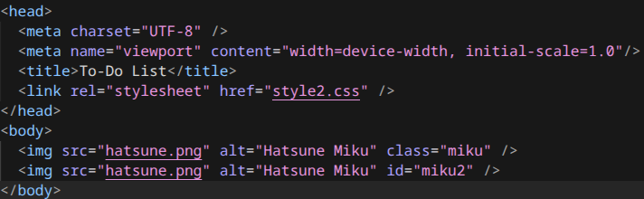
CSS Selectors
selector {
property: value;
}
Class selectors: Add . Before selector name
ID selectors: Add # Before selector name
Add the appropriate attribute in the HTML first

Slide 12
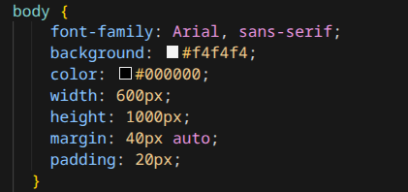
CSS Page Styling
Apply styling to the body component
font-family: Determines what type of font we are using. First font is always used, other fonts in list are simply fallback options. serif and sans-serif are families.
background: Background color. Use rgb or hex values
color: text-color
width & height: Element dimensions
Units:
Fixed: px
Relative to parent container: %
Relative to viewport: vw/vh
Relative to font: em/rem

Slide 13

CSS Display Options
Block
Flexbox
Grid
display: block
display: grid
display: flex

Slide 14
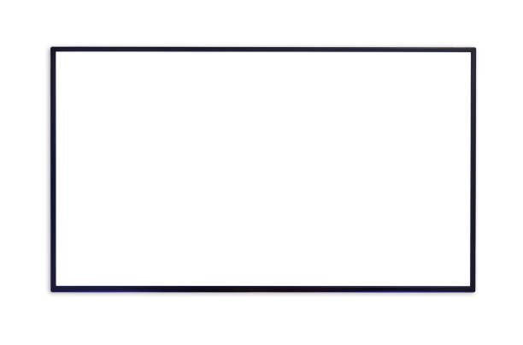


CSS Flexbox
align-items:
flex-start
flex-end
center
stretch
justify-content: flex-start
flex-end
center
space-between
space-evenly
Other common options: align-self: Overrides align-items for particular item
flex-grow: how much space an an element takes
along the axis.
flex-shrink: allows item to shrink if necessary
flex-wrap: wraps content to multiple lines
https://css-tricks.com/snippets/css/a-guide-to-flexbox/

Slide 15
CSS Padding and Margins
Padding: Extra space inside an element.
Margin: Extra space outside an element.
Tips: Add -left, -right, -top, -bottom to control spacing in a particular direction. Or use multiple values for the margin or padding property
h1 {
margin: 10px 10px;
}
h1 {
padding: 10px 10px 5px 1px;
}
Is equivalent to
Is equivalent to
h1 {
padding-top: 10px;
padding-right: 10px;
padding-bottom: 5px;
padding-left: 1px;
}
h1 {
margin-left: 10px;
margin-right: 10px;
margin-top: 10px;
margin-bottom: 10px;
}

Slide 16
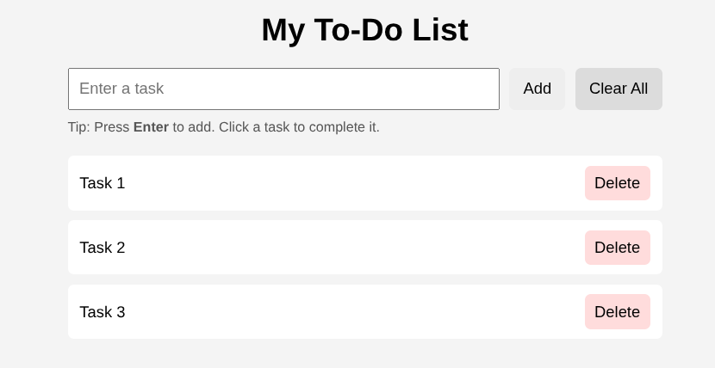
Task
Implement To-Do List CSS
It should look similar to this:
https://www.w3schools.com/css/

Slide 17

JavaScript
Adds behavior to web pages
Responds to user actions
Dynamically changes HTML and CSS
Runs in the browser
TLDR: It’s what makes the UIs Functional

Slide 18
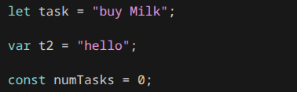
JavaScript variables
JavaScript is dynamically typed
Declare variables with let, var, or const.
- let: dynamic, variables can change
- var: same as let*
- const: variables cannot change once declared
var is typically globally scoped, and can redeclare
variables with the same values.

Slide 19
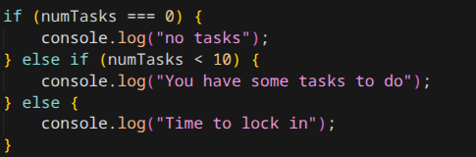
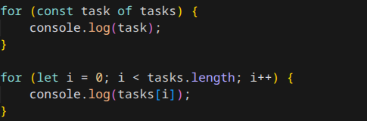
JavaScript loops and conditionals
Conditionals use if/else, same as many programming languages
Loops:
- Traditional for loop: Use an iterator
- for … of loop: Iterates through values of elements in array/map/object directly
- for … in loop: Iterates through keys of elements in an object
- while loop: Iterate as long as
Condition is true

Slide 20
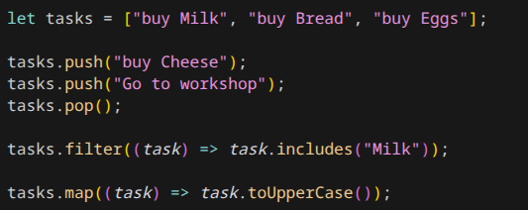
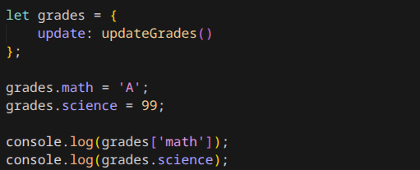
JavaScript Arrays and Objects
Arrays stored ordered list of items
To add to array, use push()
To remove last item, use pop()
Length of array: use .length property
Index elements with []
Filter function: Removes elements that do not meet filter requirements, resulting in a new array
Map function: Transform each item in an array, resulting in a new array
Objects store an unordered collection of variables in key-value pairs. Keys are strings
Initialize with {}
Keys also known as property. To access a property of an object, use .property or [property]:
Accessing properties that do not exist will return a value of undefined
You can also define functions as
values of keys

Slide 21
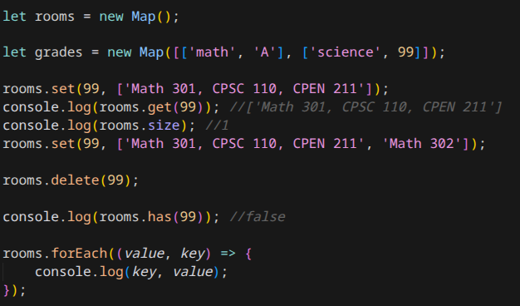
JavaScript Maps
Maps are a special type of object
Keys can be any type
Maps remember insertion order of keys, and maps are iterables
Create Maps using new Map()
Update or add using set()
Get value of key using get()
Get size of map using .size
Delete with delete(key)
Use .has to determine if a key exists
.forEach can be used to run a function that loops over each key/value pair

Slide 22
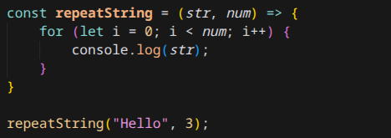
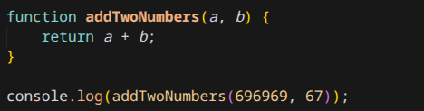
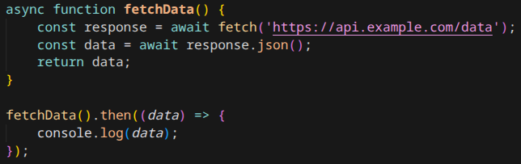
JavaScript Functions
Reusable blocks of code that execute only when called
Increases modularity and reduces duplication
Functions are hoisted, can be called before they are actually defined
2. Arrow functions
1. use function keyword
3. Async functions

Slide 23
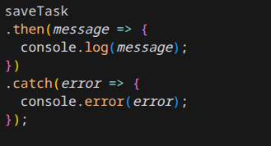
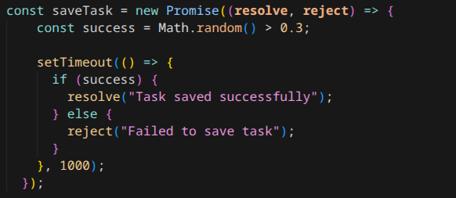
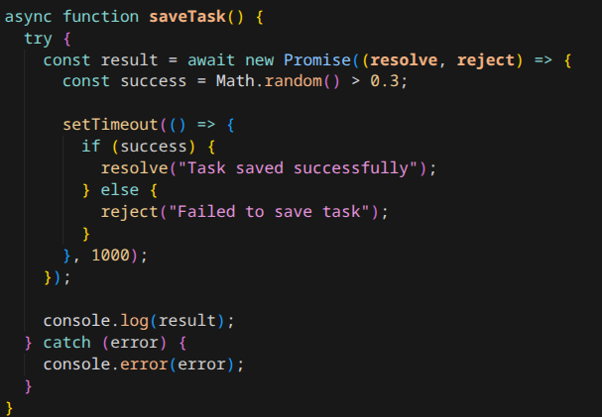
JavaScript Promises
For representing values that exist in the future, important for asynchronous ops
Examples: fetching data, timers, file loading
States:
Pending: Initial state, operation not completed
Fulfilled: Operation successfully completed. Promise now has a value
Rejected: Operation returned an error
How to use the promise
.then runs on resolve case, and .catch catches any errors
async/await paradigm
(catch block handles all reject cases)
Creating promises
Resolve handles value when promise fulfilled, reject handles error

Slide 24
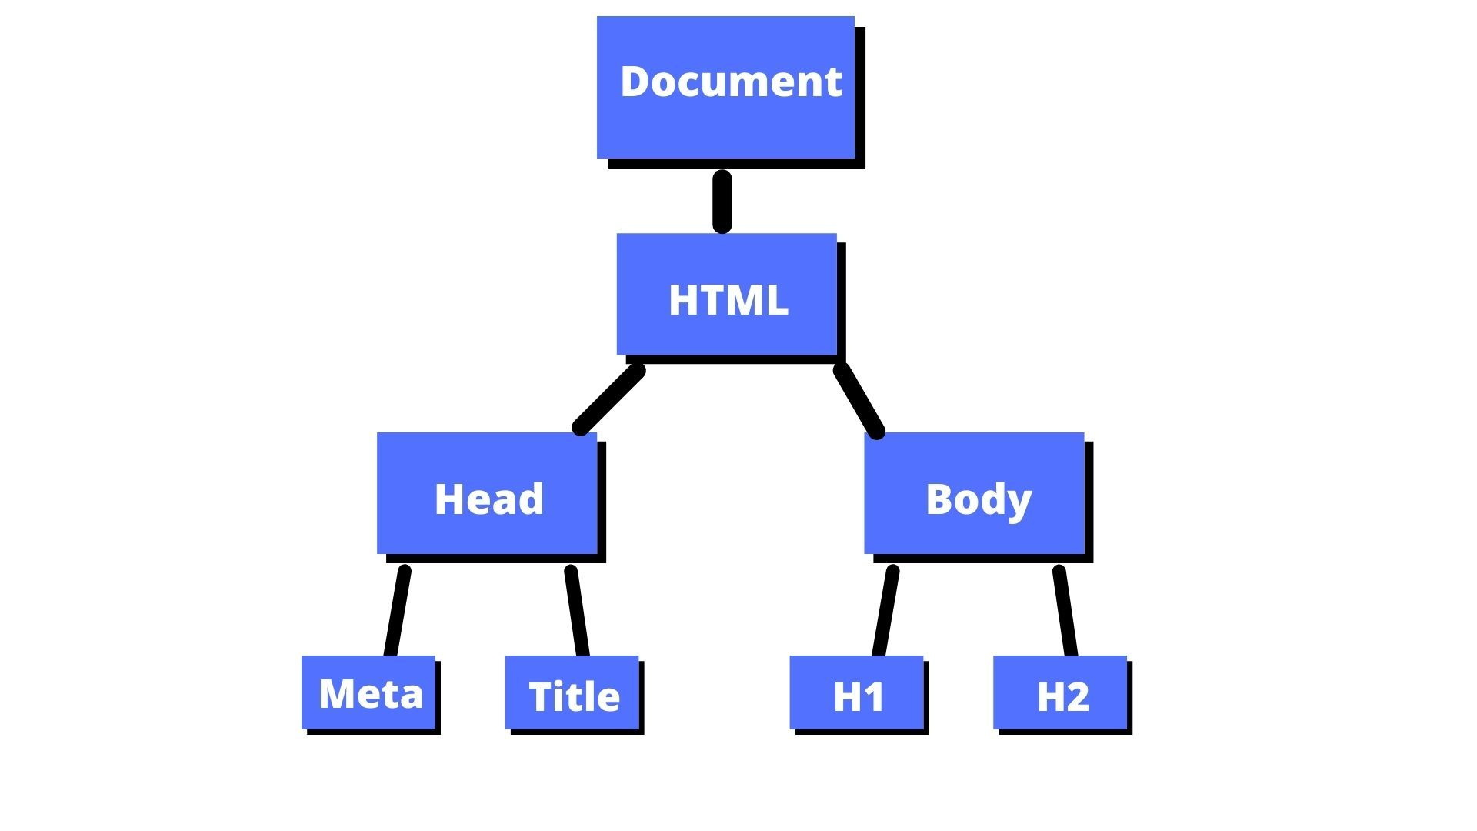
The DOM
Short for Document Object Model
An object tree that browsers see, representing the HTML structure of the site
JavaScript uses the DOM to interact with the website by:
- Reading HTML
- Adding or removing HTML elements
- Changing properties of HTML elements
Affecting content, structure, and style of page in real time

Slide 25
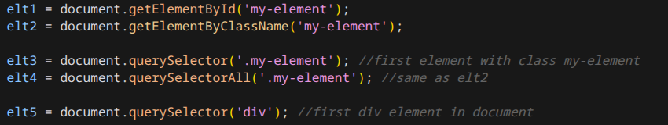
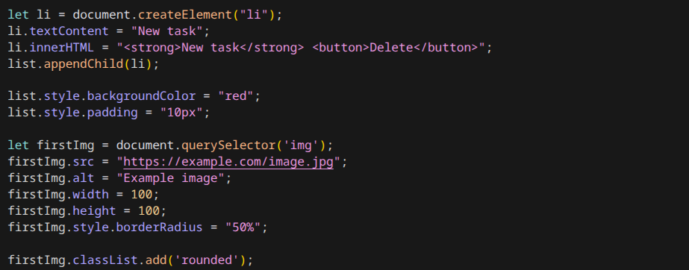
DOM JavaScript Essentials
Manipulating Elements
Many ways to do so, here are common ones:
- createElement: Creates new element, but not insert into DOM yet
- appendChild: Appends a child element to a selected parent element
- textContent: Edits text that is displayed in element
- innerHTML: Alternative to above but allows for direct HTML injection
- style: Adds CSS. Use CSS properties to edit a particular style
- classList.add: adds a class
- classList.remove: removes a class
Selecting Eelements
document.getElementById – Gets the first element that matches the id
document.getElementByClassName – Gets all elements that have the same class
document.QuerySelector – Get first element that match specific CSS selectors

Slide 26
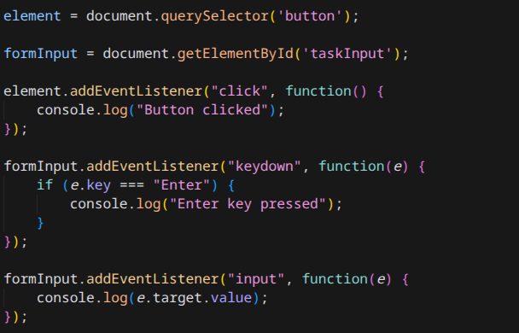

Listeners
- Responds and “listens” to user actions (AKA Events)
- Function that triggers upon a specified event taking place
Syntax: addEventListener(event, action)
Common Events:
- click
- input
- keydown

Slide 27
Task
Put everything you learned together to complete the full To-Do list
Functionality: Add Items to list, remove items, and clear all items.

Slide 28

React
React is a JavaScript library for building user interfaces
UI is built from components
React automatically updates the DOM for you
You describe what the UI should look like, not how to update it
Vanilla JS: You control DOM elements
React: Automatic control when state changes
npm create vite@latest todo-react

Slide 29
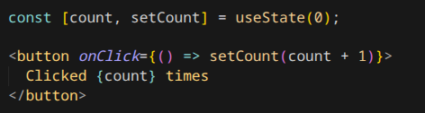
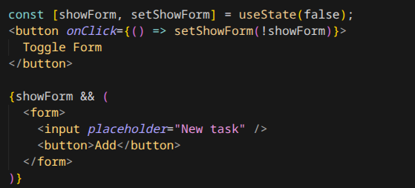
useState
useState stores component data
State = data that changes over time
Updating state automatically updates the UI
A state change will cause a re-render of the component
Can conditionally render components based on state (see 2nd example)

Slide 30
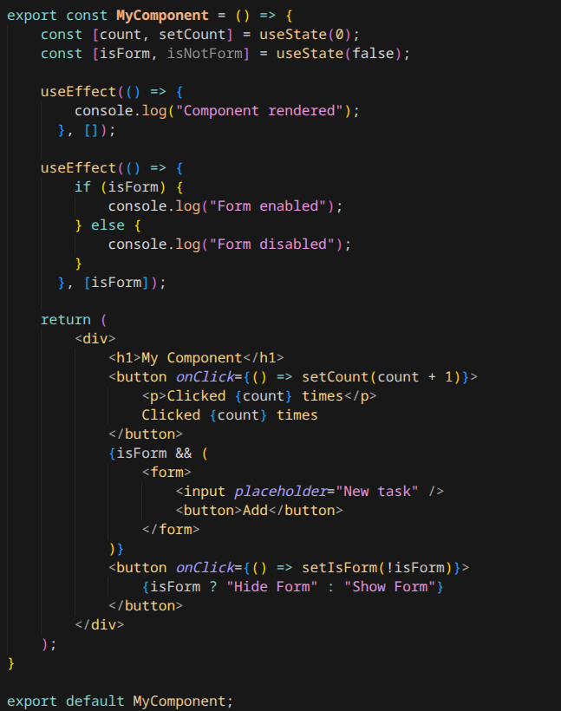
useEffect
Runs functions after rendering
Used for fetching data, subscribing to events, or syncing with external systems
Important to understand: Dependency arrays
- Empty array: function runs after every render
- Otherwise, function runs once initially, then only when dependencies in the list changes
https://react.dev/
https://www.w3schools.com/react

Slide 31
Sources
https://encrypted-tbn0.gstatic.com/images?q=tbn:ANd9GcQEz5LiT5E4d9Ag8ZJGdfiP-OaBINrw8Fu_uw&s
https://www.pngarts.com/explore/185921
https://www.freecodecamp.org/news/content/images/2021/09/Document.jpg
https://www.pngarts.com/files/9/Lego-Minecraft-Steve-PNG-Transparent-Image.png
https://cdn.freebiesupply.com/images/large/2x/apple-logo-transparent.png
https://react.dev/learn
https://www.w3schools.com/

