Slide 1
Putty AWS Connect
Tony Mei
Student Developer 2016

Slide 2
Prerequisites
Have an AWS Account
Signed in
Go to EC2 Dashboard

Slide 3
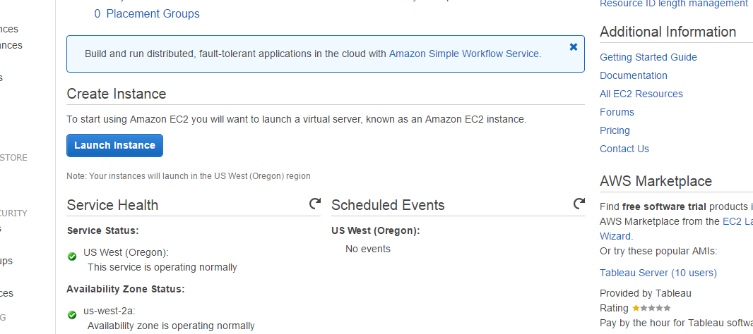
Launch Instance

Slide 4
Steps
Step 1: Choose Operating System of Instance. I had mine Ubuntu.
Step 2: Choose Instance Type. I choose the Free Tier Eligible One.
Step 3: No changes to Configure Instance Details.
Step 4: No changes to Add Storage.
Step 5: No changes to Tag Instance.

Slide 5
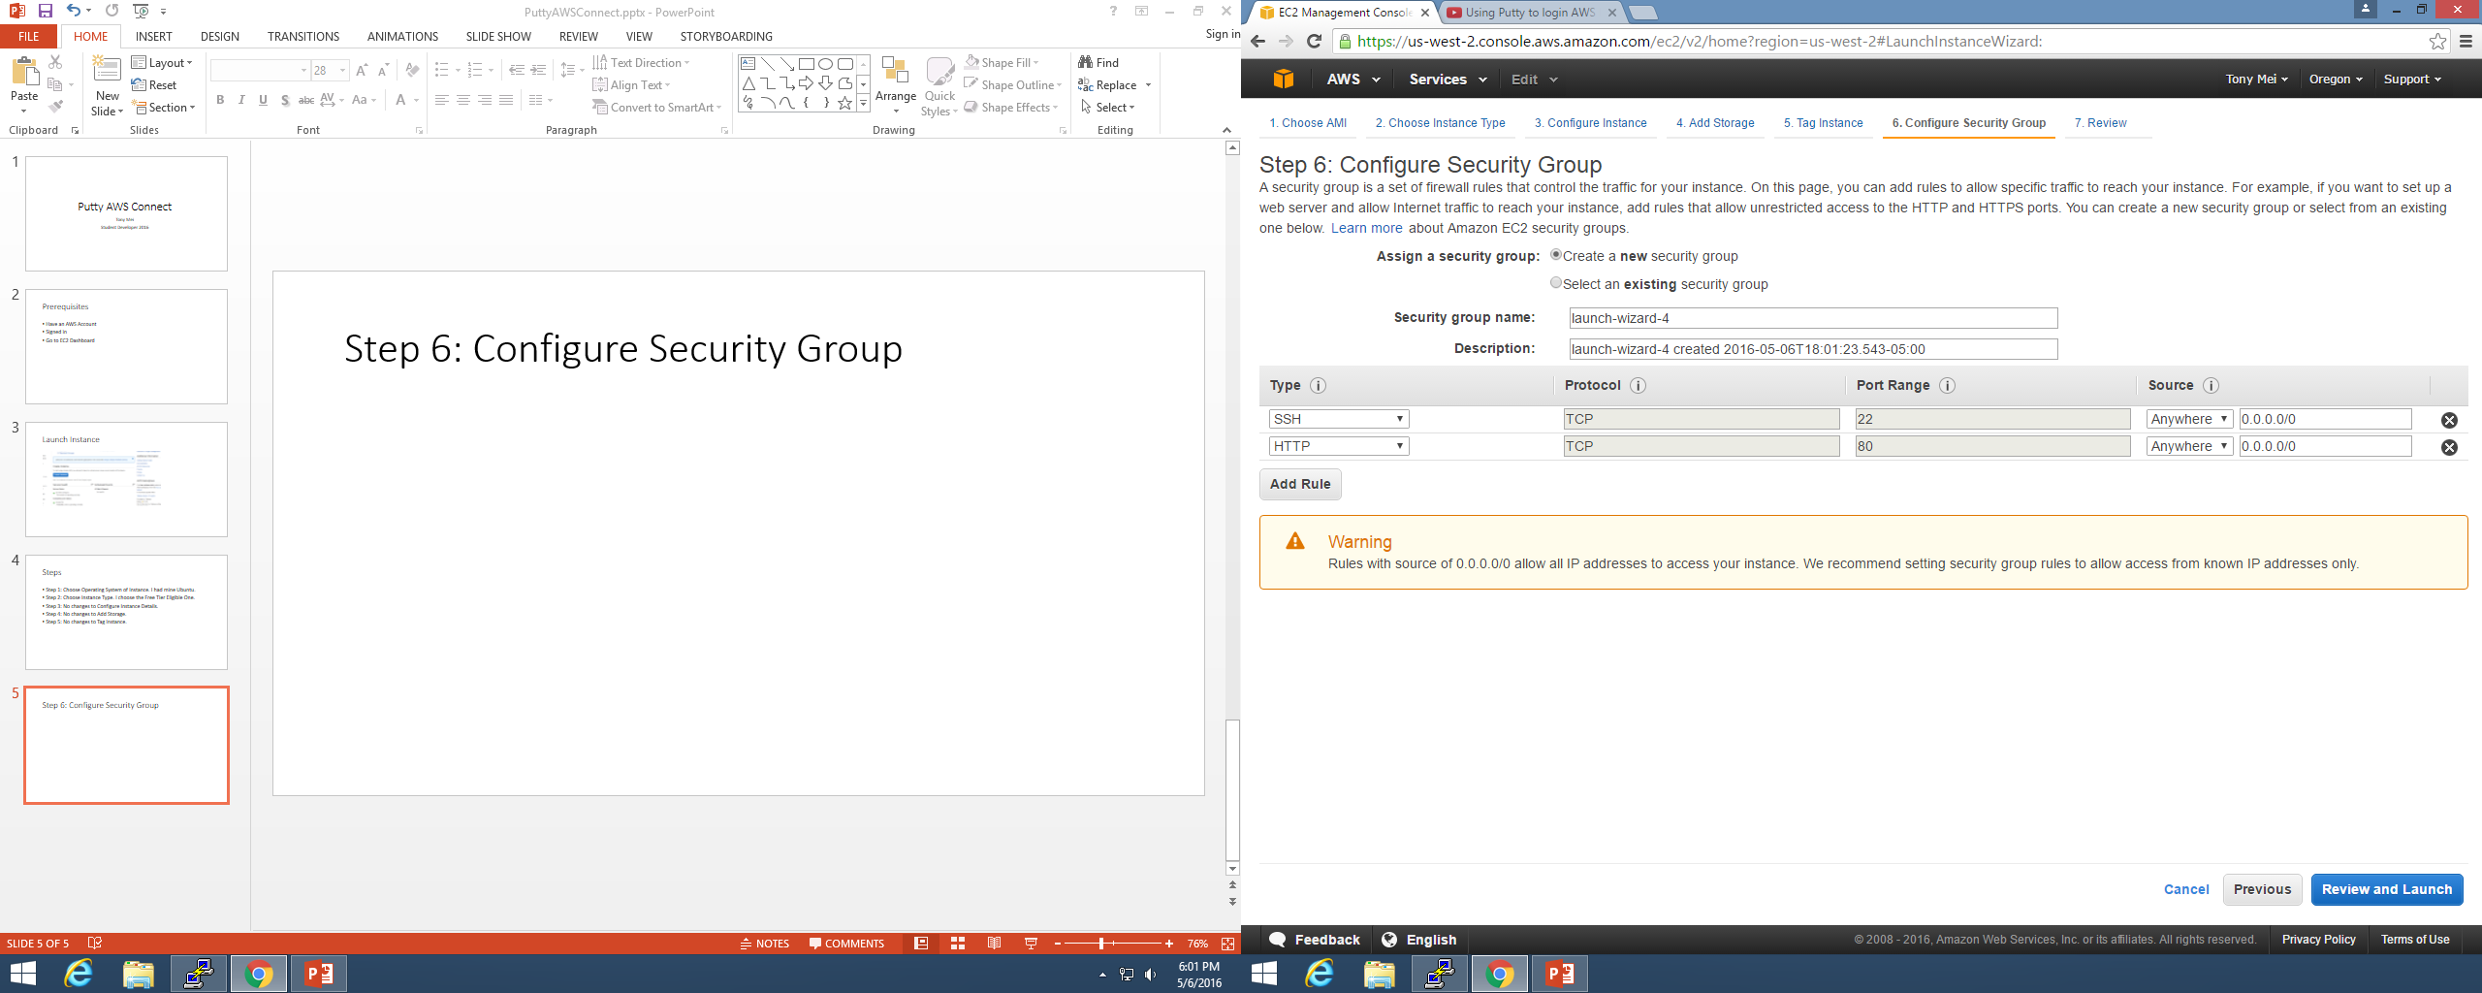
Step 6: Configure Security Group

Slide 6
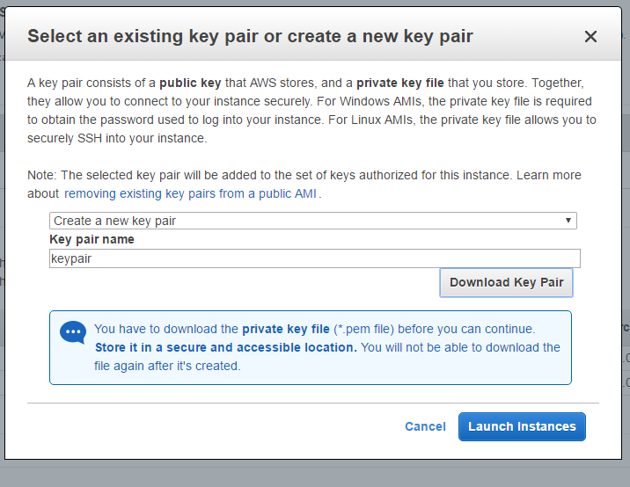
Download Key Pair
Review and Launch Instance. Download new Key.
Click Launch Instances.
Then Click View Instances.

Slide 7
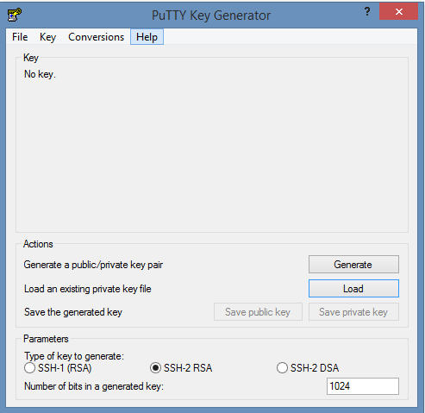
Download Putty and Puttygen
Open Puttygen
Type of Key: SSH-2 RSA
NUMBER OF BITS: 1024!!!

Slide 8
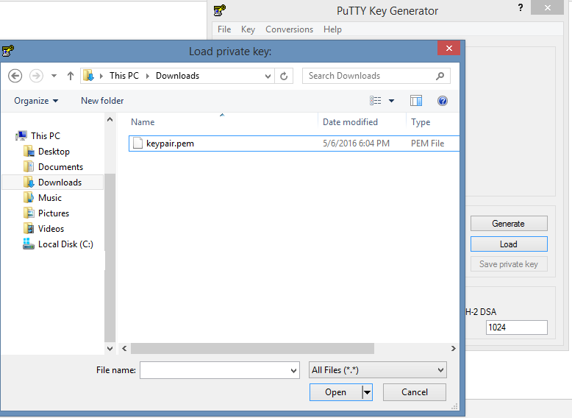
Puttygen Continued
Click Load to Load an existing private key file
Select your key which should be .pem
LOAD
ALL FILES!

Slide 9
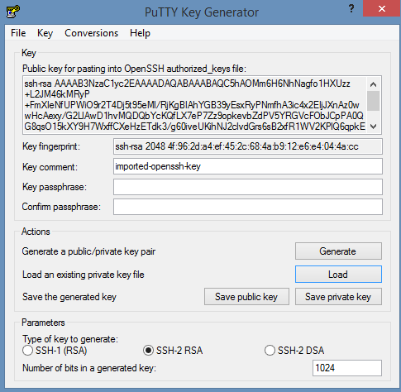
Puttygen Continued
Click on Save Private key
I haven’t put in a Key passphrase, but you can try it.

Slide 10
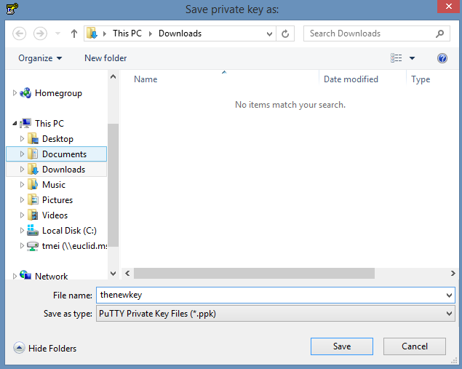
Puttygen continued
Save the new key as .ppk
.ppk works for Putty.
Exit out of Puttygen

Slide 11
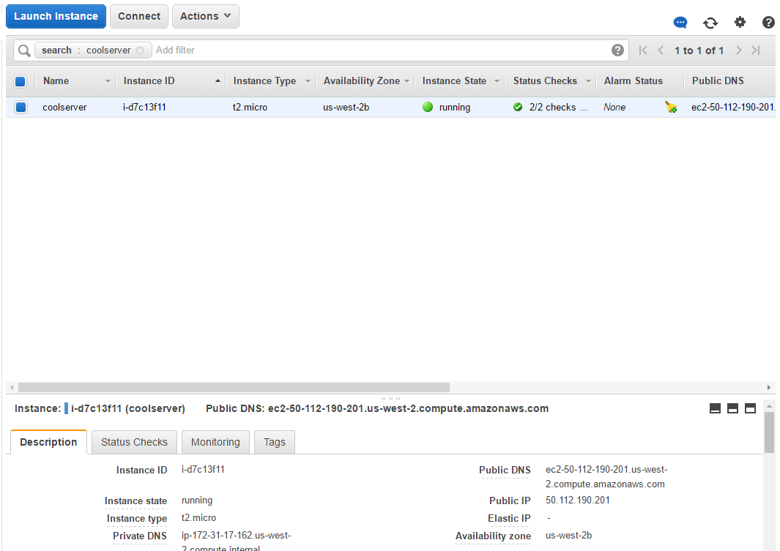
Putty
Hostname is username@public_dns_name
I’m using Ubuntu so username is Ubuntu. Find other usernames at http://docs.aws.amazon.com/AWSEC2/latest/UserGuide/putty.html
Public_DNS_Name:

Slide 12
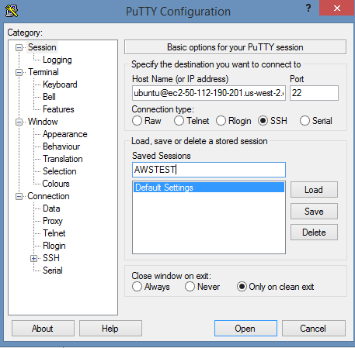
Putty continued
Enter host name.
Port is 22 because SSH
You can put something in Save sessions and then press save

Slide 13
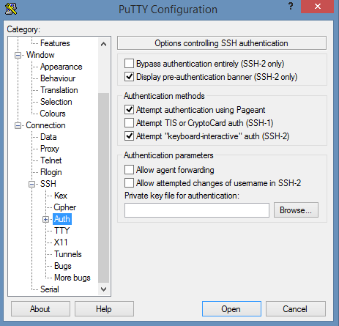
Putty Continued
Go to Connection->SSH->Auth.
Click on Browse and select the key you generated using Puttygen.

Slide 14
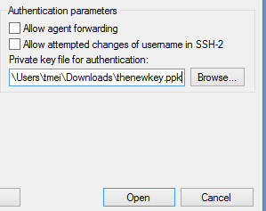
Putty Continued
After you selected the key, click open

Slide 15
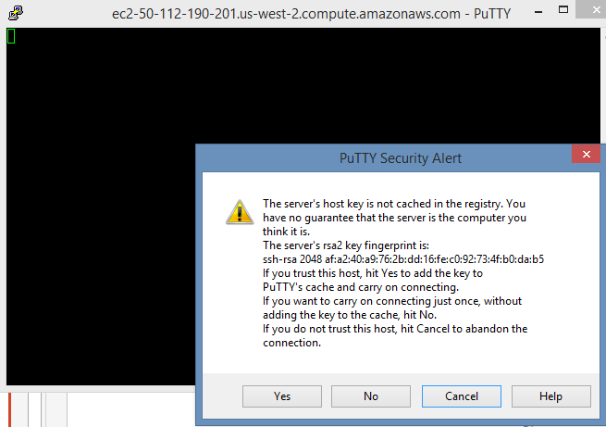
Putty continued
You should see this
Click Yes.
You do trust your own instance, right?

Slide 16
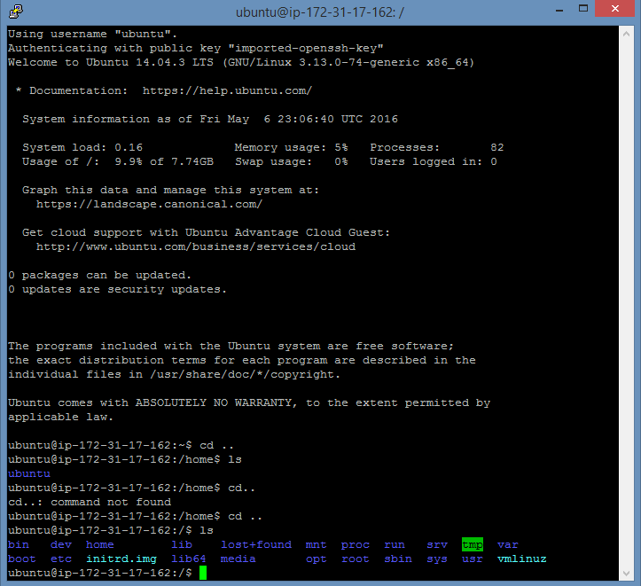
Putty Continued
Wait for a moment for connection to be made.
And COOL!
Continue on with my guides on installing apache, php, mysql, etc.

