Slide 1
Deploy a Virtual Server on Amazon Web Services
Tony Mei
Student Developer 2016

Slide 2
First things first
Sign up for a free trial of Amazon Web Service: https://aws.amazon.com
You will need an email address and credit card information. Don’t worry. You only get charged if free trial is all used.

Slide 3
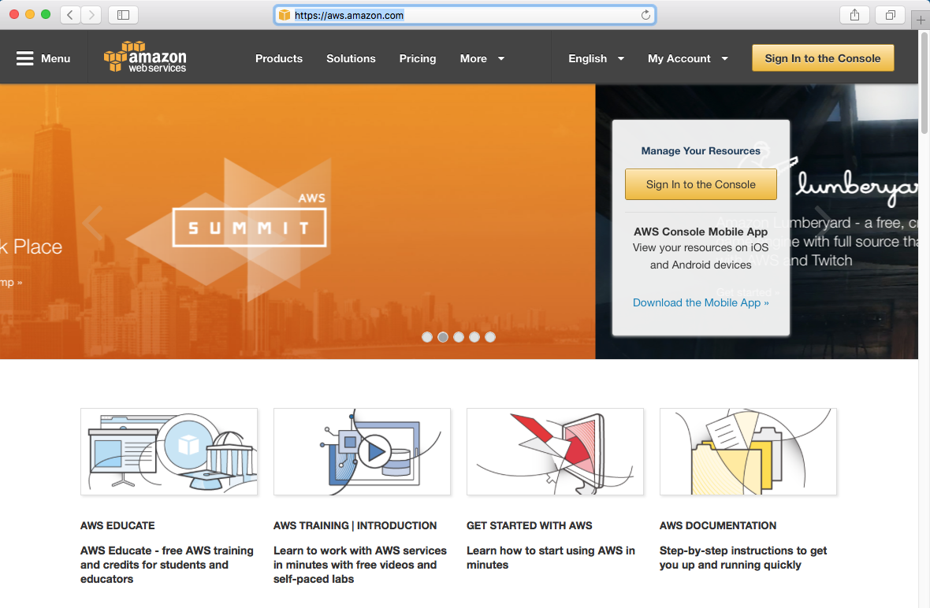

Slide 4
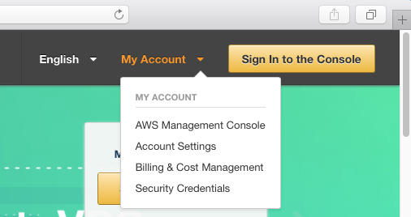
Dashboard
At the top, click My Account -> AWS Management Console.
You will be greeted with a dashboard of Amazon Web Services.

Slide 5
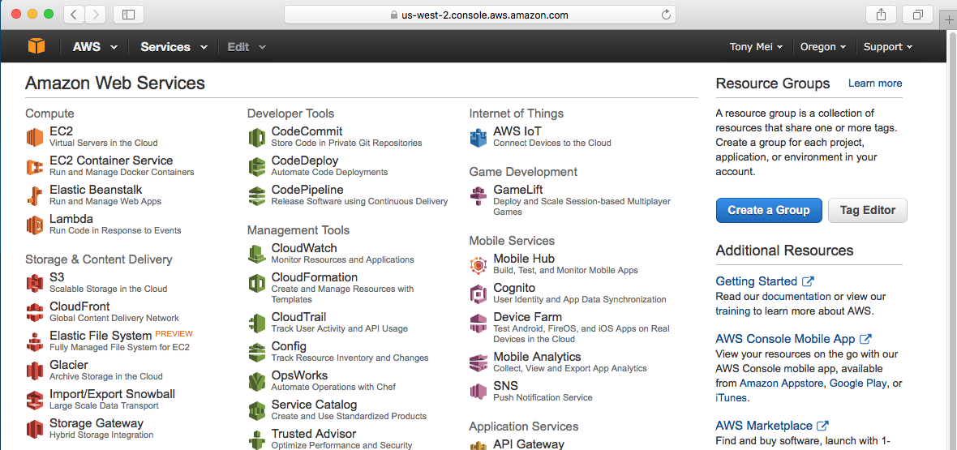
Be sure to change your location. I had it set to Oregon which is US West.
We will be using EC2 for simplicity. Click on EC2.

Slide 6
EC2 Dashboard
Once you click on EC2, you will be greeted with a dashboard.
At first glance, it will seem overwhelming, but we will go over only the configurations you need to deploy a web app.

Slide 7
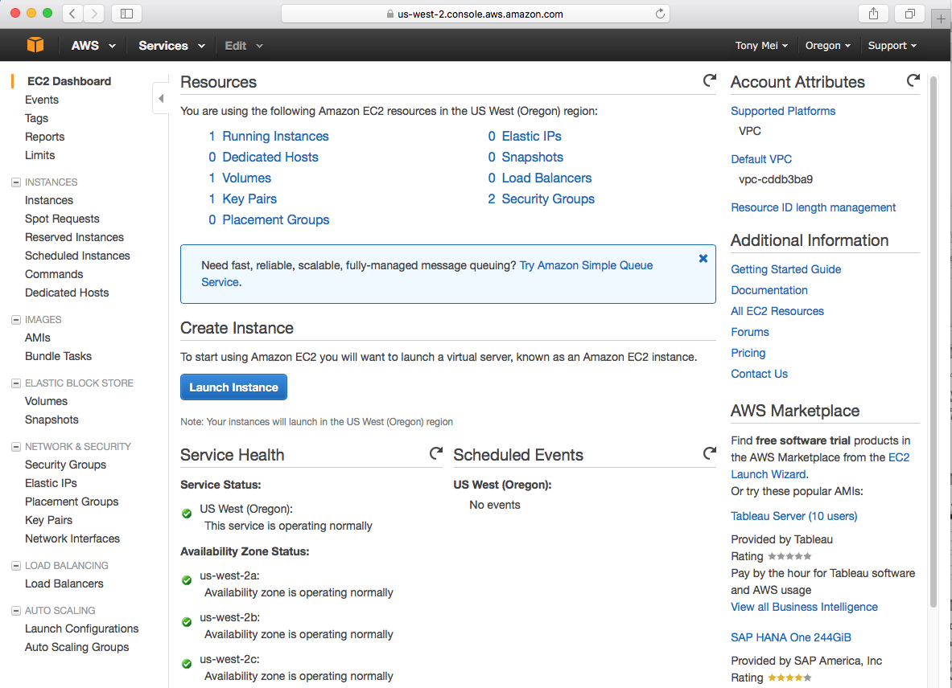

Slide 8
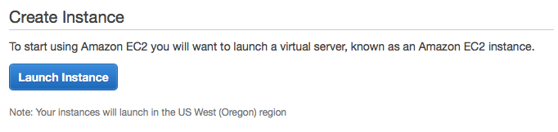
Right in the middle of the dashboard, and you will see this:
Click on Launch Instance. From my understanding, an Instance is a virtual server.

Slide 9
Step 1
Once you clicked on Launch Instance, you will be greeted at Step 1, which is choosing an Amazon Machine Image.
To make things simple, you choose what kind of Operating System you want on your virtual machine.
There are Windows Server and several Linux Distributions to choose from.

Slide 10
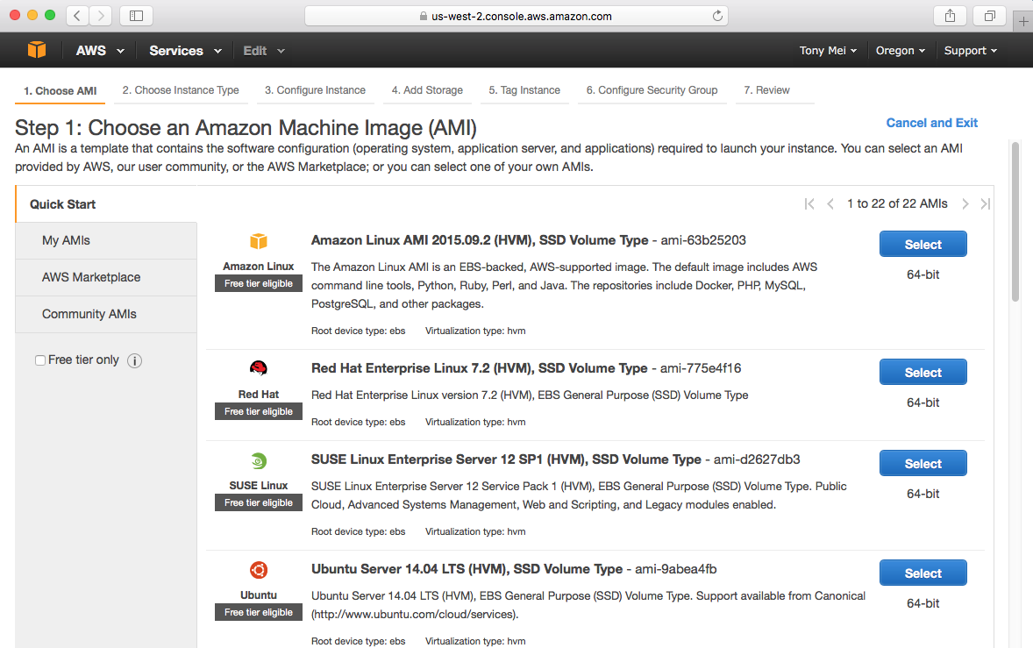
Keep in mind which are covered in the Free Trial!
We will be using Ubuntu Server 14.04.

Slide 11
Step 2
From my understanding, Step 2 allows you to specify the specs of the virtual machine you want.
You can choose what CPUs, how much memory, etc for your machine.

Slide 12
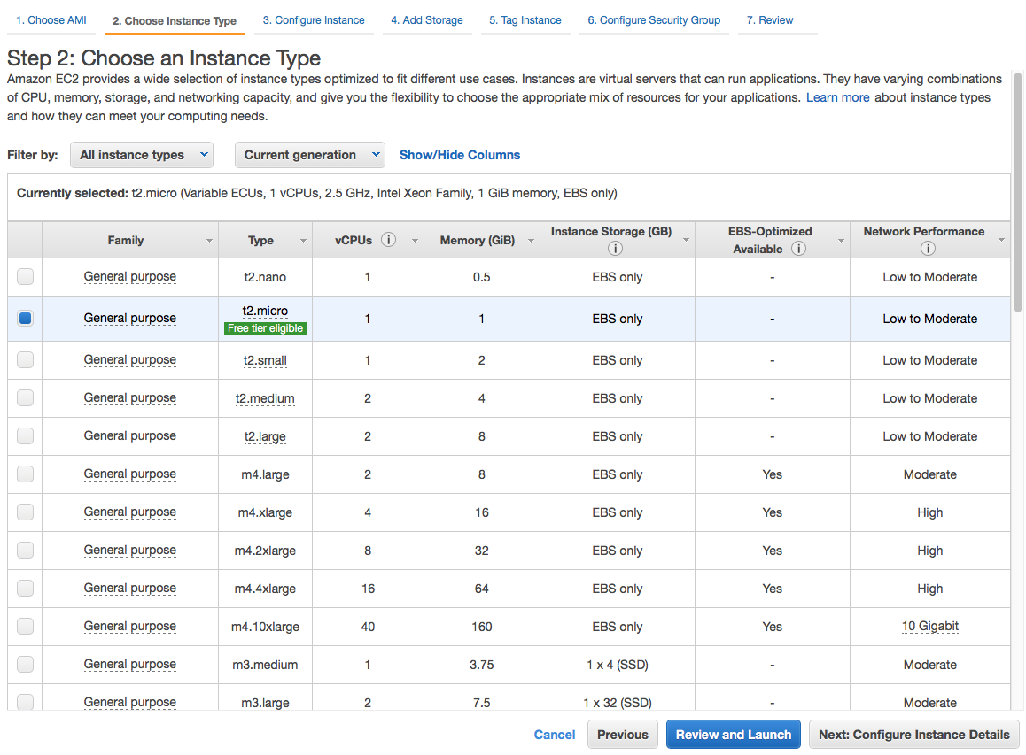
I will choose the Free tier eligible one.
Click here.

Slide 13
Step 3
Here you can set how many instances you want.
There are other settings you can change but for simplicity, I’ll leave it as is without any changes.

Slide 14
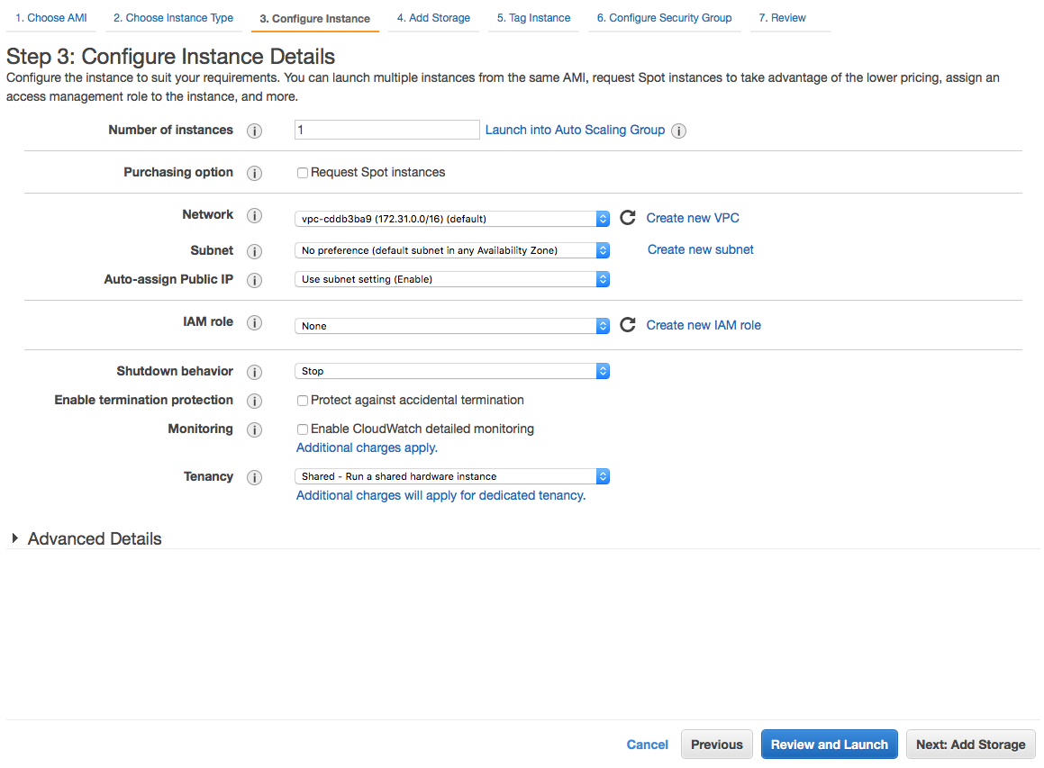
I didn’t change anything.
Click to Continue.

Slide 15
Step 4
Step 4 is Add Storage where you can, well, add more Storage.
You can add more storage memory to your virtual server, but keep in mind that there is a limit for Free Tier customers.

Slide 16
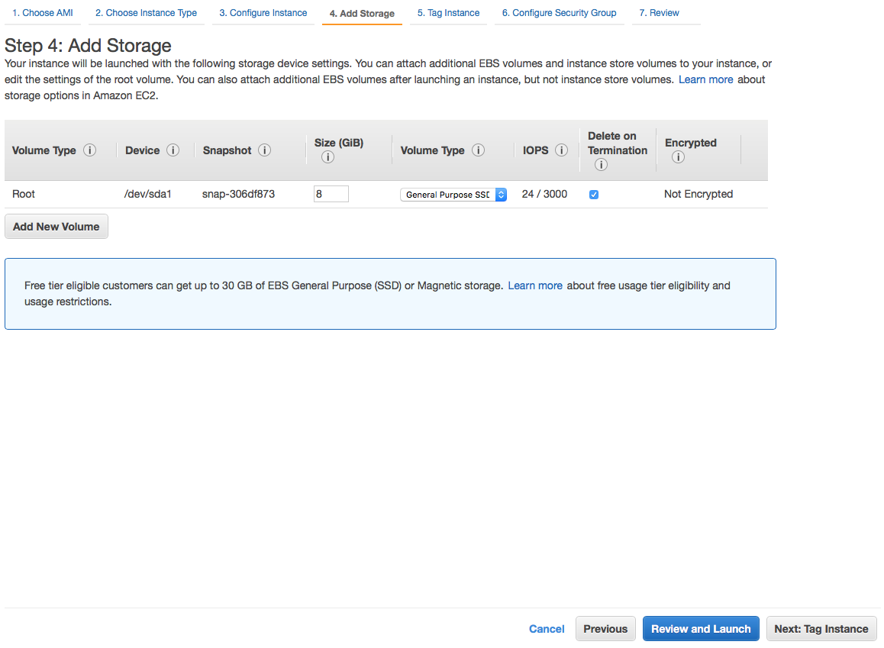
Again, I left it alone. Click here to continue.

Slide 17
Step 5
Step 5 is about tagging instances and resources. I don’t really need it so I left it alone and continue.

Slide 18
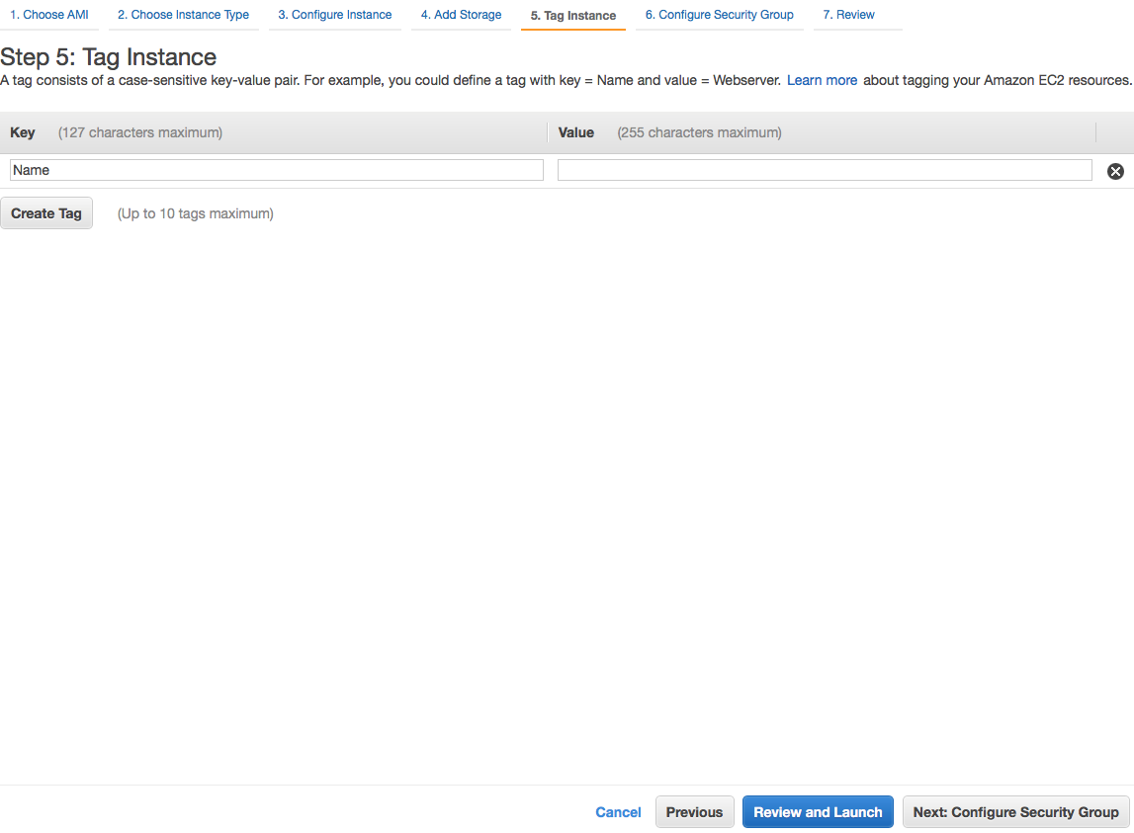
Click to continue.

Slide 19
Step 6
Here, we actually need to something.
We should create a new security group. Security group is essentially a set of rules that control the traffic for your instance.
You can allow or disallow SSH, POP3, DNS, etc on your virtual server.

Slide 20
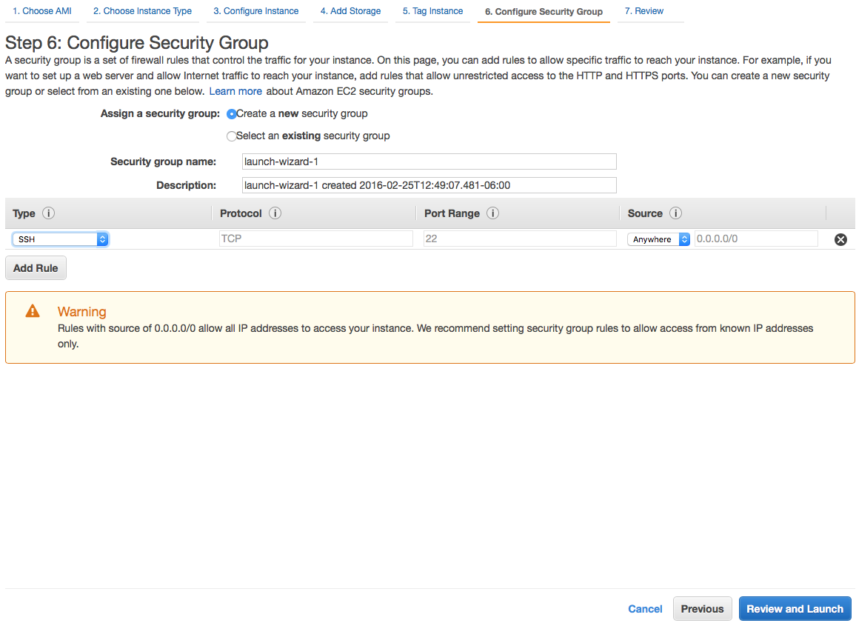
You can choose a name
We need to Add a New Rule. Click here.

Slide 21
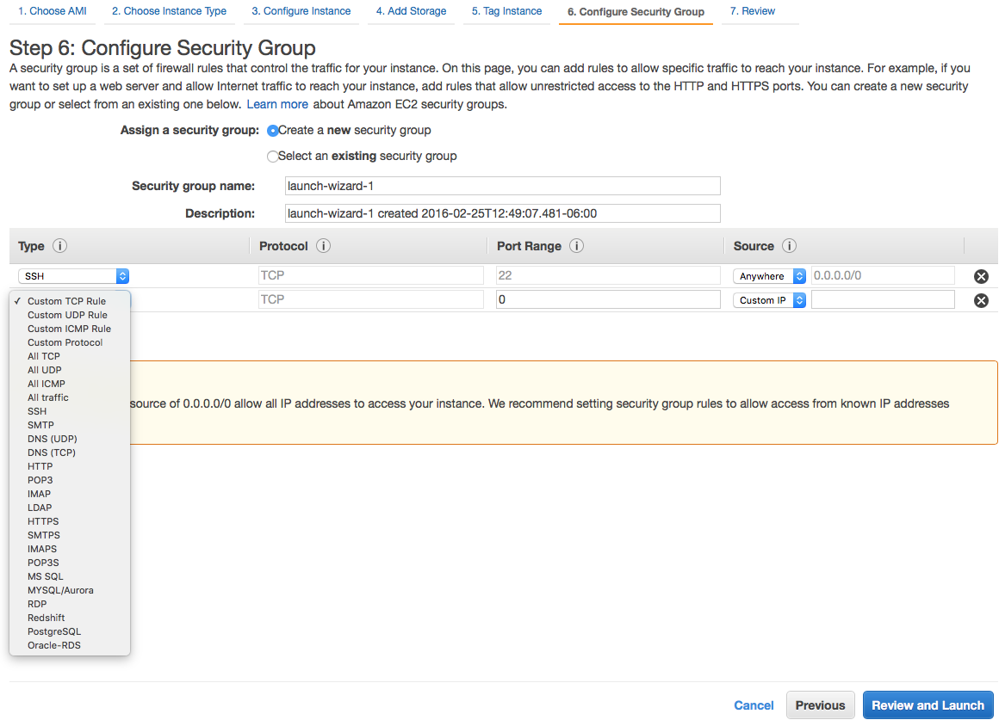
Because we deploying a web application, we need to add HTTP.
Click Here.

Slide 22
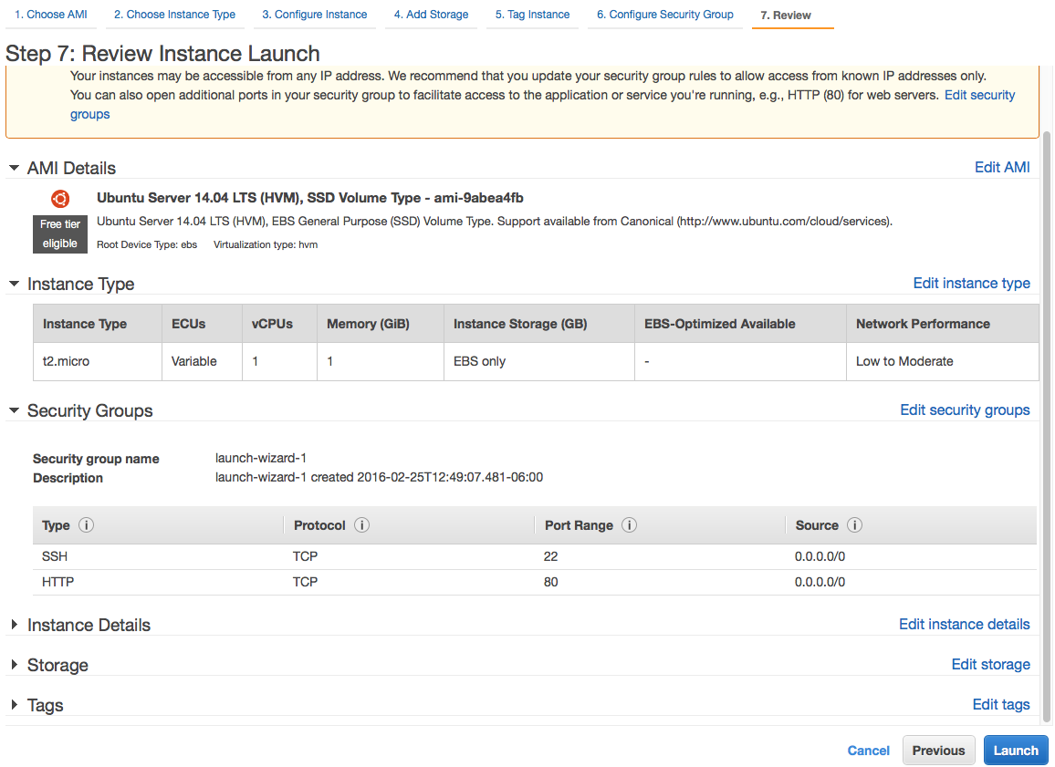
Step 7
Here, you can review your Instance and settings before launch.

Slide 23
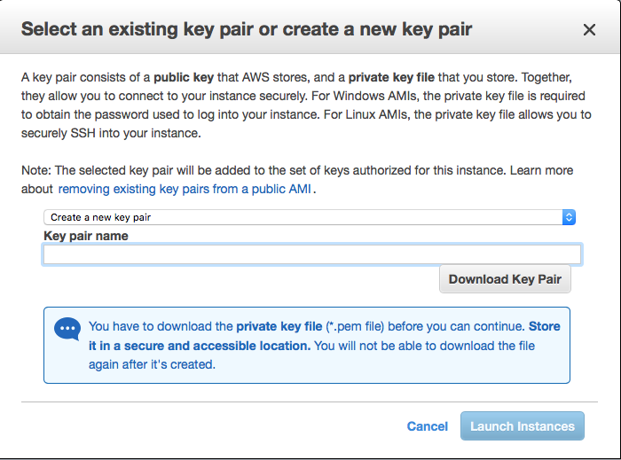
Here, you are greeting with this where you can create a key pair to connect to your instance or virtual machine.
Choose Create a new Key Pair and Choose the name of your key and download it. Once you downloaded it, you can launch the instance!

Slide 24
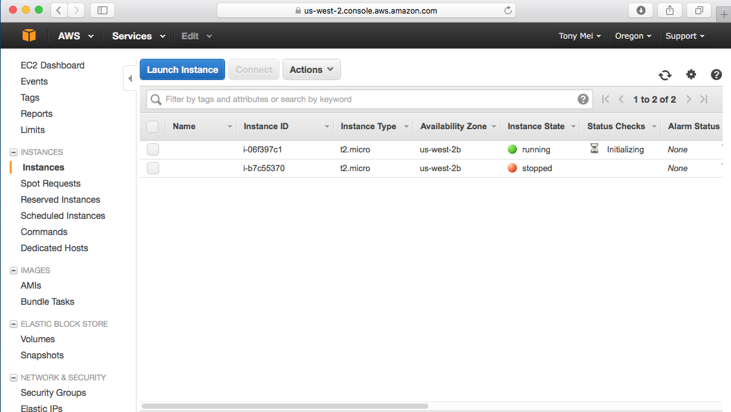
Ignore this one, this is an instance I created before the tutorial.
You will find your instance on the dashboard

Slide 25
SSH
We will be using SSH to connect to our Instance. This is where it gets complicated with many steps. I will try to make it as simple as possible.

Slide 26
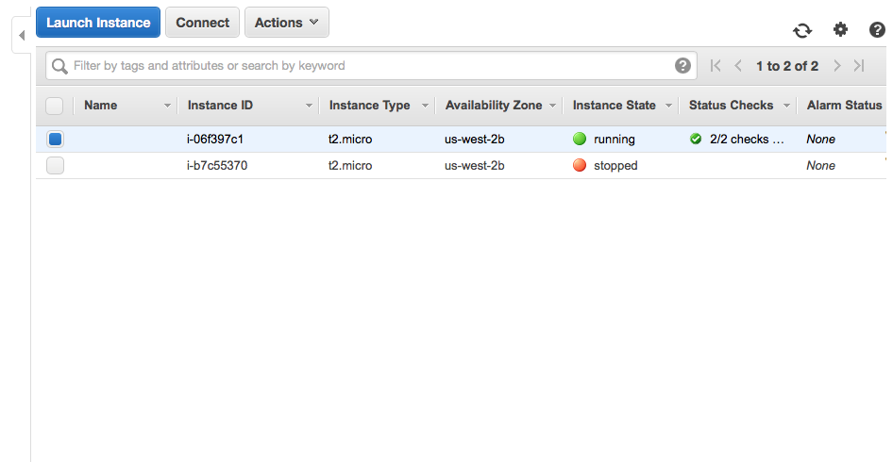
1. Click on your instance. You will see the blue dot.
2. Click on Connect.

Slide 27
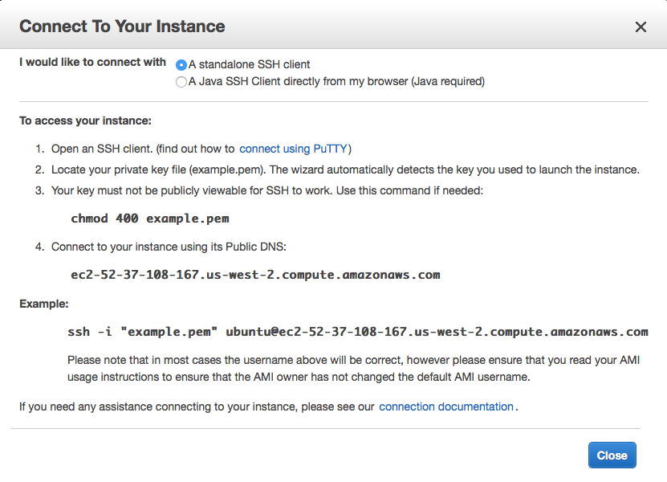
You will be greeted with specific instructions to connect to your instance. You will have
different instructions. If you are using Linux or Mac OS X, you will use terminal. If you are using
Windows, you will need to install PuTTY. For this tutorial, I am using a Mac.

Slide 28
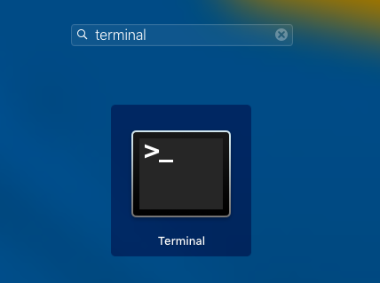
If you are using a Mac or Linux, search for Terminal.

Slide 29
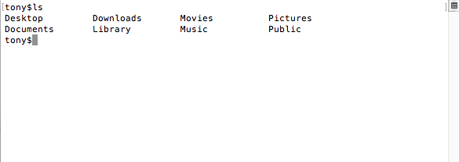
Terminal Commands
Here are some Terminal Commands you commonly use:
First is ls which shows all the files and folders on your current directory. ls, Enter/Return.

Slide 30
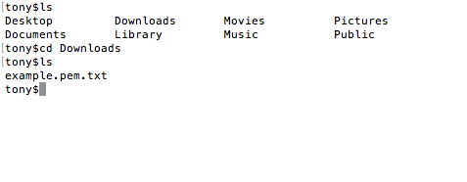
Terminal Commands
Next is cd. It changes your directory. Before, we downloaded the key. The key is in my downloads folder so cd Downloads to get in.
Note that for every command, you have to press enter/return to submit it.

Slide 31
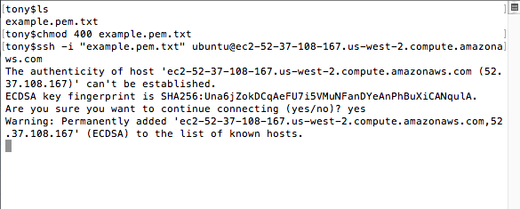
1
2
3
1. Note that example.pem.txt is the name of the key.
2 Chmod command makes the key not publicly viewable for security reasons.
3. ssh –i “name of your key” ubuntu@public DNS

Slide 32
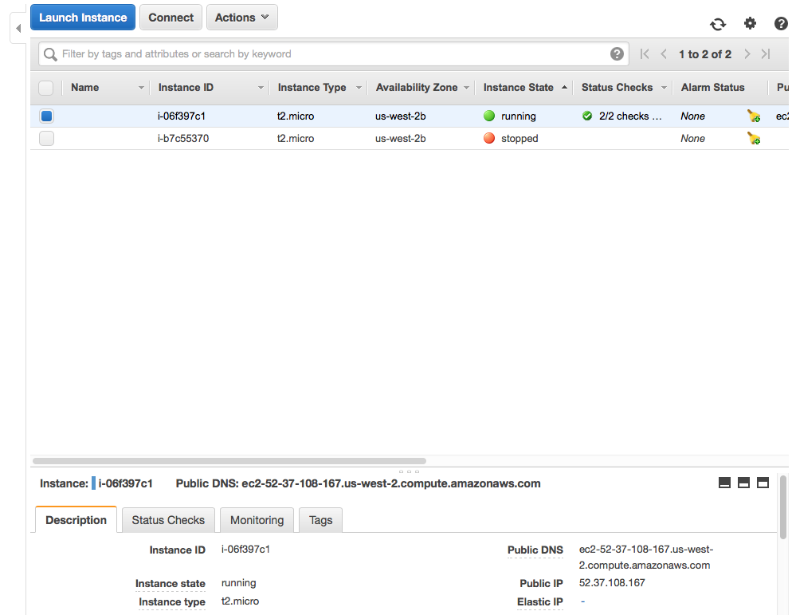
You can also find Public DNS here:

Slide 33
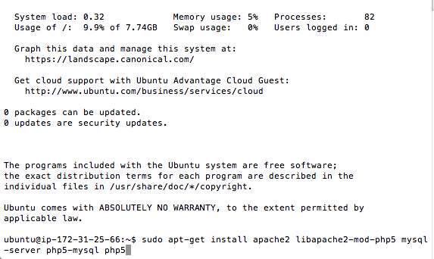
Step 1
Step 1 is to install a bunch of stuff to the virtual machine: Apache2, php5, my-sql.
Type this:

Slide 34
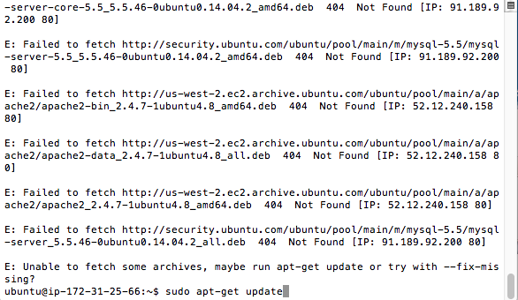
Step 2
Once you install. Update.
Type this

Slide 35
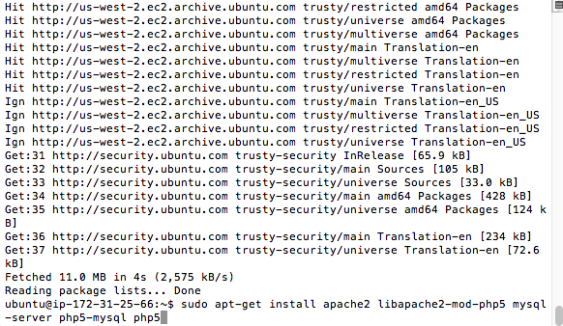
Step 3
Try installing the stuff again to make sure everything is up to date.

Slide 36
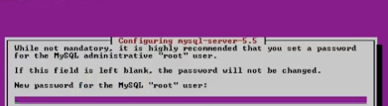
Step 4
Step 4 is setting password for mysql.

Slide 37
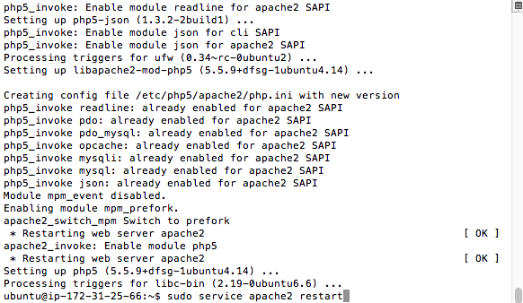
Step 5
Refresh apache server.

Slide 38
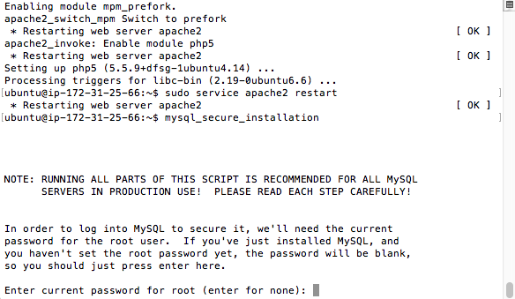
Step 6
Do mysql installation. And Enter the same password you set in Step 4. Choose
Type this.
Enter.

Slide 39
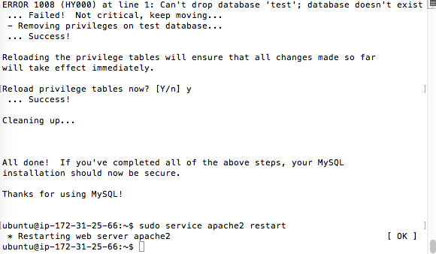
Step 7
You will be prompted with a bunch of questions, I answered Yes to all of them. Restart apache again.

Slide 40
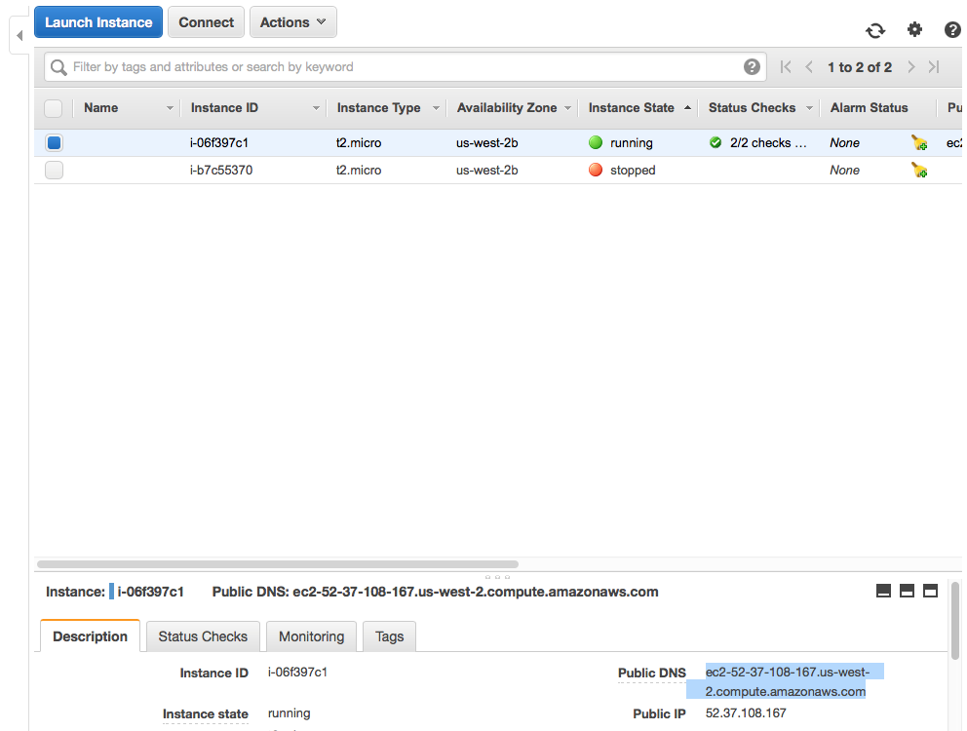
Step 8
Check to see if virtual server works.
Copy the Public DNS and paste it to a Web Browser

Slide 41
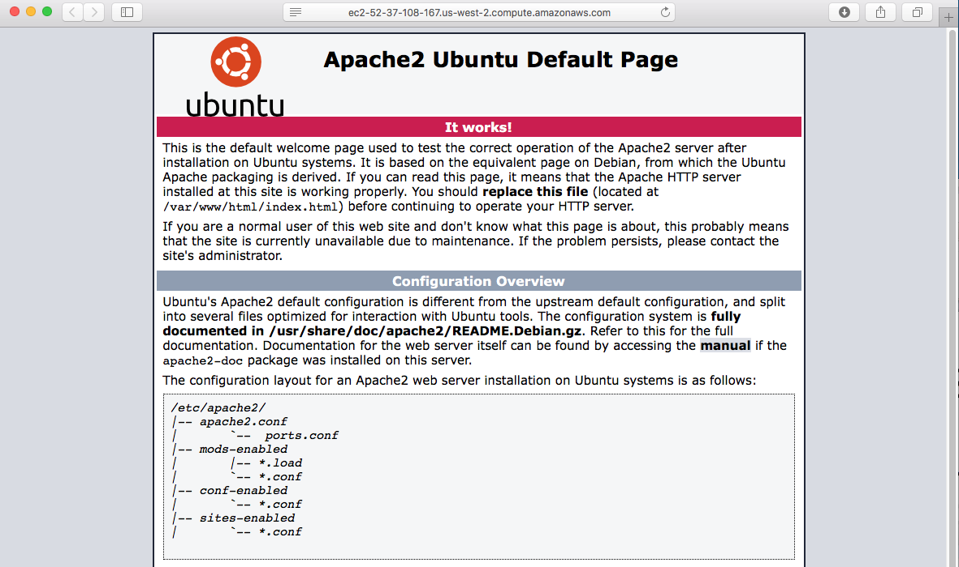
Congrats! Virtual Server Works!

Slide 42
More information
I based of this tutorial from a video here. Check it out: https://www.youtube.com/watch?v=wNr7YqjjzOY

Slide 43
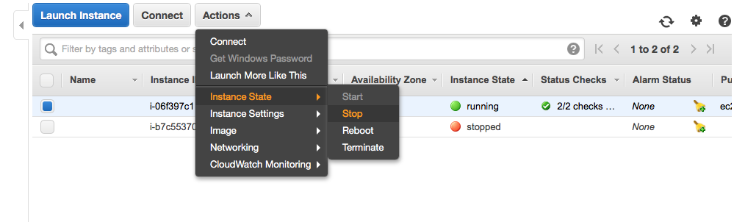
Stopping Instances
AWS is Pay as you go meaning you pay for the service you get. If you want to stop the instance to save money or save hours on the Free Trial. Do this:
I will be stopping the instance. Please note that whenever you stop and start an instance again, the public DNS will change! And you will have to SSH with a different public DNS.

