Slide 1
Deploying Guide on the Side on Amazon Web Service
Tony Mei
Student Developer 2016

Slide 2
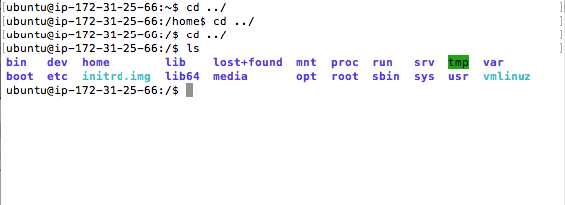
Step 1
Assuming you are already connected to your virtual server via ssh, we configure apache.
Use cd ../ command to go back in directories and use ls to make sure yours look like this:

Slide 3
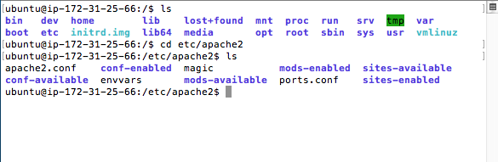
Step 1 continued
cd etc/apache2 to navigate to here:

Slide 4
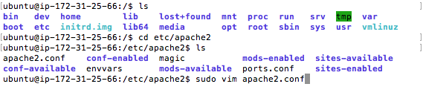
Step 1 continued
Open apache2.conf file by command: sudo vim apache2.conf

Slide 5
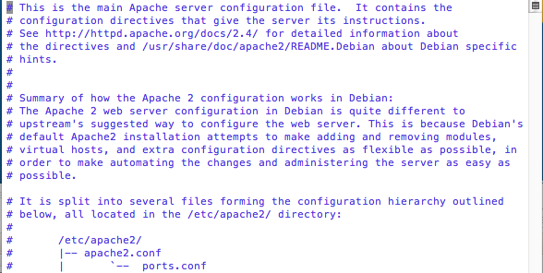
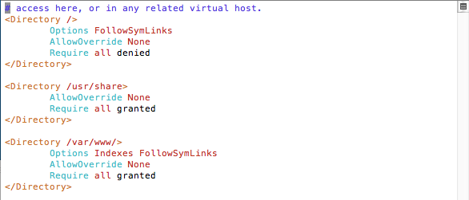
Step 1 continued
You will be greeted with the contents of the file.
Scroll down until you see this

Slide 6
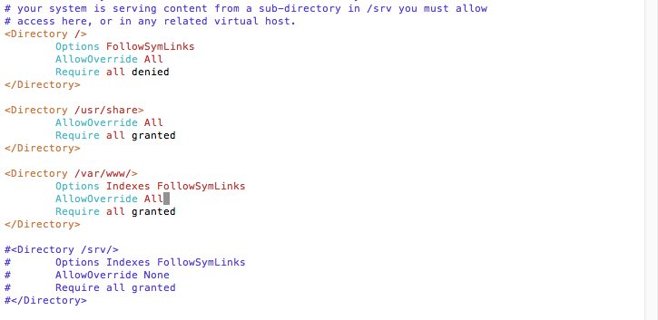
Step 1 continued
Select a place. Insert/edit text by option i on Mac, then press s.
Change it so it would look like this:

Slide 7
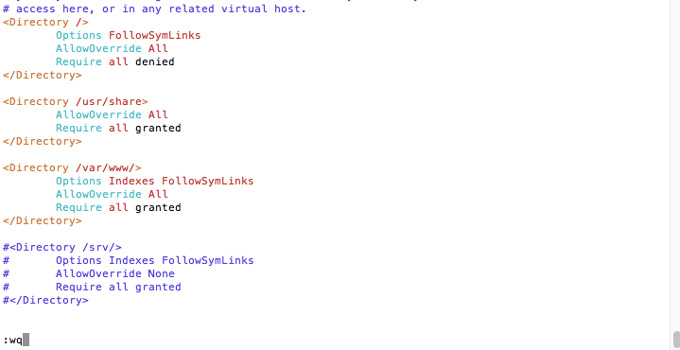
Step 1 continued
Press Escape to exit Insert. Then type in :wp and enter it to save and exit.

Slide 8
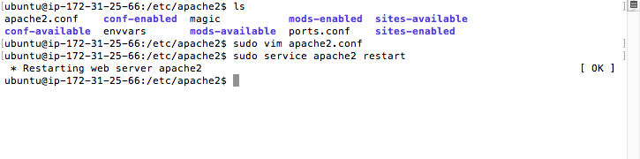
Step 1 continued
Restart apache server with the command: sudo service apache2 restart

Slide 9
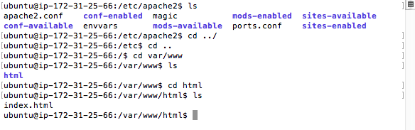
Step 2
Step 2 is download Guide on the Side
Navigate to var/www/html

Slide 10
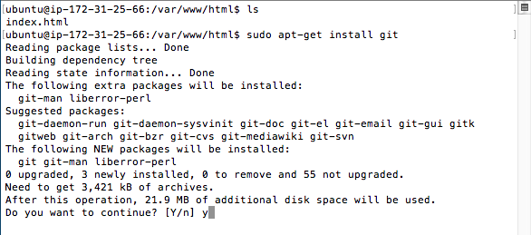
Step 2 continued
Cloning requires updating git
Do command: sudo apt-get install git

Slide 11
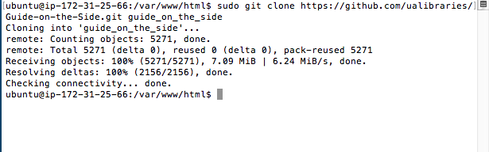
Step 2 continued
Clone guide on the side with the command:
sudo git clone https://github.com/ualibraries/Guide-on-the-Side.git guide_on_the_side

Slide 12
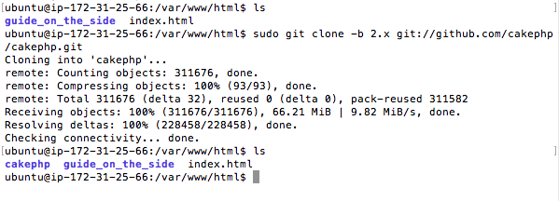
Step 2 continued
Install CakePHP:
sudo git clone -b 2.x git://github.com/cakephp/cakephp.git
Your /var/www/html should have these.

Slide 13
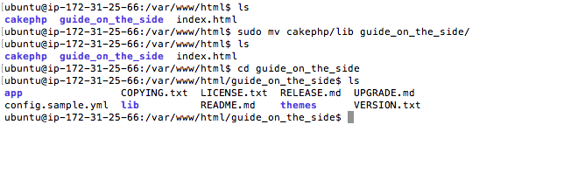
Step 2 continued
Put cakephp into Guide on the side:
sudo mv cakephp/app/Lib guide_on_the_side/
You should see a lib folder in guide_on_the_side.

Slide 14
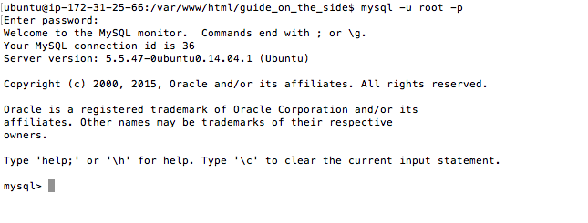
Step 3
Configure MySQL
Log in to MySQL: mysql –u root –p

Slide 15
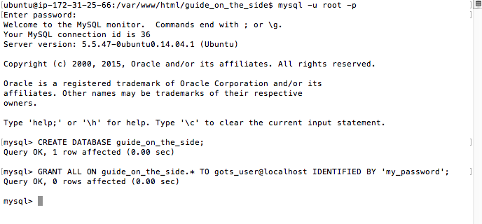
Step 3 continued
Create a MySQL database and create MySQL user and password:
gots_user is name. my_password is password. You can choose whatever name or password but you need it later.

Slide 16
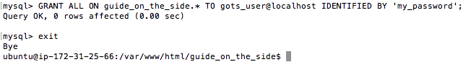
Step 3 continued
Exit mysql

Slide 17
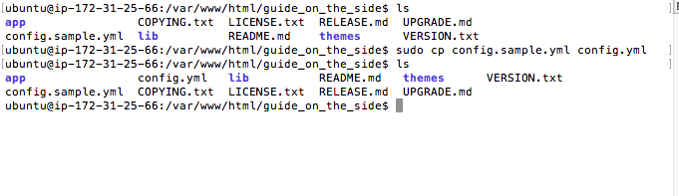
Step 4
Step 4 is configuring a file. Copy config.sample.yml to config.yml
Command: sudo cp config.sample.yml config.yml
You should have config.yml in your guide on the side folder

Slide 18
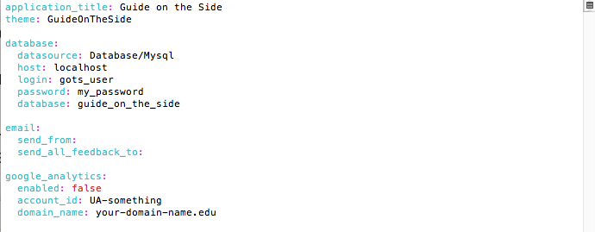
Step 4 continued
Open and edit config.yml by sudo vim config.yml
Fill in login and password and database.

Slide 19
Step 5
Step 5 is Install database schema and samples
Navigate to guide_on_the_side/app
Enter sudo ../lib/Cake/Console/cake Migrations.migration run all --plugin Tags

Slide 20
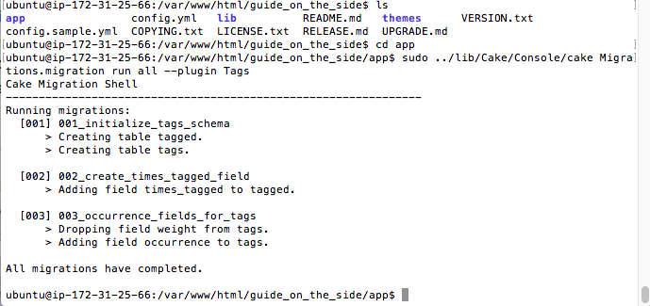

Slide 21
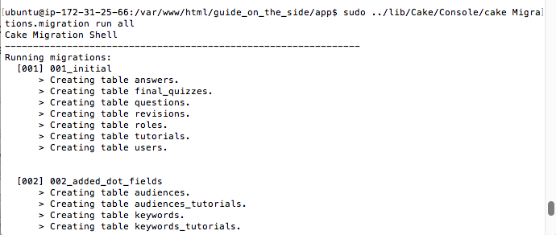
Step 5 continued
Next command: sudo ../lib/Cake/Console/cake Migrations.migration run all

Slide 22
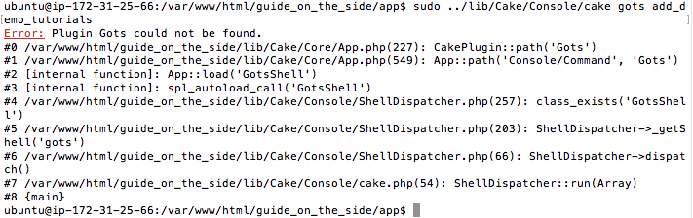
Step 5 continued
Next command: sudo ../lib/Cake/Console/cake gots add_demo_tutorials

Slide 23
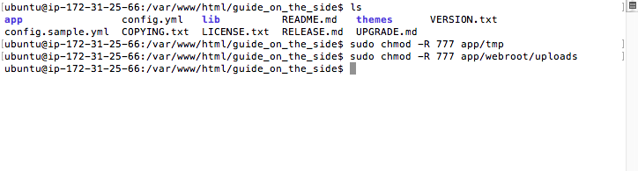
Step 6
We need to change permissions. Navigate back to the guide_on_the_side directory.
sudo chmod -R 777 app/tmp
sudo chmod -R 777 app/webroot/uploads

Slide 24
Step 7
Step 7 is something I found out that’s not covered in the Guide on the side tutorials.
http://www.jarrodoberto.com/articles/2011/11/enabling-mod-rewrite-on-ubuntu
What this does is it disables directory listings of files when you view the page.
All I did was this command: sudo a2enmod rewrite

Slide 25
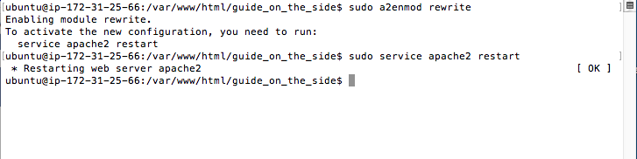
Step 7 continued
sudo a2enmod rewrite
sudo service apache2 restart

Slide 26
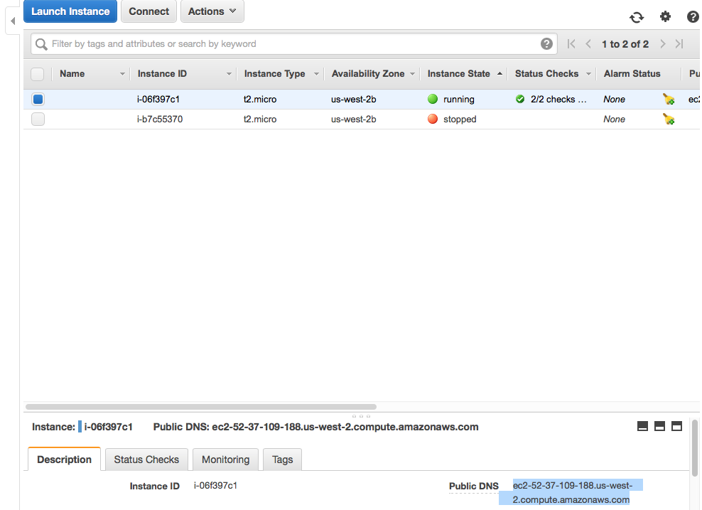
Step 8
Get the public DNS of your virtual server.

Slide 27
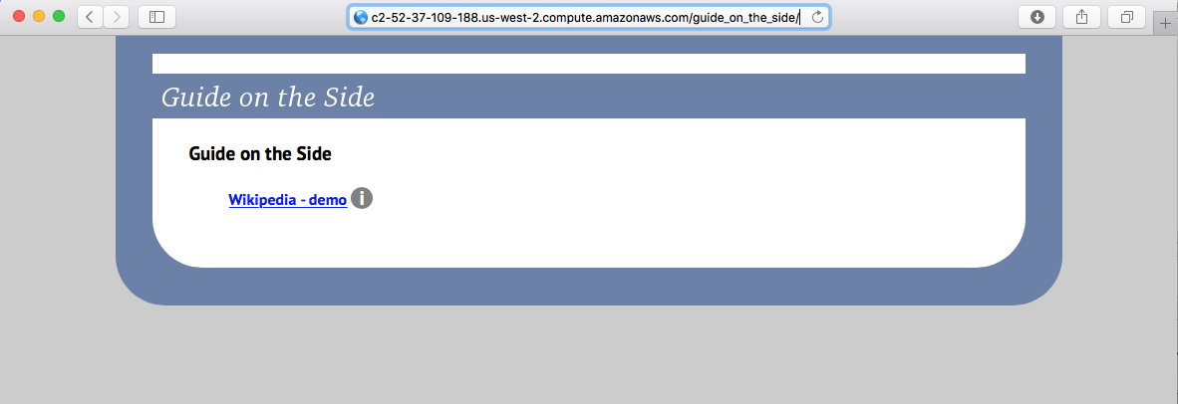
Step 8 continued
PublicDNS/guide_on_the_side into web browser.
If you see Guide on the Side, congrats!

Slide 28
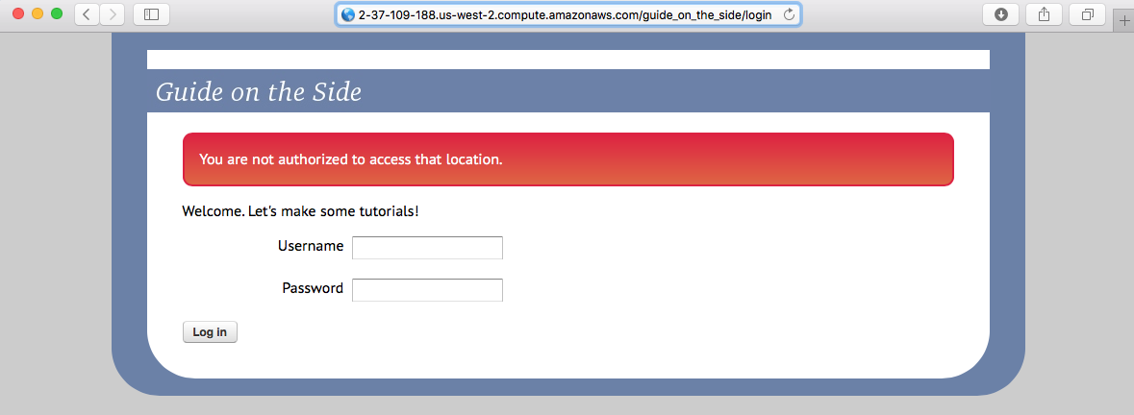
Step 8 continued
PublicDNS/guide_on_the_side/admin or login to access/edit/add tutorials!
The default username: admin
Password: GuideOnTheSideAdmin#1

Slide 29
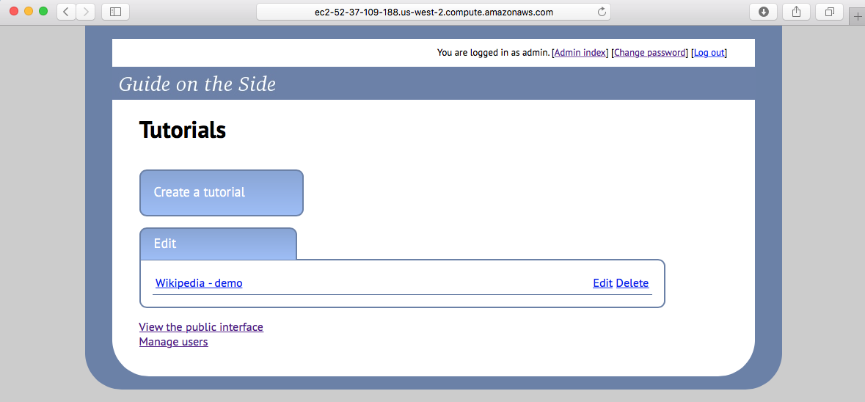
Here you can manage users. You can add more users and you can change password.

Slide 30
More information
This guide was based off from here: https://github.com/ualibraries/Guide-on-the-Side/blob/master/README.md#about
Keep in mind, I made several adjustments in this guide that’s different to accommodate for Amazon Web Services and ease of use.
I haven’t covered security here. I’ll leave that up to you.

