Slide 1
Virtual Server Security Guide Version 2
Tony Mei
Student Developer 2016

Slide 2
Intro
In this guide, I will be covering security, specifically Apache Server on Ubuntu OS.
I have tested the various security configurations so that they won’t have an impact on Guide on the Side’s functionality.

Slide 3
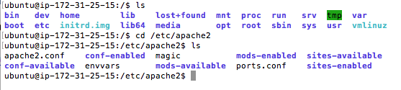
Apache2.config
Once you SSH to your virtual server, go to /etc/apache2/
You will see apache2.conf, where you can configure apache server.

Slide 4
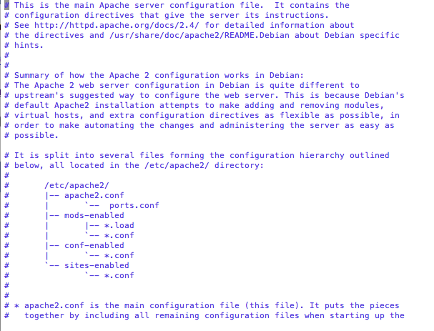
Apache2.config
Open the file. I did sudo vim apache2.conf

Slide 5
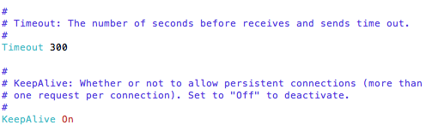
Denial of Service
Denial of Service is an attack to flood traffic of the server causing it to be unavailable.
We can mitigate the effects of DOS by lowering the timeout value. Scroll down to timeout in apache.conf:

Slide 6
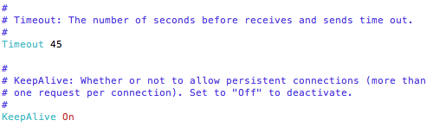
Denial of Service
By default, it is a rather high number. We want to make it lower. I made it 45, but it’s up to you.
Use option i on Mac or Insert on Windows to edit text.

Slide 7
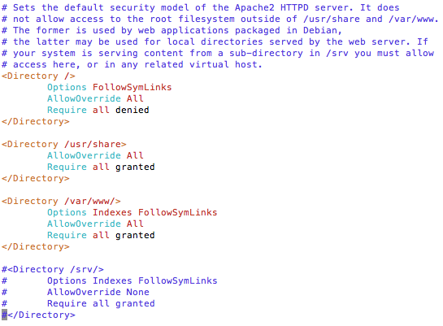
Denial of Service
Another thing we should do is limit request size. Apache server has no limit of the size of a HTTP request by default. We need to limit that in order prevent DOS attacks. Scroll to the section with Directories:

Slide 8
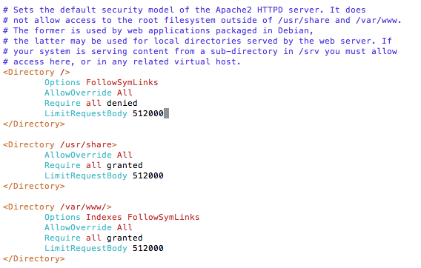
Denial of Service
Add a request size limit using LimitRequestBody. I put a limit of 500k:

Slide 9
Denial of Service
Other things to look at and configure:
MaxClients (Default: 256)
KeepAliveTimeout (Default: 5 (secs))
LimitRequestFields (Default: 100)
LimitRequestFieldSize (Default: In bytes)
You would add them between the Directory tags, similar to how you did on the previous slide.

Slide 10
Denial of Service
Once you are done, press escape to escape insert mode, type :wq to save and quit out of the apache2.conf file.
Type sudo service apache2 restart to restart the server and make your changes.
Always test your web application to see if any functionality is not working.

Slide 11
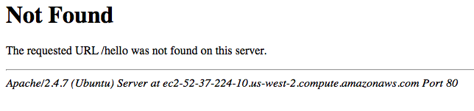
Privacy
We need to keep some information private.
First, we need to hide Apache Version and Operating System as shown below like Ubuntu. Less knowledge for attackers, the better.

Slide 12
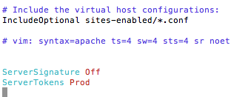
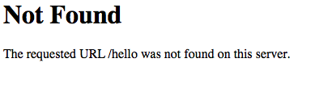
Privacy
Go back to apache2.conf. Add these to the file. I added them at the end of the file, but up to you:
ServerSignature Off
ServerTokens Prod
Save, quit, restart apache server, and it works:

Slide 13
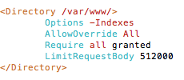
Privacy
We need to disable directory listing. We don’t want people to see our server and web application files and config files.
Set Options to either None or –Indexes:
You might want to set it to more directories other than /var/www/.

Slide 14

Privacy
We need to disable Trace HTTP Request. Trace allows for Cross Site Tracing Issue and might give a hacker access to your cookie information.
Add TraceEnable Off to apache2.conf file:

Slide 15
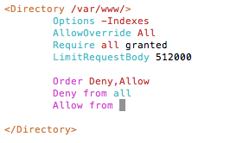
Privacy
You can restrict access to a specific network or IP. You can do this between a directory tag or others:
Order Deny, Allow followed by Deny from all and Allow from a specific IP address or network.

Slide 16
Privacy
We need to disable server side includes or SSI because it can display information to others.
We also need to disable CGI, because CGI allows Apache server to interact with external programs. We don’t want nor need it.
Continue on the next slide to disable those…....

Slide 17
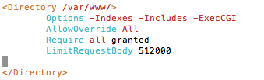
Privacy
Turn off server side includes or SSI: Options: -Includes
Turn off CGI execution: Options: -ExecCGI
Be sure to restart apache2 to see the changes you made to apache2.conf.
Adding Options: -FollowSymLinks will make Guide on the side not work. But for other web applications, you can to improve security, but be sure to test it.

Slide 18

Privacy
Etag allows attackers to get information like inode number, childprocess and other information in the Etag header.
Turn Etag off by adding: FileETag None to apache2.conf file.
Restart apache.

Slide 19
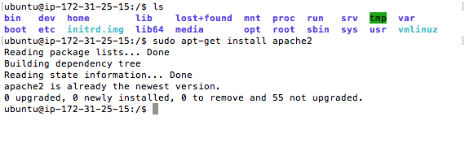
Update
Next, we will cover how to update. Exit out of apache2.conf file.
Regularly check for Apache Security Updates:
sudo apt-get install apache2

Slide 20
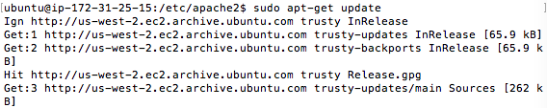
Update
Other than the Apache server, you should also update the OS and other files:
sudo apt-get update

Slide 21
Conclusion
I covered some of the main, common security configurations for Apache server.
There are many more configurations. Be sure to check these sites which covers the configurations in this guide and more:
http://www.petefreitag.com/item/505.cfm
https://geekflare.com/10-best-practices-to-secure-and-harden-your-apache-web-server/
https://geekflare.com/apache-web-server-hardening-security/
http://www.tecmint.com/apache-security-tips/
http://www.thegeekstuff.com/2011/03/apache-hardening/
https://www.rosehosting.com/blog/7-basic-tips-to-improve-apache-security/
https://www.maketecheasier.com/securing-apache-ubuntu/
http://www.cyberciti.biz/tips/php-security-best-practices-tutorial.html

Slide 22
Conclusion
Information about Amazon Web Services Security: https://aws.amazon.com/security/

