Slide 1
Group 4
2021/03/09

Slide 2
Outline
Example of Real Life Process (汪宸宇)
Does Code Decay? (李紹銘, 陳熙)
Term Project Proposal
Web Framework Survey
React.js
Flask
Fast API
Spring Cloud
Company Visit
Candidates of IT Company Survey

Slide 3
Example of Real Life Processes: Driver’s Process
1. check that there's no car apporaching from behind
2. open the door and get into the car
3. adjust the seat (move forward or backward in your confort)
4. buckle up
5. adjust rear mirrors
6. ignite the engine (hit the brake at the meantime)
7. release your handbrake, shift the gears, and hit the road

Slide 4
Does Code Decay? Assessing the
Evidance from Change Management Data
李紹銘, 陳熙

Slide 5
Causes, Risk factors
Process
Management Data
Code Decay
Change
on software
More Difficult ( Response )
Symptoms
Is real ? … The Evidences
Can be characterized ? … Medical Metaphor
Can be measurement ? … Code Decay Indexs
Environments change
Required functionality
Predictive CDI

Slide 6
Code Decay
Three Key Responses
Cost of the Change (Effort)
Interval to Complete the Change
Quality of the changed software
Code can be correct and decayed
Software that is decaying may nevertheless be increasing in value
A region of the code can decay as the result of changes elsewhere is entirely possible
“Code is Decayed if it is more difficult to change than it should be”

Slide 7
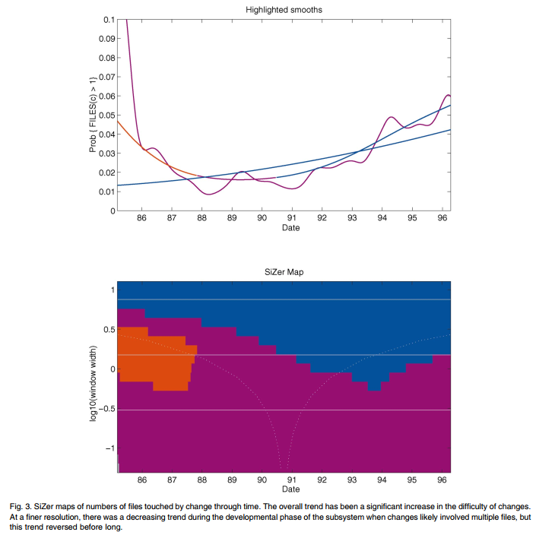
The Evidence for Decay
Temporal Behavior of the Span of Changes
The number of files touched per change to the code is increasing.
Notes:
The number of files touched per change to the code is increasing.

Slide 8
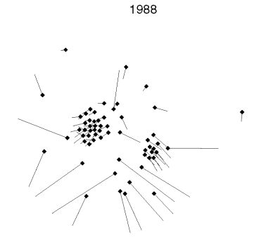
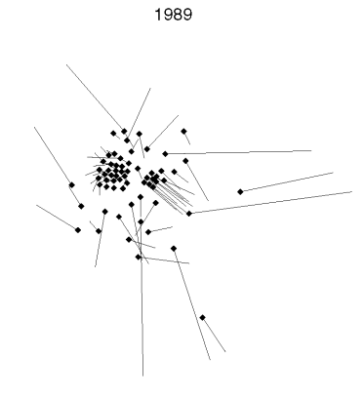
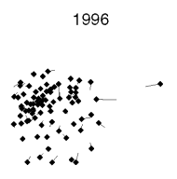
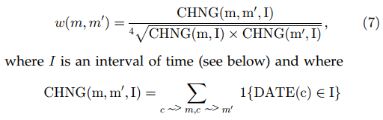
The Evidence for Decay
Time Behavior of Modularity

Slide 9


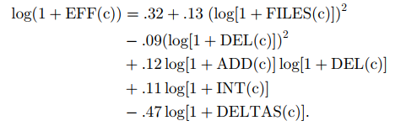
The Evidence for Decay
Prediction of Faults
Models for Effort
span of change

Slide 10
Term Project Topic

Slide 11
Proposal
量化交易平台

Slide 12
Framework Introduction
Frontend

Slide 13

React
An front end, JavaScript framework for building UI or UI components
React code is made of entities called components.
Independent ,reusable pieces
support OOP
A notable feature is the use of a virtual DOM.
An efficient algorithm then determines the changes made to the virtual DOM to identify the changes that need to be made to the real DOM.

Slide 14
Framework Introduction
Backend

Slide 15

Python Flask
Features
microframework:
no database abstraction layer, no default admin site, only what you need
lightweight, easy to use and setup
very flexible, a good choice for building product prototype
various extensions avaliable:
flask-markdown for markdown rendering
flask-SocketIO for websocket
flask-sqlalchemy for database abstraction
development server and debugger:
automatically detect change in code and restart accordingly

Slide 16
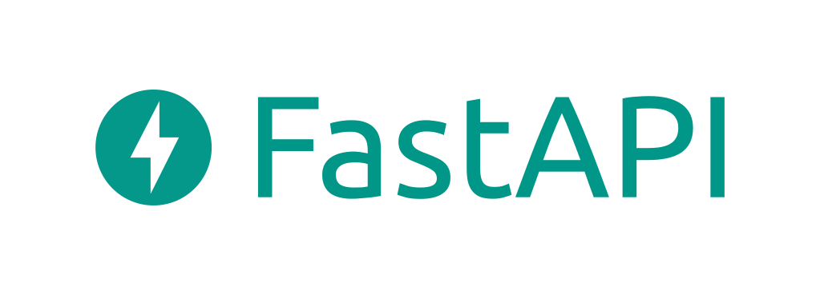
Fast API
Features
Fast: Very high performance, on par with NodeJS and Go. One of the fastest Python frameworks available.
https://www.techempower.com/benchmarks/#section=data-r20&hw=ph&test=query&l=zijzen-sf&a=2
https://www.techempower.com/benchmarks/#section=data-r20&hw=ph&test=query&a=2
Fast to code: Increase the speed to develop features by about 200% to 300%.
Fewer bugs: Reduce about 40% of human (developer) induced errors.
Easy: Designed to be easy to use and learn. Less time reading docs.
Short: Minimize code duplication. Multiple features from each parameter declaration.
Documentation: With automatic interactive documentation
Standards-based: Based on the open standards: OpenAPI and JSON Schema

Slide 17
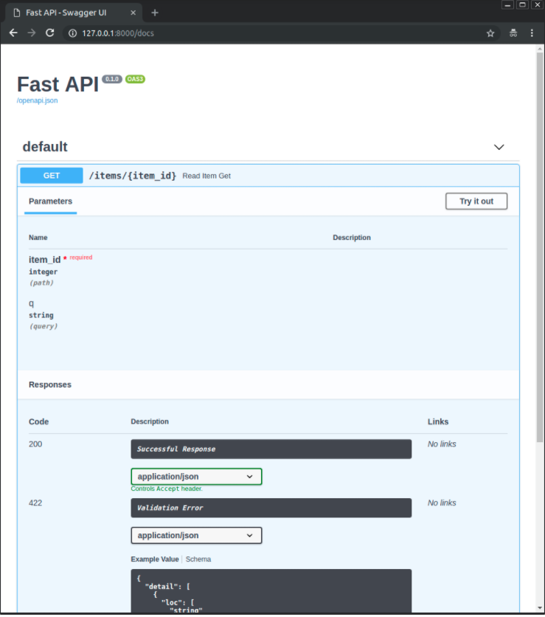
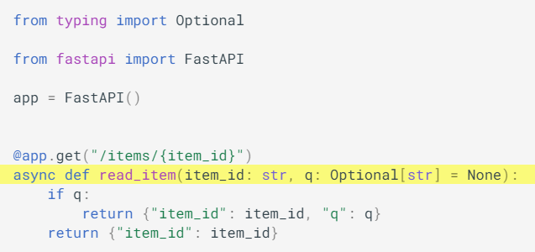
Fast API

Slide 18

Spring Cloud
Provides tools for developers to quickly build some of the common patterns in distributed systems
configuration management, service discovery, circuit breakers, intelligent routing, micro-proxy, control bus, one-time tokens, global locks, leadership election, distributed sessions, cluster state
Features
Distributed/versioned configuration
Service registration and discovery
Routing
Service-to-service calls
Load balancing
Circuit Breakers
Global locks
Leadership election and cluster state
Distributed messaging

Slide 19
Company Visit

Slide 20
Candidate List
Kronos Research
一家加密貨幣交易公司，前陣子實習、正職一直開，也積極找人才，有到 EECS 開過徵才，企業文化看起來活潑，算是小型公司，應該比較容易接受訪談
microsoft
跨國的大型企業，覺得此種企業內部的流程應該很嚴謹且講究效率，所以想去了解
cubist systematic
appier
因為AI現在很紅，但不太確定主要提供AI服務的軟體公司是如何開發產品的，所以想去了解。

Slide 21
Candidates of IT Company Survey

Slide 22
Tesla
對自駕車有興趣
Elon Musk最近很有影響力，且他的很多想法也很前瞻，所以想多了解他的公司是怎麼運作的
Netflix
American over-the-top content platform and production company
It was reported in 2020 that Netflix's operating income is $1.2 billion.

