Slide 1
Term Project Presentation
presenter : 鄒咏霖
Quantitative Trading Platform
Group 4
鄒咏霖・侯思岑・李辰暘・陳熙・李紹銘・汪宸宇

Slide 2
Outline
Work Distribution
PEP
WBS
Requirement Analysis
System Architecture
Use Case Diagram
Use Case Spec.
Class Diagram
Class Breakdown (Implementation)
Backend
Frontend
Sequence Diagram
API
Jenkins Setup
Demo

Slide 3
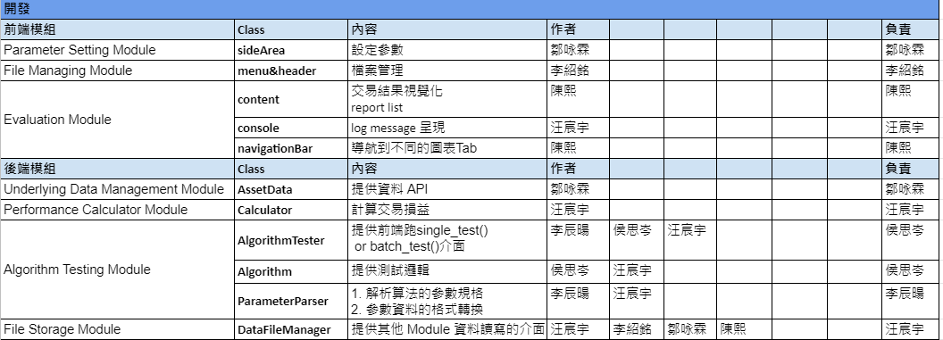
Work Distribution

Slide 4
PEP

Slide 5
PEP
Frontend framework : React.js
Backend framework : Flask
Version control tool : GitLab
DevOps tool : Jenkins
Training Plan：
訓練項目 | 參與人員 | 訓練方式 | 訓練時間
量化交易相關知識 | 鄒咏霖、陳熙、李紹銘、侯思岑、李辰暘 | 由組員汪宸宇向其他組員講解基礎知識 | 2021/3/9 ~ 2021/5/4
DevOps tool - Jenkins 用法 | 全體 | 閱讀線上相關document | 2021/3/9 ~ 2021/3/16
Web frontend framework - React.js 用法 | 鄒咏霖、汪宸宇、陳熙、李紹銘 | 閱讀線上相關的document 由組員李紹銘向其他組員講解用法 互相交流不懂的地方 | 2021/5/4 ~ 2021/5/25
Web backend framework - Flask 用法 | 侯思岑、李辰暘 | 由組員汪宸宇向其他組員講解用法 閱讀線上相關document | 2021/5/4 ~ 2021/5/25

Slide 6
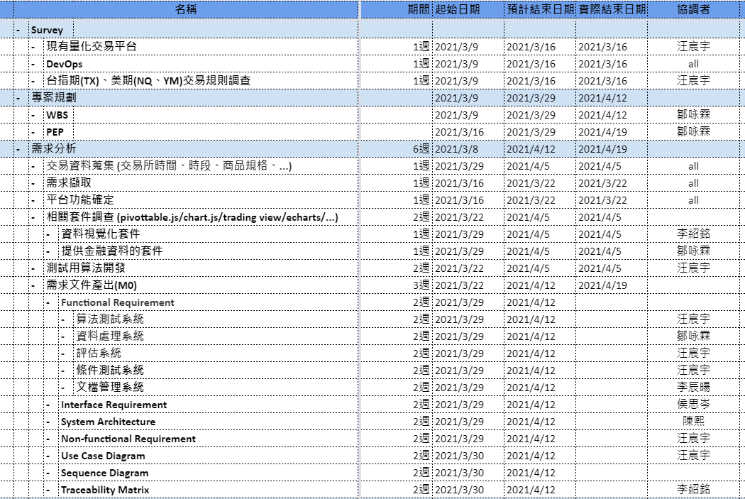
PEP
WBS

Slide 7
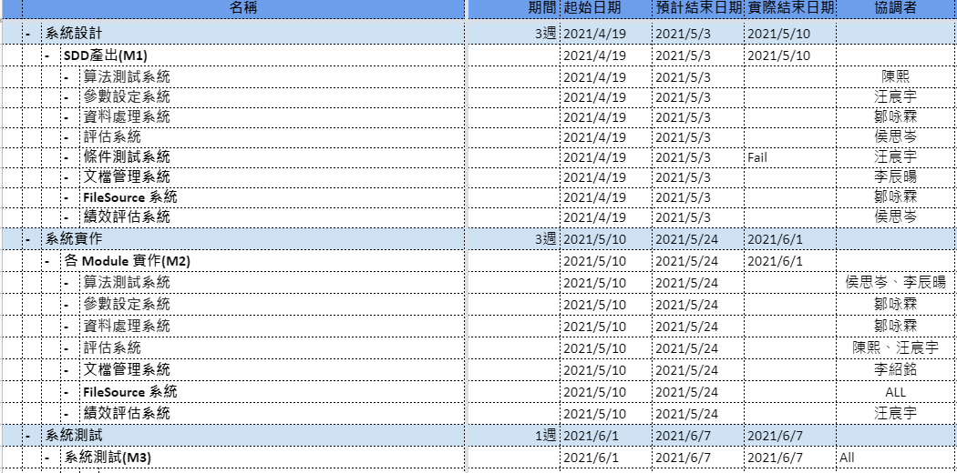
PEP
WBS

Slide 8
Requirement Analysis
presenter : 鄒咏霖

Slide 9
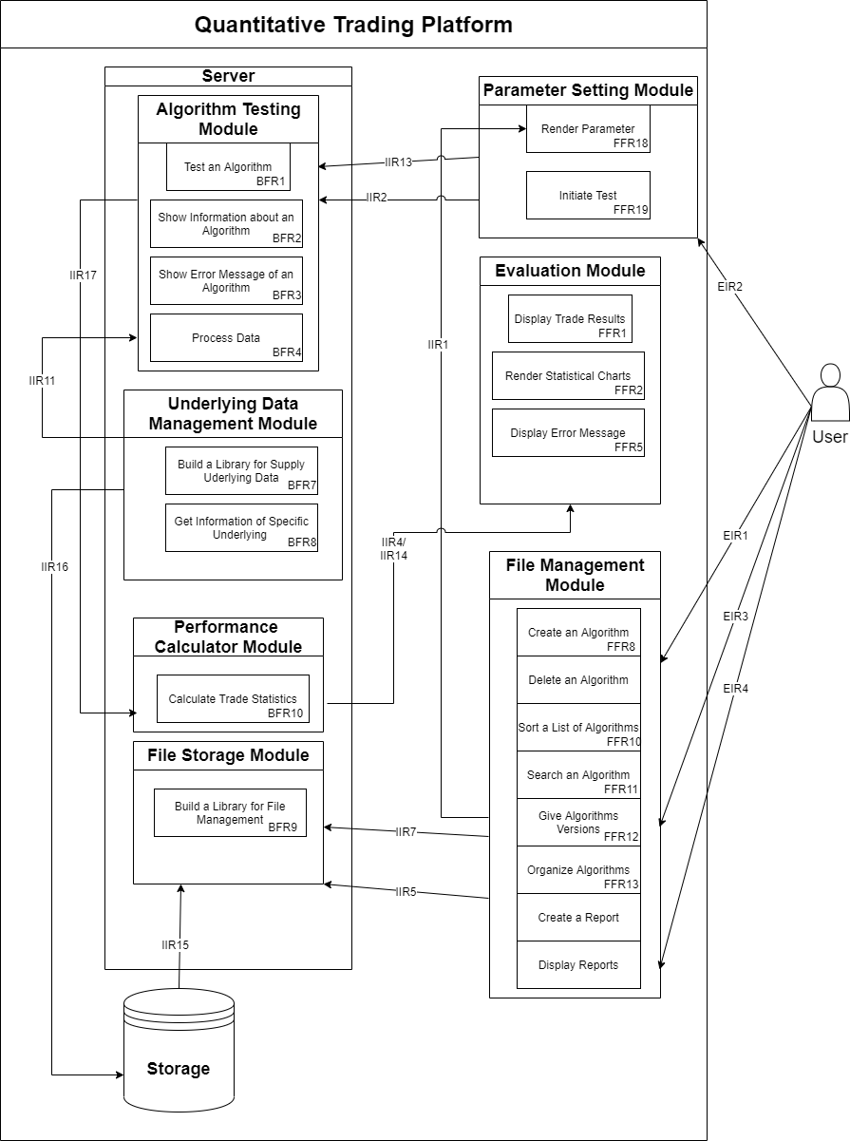
System Architecture
Module | Description
文檔管理系統 File Management Module(Frontend) | Provides the ability to manage algorithms and reports.
參數設定系統 Parameter Setting Module(Frontend) | Rendering and setting parameters of an algorithm
算法測試系統 Algorithm Testing Module(Backend) | Building and testing trading algorithms
標的資料系統 Underlying Data Management Module(Backend) | Provide the underlying assets’ data for Algorithm Testing Module
績效計算系統 Performance Calculator Module(Backend) | Calculating Performance of an Algorithm
評估系統 Evaluation Module(Frontend) | Evaluating performance of an algorithm
文檔儲存系統 File Storage Module(Backend) | Store the file(algo., report, parameter) create by user action

Slide 10
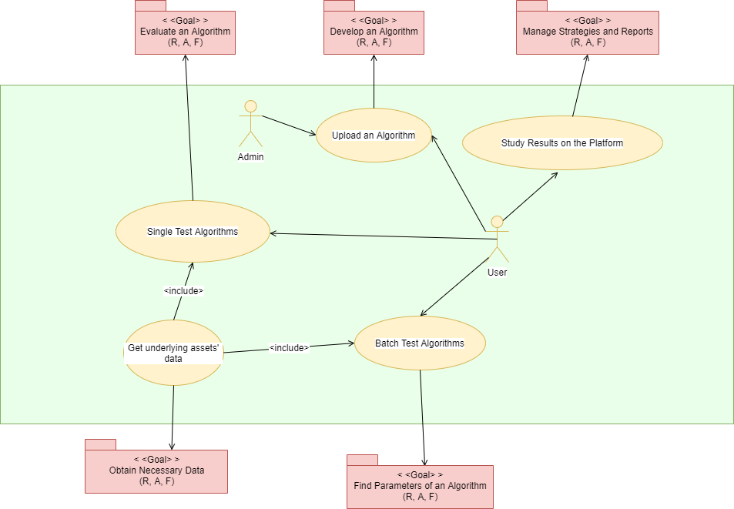
Use Case Diagram
presenter: 汪宸宇
UC-001
UC-009
UC-002
UC-003
UC-005

Slide 11
Use Case Spec. (1/5)
[UC-001] User/Admin uploads an algorithm
Goal New algorithms can be developed.
Requirements [FFR8 : Create an algorithm], [FFR12 : Give algorithm versions], [BFR10 : Store File]
Basic Flow
Click the “New button,” then show a “Input Modal” which requires User/Admin input algorithm information
(Title, Version, Description).
Click the “Confirm button,” then show the “Input File Modal” which requires User/Admin to upload the source code.
User/Admin uploads the new algorithm.
Add the new algorithm to the “Algorithm Menu”.
Alternative Flow
2.1 User input lacks in Title or Version, back to Step 1.
2.2 User clicks “Exit Button” in Input Modal, Exit.
3.1 Duplicate “Title and Version”, Exit.

Slide 12
Use Case Spec. (2/5)
[UC-002] Display results after the user executes evaluations
Goal
Algorithms can be evaluated.
Requirements
[FFR1 : Display Trade Results], [FFR2 : Render Statistical Charts], [FFR5 : Display Error Messages]
Basic Flow
The user executes a new test.
The trade results include trade statistics and trade actions.
Common statistical charts can be displayed based on the trade results.
The user selects a period of time span to show trade results.
Alternative Flow
1.1 if any error occur when testing that algorithm, error messages is displayed on the web page

Slide 13
Use Case Spec. (3/5)
[UC-003] Call API to obtain underlying assets’ data
Goal
Get underlying assets’ data
Requirements
[BFR7 : Build a Library for Provide Underlying Assets’ Data provide]
[BFR8 : Get specific Underlying Asset’s information]
Basic Flow
import the asset data library
call specific api, pass in required parameters
obtain structured data
Alternative Flow
2.1 if any error occurs during api call, return a specific error code so that “Algorithm Testing Module” can send the corresponding error message to the web page

Slide 14
Use Case Spec. (4/5)
[UC-005] Batch test algorithms
Goal
Parameters of Algorithms can be found.
Requirements
[FFR18 : Render Parameter], [FFR19 : Initiate Test], [FFR1 : Display TradeResult],
[FFR2 : Render Statistical Charts], [BFR1 : Testing an Algo], [BFR2 : Show information about an Algo],
[BFR7 : Build a Library for Provide Underlying Assets’ Data]
Basic Flow
Choose the algorithm to be tested
Set the batch-testing parameters
Execute the test
The web page displays several trade statistics for each parameter setting
Users can see the heatmap of some trade statistics of different parameters, and find the better ones
Alternative Flow
3.1 If for some parameter set, the algorithm being tested encountered error during execution,
trade statistics for that parameter set is skipped, until no other parameter sets are left

Slide 15
Use Case Spec. (5/5)
[UC-009] View reports and algorithms
Goal
Manage algorithms and reports
Requirements
[FFR10 : Sort a list of algorithms], [FFR11 : Search algorithms], [FFR17: Display reports]
Basic Flow
The user finds the target algorithm on the file manager page, by following ways:
sort the display list of algorithms by, for example, Last Modified;
search the title of the algorithm.
After the algorithm item is found, the user selects the intended version.
The user studies the algorithm by analysing the related data, for example, trade results, or by reading the reports.
Alternative Flow
3.1 if the report in the backend failed to open, error message is displayed on the web page

Slide 16
Class Diagram
presenter: 侯思岑

Slide 17
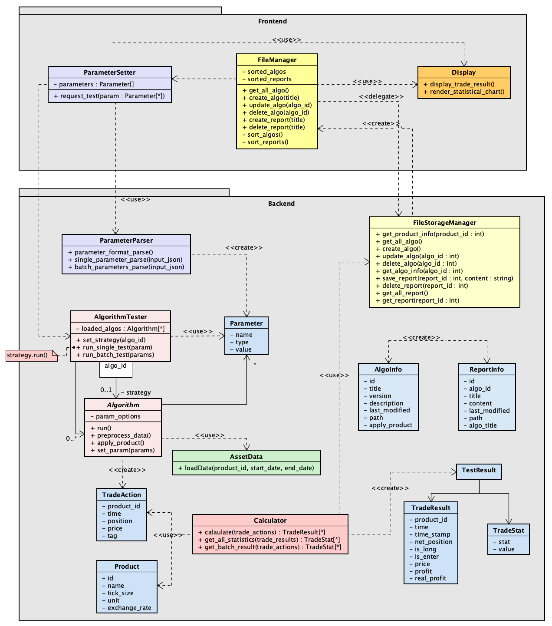
Class Diagram
Algorithm Testing Module
Evaluation (Display) Module
File Management Module
File Storage Module
Underlying Data Management Module
Parameter Setting Module
Performance Calculator Module
Data Design

Slide 18
Class Breakdown

Slide 19







Class Breakdown
Frontend: Correspondence between Classes and React Components
presenter:李紹銘
Class | React Component
ParameterSetter | sideArea
Display | content
 | console
FileManager | header
 | menu

Slide 20
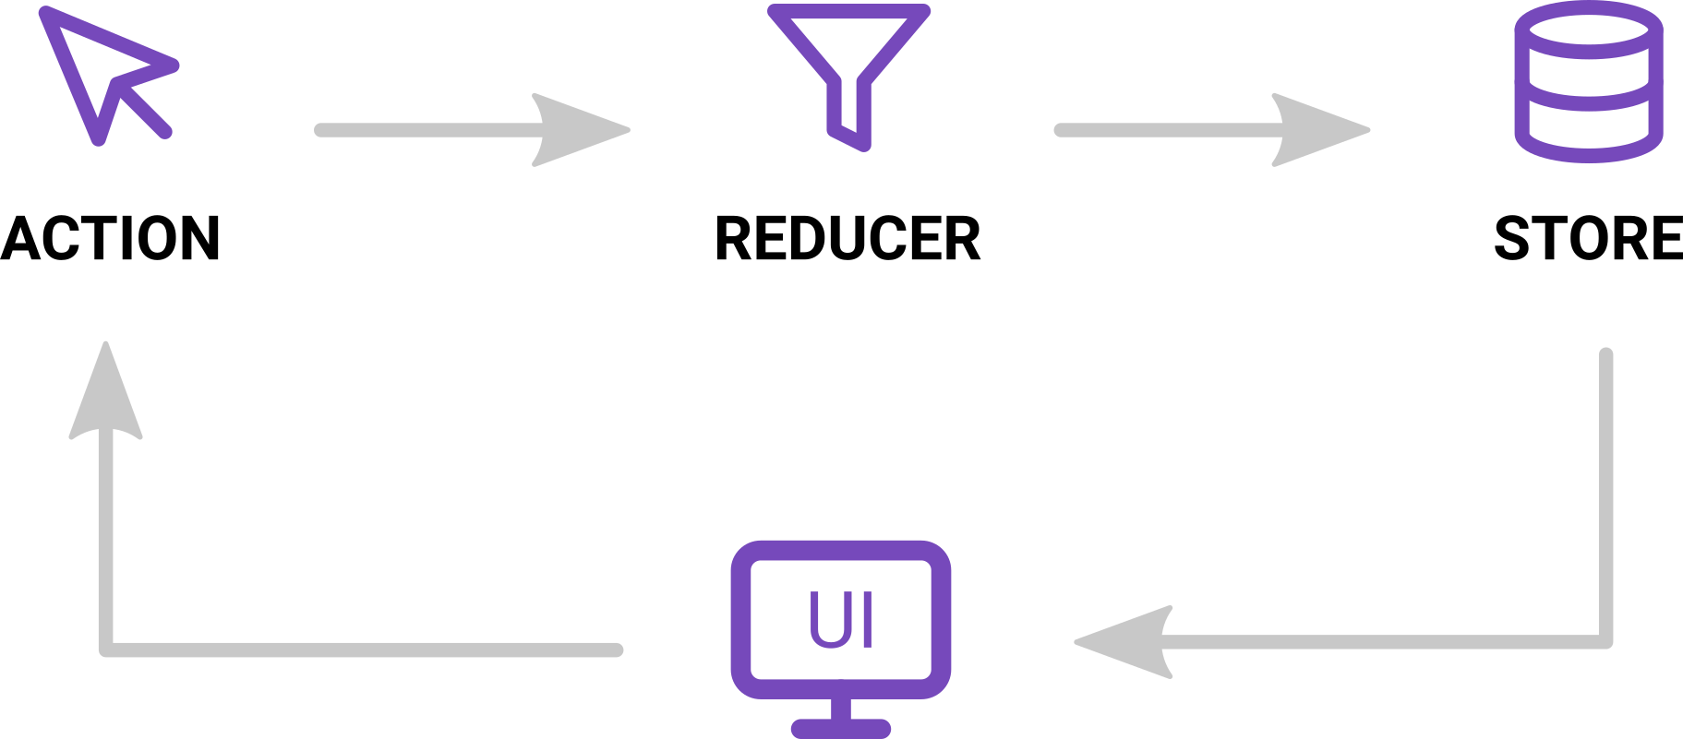
Class Breakdown
Redux
The three building blocks of Redux — Actions, Reducers and Store
https://javascript.plainenglish.io/the-only-introduction-to-redux-and-react-redux-youll-ever-need-8ce5da9e53c6

Slide 21
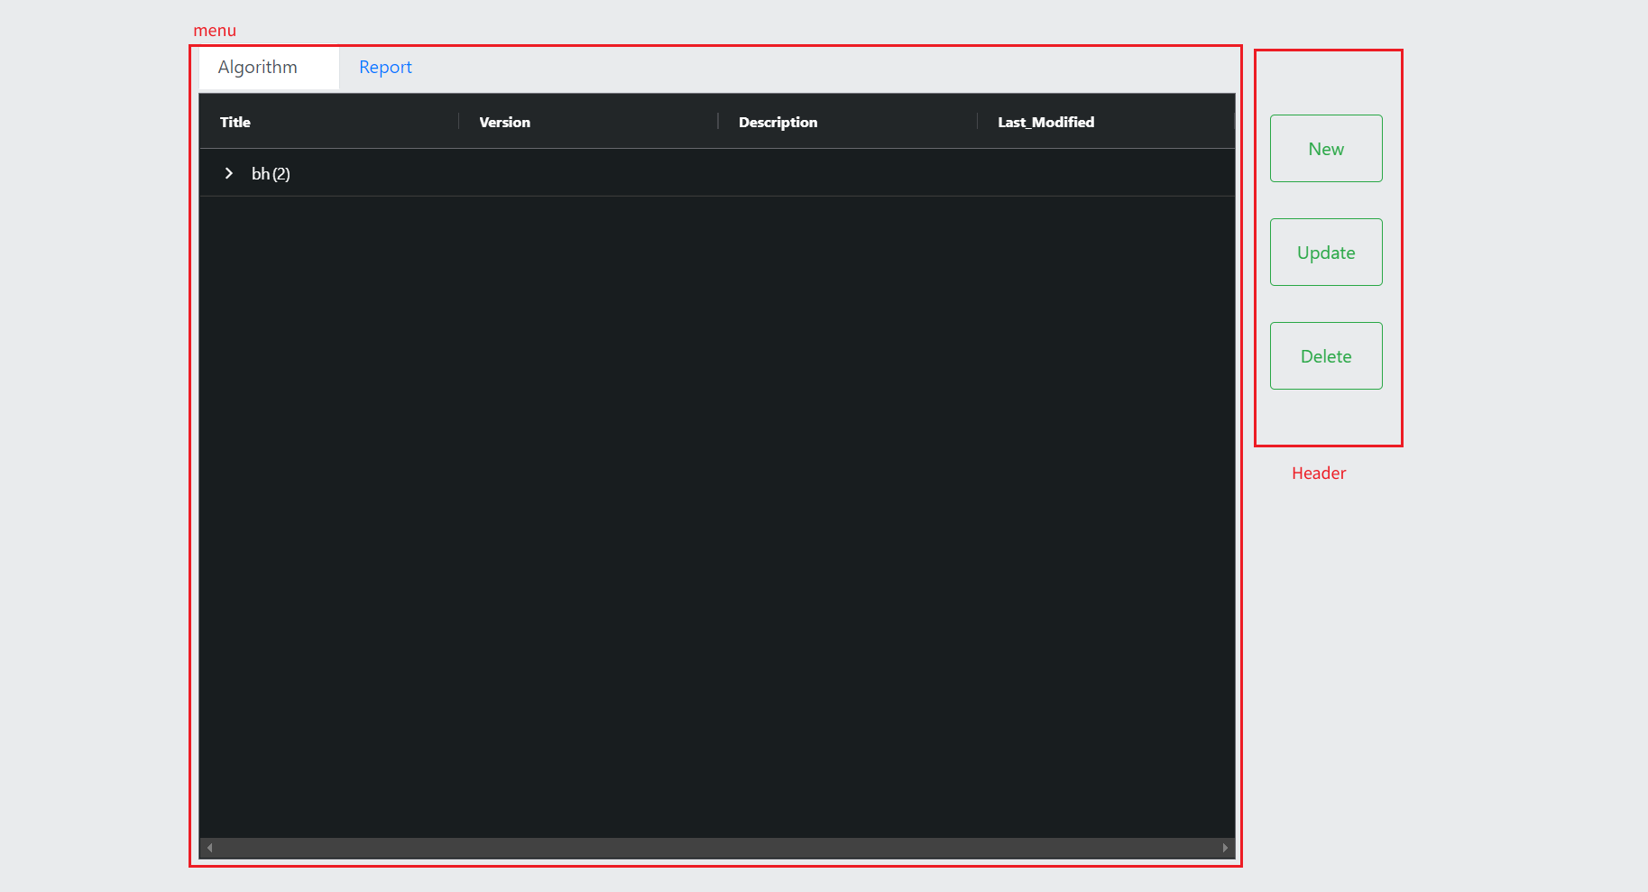

Slide 22
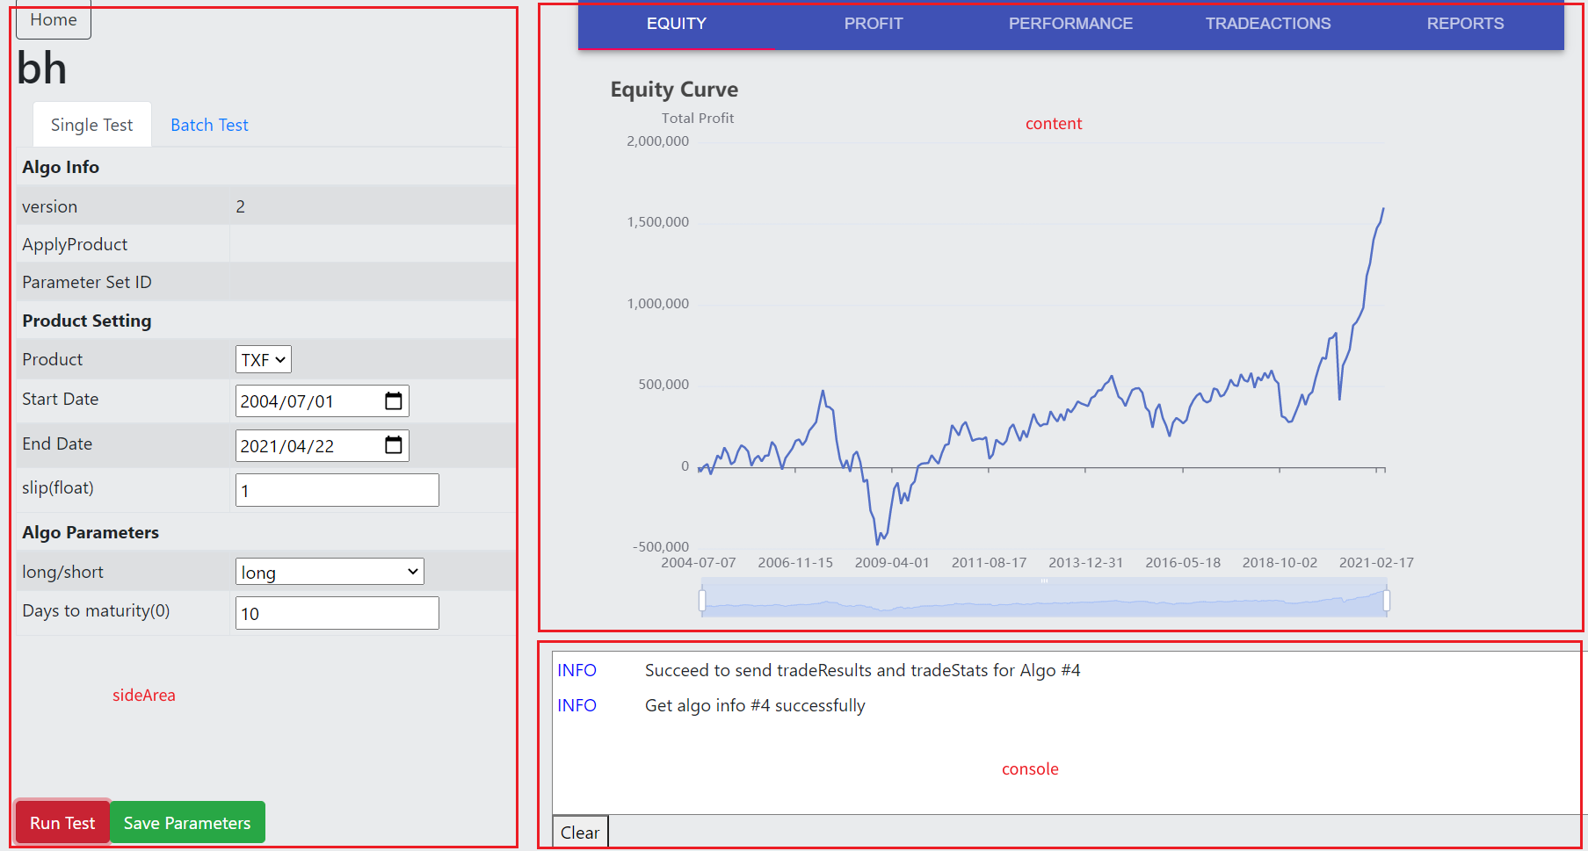

Slide 23
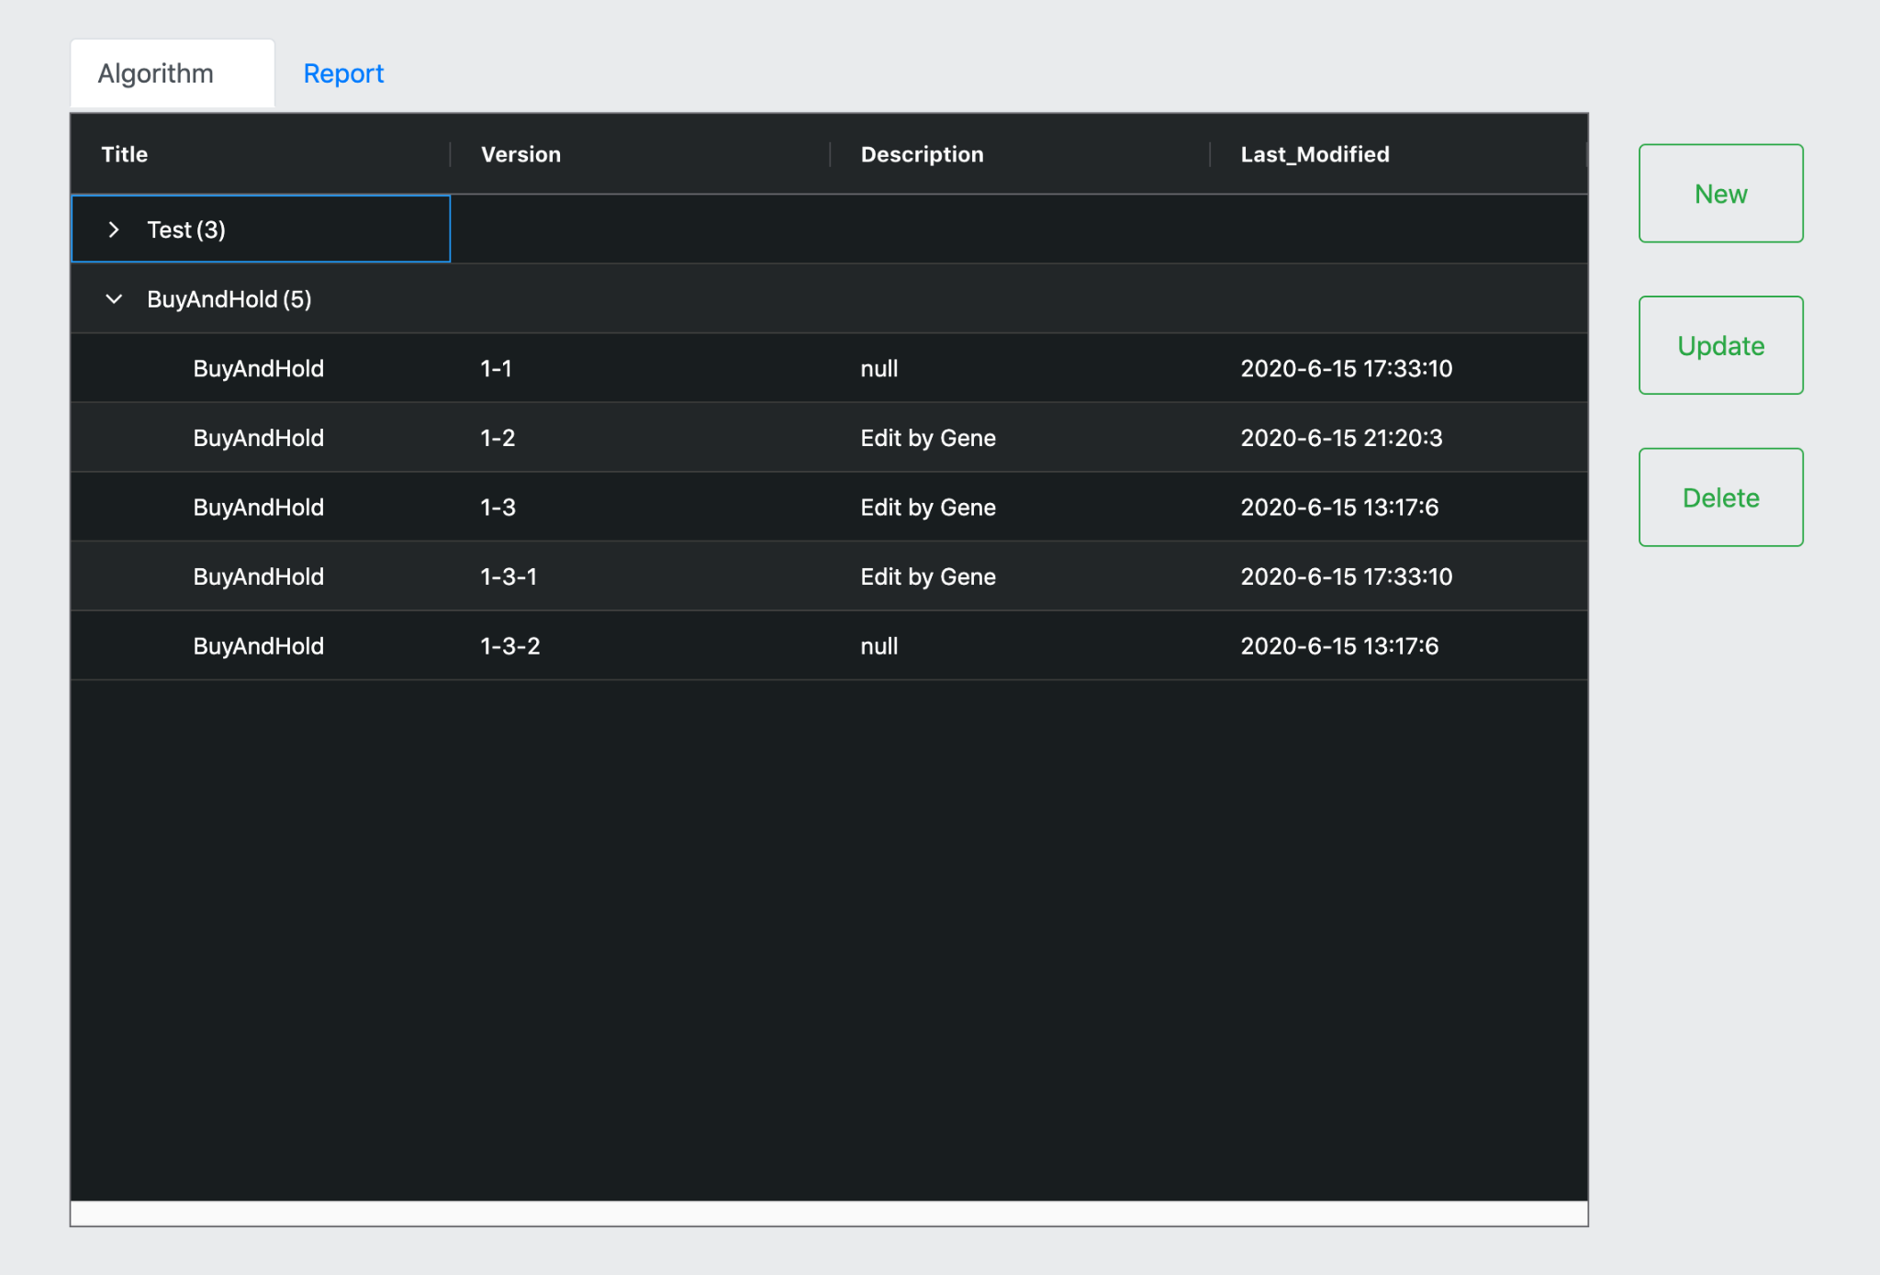
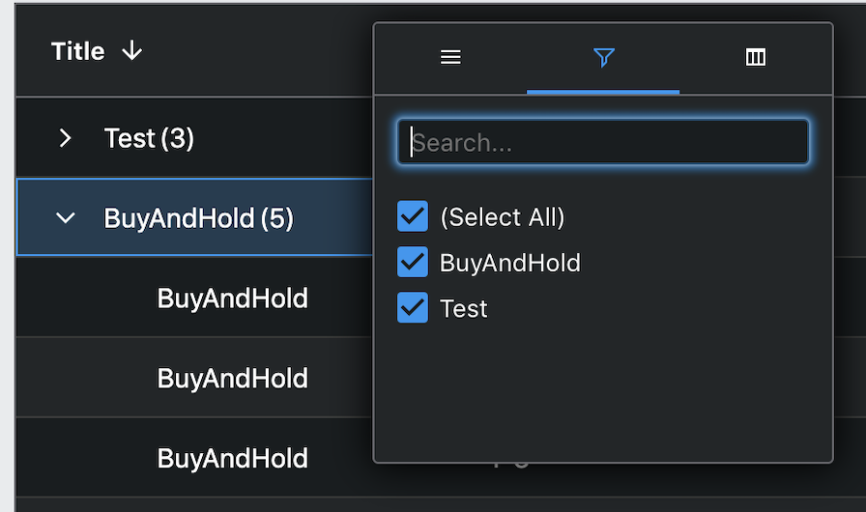
Class Breakdown
Frontend: Homepage
Show algorithms and reports
grouping ,search , sort
New / Update / Delete algorithm , Delete report
Select algorithm by double click
View report by double click
sort
search

Slide 24
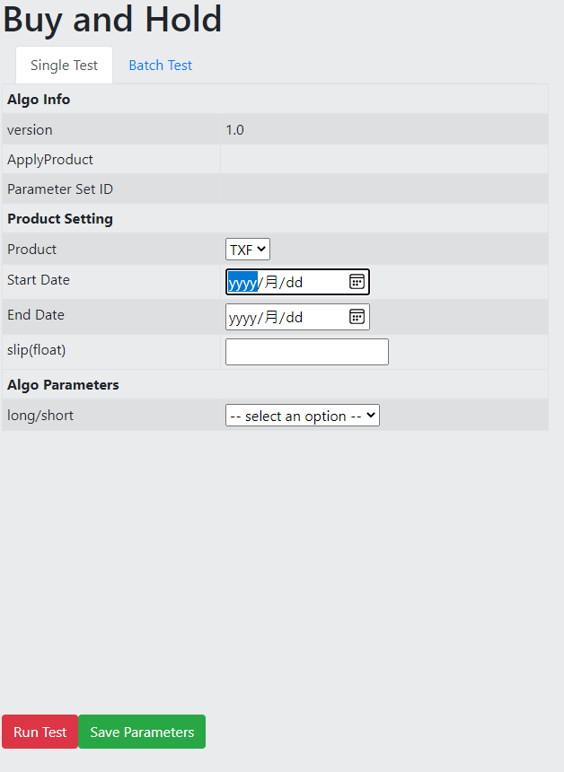
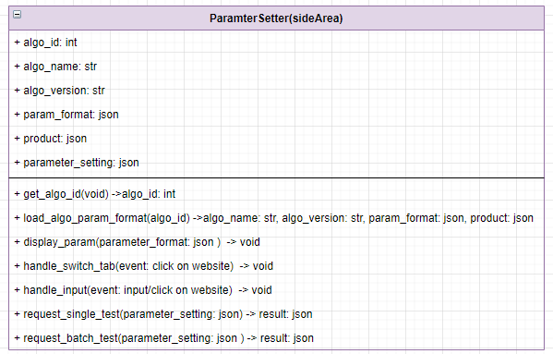
Class Breakdown
Frontend: sideArea(ParameterSetter)
presenter : 鄒咏霖

Slide 25
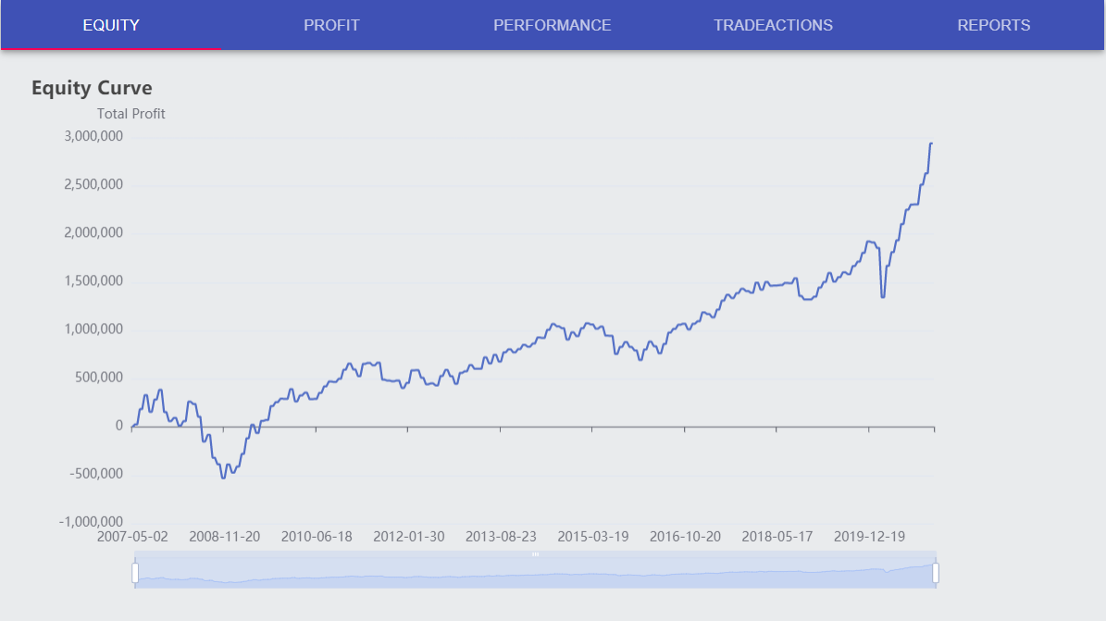
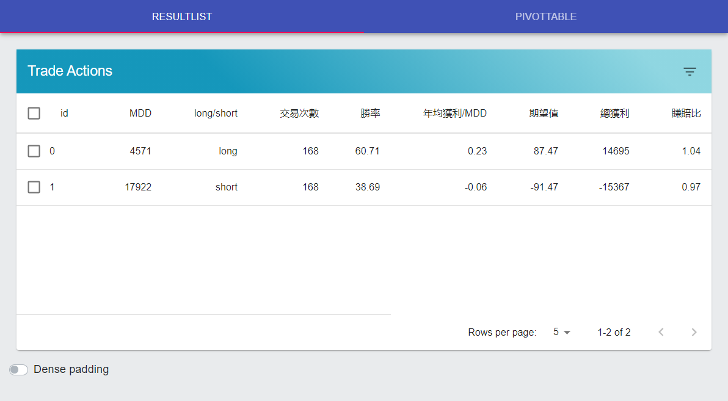
Class Breakdown
Frontend: Content
presenter: 陳熙
Purpose: Rendering trade results.
Single Testing:
Equity Curve
Profit Bar
Trade Statistics
Trade Actions
Relative Reports of the Selected Algorithm
Batch Testing:
Trade Statistics of Different Parameters
Pivot Table
Libraries used:
Echarts: Equity Curve and Profit Bar
Material-UI: Tables and Navigation Bar
React-PivotTable: Pivot Table
Stackedit-js: Reports
Redux: Obtain Data

Slide 26
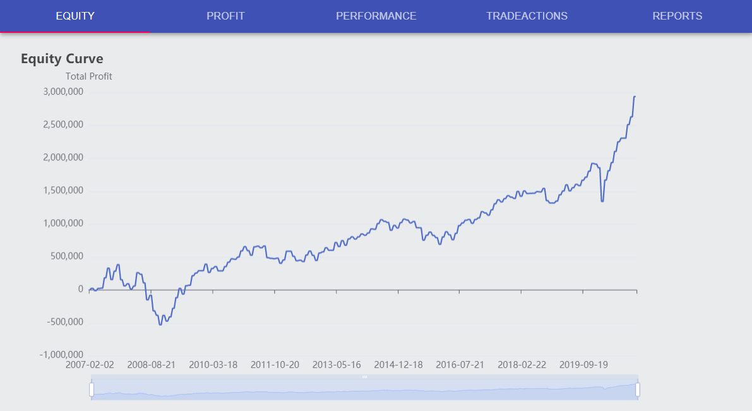
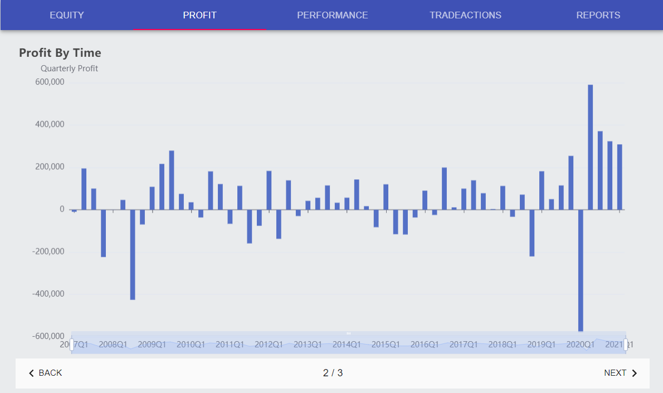
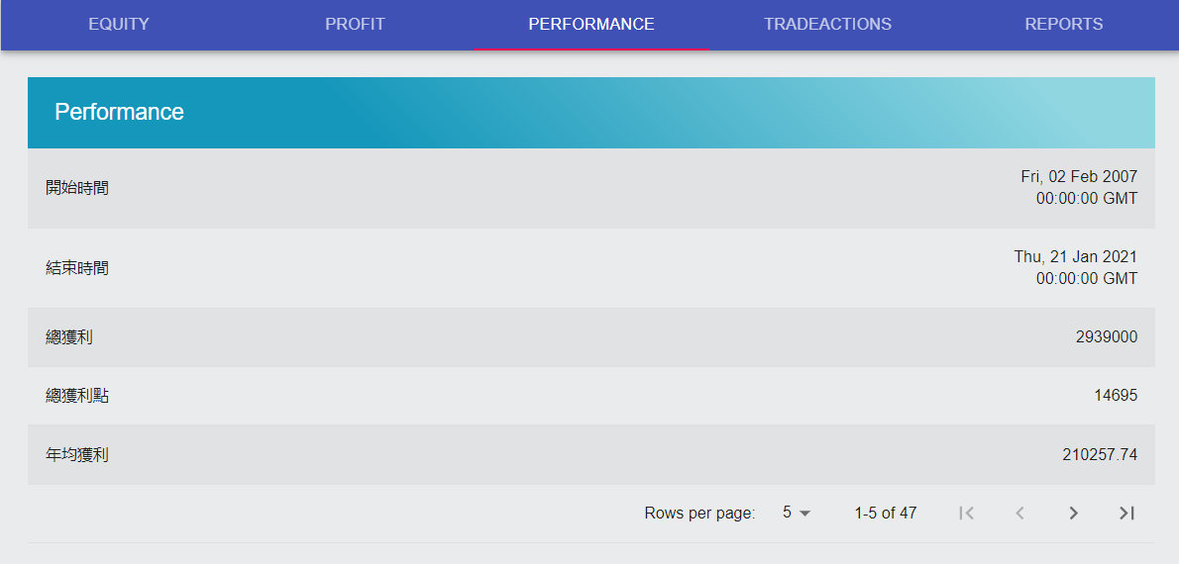
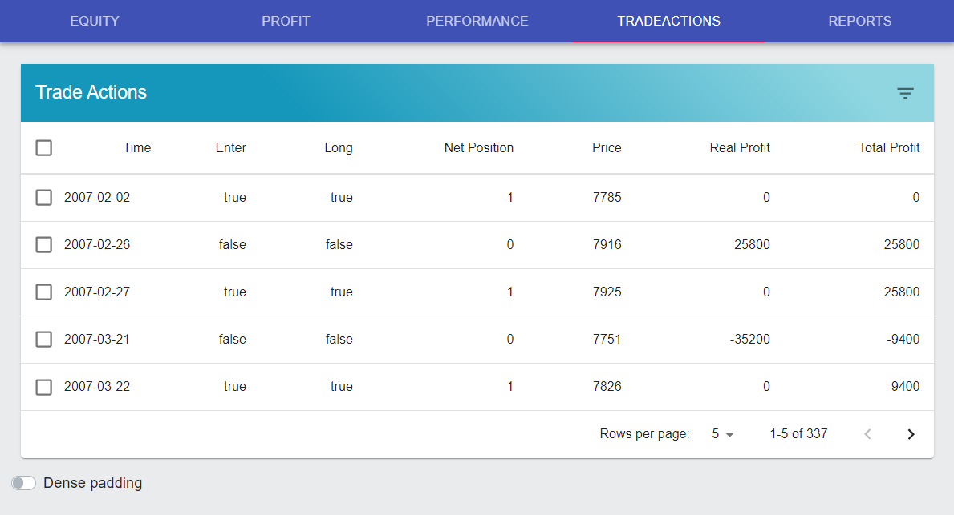
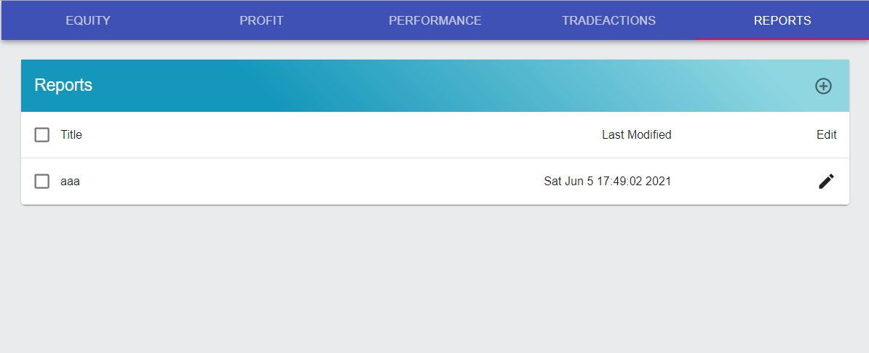
Class Breakdown
Frontend: Content
Equity Curve
Monthly, Quarterly and Yearly Profit
Trade Performance Statistics
Trade Actions
Relative Report List

Slide 27
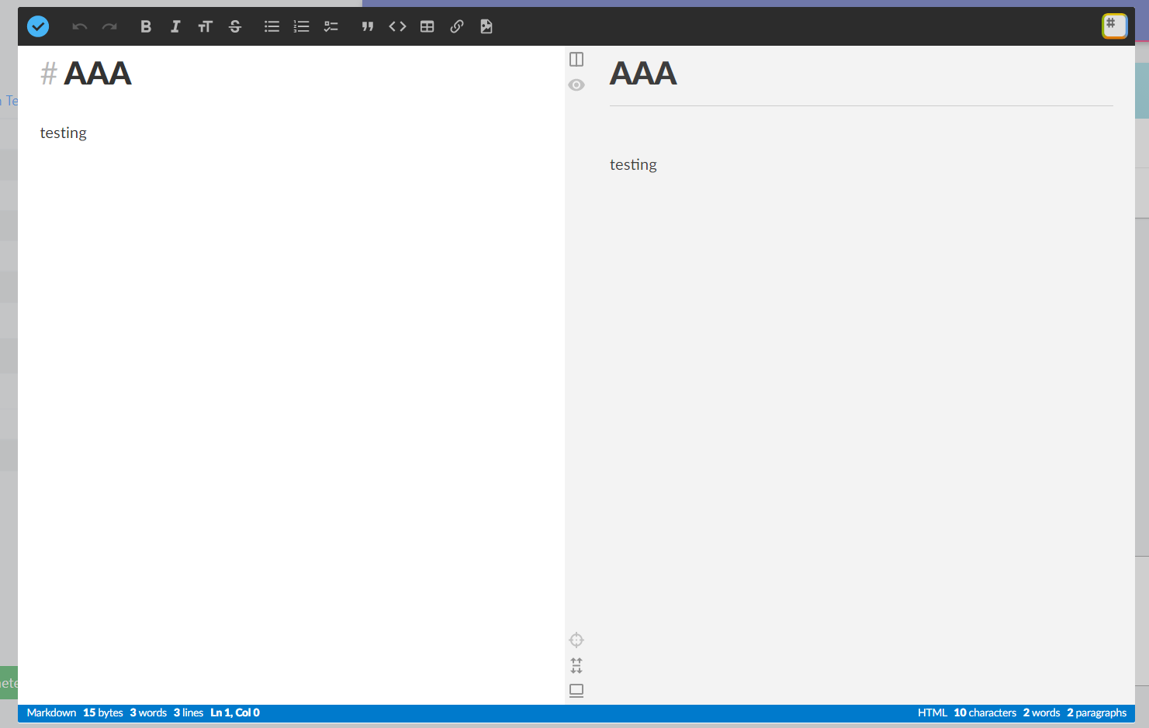
Class Breakdown
Frontend: Content
Report Editor

Slide 28
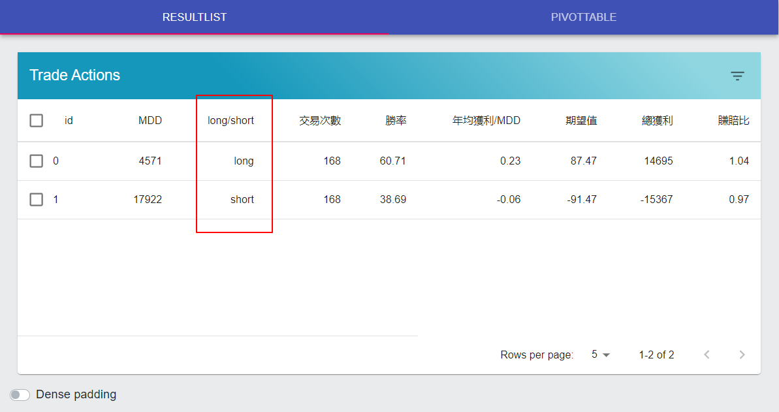
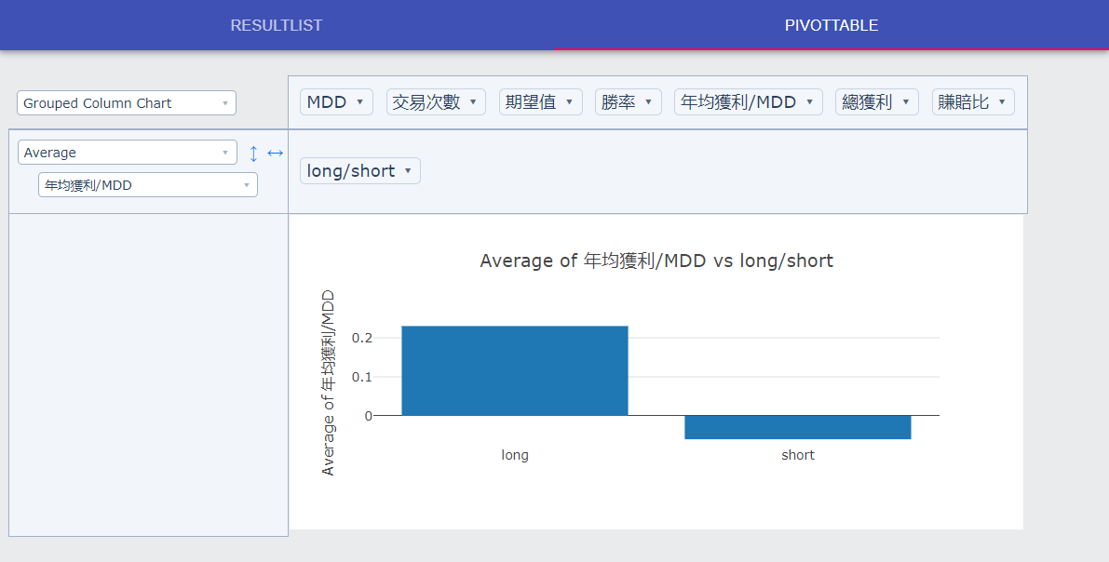
Class Breakdown
Frontend: Content
Trade Statistics of Different Parameters
Pivot Table

Slide 29
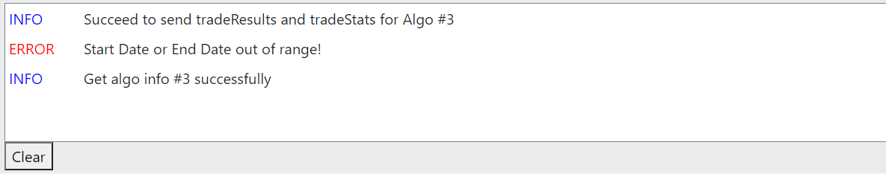
Class Breakdown
Frontend: Console (Display)
Responsible for showing log message when sending / receiving at frontend
Types of log levels:
Error
Warning
Info
Debug

Slide 30
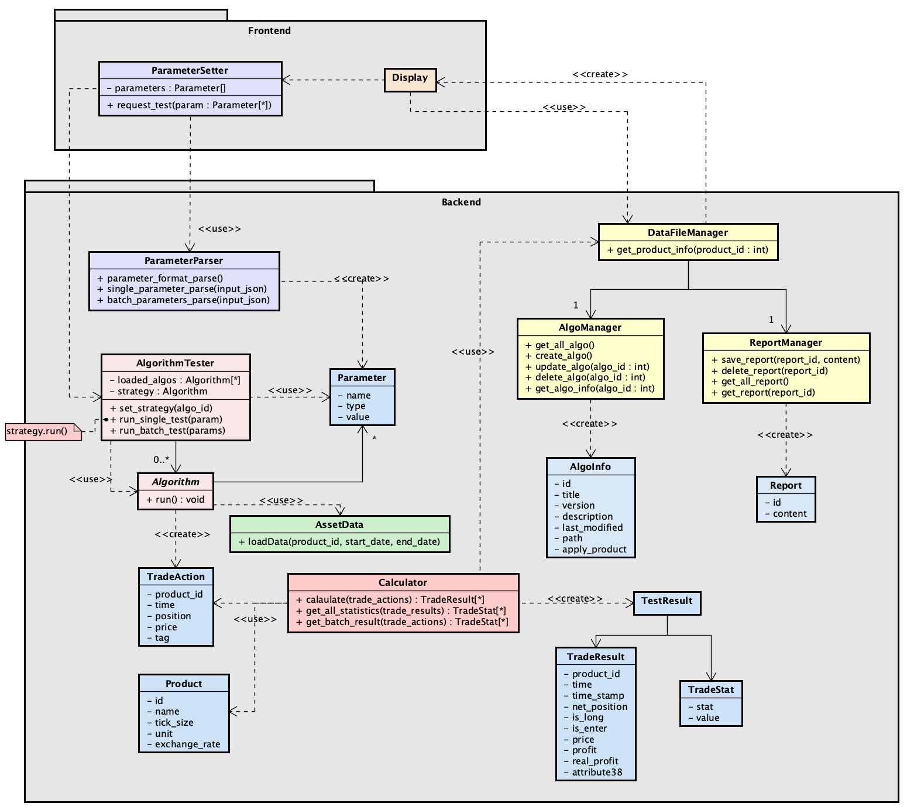
Class Breakdown
Backend: AlgorithmTester
presenter: 侯思岑
Strategy pattern in AlgorithmTester.
Responsible for delegating run() to current strategy.
Including single_test() and batch_test()

Slide 31
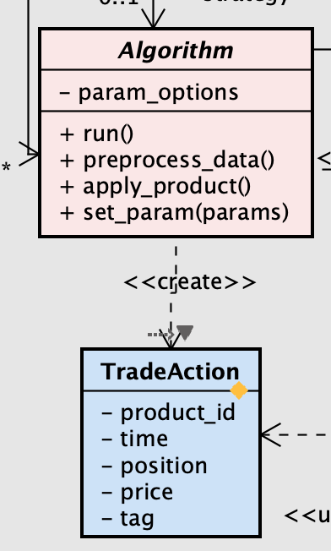
Class Breakdown
Backend: Algorithm (1/5)
presenter: 侯思岑
Abstract class with run() method.
Providing its parameter options.
Responsible for running the strategy with selected product and parameters.
Most need to preprocess the input data.
Producing a list of TradeAction.

Slide 32
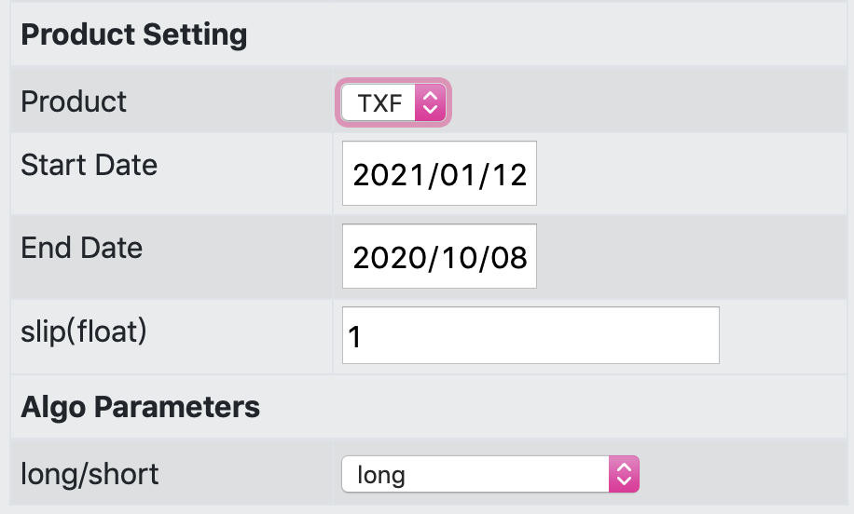
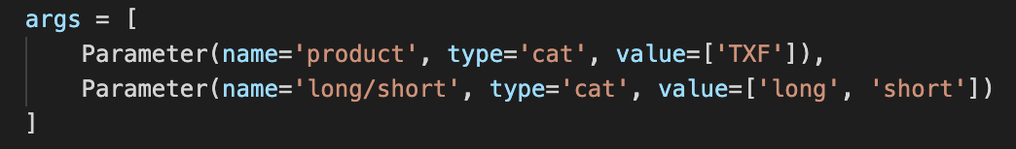
Class Breakdown
Backend: Algorithm (2/5)
Abstract class with run() method.
Providing its parameter options.
Responsible for running the strategy with selected product and parameters.
Most need to preprocess the input data.
Producing a list of TradeAction.

Slide 33
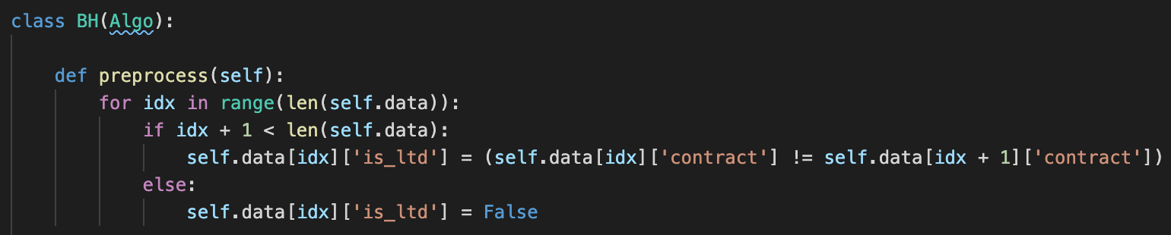
Class Breakdown
Backend: Algorithm (3/5)
Abstract class with run() method.
Providing its parameter options.
Most need to preprocess the input data.
Responsible for running the strategy with selected product and parameters.
Producing a list of TradeAction.

Slide 34
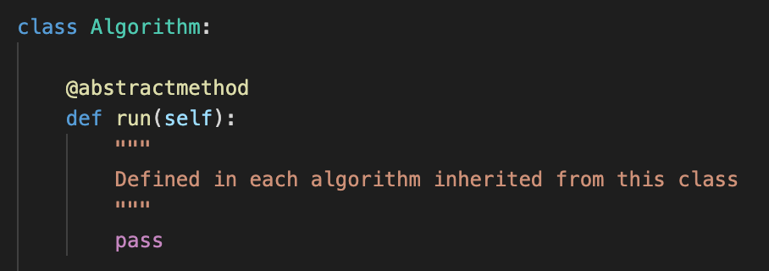
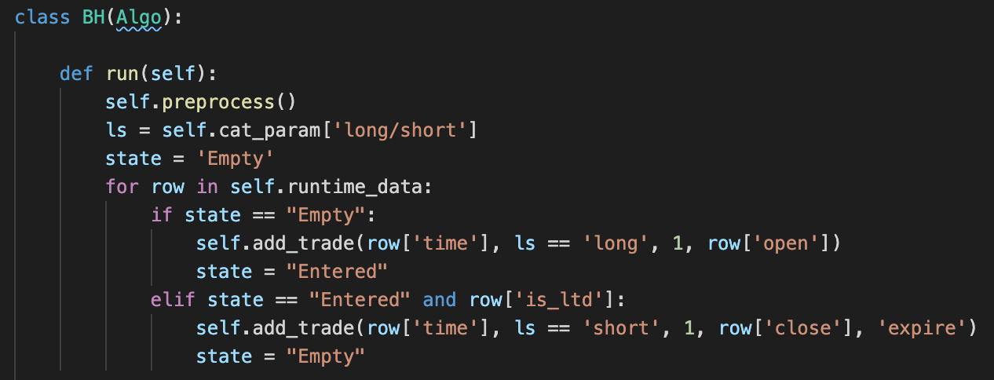
Class Breakdown
Backend: Algorithm (4/5)
abstract class
Abstract class with run() method.
Providing its parameter options.
Most need to preprocess the input data.
Responsible for running the strategy with selected product and parameters.
Producing a list of TradeAction.
concrete class

Slide 35
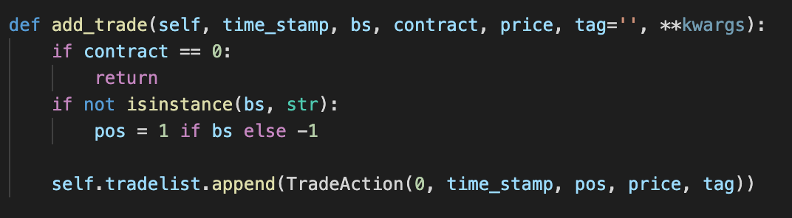
Class Breakdown
Backend: Algorithm (5/5)
Abstract class with run() method.
Providing its parameter options.
Responsible for running the strategy with selected product and parameters.
Most need to preprocess the input data.
Producing a list of TradeActions.

Slide 36
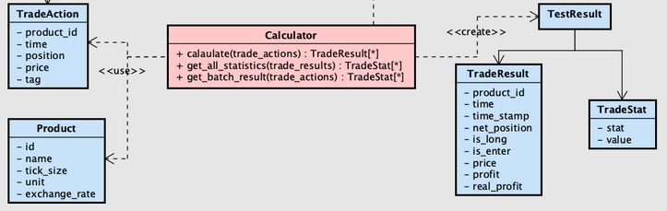
Class Breakdown
Backend: Calculator
presenter: 汪宸宇
Responsible for turning “trade actions” into statistical results
General steps:
using FIFO method to map TradeActions into TradeResults
using TradeResults to calculate statistics such as: mean, std, win rate, etc.
Take consideration of:
slippage
exchange rate of different products traded

Slide 37
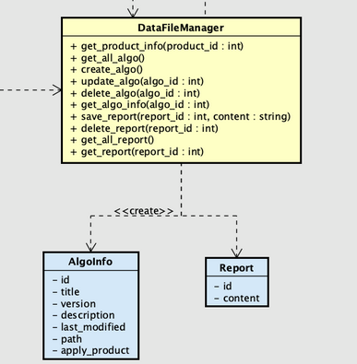
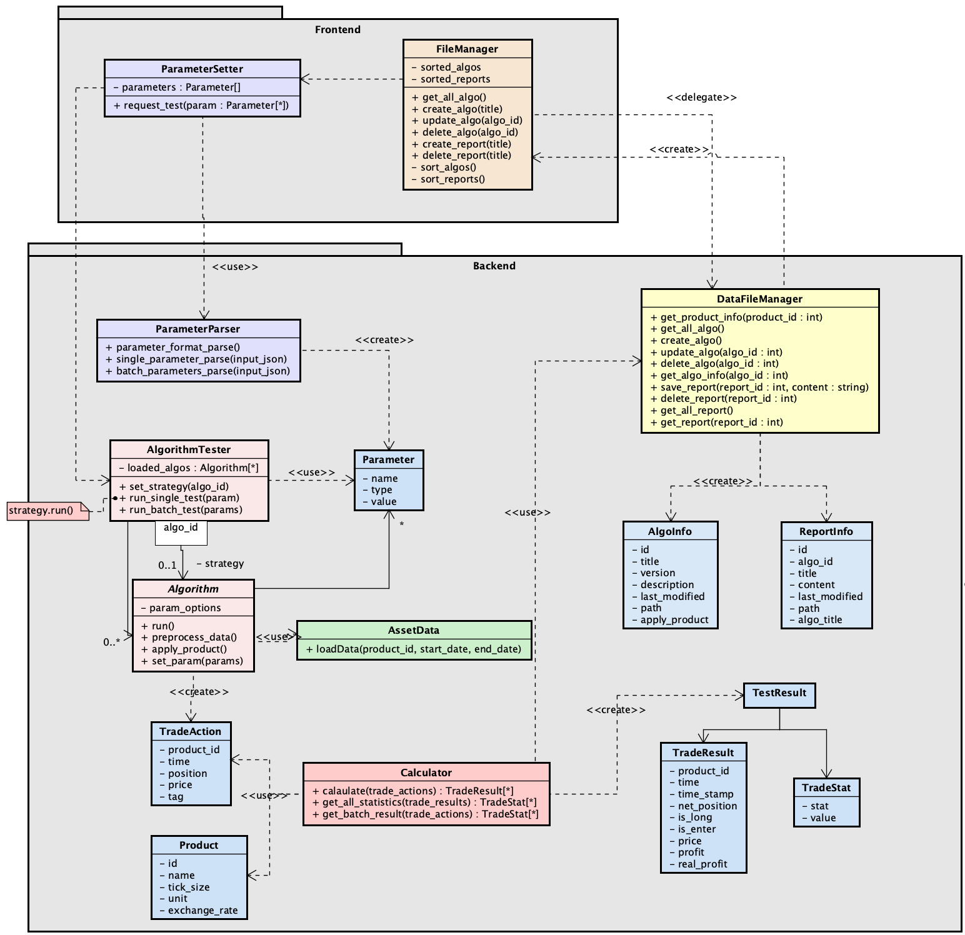
Class Breakdown
Backend: DataFileManager
(Frontend) FileManager
Responsible for writing files to backend folder, and providing file access
Similar to a DAO class, but using json files to store data for now
Current files to write:
Algorithm files
Report files
Current json data to maintain:
Algo Info
Report Info
Product Info
Made as singleton to ensure json data’s consistency

Slide 38
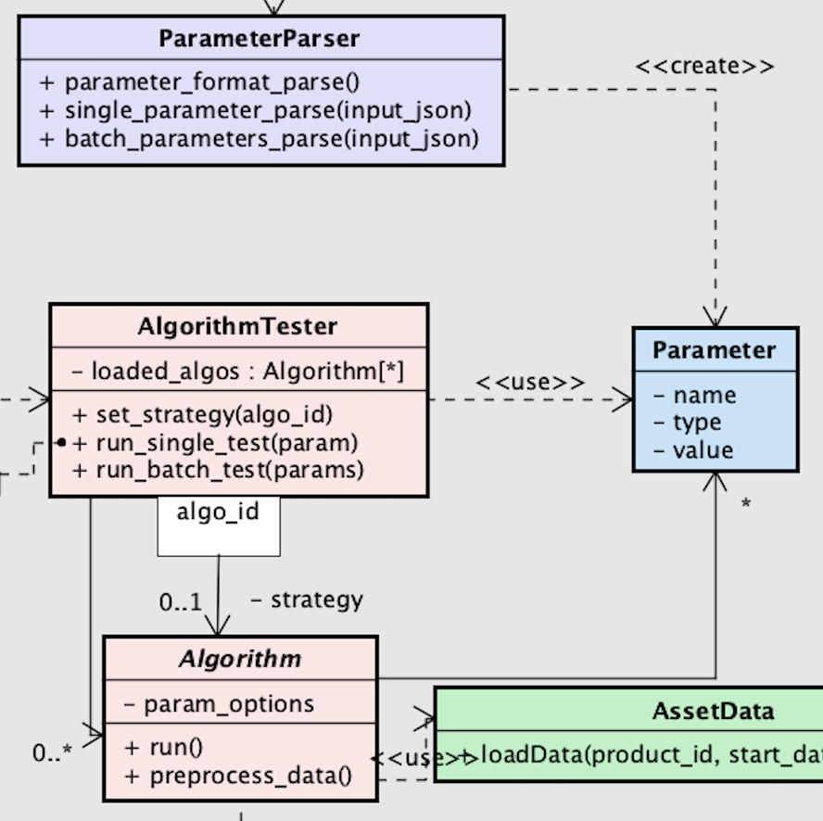
Class Breakdown
Backend: ParameterParser (1/4)
presenter: 李辰暘
Provides three static functions related to parameter processing
Creates Parameters used by AlgorithmTester and Algorithms
Parameter consists of three attributes: name, type, and value
name: title of the parameter
type: categorical or numerical
value: dynamic type (e.g. List, float)

Slide 39
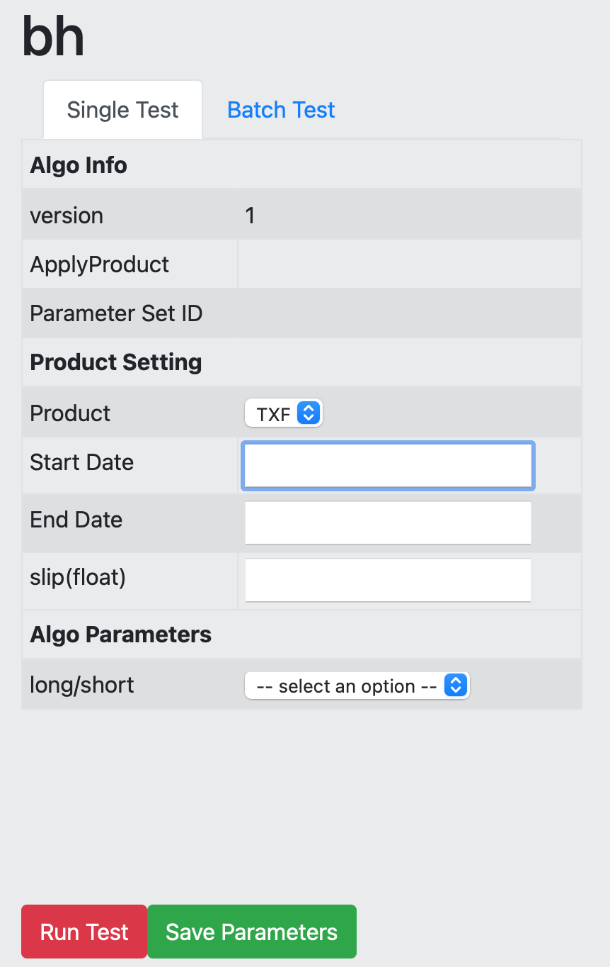
Class Breakdown
Backend: ParameterParser (2/4)
Function #1:parameter_format_parse(filepath: str): List[dict]
Extracts parameter format from the source code of an algorithm
The parameter format later will be shown for the user (right figure)

Slide 40
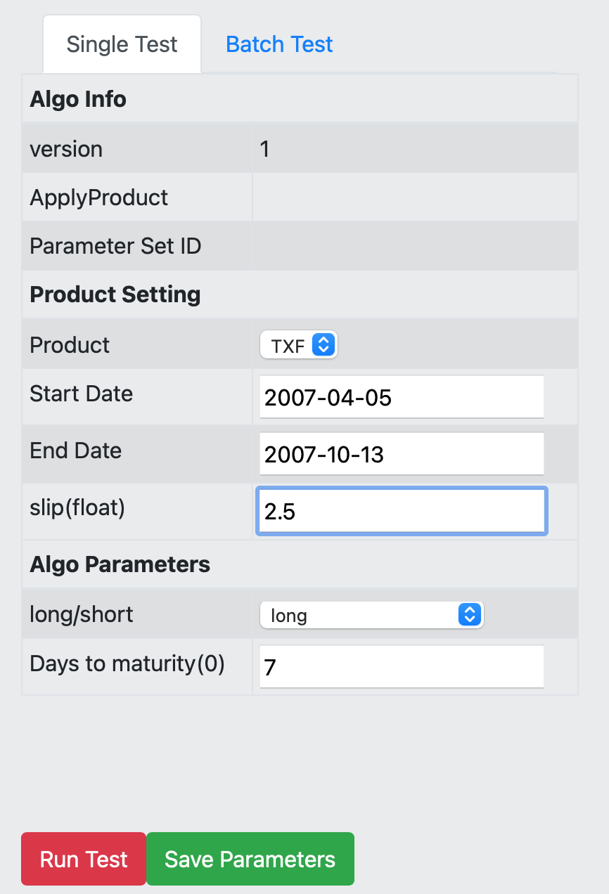
Class Breakdown
Backend: ParameterParser (3/4)
Function #2: single_parameters_parse(dict): List[Parameter]
Given the input sent from the front end, convert the selected parameters into Parameter objects
For example:
parameters = [Parameter(’long/short’, ’cat’, ’long’), Parameter(’Days to maturity’, ’num’, 7)]

Slide 41
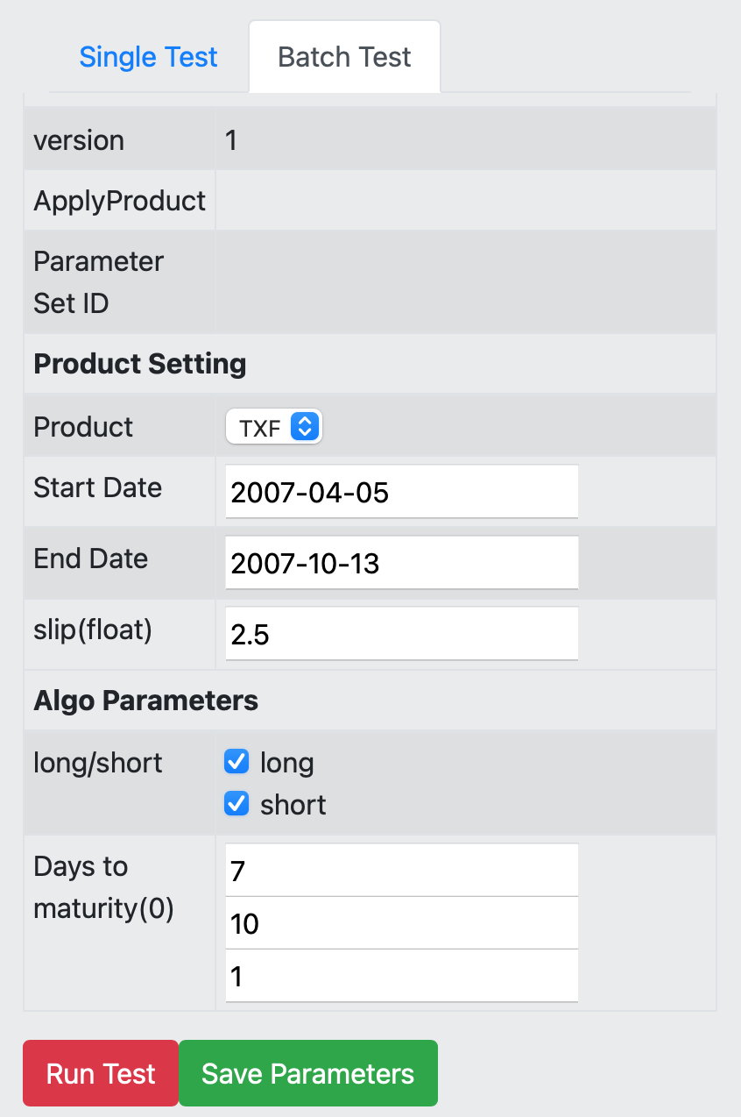
Class Breakdown
Backend: ParameterParser (4/4)
Function #3: batch_parameters_parse(dict): List[List[Parameter]]
Like last function single_parameter_parse, but parse parameters for batch test setting
For example, output parameters in this case will be [p1, p2, p3, p4, p5, p6], where:
p1 = [Parameter(’long/short’, ’cat’, ’long’), Parameter(’Days to maturity’, ’num’, 7)]
...
p6 = [Parameter(’long/short’, ’cat’, ’short’), Parameter(’Days to maturity’, ’num’, 9)]

Slide 42
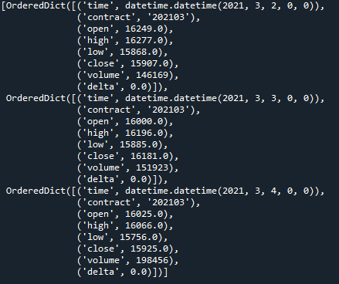
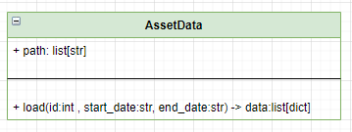
Class Breakdown
Backend: AssetData
presenter : 鄒咏霖
Use by Algorithm
Return
list[dict] when request success
-1 when necessary parameter not provide
-2 when specific data not exist
-3 when parameter setting wrong
▲ load(id=0, start_date=‘2021-03-02’, end_date=‘2021-03-04’)

Slide 43
Sequence Diagram
presenter: 侯思岑

Slide 44
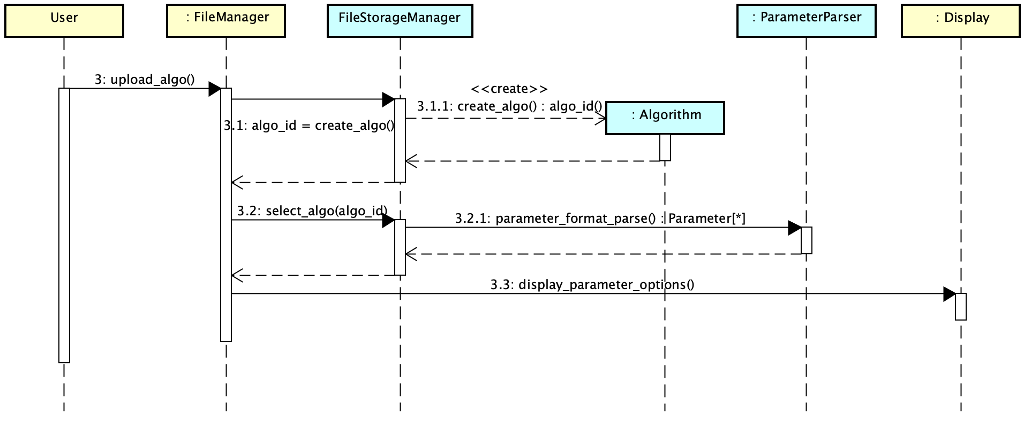
Sequence Diagram (1/3)
User uploads an algorithm, and gets the parameter options displayed on the screen.
frontend
backend

Slide 45
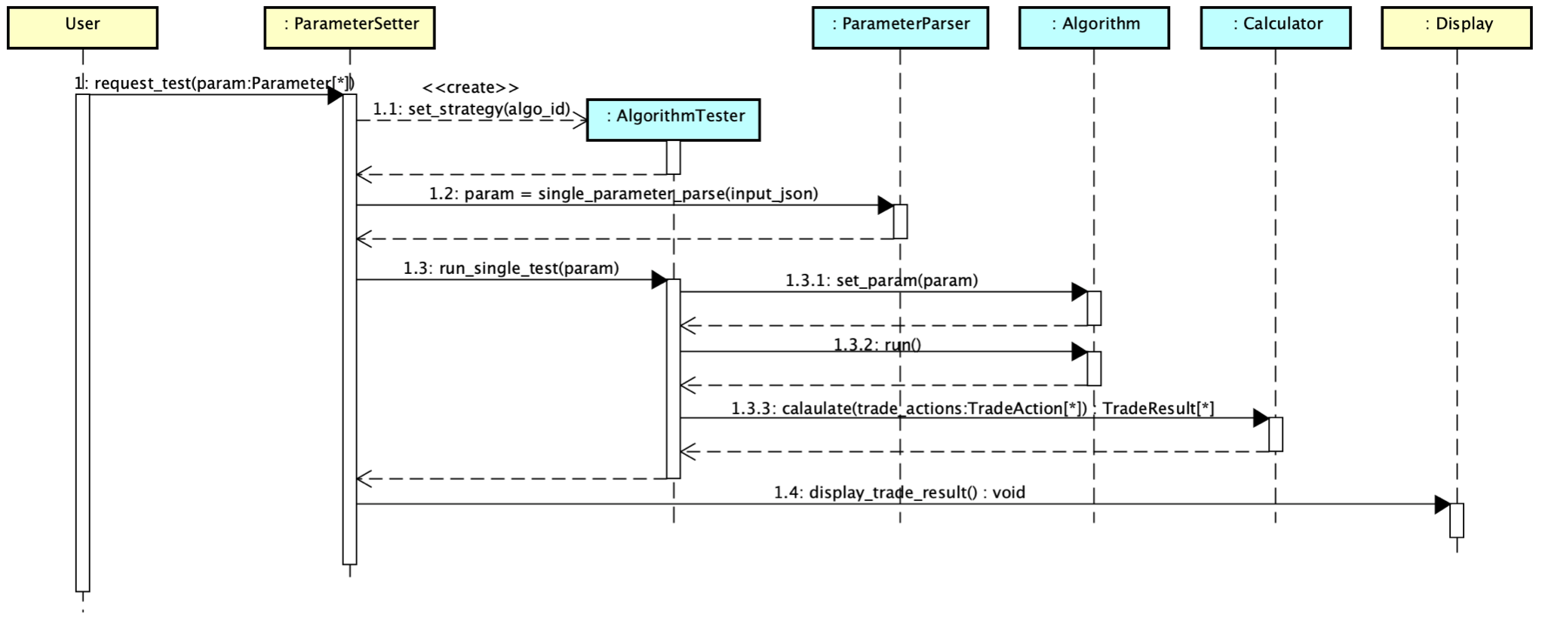
Sequence Diagram (2/3)
After setting parameters, user clicks "run single test" botton.
frontend
backend

Slide 46
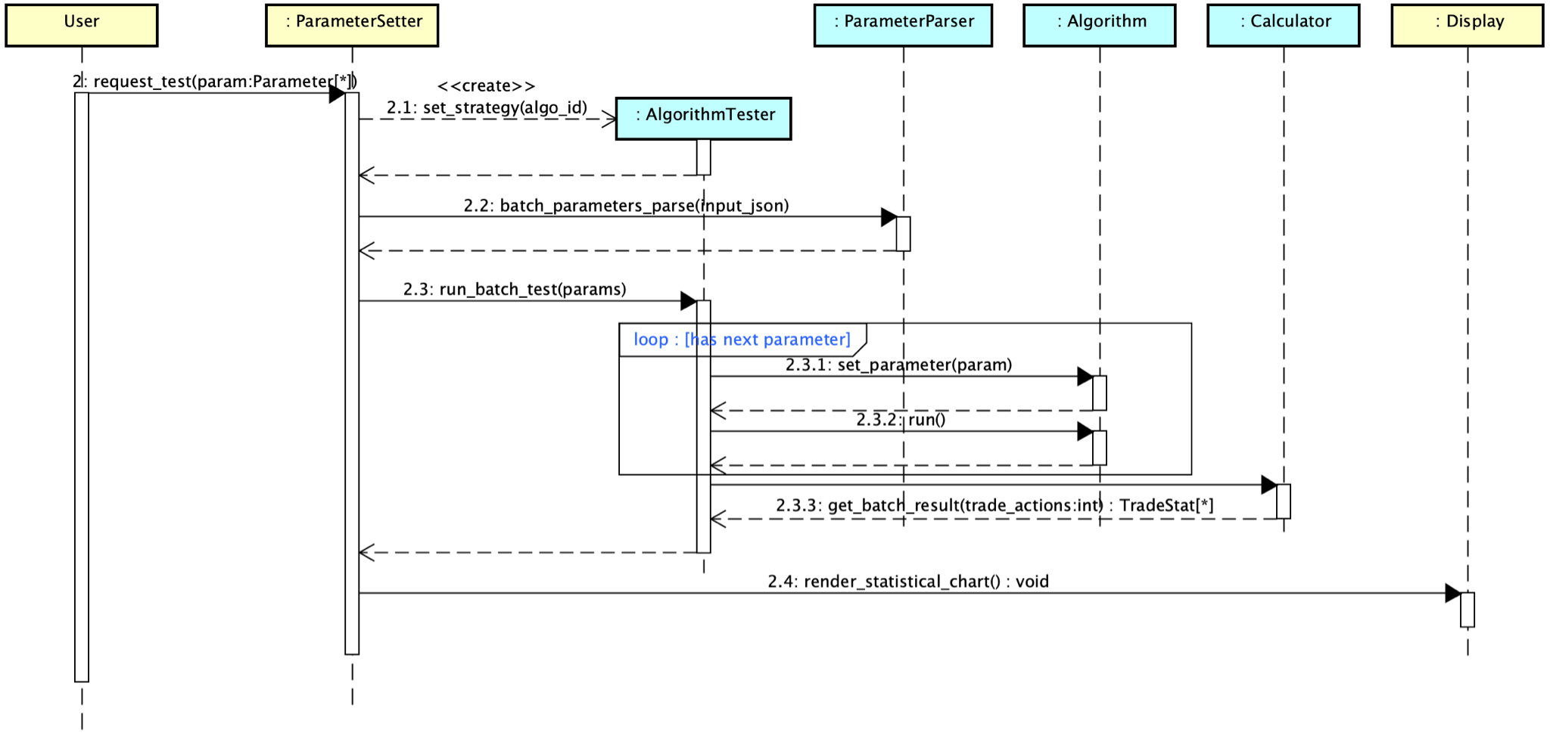
Sequence Diagram (3/3)
After setting a set of parameters, user clicks "run batch test" botton.
frontend
backend

Slide 47
API
presenter : 鄒咏霖
URL | Function | Description
/get-all-aglo [GET] | get_all_algo() | input : none output : All algo’s info
/create-algo [POST] | create_algorithm() | input: algo info and .py file output : sucess message
/update-algo [POST] | update_algorithm() | input : algo_id and py file output : sucess message
/delete-algo/<algo_id> [DELETE] | delete_algo() | input : algo_id output : sucess message.
/get-all-report [GET] | get_all_report() | input : none output : All report’s info
/get-report-list?algo_id=<algo_id> [GET] | get_report_list() | input : algo_id output : All report’s info that is about the specific algo
/get-report/<report_id> [GET] | get_report() | input : report_id output : report content

Slide 48
API
URL | Function | Description
/create-report [POST] | create_report() | input : report info and repot content output : sucess message
/save-report [POST] | save_report() | input : report_id output : sucess message
/delete-report/<report_id> [DELETE] | delete_report() | input: report_id output : sucess message
/get-algo-param-format/<algo_id> [GET] | get_algo_param_format() | input : algo_id output : algo info and algo parameter_format
/single-test [POST] | single_test() | input : algo info, product setting and parameter setting output : trade statistic
/batch-test [POST | batch_test() | input : algo info, product setting and parameter setting output : trade statistic

Slide 49
Jenkins Setup
presenter: 汪宸宇

Slide 50
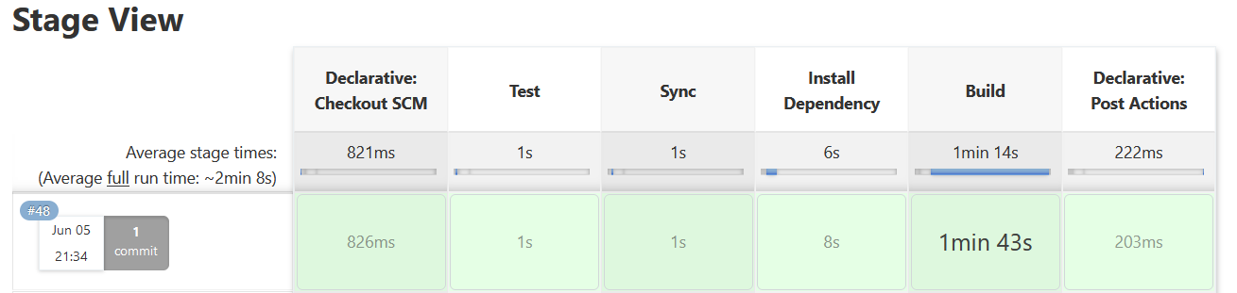
Jenkins Pipeline
Testing and Operation on the same environment, but at different repositories
Testing Repository：/tmp2/user/jenkins/Web-Application
Operation Repository：/home/user/project/Web-Application
On Gitlab push event,
automatically sync in testing repository
Update and build in operation repository
Unit testing backend functions in testing repository
Sync in operation repository
Clean up testing repository

Slide 51
Demo

Slide 52
影片連結
https://drive.google.com/file/d/1olPtFlmjVt7EAkXA5vbCXOe8Zg1aZ64H/view?usp=sharing

