Slide 1
US Equity Market-Neutral
Gradient-boosted trees on 147 firm characteristics, traded through a sector-, size- and beta-residualised long/short book
INFORMATION RATIO
IR AFTER 20BPS
BETA VS S&P 500
MAX DRAWDOWN
+0.88
+0.71
-0.159
-6.53%
vs 3M T-bill + 4%, gross
trading costs applied
se=0.120
monthly marks
Evaluation window 2021-01 to 2026-08 (68 months) · 200 names · 200% gross · net +12.5%
Measured against the universe it picks from, the long leg is positive in both halves of the window (+8.03% over the full period, t +2.8). The short leg's own contribution is concentrated in the 2021-22 unwind (-15.63%) and is indistinguishable from zero since. We treat it as the hedge, not as a second source of alpha.
[TEAM NAME - FILL IN]
Junhong Zhou · Tony Tran · Faig Haji · Bohan Zhang · Alex [surname]
Notes:
Headline is the information ratio against cash plus 4 percent, which is the competition's scoring metric. Gross figure first, net of 20bps beside it. Beta is the neutrality evidence and is checked before anything else.

Slide 2
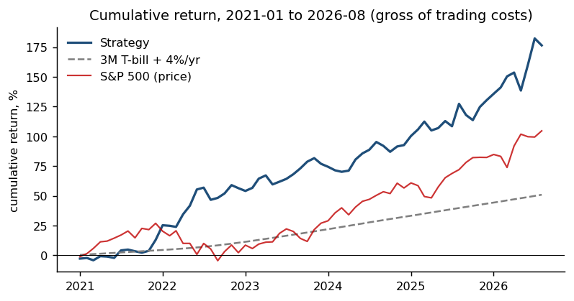
The strategy
Rank, then remove everything we are not trying to bet on
1
Screen Price >= $5, no nano or micro caps. Unscreened, the short book had a $50m median cap and a $2.63 median price - not borrowable at size.
Top 10 long positions, average weight 01/2021-08/2026
Ticker | Company name | Avg wt
INCY | Incyte Corp | 1.13%
USNA | Usana Health Sciences Inc | 0.78%
YELP | Yelp Inc | 0.76%
NNI | Nelnet Inc | 0.74%
GOOGL | Alphabet Inc | 0.72%
HSTM | Healthstream Inc | 0.69%
TNET | Trinet Group Inc | 0.67%
CORT | Corcept Therapeutics Inc | 0.66%
USLM | United States Lime Minerals Inc | 0.64%
WINA | Winmark Corp | 0.62%
2
Residualise The forecast is regressed on sector, size and beta each month; only the residual is traded.
3
Smooth Scores averaged over three months. Turnover falls 56% to 24.6%; break-even rises to 100 bps.
4
Size Inverse-volatility weights inside each leg, capped near 2% of capital.
5
Match beta Leg notionals set from each leg's own realised sensitivity over 24 completed months, not from per-stock estimates.
Neutrality enforced: beta, not dollar. The legs are sized so their beta-weighted exposures cancel, so net dollar exposure averages +12.5% rather than zero. Realised beta is -0.159 (se 0.120), correlation with the S&P 500 -0.19.
Top 10 short positions, average weight 01/2021-08/2026
Ticker | Company name | Avg wt
FSLR | First Solar Inc | -0.73%
DAL | Delta Air Lines Inc | -0.72%
LVS | Las Vegas Sands Corp | -0.68%
UAL | United Airlines Holdings Inc | -0.60%
SWCH | Switch Inc | -0.58%
VIRT | Virtu Financial Inc | -0.58%
PCG | PG&E Corp | -0.57%
AAL | American Airlines Group Inc | -0.55%
CNNE | Cannae Holdings Inc | -0.54%
COOP | Mr Cooper Group Inc | -0.54%
Signals driving the forecast: profitability 20%, investment 19%, risk 19%, past returns 11% of the model's split gain, across 147 characteristics. Full ranking on page 3.
Notes:
Page 2 answers the brief's four questions in order: how the legs are built, which neutrality we enforce, which signals drive it, and the top ten of each leg with the cumulative chart. Short book median daily dollar volume $55m, long leg $27m.

Slide 3
Data and method
147 supplied characteristics; which of them the model actually uses
Forecast
Which characteristics the model uses
Gradient-boosted trees, refit annually on an expanding window with a rolling two-year validation block, split by target month. Trees won four of the six folds; Ridge joined the blend in 2022 and 2023, on that fold's validation rank correlation.
Missing values are NOT imputed for the trees. Missingness is informative - stocks missing the most characteristics have a median cap of $282m against $1,687m.
The target is demeaned within each month. Fitting raw returns stopped after ONE boosting round: training averaged +0.27%/month against +2.52% in validation.
Model choice is made inside each fold on that fold's validation block only.
Weights are fractions of NAV, summing to 200% gross and +12.5% net. Returns are built as spread = sum of weight x ret_exc_lead1m, total = 3M T-bill + spread, hurdle = 3M T-bill + 4%/12. The rules warn not to assume the risk-free rate inside ret_exc is the T-bill, so we measured it: backed out of the panel it runs 3.111% against the T-bill's 3.281%, and at our net exposure that residual is +0.033%/yr, moving the information ratio by -0.0026. Reported, not assumed.
Family | Share of split gain
profitability | 20.0%
investment / growth | 18.9%
risk / volatility / beta | 18.6%
past returns / momentum | 11.1%
liquidity / trading | 10.9%
valuation | 10.8%
accruals / quality / distress | 9.0%
Ten most used characteristics, averaged over six annual refits
Characteristic | What it measures | Share
ivol_capm_252d | Idiosyncratic volatility vs CAPM, 252d | 7.53%
lti_gr1a | Growth in long-term investments | 4.67%
op_at | Operating profit / assets | 3.60%
sti_gr1a | Growth in short-term investments | 2.13%
ni_me | Earnings yield (net income / market cap) | 1.99%
rmax5_21d | Mean of 5 best daily returns, 21d | 1.80%
market_equity | Market capitalisation | 1.75%
fcf_me | Free cash flow yield | 1.72%
zero_trades_21d | Zero-volume days in 21d (illiquidity) | 1.71%
op_atl1 | Operating profit / lagged assets | 1.66%
Out-of-sample R-squared, benchmarked against zero
Model | OOS R2 | Monthly IC
Gradient-boosted trees | +0.3956% | +0.1354
Ridge | +0.0278% | +0.1193
OLS | -0.0068% | +0.0806
Lasso / Elastic Net | negative | +0.08
The rules note 1-2% is typical even for neural networks; a large positive number would mean a leak, not skill. The 8-K corpus was measured and excluded - the appendix has all three tests.
Where AI was used, and where it deliberately was not. No part of the traded pipeline is agentic: every forecast comes from LightGBM and Ridge fitted to the supplied characteristics, and no language model reads a filing, proposes a feature or scores a stock. AI was used to write and review pipeline code, to run diagnostics, and to attack our own results - the short-leg regime split, the cross-fold leak in model selection, the survivorship structure of the 8-K linkage and the sector-neutrality tests were all found that way. Keeping it out of the forecast is how we prevent model-side look-ahead: an LLM trained past 2021 cannot be shown a 2021 stock and asked what happens next. Every AI-proposed change was scored on the pre-registered validation window before it was allowed near the book, and the ones that failed there are reported in the appendix rather than dropped.
Notes:
Page 3 answers three of the brief's questions: why this model, how training is structured, and which characteristics drive it. The agentic paragraph answers the fourth honestly - our pipeline is not agentic, and that is a choice we can defend rather than a gap.

Slide 4
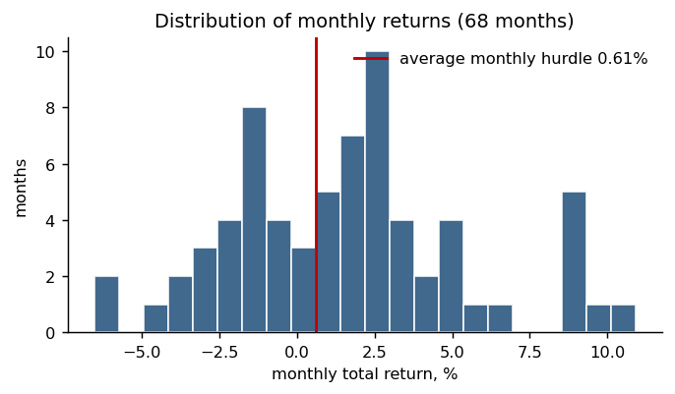
Returns
2021-01 to 2026-08, 68 months, gross of trading costs unless stated
ANNUALISED (CAGR)
CUMULATIVE
HIT RATE
MEAN MONTH
+19.65%
+176.42%
61.8%
+1.575%
arithmetic +18.90%
hurdle +50.87%, S&P +104.63%
months beating the hurdle
best +10.90% 2022-01 / worst -6.53% 2022-08
Each leg separately, per month: long +1.297%, short +0.004%. The short leg contributes almost nothing on average and earns its place by what it removes, not by what it adds.
Calendar years
Where the return came from
Year | Strategy | Hurdle | S&P 500
2021 | +12.95% | +4.12% | +26.89%
2022 | +38.51% | +6.19% | -19.44%
2023 | +13.07% | +9.45% | +24.23%
2024 | +8.89% | +9.34% | +23.31%
2025 | +19.60% | +8.37% | +16.39%
2026 | +19.99% | +5.21% | +12.28%
Leg, measured against the eligible universe | 2021-22 | 2023-26
Long leg excess | +6.12% | +9.07%
Long leg t-statistic | +1.2 | +2.7
Short leg excess (negative is good) | -15.63% | -0.44%
Short leg t-statistic | -2.2 | -0.1
Raw contribution conflates a rising market with poor selection. Measured against the universe we could actually trade, the long leg is positive in both periods; the short leg's own edge sits in the 2021-22 unwind and is flat afterwards.
Notes:
2024 is the only year that trails the hurdle. 2022's +38.51% coincides with a -19.44% market and is the period we treat as non-repeatable.

Slide 5
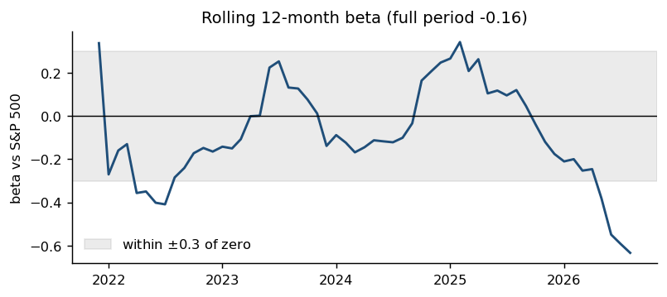
Risk-adjusted performance
The information ratio is the headline; beta is the entry requirement
INFORMATION RATIO
SHARPE
ALPHA VS S&P 500
BETA
+0.88
+1.19
+17.29%
-0.159
vs cash + 4%, annualised
over cash, annualised
t=+3.22
se 0.120
Cost sensitivity
Cost per trade | Information ratio | Annualised
0 bps | +0.88 | +19.65%
10 bps | +0.79 | +18.29%
20 bps | +0.71 | +16.93%
30 bps | +0.62 | +15.60%
50 bps | +0.44 | +12.96%
Break-even cost: 100 bps per trade
Outside +/-0.3: 10 of 57 windows, which is 3 distinct episodes once the overlap between 12-month windows is collapsed - 2021-01..2022-07, 2024-03..2025-02, 2025-06..2026-08.
None of them is distinguishable from zero (largest |t| 1.9). A 12-month window measures beta 2.0x looser than the full period, so a book with our full-period beta would leave the band in 32% of windows on sampling noise alone. We leave it in 18%.
Borrow fees are not modelled. At 25bps trading plus 1%/yr borrow and a haircut on the collateral rate, the information ratio is roughly 0.5 - the number we would rather defend.
Notes:
Beta with its standard error is the neutrality evidence the rules ask for. The rolling chart is the one they say separates teams.

Slide 6
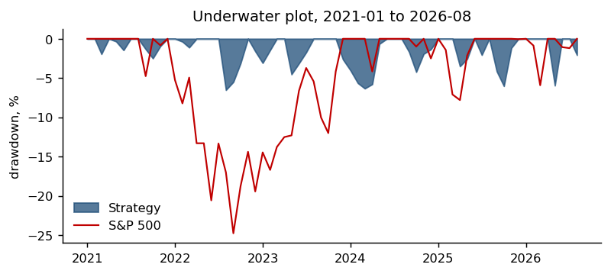
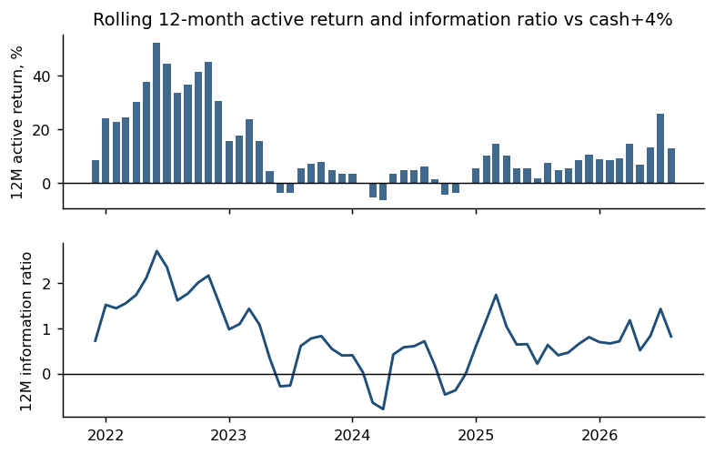
Exposure and implementation
All four trading limits hold in every one of the 68 months
Measure | Value | Range / note
Holdings | 200 | 100 long / 100 short
Gross exposure | 200.0% | range 200.0%-200.0%
Net exposure | +12.5% | range -24.0% to +30.0%
Largest single position | 2.24% | average 1.000%
Top 10 names | 9.7% | share of gross
Monthly turnover | 24.6% | range 17%-41%
Notional traded | 99% of capital | per month
Short-book borrowability
 | Short leg | Long leg
Median market cap | $3714m | $2577m
Median daily dollar volume | $55m | $27m
Median monthly dollar volume | $1.15bn | $0.56bn
Median price | $28.85 | $45.05
Small cap or below | 48.7% | nano/micro screened out
Dollar volume is the trailing 126-day daily average; the monthly row is the month's total, and the two differ by roughly the number of trading days. The short book is more liquid than the long book on both. The unscreened version had a $50m median cap and a $2.63 median price.
Notes:
Net exposure sits inside a self-imposed +/-30% cap, wider than we would like, and it is the price of reaching beta neutrality.

Slide 7
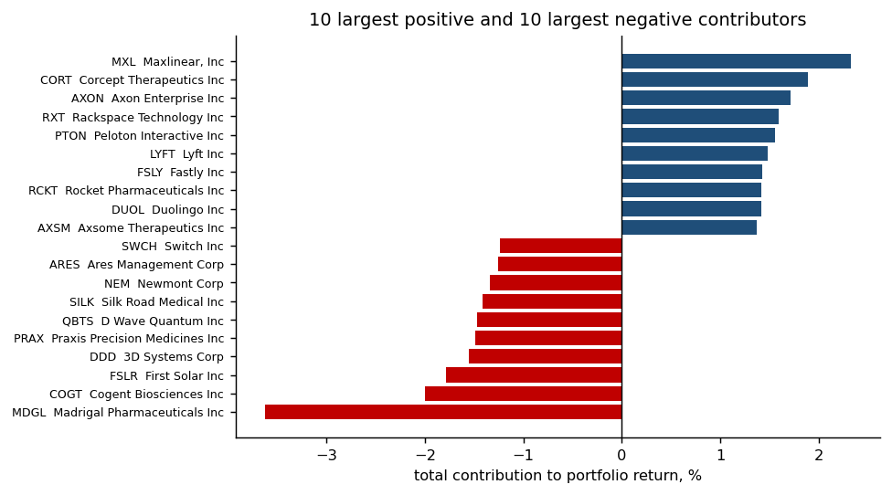
Cumulative performance
Strategy against the cash-plus-4% hurdle, with the S&P 500 for context
Beating the market is not the objective this year. The S&P 500 is shown because the rules ask for context and because the regression of our excess returns on the market's is how neutrality is verified. The number that decides the strategy is the distance from the grey hurdle line.
Notes:
Contributors chart names every stock by ticker and company name, as required.

Slide 8
What we would tell an investment committee
What worked
What did not
What we would do next
Construction moved the book from beta -0.537 to -0.159 and cut drawdown from -30% to -6.53%.
Alpha survives market, size, value and momentum: +15.15%/yr, t=+2.68, R2 0.17. Only value loads at all; the rest are indistinguishable from zero.
The long leg is the steady part: +8.03% over the eligible universe across 68 months, t +2.8, and positive in both halves (+6.12% then +9.07%).
The short leg's edge was one regime. In the pre-test validation window it pointed the wrong way (+5.42% vs universe); since 2023 it is statistically zero.
8-K signals add nothing measurable, across three independent tests - and the corpus itself is survivorship-linked, which is in the appendix.
Removing the 5 best months of 68 takes the information ratio from +0.88 to +0.36.
The second half of the window runs at +0.62 against +1.12. The later figure is the more honest forward expectation.
The short book's job is neutrality, not return. We would size it as a hedge.
Sector neutrality: 90% of capital sits in sector bets nobody chose. Every arm we tested beats the book on the test period and LOSES to it on the only window the model never saw (-0.66 against -1.05 net of costs), so we report it as untested rather than rejected and did not change the book on evidence our sample cannot resolve. Appendix.
We evaluated the test period 13 times. Nine followed a diagnosed defect.
The positions that drove it
The macro backdrop
MXL, Maxlinear, Inc +2.33% (long, 5mo)
CORT, Corcept Therapeutics Inc +1.89% (long, 46mo)
AXON, Axon Enterprise Inc +1.71% (long, 38mo)
RXT, Rackspace Technology Inc +1.60% (short, 17mo)
Largest single loss: MDGL, Madrigal Pharmaceuticals Inc -3.63% (short, 26mo) - a short in a biotech that re-rated on trial data. No characteristic in the panel anticipates a readout, which is the honest limit of this approach.
2021 +12.95% against the S&P's +26.89%. Post-COVID reflation and the retail speculative peak; the short book carried the year.
2022 +38.51% while the S&P fell -19.44%. The hiking cycle de-rated long-duration growth - our best year, and the clearest evidence the book is not a disguised long.
2023-25 AI-led concentration in mega-caps. The short edge disappears and the long leg takes over; +0.46 over those three years.
2026 +19.99% against +12.28% in eight months, with rolling beta drifting to -0.63 by August - the drift the appendix flags.
Notes:
This is the page the rules are really asking for: did it do what you trained it to, which signals drove it, which positions, which macro events, and what you would change.

Slide 9
APPENDIX
Where the alpha came from, and why it moved
Each leg measured against the universe it was picked from, which removes market direction
Period | Universe | Long vs universe | Short vs universe
2019-20 (validation build) | +25.03% | +0.85% (t +0.1) | +5.42% (t +1.1)
2021-22 | -3.73% | +6.12% (t +1.2) | -15.63% (t -2.2)
2023-26 | +11.93% | +9.07% (t +2.7) | -0.44% (t -0.1)
Full period | +6.40% | +8.03% (t +2.8) | -5.80% (t -1.5)
Applying the same standard to both legs
Recomputed on the submitted book, the two legs are not symmetric. The long leg is positive in both periods and clears its own standard error over the full window; the short leg's edge is confined to 2021-22. So the framing is not that they take turns - it is that the long leg carries the alpha and the short leg is a hedge that happened to pay during the unwind. Sizing it as a second alpha source would be reading one regime as a rule.
For the short leg a negative number is good: the names we shorted underperformed.
The only window with short-side skill is 2021-22, the speculative unwind. In the pre-test validation window the short leg was the wrong way round.
Splitting the short book by market cap, price and volatility, EVERY bucket flips positive to negative. No screen repairs it: dropping the extreme-volatility names would have cost 18.8pp of the 2021-22 gain to recover 3.7pp of the later loss.
The 2021-22 short alpha survives sector adjustment intact: -15.63% against the whole universe and -16.36% against its own sectors. It was stock selection inside sectors, not a bet against technology.

Slide 10
APPENDIX
Text data: three tests, one null, one exception
This year's theme, measured rather than assumed
Test | What we found
27 single-signal tests on item codes | None clears a monthly regression with controls
Joined into the forecast | Validation IC +0.1087 without, +0.1082 with
The model's own feature importance | 10 filing columns take 1.71% against 6.37% expected
Item 5.02 split by triage | Aggregate +0.046% (t +0.5) -> abrupt -0.640% (t -1.9)
Coverage checked against delistings | Survivorship-linked: see below
Why the aggregate hid it
70,582 officer-change filings carry no signal together. Separated, 1,632 abrupt departures move next-month returns by -0.640% while 14,746 routine appointments move them +0.121%. An aggregate null is not the same as no signal - it can be a diluted one.
The naive t-statistic was inflated in all of these. Stocks within a month move together, so 7,670 stock-months are not 7,670 independent observations. Three signals that looked alive on the naive test died on the monthly one.
Coverage is the binding constraint: only 50.7% of evaluation-window stock-months have any filing, and the abrupt-departure flag is set on 1.26%. A tree splits on what separates many rows; a rare flag is structurally ignored however accurate it is.
The triage uses no language model. Rules were read off the documents; --sample prints both sides for inspection and sorted 8 of 8 correctly on the sample shown.
THE CORPUS IS SURVIVORSHIP-LINKED, and we found it while trying to confirm that our delisted holdings were acquisitions. Of the 59 positions that lose their forward return, only 18 appear in the 8-K data at all - 0 of 11 that vanish in 2021, 0 of 10 in 2022, 0 of 12 in 2023, 0 of 7 in 2024, then 10 of 11 in 2025 and 8 of 8 in 2026. Dunkin' Brands, Fitbit, Varian Medical Systems, Alexion Pharmaceuticals, Maxim Integrated, Luminex and Raven Industries each filed 8-Ks throughout 2015-2020 and have ZERO filings in a dataset that spans 2015-2026. The company list was built from identifiers that still resolve today, so anything acquired before roughly 2025 is simply absent.
That makes missingness itself a forward-looking variable: a stock-month with no 8-K record is 12.1% likely to vanish within twelve months against 1.2% if covered (t +23.8), and it predicts next-month return at -0.24%/month (t -2.22, Fama-MacBeth). A tree splitting on missingness can therefore see survival information that was not observable at the rebalance date. It is the strongest argument for the exclusion we had already made on other grounds, and it is the most useful thing the text data told us.
t = -1.9 still does not clear the bar we set for ourselves after this many tests, and we say so.

Slide 11
APPENDIX
Robustness
Six tests, run before the deck was written
Subperiod | Information ratio | vs hurdle
2021 rebound | +0.72 | 12 months, +8.8% vs hurdle
2022 drawdown | +1.58 | 12 months, +32.3% vs hurdle
2023-25 concentration | +0.46 | 36 months, +17.6% vs hurdle
2026 so far | +1.23 | 8 months, +14.8% vs hurdle
first half | +1.12 | 34 months
second half | +0.62 | 34 months
Factor attribution
Model | Annualised alpha | t and R2
market only (FF MKT-RF) | +18.30% | t=+3.37, R2 0.05
market + size + value | +13.78% | t=+2.47, R2 0.15
market + size + value + momentum | +15.15% | t=+2.68, R2 0.17
Of the four factor loadings only value is even borderline (t +2.0); market, size and momentum are indistinguishable from zero, and the regression leaves most of the variation unexplained (t=+2.47, R2 0.15).
Delisting marks: positions with no realised return are marked at zero in the base case (50 of 13,600, 0.64% by weight). At Shumway's -30% convention the net information ratio is +0.54.
Daily marks cover 82.3% of the book by weight and 64.4% at worst. Names that cannot be resolved were acquired or renamed, so daily figures are biased optimistic.
Maximum drawdown on daily marks is -11.93% against -6.53% on monthly marks. Rolling 12-month beta averages -0.08 (range -0.63..+0.34, outside +/-0.3 in 18% of windows).
Stress test | Information ratio
all months | +0.88
minus the 1 best months | +0.79
minus the 3 best months | +0.59
minus the 5 best months | +0.36
minus the 5 best stocks | +0.76
minus the 10 best stocks | +0.67
minus the 20 best stocks | +0.50

Slide 12
APPENDIX
Research log and multiple testing
The question we expect to be asked, answered before it is
We evaluated the test period 13 times. Nine of those followed a diagnosed defect and had a reason independent of the result: penny stocks in the short book (-48% in January 2021), beta at -0.537, the wrong beta estimator, the tree target not demeaned (one boosting round per fold), leg beta measured rather than estimated, unstable validation tuning, and a cross-fold leak in model selection.
Four were genuine trials: the tree model, turnover control, the 8-K feature set, and sector neutrality. The 8-K set was removed after it failed its pre-declared test. Sector neutrality was proposed after the diagnosis that 90% of capital sits in sector positions nobody chose; it was implemented two ways, scored first on the pre-registered 2019-20 window, and then varied across quota rule, smoothing and buffer. It led in 7 of 18 configurations (binomial p = 0.48) and our own conclusion about it reversed three times. It is reported as untested rather than rejected and the book was not changed.
One correction is worth naming. choose_blend pooled all six folds' validation blocks before picking one model for all six years, so the 2021 forecast was chosen partly on 2024-25 outcomes. Each fold's own split was clean and our checks passed - the leak lived between folds, where a per-fold check cannot see it. Selection now happens inside each fold, and a new check fails on the old format.
What we take from this: with 68 months and this many looks, a t-statistic near 2 is not evidence. What makes a result worth keeping is effect size, a reason to expect it in advance, and survival across regimes - not the t. The sector work put a number on the limit: this validation window cannot resolve an information-ratio gap below 1.12, and the test period below 0.66, so effects of the size we were chasing are invisible to us either way.
Reproducibility
MAIN.py runs the whole chain from the supplied parquet files to the compliance gate and the exhibits on these slides, and exits non-zero if any rule is broken. 22 automatic checks cover look-ahead (predictor list, split keying, preprocessing fit window, cross-fold selection) and the trading criteria (100-500 names, gross <= 200%, net inside +/-50%, both legs, coverage, tradability). A separate test feeds the checker 21 deliberately broken inputs and asserts each is caught; all 21 fire. The traded book records 0 failures across all 68 months.

Slide 13
APPENDIX
A proposed improvement we tested and did not adopt
Sector neutrality: what the experiments said, and why they cannot settle it
The book carries a sector bet nobody chose
Four rounds of testing, three reversals
Residualising the score on sector dummies removes each sector's mean, not its skew. The traded book averages 8 technology longs against 28 shorts, and 89.7% of capital sits in net sector positions.
Shrinking those nets toward zero and restoring gross traces the whole curve:
Picking inside sectors loses on the clean 2019-20 window and gains nothing on the test period - until the quota rule, smoothing and buffer are varied, after which it leads in 7 of 18 configurations (binomial p = 0.48). Under a true null the best of 18 reaches ours essentially always.
A no-sector rule that evicts the weakest names beat the sector cap at one smoothing setting and lost at the other two, net of costs. We withdrew that conclusion too.
Neutralisation | Net sector | Spread | Vol | IR
none (traded book) | 89.7% | +15.62% | 13.15% | +0.88
a quarter removed | 73.2% | +16.16% | 13.04% | +0.93
half removed | 53.6% | +16.87% | 13.14% | +0.98
three quarters | 29.9% | +17.85% | 13.60% | +1.02
fully neutral | 0.0% | +19.28% | 14.68% | +1.04
Net of 20bps | Validation | Test period
Traded book | -0.66 | +0.67
Sector cap 5 | -1.05 | +0.91
Evict 10/month | -1.32 | +0.97
Volatility is flat until sector exposure falls below about half of capital, then rises. Variant S sits at 38.2%, where the curve predicts its volatility to within 0.11pp - so its flat vol is not a puzzle. Its return, though, beats the curve by 4.2pp: only about a third of variant S's gain is the sector exposure it removes.
Every arm beats the traded book on the test period and loses to it on the only window the model never saw. Exploratory arms were run on an earlier build (baseline +0.85); the dose curve and variant S are on the submitted book.
What this evidence can decide, and what it cannot
Exact. Sector net exposure falls from 89.7% of capital to 38.2% of capital. That is arithmetic on the weights and carries no sampling error at all.
Estimated, and not established. Market sensitivity is the mandate metric, and it does not hold up: 28 of 57 rolling windows improve (49% -- a coin flip is 28), full-period |beta| moves -0.034 — 0.28 of one standard error — and the headline last window, -0.63 to -0.21, is 1.3 standard errors -- not significant.
Not resolvable. Validation cannot detect an IR gap below 1.12, the test period below 0.66; every effect here is between +0.2 and +0.4, and our own conclusions reversed three times. The book is unchanged: adopting would be a judgement about mandate exposure, not a statistical finding, and we would say so.

