Slide 1
ANSE and PhEDEx
Integrating Network-Awareness and Network-Management into PhEDEx

Slide 2
Introduction
Overview
Advanced Network Services for Experiments
(Short) PhEDEx intro
Current development efforts w.r.t. circuits and PhEDEx
Where/how it can be integrated
Previous results (ISGC 2014)
Circuit awareness PhEDEx
Updated FileDownload agent / ResourceManager
NSI circuits, issues encountered and proposed solution
Summary and future plans

Slide 3
ANSE
A project funded by NSF CC-NIE program
ANSE - Advanced Network Services for Experiments
Integrate network awareness into the software stacks of experiments
PhEDEx for CMS
Panda for ATLAS
Official starting date Jan 2013
Build on top of existing services (LHCOPN, LHCONE)
PIs:
Harvey Newman, PI, Caltech
Shawn McKee, co-PI, University of Michigan
Paul Sheldon, co-PI, Vanderbilt University
Kaushik De, co-PI, University of Texas at Arlington

Slide 4
PhEDEx Overview
The data management transfer tool for CMS (since 2004)
Loosely coupled set of agents written in Perl interacting via central DB
central agents (ex. FileRouter agent)
site agents running at various T1s and T2s (ex. FileDownload agent)
each agent performs a independent single task
PhEDEx front-end and data-service
Three instances running over the same network
Common workflow:
Front-end used to request data to sites
Central agents compute paths of least cost, schedule transfers, etc
Site agents execute transfer tasks
FileRouter (central) agent builds transfer queue per destination
FileDownload (site) agent examines its queue, processes it & reports back

Slide 5
PhEDEx Overview 2
PhEDEx is:
not necessarily “near” the storage (i.e. same subnet)
high level software … only knows about:
datasets, blocks, files
Hostnames/IPs from URLs
Path of files
When issuing a transfer request user supplies:
Dataset/block
Destination site(s)
Data that PhEDEx can provide
Datasets, blocks & file names & sizes
SURL (storage farm hostname, local file path)
Information about transfer queues
Limited monitoring information

Slide 6
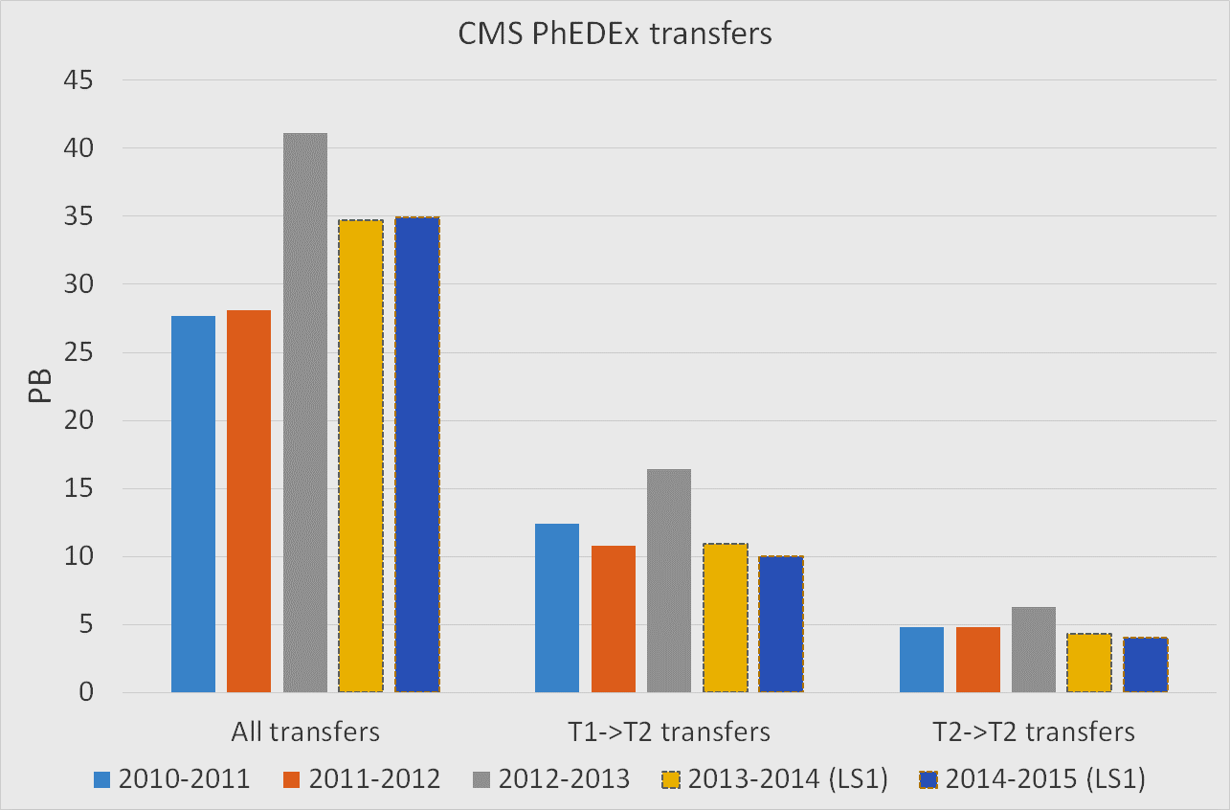
PhEDEx transfers over the past 5 years

Slide 7
ANSE & PhEDEx
Goals:
Enhance PhEDEx with circuit awareness capabilities
Provide a tool which can be used by others
Motivation*:
More deterministic transfers (schedule jobs with data)
Data prioritization over other traffic
PhEDEx integration possibilities:
In the FileDownload agent (site level):
Compromise between desired functionality and complexity
Only has a local view
In the FileRouter agent (central level):
Has a global view of the whole system
Harder to implement and optimize
* Provided that guaranteed BW is available

Slide 8
Initial prototype
Modified the FileDownload agent to:
Check its own download queue
Determine whether a circuit is needed
Request a circuit (using DYNES)
If circuit was established:
convert transfer URLs to use the new L3 path
start new transfer using the updated URLs
Manage the lifecycle of the circuit
Prototype:
Required no modifications to PhEDEx DB
Had all control logic in the FileDownload agent
Was transparent for all other PhEDEx instances
Issues:
Relied on FDT as a transfer backend
Could not be used by external apps
Could not be extended to use other circuit providers

Slide 9
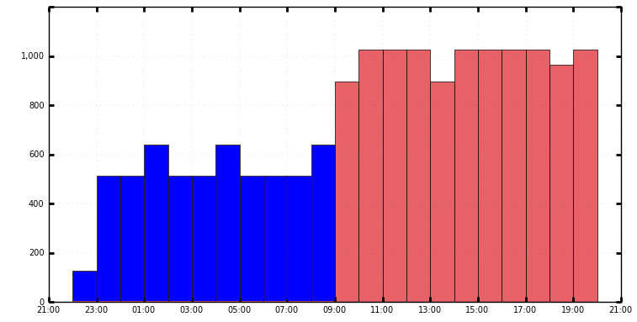
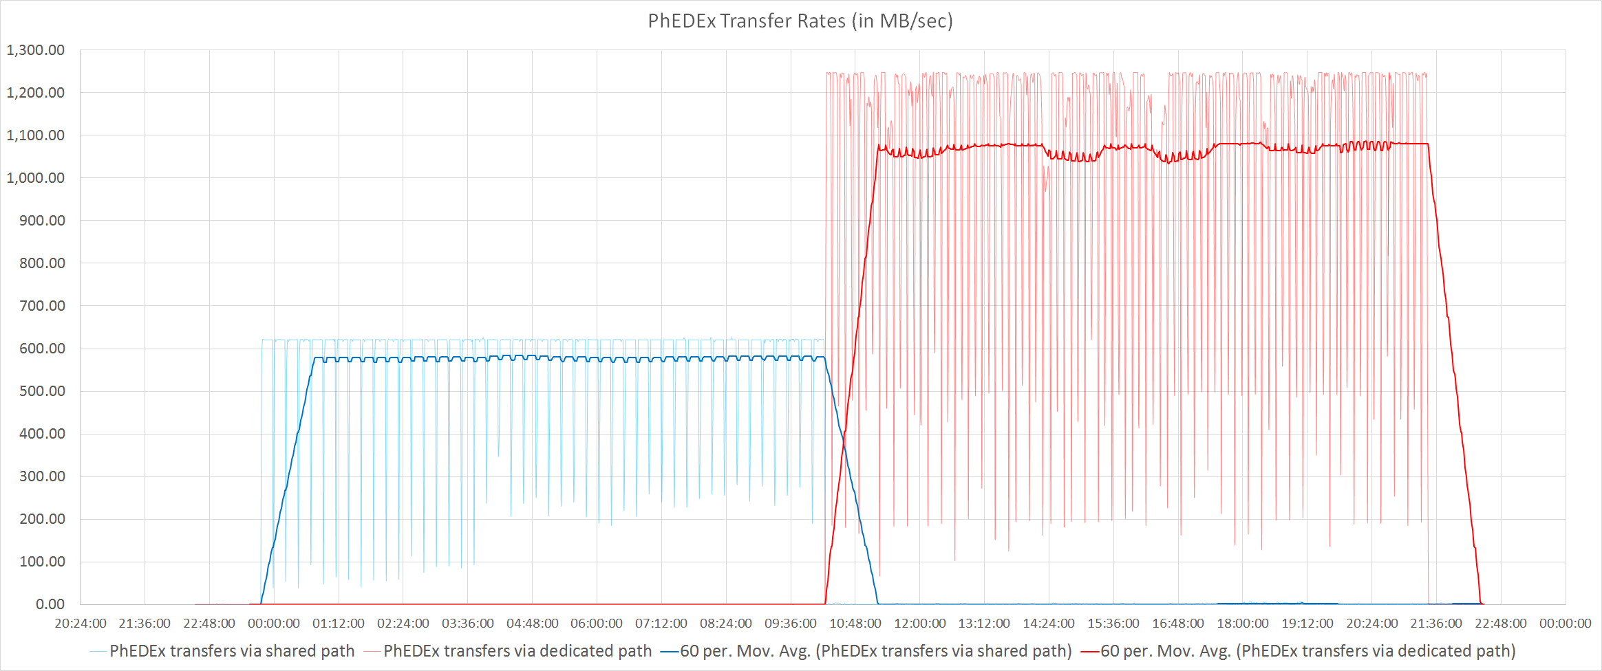
Results using the prototype
Seamless path switch
Per job link rates with PhEDEx traffic
~620MB/sec -> 1060 to 1250MB/sec
Average link rates with PhEDEx traffic
~570MB/sec -> ~1050MB/sec
1200
Phedex reported rates
MB/sec
Limited by background traffic

Slide 10
Integrating circuit awareness in PhEDEx – inner workings
Standard FileDownload agent:
Files from the transfer queue are grouped into transfer jobs
Jobs are handed to the transfer backend (FDT, FTS, etc…) for execution
Transfer backend reports back with transfer status
FileDownload agent reports back to DB
Updated FileDownload agent (CircuitAgent):
Determines whether a circuit is worthwhile and requests one if it is
Circuit request goes via the ResourceManager
When a new transfer job is ready to start
Checks if a circuit is available (via ResourceManager)
Updates job to use circuit instead of GPN
ResourceManager:
Interacts with PhEDEx via direct calls
Interacts with external programs via a REST interface
Handles the lifecycle of the circuit on behalf of those programs
Can handle different types of circuits (via plug-ins)

Slide 11
Class diagram

Slide 12
Sequence diagram

Slide 13
Using NSI
Network Service Interface
NSI is an advance-reservation based protocol
Supports tree and chain model of service chaining
Two phase reservation system
First phase: availability is checked, if available, resources are held
Second phase:
the requester either commits or aborts a held reservation
should the requester fail to do the above, a reservation can expire after a set timeout
NSI reservation properties
Source, destination endpoints (mandatory)
Start time, end time, reserved bandwidth (optional)
Limitations
Only supplies a L2 circuit
Circuit ends at site border router
Some providers don’t guarantee BW

Slide 14
Issues in dealing with L2 circuits
Transfer backends can’t directly use the NSI L2 circuit
Establishing L3 path to storage requires:
Some topology knowledge
Routing information
Direct access to the site’s network equipment
PhEDEx is a very high-level software -> Can only provide
Datasets, blocks & file names and sizes
SURL (Storage URL)
Storage farm hostname
Local file path
=> Establishing L3 paths is non trivial

Slide 15
Issues in dealing with FTS and SRM
SURLs to TURLs (FTS & SRM)
Get source TURL (call srmPrepareToGet)
Get destination TURL (call srmPrepareToPut)
Assuming that the TURL-s are gridftp endpoints, start gridftp copy
Monitor transfer progress
Release TURLs

Slide 16
Initial discussions
Technical constraints:
Only a L2 circuit
L2 circuit ends in the site’s border router
Limited feedback in case of errors
NSI adoption in production is still limited
All solutions of creating a L3 path rely either on
privileged access on site’s servers/routers
specialised hardware in place (OF capable)
Our solution must:
deal with sites serving multiple VOs
potentially deal with privileged and non privileged files transferred from the same server
work with the FTS/SRM/gridFTP
be as un-intrusive into sites operations as possible

Slide 17
Initial discussions (2)
Request circuit between site A and site B
PhEDEx specifies, list of files to be transferred
Before transfer, gridFTP checks if the file(s) should go on the circuit
If that’s the case set up a TC rule: mark packets of files to go on the circuit
Set up a PBR (or use OF) to do the routing of those files afterwards
Issues:
Relies on modifying or developing plug-ins for the transfer tools
Relies on having privileged access on servers (for packet marking)

Slide 18
Proposed solution diagram
* Ensures correct routing once L2 circuit is up
** Retrieves the IPs of gridFTP servers involved in transfer

Slide 19
Proposed solution diagram
Request circuit between site A and site B
Wrapper gets IPs of all servers involved in the transfer
Wrapper passes this information to the OF controller
PhEDEx informs the OF controller that a circuit has been established between the two sites
OF controller adds routing info in the OF switches that direct all traffic on the subnet to the circuit

Slide 20
Summary & future plans
PhEDEx is set to use circuits when they are available
No modifications done to PhEDEx DB
Control logic is in the FileDownload agent
Lifecycle handled by the ResourceManager
Transparent for all other PhEDEx instances
ResourceManager can be used as a 3rd party tool
Future plans:
Solve the issue of how to route data once a circuit is active
Demonstrate circuit management capabilities between select sites
Demonstrate improvement while using circuits

Slide 21
Thank you!

