Slide 1
ANSE and PhEDEx
Integrating Network-Awareness and Network-Management into PhEDEx

Slide 2
Introduction
Overview
Advanced Network Services for Experiments
(Short) PhEDEx intro
Current development efforts w.r.t. circuits and PhEDEx
Where/how it can be integrated
Previous results
NSI circuits, issues encountered and proposed solution
Summary and future plans

Slide 3
ANSE
A project funded by NSF CC-NIE program
ANSE - Advanced Network Services for Experiments
Integrate network awareness into the software stacks of experiments
PhEDEx for CMS
Panda for ATLAS
Started Jan 2013
Build on top of existing services (LHCOPN, LHCONE)
PIs:
Harvey Newman, PI, Caltech
Shawn McKee, co-PI, University of Michigan
Paul Sheldon, co-PI, Vanderbilt University
Kaushik De, co-PI, University of Texas at Arlington

Slide 4
PhEDEx Overview
The data management transfer tool for CMS (since 2004)
Loosely coupled set of agents written in Perl interacting via central DB
central agents (ex. FileRouter agent)
site agents running at various T1s and T2s (ex. FileDownload agent)
each agent performs a independent single task
Common workflow:
Front-end used to request data to sites
Central agents compute paths of least cost, schedule transfers, etc
Site agents execute transfer tasks
FileRouter (central) agent builds transfer queue per destination
FileDownload (site) agent examines its queue, processes it & reports back

Slide 5
PhEDEx Overview 2
PhEDEx is:
not necessarily “near” the storage (i.e. same subnet)
high level software … only knows about:
datasets, blocks, files
Hostnames/IPs from URLs
Path of files
When transferring data, PhEDEx provides…
Datasets, blocks & file names & sizes
SURL (storage farm hostname, local file path)
Information about transfer queues
Limited monitoring information (src-dst rates, quality)

Slide 7
ANSE & PhEDEx
Goals:
Enhance PhEDEx with circuit awareness capabilities
Provide a tool which can be used by others (CMS, non-CMS, non-HEP)
Enhance PhEDEx with knowledge of network status (not covered here)
Motivation*:
More deterministic transfers (schedule jobs with data, set/meet deadlines)
Data prioritization over other traffic
PhEDEx integration possibilities:
In the FileDownload agent (site level):
Compromise between desired functionality and complexity
Only has a local view
In the FileRouter agent (central level):
Has a global view of the whole system
Harder to implement and optimize
* Provided that guaranteed BW is available

Slide 8
Initial prototype
Modified the FileDownload agent to:
Examine its own download queue
Determine whether a circuit is useful (expected vs. achieved transfer rate)
Request a circuit (using DYNES)
If circuit was established:
convert transfer URLs to use the new L3 path
start new transfer using the updated URLs
Manage the lifecycle of the circuit
+ No modifications to PhEDEx DB
+ All control logic in the FileDownload agent
+ Transparent for all other network users
− Relied on FDT as a transfer backend – not widely used
− Embedded in the FileDownload agent, could not be used by external apps
− Single-purpose, could not be extended to use other circuit providers
− DYNES no longer supported, not a candidate for production use

Slide 9
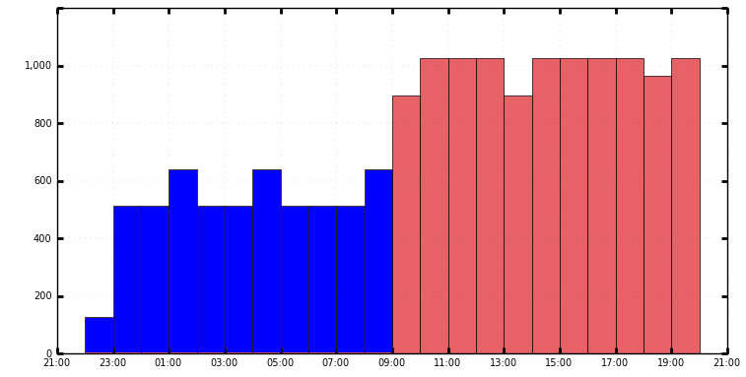
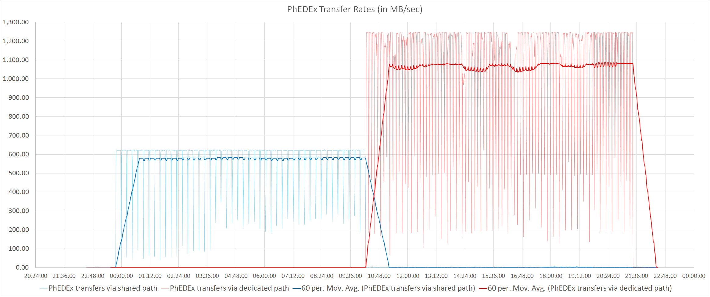
Results using the prototype
Seamless path switch
Per job link rates with PhEDEx traffic
~620MB/sec -> 1060 to 1250MB/sec
Average link rates with PhEDEx traffic
~570MB/sec -> ~1050MB/sec
1200
Phedex reported rates
MB/sec
Transparent switch to using dedicated circuit
Limited by background traffic

Slide 10
Using NSI to create circuits
‘Network Service Interface’
NSI is an advance-reservation based protocol
Supports tree and chain model of service chaining
Two phase reservation system
First phase: availability is checked, if available, resources are held
Second phase:
the requester either commits or aborts a held reservation
should the requester fail, reservation expires after a timeout
NSI reservation properties
Source, destination endpoints (mandatory)
Start time, end time, reserved bandwidth (optional)
Limitations
Only supplies a L2 circuit
Circuit ends at site border router, not at storage farm nodes
Some providers don’t guarantee BW
Not widely adopted - yet

Slide 11
Issues in dealing with L2 circuits
Transfer backends can’t directly use the NSI L2 circuit
Establishing L3 path to storage requires:
Some topology knowledge
Routing information
Direct access to the site’s network equipment
=> non-trivial to establish!
PhEDEx is a very high-level software -> Can only provide
Datasets, blocks & file names and sizes
SURL (Storage URL)
Storage farm hostname
Local file path

Slide 12
SURLs and TURLs…
SURLs to TURLs (FTS & SRM)
Get source TURL (call srmPrepareToGet)
Get destination TURL (call srmPrepareToPut)
Assuming that the TURL-s are gridftp endpoints, start gridftp copy
Monitor transfer progress
Release TURLs

Slide 13
So what do we do?
Technical constraints:
Only a L2 circuit
L2 circuit ends in the site’s border router
Limited feedback in case of errors
NSI adoption in production is still limited
All solutions of creating a L3 path rely either on
privileged access on site’s servers/routers
specialised hardware in place (OF capable)
Our solution must:
deal with sites serving multiple VOs
potentially deal with privileged & non privileged traffic on the same path
work with FTS/SRM/gridFTP
be as non-intrusive into sites operations as possible

Slide 14
Proposed solution diagram
Request circuit between site A and site B
Wrapper gets IPs of all servers involved in the transfer
Wrapper passes this information to the OF controller
PhEDEx informs the OF controller that a circuit exists between the two sites
OF controller adds routing info in the OF switches that direct traffic on the subnet to the circuit
Least intrusive option (least privilege), but requires OF controllers in the network

Slide 15
Summary & future plans
PhEDEx is ready to use circuits in production as soon as they are available
No modifications to the PhEDEx DB
Control logic is in the FileDownload agent
Lifecycle handled by the ResourceManager
Transparent for all other PhEDEx instances
ResourceManager can be used as a 3rd party tool
No CMS-specific parts
Future plans:
Solve the issue of how to route data once a circuit is active
Demonstrate circuit management capabilities between select sites
Demonstrate improvement while using circuits

Slide 16
Questions?

