Slide 2
AsyncStageOut: Distributed user data management for CMS Analysis
Hassen Riahi CERN IT-SDC
Tony Wildish Princeton University (US)
Diego Ciangottini University & INFN Perugia (IT)

Slide 3
Outline
Overview
Problem and strategy
Architecture
Integration
Results
Conclusions

Slide 4
Distributed data analysis in CMS
1000 individual users per month
More than 60 sites
20k jobs/hour
Typically 1 file/job
Files vary in size
200k completed jobs per day
Minimal latencies
Chaotic environment

Slide 5
Problem
15% to 20% the jobs fail and about 30% to 50% of the failures are due to the jobs not being able to upload their output data to a remote disk storage
between 5% and 10% of jobs fail in the remote copy of outputs
the overall CPU loss is even higher than 5-10% since those jobs fail at the end of the processing after multiple retries
often it results in DDoS to CMS Tier-2 storage systems
AsyncStageOut (ASO) is implemented to reduce the most common failure mode of analysis jobs

Slide 6
Asynchronous stage-out stretagy

Slide 7
Architecture overview

Slide 8
Architecture and evolution
ASO CouchDB
ASO Core Components
Real-time Ops Monitoring
Transfer
Retry Manager
(Strategy)
Submitter
Database
PhEDExMonitor
Cleaner
(File Deletion)
AuthN/AuthZ
Reporter
Publication
(Catalogue)
Analytics
(Reports, Stats)
REST interface
FTS3
API (HTTPS)
Clients
Dashboard
FTS Dashboard (Activity Monitoring/Stats)
CMS Analysis jobs Dashboard (FTS File Status)

Slide 9
CMS analysis jobs Dashboard

Slide 10
Integration

Slide 11
Deployment models
Production model
Highly scalable/available model based on CouchDB v2.0

Slide 12
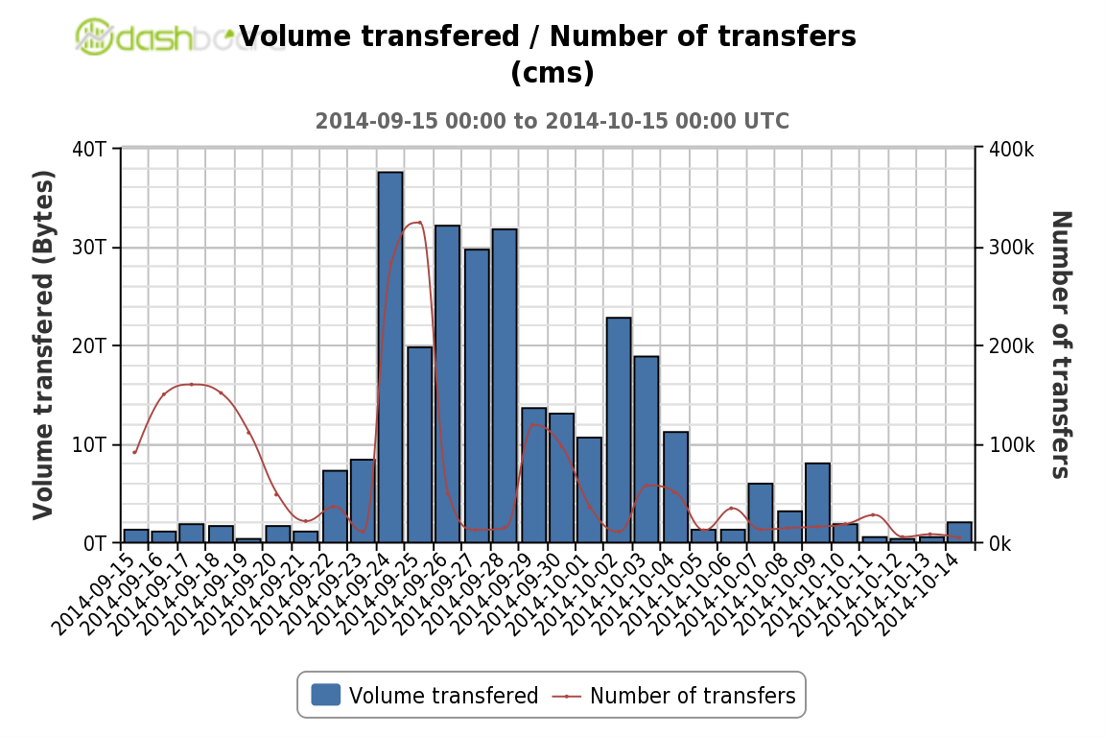
CSA14 exercise
Running CRAB jobs
Full production scale

Slide 13
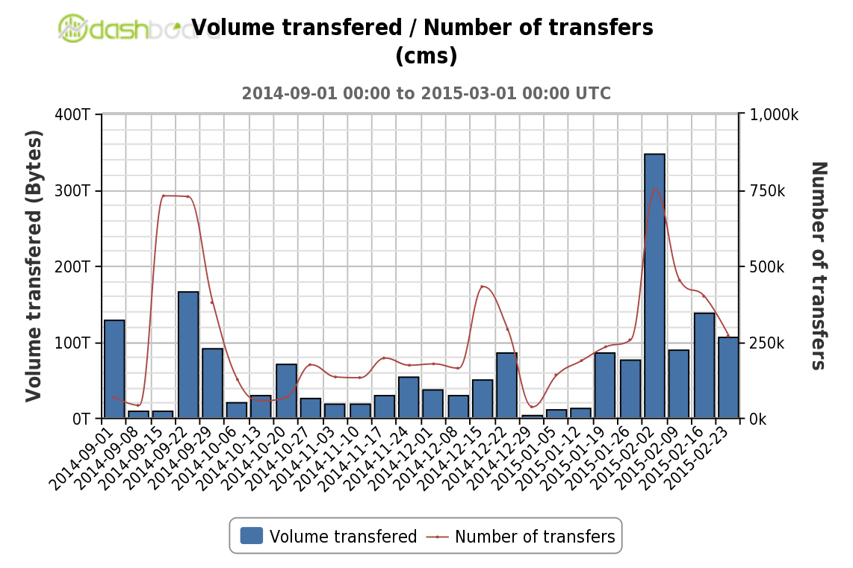
Production results
ASO has started production in June 2014
More than 2 PB/7 M files transferred during the last 6 months
Peaks of more than 700k transfers per week

Slide 14
Scale tests
Goal:
Simulate data transfers using PhEDEx LifeCycle Agent
Explore the scalability limits of ASO by scaling-up to 2-4 times the design load within the production and the new version of CouchDB
The design load is ~ 200 k completed analysis jobs/day
~ 300 k completed files/day (~ 200k outputs + ~ 100k logs)
Configuration:
200 parallel users
100 files per FTS job
60 sites
File size: 2 GB
Transfer throughput: 100 MB/s
Run the system for more than 12 hours

Slide 15
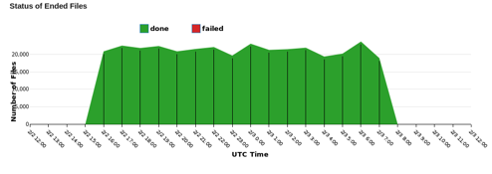
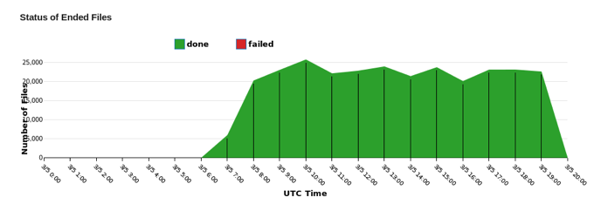
2 times scale
600 k completed files/day
CouchDB 1.1 (production)
Injection ends
Injection starts
20,000
15:00
7:00
CouchDB 1.6
20,000
6:00
19:00
Independently of the version of CouchDB, ASO can manage 2 times scale the design load

Slide 16
4 times scale
1,2 M completed files/day
Injection starts
Core dump in the Monitor component
Injection ends
7 h delay
100,000
21:00
9:00
16:00
30,000
8:00
15:00
ASO can manage ~ 3 times scale the design load with tuned parameters

Slide 17
Summary and conclusions
ASO has evolved from a limited prototype to a highly adaptable and scalable service
ASO has shown good performance during commissioning and production
ASO can manage 2 times scale of the design load
The management of 4 times scale is possible with an accurate tune of ASO and system parameters
Re-use of design and components from PhEDEx point the way to a more modular architecture for data-management tools in CMS
Long-term maintainability, performance and adaptability

