Slide 1
CSE 135 Discussion Week 3
Jules Testard

Slide 2
What we are going to cover
Examples from class
How to get setup for the project
(if we have time) : E/R modeling exercises from www.newgradiance.com.

Slide 3
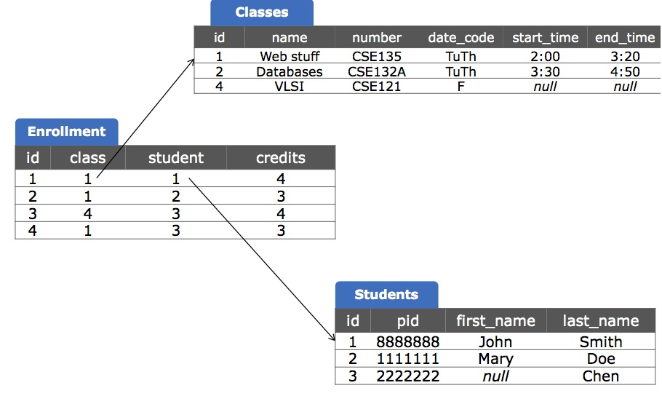
Examples from class : Recall the sample database

Slide 4
Query
Produce a table where each row has the name of a CSE 135 student and the name of another class he/she takes.
SELECT c_others.name,first_name,last_name
FROM classes AS c_135, enrollment AS e_135,
students, enrollment AS e_others, classes AS c_others
WHERE c_135.number = 'CSE135'
AND c_135.id = e_135.class
AND e_135.student = students.id
AND students.id = e_others.student
AND e_others.class = c_others.id
AND NOT (c_others.number = 'CSE135');

Slide 5
Same Query using Joins
SELECT c_others.name,first_name,last_name
FROM classes AS c_135
JOIN enrollment AS e_135 ON c_135.id = e_135.class
JOIN students ON e_135.student=students.id
JOIN enrollment AS e_others ON students.id = e_others.student
JOIN classes AS c_others ON e_others.class = c_others.id
WHERE c_135.number = 'CSE135'
AND NOT (c_others.number = 'CSE135');

Slide 6
Sample Query using a subquery
SELECT c_others.name, students.first_name,students.last_name
FROM enrollment AS e_others
JOIN classes AS c_others ON e_others.class = c_others.id
JOIN students ON e_others.student=students.id
WHERE NOT (c_others.number = 'CSE135')
AND students.id IN (
SELECT e_135.student
FROM classes AS c_135
JOIN enrollment AS e_135 ON c_135.id = e_135.class
WHERE c_135.number = 'CSE135'
);

Slide 7
Project Setup

