Slide 1
Sorting
Chapter 7
Fall 2021

Slide 2
Sorting
Sorting is a common problem when working with data.
Data is often collected in unsorted order and must be sorted for reporting or other processing.
Small sets of data can be sorted in main memory, called internal sorting.
Large sets of data may require utilizing tape or disk, called external sorting.
Our main focus will be internal sorting, sorting arrays in memory, though we will briefly look at external sorting using tape.

Slide 3
Preliminaries
The algorithms studied here can be called interchangeably, we simply pass an array with N elements.
We first consider comparison-based sorting, which assumes the data being sorted supports the Comparable interface.

Slide 4
Insertion Sort
One of the simplest sorting algorithms.
Sorts in N-1 passes.
For each pass p, ensures elements in positions 0 through p are in sorted order.
Uses fact that elements in 0 through p-1 are known to be sorted.
In each pass, move element in position p so that it is in the correct order with respect to the previous elements.

Slide 5
Original
p=1
p=2
p=3
p=4
p=5
0
1
2
3
4
5
34
8
8
8
8
8
8
34
34
34
32
21
64
64
64
51
34
32
51
51
51
64
51
34
32
32
32
32
64
51
21
21
21
21
21
64
Done
N=6, requires 5 passes (i.e., N-1).

Slide 6
a[ ]
public static <AnyType extends Comparable<? super AnyType>> void insertionSort(AnyType a[])
{
int j;
for (int p=1; p<a.length; p++) // N-1 passes
{
AnyType tmp = a[ p ]; // save next item to sort (create hole)
// for each element preceding p and < tmp
for (j = p; j > 0 && tmp.compareTo(a[ j – 1]) < 0 ; j--)
a[ j ] = a [ j – 1]; // slide element up one
a[ j ] = tmp; // put element p into hole
// (its correct position)
}
}
0
1
2
3
4
5
34
j - 1
p
8
j
tmp
64
51
32
21
O(N²) since nested loops 1 to N

Slide 7
Analysis of Insertion Sort
Insertion sort uses nested for loops and has a running time of O(N²).
If the data is already sorted, the time is O(N) because the inner loop would always be skipped.
Data that is mostly sorted would run quickly.
However, the average case running time is Θ(N²).

Slide 8
Lower Bound for Simple Sorts
A pair of elements in a list that are not in sorted order is called an inversion.
A simple sort such as insertion sort, bubble sort, and selection sort removes inversions by comparing and swapping adjacent elements.
The number of swaps required corresponds to the number of inversions present, since correcting each inversion requires a swap.

Slide 9
Lower Bound for Simple Sorts
An inversion in a list occurs if i<j, but a[i] > a[j].
This list has 9 inversions:
34, 8, 64, 51, 32, 21
They are:
(34, 8), (34, 32), (34, 21), (64, 51), (64, 32),
(64, 21), (51, 32), (51, 21), (32, 21)
This is the number of swaps that need to be made by insertion sort, because each swap of adjacent elements that are inverted removes one inversion.
Insertion sort runs in O(I+N) where I is the number of inversions. It is O(N) if I is O(N).

Slide 10
Lower Bound for Simple Sorts
For insertion sort to sort a list of N elements requires 1 + … + N-2 + N-1 swaps in the worst case, which is N(N-1)/2.
Consider any list L, and its reverse, L_{R}.
Any pair (x,y) is inverted either in L or L_{R}.
So, the total inversions for both lists together would be N(N-1)/2.
Thus, an average list has half this number, which is N(N-1)/4.

Slide 11
Lower Bound for Simple Sorts
Since each swap removes only one inversion, any algorithm that sorts by exchanging adjacent elements requires Ω(N²) time on average.
To beat this time, an algorithm must do comparisons and exchanges between elements that are far apart and eliminate more than one inversion per exchange.

Slide 12
Shellsort
Shellsort (named after Donald Shell, its inventor) was one of the first sorting algorithms to break the quadratic time barrier.
It is an extension of insertion sort which gains speed by allowing exchanges of elements that are far apart.
It works by comparing and swapping distant elements at first, and the distance decreases as the algorithm runs, until the last phase when adjacent elements are compared.

Slide 13
Shellsort
Shellsort uses a sequence, h1,h2,…,ht.
Any sequence where h1=1 will work.
Sometimes called a diminishing sequence sort or diminishing increment sort.
Shellsort rearranges the array so that elements spaced h_{k}-distance apart throughout the array are sorted. Such an array is said to be h_{k}-sorted.

Slide 14
Original
Here we are 5-sorting the list
5-sorted
81
94
11
96
12
35
17
95
28
58
41
75
15
35
94
11
96
12
81
17
95
28
58
41
75
15
35
17
11
96
12
81
94
95
28
58
41
75
15
35
17
11
96
12
81
94
95
28
58
41
75
15
35
17
11
28
12
81
94
95
96
58
41
75
15
35
17
11
28
12
81
94
95
96
58
41
75
15
35
17
11
28
12
41
94
95
96
58
81
75
15
35
17
11
28
12
41
75
95
96
58
81
94
15
35
17
11
28
12
41
75
15
96
58
81
94
95

Slide 15
5-sorted
Here we are 3-sorting the list
3-sorted
35
17
11
28
12
41
75
15
96
58
81
94
95
28
17
11
35
12
41
75
15
96
58
81
94
95
28
12
11
35
17
41
75
15
96
58
81
94
95
28
12
11
35
17
41
75
15
96
58
81
94
95
28
12
11
35
17
41
75
15
96
58
81
94
95
28
12
11
35
15
41
75
17
96
58
81
94
95
28
12
11
35
15
41
75
17
96
58
81
94
95
28
12
11
35
15
41
58
17
96
75
81
94
95
28
12
11
35
15
41
58
17
96
75
81
94
95
28
12
11
35
15
41
58
17
94
75
81
96
95
28
12
11
35
15
41
58
17
94
75
81
96
95

Slide 16
3-sorted
Here we are 1-sorting the list
sorted
28
12
11
35
15
41
58
17
94
75
81
96
95
12
28
11
35
15
41
58
17
94
75
81
96
95
11
12
28
35
15
41
58
17
94
75
81
96
95
11
12
28
35
15
41
58
17
94
75
81
96
95
11
12
15
28
35
41
58
17
94
75
81
96
95
11
12
15
28
35
41
58
17
94
75
81
96
95
11
12
15
28
35
41
58
17
94
75
81
96
95
11
12
15
17
28
35
41
58
94
75
81
96
95
11
12
15
17
28
35
41
58
94
75
81
96
95
11
12
15
17
28
35
41
58
75
94
81
96
95
11
12
15
17
28
35
41
58
75
81
94
95
96
11
12
15
17
28
35
41
58
75
81
94
96
95
11
12
15
17
28
35
41
58
75
81
94
95
96
16

Slide 17
Shellsort
The final step in a Shellsort is a 1-sort, which is the same as an insertion sort.

Slide 18
public static <AnyType extends Comparable<? super AnyType>> void shellsort(AnyType a[])
{
int j;
for( int gap = a.length / 2; gap > 0; gap /= 2 ) // gap=N/2, N/4…1
for( int i = gap; i < a.length; i++ ) // i = gap to N-1
{
AnyType tmp = a[i]; // save current item (create hole)
// for all items gap apart, put tmp in proper position
for(j = i; j >= gap &&
tmp.compareTo(a[ j - gap ]) < 0; j -= gap )
a[ j ] = a[ j - gap ]; // slide greater items up
a[ j ] = tmp; // put item in hole
}
}
a[ ]
0
1
2
3
4
5
6
7
8
9
10
11
12
35
17
11
28
12
41
75
15
96
58
81
94
95

Slide 19
Shellsort
The Shellsort can also be viewed as sorting columns of data as shown on the next slides:

Slide 20
Original
81
94
11
96
12
35
17
95
28
58
41
75
15
5-sort
35
17
11
28
12
41
75
15
96
58
81
94
95
81 94 11 96 12
35 17 95 28 58
41 75 15
35 17 11 28 12
41 75 15 96 58
81 94 95
Shellsort can be thought of as sorting columns

Slide 21
35
17
11
28
12
41
75
15
96
58
81
94
95
3-sort
28
12
11
35
15
41
58
17
94
75
81
96
95
17 11
12 41
15 96
81 94
95
28 12 11
35 15 41
58 17 94
75 81 96
95

Slide 22
Shellsort
Shellsort running time analysis is difficult.
The running time depends on the increment sequence used.
Shell’s original sequence of N/2, N/4, … , 1 takes Θ(N²).
Hibbard’s sequence of 2^{k}-1, … , 7, 3, 1 takes Θ(N^{3/2}).
Sedgewick has several that take O(N^{4/3}).

Slide 23
Shellsort
The next two slides prove Shellsort using Shell’s increments is Θ(N²).
First a lower bound of Ω(N²) is proven, then an upper bound of O(N²) is proven.

Slide 24
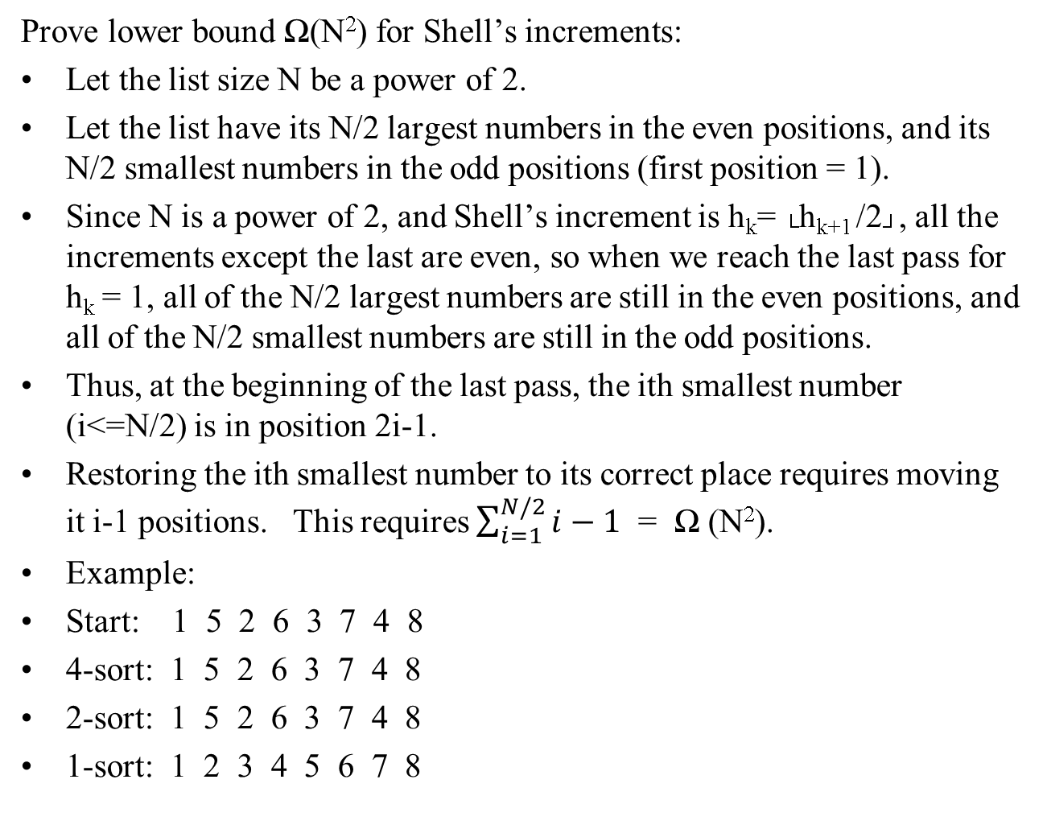
Prove lower bound Ω(N²) for Shell’s increments:
Let the list size N be a power of 2.
Let the list have its N/2 largest numbers in the even positions, and its N/2 smallest numbers in the odd positions (first position = 1).
Since N is a power of 2, and Shell’s increment is h_{k}= └h_{k+1} /2┘, all the increments except the last are even, so when we reach the last pass for h_{k} = 1, all of the N/2 largest numbers are still in the even positions, and all of the N/2 smallest numbers are still in the odd positions.
Thus, at the beginning of the last pass, the ith smallest number (i<=N/2) is in position 2i-1.
Restoring the ith smallest number to its correct place requires moving it i-1 positions. This requires $\sum_{i=1}^{N/2}{i−1}$ = Ω (N²).
Example:
Start: 1 5 2 6 3 7 4 8
4-sort: 1 5 2 6 3 7 4 8
2-sort: 1 5 2 6 3 7 4 8
1-sort: 1 2 3 4 5 6 7 8

Slide 25
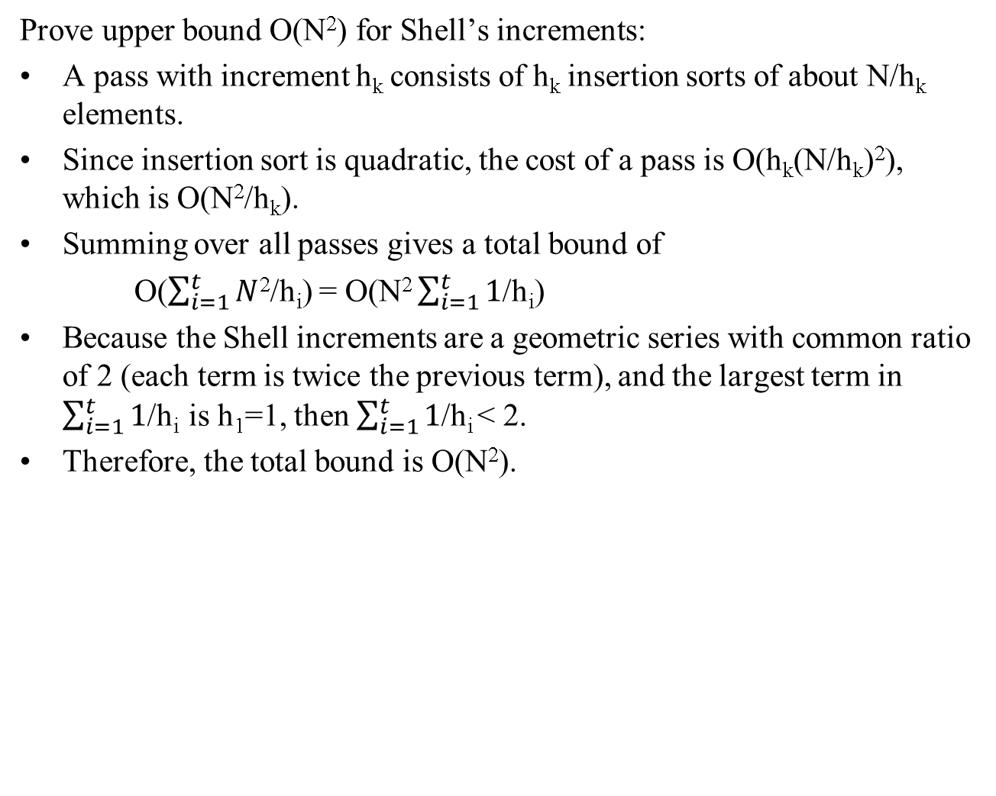
Prove upper bound O(N²) for Shell’s increments:
A pass with increment h_{k} consists of h_{k} insertion sorts of about N/h_{k} elements.
Since insertion sort is quadratic, the cost of a pass is O(h_{k}(N/h_{k})²), which is O(N²/h_{k}).
Summing over all passes gives a total bound of
O($\sum_{i=1}^{t}{N}$²/h_{i}) = O(N² $\sum_{i=1}^{t}{1}$/h_{i})
Because the Shell increments are a geometric series with common ratio of 2 (each term is twice the previous term), and the largest term in $\sum_{i=1}^{t}{1}$/h_{i} is h₁=1, then $\sum_{i=1}^{t}{1}$/h_{i} < 2.
Therefore, the total bound is O(N²).

Slide 26
Heapsort
Heapsort makes use of the heap data structure.
It can sort in O(N log N) time because there are N deleteMins needed, each of which takes O(log N) time.

Slide 27
Heapsort
One problem is where to put the items after each deleteMin, since a second array to store the items would double the space required.
One clever solution is to store the items back into the same array as items are deleted.
For example, after the first deleteMin, there is now space at the end of the array for one item.
This results in a descending ordered list, but could be fixed by building a maxheap rather than a minheap.

Slide 28
97
53
59
26
41
58
31
97 53 59 26 41 58 31
0 1 2 3 4 5 6 7 8 9
59
after deleteMax
53
58
26
41
31
59 53 58 26 41 31 97
0 1 2 3 4 5 6 7 8 9

Slide 29
Mergesort
Mergesort is a recursive algorithm.
It runs in O(N log N) time.
To sort a list, it is recursively split into 2 smaller lists which are sorted.
These lists are then merged back together.
This is called a “Divide-and-conquer” approach.

Slide 30
Divide
5,8,4,3,7,2
5,8,4
3,7,2
5,8
4
3,7
2
Divide lists
into halves
5
8
3
7
5,8
3,7
Merge
halves in
correct order
4,5,8
2,3,7
Conquer
2,3,4,5,7,8

Slide 31
private static <AnyType extends Comparable<? super AnyType>> void mergeSort(AnyType a[], AnyType tmpArray[], int left, int right )
{
if( left < right )
{
int center = ( left + right ) / 2;
mergeSort( a, tmpArray, left, center );
mergeSort( a, tmpArray, center + 1, right );
merge( a, tmpArray, left, center + 1, right );
}
}
a[ ]
left
0
1
2
3
4
5
6
7
8
9
10
11
12
35
17
11
28
12
41
75
15
96
58
81
94
95
center
right

Slide 32
private static <AnyType extends Comparable<? super AnyType>> void merge(AnyType a[], AnyType tmpArray[],
int leftPos, int rightPos, int rightEnd )
{
int leftEnd = rightPos – 1;
int tmpPos = leftPos;
int numElements = rightEnd - leftPos + 1;
while( leftPos <= leftEnd && rightPos <= rightEnd ) // for each half
if( a[ leftPos ].compareTo(a[ rightPos ] ) <= 0 ) // take lesser
tmpArray[ tmpPos++ ] = a[ leftPos++ ]; // element next
else
tmpArray[ tmpPos++ ] = a[ rightPos++ ];
while( leftPos <= leftEnd ) // Copy rest of first half
tmpArray[ tmpPos++ ] = a[ leftPos++ ];
while( rightPos <= rightEnd ) // Copy rest of right half
tmpArray[ tmpPos++ ] = a[ rightPos++ ];
// Copy tmpArray back to original vector a
for( int i = 0; i < numElements; i++, rightEnd-- )
a[ rightEnd ] = tmpArray[ rightEnd ]; // rightEnd already at end
}
a[ ]
leftPos
0
1
2
3
4
5
6
7
8
9
10
11
12
11
12
17
28
35
41
75
15
58
81
94
95
96
leftEnd
rightPos
rightEnd

Slide 33
Merge
a[ ]
tmpArray[ ]
leftPos
0
1
2
3
4
5
6
7
8
9
10
11
12
11
12
17
28
35
41
75
15
58
81
94
95
96
0
1
2
3
4
5
6
7
8
9
10
11
12
11
12
15
tmpPos
leftEnd
rightPos
rightEnd

Slide 34
Algorithm Analysis
For Mergesort, we have the following recurrence formula:
T(1) = 1
T(N) = 2T(N/2) + N
because each call requires 2 calls of size N/2, plus the additional work to merge the items is N.
Two ways to solve this recurrence are shown on the following slides. For simplicity, N=2^{k}:

Slide 35
T(1) = 1
T(N) = 2T(N/2) + N
Method 1: Telescoping a sum
T(N) T(N/2)
------ = ------- + 1
N N/2
T(N/2) T(N/4)
------ = ------- + 1
N/2 N/4
T(N/4) T(N/8)
------ = ------- + 1
N/4 N/8
.
.
.
T(2) T(1)
------ = ------- + 1
2 1
divide through by N
substitute to generate equivalent equations
there are log N such equations
add them up, similar terms cancel, get:
T(N) T(1)
----- = ----- + log N
N 1
T(N) = N + N log N = O(N log N)

Slide 36
T(1) = 1
T(N) = 2T(N/2) + N
Method 2: Repeated substitution
T(N) = 2T(N/2) + N
T(N/2) = 2T(N/4) + N/2
2T(N/2) = 4T(N/4) + N
T(N) = 4T(N/4) + 2N
T(N/4) = 2T(N/8) + N/4
4T(N/4) = 8T(N/8) + N
T(N) = 8T(N/8) + 3N
Continuing on, we arrive at:
T(N) = 2^{k}T(N/ 2^{k}) + kN
Let k = log N.
T(N) = 2^{logN}T(N/2^{logN}) + logN(N)
T(N) = NT(1) + N log N = N + N log N
Thus T(N) = O(N log N)

Slide 37
Quicksort
Quicksort is the fastest known sorting algorithm in practice.
It can run in O(N log N) on average, although worst-case is O(N²).
Quicksort uses a divide-and-conquer approach.

Slide 38
Quicksort
Algorithm to sort an array S:
if element count is 0 or 1, return.
pick any element in S, call it the pivot.
partition into two subsets, s1 having element values less than the pivot value, s2 having element values greater than the pivot value.
Return sort(s1), pivot, sort(s2).

Slide 39
31 57 75
81 43 0
92 65
Choose pivot 65
31 57
43 0
81 75
92
65
Choose pivot 31
Choose pivot 81
57
43
0
31
Choose
pivot 43
75
81
92
43
57
0 31 43 57 65 75 81 92

Slide 40
Pivot
Picking the pivot:
First element is not good since list may already be in sorted order.
Picking pivot at random is safe but may take time to choose a random number.
Best choice is median value of the array, but that takes time to find.
A “median-of-three” value is a good estimate of the median, it can be found by taking the median value of the left-most, center, and right-most elements.

Slide 41
Implementing Quicksort
Quicksort can be implemented by partitioning an array so that values on the left side are less than the pivot, and values on the right side are greater than the pivot.
An easy way to do this is to swap the pivot value with the rightmost value, temporarily getting the pivot value out of the way.
The list can then be partitioned as shown on the following slide:

Slide 42
Partitioning
around a pivot.
8 1 4 9 6 3 5 2 7 0
i j
// pivot is 6
8 1 4 9 0 3 5 2 7 6
i j
// swap pivot out to right
Move i to right
until value is > pivot.
8 1 4 9 0 3 5 2 7 6
i j
Move j to left
until value is < pivot.
8 1 4 9 0 3 5 2 7 6
i j
// swap 8 with 2
Repeat moving i and j.
2 1 4 9 0 3 5 8 7 6
i j
// swap 9 with 5
Repeat moving i and j.
2 1 4 5 0 3 9 8 7 6
j i
// i >= j, stop here
// swap pivot 6 back with i.
// list is now partitioned
// around 6
2 1 4 5 0 3 6 8 7 9
i
Now, call quicksort again for each partition

Slide 43
Median-of-3
Implementing the median-of-3 technique for choosing a pivot allows for an efficiency improvement.
Since finding the value requires comparing 3 values (left-most, middle, and right-most), these values can be swapped into their correct positions with respect to each other.
Thus, the partitioning can begin one space in from each end.

Slide 44
private static <AnyType extends Comparable<? super AnyType>> AnyType median3(AnyType a[], int left, int right )
{
int center = ( left + right ) / 2;
if( a[ center ].compareTo(a[ left ]) < 0 )
swapReferences( a, left, center ); // swaps elements
if( a[ right ] .compareTo(a[ left ] < 0 )
swapReferences( a, left, right );
if( a[ right ] .compareTo(a[ center ] < 0 )
swapReferences( a, center, right );
// Place pivot at position right – 1, since a[right] is in correct place
swapReferences( a, center, right-1 );
return a[ right - 1 ];
}

Slide 45
Partitioning with median-of-3
8 1 4 9 6 3 5 2 7 0
// median-of-3 considers 8, 6, 0
0 1 4 9 6 3 5 2 7 8
// swaps 8, 6, 0
0 1 4 9 7 3 5 2 6 8
// swaps pivot 6 with right – 1, since 8
is already in correct partition
0 1 4 9 7 3 5 2 6 8
i j
// i can begin over 1, j can begin over 2

Slide 46
private static <AnyType extends Comparable<? super AnyType>> void quicksort( AnyType a[], int left, int right )
{
if( left + CUTOFF <= right ) {
AnyType pivot = median3( a, left, right ); // get pivot as median of 3
int i = left, j = right - 1; // i starts at left, j starts at right – 1 (because of pivot)
for( ; ; ) {
while( a[ ++i ].compareTo(pivot) < 0 ) { } // move i right while < pivot
while( a[ --j ].compareTo(pivot) > 0 ) { } // move j left while > pivot
if( i < j ) // if i still left of j
swapReferences( a, i, j ); // swap the pair
else break; // break when i is no longer left of j
}
swapReferences( a, i, right - 1 ] ); // Restore pivot
quicksort( a, left, i - 1 ); // Sort elements in left partition (elements < pivot)
quicksort( a, i + 1, right ); // Sort elements in right partition (elements > pivot)
}
else // list size has reached cutoff point, just do insertion sort
insertionSort( a, left, right );
}

Slide 47
Quicksort Running Time
Assume a random pivot and no cut-off for small arrays.
The running time consists of the two recursive calls plus the partitioning time:
T(0) = T(1) = 1
T(N) = T(i) + T(N – i – 1) + cN
where i is the size of the left partition.

Slide 48
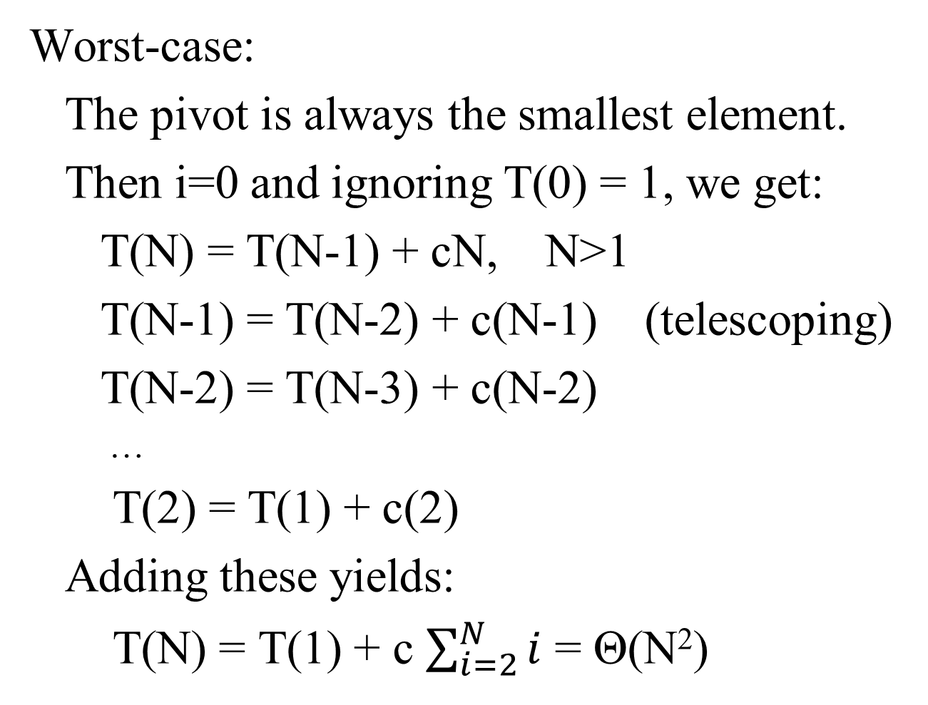
Worst-case:
The pivot is always the smallest element.
Then i=0 and ignoring T(0) = 1, we get:
T(N) = T(N-1) + cN, N>1
T(N-1) = T(N-2) + c(N-1) (telescoping)
T(N-2) = T(N-3) + c(N-2)
…
T(2) = T(1) + c(2)
Adding these yields:
T(N) = T(1) + c $\sum_{i=2}^{N}{i}$ = Θ(N²)

Slide 49
Best-case:
The pivot is always the median.
Assuming each half is exactly half of the original (a slight overestimate since the pivot is excluded):
T(N) = 2T(N/2) + cN
This is the same recurrence as in Mergesort, so the result is Θ(N log N) by the same analysis.

Slide 50
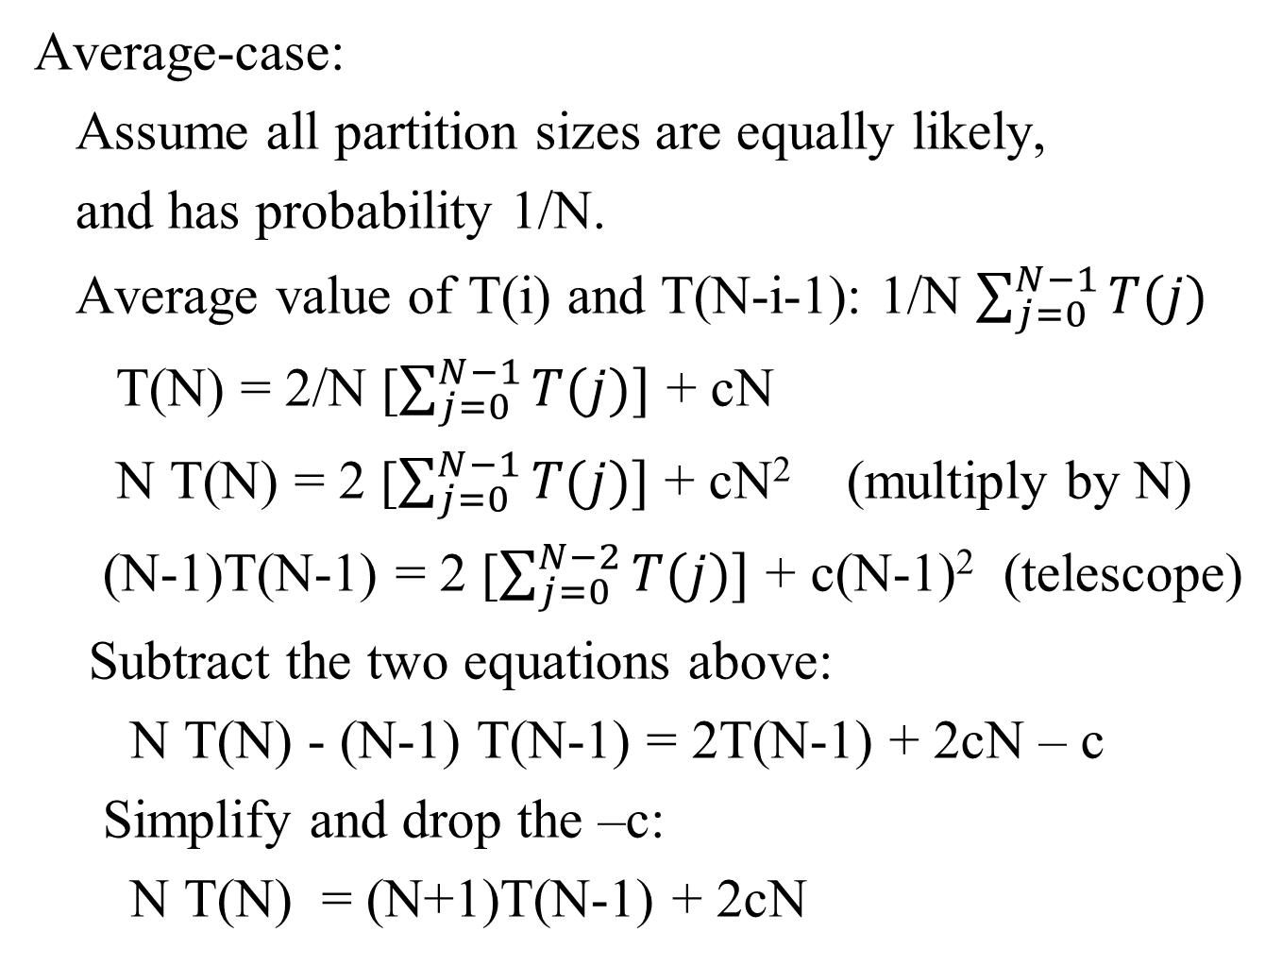
Average-case:
Assume all partition sizes are equally likely,
and has probability 1/N.
Average value of T(i) and T(N-i-1): 1/N $\sum_{j=0}^{N−1}{T(j)}$
T(N) = 2/N [$\sum_{j=0}^{N−1}{T(j)]}$ + cN
N T(N) = 2 [$\sum_{j=0}^{N−1}{T(j)]}$ + cN² (multiply by N)
(N-1)T(N-1) = 2 [$\sum_{j=0}^{N−2}{T(j)]}$ + c(N-1)² (telescope)
Subtract the two equations above:
N T(N) - (N-1) T(N-1) = 2T(N-1) + 2cN – c
Simplify and drop the –c:
N T(N) = (N+1)T(N-1) + 2cN

Slide 51
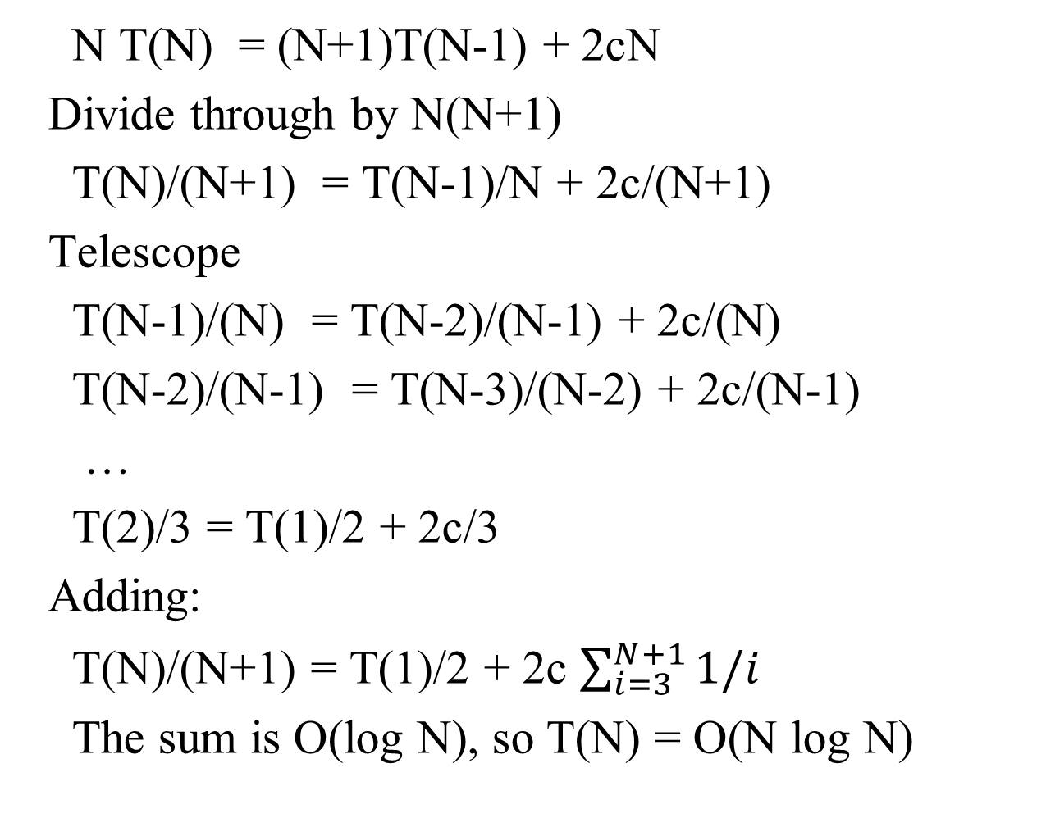
N T(N) = (N+1)T(N-1) + 2cN
Divide through by N(N+1)
T(N)/(N+1) = T(N-1)/N + 2c/(N+1)
Telescope
T(N-1)/(N) = T(N-2)/(N-1) + 2c/(N)
T(N-2)/(N-1) = T(N-3)/(N-2) + 2c/(N-1)
…
T(2)/3 = T(1)/2 + 2c/3
Adding:
T(N)/(N+1) = T(1)/2 + 2c $\sum_{i=3}^{N+1}{1/i}$
The sum is O(log N), so T(N) = O(N log N)

Slide 52
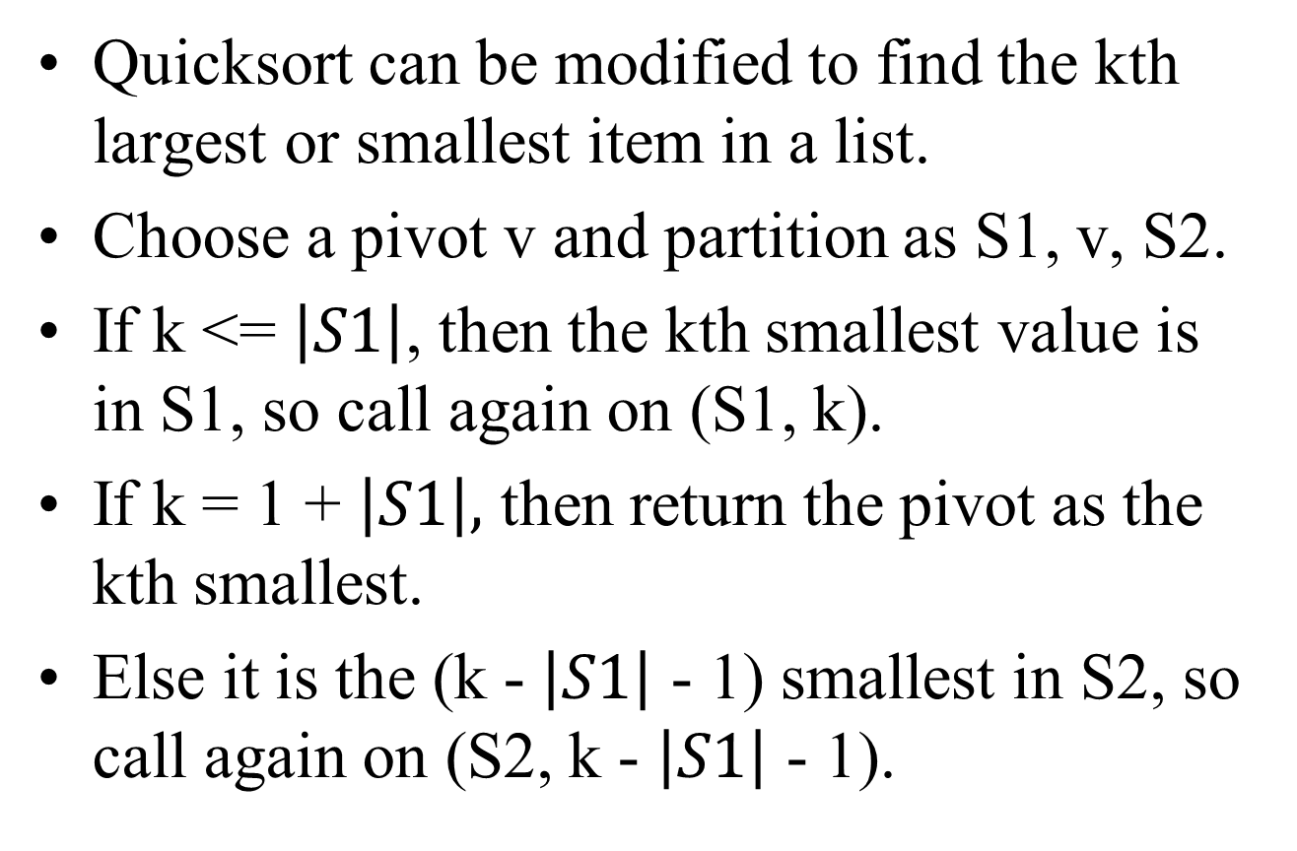
Quickselect
Quicksort can be modified to find the kth largest or smallest item in a list.
Choose a pivot v and partition as S1, v, S2.
If k <= $\left|S1\right|$, then the kth smallest value is in S1, so call again on (S1, k).
If k = 1 + $\left|S1\right|,$ then return the pivot as the kth smallest.
Else it is the (k - $\left|S1\right|$ - 1) smallest in S2, so call again on (S2, k - $\left|S1\right|$ - 1).

Slide 53
Quickselect
The analysis is similar to Quicksort with a worst case of O(N²) when one of S1 or S2 is always empty.
The average case, however, is O(N).

Slide 54
A General Lower Bound for Sorting
Any algorithm for sorting that uses only comparisons requires Ω(N log N) comparisons (and hence time) in the worst case.
The proof can be shown with a decision tree.
Every list can be expressed as a decision tree.
Such a tree of depth d has at most 2^{d} leaves.
Thus, L leaves implies at least ┌ log L ┐ depth.
A list of N items has N! possible arrangements.
This leads to a tree with N! leaves, thus log(N!) depth, and therefore log(N!) comparisons.
Log(N!) is Ω(N log N), therefore the number of comparisons required is Ω(N log N) .

Slide 55
Decision tree.
a<b<c
a<c<b
b<a<c
b<c<a
c<a<b
c<b<a
a<b
a>b
Leaf nodes are
possible sorted
lists.
a<b<c
a<c<b
c<a<b
b<a<c
b<c<a
c<b<a
a<c
c<a
b<c
c<b
a<b<c
a<c<b
c<a<b
b<a<c
b<c<a
c<b<a
b<c
c<b
a<c
c<a
a<b<c
a<c<b
b<a<c
b<c<a

Slide 56
Bucket Sort
Input consists of integer values smaller than M.
Start with an array of size M.
Initialize the array to all zeroes.
If a value is read, increment the element in the array corresponding to the value (using it as an index into the array).
After all values are processed, we can traverse the array, printing values for every element that is non-zero (with elements > 1 implying duplicates).
Since we traverse the list in order, the list will print out in sorted order.
The list can be traversed in M time. Printing takes N time. So worst case running time is O(M+N), which is linear.

Slide 57
Original
Sorted
5
7
1
8
2
1
5
5
6
8
1
4
5
1
1
1
2
4
5
5
5
5
6
7
8
8
0
1
2
3
4
5
6
7
8
9
10
3
1
1
4
1
1
2

Slide 58
Radix Sort
Input consists of integer values.
The bucket sort required a bucket for each value, meaning the array is large if the values are large.
The Radix sort uses a smaller array to sort a list.
Radix sort sorts by each digit, least significant first.
It runs in O(N).

Slide 59
Original
Sorted
1st Digit Sort
2nd Digit Sort
3rd Digit Sort
0
1
2
3
4
5
6
7
8
9
0
0
1
2
3
4
5
6
7
8
9
0,1,8
0
1
2
3
4
5
6
7
8
9
0,1,8,27,64
0
1
512
343
64
125
216
27
8
729
0
1
8
27
64
125
216
343
512
729
1
512,216
125
512
125,27,729
216
343
343
64
343
125
512
216
64
27
729
8
729

Slide 60
External Sorting
Some data sets are too large to be sorted in memory.
Other algorithms are needed to sort these cases.
One algorithm is to read the first set of records that can be sorted in memory, sort them and write them back out to a different file, then repeat this for the rest of the list.
Then merge these sorted sets back together into a single sorted list.

Slide 61
T1 has the input data to sort
T1
7 1 8 2 1 5 5 6 8 1 4 3 9 6 4
T2
Suppose 4 at a time can be sorted in memory.
Each sorted run is written to an alternate tape.
T3
1 5 7 8
1 4 6 8
T4
1 2 5 5
3 4 6 9
Now, merge corresponding runs
T1
1 1 2 5 5 5 7 8
T2
1 3 4 4 6 6 8 9
and continue merging until
everything is in one list.
T3
1 1 1 2 3 4 4 5 5 5 6 6 7 8 8 9
61

Slide 62
External Sort
To sort N records in runs of M requires:
┌ log(N/M) ┐ passes plus initial pass.
For example, N=10 million records of 128 bytes each, and 4 meg of memory is available:
4 meg / 128 bytes = 32768 records per run
N/M = 10 million / 32768 = 306 runs
┌ log(306) ┐ = 9
So, 9 more passes needed to merge the runs.

Slide 63
Multiway Merge
If more tapes are available, then instead of comparing and merging two tapes at a time, we can compare and merge k tapes.
If there are k tapes to merge, then the smallest value across the k tapes must be found.
This could be done using a priority queue.
After the initial run creating pass, this requires ┌ log _{k} (N/M) ┐ more passes.

Slide 64
Multiway Merge
One drawback of performing a multiway merge is the number of tapes required.
In the two-way merge, four tapes were used.
In a k-way merge, 2k tapes are required.

Slide 65
Polyphase Merge
An approach to reduce the number of tapes merges k tapes into one tape, thus requiring only k+1 tapes.
Suppose k=2 and k+1=3 tapes are used, and the input tape has enough for 34 runs.
If 17 are put on one tape and 17 on another, these can be merged to result in 17 of twice the size on the third tape.
Now the first 8 could be copied to one tape, followed by the merge of 8 and 9.

Slide 66
Polyphase Merge
But to do this, half of the list had to be copied to the other tape.
This would continue with each pass, adding an extra half pass to each pass.

Slide 67
Polyphase Merge
Another method is to split the 34 runs unevenly initially as 21 and 13.
The 13 could be merged leaving 8.
The 8 could be merged leaving 5.
The 5 can be merged leaving 3.
The 3 can be merged leaving 2.
The 2 can be merged leaving 1.
The 2 that were merged can now be merged with the remaining 1 to create the final run.

Slide 68
Polyphase Merge
The choice of splitting 21/13 is optimal and corresponds to the two preceding Fibonacci numbers: 0 1 1 2 3 5 8 13 21 34
This works for a 2-way merge, whereas a k-way merge uses a kth-order Fibonacci number which is the sum of the previous k numbers.

Slide 69
Replacement Selection
One further enhancement can be made in creating the runs.
Originally, the run size was determined by how many could be sorted in memory.
However, once the smallest one is written, this space is available to read a new record.
Next, the smallest among this set is written and another new record is read.

Slide 70
Replacement Selection
This continues until the new record is smaller than the last record written.
In that case, the new record starts a new run.
A priority queue can be used to find the smallest among the set.
On average, this produces runs twice as long, and therefore half as many, which may result in fewer passes.

Slide 71
End of Slides

