Slide 1
CS 111 week 7 Project 4B: Sensors
Diyu Zhou

Slide 2
Project 4B: Overview
Attach the temperature sensor and a push button to the BeagleBone
a. Read from the temperature sensor and reports the temperature every 1 second b. When the push button is pressed, output shutdown message and exit.
Support command line arguments: --period=N: set the temperature reporting period to N seconds. --scale=C/--scale=F: set the scale of reporting temperature (Fahrenheit or Celsius) --log=path_to_file: output results not only to stdout and also to the log file.
Support commands to stdin: SCALE=F, SCALE=C, PERIOD=N, OFF STOP: stop generating temperature report START: resume generating temperature report LOG STR: log to the logfile “LOG STR”
Support code debugging without using BeagleBone

Slide 3
Dealing with sensors

Slide 4
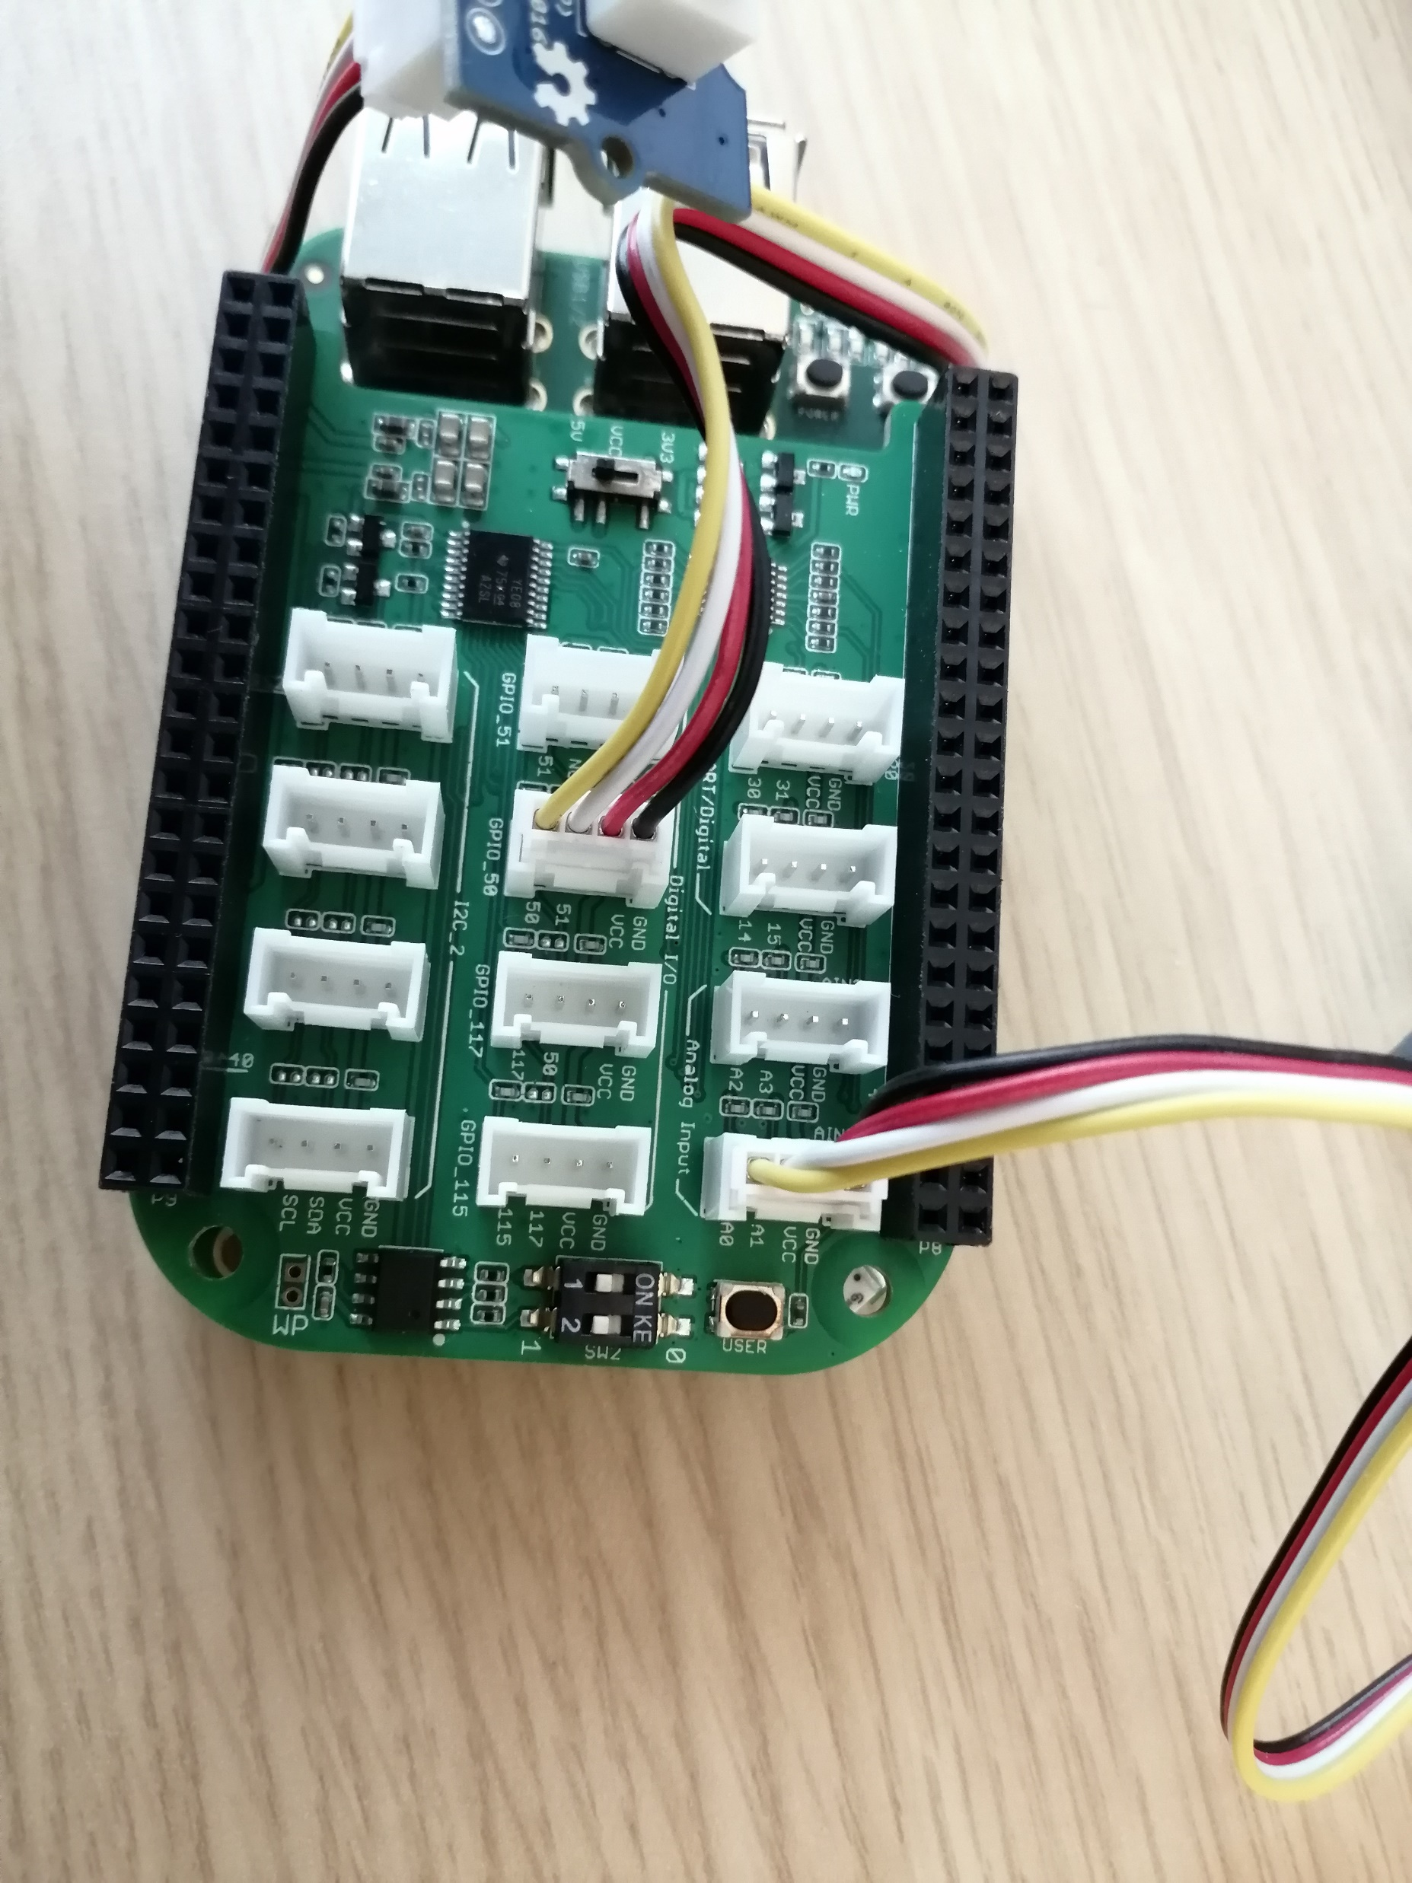
BeagleBone Connection
Connect temperature sensor to the Analog A0/A1 (IO address: 1)
Connect push button to GPIO_50 (IO address: 60)

Slide 5
How can we talk to sensors
Similar to how OS talk to other devices: Disk, Graphic Card, Network interface card…
There are registers/memories on these devices
The push button has a register for read indicating whether it has been pushed or not.
Disk has registers for write to allow OS to specify which block it wants to read, once ready, the data will be put on memories of disk.
How can we access these registers/memories?
Special instructions: in %eax, 100 #read from registers at port 100. out 100, %eax #write to registers at port 100.
Memory remapping: Some memory addresses are mapped to registers on device. mov %eax, 0x10000

Slide 6
MRAA libraries
Read/Write syscalls hide the low-level disk/NIC device details from programmers → MRAA library hides the low-level sensor details for you.
General purpose IO APIs for digital devices mraa_gpio_init, mraa_gpio_dir //set the “direction”: read or write mraa_gpio_read, mraa_gpio_write, mraa_gpio_close
APIs for analogy devices mraa_aio_init, mraa_aio_read, mraa_aio_close
Note: mraa_gpio_read, mraa_aio_read is non-blocking!

Slide 7
MRAA gpio code example
int main(void) {
int ret = 0;
//Assume device is connected with address 62
mraa_gpio_context dev = mraa_gpio_init(62);
// configure the dev interface to be an input pin
//MRAA_GPIO_OUT: set the interface to be an output pin
mraa_gpio_dir(dev, MRAA_GPIO_IN);
//read from device, results store in ret.
ret = mraa_gpio_read(dev);
//mraa_gpio_write(dev, value); write value to dev
mraa_gpio_close(dev);
}

Slide 8
MRAA aio code example
int main(void)
{
int ret = 0;
//Assume device is connected with address 70
mraa_aio_context dev = mraa_aio_init(70);
//read from device, results store in ret.
ret = mraa_aio_read(dev);
mraa_aio_close(dev);
}

Slide 9
Handling temperature Sensor: Convert read from sensor to real temperature
#define B 4275
#define R0 100000.0
float convert_temper_reading(int reading)
{
float R = 1023.0/((float) reading) - 1.0;
R = R0*R;
//C is the temperature in Celcious
float C = 1.0/(log(R/R0)/B + 1/298.15) - 273.15;
//F is the temperature in Fahrenheit
float F = (C * 9)/5 + 32;
}

Slide 10
Get the human readable time

Slide 11
Get the current time: localtime
Spec requires output temperature with timestamp:
11:37:41 98.6
11:37:42 98.6
11:37:43 98.6
The APIs to get real world time → clock_gettime →
struct timespec {
time_t tv_sec;
long tv_nsec;
}; //time elapse since epoch (January 1, 1970 (midnight UTC/GMT)), not counting leap seconds
Need to convert the time to human readable time → localtime

Slide 12
localtime API
struct tm *localtime(const time_t *tv_sec);
Input: number of seconds since epoch returns a tm containg human readable time
struct tm {
int tm_sec; /* seconds */
int tm_min; /* minutes */
int tm_hour; /* hours */
int tm_mday; /* day of the month */
int tm_mon; /* month */
int tm_year; /* year */
int tm_wday; /* day of the week */
int tm_yday; /* day in the year */
int tm_isdst; /* daylight saving time */
};

Slide 13
localtime API: example
void print_current_time(void)
{
struct timespec ts;
struct tm * tm;
clock_gettime(CLOCK_REALTIME, &ts);
tm = localtime(&(ts.tv_sec));
printf(“hour:%d, min:%d, second: %d\n”, tm->tm_hour,
tm->tm_min, tm->tm_sec);
}

Slide 14
Overall Code Architecture

Slide 15
poll implementation
int main(int argc, char * argv[]) {
period, scale, log = process_cmd_line_arg(argc, argv);
initialize_the_sensors();
while (true) {
if (it is time to report temperature && !stop) read from temperature sensor, convert and report
// use poll syscalls, no or very short< 50ms timeout interval
if (there are input from stdin) {
read from stdin till encountering ‘\n’ (thus we get an command) process the command.
}
if (push button is pressed)
log and exit.
}
}

Slide 16
Non-blocking read
read can be blocked → we need to poll(2) to check when its ready
file control syscall: fcntl, can set/change the status of file descriptor
fcntl(fd, F_SETFL, O_NONBLOCK); //does not block read/write on this fd.
// if nothing can be read, read return -1,
// with errno set to EAGAIN

Slide 17
Non-blocking read: example
int main(void) {
int ret = 0;
char buf[1000]; fcntl(0, F_SETFL, O_NONBLOCK);
while (1) {
//Even though nothing is written to stdin, read will still return
ret = read(0, &buf, 1000);
if (ret > 0) {
handle_input(buf, ret);
} else if (ret < 0 && errno != EAGAIN) {
error handling
}
}
}

Slide 18
poll implementation
int main(int argc, char * argv[]) {
period, scale, log = process_cmd_line_arg(argc, argv);
initialize_the_sensors();
while (true) {
if (it is time to report temperature && !stop) read from temperature sensor, convert and report
// use poll syscalls, no or very short< 50ms timeout interval
if (there are input from stdin) {
read from stdin till encountering ‘\n’ (thus we get an command) process the command.
}
if (push button is pressed)
log and exit.
}
}
Anything we can do to solve this?

Slide 19
Let push botton generates an interrupt/signal!
void do_when_pushed(void * arg) {
printf(“pushed!\n”);
}
int main(void) {
mraa_gpio_context button;
//assume push button is at pin 72
button = mraa_gpio_init(72);
mraa_gpio_dir(button, MRAA_GPIO_IN);
//execute do_when_interrupted, when there is a rising edge.
//Pass NULL (4th arg) as the arg in function do_when_pushed.
mraa_gpio_isr(button, MRAA_GPIO_EDGE_RISING, do_when_pushed, NULL);
while (1); //wait at here
}

Slide 20
void * thread_worker_for_stdin(void * dummy) {
while (true) {
read from stdin till encountering ‘\n’ (thus we get an command) process the command.
}
void * thread_worker_for_button(void * dummy) {
while (true) {
if (push button is pressed)
log and exit.
}
}
int main(int argc, char * argv[]) {
period, scale, log = process_cmd_line_arg(argc, argv);
initialize_the_sensors();
Create an thread to handle stdin
Create an thread to handle button or let the button generates an interrupt
while (true) {
if (it is time to report temperature && !stop) read from temperature sensor, convert and report
}
}
Thread Implementation
Note: shared variables need to be protected by locks, or accessed with
atomic functions (e.g. __sync_val_compare_and_swap)

Slide 21
Debug without using BeagleBone

Slide 22
DUMMY flag: Support debugging on your local computer
#ifdef DUMMY
#define MRAA_GPIO_IN 0
typedef int mraa_aio_context;
typedef int mraa_gpio_context;
…
int mraa_aio_read(mraa_aio_context c) {
return 650;
}
void mraa_aio_close(mraa_aio_context c) {
}
…
#else
#include <mraa.h>
#include <mraa/aio.h>
#endif

Slide 23
Passing the dummy flag during compliation
Note: gcc command and the makefile content is incomplete, compile.sh is pseudo code
gcc –o lab4b –DDUMMY lab4b.c …
Inside Makefile:
lab4b: lab4b.c
./compile.sh
compile.sh:
if [ `uname –a` has string beaglebone in it ]
gcc –o lab4b lab4b.c …
else
gcc –o lab4b –DDUMMY lab4b.c
endif

