Slide 1
CS 111 week 5 Project 2a: Races and Synchronization
Discussion 1B
Tianxiang Li

Slide 2
Project Overview
Part A: Concurrent adds to a shared global variable Part B: Concurrent accesses and modifications to a shared, sorted, doubly linked list.
Demonstrate the Race Conditions Apply mechanisms to prevent the Race Conditions Measure the performance overhead of different prevention mechanisms and draw figure.

Slide 3
Part A: Adds to a shared variable

Slide 4
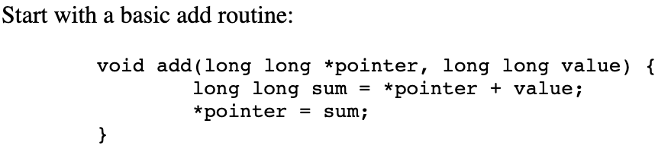
Write a test driver program (lab2_add)
Options
--threads=th_num, default 1
--iterations=it_num, default 1
--yield, sets opt_yield to 1
Variables
Counter: init zero (long long)
Starting time: clock_gettime(3)
Start th_num of threads, each run add function to:
Add 1 to counter it_num times
Add -1 to counter it_num times
Exit to re-join parent thread
Wait for all threads to complete
note the ending time for the run
Print to Stdout csv recording

Slide 5
Pthread APIs
int pthread_create(pthread_t *thread, const pthread_attr_t *attr,
void *(*start_routine) (void *), void *arg);
thread: returns the thread descriptor of the newly created thread
attr: thread attribute (which stack/CPU the thread runs), NULL for default
start_routine: function pointer to the function the new thread will execute
arg: argument to the start_routine
int pthread_join(pthread_t thread, void **retval);
pthread_join: block and wait for the specified thread to finish
retval: If not NULL, stores the return value of start_routine.

Slide 6
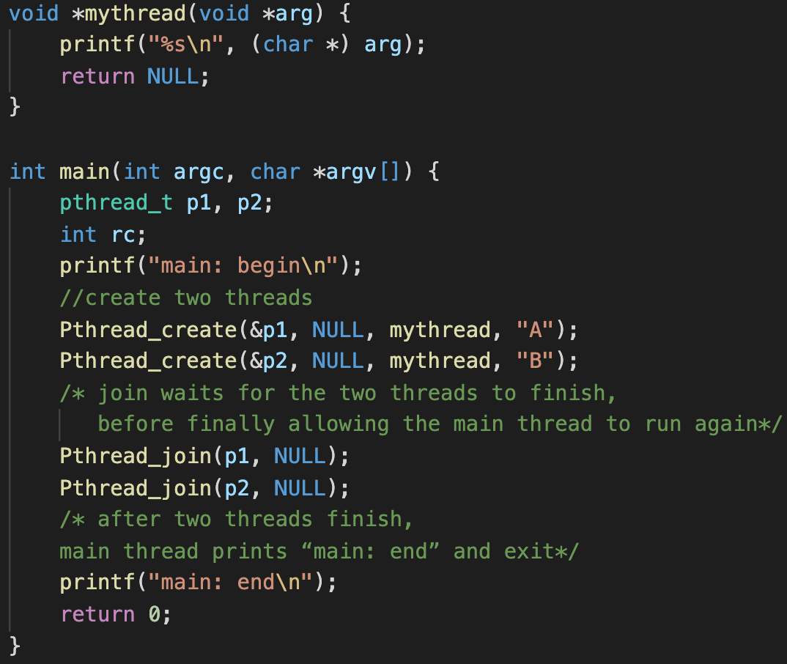
Thread API Example
What are the possible execution orders?

Slide 7
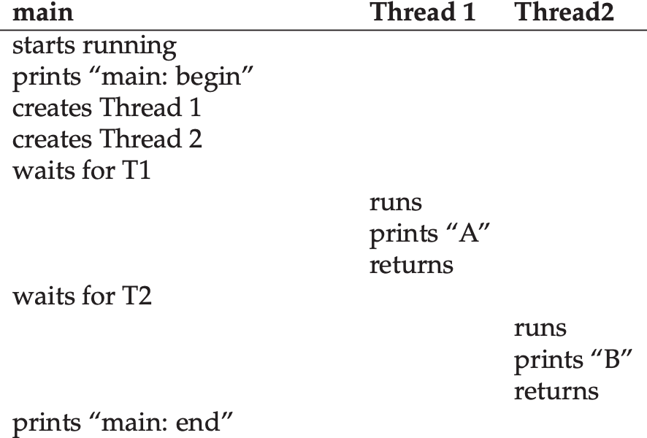
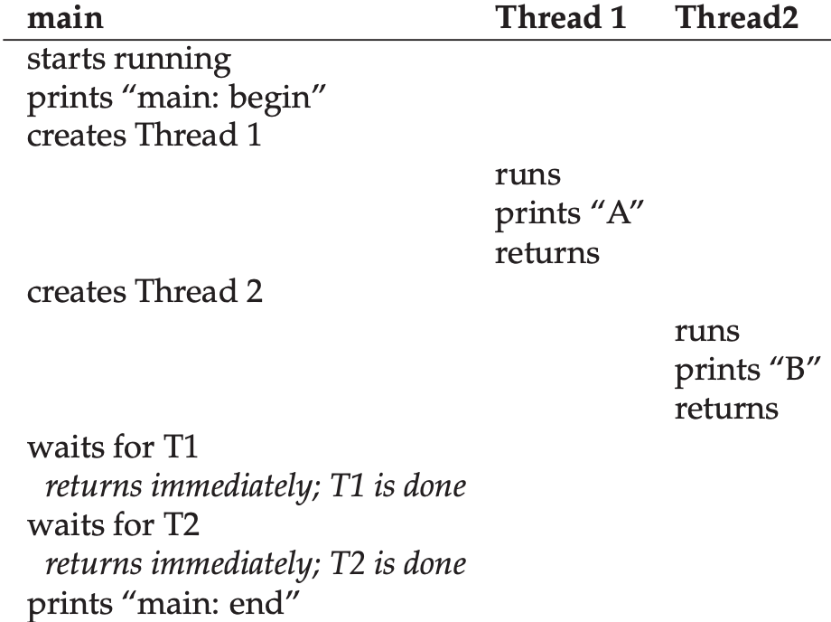
Thread API Example
What are the possible execution orders?
system creates a new thread of execution for the routine that is being called, and it runs independently of the caller

Slide 8
Part A Overview
long long sum = 0;
void * thread_worker(iteration) {
for (i = 0; i < iteration; i++) add(&sum, 1);
for (i = 0; i < iteration; i++) add(&sum, -1);
}
int main(argc, argv) {
threads, iterations = process_arg(argc, argv);
start = clock_gettime() // get the time when starts
for (i = 0; i < threads; i++) thread[i] = pthread_create(thread_worker, iteration);
for (i = 0; i < threads; i++) pthread_join(thread[i]);
end = clock_gettime() // get the time when ends
total_runtime = end - start;
print_out(name, threads, iterations, total_runtime, sum);
}

Slide 9
Pthread APIs: example
long sum = 0;
void * thread_worker(void *arg) {
unsigned long iter = *((unsigned long*) arg), i = 0; //iter = 2047;
for (i = 0; i < iter; i++) sum++; return (void *) 100;
}
int main(void) {
pthread_t th;
unsigned long all= 2047, void * ret = NULL;
pthread_create(&th, NULL, thread_worker, &all);
pthread_join(th, &ret); // ret = (void *) 100;
return 0;
}

Slide 10
Part A: Demonstrate the Race Conditions

Slide 11
Is the value of sum always 0?
unsigned long long sum = 0;
void * thread_worker(iteration) {
for (i = 0; i < iteration; i++) add(&sum, 1);
for (i = 0; i < iteration; i++) add(&sum, -1);
}
int main(argc, argv) {
threads, iterations = process_arg(argc, argv);
start = clock_gettime() // get the time when starts
for (i = 0; i < threads; i++) thread[i] = pthread_create(thread_worker, iteration);
for (i = 0; i < threads; i++) pthread_join(thread[i]);
end = clock_gettime() // get the time when ends
total_runtime = end - start;
print_out(name, threads, iterations, total_runtime, sum);
}

Slide 12
Reason: uncontrolled scheduling
compiler code sequence to update the counter
mov 0x8049a1c, %eax
add $0x1, %eax
mov %eax, 0x8049a1c
counter is located at address 0x8049a1c, mov instruction is used to get the memory value at the address and put it into register eax
add is performed, adding 1 (0x1) to the contents of the eax register
contents of eax are stored back into memory at the same address

Slide 13
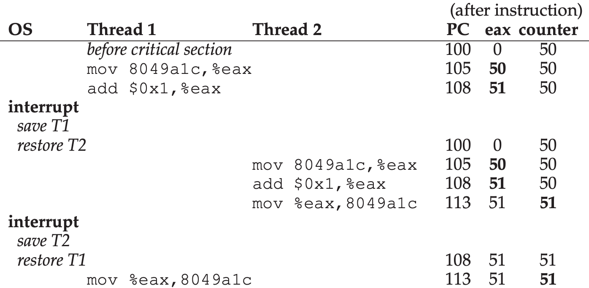
Reason: uncontrolled scheduling
Notes:
T1 loads value of counter(50) into its register eax, add 1 to eax(51)
A timer interrupt goes off; thus, the OS saves the state of the currently running thread (its PC, its registers including eax, etc.) to the thread’s TCB.
T2 runs, getting the value of counter(50) and putting it into its eax (51).
T2 saves the contents of eax into counter. Now global variable counter is 51.
Context switch occurs, T1 resumes running. T1 eax=51. Then mov executes, the counter is set to 51 again.

Slide 14
Finding inconsistent sum
Run your program for ranges of iterations (100, 1000, 10000, 100000)
capture the output, and note how many threads and iterations it takes to (fairly consistently) result in a failure (non-zero sum).
Name of test, thread#, itera#, operation#, runtime, avg t/oper, total

Slide 15
Yield to exacerbate to condition
int opt_yield; //get from command line arguments
void add(long long *pointer, long long value) {
long long sum = *pointer + value;
if (opt_yield)
sched_yield();
*pointer = sum;
}
a thread can call yield when it wants to give up the CPU and let another thread run
--yield option
sets opt_yield flag to 1
Re-run your tests, with yields, for ranges of
threads (2,4,8,12) and iterations (10, 20, 40, 80, 100, 1000, 10000, 100000)

Slide 16
Part A: Prevent Race Condition

Slide 17
Implement three new versions of add function:
Using Locks
pthread_mutex
pthread_mutex_init
phread_mutex_lock
pthread_mutex_unlock
Spin-lock
__sync_lock_test_and_set
__sync_lock_release
Compare and Swap
__sync_val_compare_and_swap

Slide 18
Race Prevention: Using lock
Lock: only enable one thread to execute the code at one time.
Example critical section
balance = balance + 1;
To use lock, we add some code around the critical section like this:
lock_t mutex; // some globally-allocated lock ’mutex’ –> mutual exclusion object
...
lock(&mutex); //acquire the lock
balance = balance + 1; // critical section
unlock(&mutex); //free the lock
Lock variable has two states: locked or free
A mutual exclusion object (mutex) is a program object that allows multiple program threads to share the same resource, but not simultaneously.
Notes:
In computer programming, a mutual exclusion object (mutex) is a program object that allows multiple program threads to share the same resource, such as file access, but not simultaneously. When a program is started, a mutex is created with a unique name.

Slide 19
Lock APIs: pthread_mutex
Init:
pthread_mutex_t mutex = PTHREAD_MUTEX_INITIALIZER; //initializes static mutex
int pthread_mutex_init(pthread_mutex_t * mutex, pthread_mutexattr_t *restrict attr);
attr: NULL for default.
pthread_mutex_t mutex;
pthread_mutex_init(&mutex, NULL);
Lock:
pthread_mutex_lock(&mutex);
Unlock:
pthread_mutex_unlock(&mutex);
Notes:
PTHREAD_MUTEX_INITIALIZER macro initializes the static mutex mutex, setting its attributes to default values
The pthread_mutex_init() function shall initialize the mutex referenced by mutex with attributes specified by attr. If attr is NULL, the default mutex attributes are used;
Return 0 on success

Slide 20
Pthread APIs: example
long sum = 0;
pthread_mutex_t mutex = PTHREAD_MUTEX_INITIALIZER;
void * thread_worker(void *arg) {
unsigned long iter = *((unsigned long*) arg), i = 0; //iter = 2047;
pthread_mutex_lock(&mutex);
for (i = 0; i < iter; i++) sum++;
pthread_mutex_unlock(&mutex); return (void *) 100;
}
int main(void) {
pthread_t th;
unsigned long all= 2047, void * ret = NULL;
pthread_create(&th, NULL, thread_worker, &all);
pthread_join(th, &ret); // ret = (void *) 100;
return 0;
}

Slide 21
Spin Lock
When you don’t get the lock
Keep trying again (spinning)
Good point
Enforce access to critical sections
Simple to program
Dangers
Wasteful
Spin locking takes up processor cycles
May delay freeing of required resource

Slide 22
Spin Lock
While(lock==1) //If lock =1 (locked by other threads), we keep looping until lock is released (lock=0)
Lock=1 //acquire the lock
…
Lock=0 //release the lock

Slide 23
Spin Lock problem
Thread1 Thread2 Thread3
Lock=0
While(lock==1)
While(lock==1)
Lock=1
Lock=1

Slide 24
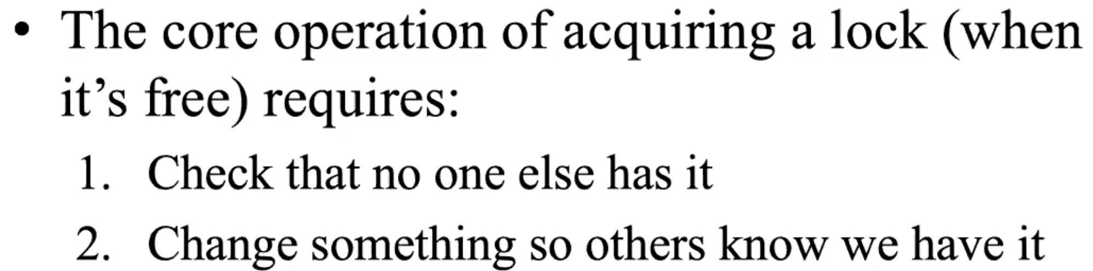
Test and Set (Atomic instruction)
//Pseudo code for test and set (machine language instructions)
long TS(long*lock, long value){
long* old = *lock;
*lock = value; //set lock to new value
return old; / /return old value
}
If !TS(&lock,1){
/* We have control of the critical section!*/
}

Slide 25
Lock APIs: spinlock
init:
long lock = 0;
Lock:
while (__sync_lock_test_and_set (&lock, 1));
//If lock =1 (locked by other threads), we keep looping until lock is released (lock=0)
//if lock=0, we acquire the lock(lock=1) and jump out of the loop
Unlock:
__sync_lock_release(&lock);

Slide 26
Example code
long sum = 0;
void * thread_worker(void *arg) {
unsigned long iter = *((unsigned long*) arg), i = 0; //iter = 2047;
for (i = 0; i < iter; i++) sum++; return (void *) 100;
}
int main(void) {
pthread_t th;
unsigned long all= 2047, void * ret = NULL;
pthread_create(&th, NULL, thread_worker, &all);
pthread_join(th, &ret); // ret = (void *) 100;
return 0;
}
Where do we add spinlock code?

Slide 27
spinlock: example
long sum = 0;
long lock = 0;
void * thread_worker(void *arg) {
unsigned long iter = *((unsigned long*) arg), i = 0; //iter = 2047;
while (__sync_lock_test_and_set (&lock, 1));
for (i = 0; i < iter; i++) sum++;
__sync_lock_release(&lock); return (void *) 100;
}
int main(void) {
pthread_t th;
unsigned long all= 2047, void * ret = NULL;
pthread_create(&th, NULL, thread_worker, &all);
pthread_join(th, &ret); // ret = (void *) 100;
return 0;
}

Slide 28
spinlock vs pthread_mutex_lock
What to do if failed to acquire the lock:
1. Keep spinning: spinlock
Drawback: waste CPU cycles → ideal for low contention, short critical sections
2. Yield: the thread is put into asleep
Drawback: large overhead to sleep/wake up threads →
ideal for high contention, large critical sections.
Ideal: Transparently select appropriate locks for different critical sections.
pthread_mutex_lock: middle ground:
spins on the lock for a threshold (e.g. 1000 times), if not acquired the lock, put into asleep.

Slide 29
Compare and Swap for atomic adds
void add(long long *pointer, long long value) {
long long sum = *pointer + value;
*pointer = sum;
}
Insight: essentially just needs an atomic_add operation →
atomic_add(pointer, value);
Goal: Implement atomic_add with compare and swap

Slide 30
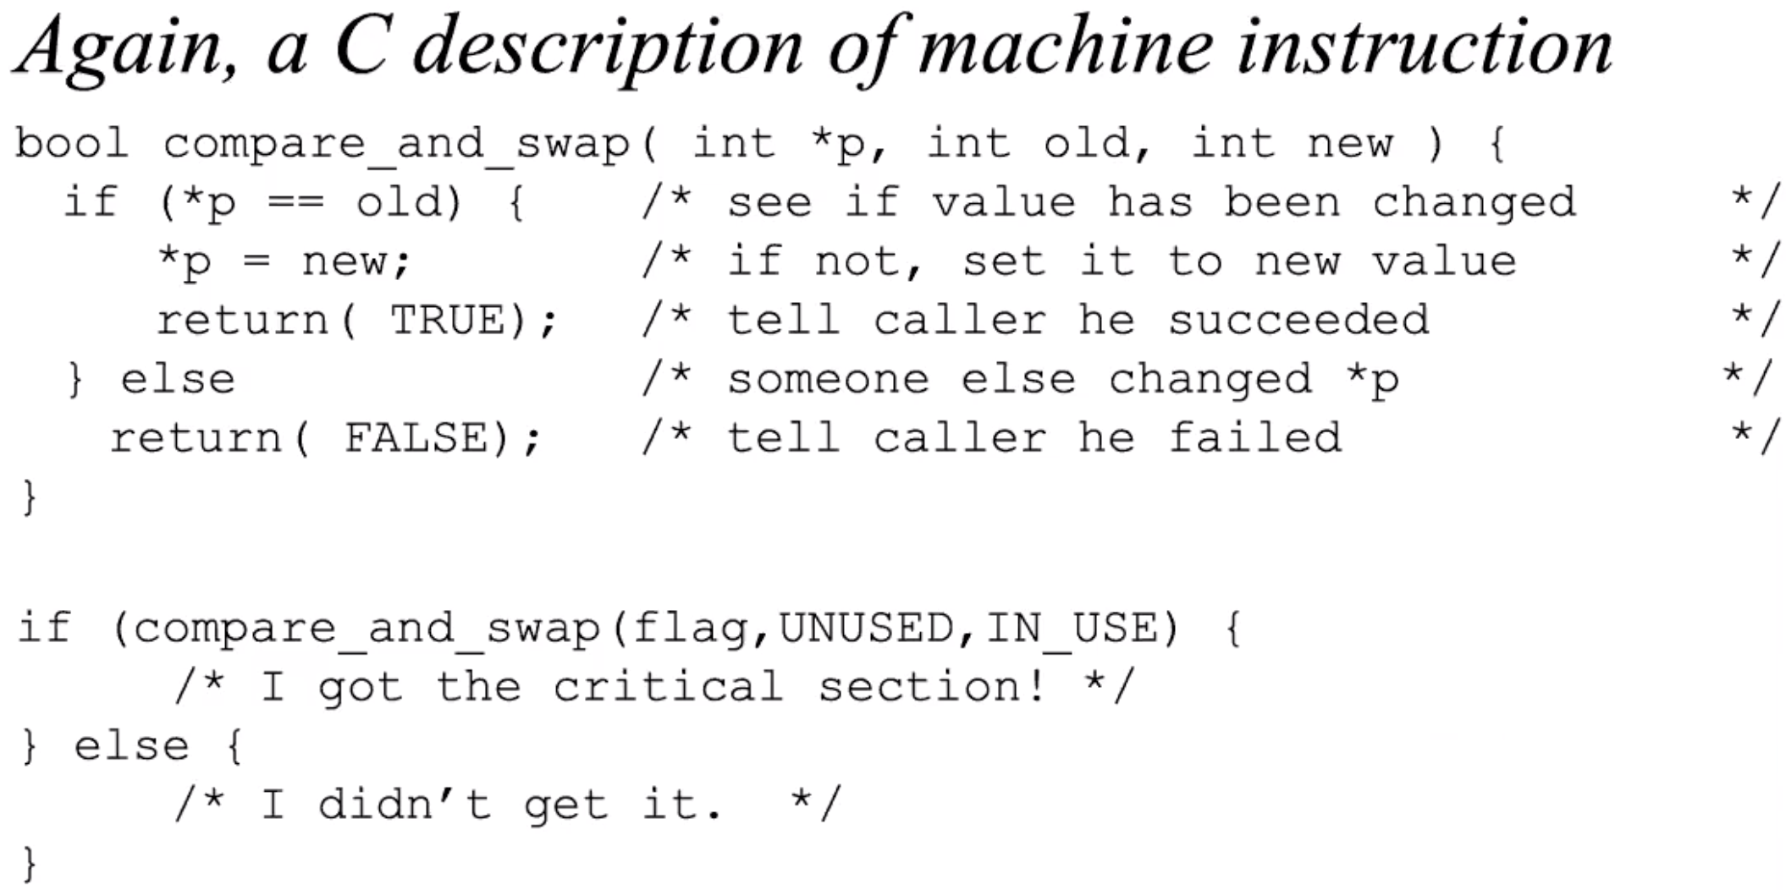
Compare and Swap (Atomic Instruction)
Notes:
test whether the value at the address specified by ptr is equal to expected; if so, update the memory location pointed to by ptr with the new value. If not, do nothing. In either case, return the original value at that memory location, thus allowing the code calling compare-and-swap to know whether it succeeded or not.

Slide 31
Compare and swap implementation for atomic add
bool sync_bool_compare_and_swap(long long *p, long long old, long long new ) {
if (*p == old) { /* see if value has been changed */
*p = new; /* if not, set it to new value */
return true; /* tell caller he succeeded */
}
else /* someone else changed *p */
return false; /* tell caller he failed */
}
void atomic_add(void * pointer, unsigned long value) {
long long prev, sum;
do {
prev = *pointer;
sum = prev + value;
} while(__sync_bool_compare_and_swap (pointer, prev, sum) == false);
}

Slide 32
Part A: Measure Performance

Slide 33
Part A Overview
long long sum = 0;
void * thread_worker(iteration) {
for (i = 0; i < iteration; i++) add(&sum, 1);
for (i = 0; i < iteration; i++) add(&sum, -1);
}
int main(argc, argv) {
threads, iterations = process_arg(argc, argv);
start = clock_gettime() // get the time when starts
for (i = 0; i < threads; i++) thread[i] = pthread_create(thread_worker, iteration);
for (i = 0; i < threads; i++) pthread_join(thread[i]);
end = clock_gettime() // get the time when ends
total_runtime = end - start;
print_out(name, threads, iterations, total_runtime, sum);
}

Slide 34
clock_gettime API
struct timespec {
time_t tv_sec; // seconds: number of whole seconds elapsed since some staring point
long tv_nsec; //nanoseconds: number of nanoseconds elapsed since tv_sec value
};
int clock_gettime(clockid_t clock_id, struct timespec *tp);
clock_id can be: CLOCK_REALTIME (Real World time, adjust based on time server)
CLOCK_MONOTONIC (Elapsed time since some unspecified starting point, increasing)
CLOCK_PROCESS_CPUTIME_ID (CPUTIME of the current processes)
CLOCK_THREAD_CPUTIME_ID (CPUTIME of the current threads)
clockid argument is the identifier of the particular clock on which to act
Notes:
Clock that cannot be set and represents monotonic time since some unspecified starting point

Slide 35
clock_gettime API examples
static inline unsigned long get_nanosec_from_timespec(struct timespec * spec)
{
unsigned long ret= spec->tv_sec; //seconds
ret = ret * 1000000000 + spec->tv_nsec; //nanoseconds
return ret;
}
int main(void) {
struct timespec begin, end;
unsigned long diff = 0;
clock_gettime(CLOCK_MONOTONIC, &begin);
do_something;
clock_gettime(CLOCK_MONOTONIC, &end);
//diff stores the execution time in ns
diff = get_nanosec_from_timespec(&end) - get_nanosec_from_timespec(&begin);
}

Slide 36
Generate Figures
Within Makefile (note the below makefile code does not consider the proper decencies for targets)
tests:
rm -rf lab2_add.csv
./lab2_add --threads=2 --iterations=100 >> lab2_add.csv
./lab2_add --threads=2 --iterations=1000 >> lab2_add.csv
./lab2_add --threads=2 --iterations=10000 >> lab2_add.csv
...
./lab2_add --threads=12 --iterations=10000 --sync=s >> lab2_add.csv
graphs:
gnuplot ./lab2_add.gp

Slide 37
Part B

Slide 38
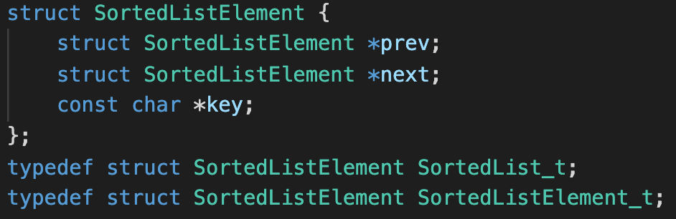
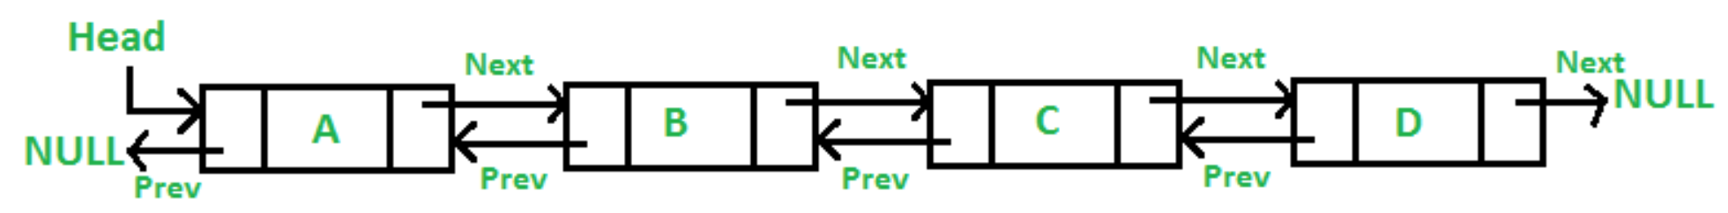
Doubly linked list

Slide 39
Sortedlist.h functions
sortedList_insert(list, element);
insert an element into a sorted list
sortedList_delete(element);
remove an element from a sorted list
sortedList_lookup(list, key);
search sorted list for a key
specified list will be searched for an element with the specified key
sortedList_length(list)
count elements in a sorted list while enumerating list
checks all prev/next pointers

Slide 40
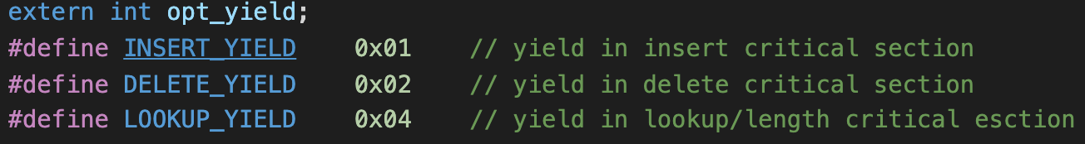
PART B: sorted, doubly-linked, list
implement all four methods in sortedList.c.
Identify the critical section in each of four methods
Add calls to pthread_yield or sched_yield
in SortedList_insert if opt_yield & INSERT_YIELD
in SortedList_delete if opt_yield & DELETE_YIELD
in SortedList_lookup if opt_yield & LOOKUP_YIELD
in SortedList_length if opt_yield & LOOKUP_YIELD

Slide 41
Write test driver program lab2_list
Options
--threads=#, default 1
--iterations=#, default 1
--yield=[idl], i for insert, d for delete, l for lookups
Initialization
initializes an empty list.
creates/initializes (random keys) the required number (threads x iterations) of list elements.
Starts threads, each:
starts with a set of pre-allocated and initialized elements (--iterations=#)
inserts them all into a (single shared-by-all-threads) list
gets the list length
looks up and deletes each of the keys it had previously inserted
exits to re-join the parent thread
Waits for all threads to complete
notes the ending time for the run.
checks the length of the list to confirm that it is zero.
print to csv recording

Slide 42
SortedListElement_t *listhead, * pool;
void * thread_worker(threadNum) {
startIndex = threadNum * iteration;
for (i = startIndex; i < startIndex + iteration; i++) SortedList_insert(listhead, pool[i]); //insert element
SortedList_length(listhead); //check length for (i = startIndex; i < startIndex + iteration; i++) {
e = SortedList_lookup(listhead, pool[i]->key); //lookup inserted element
SortedList_delete(listhead, e); //remove inserted element
}
}
int main(argc, argv) {
threads, iterations = process_arg(argc, argv);
pool = malloc(threads * iterations * sizeof(SortedListElement_t));
for (i = 0; i < threads * iterations; i++) init_elem(&pool[i]);
start = clock_gettime() // get the time when starts
for (i = 0; i < threads; i++) thread[i] = pthread_create(thread_worker, i);
for (i = 0; i < threads; i++) pthread_join(thread[i]);
end = clock_gettime() // get the time when ends
total_runtime = end - start;
print_out(name, threads, iterations, total_runtime, sum);
}

Slide 43
Part B: Demonstrate the Race Conditions

Slide 44
Note: The code in this slide cannot be directly applied to project.
void list_remove(node *element) {
node*n = element->next; //say n = 0x1234
list_remove(0x1234);
node*p = element->prev;
n->prev = p;
p->next = n;
element->next = NULL;
element->prev = NULL;
}
p
element
n
prev
next
prev
next
prev
next

Slide 45
Note: The code in this slide cannot be directly applied to project.
void list_remove(node *element) {
node*n = element->next; //say n = 0x1234
list_remove(0x1234);
node*p = element->prev;
n->prev = p;
p->next = n;
element->next = NULL;
element->prev = NULL;
}
n (0x1234) was removed
but p still points to n as next element
we can no longer access elements after n
thus, list is corrupted
p
element
n
prev
next
prev
next
prev
next

