Slide 1


JUNE 2023
GitOps with FluxCD and ArgoCD

Slide 2




GitOps

Slide 3



1. INTRODUCTION
1
Introduction

Slide 4




1. INTRODUCTION
Objectives
What will you learn?
What are the outcomes?
GitOps
FluxCD
ArgoCD
GitOps with FluxCD
GitOps with ArgoCD
By the end of this lesson, you will be able to have a greater understanding of the topic we are covering.

Slide 5
2. KEY CONCEPTS
What is GitOps
What is GitOps?
"GitOps is a way to do Kubernetes cluster management and application delivery. It works by using Git as a single source of truth for declarative infrastructure and applications. With Git at the center of your delivery pipelines, developers can make pull requests to accelerate and simplify application deployments and operations tasks to Kubernetes."

Slide 6
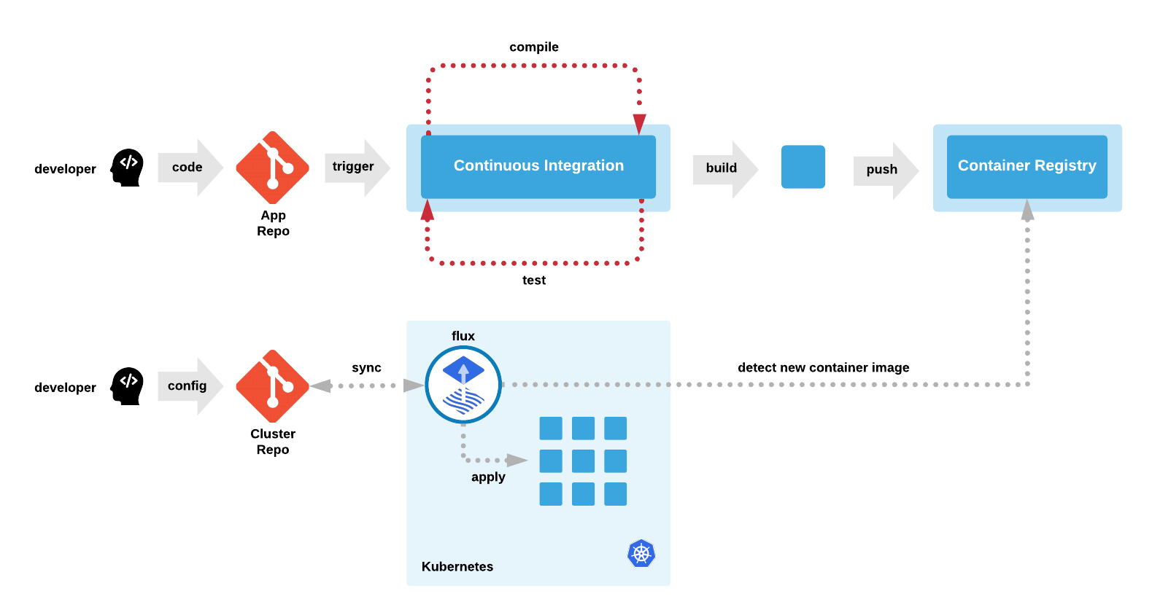
2. KEY CONCEPTS
What is GitOps

Slide 7
2. KEY CONCEPTS
Flux: The GitOps Kubernetes Operator
FluxCD
- Ensures that the state of a cluster matches the config in Git
- Uses an operator in the cluster
- Monitors image repositories, detects new images, triggers deployments
- No separate CD tool
- No access to the cluster for CI tools
- Every change is atomic and transactional - Git has the audit log

Slide 8
2. KEY CONCEPTS
Flux: The GitOps Kubernetes Operator
FluxCD
Automated Deployments
Synchronization with Git
Helm Chart Support
Automated image updates
Release managements

Slide 9
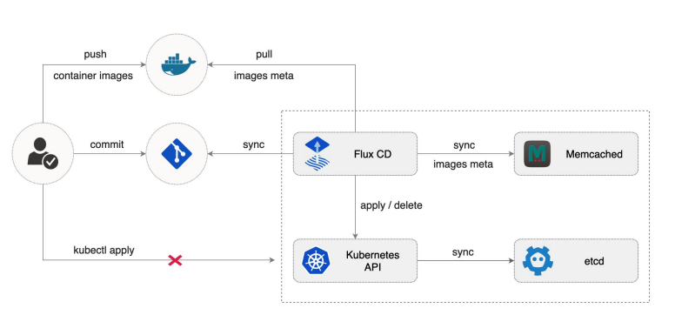
2. KEY CONCEPTS
Flux: The GitOps Kubernetes Operator
Definition

Slide 10
2. KEY CONCEPTS
ArgoCD: The GitOps Kubernetes Operator
ArgoCD
GitOps Driven Deployment
Application Lifecycle management
Declarative Application definitions
Automated synchronization
Web based UI and CLI

Slide 11
2. KEY CONCEPTS
Key Differences
FluxCD vs ArgoCD
Scope and Focus
User Interface
Application Definitons and Configurations
Advanced Deployment Strategies
Ecosystem and Integration

Slide 12
3. ACTIVITIES
Demo

Slide 13

3. ACTIVITIES
GitOps with FluxCD

Slide 14
3. ACTIVITIES
GitOps with ArgoCD

Slide 15
4. WRAP-UP
Further reading
GitOps with FluxCD
FluxCD
ArgoCD
GitOps with ArgoCD

Slide 16
Thank you

