Slide 1
Ethereum Development
신민호
명지대학교
hmcl.mju.ac.kr
mhshin@mju.ac.kr

Slide 2
Ethereum HIgh-level Languages
LLL
First Ethereum language, functional, rarely used
Serpent
Procedural, similar to Python, by Vitalik, little used
Solidity
Procedural, similar to Java/C++, Most popular, by Gavin
Vyper
Functional, Pyton-like, by Vitalik
Bamboo
No loops, Increase auditability, very new

Slide 3
Development Tools
(Option 1) Use any standalone editor
Use Atom, VI, Emacs, …
Compile with solc
(Option 2) Web-based environment
remix.ethereum.org
EthFiddle.com

Slide 4
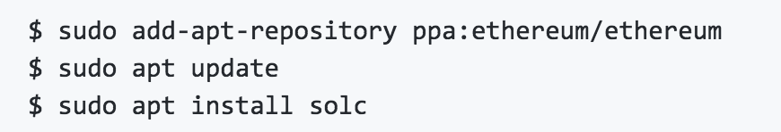
Compiling a Smart Contract
Get Solidity compiler
https://github.com/ethereum/solidity
Solc (Solidity Compiler)
Ubuntu
Version: 0.4.24 (latest)
MAJOR.MINOR.PATCH
0.x.y 에서는 0.MAJOR.MINOR
Pragma solidity ^0.4.24;
Compile
$ solc –version
$ solc --optimize –bin Faucet.sol
$ solc --abi Faucet.sol

Slide 5
Data types
Boolean
bool x;
!(not), &&(and), ||(or), ==(equal), != (not equal)
Integer
int (signed)/ uint (unsigned) + bit length
uint8, uint16, uint24, …, uint256 (default)
Fixed point
(u)fixedMxN
M(bit size)=8,16,…,256, N(#decimals)=0,1,…,18
ufixed32x2
address (object)
20-byte Ethereum address
many useful methods: a.balance(), a.transfer()
bytearray (fixed length)
bytes1, bytes2, …, bytes32
bytearray (variable length)
bytes or string

Slide 6
Data types
Enumeration
constants for enumerating
enum {APPLE, ORANGE, STRAWBERRY }
Array
array of any type
uint32[10], address[]
Struct
User-defined complex data container
struct position {int x; int y; int z}
Mapping
Hash lookup (key, value) storage for any type
mapping( address => string ) account_names
Time units
60 seconds, 1 minutes, 2 hours, 7 days, … (all converting to seconds)
Ether units
1000 wei, 100 finneys, 8 szabo, … (all converting to wei)

Slide 7
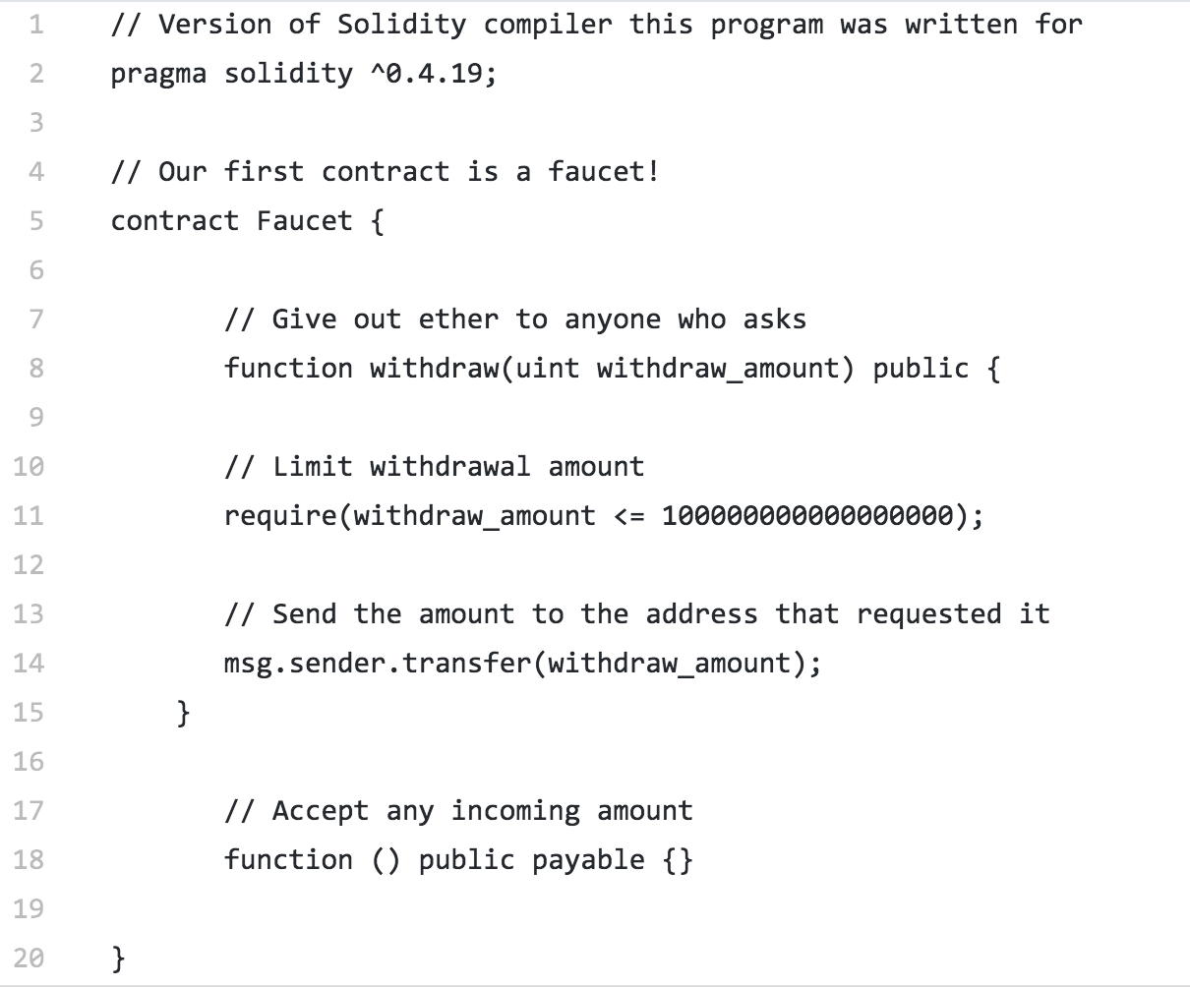
Faucet.sol (revisit)
not readable

Slide 8
Using ether units
For readability, use appropriate ether units
Faucet.sol
[EX] change Faucet.sol
0.1 ether);

Slide 9
Predefined global variables
msg object
Transaction call (from EOA) or message call (from contract)
msg.sender: address initiating this call (not necessarily originating EOA)
msg.value: ether in wei
msg.gas: remaining gas (replaced by gasleft())
msg.data: data payload
msg.sig; first 4 bytes of data payload (function selector)
tx object
transaction related information
tx.gasprice
tx.origin: originating EOA
block
block.coinbase: miner address
block.difficulty: PoW difficulty
block.gaslimit
block.number
block.timestamp

Slide 10
Predefined global variables
Address
address.balance
address.transfer(amnt): send ether to this address, throwing exceptions if error
address.send(amnt): send ether to this address, returning T/F
Functions
addmod/mulmod: add/multiply with mod
keccak256/sha256/ripemd160
ecrecover: recover the address from a signature
selfdestruct(addr): delete the contract, returning left ether to addr
this: address of the contract account

Slide 11
Principal data types
Contract
Interface: like Java interface
Library: provides useful functions. Use “delegatecall()”

Slide 12
Functions
function <name>(<params>) <accessibility> <behavior> <modifier> <returns> { <definition> }
<accessibility>=public|external|internal|private
Public: both outside and inside can call
External: only from outside unless (this.<func>)
Internal: only from inside and derived contracts
Private: only from inside, not from derived ones
<behavior>=constant|view|pure|payable
Constant(view): no change in state(storage)
Pure: no access to state (declarative)
Payable: accept incoming payment

Slide 13
Constructor & Destructor
Name of constructor
~0.4.21: <contract_name>()
0.4.22~: constructor()
Destroying a contract
Call “selfdestruct( address recipient )”
Remove the contract and send left ether to recipient
Make sure you prepare a public function to destroy
Should be called only by the creator
Require(msg.sender == owner)
[EX] Add constructor/destructor to Faucet.sol

Slide 14
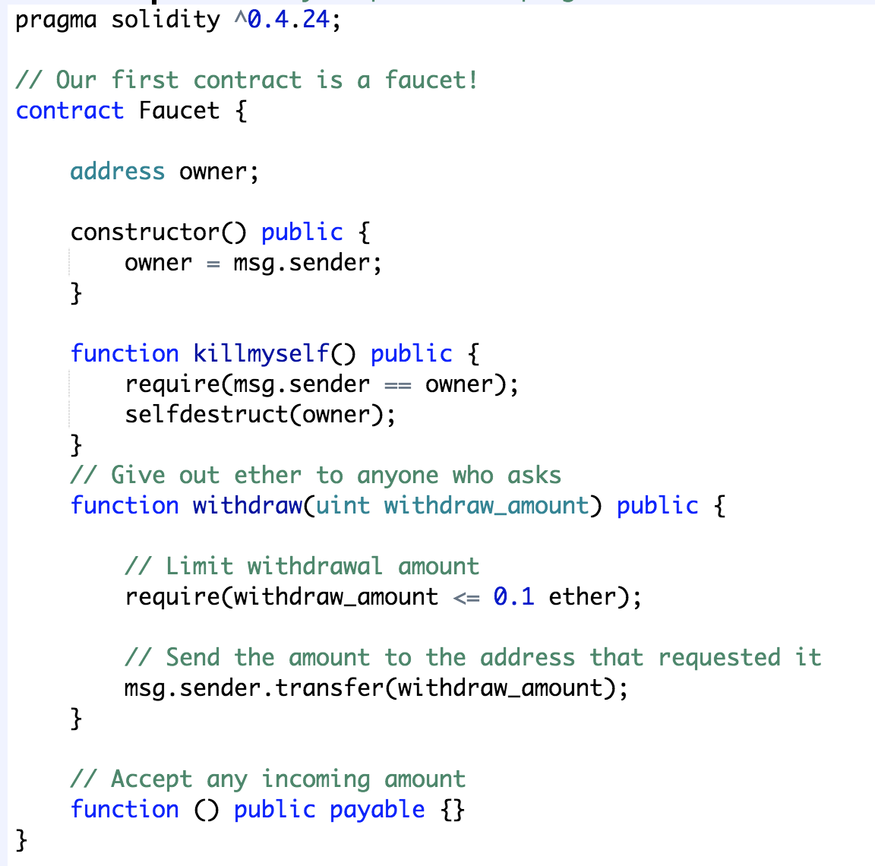
Faucet.sol: constructor/destructor

Slide 15
Function Modifier
Defines requirements applying multiple functions
Eg: the caller should be the owner of the contract
Modifier onlyOwner {
require(msg.sender == owner);
_;
}
Function destructor() public onlyOwner { selfdestruct(owner); }
“_;” : placeholder for the modified function
Modifier can access variables in modified function
Not vice versa

Slide 16
Contract Inheritance
Child contract inherits Parent contract
Contract Child is Parent { … }
Contract Child is Parent1, Parent2 { … }
[EX] Faucet with inheritances
Create Owned contract w/ onlyOwner modifier
Create Mortal contract inheriting Owner, w/ destructor
Create Faucet contract inheriting Mortal, w/ withdraw and feedback

Slide 17
Faucet with Inheritance
contract Owned { address owner;
constructor() { owner = msg.sender; }
modifier onlyOwner {require(msg.sender == owner); _; }
}
contract Mortal is Owned {
function destroy() public onlyOwner { selfdestruct(owner); }
}
contract Faucet is Mortal {
function withdraw(uint withdraw_amount) public {
require(withdraw_amount <= 0.1 ether);
msg.sender.transfer(withdraw_amount); }
function () public payable {}
}

Slide 18
Error handling
Error handling by assert(), require(), revert()
Upon error
Contract terminates
all state changes are reverted (on every called contracts)
assert and require is the same: but conventionally
assert: test internal conditions
require: test inputs
require(<condition>, “message”)
msg.sender.transfer(withdraw_amount);
This will error anyway if balance of sender < withdraw_amount
Use require(this.balance >= withdraw_amount, “Insufficient balance” );

Slide 19
Event
When transaction completes (success or not)
transaction receipt is produced
the receipt contains logs
Event generates these logs
DApps can can monitor “events”
Declaration
event <name>( <type> [indexed] <param1>, … )
ex: event Withdrawal(address indexed to, uint amount);
Parameters are recorded in the log
Indexed parameters are used for filtering for specific value
Emitting
emit <name>( <param1_value>, … )
ex: emit Withdrawl(msg.sender, withdraw_amount);
Check with etherscan’s Transaction info (Event log)
topic[0]: Keccak256(<function prototype>)
topic[i]: ith indexed value
Data: non-indexed value
Online keccack256: https://emn178.github.io/online-tools/keccak_256.html
Online Hex→Decimal converter: https://www.rapidtables.com/convert/number/hex-to-decimal.html

Slide 20
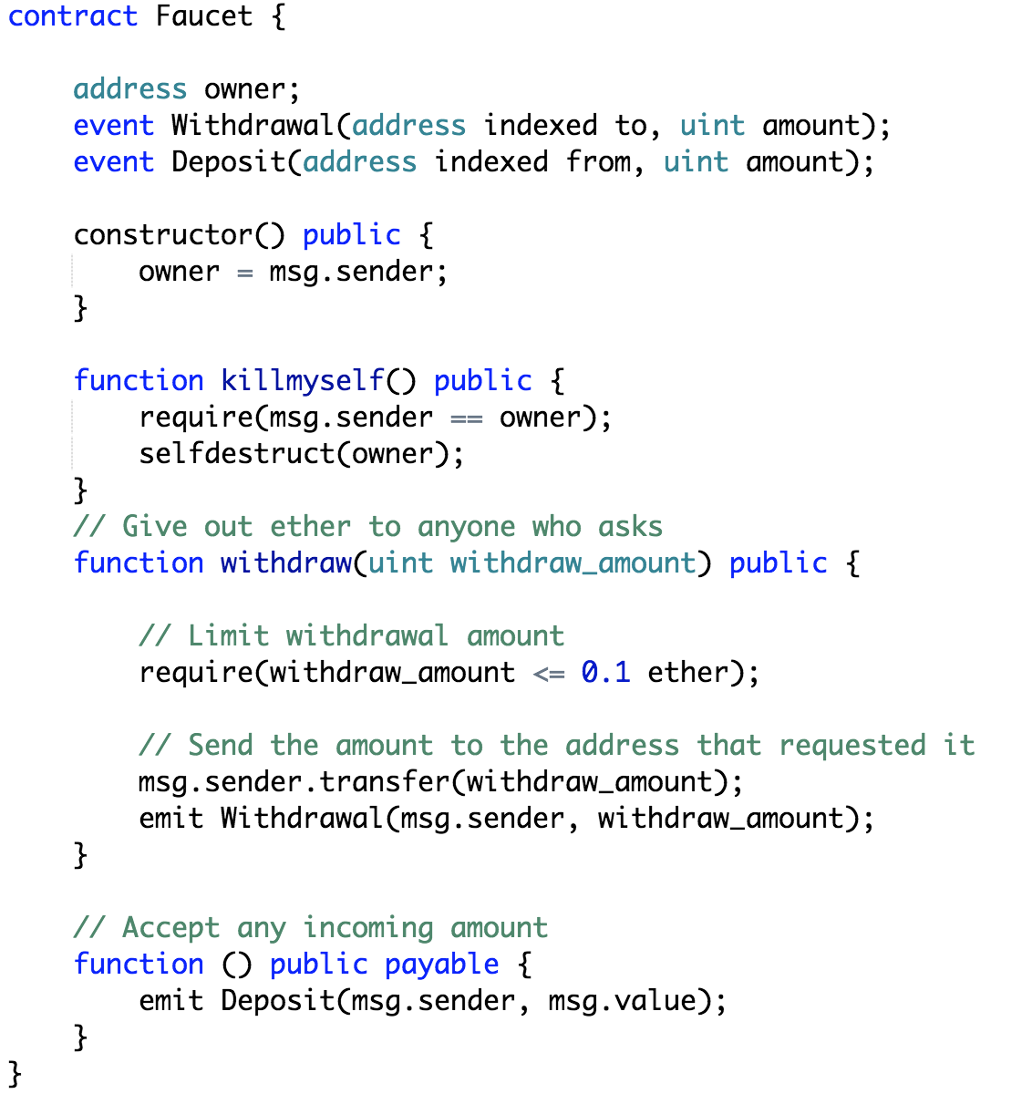
Faucet.sol: Events

Slide 21
Constructor with arguments
Constructor can have arguments
Given in the data of the contract creationg tx
If not given, argument value is considered 0
constructor(int _initval) public { initval = _initval; }
EX
Check if the argument of the constructor is passed correcgtly, using Event

Slide 22
Casting to Contract / Address
Given an address, convert to a contract type
<ContractName>(<address>)
foo( address faucet_addr ) { Faucet faucet = Faucet(faucet_addr); }
Now can access methods of Faucet by faucet.<method>
Given a contract type, convert to address
address(<Contract>)
address(faucet).balance
Now you can handle a contract by the address

Slide 23
Calling other (new) Contracts
Calling other contract from a contract is useful and dangerous
Risk: no idea about the called contract or calling contract
Safest way
Create the contract by yourself and then call it
Create a contract within a contract
new <Contract_Name>(agruments)
Declare a variable to assign the created contract address
Destroy created contract when creating contract is destroyed

Slide 24
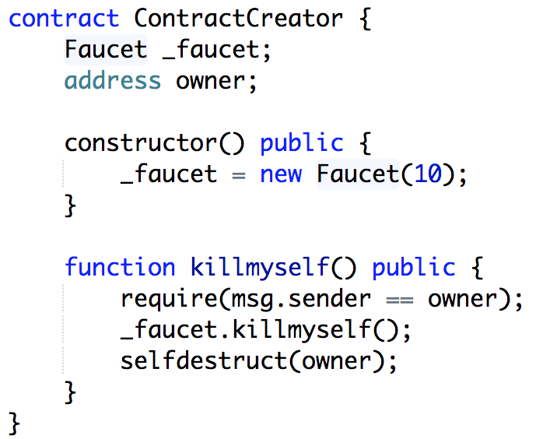
ContractCreator.sol

Slide 25
Calling Other Existing Contract
Call already-existing contract’s function
Make sure you know what you are doing
Steps
get the reference to the contract from the address
declare a variable: Faucet _faucet;
cast the address: _faucet = Faucet(faucet_addr);
Call the function
_faucet.withdraw(0.1 ether);
Warning!
You are not sure if the called function will do what you except it to do
The call can succeed only if the function signature matches
You may don’t want to try to kill the contract upon your destruction

Slide 26
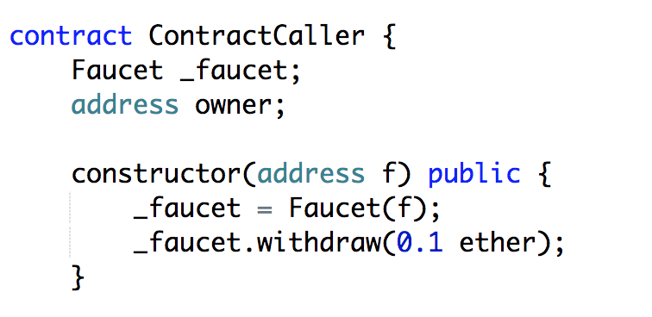
ContractCaller.sol

Slide 27
Low-level Contract Calling: call
Most flexible and most dangerous method
faucet_addr.call( “withdraw(uint)”, 0.1 ether );
call returns true/false for error handling
if !(faucet_addr.call( “withdraw”, 0.1 ether ) ) { revert( “Withdrawal failed” ); }

Slide 28
Low-level Contract Calling: delegatecall
Same as “call’ except
calls the other contracts function within its own context
eg., msg.sender, this doesn’t change
Mostly used for library call
If not, use with great caution
math_addr.delegatecall(“squareroot”, 4);
math_addr.delegatecall(bytes4(keccak256(“squareroot(uint256)”)), 4);
Difference: with func name, arguments are 32-bytes padded

Slide 29
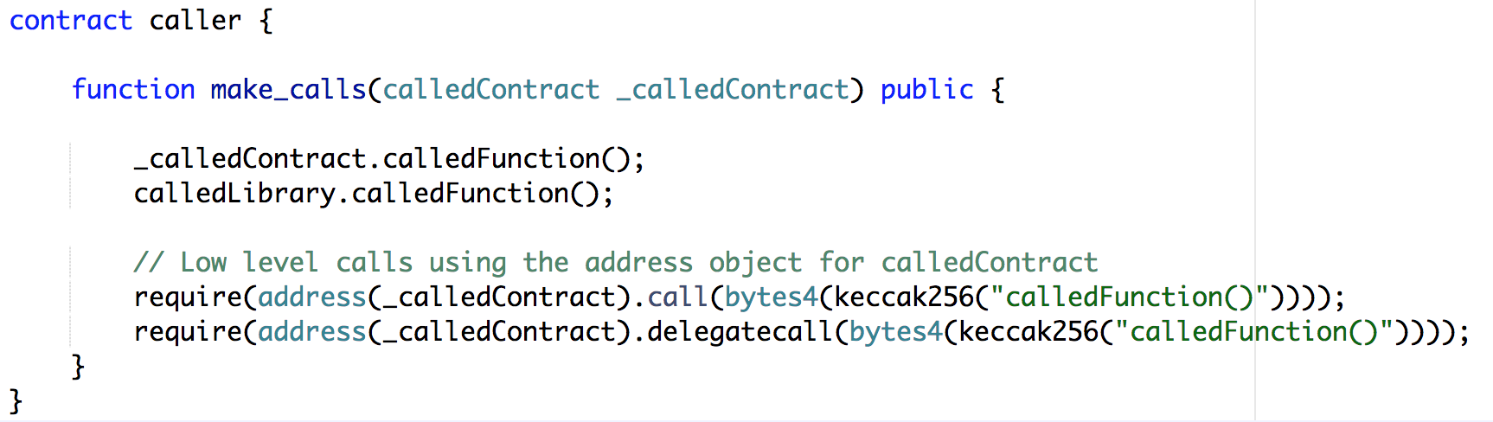
Calling Contexts

Slide 30
Gas
Gas is used to execute your functions
If gas ran short in the middle of execution
“Out of gas” (OOG) exception is thrown
All state changes are reverted
Gases used are payed (not refund)
How to minimize gas consumption
Avoid dynamic-size array: int a[]
Avoid calls to other contract: you never know
Estimate gas cost

Slide 31
Devflow: Ganache/Remix/Metamask
Using Ropsten test network takes time for mining
Using JavascriptVM is too rudimentary
Ganache provides a private blockchain of one node
A client can connect to it via HTTP protocol
One possible simple devflow:
Remix for compilation and deployment of contracts
Metamask for account management
Ganache for block chain

Slide 32
Design of Smart Contract

Slide 33
Proj-1: Simple Coin
Goal: Create a virtual coin in a smart contract
Use cases
The minter can create more coins
Coins can be sent to other EOAs
Coin transfers are logged
Design questions
Name of the contract?
What public methods?
What internal data?

Slide 34
Proj-1: Simple Coin
Funcs
constructor(): sets who is the minter
mint(amount): create more coins
send(from, to, amount): transfer coin between EOAs
Data
minter: can mint coins
balances: manage coin balances of each EOA
mapping from account to number of coins
Event
sent(from, to, amount): log the transfer of coins
Use modifier for minter check

Slide 35
Proj-1: Simple Coin
Contract
contract SimpleCoin { … }
Data
minter: can mint coins
address minter;
balances: manage coin balances of each EOA
mapping from account to number of coins
mapping (address => uint) balances;

Slide 36
Proj-1: Simple Coin
Funcs
constructor(): sets who is the minter
constructor() public { minter = msg.sender; }
modifier onlyMinter
modifier onlyMinter { require( msg.sender == minter ); _; }
mint(amount): create more coins
function mint(uint amount) public onlyMinter { balances[minter] += amount; }
send(from, to, amount): transfer coin between EOAs
function send(address from, address to, uint amount) public onlyMinter { require(balances[from] >= amount); balances[from] -= amount; balances[to] += amount; }

Slide 37
Proj-1: Simple Coin
Event
sent(from, to, amount): log the transfer of coins
event sent(address indexed from, address indexed to, uint amount);
emit sent(from, to, amount);

Slide 38
Proj-1: Simple Coin (variations)
balanceOf( address eoa )
Returns the balance of eoa
mintTo( address receiver, uint amount)
Mint new coin and give it directly to a receiver
event Minted( receiver, amount )
Log how much coins are minted and given to who

Slide 39
Proj-1: Simple Coin (variations)
balanceOf( address eoa )
Returns the balance of eoa
function balanceOf(address eoa) public view returns (uint) { return balances[eoa]; }
mintTo( address receiver, uint amount)
Mint new coin and give it directly to a receiver
function mintTo(address rec, uint amnt) public onlyMinter { balances[rec] += amnt; }
event minted( receiver, amount )
Log how much coins are minted and given to who
event minted( address indexed receiver, uint amount);
emit minted( minter, amount ); // in mint()
emit minted( receiver, amount ); // in mintTo()

Slide 40
Tips
What’s the difference between public and private data?
What does it mean to return a value by a function?
What it means for a function to have ”view” modifier?

Slide 41
Proj-2: Ballot v.1
Goal: Manage a voting ballot for transparent voting process
Use cases
U1: Chairman can create a ballot with a set of candidates
U2: Chairman can give a voting right to an EOA
U3: An EOA with voting right can vote for a candidate, only once!
U4: Chairman can determine the winner, and announce it
[EX] define contract Ballotv1 with modifier onlyChairman
Ballot
EOA2
UC1: [cand1, cand2, …, cand N]
UC3: vote( i )
once
EOA1
UC2: registerVoter( EOAi )
chairman
UC3: vote( i )
EOAN
UC4: winnerAnnounce()
once
Cand1
Cand2
CandN

Slide 42
Proj-2: Ballot v.1 (simple)
U1: Chairman can create a ballot with a set of candidates
constructor( byte32[] candidateNames ) public {…}
We need a data structure to store candidate information
struct Candidate { byte32 name; uint voteCount; }
We need a data structure to store the list of candidate names
use a variable-size array of all candidates
Candidate[] candidates;
Adding a candidate
candidates.push( Candidate( { name: <name>, voteCount: <count> } ) )
Chairman is a voter!
We need a data structure for a voter
struct Voter { bool voter, bool voted, uint vote }
We need a voter database
mapping (address => Voter) voters;

Slide 43
Proj-2: Ballot v.1 (simple)
contract Ballotv1 {
struct Candidate {
byte32 name;
uint voteCount; }
struct Voter {
bool registered;
bool voted;
uint votedFor; }
address chairman;
mapping( address => Voter ) voters;
Candidate[] candidates;
modifier onlyChairman { require( msg.sender == chairman ); _; }
constructor( byte32[] candNames ) public {
chairman = msg.sender;
for( uint I = 0; I < candNames.length; i++) {
candidates.push( Candidate( { name: candNames[i], voteCount: 0 } ) ); }
registerVoter( chairman );
}}

Slide 44
contract Ballotv1 {
struct Candidate {
bytes32 name;
uint voteCount; }
struct Voter {
bool registered;
bool voted;
uint votedFor; }
address chairman;
mapping( address => Voter ) voters;
Candidate[] candidates;
modifier onlyChairman { require( msg.sender == chairman ); _; }
constructor( bytes32[] candNames ) public {
chairman = msg.sender;
for( uint I = 0; I < candNames.length; i++) {
candidates.push( Candidate( { name: candNames[i], voteCount: 0 } ) ); }
//registerVoter( chairman );
}
}

Slide 45
Proj-2: Ballot v.1 (simple)
contract Ballotv1 {
…
constructor( byte32[] candNames ) public {
chairman = msg.sender;
for( uint I = 0; I < candNames.length; i++) {
candidates.push( Candidate( { name: candNames[i], voteCount: 0 } ) ); }
registerVoter( chairman );
}
}

Slide 46
Proj-2: Ballot v.1 (simple)
U2: Chairman can give a voting right to an EOA
function registerVoter( address voter )
Only chairman can do
Set Voter.registered to true
function registerVoter( address voter ) public onlyChairman { voters[voter].registered = true; voters[voter].voted = false; // not necessary voters[voter].votedFor = 0; // not necessary }
Do we need to check if the voter is already registered?

Slide 47
Proj-2: Ballot v.1 (simple)
U3: An EOA with voting right can vote for a candidate, only once!
check if already voted
set the vote to the voter object
increase the voting count of the candidate
function vote( uint candNo ) public { require( voters[msg.sender].registered ); require( !voters[msg.sender].voted ); require( candNo < candidates.length ); voters[msg.sender].votedFor = candNo; candidates[ candNo ].voteCount++; }

Slide 48
Proj-2: Ballot v.1 (simple)
U4: When ballot is over, chairman can determine the winner, and announce it
We need a variable for winner
bytes32 winnerName;
function winnerView() public view return (bytes32) { require(winnerName != “”); return winnderName; }
function winnerAnnounce() { require(winnerName==“”); int maxVoteCount = 0; for( uint i=0; i < candidates.length; i++ ) { if( candidates[i].voteCount > maxVoteCount ) { maxVoteCount = candidates[i].voteCount; winnerName = candidates[i].name; } } }
?

Slide 49
Proj-2: Ballot v.2
Use cases
U1: Chairman can create a ballot with a set of candidates
U2: Chairman can give a voting right to an EOA
U3: An EOA with voting right can vote for a candidate, only once!
U4: When ballot is over, chairman can determine the winner, and record it
U5: Chairman can declare the start of voting period
U6: Chairman can declare the end of voting period
U7: Voter can only vote during the voting period

Slide 50
Proj-2: Ballot v.2
U5: Chairman can declare the start of voting period
U6: Chairman can declare the end of voting period
U7: Voter can only vote during the voting period
We need a variable indicating whether the ballot is open or not
bool ballotOpen;
initialized to ”false” in the constructor
We need functions to control the variable by Minter
function openBallot()
function closeBallot()
Accept votes only for open ballots
in vote(), require the ballot to be open
Allow voter registration only when the ballot is closed

Slide 51
Proj-2: Ballot v.2
We need a variable indicating whether the ballot is open or not
Define: bool ballotOpen;
in constructor(): ballotOpen = false;
We need functions to control the variable by Minter
function openBallot() public onlyChairman { ballotOpen=true; }
function closeBallot() public onlyChairman { ballotOpen=false; }
Define: modifier onlyOpenBallot {require(ballotOpen);}
Accept votes only for open ballots
function vote(uint candNo) public onlyOpenBallot {…}
Allow voter registration only when the ballot is closed
Do we need to define another modifier onlyClosedBallot() ?

Slide 52
Modifier with parameters
Modifier can have a parameter
modifier onlyBallotOpenIs(bool open) { require(ballotOpen==open); _; }
We can use like:
function vote( uint candNo ) public onlyBallotOpenIs(true) {
or
function winnerAnnounce() public onlyBallotOpenIs(false) {
This is also possible
function vote( uint candNo, bool open ) public onlyBallotOpenIs(open) {

Slide 53
Ballot v.2
contract BallotV2{
bool ballotOpen;
modifier onlyBallotOpenIs(bool open) { require(ballotOpen==open); _;}
constructor( bytes32[] candNames ) public {
ballotOpen = false;
… }
function registerVoter( address voter ) public onlyChairman onlyBallotOpenIs(false) { … }
function vote( uint candNo ) public onlyBallotOpenIs(true) {…}
function winnerView() public view onlyBallotOpenIs(false) returns (bytes32) {…}
function winnerAnnounce() public onlyBallotOpenIs(false) {…}
function openBallot() public onlyChairman { ballotOpen=true; }
function closeBallot() public onlyChairman { ballotOpen=false; }
}

Slide 54
Proj-2: Ballot v.3
Use cases
U1: Chairman can create a ballot with a set of candidates
U2: Chairman can give a voting right to an EOA
U3: An EOA with voting right can vote for a candidate, only once!
U4: When ballot is over, chairman can determine the winner, and record it
U5: Chairman can declare the start of voting period
U6: Chairman can declare the end of voting period
U7: Voter can only vote during the voting period
U8: Ballot takes three stages
REGISTRATION→VOTING→ANNOUNCED

Slide 55
Proj-2: Ballot v.3
U8: Ballot takes three stages
REGISTRATION→VOTING→ANNOUNCED
enum Stage { REGISTRATION, VOTING, ANNOUNCED }
Define: Stage stage
When constructor()
REGISTRATION stage
During REGISTRATION:
registerVoter()
startVoting(): REGISTRATION → VOTING
During VOTING
vote()
endVoting(): calls winnerAnnounce(), and VOTING → ANNOUNCED
Now winnerAnnounce() becomes a private function
When ANNOUNCED
winnerView()
const()
REG
registerVoter()
startVoting()
VOTING
vote()
endVoting()
ANNOU
winnerView()

Slide 56
Ballot v.3
contract BallotV3{
enum Stage { REGISTRATION, VOTING, ANNOUNCED }
Stage stage = Stage.REGISTRATION;
modifier onlyStage(Stage st) { require(stage == st); _; }
constructor( bytes32[] candNames ) public {…}
function registerVoter( address voter ) public onlyChairman onlyStage(Stage.REGISTRATION) {…}
function startVoting() onlyStage(Stage.REGISTRATION) { stage = Stage.VOTING; }
function vote( uint candNo ) public onlyStage(Stage.VOTING) {…}
function endVoting() onlyStage(Stage.VOTING) {
winnerAnnounce();
stage = Stage.ANNOUNCED; }
function winnerAnnounce() private {…}
function winnerView() public view onlyStage(Stage.ANNOUNCED) returns (bytes32) {…}
}

Slide 57
Proj-2: Ballot v.4
Let the stage of a Ballot change over time
REGISTRATION starts at time 0 (contract creation)
REGISTRATION for 7 days
VOTING for 1 day
COUNTING ends when winnerAnnounce() is called
winnerAnnounce() starts ANNOUNCED state
How smart contract accesses time?
It cannot use miner’s system clock. Why?
All the execution of contract must have the same clock
Use block’s timestamp
“now” keyword
returns the timestamp of the block (of the transaction)
Define startTime (uint)
startTime = now; // constructor()
requrie( now < startTime + 7 days) // in registerVoter()
const()
REG
registerVoter()
after 7 days
VOTING
vote()
after 1 day
COUNTING
winnerAnnounce()
ANNOU
winnerView()

Slide 58
Proj-2: Ballot v.4
How to determine the state?
Define constants for durations
uint constant deadlineREG = 7 days;
uint constant deadlineVOT = 1 days;
If startTime <= now < startTime+deadlineREG
in REGISTRATION
If startTime+deadlineREG <= now < startTime+deadlineVOT
in VOTING
If startTime+deadlineVOT <= now & winnerName = “”
in COUNTING
If startTime+deadlineVOT <= now & winnerName != “”
in ANNOUNCE
modifier onlyState(State st) {...}

Slide 59
Proj-2: Ballot v.4 Code
contract BallotV4{
…
enum Stage { REGISTRATION, VOTING, COUNTING, ANNOUNCED }
uint public startTime;
uint constant deadlineREG = 7 days;
uint constant deadlineVOT = 1 days;
modifier onlyStage(Stage st) {
require( now >= startTime, "Opps, something's wrong with startTime" );
if( st == Stage.REGISTRATION )
require( now < startTime + deadlineREG, "Not in REGISTRATION stage");
else if( st == Stage.VOTING )
require( startTime + deadlineREG < now && now <= startTime + deadlineVOT );
else if( st == Stage.COUNTING )
require( startTime + deadlineVOT < now && winnerName == "" );
else // Stage.ANNOUNCED
require( startTime + deadlineVOT < now && winnerName != "" );
_;
}
function registerVoter( address voter ) public onlyChairman onlyStage(Stage.REGISTRATION) {...}
function vote( uint candNo ) public onlyStage(Stage.VOTING) {…}
function winnerAnnounce() public onlyStage(Stage.COUNTING) {…}
function winnerView() public view onlyStage(Stage.ANNOUNCED) returns (bytes32) {…}
function destroy() public onlyChairman onlyStage(Stage.ANNOUNCED) {…}

Slide 60
Proj-2: Ballot v.4
What if winner ties?
Current code: the candidate appearing first in the candidates[] wins
Better code: announce tie, winnerName = “TIE”
function winnerAnnounce() public onlyStage(Stage.COUNTING) {
uint maxVoteCount = 0;
for( uint i=0; i < candidates.length; i++ ) {
if( candidates[i].voteCount > maxVoteCount ) {
maxVoteCount = candidates[i].voteCount;
winnerName = candidates[i].name;
} else if( candidates[i].voteCount == maxVoteCount ) {
winnerName = "TIE";
}
}
}
What if nobody votes?

Slide 61
Proj-3: Auction v.1
Goal: A seller and multiple buyers can bid for a product and the bidder with highest offer will win
U1: Seller can open an auction and close after a while
U2: Bidders can send bid by offering the price
U3: Seller can determine the winner and announce
U4: The winnner will send the money (ether) to seller
Auction
EOA2
UC1: constructor(), close()
UC2: bid( x )
EOA1
UC3: winnerAnnounce()
seller
UC2: bid( y )
EOAN
$$

Slide 62
Proj-3: Auction v.1 Code
U1: Seller can open an auction and close after a while
address seller;
bool open;
constructor() public { open=true; seller = msg.sender; }
close() public onlyOwner { open=false; }
modifier ifOpen { require( open ); }

Slide 63
Proj-3: Auction v.1
U2: Bidders can send bid by offering the price
U3: Seller can determine the winner and announce
Method 1: collect bids and close, then determine
address[] bidders;
mapping(address=>uint[]) bids;
bid(uint p) { bids.push[msg.sender]; bids[msg.sender].push( p ); }
winnderAnnounce() { // iterate all bidders to find the higest bidder }
Method 2: determine as we go
uint highestBid = 0;
address highestBidder;
bid(uint p) { if( p > highestBid ) { highestBid = p; highestBidder = msg.sender; } }

Slide 64
Proj-3: Auction v.1 Code
contract AuctionV1 {
address seller;
uint highestBid = 0;
address highestBidder;
constructor() public { seller = msg.sender; }
close() public onlyOwner { open=false; }
modifier ifOpen { require( open ); _; }
function bid(uint p) public ifOpen {
if( p > highestBid ) {
highestBid = p;
highestBidder = msg.sender;
}
}
What if the winner doesn’t pay and run away?

Slide 65
Proj-3: Auction v.2
U1: Seller can open an auction and close after a while
U2: Bidders can send bid by sending ether
U3: Seller can determine the winner and announce
U4: Seller can receive the highest bid in ether after close
U5: Non-highest bidders get their money back
UC1: constructor()
Auction
Seller
UC2/3: bid() w $$
UC1/4: close()
Bidder
$$
UC5: close()
$$

Slide 66
Proj-3: Auction v.2
U2: Bidders can send bid by sending ether
function bid() public payable ifOpen { if( msg.value > highestBid ) { highestBid = msg.value; highestBidder = msg.sender; } }
U4: Seller can receive the highest bid in ether after close
U5: Non-highest bidders get their money back
function close() public ifOpen { close=true; msg.sender.transfer(highestBid); for( uint i=0; i < bidders.length; i++ ) bidders[i].transfer(bids[bidders[i]]); }
Too complicated housekeeping
Principles:
For safety, do not interact with multiple addresses in one function
Do not push the money to other address; let it pull the money

Slide 67
Proj-3: Auction v.2
U1: Seller can open an auction and close after a while
U2: Bidders can send bid by sending ether
U3: Seller can determine the winner and announce
U4: Seller can receive the highest bid in ether after close
U5: Non-highest bidders get their money back
UC1: constructor()
Auction
Seller
UC2/3: bid() w $$
UC1/4: close()
Bidder
$$
UC5: withdraw()
$$

Slide 68
Proj-3: Auction v.2
U2: Bidders can send bid by sending ether
function bid() public payable ifOpen { require( msg.value > highestBid ); //refuse money if not highest if( highestBid != 0) moneyback[highestBidder] += highestBid; //why not just return here? highestBid = msg.value; highestBidder = msg.sender; }
U4: Seller can receive the highest bid in ether after close
function close() public ifOpen { close=true; msg.sender.transfer(highestBid); }
U5: Non-highest bidders get their money back
function withdraw() public { if( moneyback[msg.sender] > 0 ) { msg.sender.transfer( moneyback[msg.sender] ); moneyback[msg.sender] = 0; } }

Slide 69
Proj-3: Auction v.2
function withdrawUnsafe() public { if( moneyback[msg.sender] > 0 ) { msg.sender.transfer( moneyback[msg.sender] ); moneyback[msg.sender] = 0; } }
Watch out re-entry attack
The contract, receiving ether, can call withdraw() again and again … steal all the money!!
Principle: use checks-effects-interactions pattern
function foo() { // checks: check required conditions // effects: make state changes necessary // interactions: call other contracts’ functions, if needed
function withdrawSafe() public { require( moneyback[msg.sender] > 0 ); // check uint amount = moneyback[msg.sender]; moneyback[msg.sender] = 0; // effect msg.sender.transfer( moneyback[msg.sender] ); // interact }

Slide 70
Proj-3: Auction v.2 Code
contract AuctionV2 {
address seller;
uint highestBid = 0;
address highestBidder;
bool open = true;
mapping (address=>uint) moneyback;
modifier ifOpen { require( open ); _; }
modifier onlySeller { require( msg.sender == seller ); _; }
constructor() public { seller = msg.sender; }
function bid() public payable ifOpen {
require( msg.value > highestBid );
if( highestBid != 0 ) moneyback[highestBidder] += highestBid;
highestBid = msg.value;
highestBidder = msg.sender; }
function withdraw() public {
require( moneyback[msg.sender] > 0 );
uint amount = moneyback[msg.sender];
moneyback[msg.sender] = 0;
msg.sender.transfer( amount ); }
function close() public onlySeller ifOpen { open=false;
msg.sender.transfer( highestBid ); }
}

Slide 71
addr.send(x) vs addr.transfer(x)
Basically the same
Sends x ether to the address
Uses up to 2300 gas limit
Safe against re-entry attacks (by gas limit)
Difference
error handling: transfer() reverts, send() returns boolean
addr.transfer(x); is equal to require(addr.send(x));
To specify more gas
addr.call.gas(100000).value(x)(“”);
//returns boolean

Slide 72
Proj-3: BlindAuction V1
U6: Nobody knows who bid how much during the bidding
Method 1
BIDING: Bidder→Seller: H(x) (called commitment)
REVEAL: Bidder→Seller: x
Method 2
BIDDING: Bidder→Seller: H(x), $=x
REVEAL: Bidder→Seller: x
Method 3
BIDDING: Bidder→Seller: H(x), $≥x
REVEAL: Bidder→Seller: x
Method 4
BIDDING:
pick f←{T,F}
if f, pick random (x,$),
otherwise, pick $ ≥ x,
Bidder→Seller: [H(x,f),$]
Repeat multiple times
REVEAL:
Bidder→Seller: (x, f)
But winner can always run away
Others know your bid value
Others know the upper bound of your bid (x≦$): they can beat you
H(x,f) is not safe against brute-force attack: try H(x,f) for all x<$ and f

Slide 73
Proj-3: BlindAuction V1
U6: Nobody knows who bid how much during the bidding
Method 1
BIDING: Bidder→Seller: H(x)
REVEAL: Bidder→Seller: x
But winner can always run away
Method 2
BIDDING: Bidder→Seller: H(x), $=x
REVEAL: Bidder→Seller: x
But not blind
Method 3
BIDDING: Bidder→Seller: H(x), $>=x
REVEAL: Bidder→Seller: x
But others know the upper bound of the bid: they can beat you
Method 4
BIDDING: Bidder→Seller:
pick f←{T,F}, if f, pick random (x,$), otherwise, pick $>=x, send [H(x,f),$]
Repeat multiple times
REVEAL: Bidder→Seller: (x, f)
But H(x,f) is not safe against brute-force attack: try H(x,f) for all x<$ and f
Method 5 (safe)
BIDDING:
pick f←{T,F}, s←{0,1}²⁵⁶,
if f, pick random (x, $),
otherwise pick $>=x,
Bidder→Seller: [H(x,f,s), $]
REVEAL:
Biddder→Seller: (x,f,s)

Slide 74
Proj-3: BlindAuction V1 Protocol
U6: Nobody can figure out who bid how much
Seller
Auction
Bidder
constructor()
B=H(V, F, S)
bid(B) / $
endBid()
reveal(V, F, S)
check B==H(V, F, S)
if not F and $>=V, bid V
else, refund $
close()
withdraw()

Slide 75
Proj-3: BlindAuction V1: One-time
Bid only once
enum Stage{BIDDING, REVEAL, END}
Stage stage = BIDDING;
struct Bid{ bytes32 bidHash, uint deposit }
bid(b) { bids[msg.sender] = Bid( {bidHash: b, deposit: msg.value} ); }
reveal(v, f, s) { Bid storage b = bids[msg.sender]; uint refund=b.deposit; if( b.bidHash != keccak256(v, f, s) ) return; if( !f && b.deposit < v ) return; if( !f && b.deposit >= v && v > highestBid ) { if( highestBid != 0 ) moneyback[highestBidder] += highestBid; highestBid = v; highestBidder = msg.sender; return; } if( !f && b.deposit >= v && v <= highestBid ) { b.deposit = 0; } else if( f ) { b.deposit = 0; } msg.sender.transfer(refund); // interact last }

Slide 76
Proj-3: BlindAuction V1: Multi-bid
Bid multiple times
struct Bid{ bytes32 bidHash, uint deposit }
mapping (address=>mapping (bytes32=>Bid)) bids;
bid(b) { bids[msg.sender][b] = Bid( {bidHash: b, deposit: msg.value} ); }
reveal(v, f, s) { bytes32 bhash = keccak256(abi.encodePacked(v, f, s)); Bid storage b = bids[msg.sender][bhash]; require( b.bidHash != 0x0 ); if( !f && b.deposit < v ) return; if( !f && b.deposit >= v && v > highestBid ) { if( highestBid != 0 ) moneyback[highestBidder] += highestBid; highestBid = v; highestBidder = msg.sender; return; } uint refund=b.deposit; if( f || ( b.deposit >= v && v <= highestBid ) ) { b.deposit = 0; msg.sender.transfer(refund); } }
In solidity document, there is multiple-reveal-in-one-shot code: reveal (uint [], bool[], bytes32[])

Slide 77
Proj-3: BlindAuction V1: Code
import './AuctionV2.sol';
contract BlindAuctionV1 is AuctionV2 {
bool bidding = true;
struct Bid { bytes32 bidHash; uint deposit; }
mapping (address=>mapping (bytes32=>Bid)) bids;
modifier ifBidding { require( bidding ); _; }
function bid(bytes32 blindBid) public payable ifBidding {
bids[msg.sender][blindBid] = Bid( {bidHash: blindBid, deposit: msg.value} ); }
function closeBidding() public onlySeller ifBidding { bidding=false; }
function reveal(uint v, bool f, bytes32 s) public {
bytes32 bhash = keccak256(abi.encodePacked(v, f, s)); Bid storage b = bids[msg.sender][bhash]; require( b.bidHash != 0x0 ); if( !f && b.deposit < v ) return; if( !f && b.deposit >= v && v > highestBid ) { if( highestBid != 0 ) moneyback[highestBidder] += highestBid; highestBid = v; highestBidder = msg.sender; return; } uint refund=b.deposit; if( f || ( b.deposit >= v && v <= highestBid ) ) { b.deposit = 0; msg.sender.transfer(refund); } }
}

Slide 78


Proj-4: BazaarAuction
Goal: Givan a set of items, bidders bid their ethers to the items. Each item is sold to the highest bidder.

Slide 79
Proj-4: BazaarAuction
bidder management
Bazaar
Auction
auction management
Auction
1
Auction
2
Auction
3
bidding
Bidder
1
Bidder
2
Bidder
3
Bidder
4

Slide 80
Proj-4: BazaarAuction
S
Bazaar
ItemAuc
Bidder
B
create
addItem
create
create
register
open
open
bid
bid
close
close
$
result
winner
withdraw
withdraw
$

Slide 81
Proj-4: BazaarAuction
S
Bazaar
ItemAuc
Bidder
B
create
input: NONE
set owner
addItem
create
create
register
open
open
bid
bid
close
close
$
result
winner
withdraw
withdraw
$

Slide 82
Proj-4: BazaarAuction
S
Bazaar
ItemAuc
Bidder
B
create
addItem
create
create
input: NONE
create an item
remember the items
register
open
open
bid
bid
close
close
$
result
winner
withdraw
withdraw
$

Slide 83
Proj-4: BazaarAuction
S
Bazaar
ItemAuc
Bidder
B
create
addItem
create
create
register
input: address seller
remember seller
open
open
bid
bid
close
close
$
result
winner
withdraw
withdraw
$

Slide 84
Proj-4: BazaarAuction
S
Bazaar
ItemAuc
Bidder
B
create
addItem
create
create
register
input: address bazaar
remember bazaar
call bazaar.register
open
open
bid
bid
close
close
$
result
winner
withdraw
withdraw
$

Slide 85
Proj-4: BazaarAuction
S
Bazaar
ItemAuc
Bidder
B
create
addItem
create
create
register
input: NONE
remember bidder
return item addresses
open
open
bid
bid
close
close
$
result
winner
withdraw
withdraw
$

Slide 86
Proj-4: BazaarAuction
S
Bazaar
ItemAuc
Bidder
B
create
addItem
create
create
register
open
open
input: NONE
open all items
bid
bid
close
close
$
result
winner
withdraw
withdraw
$

Slide 87
Proj-4: BazaarAuction
S
Bazaar
ItemAuc
Bidder
B
create
addItem
create
create
register
open
open
input: NONE
open
bid
bid
close
close
$
result
winner
withdraw
withdraw
$

Slide 88
Proj-4: BazaarAuction
S
Bazaar
ItemAuc
Bidder
B
create
addItem
create
create
register
open
open
bid
bid
input: itemIndex, $
call item’s bid()
close
close
$
result
winner
withdraw
withdraw
$

Slide 89
Proj-4: BazaarAuction
S
Bazaar
ItemAuc
Bidder
B
create
addItem
create
create
register
open
open
bid
bid
close
input: NONE
check if bidder is registered
close
$
result
winner
withdraw
withdraw
$

Slide 90
Proj-4: BazaarAuction
S
Bazaar
ItemAuc
Bidder
B
create
addItem
create
create
register
open
open
bid
bid
close
close
$
input: NONE
call iterms’ close()
result
winner
withdraw
withdraw
$

Slide 91
Proj-4: BazaarAuction
S
Bazaar
ItemAuc
Bidder
B
create
addItem
create
create
register
open
open
bid
bid
close
close
$
input: address benef
close auction
send $ to seller
result
winner
withdraw
withdraw
$

Slide 92
Proj-4: BazaarAuction
S
Bazaar
ItemAuc
Bidder
B
create
addItem
create
create
register
open
open
bid
bid
close
close
$
result
winner
input: NONE
call iterms’ winner
record in a public variable
withdraw
withdraw
$

Slide 93
Proj-4: BazaarAuction
S
Bazaar
ItemAuc
Bidder
B
create
addItem
create
create
register
open
open
bid
bid
close
close
$
result
winner
input: NONE
return winner address
withdraw
withdraw
$

Slide 94
Proj-4: BazaarAuction
S
Bazaar
ItemAuc
Bidder
B
create
addItem
create
create
register
open
open
bid
bid
close
close
$
result
winner
withdraw
withdraw
$
input: NONE
call iterms’ withdraw(owner)

Slide 95
Proj-4: BazaarAuction
S
Bazaar
ItemAuc
Bidder
B
create
addItem
create
create
register
open
open
bid
bid
close
close
$
result
winner
withdraw
withdraw
input: address benef
send $ to benef
$

Slide 96
Owned.sol
pragma solidity ^0.4.24;
contract Owned {
address internal owner;
constructor() public { owner = msg.sender; }
modifier onlyOwner { require(msg.sender == owner); _; }
}

Slide 97
Mortal.sol
pragma solidity ^0.4.24;
import "./Owned.sol";
contract Mortal is Owned {
function destroy() public onlyOwner {
selfdestruct(owner);
}
}

Slide 98
Implement
?

Slide 99
Proj-5: Lottery V1
Goal: Participants send 1 ether to the lottery contract, and the contract randomly picks one person as the winner. The half of the collected money is given to the winner.
Generating a random number in blockchain
Use block.timestamp and block.difficulty
Other source of randomness
blockhash( #block number )
# of participants
Make a betting contract

Slide 100
Proj-5: Lottery V1
constructor() public
function enter() public payable
function determineWinner() public
function random() internal view keccak256(abi.encodePacked(block.timestamp, block.difficulty)) → convert into uint256 → modulo x → gets 0~x-1 at random

Slide 101
Proj-5: Lottery V2
Goal: Among 0~9, participants pick one number and submit the number with 1 ether. Lottery contract randomly picks a number and the half of the stakes are given to people who picked the same number.

Slide 102
Crowdfunding
You have a good idea but no money to realize it
You ask for donations, but donors are not sure if you will achieve your goal
Crowdfunding
You set up a goal and deadline
If you miss the goal, donations are returned
If you reach the goal, you take the money
Why it works? The code is open source running on a trusted platform (e.g., Ethereum)

Slide 103
Tokens
How to manage rewards for doners?
If donor misses the campagn, cannot get in
If donor changes their mind, cannot get out
If donor get on the campagn, get the reward
Manage rewards by tokens
Tokens
Create, track ownership, sell/buy
When ready, tokens get exchanged with real products
If fails, donors can keep the token

Slide 104
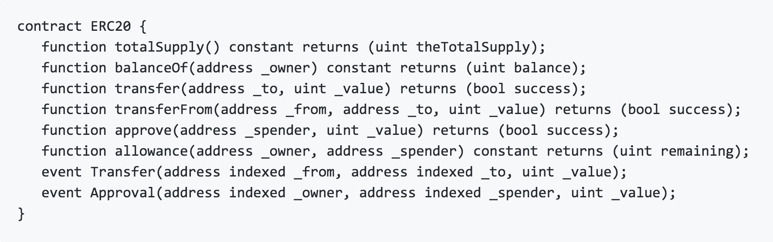
ERC-20 for Fungible Token
Introduced in Nov 2015, now EIP-20
https://github.com/ethereum/EIPs/blob/master/EIPS/eip-20.md
Standard for fungible tokens
different units of an ERC20 token are interchangeable and have no unique properties
Defines
Common interface for fungible token’s contracts

Slide 105
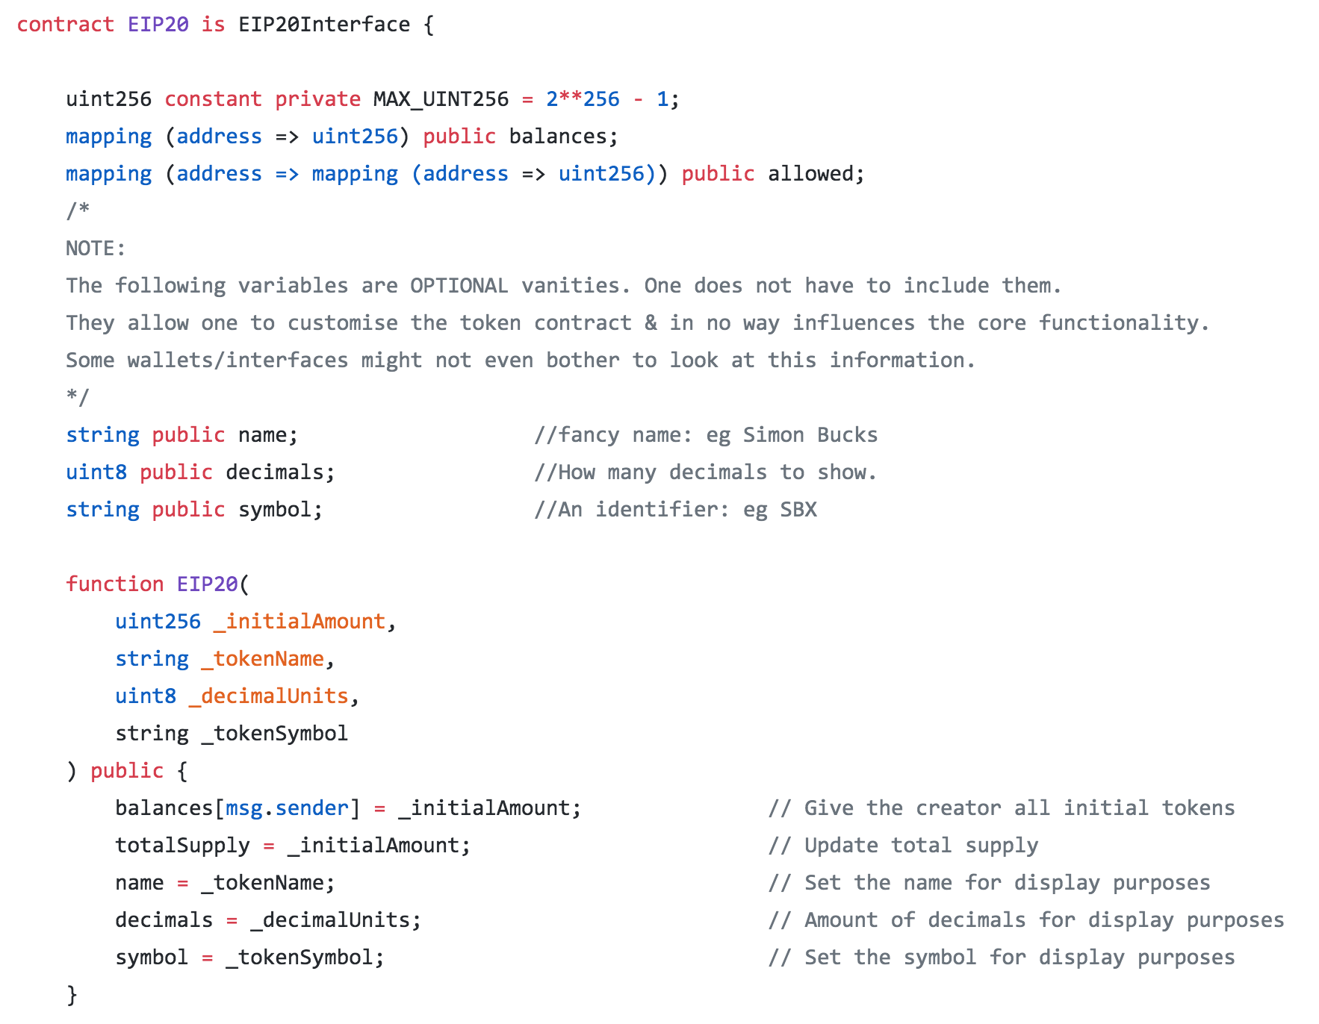
EIP20.sol by Consensys

Slide 106
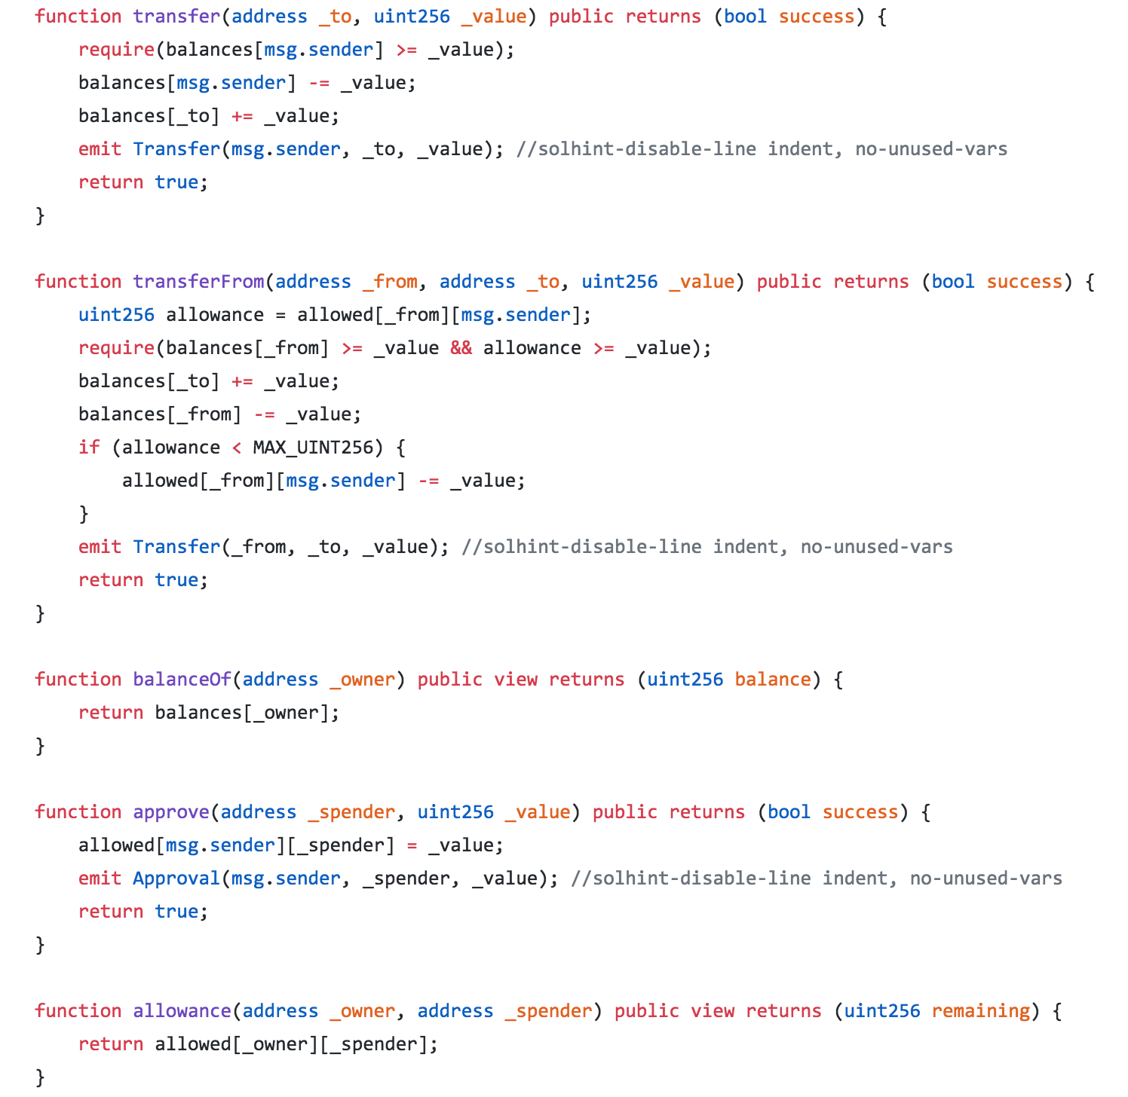

Slide 107
Proj-7: Crowdsale
Goal: Realize crowdfunding
UC1: Fundraiser can set the beneficiary, funding goal, deadline, token price, and the token address
After deadline, funding can go on until the raiser calls the end
UC2: Give token supply to the crowdsale contract
UC3: Receive ether from a donor, then
make sure still under campaign
remember the fund from the donor
transfer tokens for the donation to the donor
Keep track of funds raised so far
Selfdistructing contract after closing will burn any money sent to it → not good
UC4: After deadline, fundraiser can check the funding goal, and shutdown the sale
UC5: If succeeded, the beneficiary can withdraw money
UC6: If failed, the donors can withdraw their money

Slide 108
Crowdsale
interface token { function transfer(address, uint) external; }
data
address public beneficiary;
uint public fundingGoal;
uint public amountRaised = 0;
uint public deadline;
uint public price;
token public tokenReward;
mapping(address => uint) public balanceOf;
bool fundingGoalReached = false;
bool crowdsaleClosed = false;

Slide 109
Crowdsale: constructor
constructor()
Initialize the followings
beneficiary: address to send money if succeeds
fundingGoal: funding goal
deadline: fundraising deadline
price: price per token
tokenReward
constructor(
address beneficiary_,
uint fundingGoal_,
uint durationInMinutes_,
uint etherCostOfEachToken_,
address addressOfToken_
) public {
beneficiary = beneficiary_;
fundingGoal = fundingGoal_ * 1 ether;
deadline = now + durationInMinutes_ * 1 minutes;
price = etherCostOfEachToken_ * 1 ether;
tokenReward = MyToken(addressOfToken_);
}
modifier afterDeadline() { require(now >= deadline); _; }

Slide 110
Crowdsale: ()
function ()
make sure still under campaign
remember the fund from the donor
transfer tokens for the donation to the donor
Keep track of funds raised so far
event fundRaised( address, uint );
function () payable public {
require(!crowdsaleClosed);
uint amount = msg.value;
balanceOf[msg.sender] += amount;
amountRaised += amount;
tokenReward.transfer(msg.sender, amount / price);
emit FundTransfer(msg.sender, amount);
}

Slide 111
Crowdsale: checkGoalReached
checkGoalReached ()
Only if deadline has passed
If funding goal was reached, set it
Close the fundraising anyway
event goalReached( address, uint );
function checkGoalReached() public afterDeadline {
if (amountRaised >= fundingGoal){
fundingGoalReached = true;
emit goalReached(beneficiary, amountRaised);
}
crowdsaleClosed = true;
}

Slide 112
Crowdsale: completeFundraising
completeFundraising ()
Only if deadline has passed
Only if beneficiary called
Only if fundingGoalReached
Send raised funds to the beneficiary
event fundTranferred( address, uint );
function completeFundraising() public afterDeadline {
require( beneficiary == msg.sender );
require( fundingGoalReached );
uint amount = amountRaised;
amountRasied = 0;
if ( beneficiary.send(amount) )
emit fundTransferred(beneficiary, amountRaised);
else
amountRaised = amount;
}

Slide 113
Crowdsale: getRefund
getReturn ()
Only if deadline has passed
Goal was not reached
There are funds to return
Close the fundraising anyway
event donationRefunded( address, uint );
function getRefund() public afterDeadline {
require( ! fundingGoalReached );
require( balanceOf[msg.sender > 0 );
uint amount = balanceOf[msg.sender];
balanceOf[msg.sender] = 0;
if (msg.sender.send(amount)) {
emit donationRefunded(msg.sender, amount);
} else {
balanceOf[msg.sender] = amount;
}
}

Slide 114
Proj-8: Person Certification
Goal: A person can share their personal information with other person for certain period. Organizations can certify that the person once belonged to the organization.

Slide 115
Proj-9: Pet shop
A toy example of Dapp using smart contract over Etehereum
Goal: A pet shop has 16 puppies, and users can open the Dapp and choose dogs to adopt.

Slide 116
Overview of developent steps
Make a project directory, say <root>
in <root>, “truffle unbox pet-shop”
https://truffleframework.com/boxes
Write a smart contrat in contracts folder
in <root> “truffle compile”
Run your private block chain
run ganache
or run “truffle develop”
Modify “truffle.js” for setting up RPC config
Craete “2_deploy_contracts.js” in ”migrations” folder
in <root>, “truffle migrate –reset”
Modify ”src/js/app.js” properly
Develop web resources in “src”
Setup matamask to connect to your blockchain with accounts
in <root> “npm run dev”

