Slide 1
Automation for Query Development and Execution
Henok Lachmann, Noel Bastubbe

Slide 2

Basics
Theoretical knowledge of query development
DBS1
DBS2
Build your own Database Seminar
Lack of practise on real-world applications
ChatGPT as LLM

Slide 3

Task 1: Query Development – our experience
Steps of query development: iterative (write small query → test → debug → write correct small query → restart with bigger query)
Time-consumption: 3 hours
Difficulty: hard start and debugging cost us a lot of nerves
Degree of automation: Syntax check via PostgreSQL
Notes:
We could integrate automation via LLM into an iterative query development process by identifying subqueries and using a LLM to generate them, then test them on samples and if they work as intended use them to extend the query until we have generated the target query

Slide 4

Task 1: Query Development – with LLM
Quality of LLMs implementation: not functional but structure is close
Helpfulness of LLM: good as a starting point to jumpstart the process
Prompt count: 4
Task description
Schema
Correction about friend’s friend
Correction about knows relation
Notes:
We could integrate automation via LLM into an iterative query development process by identifying subqueries and using a LLM to generate them, then test them on samples and if they work as intended use them to extend the query until we have generated the target query

Slide 5
Task 2: Query Extension
Steps of query development: linear for our solution (take task1 query → adapt → test)
Time-consumption: 20 minutes
Difficulty: a lot easier as we had experience from task 1
Degree of automation: Syntax check via PostgreSQL
extending LLMs solution was painful as it was hard to read and not structured like human thought processes
Notes:
We could integrate automation via LLM into an iterative query development process by identifying subqueries and using a LLM to generate them, then test them on samples and if they work as intended use them to extend the query until we have generated the target query

Slide 6
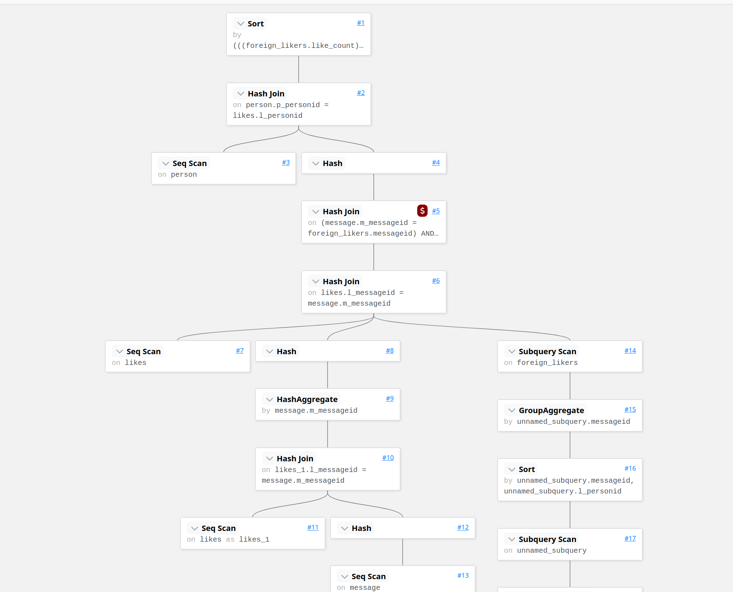
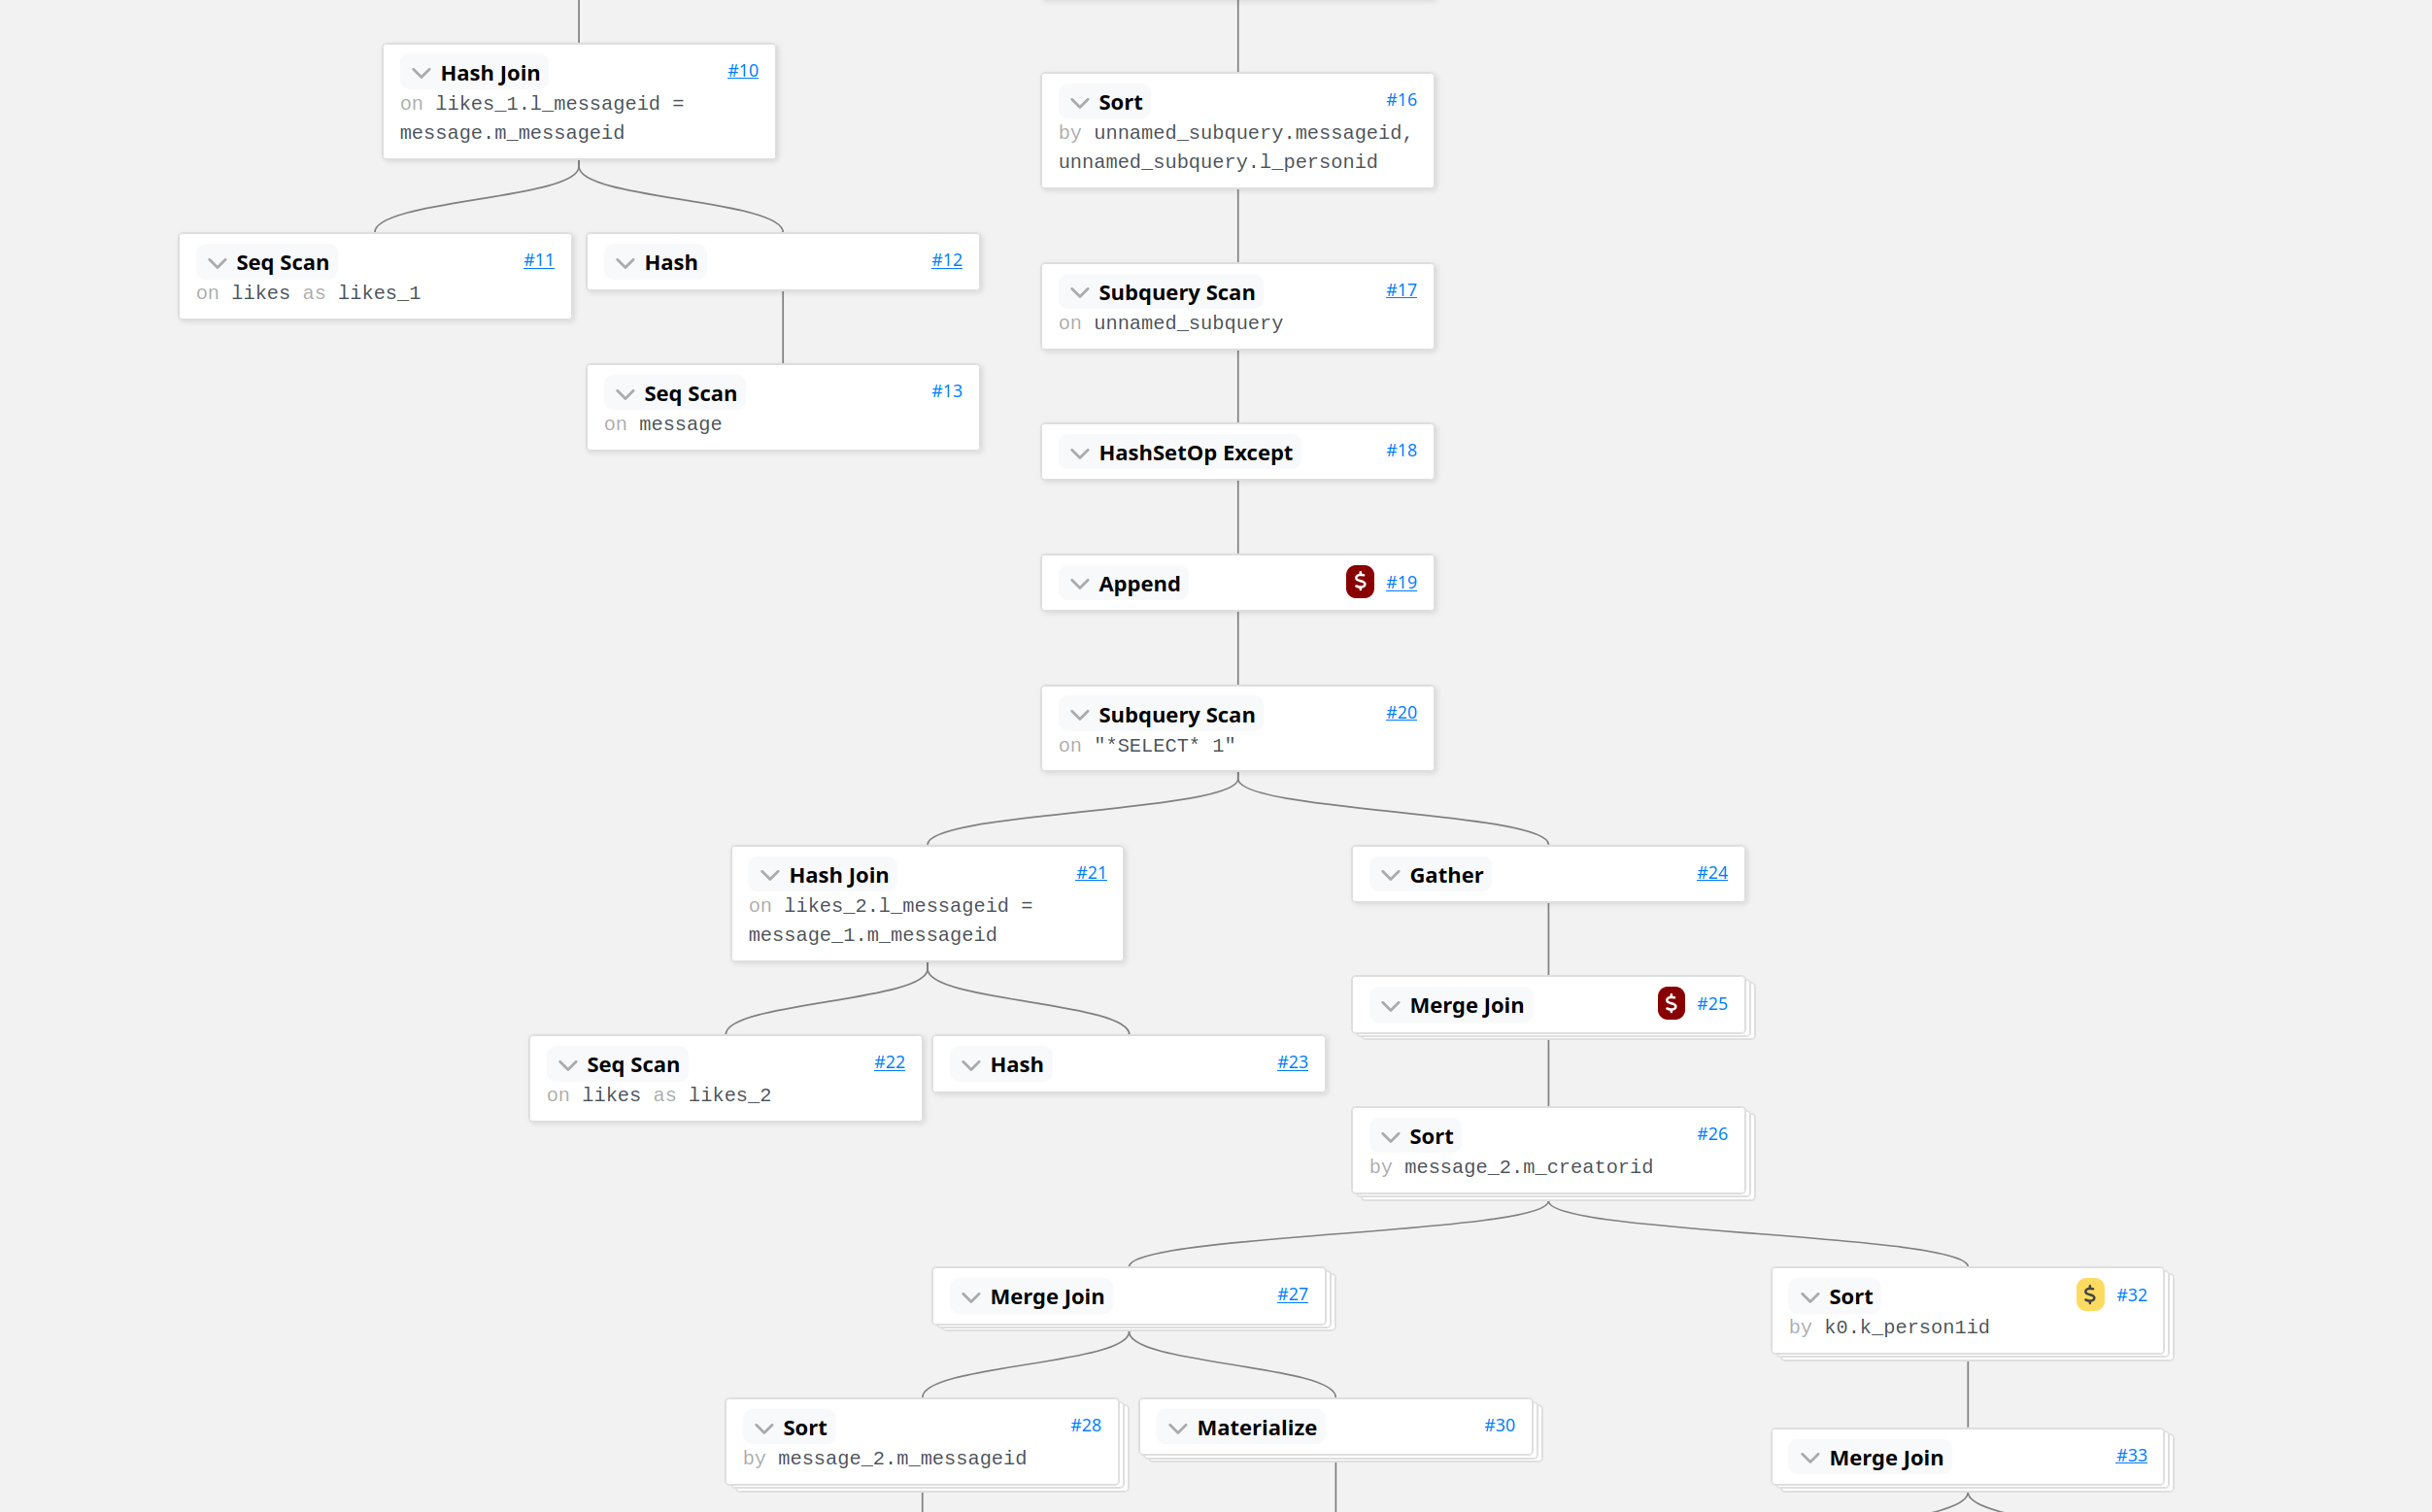
Task 3: Query Execution
Notes:
We could integrate automation via LLM into an iterative query development process by identifying subqueries and using a LLM to generate them, then test them on samples and if they work as intended use them to extend the query until we have generated the target query

Slide 7

Task 3: Query Execution - reflections
postgreSQL already applies various query optimizations
LLM is useful to get a first understanding of the query plan
Generating execution plans is already automated by a far more specialized system
Notes:
We could integrate automation via LLM into an iterative query development process by identifying subqueries and using a LLM to generate them, then test them on samples and if they work as intended use them to extend the query until we have generated the target query

Slide 8
Improvements?
Debugging a query takes long W
Waiting for LLMs response is tedious
Possible Solution: give a query automation system natural language description + test data + expected result
Eliminate testing by hand and a lot of copy paste
Notes:
We could integrate automation via LLM into an iterative query development process by identifying subqueries and using a LLM to generate them, then test them on samples and if they work as intended use them to extend the query until we have generated the target query

Slide 9
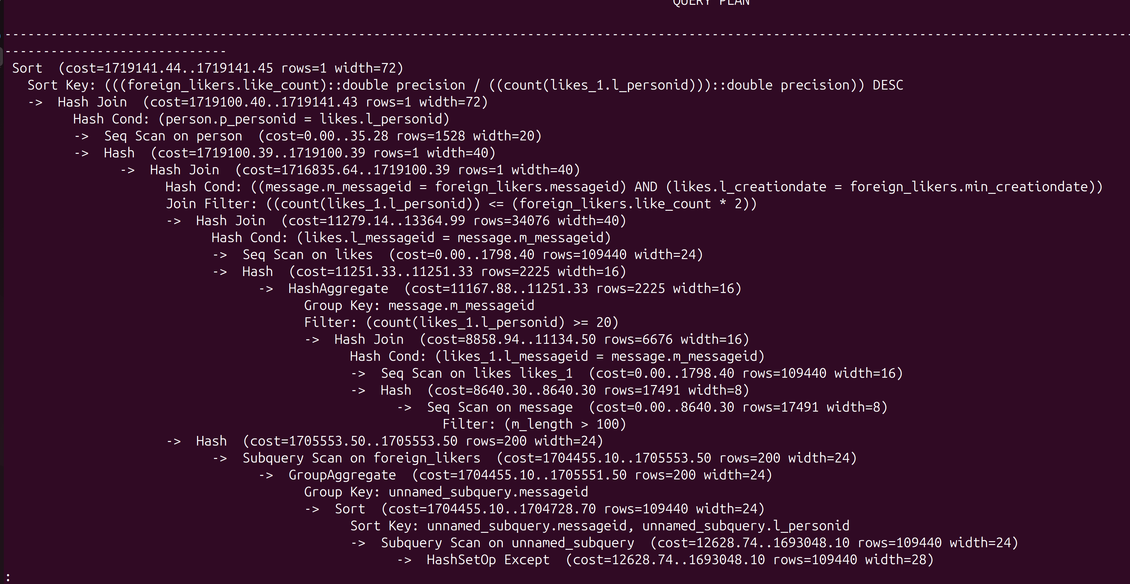
Task 3: Query Execution

Slide 12
Chat for first task
Visualization of the query plan for the second task
Chat for third task

