Slide 1

Superstore Sales Analysis
File created on: 31/10/2023 12:30:22

Slide 2
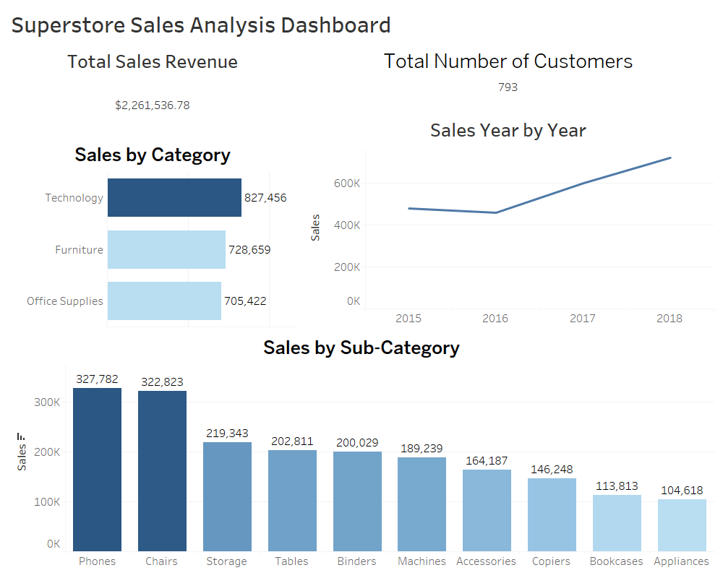

Slide 3
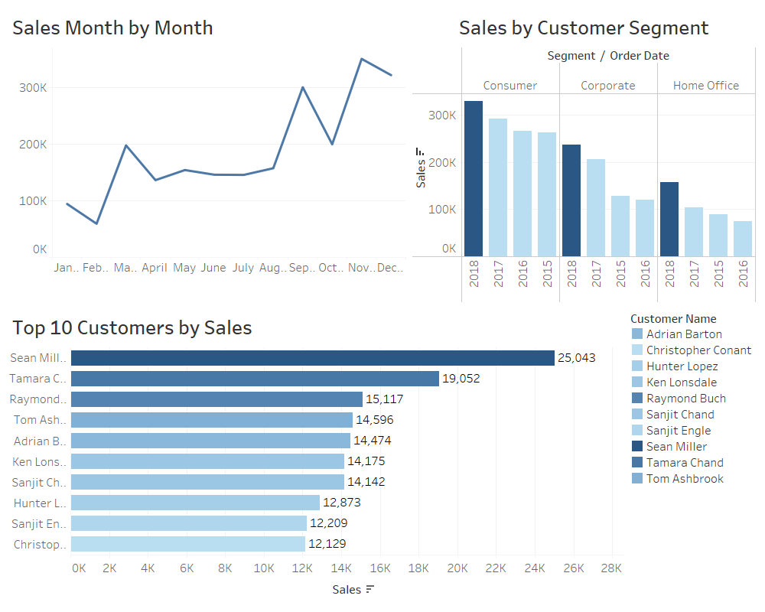

Slide 4
