Slide 1
Team Cookies
Kaya Peng, Lloyd Deng, Tony Moon

Slide 2
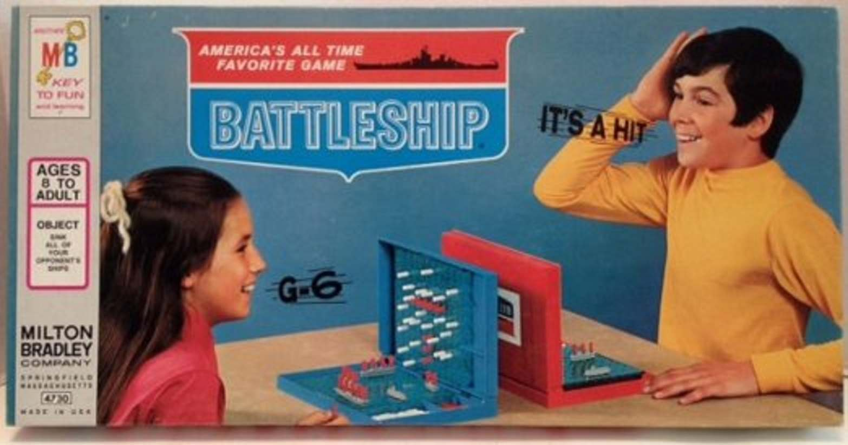
Sea Battle
C++ Battleship game using TCP client-server architecture
Two terminal windows take turns guessing the location of each other’s ships
Our game consists of player, board, and battleships
https://flashbak.com/sank-battleship-celebrating-milton-bradleys-beloved-strategy-game-58200/
Notes:
Terminal windows: A FUN and NOVEL idea!!

Slide 3
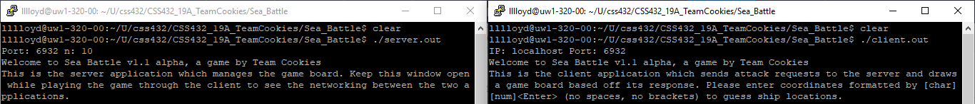
Game initialization details
To run the game, run the server and then the client
main.cpp handles which file to run
Server sends first guess
Gameplay is otherwise identical between the two

Slide 4
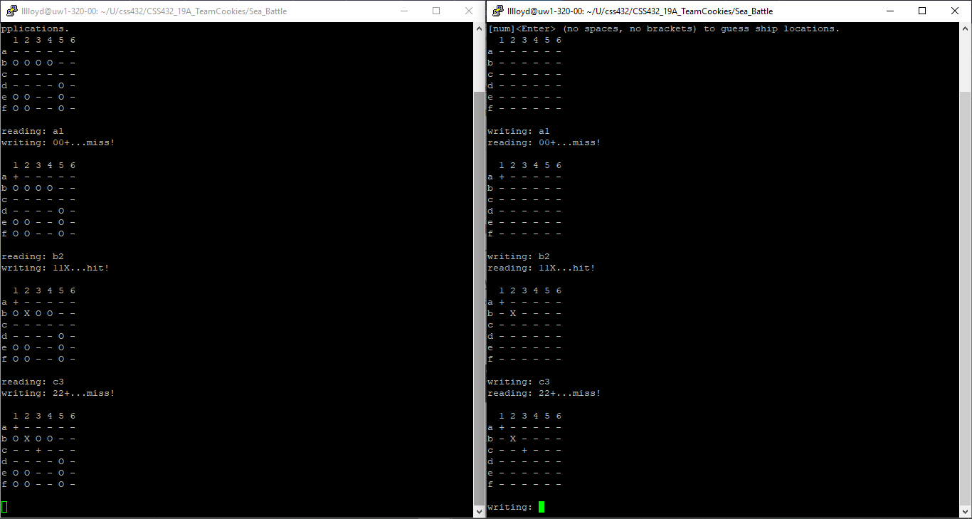
Gameplay turn details
server
client
A turn begins when the player enters a coordinate pair guess to the client window which sends the info to the server window
The server checks its board for a hit or miss, updates it accordingly, and sends the update back to the client
The client decodes the coordinate guess and update their own board and the map of the enemy's board.

Slide 5
Game conclusion details
The game continues until all ships have fallen on either board
Or, if one player sends the code “forfeit”
Network port closes and the user exits the game

Slide 6
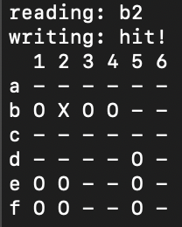
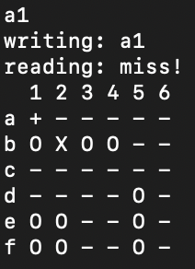
Board Implementation
server
client
Players can see their own board and ship placement
Enemy ship placement is a ~mystery~
Boards are made of 2D array of chars
Healthy ships marked “0”
Hit ships marked “X”
Missed guesses marked "+"
Empty tiles marked “-”

Slide 7
Battleship Implementation
server
client
Ships are randomly generated for each player on game initialization
Ship count (and game time) varies based on how players defines the board size
Ships are positioned in straight lines or in blocks
Healthy ships marked “0”
Hit ships marked “X”
Missed guesses marked "+"
Empty tiles marked “-”

Slide 8
Current Progress
Enemy
Player
TCP Networking architecture is based on provided code from HW1
Player begins with an empty enemy map and must guess ship locations
Game functions are fully functional
Currently single player
Player board has not yet been created yet and players are invulnerable to the enemy
Board supports up to 9x9 due to coordinates being passed in as single-digit chars

Slide 9
Some finished functions
atkHlp decodes client-server communications | initBoardShips and initBoardSea initializes game boards | getBoard is overloaded and returns full or single tile on board attackBoard checks board for hit or miss

Slide 10
Plan for the next five weeks
Week 7: Move board methods from server.cpp & client.cpp into board.cpp module
Week 8: Implement two-player gameplay
Week 9: Implement battleship placement
Week 10: Write integration and unit tests
Week 11: Implement in-game chat

