Slide 1


IPL Dataset Analysis(2008-2019) Introduction to data science- INT217
Presentation by:
Divyanisha
11810030
Section : KM078

Slide 2

Introduction of project
The main idea of project is to analyse the various trends in IPL matches.
This has been done with the help of data visualization in excel via using various in-build functions.
The dataset on which I worked, consists of data about IPL matches played from the year 2008 to 2019.

Slide 3


Functions used:
Pivot table
Data models
Charts
Slicer

Slide 4
ETL Process
DATA EXTRACTION
TRANSFORMATION
LOAD
Extraction of raw data from source.
Performing various steps to give data a desired structures.
Loading the data to datawarehouse (here csv format)

Slide 5

Following analysis has been performed-
To show number of matches won by every team season wise.
To find top 10 batsman.
To find the player with most man of the match award.
To find the venue that hosted maximum number of IPL matches.
To find whether winning a toss increases the chances of victory.
Find country to which batsman with highest score belongs.
Country wise analysis of left-hand and right-hand batsman.

Slide 6
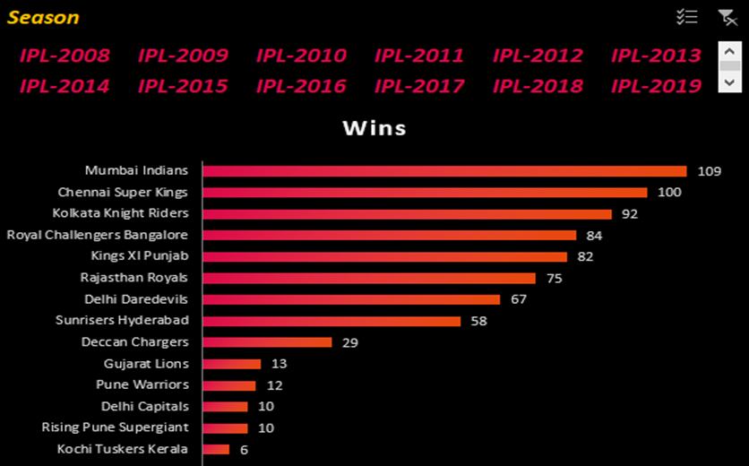

To show number of matches won by every team season wise.
Conlusion: Mumbai Indians has secured most number of wins

Slide 7
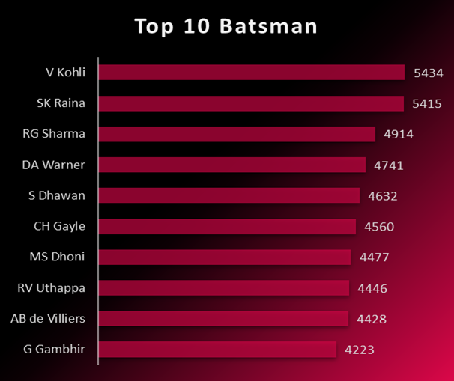
To find top 10 batsman.
Conclusion: Virat Kohli has secured the top position with highest runs followed by Suresh Raina.

Slide 8
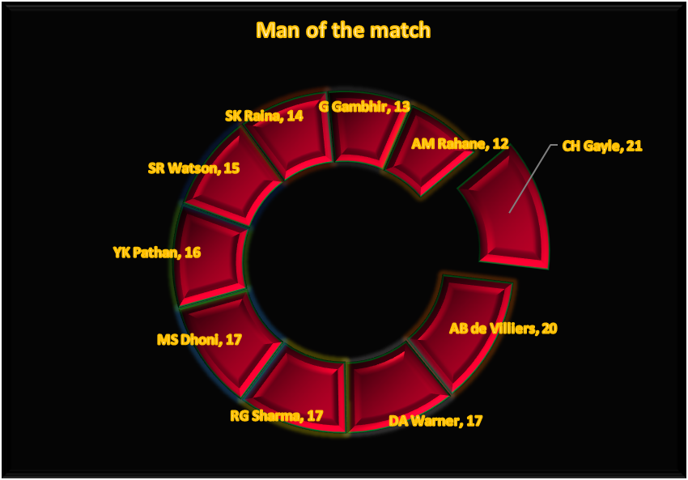
To find the player with most man of the match award.
Conclusion: Chris Gayle is the player who won the most player of the match awards and hence is the most valuable player.

Slide 9
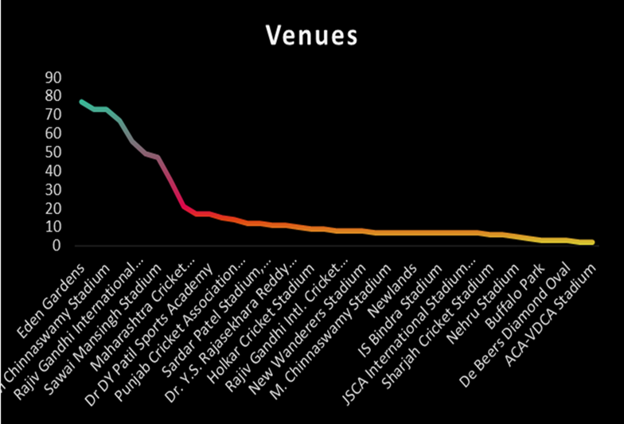
To find the venue that hosted maximum number of IPL matches
Conclusion: Eden Gardens has hosted the maximum number of IPL matches

Slide 10
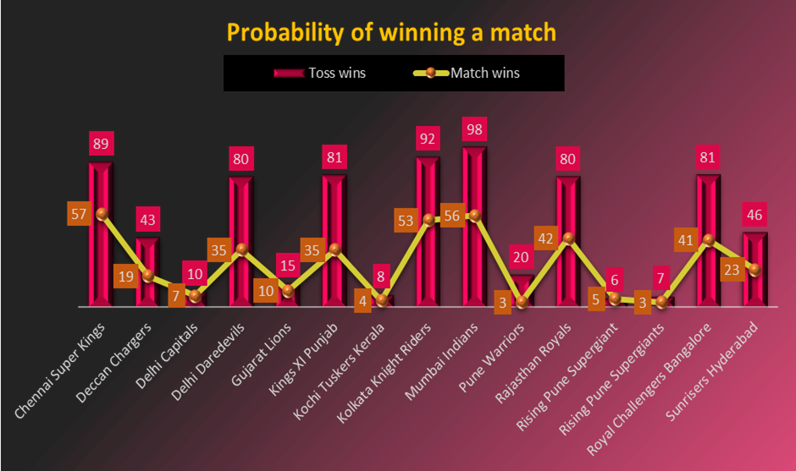
To find whether winning a toss increases the chances of victory.
Conclusion: probability is 52%. So winning toss gives slight edge of wiining match.

Slide 11
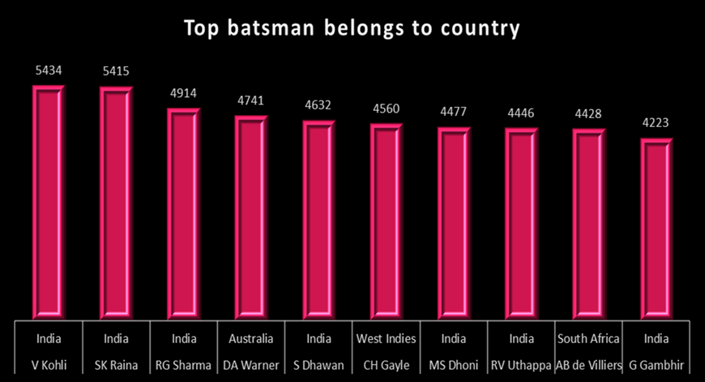
Find country to which batsman with highest score belongs.
Conclusion: top 3 ranking holds INDIA

Slide 12
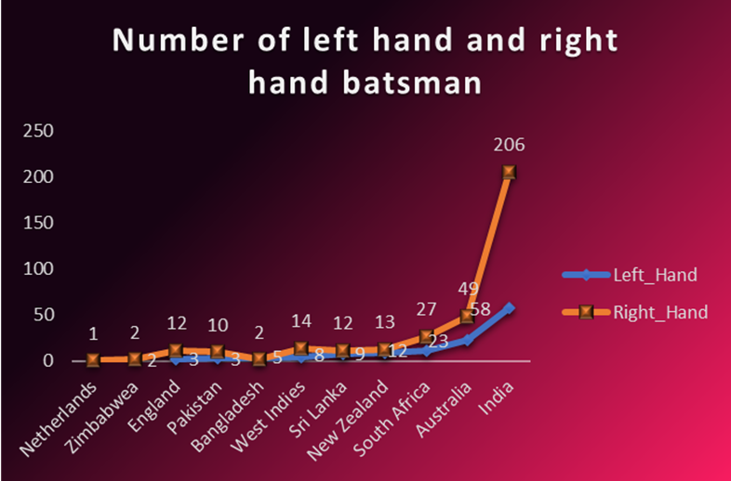
Country wise analysis of left-hand and right-hand batsman.
Conclusion: Every country has more number of right-hand batsman than number of left-hand batsman.

Slide 13
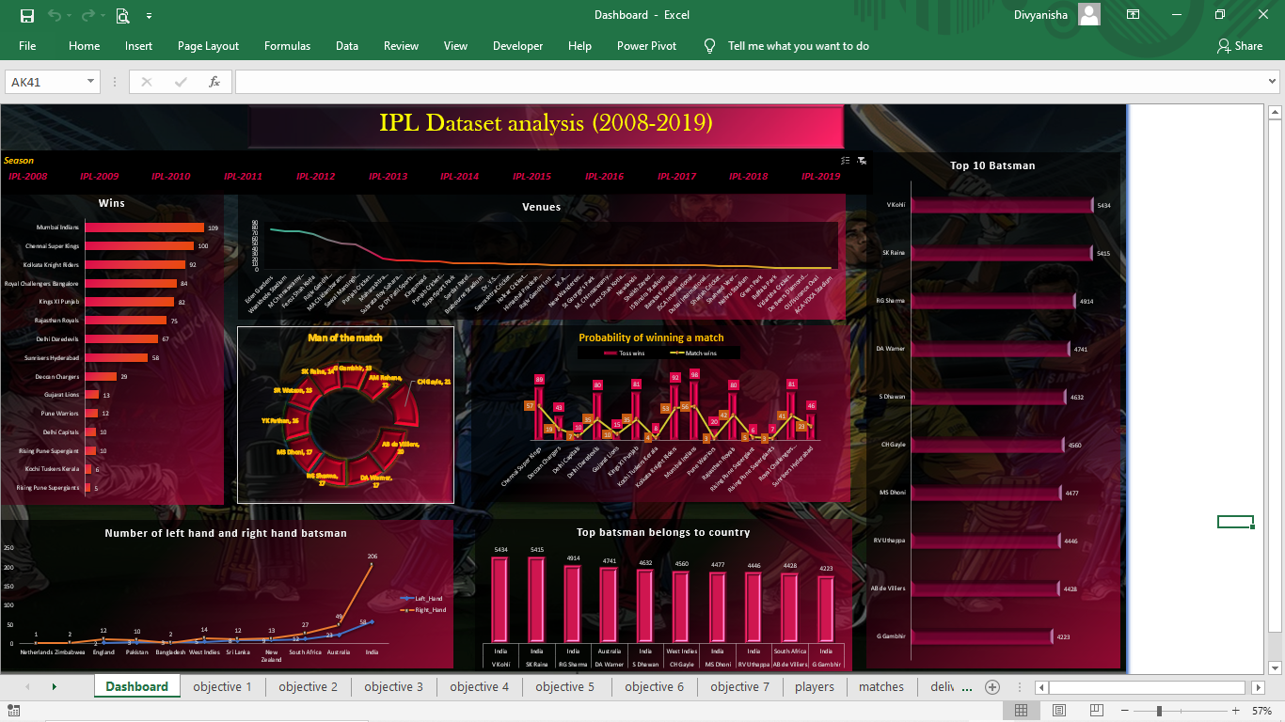

Slide 14


