Slide 1
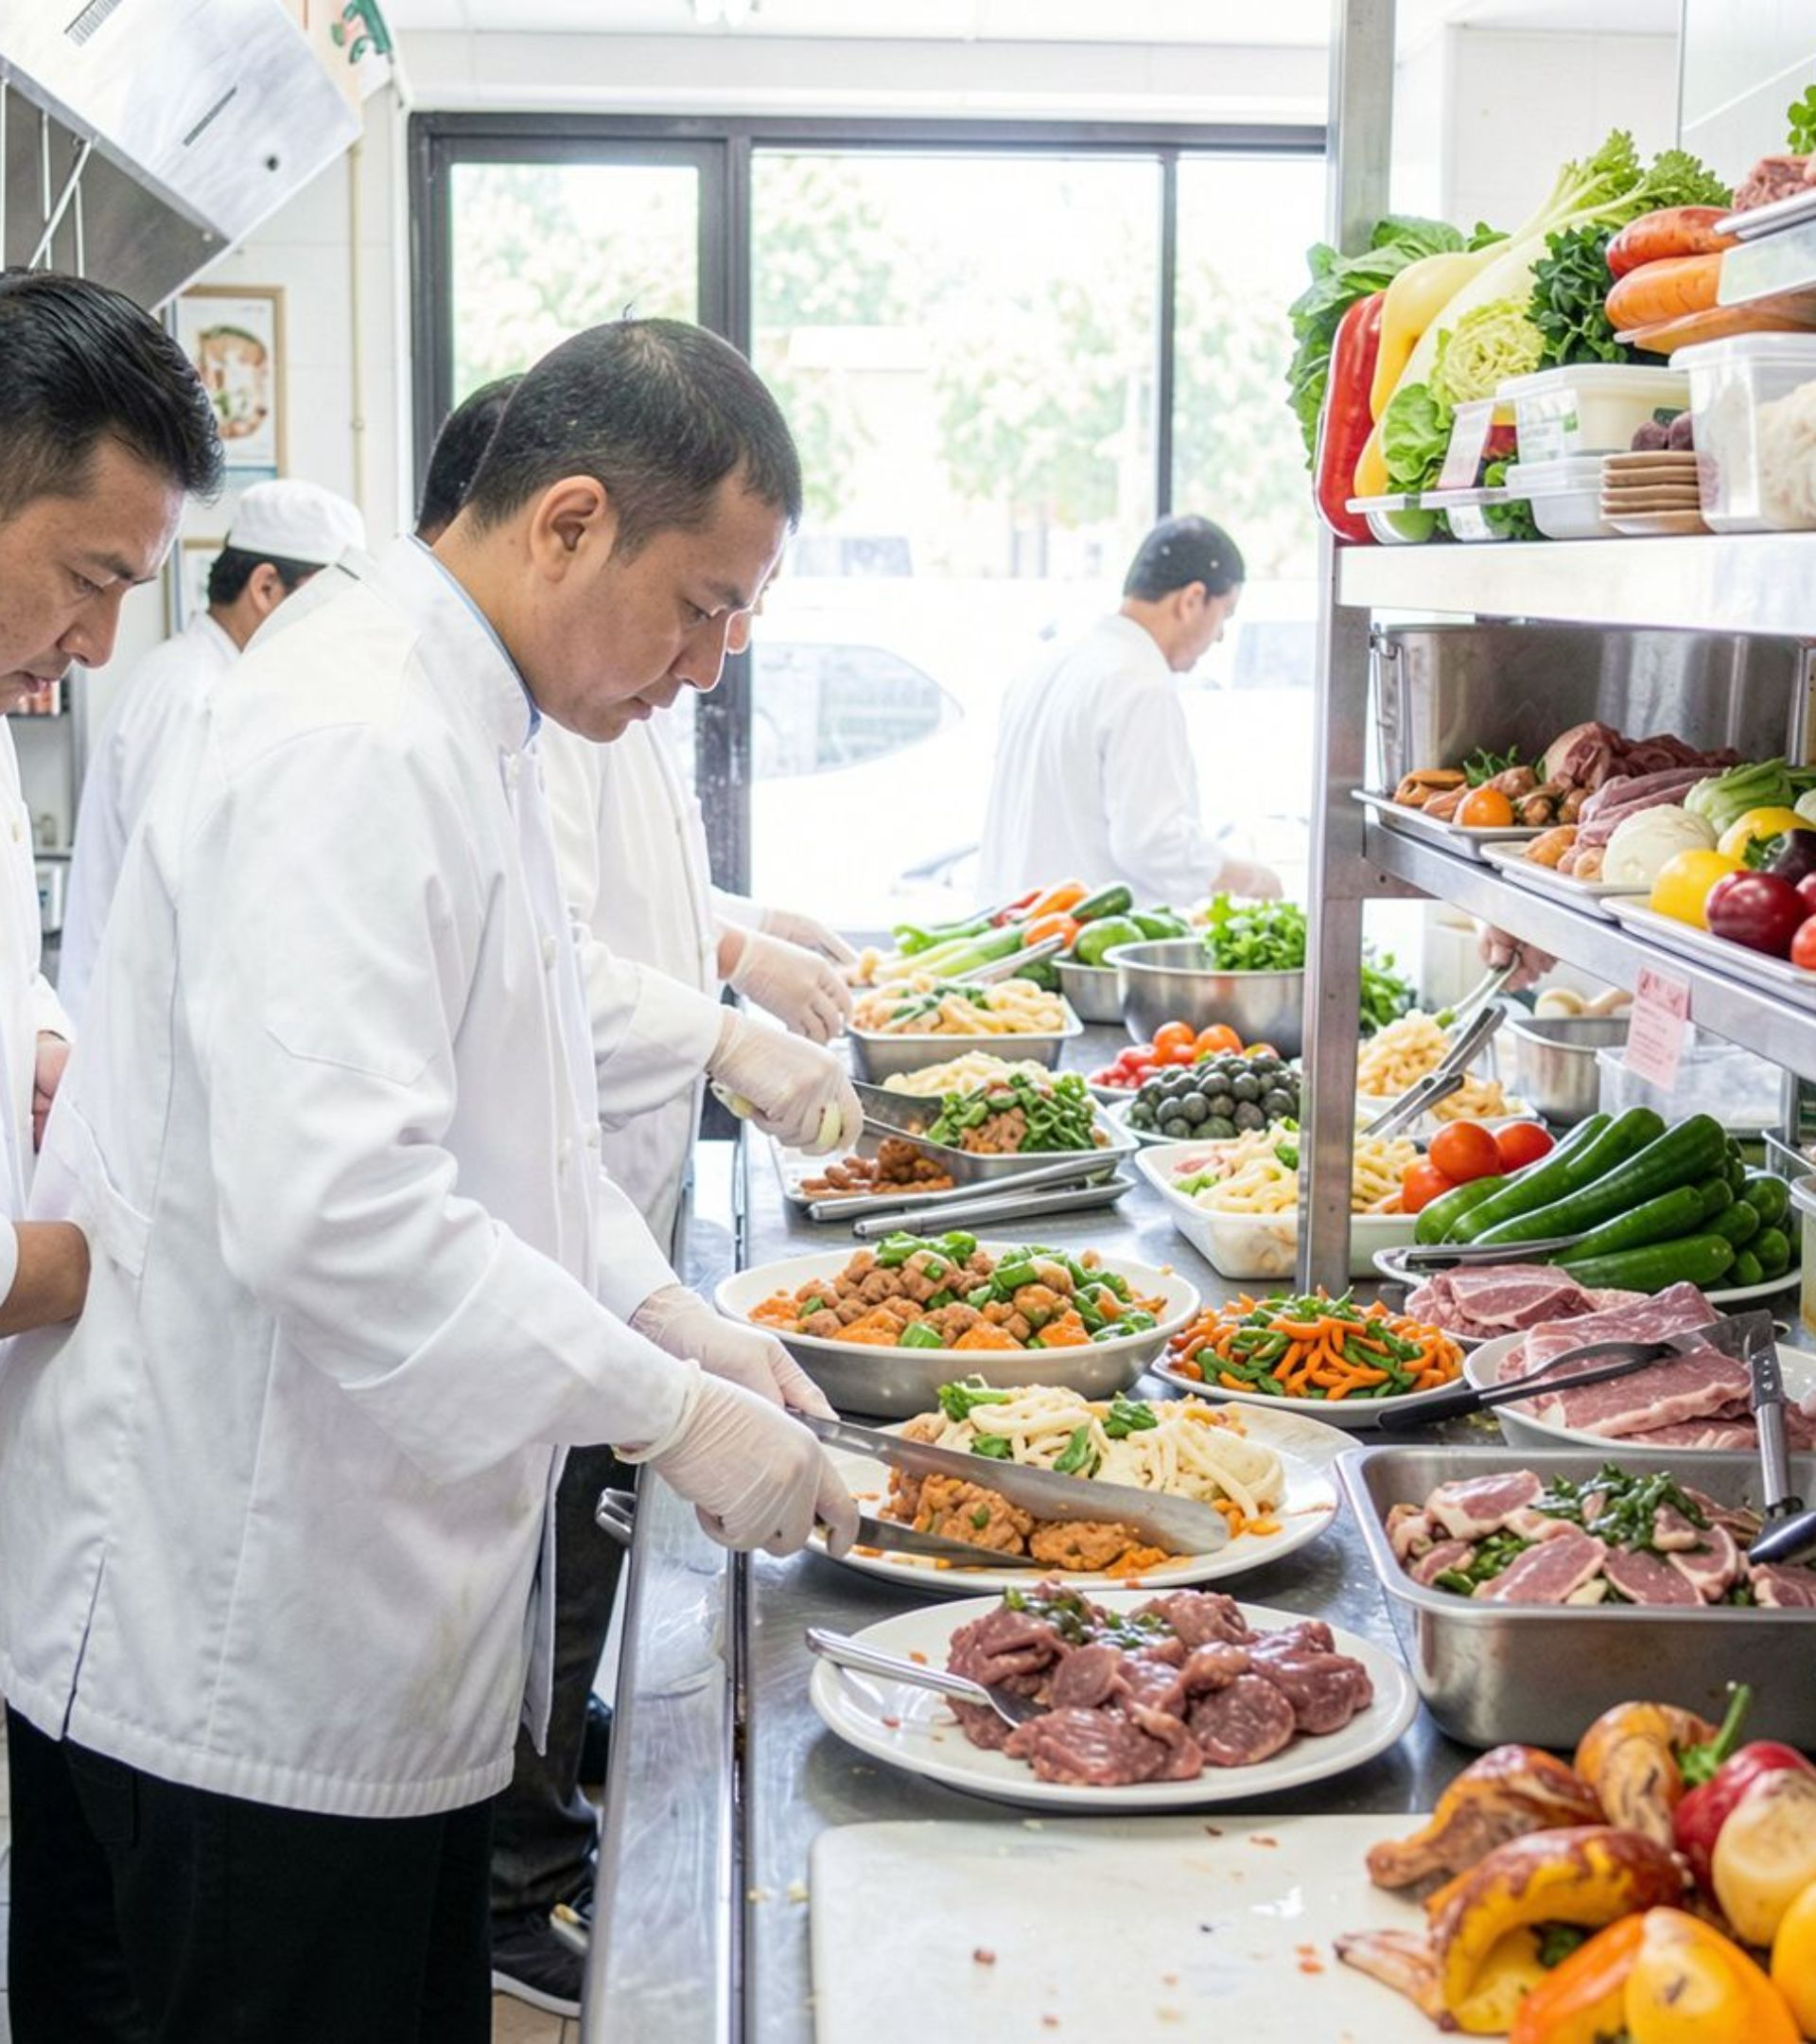
An enhanced approach to minimizing food waste
Intelligent food waste administration in restaurants
Employing routine restaurant data to inform improved decisions, serve patrons effectively and reduce food waste.
Presented by
Abhijith Rajeevan · Matriculation Number: 49313532

Slide 2
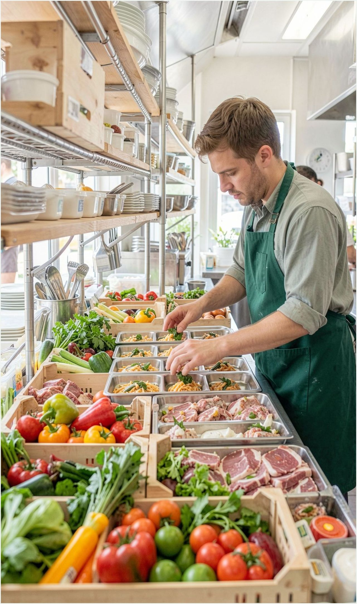
A busy kitchen must decide before demand is known
Excessive preparation: a restaurant prepares more portions than customers ultimately order; surplus food may not be safe or appropriate to serve later.
Ingredients remain unused: fresh vegetables, meat and dairy products may expire when stock is not consumed in time.
The pattern repeats: without clear records, staff may not see which dishes or days consistently generate the greatest waste.
Food wasted represents money, time, ingredients and effort wasted as well.
2 / 8

Slide 3
Food waste affects the business as well as the environment
The objective is not to prepare smaller quantities indiscriminately, but to prepare the appropriate quantity at the appropriate moment.
01
02
03
Financial strain
Resource use
Customer expectations
Every discarded ingredient has already incurred a cost.
Food, water, energy, staff time and transport are used to prepare meals; discarding food also discards these resources.
Many customers appreciate businesses that make a genuine effort to minimise needless waste.

Slide 4
A simple system turns routine records into practical guidance
The system supports the kitchen manager; people retain control.
01
02
03
04
Record
Comprehend
Estimate
Act
Staff record food left over or discarded, including item and quantity.
The system compares waste with sales, stock levels, days of the week and meal periods.
Historical sales data helps estimate how much of each dish customers are likely to order.
The manager receives a recommendation for preparation and stock planning.

Slide 5
Monday lunch: use the past to prepare more carefully
The recommendation should use real restaurant data and be reviewed by staff.
Previously
Illustrative recommendation
→
100
70
Monday sales are typically lower than weekend sales; recent trends and special events also matter.
portions were prepared on Mondays
Approximately 65 were sold.
portions, then adjust according to actual demand.
70 portions is only an illustration. Estimates can improve by comparing them with actual sales over time.

Slide 6
The dashboard should answer practical questions quickly
Daily overview
Stock reminders
What happened today?
What should be used first?
How much food was discarded today, which dishes generated the highest waste, and the approximate cost.
Which ingredients are nearing expiry and what should be used first.
Demand insights
Preparation suggestions
When do dishes sell?
What may be required tomorrow?
Which dishes sell more on weekdays or weekends, and whether lunch and dinner show different patterns.
How many portions may be required tomorrow and which items need attention.
Clear information matters more than a complex dashboard filled with technical charts.

Slide 7
The concept is useful, but its limits must be visible
Potential advantages
Points to consider
Reduced avoidable food waste
More effective use of ingredients
Better-informed purchasing choices
Improved understanding of customer demand
Possible reductions in food costs
Staff must record waste consistently.
Inaccurate data may produce poor recommendations.
Abrupt shifts in demand are hard to forecast.
The system needs sufficient historical data.
Staff should always verify recommendations.
Begin on a small scale: trial the concept in one restaurant, learn from the outcomes and refine it before expansion.

Slide 8
Reduced waste.
Better decisions.
More intelligent restaurants.
By documenting waste and analysing sales trends, restaurants can make better-informed decisions about what to purchase and how much food to prepare.
Thank you
Abhijith Rajeevan · 49313532

