Slide 1
print(@Readonly Object x) {
List<@NonNull String> lst;
…
}
Detecting and preventing bugs with pluggable type-checking
Michael D. Ernst
University of Washington
Joint work with Werner Dietl, and many others
http://checkerframework.org/

Slide 2
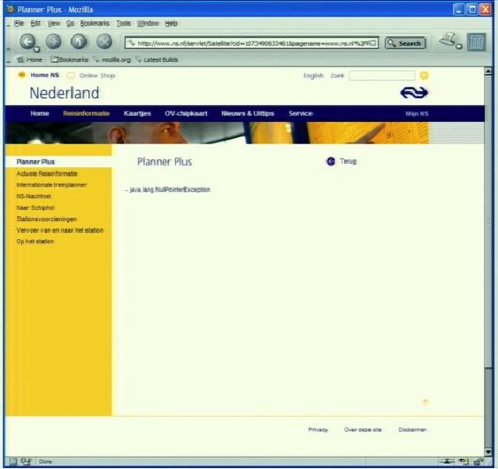
Motivation
java.lang.NullPointerException

Slide 3
Java’s type checking is too weak
Type checking prevents many bugs
int i = “hello”; // type error
Type checking doesn’t prevent enough bugs
System.console().readLine();
NullPointerException
Collections.emptyList().add(“One”);
UnsupportedOperationException
Notes:
Programmers wish to prevent these.

Slide 4
Some errors are silent
Date date = new Date(0); myMap.put(date, “Java epoch”); date.setYear(70); myMap.put(date, “Linux epoch”);
Corrupted map
dbStatement.executeQuery(userInput);
SQL injection attack
Initialization, data formatting, equality tests, …
Notes:
Also: UnsupportedOperationException, SQLException

Slide 5

Problem: Your code has bugs
Who discovers the problems?
If you are very lucky, testing discovers (some of) them
If you are unlucky, your customer discovers them
If you are very unlucky, hackers discover them
If you are smart, the compiler discovers them
It’s better to be smart than lucky

Slide 6
Solution: Pluggable type systems
Design a type system to solve a specific problem
Write type qualifiers in code (or, use type inference)
@Immutable Date date = new Date(0);
date.setTime(70); // compile-time error
Type checker warns about violations (bugs)
% javac -processor NullnessChecker MyFile.java
MyFile.java:149: dereference of possibly-null reference bb2
allVars = bb2.vars;
^

Slide 7
Outline
Type qualifiers
Pluggable type checkers
Writing your own checker
Verification vs. bug finding
Conclusion

Slide 8
Type qualifiers
In Java 8: annotations on types
@Untainted String query;
List<@NonNull String> strings;
myGraph = (@Immutable Graph) tmpGraph;
class UnmodifiableList<T>
implements @Readonly List<@Readonly T> {}
Backward-compatible (not in Java 8): compile with any Java compiler
List</*@NonNull*/ String> strings;

Slide 9
Benefits of type qualifiers
Find bugs in programs
Guarantee the absence of errors
Improve documentation
Improve code structure & maintainability
Aid compilers, optimizers, and analysis tools
Reduce number of assertions and run-time checks
Possible negatives:
Must write the types (or use type inference)
False positives are possible (can be suppressed)

Slide 10
Outline
Type qualifiers
Pluggable type checkers
Writing your own checker
Verification vs. bug finding
Conclusion

Slide 11
What bugs can you detect & prevent?
The property you care about:
The annotation you write:
Null dereferences @NonNull
Mutation and side-effects @Immutable
Concurrency: locking @GuardedBy
Security: encryption, @Encrypted tainting @OsTrusted, @Untaint…
Aliasing @Linear
Equality tests @Interned
Strings: localization, @Localized regular expression syntax, @Regex signature representation, @FullyQualified format string syntax @Format
Enumeractions @Fenum
Typestate (e.g., open/closed files) @State
Users can write their own checkers!

Slide 12
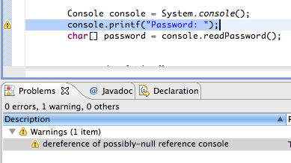
Using a checker
Run in IDE or on command line
Works as a compiler plug-in (annotation processor)
Familiar workflow and error messages
% javac –processor NullnessChecker MyFile.java
MyFile.java:9: incompatible types. nonNullVar = nullableValue; ^ found : @Nullable String required: @NonNull String

Slide 13
Nullness and mutation demo
Detect errors
Guarantee the absence of errors
Verify the correctness of optimizations

Slide 14
Checkers are effective
Over 3,000,000 LOC checked (as of 2011)
Each checker found errors in each code base it ran on
Verified by a human and fixed

Slide 15
Selected case study results
Compiler messages: 8 wrong keys in Checker Framework
Fake enumerations: minor problems in Swing, JabRef
Signature strings: 28 errors in OpenJDK, ASM, AFU
Interning: >200 minor problems in Xerces, Lucene
Nullness: >200 errors in Google Collections, Daikon, javac
Regular expressions: 56 errors in Apache, etc.; 200 annos
Format strings: 104 errors, only 107 annotations required
… many more
First-year CS majors used the Checker Framework
Stated they preferred using it to not

Slide 16
Comparison: other nullness tools
 | Null pointer errors |  | False warnings | Annotations written
 | Found | Missed
Checker Framework | 8 | 0 | 4 | 35
FindBugs | 0 | 8 | 1 | 0
Jlint | 0 | 8 | 8 | 0
PMD | 0 | 8 | 0 | 0
Checking the Lookup program for file system searching (4KLOC)
Distributed with Daikon (>100KLOC verified by our checker)
False warnings are suppressed via an annotation or assertion
Also, errors in Google Collections (>20,000 tests, FindBugs)

Slide 17
Checkers are featureful
Full type systems: inheritance, overriding, etc.
Generics (type polymorphism)
Also qualifier polymorphism
Flow-sensitive type qualifier inference
Infers types for local variables
reusable component
Qualifier defaults
Warning suppression

Slide 18
Checkers are usable
Integrated with toolchain
javac, Eclipse, Ant, Maven
Few false positives
Annotations are not too verbose
@NonNull: 1 per 75 lines
with program-wide defaults, 1 per 2000 lines
@Interned: 124 annotations in 220 KLOC revealed 11 bugs
@Format: 107 annotations in 2.8 MLOC revealed 104 bugs
Possible to annotate part of program
Fewer annotations in new code
Inference tools: nullness, mutability
Adds annotations throughout your program
More forthcoming

Slide 19
What a checker guarantees
The program satisfies the type property. There are:
no bugs (of particular varieties)
no wrong annotations
Caveat 1: only for code that is checked
Native methods
Reflection
Code compiled without the pluggable type checker
Suppressed warnings
Indicates what code a human should analyze
Checking part of a program is still useful
Caveat 2: The checker itself might contain an error

Slide 20
Annotating libraries
Each checker comes with JDK annotations
For signatures, not bodies
Finds errors in clients, but not in the library itself
Inference tools for annotating new libraries

Slide 21
Outline
Type qualifiers
Pluggable type checkers
Writing your own checker
Verification vs. bug finding
Conclusion

Slide 22
SQL injection attack
Server code bug: SQL query constructed using unfiltered user input
query = “SELECT * FROM users ”
+ “WHERE name=‘” + userInput + “’;”;
User inputs: a’ or ‘1’=‘1
Result:
query ⇒ SELECT * FROM users
WHERE name=‘a’ or ‘1’=‘1’;
Query returns information about all users

Slide 23
Taint checker
@TypeQualifier
@SubtypeOf(Unqualified.class)
@ImplicitFor(trees = {STRING_LITERAL})
public @interface Untainted { }
To use it:
Write @Untainted in your program
List getPosts(@Untainted String category) {…}
Compile your program
javac -processor BasicChecker -Aquals=Untainted MyProgram.java

Slide 24
Taint checker demo
Detect SQL injection vulnerability
Guarantee absence of such vulnerabilities

Slide 25
Defining a type system
@TypeQualifier
public @interface NonNull { }

Slide 26
Defining a type system
Qualifier hierarchy – rules for assignment
Type introduction – types for expressions
Type rules – checker-specific errors
@TypeQualifier
public @interface NonNull { }

Slide 27
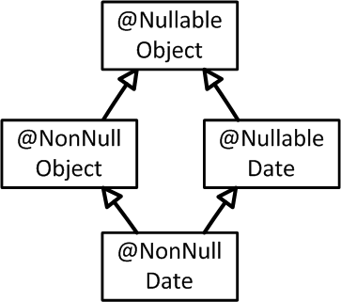
Defining a type system
What assignments are legal:
Qualifier hierarchy
Type introduction
Type rules
@TypeQualifier
@SubtypeOf( Nullable.class )
public @interface NonNull { }
Notes:
Also method call, overriding, etc.

Slide 28
Defining a type system
Gives the type of expressions:
Qualifier hierarchy
Type introduction
Type rules
@TypeQualifier
@SubtypeOf( Nullable.class )
@ImplicitFor(trees={ NEW_CLASS,
PLUS,
BOOLEAN_LITERAL, ... } )
public @interface NonNull { }
new Date()
“hello ” + getName()
Boolean.TRUE

Slide 29
Defining a type system
Errors for unsafe code:
Qualifier hierarchy
Type introduction
Type rules
void visitSynchronized(SynchronizedTree node) {
ExpressionTree expr = node.getExpression();
AnnotatedTypeMirror type = getAnnotatedType(expr);
if (! type.hasAnnotation(NONNULL))
checker.report(Result.failure(...), expr);
}
synchronized (expr) {
…
}
Warn if expr may be null

Slide 30
Outline
Type qualifiers
Pluggable type checkers
Writing your own checker
Verification vs. bug finding
Conclusion

Slide 31
Verification
Bug-finding
Goal: prove that no bug exists
Specifications: user provides
False negatives: none
False positives: user suppresses warnings
Downside: user burden
Goal: find some bugs at low cost
Specifications: infer likely specs
False negatives: acceptable
False positives: heuristics focus on most important bugs
Downside: missed bugs
Neither is “better”; each is appropriate in certain circumstances. The approaches are converging.
Notes:
Verification: User even has to provide specifications for libraries. Inference is still possible.
Bug-finding: Specifications may be inaccurate
Neither one leads to more user confusion; verification might even lead to less
My research agenda enables verification; Coverity’s profitable business model focuses on bug-finding. The two are converging.

Slide 32
Other design considerations
Visibility of specifications and warning suppressions
In the source code
documentation aids programer understanding
In the tool
reduces code clutter
Analysis comprehensibility
A transparent tool gives understandable outcomes
requires more upfront effort; more false positives
An opaque tool can use more powerful analyses
requires more effort to understand warnings
Notes:
This is orthogonal to the previous issue.

Slide 33
Outline
Type qualifiers
Pluggable type checkers
Writing your own checker
Verification vs. bug finding
Conclusion

Slide 34
Pluggable type-checking
Java 8 syntax for type annotations
Checker Framework for creating type checkers
Featureful, effective, easy to use, scalable
Prevent bugs at compile time
Create custom type-checkers
Learn more, or download the Checker Framework: http://checkerframework.org/ (or, web search for “Checker Framework”)
Notes:
Catch me anytime for a demo.

