Slide 1

print(@Readonly Object x) {
List<@NonNull String> lst;
…
}
Create your own type system
for fun and profit
Michael D. Ernst
& the PLSE group, UW CSE
http://CheckerFramework.org/

Slide 2
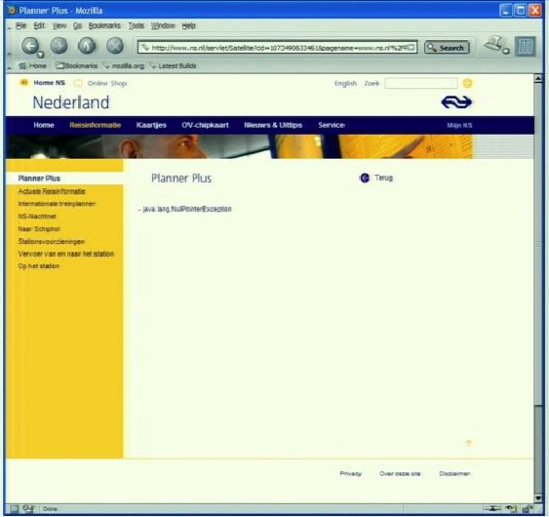
Motivation
Sofware bugs cost money
$312 billion per year (2013)
$440 million loss by Knight Capital Group in 30 minutes
$6 billion: 2003 blackout in northeastern USA & Canada
Software bugs cost lives
2003: 11 deaths: blackout
1997: 225 deaths: jet crash caused by radar software
1991: 28 deaths: Patriot missile guidance system
1985-2000: >8 deaths: Radiation therapy
java.lang.NullPointerException

Slide 3
Java’s type checking is too weak
Type checking prevents many bugs
int i = "hello"; // type error
Type checking doesn’t prevent enough bugs
System.console().readLine();
NullPointerException
Collections.emptyList().add("One");
UnsupportedOperationException
Notes:
Programmers wish to prevent these.

Slide 4
Some errors are silent
Date date = new Date(0); myMap.put(date, "Java epoch"); date.setYear(70); myMap.put(date, "Linux epoch");
Corrupted map
dbStatement.executeQuery(userInput);
SQL injection attack
Initialization, data formatting, equality tests, …
Goal: Find errors at compile time
… before testing, customers, or hackers find them
Notes:
Also: UnsupportedOperationException, SQLException

Slide 5
Solution: Pluggable type systems
Design a type system to solve a specific problem
Write type qualifiers in code (or, use type inference)
@Immutable Date date = new Date(0);
date.setTime(70); // compile-time error
Type checker warns about violations (bugs)
% javac -processor NullnessChecker MyFile.java
MyFile.java:149: dereference of possibly-null reference bb2
allVars = bb2.vars;
^

Slide 6
Type qualifiers
In Java 8: annotations on types
@Untainted String query;
List<@NonNull String> strings;
myGraph = (@Immutable Graph) tmpGraph;
@English String @ReadOnly [] words;
class UnmodifiableList<T>
implements @Readonly List<@Readonly T> {}
Backward-compatible: with any Java compiler
List</*@NonNull*/ String> strings;

Slide 7
Benefits of type qualifiers
Find bugs in programs
Guarantee the absence of errors
Improve documentation
Improve code structure & maintainability
Aid compilers, optimizers, and analysis tools
Reduce number of run-time checks
Possible negatives:
Must write the types (or use type inference)
False positives are possible (can be suppressed)

Slide 8
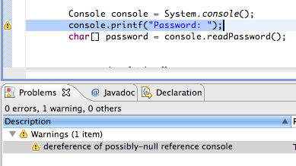
Using a checker
Run in IDE or on command line
Works as a compiler plug-in (annotation processor)
Familiar workflow and error messages
% javac –processor NullnessChecker MyFile.java
MyFile.java:9: incompatible types. nonNullVar = nullableValue; ^ found : @Nullable String required: @NonNull String

Slide 9
Optional Type Checking
No errors
Source
Compiler
Executable
Fix bugs
Errors
Change types

Slide 10
Optional Type Checking
No errors
Source
Compiler
Executable
Guaranteed behavior
Fix bugs
Optional Type Checker
Errors
Change types
Fix bugs
Warnings
Add/change annotations

Slide 11
Optional Type Checking
No errors
Source
Compiler
Executable
Guaranteed behavior
Fix bugs
Optional Type Checker
Errors
Optional Type Checker
Change types
Optional Type Checker
Fix bugs
Warnings
Add/change annotations

Slide 12
Nullness and mutation demo
Detect errors
Guarantee the absence of errors
Verify the correctness of optimizations

Slide 13
Checkers are effective
Practical: in daily use at Google, on Wall Street, etc.
Scalable: > 6 MLOC checked at UW
Selected case study results:
Signature strings: 28 errors in OpenJDK, ASM, AFU
Nullness: >200 errors in Google Collections, javac, Daikon
Interning: >200 problems in Xerces, Lucene
Format strings: 104 errors, only 107 annotations required
Regular expressions: 56 errors in Apache, etc.; 200 annos
Fake enumerations: problems in Swing, JabRef
Compiler messages: 8 wrong keys in Checker Framework

Slide 14
Comparison: other nullness tools
 | Null pointer errors |  | False warnings | Annotations written
 | Found | Missed
Checker Framework | 8 | 0 | 4 | 35
FindBugs | 0 | 8 | 1 | 0
Jlint | 0 | 8 | 8 | 0
PMD | 0 | 8 | 0 | 0
Checking the Lookup program for file system searching (4KLOC)
False warnings are suppressed via an annotation or assertion

Slide 15
Checkers are featureful
Full type systems: inheritance, overriding, generics (type polymorphism), etc.
Type qualifier polymorphism
Flow-sensitive type qualifier inference
no annotations within method bodies
Qualifier defaults
Pre-/post-conditions, side effect annotations
Warning suppression

Slide 16
Checkers are usable
Type-checking is familiar to programmers
Modular: fast, incremental, partial programs
Integrated with toolchain: javac, Eclipse, Ant, Maven
Annotations are not too verbose
@NonNull: 1 per 75 lines
@Interned: 124 annotations in 220 KLOC revealed 11 bugs
@Format: 107 annotations in 2.8 MLOC revealed 104 bugs
Possible to annotate part of program
Fewer annotations in new code
Inference tools add annotations to your program
Few false positives
First-year CS majors preferred using checkers to not

Slide 17
What a checker guarantees
The program satisfies the type property. There are:
no bugs (of particular varieties)
no wrong annotations
Caveat 1: only for code that is checked
Native methods (handles reflection!)
Code compiled without the pluggable type checker
Suppressed warnings
Indicates what code a human should analyze
Checking part of a program is still useful
Caveat 2: The checker itself might contain an error

Slide 18
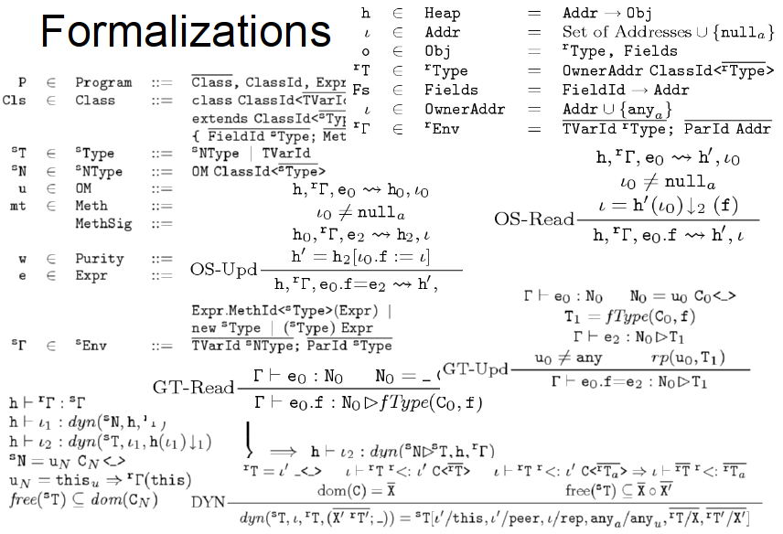

Slide 19
Annotating libraries
Each checker comes with JDK annotations
For signatures, not bodies
Finds errors in clients, but not in the library itself
Inference tools for annotating new libraries

Slide 20
What bugs can you detect & prevent?
The property you care about:
The annotation you write:
Null dereferences @NonNull
Mutation and side-effects @Immutable
Concurrency: locking @GuardedBy
Security: encryption, @Encrypted tainting @OsTrusted, @Untaint…
Aliasing @Linear
Equality tests @Interned
Strings: localization, @Localized regular expression syntax, @Regex signature representation, @FullyQualified format string syntax @Format
Enumeractions @Fenum
Typestate (e.g., open/closed files) @State
Users can write their own checkers!

Slide 21
Example: Regular expressions
// Prints the first matching group.
// For example:
// java RegexExample ([0-9]*):([0-9]*) 23:59
// prints “Group 1 = 23”
public static void main(String[] args) {
String regex = args[0];
String content = args[1];
Pattern pat = Pattern.compile(regex);
Matcher mat = pat.matcher(content);
if (mat.matches()) {
System.out.println("Group 1 = "
+ mat.group(1));
}
}
PatternSyntaxException
IndexOutOfBoundsException

Slide 22
Regular expression type system
What runtime errors to prevent? PatternSyntaxException and IndexOutOfBoundsException.
What operations are legal? Pattern.compile only on valid regex. Matcher.group(i) only if >i groups.
What properties of data should hold? Strings: valid regex vs. invalid. Number of groups in a regex.

Slide 23
Example: Encrypted communication
void send(@Encrypted String msg) {…}
@Encrypted String msg1 = ...; send(msg1); // OK
String msg2 = ...; send(msg2); // Warning!

Slide 24
Encryption type system
What runtime exceptions to prevent? Invalid information flow.
What operations are legal? send() only on encrypted data.
What properties of data should hold? Separate encrypted from plaintext strings.

Slide 25
SQL injection attack
Server code bug: SQL query constructed using unfiltered user input
query = “SELECT * FROM users ”
+ “WHERE name=‘” + userInput + “’;”;
User inputs: a’ or ‘1’=‘1
Result:
query ⇒ SELECT * FROM users
WHERE name=‘a’ or ‘1’=‘1’;
Query returns information about all users

Slide 26
Taint checker
@TypeQualifier
@SubtypeOf(Unqualified.class)
@ImplicitFor(trees = {STRING_LITERAL})
public @interface Untainted { }
To use it:
Write @Untainted in your program
List getPosts(@Untainted String category) {…}
Compile your program
javac -processor BasicChecker -Aquals=Untainted MyProgram.java

Slide 27
Defining a type system
@TypeQualifier
public @interface NonNull { }

Slide 28
Defining a type system
Qualifier hierarchy – rules for assignment
Type introduction – types for expressions
Type rules – checker-specific errors
@TypeQualifier
public @interface NonNull { }

Slide 29
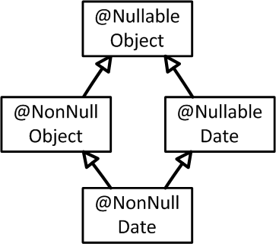
Defining a type system
What assignments are legal:
Qualifier hierarchy
Type introduction
Type rules
@TypeQualifier
@SubtypeOf( Nullable.class )
public @interface NonNull { }
Notes:
Also method call, overriding, etc.

Slide 30
Defining a type system
Gives the type of expressions:
Qualifier hierarchy
Type introduction
Type rules
@TypeQualifier
@SubtypeOf( Nullable.class )
@ImplicitFor(trees={ NEW_CLASS,
PLUS,
BOOLEAN_LITERAL, ... } )
public @interface NonNull { }
new Date()
"hello " + getName()
Boolean.TRUE

Slide 31
Defining a type system
Errors for unsafe code:
Qualifier hierarchy
Type introduction
Type rules
void visitSynchronized(SynchronizedTree node) {
ExpressionTree expr = node.getExpression();
AnnotatedTypeMirror type = getAnnotatedType(expr);
if (! type.hasAnnotation(NONNULL))
checker.report(Result.failure(...), expr);
}
synchronized (expr) {
…
}
Warn if expr may be null

Slide 32
Verification
Bug-finding
Goal: prove that no bug exists
Specifications: user provides
False negatives: none
False positives: user suppresses warnings
Downside: user burden
Goal: find some bugs at low cost
Specifications: infer likely specs
False negatives: acceptable
False positives: heuristics focus on most important bugs
Downside: missed bugs
Neither is “better”; each is appropriate in certain circumstances. The approaches are converging.
Notes:
Verification: User even has to provide specifications for libraries. Inference is still possible.
Bug-finding: Specifications may be inaccurate
Neither one leads to more user confusion; verification might even lead to less
My research agenda enables verification; Coverity’s profitable business model focuses on bug-finding. The two are converging.

Slide 33
Pluggable type-checking
Java 8 syntax for type annotations
Checker Framework for creating type checkers
Featureful, effective, easy to use, scalable
Prevent bugs at compile time
Create custom type-checkers
Learn more, or download the Checker Framework: http://CheckerFramework.org/ (or, web search for “Checker Framework”)
Notes:
Catch me anytime for a demo.

