Slide 1


PROPOSAL FOR italdizan
Apple Wallet & Google Wallet
Integration for italdizan Loyalty
Digitalization of the loyalty program — real-time, secure, and scalable.
PREPARED BY
DATE
VERSION
Walvero Loyalty
May 2026
1.0
Confidential — Prepared for italdizan

Slide 2
Agenda
What we'll cover in this proposal
01
02
03
Understanding Your Needs
Our Solution Overview
Why Choose Our Platform
Recap of business and technical requirements
The Walvero platform at a glance
Differentiators and proven track record
04
05
06
System Architecture
Apple & Google Wallet Modules
Real-time Sync & Push
How 1C, the API and the wallets connect
Pass generation, updates, redemption
APNS and FCM messaging pipeline
07
08
09
1C ↔ API Integration
End-to-End Business Flows
Flow Sequence Diagram
Endpoints, fields, security, formats
Registration, earning, redeeming
Visual schema of all three flows
10
11
12
Card Design Best Practices
Security & Privacy
Analytics Dashboard
UX/UI guidance per platform
Encryption, isolation, NDA
Sample reports and KPIs
13
14
Timeline & Phases
Pricing Estimate
Delivery roadmap and milestones
Budget breakdown by phase
Wallet Integration Proposal • Walvero Loyalty → italdizan
2 / 18

Slide 3

Understanding italdizan's Needs
Recap of your stated requirements
CURRENT STATE
WHAT YOU REQUESTED
100%
4
Replace plastic cards
Full digital migration to Apple & Google Wallet
Real-time 1C ↔ API sync
digital migration target
stores / warehouses
Cards generated, updated and synced automatically
Card data on pass
Name, cashback %, accumulated balance, statuses
1
% + AZN
Push notifications
Promo and balance updates pushed to the device
Analytics & dashboards
unique customer ID (phone)
cashback + discount tiers
Visualisations of purchases, customers, card use
Data privacy & NDA
Customer data protection and confidentiality
Wallet Integration Proposal • Walvero Loyalty → italdizan
3 / 18

Slide 4






Our Solution Overview
Production-ready loyalty platform with native Wallet support
LoyaltyApi — multi-tenant SaaS, .NET 8 + EF Core
A live, battle-tested platform — Apple Wallet, Google Wallet, POS sync, push notifications, customer enrolment, branch management and analytics — already built and running.
Wallet Cards
Real-time Sync
Push Notifications
Native Apple .pkpass + Google Wallet JWT save-links
Card balance and tier updates pushed to devices instantly
APNS for iOS, FCM for Android — promo + balance alerts
Open API for 1C
Security by Design
Analytics Dashboard
REST endpoints with token auth, webhooks back to 1C
Encrypted credentials, tenant isolation, audit logs
Customers, sales, cards, redemptions, retention
Wallet Integration Proposal • Walvero Loyalty → italdizan
4 / 18

Slide 5
Why Our Platform
Five reasons this proposal de-risks your project
01
Already Built & Production-tested
No greenfield risk. Apple Wallet, Google Wallet, POS sync, customer enrolment and webhooks are fully implemented in the LoyaltyApi codebase.
02
Multi-tenant Architecture
Per-tenant credentials, isolated data, separate Wallet credentials. Scales beyond your 4 stores without re-architecture.
03
Open, Documented API
REST endpoints, Postman collections, OpenAPI/Swagger. Your 1C team can integrate in days, not weeks.
04
Real-time Bi-directional Sync
POS → Wallet (balance updates) and Wallet → POS (redemptions, transactions). APNS + FCM under the hood.
05
Security & Privacy First
Encrypted sensitive data (cert keys, tokens), JWT signing, tenant-scoped tokens. NDA is standard practice.
Wallet Integration Proposal • Walvero Loyalty → italdizan
5 / 18

Slide 6




System Architecture
How 1C, our API and the wallets connect
Your 1C Source
Walvero API on Microsoft Azure
Customer Devices
Apple Wallet
.pkpass + APNS push
Customer master
WebAPI Controllers
Cards & balances
REST + Webhooks
REST endpoints + webhooks
APNS / FCM
Cashback rules
Business Services
Google Wallet
Apple/Google Wallet, POS sync, Push
LoyaltyObject + FCM push
Transactions
Branches & POS
Data Access (EF)
Multi-tenant DB, audit, repos
M·A
Microsoft Stack + Azure Cloud
Built on Microsoft technologies — .NET 8, EF Core, SQL Server — and hosted on Microsoft Azure.
Wallet Integration Proposal • Walvero Loyalty → italdizan
6 / 18

Slide 7
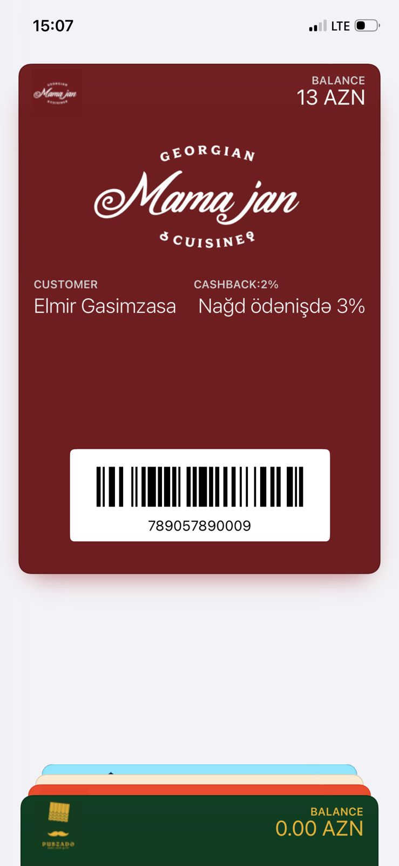






Apple Wallet Integration
Native .pkpass passes — live example from our Mamajan deployment
WHAT WE BUILD
Server-signed, dynamically-updated passes
Customisable design
Logo, colours, hero image, label fields — fully tailored to italdizan brand within Apple's layout guidelines.
Live updates
Balance, cashback %, tier or status field updates push to device without re-install.
APNS push
Server pushes a silent notification → device pulls fresh pass automatically.
PKI signing
Pass type cert + WWDR + tenant key. Stored encrypted in our database.
Add-to-Wallet link
Download URL or QR. Works from SMS, email, or web.
Per-customer pass
Unique serial number; mapped to customer, branch and programme.
Live production — Mamajan loyalty card (Apple Wallet)
Wallet Integration Proposal • Walvero Loyalty → italdizan
7 / 18

Slide 8
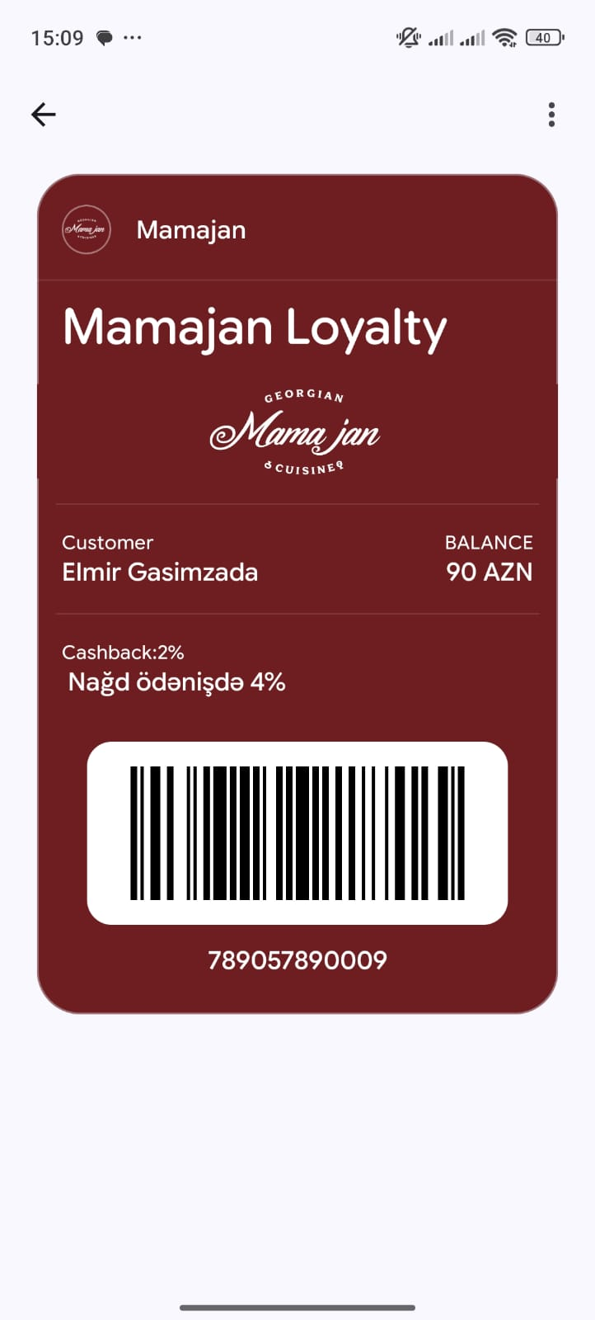

Google Wallet Integration
LoyaltyClass + LoyaltyObject — live example from our Mamajan deployment
WHAT WE BUILD
LoyaltyObject API + JWT save-links
Customisable design
Logo, hero, programme name, label colours — fully tailored to italdizan brand within Google's layout rules.
LoyaltyObject updates
PATCH the object → all customer devices see new values in seconds.
FCM push (Android)
Custom messages + balance updates via Firebase Cloud Messaging.
Service account auth
Encrypted service-account JSON per tenant; scoped issuer IDs.
Save-to-Wallet JWT
Signed JWT generated per customer — drop-in link or button.
Per-customer object
Unique objectId mapped to programme, customer and branch.
Live production — Mamajan loyalty card (Google Wallet)
Wallet Integration Proposal • Walvero Loyalty → italdizan
8 / 18

Slide 9




Real-time Sync & Push
From 1C transaction to customer's lock-screen in seconds
01
02
03
04
05
1C event
Webhook → API
Business logic
Push
Updated pass
Purchase, top-up,
tier change
REST call with
customer + delta
Apply rules,
persist, recalc
APNS for iOS,
FCM for Android
Wallet refreshes
automatically
Typical latency
Notification types
Reliability
< 3 seconds end-to-end (POS → pass updated on device)
Balance update • Promo • Cashback earned • Reward unlocked
Retries with exponential backoff, dead-letter, idempotency keys
Wallet Integration Proposal • Walvero Loyalty → italdizan
9 / 18

Slide 10

1C ↔ API Integration
What we'll expose, what we need, how it's secured
KEY API ENDPOINTS
FIELDS WE EXPECT FROM 1C
Logical name
JSON key
Type
Notes
POST
/api/wallet/collect
Customer ID
external_id
string
required
Customer enrols — phone, OTP, profile
Phone number
phone (E.164)
string
unique key
POST
/api/wallet/get_wallet
Fetch wallet balance + status from 1C
Full name
full_name
string
optional
POST
/api/wallet/set_redeem
Cashback %
cashback_percent
decimal
required
Apply redemption / earn event
Discount %
discount_percent
decimal
optional
/api/wallet/set_verify
Balance
balance_amount
decimal
required
POST
Verify OTP for redemption
Tier / status
tier
string
optional
Branch / store
branch_code
string
required
Auth: tenant-scoped Bearer tokens
HMAC webhook signatures + IP allowlist + TLS 1.2+
Transaction event
tx { id, amount, type }
object
webhook
Wallet Integration Proposal • Walvero Loyalty → italdizan
10 / 18

Slide 11
End-to-End Business Flows
How customer registration, earning and redemption work in practice
01
02
03
Customer Registration
Earning a Bonus
Spending a Bonus
1
Customer fills the form on the Walvero app or web.
1
Customer makes a purchase at an italdizan store.
1
Customer asks to spend X AZN → SMS with OTP sent to their phone.
2
An OTP is sent to the phone number — verifies ownership.
2
1C sends to Walvero: customer ID + purchase amount
(or the calculated bonus amount).
2
Cashier enters the OTP code into 1C → 1C calls Walvero.
3
On valid OTP, customer is added to Walvero.
3
Walvero applies the rule, updates the balance in the database.
3
Walvero verifies the OTP.
4
Walvero checks italdizan 1C by phone number.
4
Wallet card is updated — Apple + Google in real-time.
4
If valid → balance is deducted; success status returned to 1C.
5
If found → pull ID + balance, push to Wallet card.
If not → call italdizan's add-customer endpoint to create them there.
5
Push notification is sent: “Bonus earned — new balance is X”.
5
Push notification sent to the customer.
If OTP is wrong → error message returned to 1C.
Wallet Integration Proposal • Walvero Loyalty → italdizan
11 / 18

Slide 12
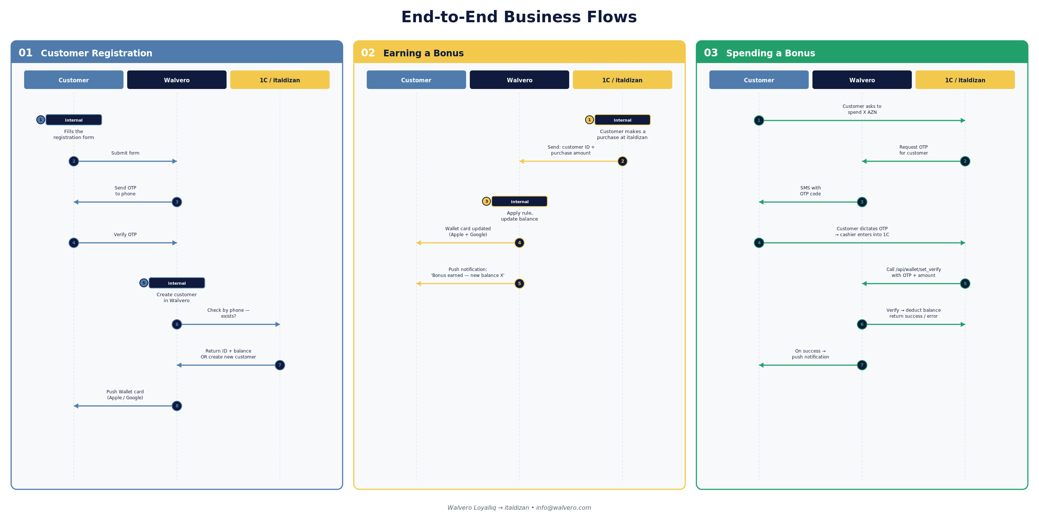
Business Flow Diagram
Sequence diagram — Customer ↔ Walvero ↔ 1С/italdizan
Wallet Integration Proposal • Walvero Loyalty → italdizan
12 / 18

Slide 13

Wallet Card Design
UX/UI best practices we apply per platform
Apple Wallet
Google Wallet
Tightly constrained layout — every label matters
More flexible — programme + object hierarchy
5 fields max: header, primary, secondary, auxiliary, back
Hero image, logo, programme name visible always
Logo + strip image + background tint colour
Custom 'text modules' for additional content
Barcode at the bottom (PDF417 or QR)
Linked offers / rewards block
Foreground / label / background colours
Account number + tier shown side-by-side
Tap-back fields for terms, support, policy links
Rich notification messages (image + CTA)
Auto-relevancy: locations, beacons (optional)
Multiple languages via localized fields
Tip: We ship a tenant-branded design system — colours, logo, hero, fonts — configurable from the admin panel.
Wallet Integration Proposal • Walvero Loyalty → italdizan
13 / 18

Slide 14

Security & Privacy
Customer data protection — at rest, in transit, and in process
Encrypted database
TLS in transit
Multi-tenant isolation
All italdizan data — customer records, balances, credentials — is stored in the database in encrypted form, not plaintext.
HTTPS only. TLS 1.2+, HSTS, modern ciphers. No plaintext customer data ever leaves the API.
italdizan's data is fully isolated — separate credentials, integration rows and audit logs. No cross-tenant access possible.
Auth & access control
Auditing & logging
NDA ready
Tenant-scoped Bearer tokens, role-based admin, IP allowlists for inbound webhooks from 1C.
Every wallet event, push and 1C call is logged with correlation IDs and retained for review.
We are ready to sign an NDA on day 1 — no objections. GDPR-friendly retention; right-to-delete supported by design.
Wallet Integration Proposal • Walvero Loyalty → italdizan
14 / 18

Slide 15
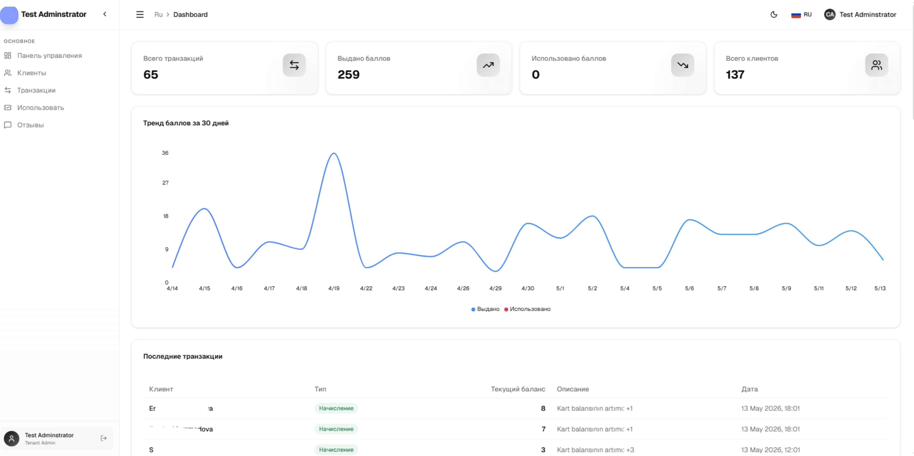
Analytics Dashboard
Live example — extra visuals added per italdizan's request
Wallet Integration Proposal • Walvero Loyalty → italdizan
15 / 18

Slide 16
Timeline & Phases
Indicative roadmap — 4 weeks to live, then 2-month free trial
1
Week 1
Technical Finalisation
NDA + contract signing, requirements workshop, 1C field mapping, Apple/Google credentials. Output: SRS document.
2
Week 2
Design & Trial Approval
Wallet card design per platform (Apple + Google), push templates, trial version review and sign-off.
3
Weeks 3-4
Full Delivery
Integration with 1C, push notifications setup, end-to-end testing, training, production cut-over for all 4 stores.
4
Months 1-2
Free Trial Period
Live production with full features at no charge. Pay only after the 2-month trial — risk-free for italdizan.
Wallet Integration Proposal • Walvero Loyalty → italdizan
16 / 18

Slide 17

Pricing Estimate
Indicative — confirmed after the discovery workshop
ONE-TIME
PER POINT OF SALE
RISK-FREE PILOT
Setup
Monthly
2-Month Trial
FREE
250 AZN
Included
Initial deployment is on us
Per active store / POS
First 2 months — no payment
Discovery & technical SRS
Hosted Walvero platform
Full platform — all features
Apple & Google credentials setup
Apple + Google Wallet pushes
Real production data
1C ↔ API integration
Real-time 1C ↔ API sync
Push notifications enabled
Wallet card design (Apple + Google)
Analytics dashboard included
Live analytics dashboard
End-to-end testing & UAT
Standard support (business hours)
No commitment until satisfied
Production cut-over & training
Storage, backups, monitoring
Pay only after the trial period
Example for italdizan (4 stores): 4 × 250 AZN = 1,000 AZN / month, starting after the 2-month free trial. Apple/Google developer-account fees are on the client.
Wallet Integration Proposal • Walvero Loyalty → italdizan
17 / 18

Slide 18
NEXT STEPS
Let’s launch your
digital loyalty cards
01
02
03
Sign NDA & contract
Free setup begins
Go live + 2-month trial
We are NDA-ready — no objections. Contract ready within 48 hours.
We deploy at no cost. Week 1: technical finalisation. Week 2: design approval.
Weeks 3-4: full rollout. Then 2 months free use before paying anything.
Ready to start? • info@walvero.com • Walvero Loyalty

