Slide 1
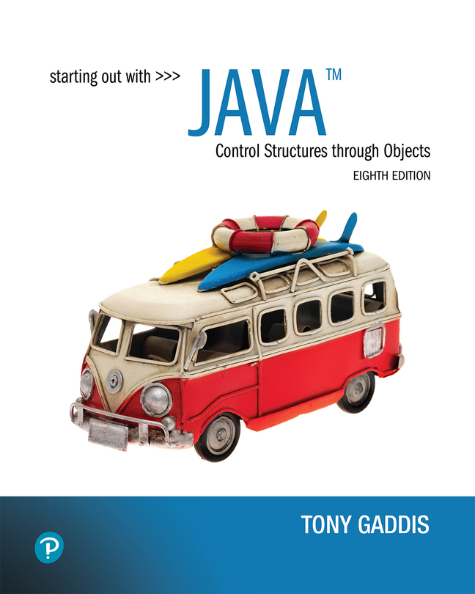

Starting Out with Java Control Structures Through Objects
Eighth Edition
Chapter 6
A First Look At Classes
Copyright © 2022 Pearson Education, Inc. All Rights Reserved
Notes:
If this PowerPoint presentation contains mathematical equations, you may need to check that your computer has the following installed:
1) MathType Plugin
2) Math Player (free versions available)
3) NVDA Reader (free versions available)

Slide 2
Chapter Topics
Chapter 6 discusses the following main topics:
Objects and Classes
Writing a Simple Class, Step by Step
Instance Fields and Methods
Constructors
Passing Objects as Arguments
Overloading Methods and Constructors
Scope of Instance Fields
Packages and import Statements

Slide 3
Objects and Classes (1 of 8)
An object exists in memory and performs a specific task.
Objects have two general capabilities:
Objects can store data. The pieces of data stored in an object are known as fields.
Objects can perform operations. The operations that an object can perform are known as methods.

Slide 4
Objects and Classes (2 of 8)
You have already used the following objects:
Scanner objects, for reading input
Random objects, for generating random numbers
PrintWriter objects, for writing data to files
When a program needs the services of a particular type of object, it creates that object in memory, and then calls that object's methods as necessary.

Slide 5
Objects and Classes (3 of 8)
Classes: Where Objects Come From
A class is code that describes a particular type of object. It specifies the data that an object can hold (the object's fields), and the actions that an object can perform (the object's methods).
You can think of a class as a code "blueprint" that can be used to create a particular type of object.

Slide 6
Objects and Classes (4 of 8)
When a program is running, it can use the class to create, in memory, as many objects of a specific type as needed.
Each object that is created from a class is called an instance of the class.

Slide 7
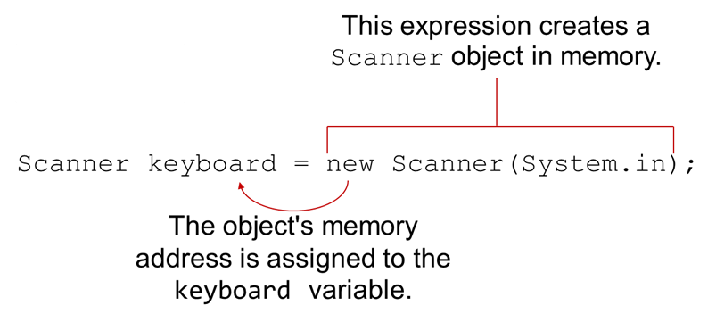
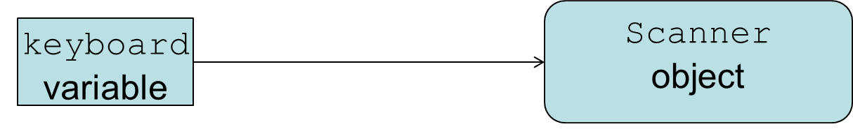
Objects and Classes (5 of 8)
Example:
Notes:
New scanner left parenthesis system period in right parenthesis semicolon is labeled, this expression creates a scanner object in memory. An arrow extends from new to keyboard and is labeled, the objects memory address is assigned to the keyboard variable.

Slide 8
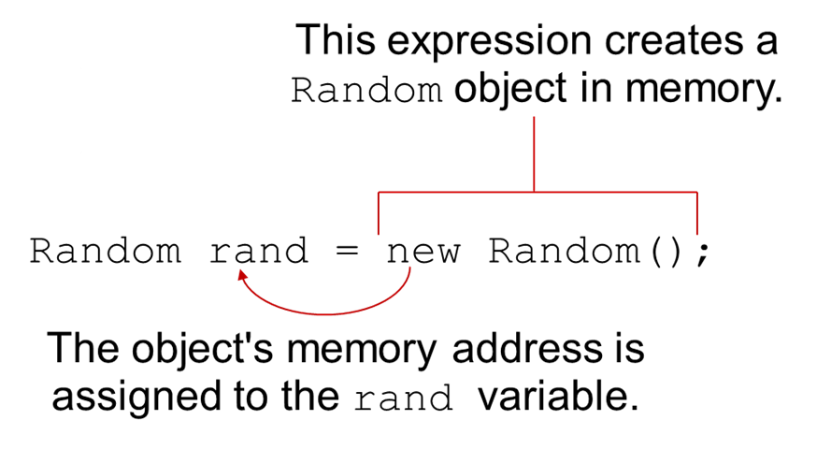
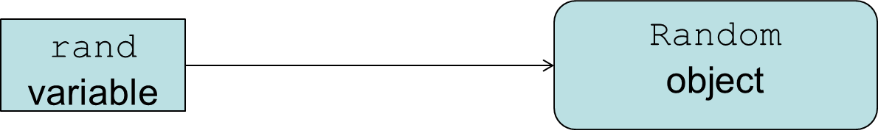
Objects and Classes (6 of 8)
Example:
Notes:
New random left parenthesis right parenthesis semicolon is labeled, this expression creates a random object in memory. An arrow extends from new to rand is labeled, the object's memory address is assigned to the rand variable.

Slide 9
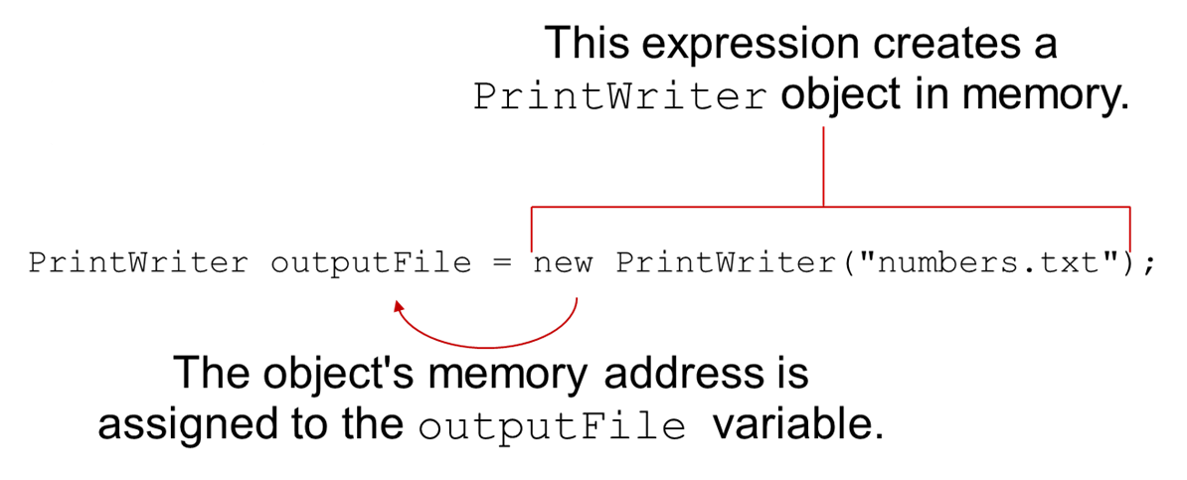
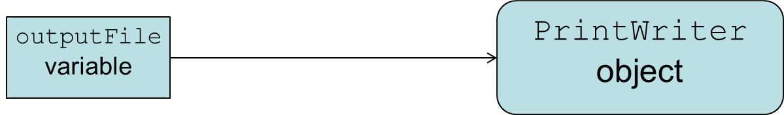
Objects and Classes (7 of 8)
Example:
Notes:
New Print Writer left parenthesis numbers period t x t right parenthesis semicolon is labeled, this expression creates a print writer object in memory. An arrow extends from new print writer to output file and is labeled, the objects memory address is assigned to the output file variable.

Slide 10
Objects and Classes (8 of 8)
The Java A P I provides many classes
So far, the classes that you have created objects from are provided by the Java A P I.
Examples:
Scanner
Random
PrintWriter
See ObjectDemo.java

Slide 11
Writing a Class, Step by Step (1 of 2)
A Rectangle object will have the following fields:
length. The length field will hold the rectangle’s length.
width. The width field will hold the rectangle’s width.

Slide 12
Writing a Class, Step by Step (2 of 2)
The Rectangle class will also have the following methods:
setLength. The setLength method will store a value in an object’s length field.
setWidth. The setWidth method will store a value in an object’s width field.
getLength. The getLength method will return the value in an object’s length field.
getWidth. The getWidth method will return the value in an object’s width field.
getArea. The getArea method will return the area of the rectangle, which is the result of the object’s length multiplied by its width.

Slide 13
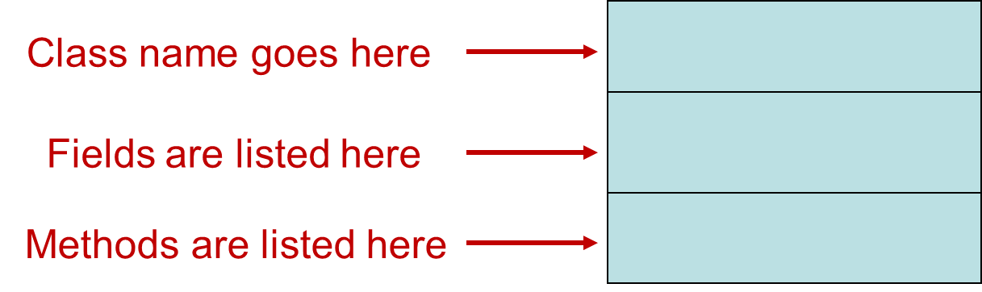
U M L Diagram
Unified Modeling Language (U M L) provides a set of standard diagrams for graphically depicting object-oriented systems.

Slide 14
U M L Diagram for Rectangle class
Rectangle
length width
setLength() setWidth() getLength() getWidth() getArea()

Slide 15
Writing the Code for the Class Fields
public class Rectangle
{
private double length;
private double width;
}

Slide 16
Access Specifiers
An access specifier is a Java keyword that indicates how a field or method can be accessed.
public
When the public access specifier is applied to a class member, the member can be accessed by code inside the class or outside.
private
When the private access specifier is applied to a class member, the member cannot be accessed by code outside the class. The member can be accessed only by methods that are members of the same class.

Slide 17
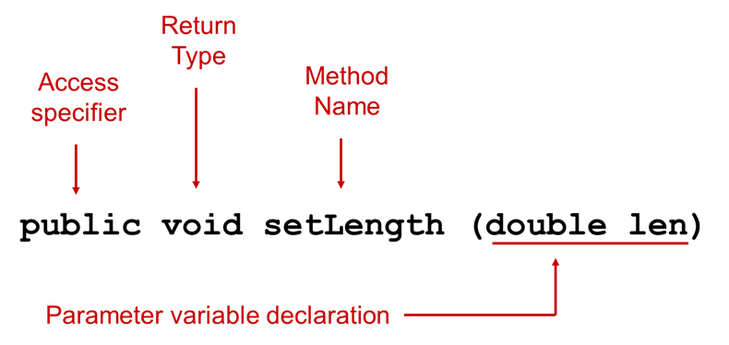
Header for the setLength Method
Notice the word static does not appear in the method header designed to work on an instance of a class (instance method).

Slide 18
Writing and Demonstrating the setLength Method
/**
The setLength method stores a value in the
length field.
@param len The value to store in length.
*/
public void setLength(double len)
{
length = len;
}
Examples: Rectangle.java, LengthDemo.java

Slide 19
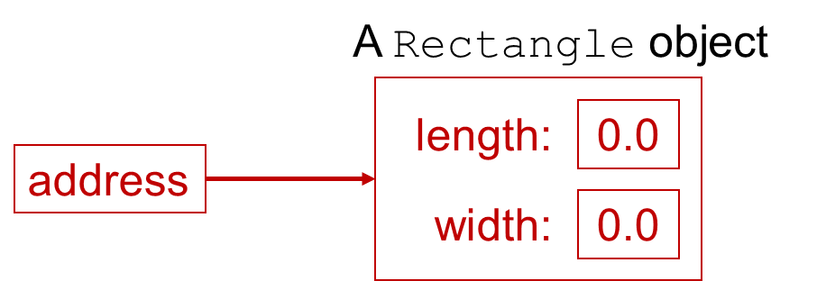
Creating a Rectangle object
Rectangle box = new Rectangle();
The box variable holds the address of the Rectangle object.

Slide 20
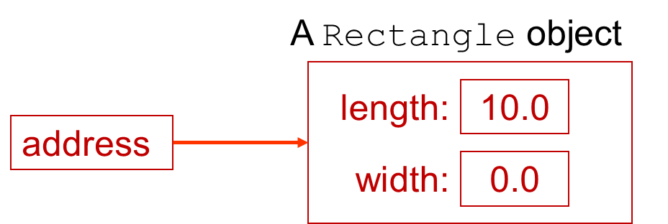
Calling the setLength Method
box.setLength(10.0);
The box variable holds the address of the Rectangle object.
This is the state of the box object after the setLength method executes.

Slide 21
Writing the getLength Method
/**
The getLength method returns a Rectangle
object's length.
@return The value in the length field.
*/
public double getLength()
{
return length;
}
Similarly, the setWidth and getWidth methods can be created.
Examples: Rectangle.java, LengthWidthDemo.java

Slide 22
Writing and Demonstrating the getArea Method
/**
The getArea method returns a Rectangle
object's area.
@return The product of length times width.
*/
public double getArea()
{
return length * width;
}
Examples: Rectangle.java, RectangleDemo.java

Slide 23
Accessor and Mutator Methods
Because of the concept of data hiding, fields in a class are private.
The methods that retrieve the data of fields are called accessors.
The methods that modify the data of fields are called mutators.
Each field that the programmer wishes to be viewed by other classes needs an accessor.
Each field that the programmer wishes to be modified by other classes needs a mutator.

Slide 24
Accessors and Mutators
For the Rectangle example, the accessors and mutators are:
setLength : Sets the value of the length field.
public void setLength(double len) …
setWidth : Sets the value of the width field.
public void setLength(double w) …
getLength : Returns the value of the length field.
public double getLength() …
getWidth : Returns the value of the width field.
public double getWidth() …
Other names for these methods are getters and setters.

Slide 25
Data Hiding (1 of 2)
An object hides its internal, private fields from code that is outside the class that the object is an instance of.
Only the class's methods may directly access and make changes to the object’s internal data.
Code outside the class must use the class's public methods to operate on an object's private fields.

Slide 26
Data Hiding (2 of 2)
Data hiding is important because classes are typically used as components in large software systems, involving a team of programmers.
Data hiding helps enforce the integrity of an object's internal data.

Slide 27
Stale Data (1 of 2)
Some data is the result of a calculation.
Consider the area of a rectangle.
It would be impractical to use an area variable here.
Data that requires the calculation of various factors has the potential to become stale.
To avoid stale data, it is best to calculate the value of that data within a method rather than store it in a variable.

Slide 28
Stale Data (2 of 2)
Rather than use an area variable in a Rectangle class:
public double getArea()
{
return length * width;
}
This dynamically calculates the value of the rectangle’s area when the method is called.
Now, any change to the length or width variables will not leave the area of the rectangle stale.

Slide 29
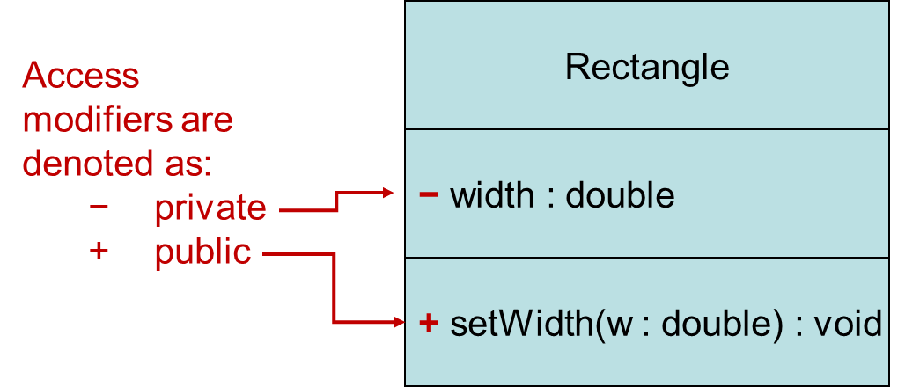
U M L Data Type and Parameter Notation (1 of 4)
U M L diagrams are language independent.
U M L diagrams use an independent notation to show return types, access modifiers, etc.
Notes:
The U M L class diagram is depicted as a table with a single column, without a header, and three rows. The class name, rectangle, is present in the first row. The access modifiers are denoted as negative symbol, indicating private and + symbol indicating public. The access modifier listed in the second row is negative width colon double. The access modifiers listed in the third row is, + set width left parenthesis w colon double right parenthesis colon void.

Slide 30
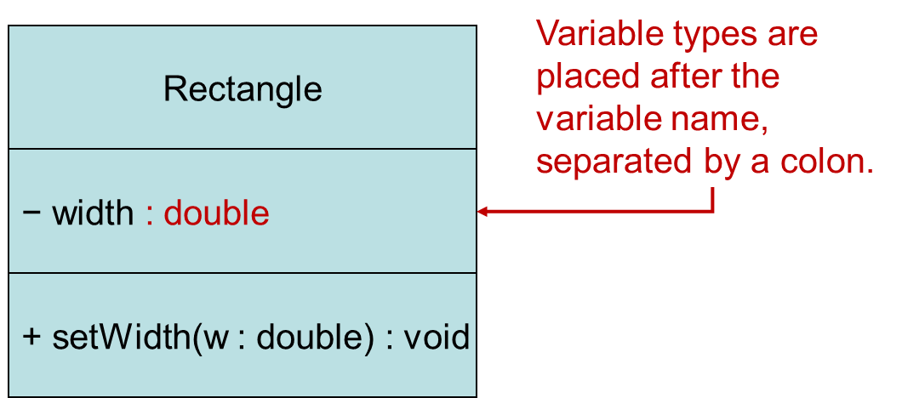
U M L Data Type and Parameter Notation (2 of 4)
U M L diagrams are language independent.
U M L diagrams use an independent notation to show return types, access modifiers, etc.
Notes:
The U M L class diagram is depicted as a table with a single column, without a header, and three rows. The class name, rectangle, is present in the first row. The access modifiers, negative private listed in the second row is negative width colon double. The access modifiers, + public listed in the third is, + set width left parenthesis w colon double right parenthesis colon void. Double in the second column is labeled, variable types are placed after the variable name, separated by a colon.

Slide 31
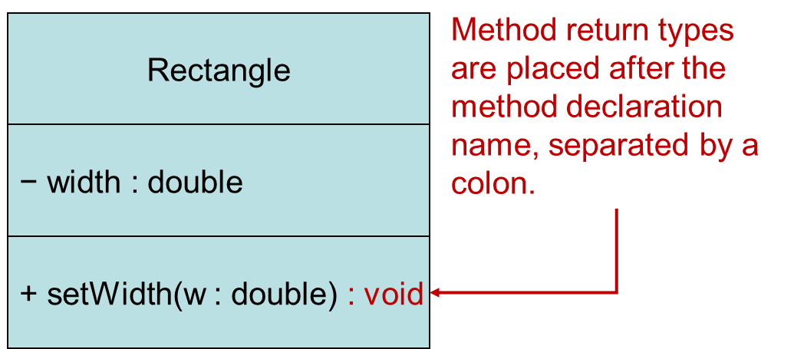
U M L Data Type and Parameter Notation (3 of 4)
U M L diagrams are language independent.
U M L diagrams use an independent notation to show return types, access modifiers, etc.
Notes:
The U M L class diagram is depicted as a table with a single column, without a header, and three rows. The class name, rectangle, is present in the first row. The access modifiers, negative private listed in the second row is negative width colon double. The access modifiers, + public listed in the third is, + set width left parenthesis w colon double right parenthesis colon void. The Void in the third row is labeled, method rerun types are placed after the method declaration name, separated by a colon.

Slide 32
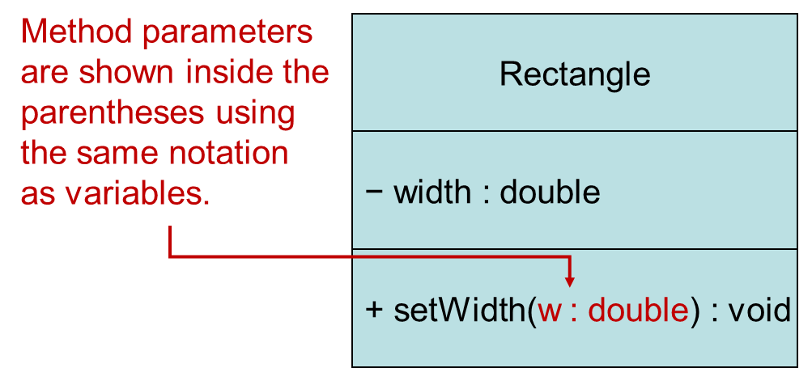
U M L Data Type and Parameter Notation (4 of 4)
U M L diagrams are language independent.
U M L diagrams use an independent notation to show return types, access modifiers, etc.
Notes:
The U M L class diagram is depicted as a table with a single column, without a header, and three rows. The class name, rectangle, is present in the first row. The access modifiers, negative private listed in the second row is negative width colon double. The access modifiers, + public listed in the third is, + set width left parenthesis w colon double right parenthesis colon void. W colon double in the third row is labeled, method parameters are shown inside the parentheses using the same notation as variables.

Slide 33
Converting the U M L Diagram to Code (1 of 3)
Putting all of this information together, a Java class file can be built easily using the U M L diagram.
The U M L diagram parts match the Java class file structure.
class header
{
Fields
Methods
}
ClassName
Fields
Methods

Slide 34
Converting the U M L Diagram to Code (2 of 3)
The structure of the class can be compiled and tested without having bodies for the methods. Just be sure to put in dummy return values for methods that have a return type other than void.
public class Rectangle
{
private double width;
private double length;
public void setWidth(double w)
{
}
public void setLength(double len)
{
}
public double getWidth()
{ return 0.0;
}
public double getLength()
{ return 0.0;
}
public double getArea()
{ return 0.0;
}
}
Rectangle
+ setWidth(w : double) : void
+ setLength(len : double): void
+ getWidth() : double
+ getLength() : double
+ getArea() : double

Slide 35
Converting the U M L Diagram to Code (3 of 3)
Once the class structure has been tested, the method bodies can be written and tested.
public class Rectangle
{
private double width;
private double length;
public void setWidth(double w)
{ width = w;
}
public void setLength(double len)
{ length = len;
}
public double getWidth()
{ return width;
}
public double getLength()
{ return length;
}
public double getArea()
{ return length * width;
}
}
Rectangle
+ setWidth(w : double) : void
+ setLength(len : double): void
+ getWidth() : double
+ getLength() : double
+ getArea() : double

Slide 36
Class Layout Conventions
The layout of a source code file can vary by employer or instructor.
A common layout is:
Fields listed first
Methods listed second
Accessors and mutators are typically grouped.
There are tools that can help in formatting layout to specific standards.

Slide 37
Instance Fields and Methods (1 of 2)
Fields and methods that are declared as previously shown are called instance fields and instance methods.
Objects created from a class each have their own copy of instance fields.
Instance methods are methods that are not declared with a special keyword, static.

Slide 38
Instance Fields and Methods (2 of 2)
Instance fields and instance methods require an object to be created in order to be used.
See example: RoomAreas.java
Note that each room represented in this example can have different dimensions.
Rectangle kitchen = new Rectangle();
Rectangle bedroom = new Rectangle();
Rectangle den = new Rectangle();

Slide 39
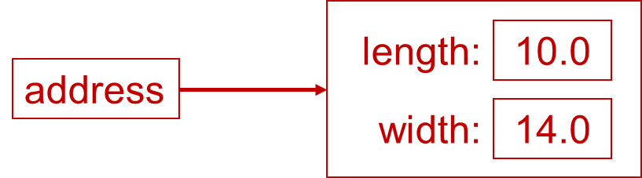
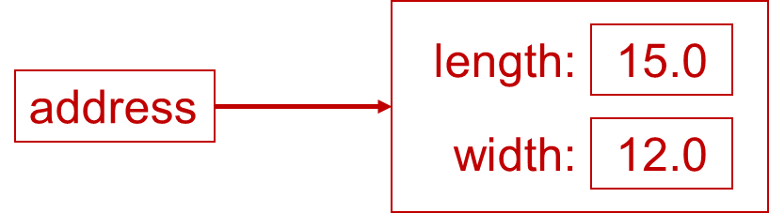
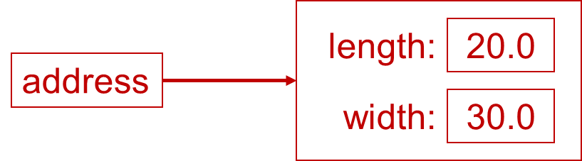
States of Three Different Rectangle Objects
The kitchen variable holds the address of a Rectangle Object.
The bedroom variable holds the address of a Rectangle Object.
The den variable holds the address of a Rectangle Object.

Slide 40
Constructors (1 of 2)
Classes can have special methods called constructors.
A constructor is a method that is automatically called when an object is created.
Constructors are used to perform operations at the time an object is created.
Constructors typically initialize instance fields and perform other object initialization tasks.

Slide 41
Constructors (2 of 2)
Constructors have a few special properties that set them apart from normal methods.
Constructors have the same name as the class.
Constructors have no return type (not even void).
Constructors may not return any values.
Constructors are typically public.

Slide 42
Constructor for Rectangle Class
/**
Constructor
@param len The length of the rectangle.
@param w The width of the rectangle.
*/
public Rectangle(double len, double w)
{
length = len;
width = w;
}
Examples: Rectangle.java, ConstructorDemo.java

Slide 43
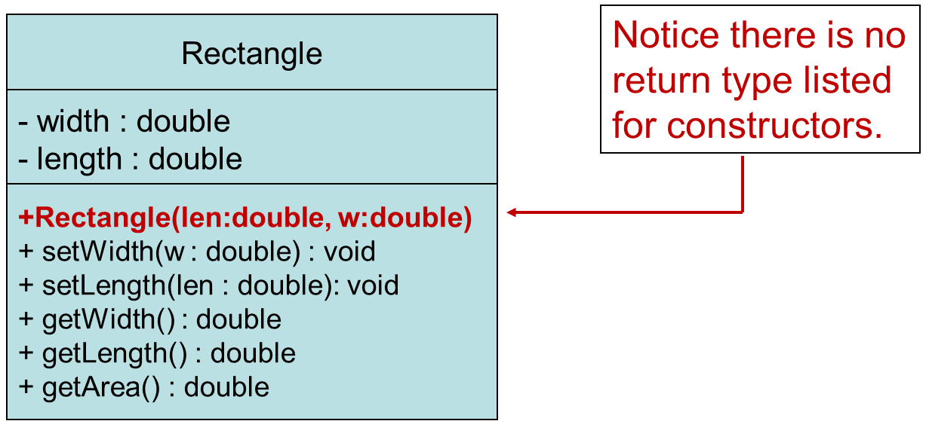
Constructors in U M L
In U M L, the most common way constructors are defined is:
Notes:
The U M L class diagram is depicted as a table with a single column, without a header, and three rows. The class name, rectangle, is present in the first row. The fields listed in the second row are negative width colon double and negative length colon double. The methods listed in the third row are + rectangle left parenthesis l e n colon double, w colon double right parenthesis, + set Width left parenthesis w colon double right parenthesis colon void, + set Length left parenthesis l e n colon double right parenthesis colon void, + get Width left parenthesis right parenthesis colon double, + get Length left parenthesis right parenthesis colon double, + get Area left parenthesis right parenthesis colon double. + rectangle left parenthesis l e n colon double, w colon double right parenthesis in the first row is labeled, notice there is no return type listed for constructors.

Slide 44
Uninitialized Local Reference Variables
Reference variables can be declared without being initialized.
Rectangle box;
This statement does not create a Rectangle object, so it is an uninitialized local reference variable.
A local reference variable must reference an object before it can be used, otherwise a compiler error will occur.
box = new Rectangle(7.0, 14.0);
box will now reference a Rectangle object of length 7.0 and width 14.0.

Slide 45
The Default Constructor (1 of 2)
When an object is created, its constructor is always called.
If you do not write a constructor, Java provides one when the class is compiled. The constructor that Java provides is known as the default constructor.
It sets all of the object’s numeric fields to 0.
It sets all of the object’s boolean fields to false.
It sets all of the object’s reference variables to the special value null.

Slide 46
The Default Constructor (2 of 2)
The default constructor is a constructor with no parameters, used to initialize an object in a default configuration.
The only time that Java provides a default constructor is when you do not write any constructor for a class.
See example: First version of Rectangle.java
A default constructor is not provided by Java if a constructor is already written.
See example: Rectangle.java with Constructor

Slide 47
Writing Your Own No-Arg Constructor
A constructor that does not accept arguments is known as a no-arg constructor.
The default constructor (provided by Java) is a no-arg constructor.
We can write our own no-arg constructor
public Rectangle()
{
length = 1.0;
width = 1.0;
}

Slide 48
The String Class Constructor (1 of 2)
One of the String class constructors accepts a string literal as an argument.
This string literal is used to initialize a String object.
For instance:
String name = new String("Michael Long");

Slide 49
The String Class Constructor (2 of 2)
This creates a new reference variable name that points to a String object that represents the name “Michael Long”
Because they are used so often, String objects can be created with a shorthand:
String name = "Michael Long";

Slide 50
Passing Objects as Arguments
When you pass a object as an argument, the thing that is passed into the parameter variable is the object's memory address.
As a result, parameter variable references the object, and the receiving method has access to the object.
See DieArgument.java

Slide 51
Overloading Methods and Constructors
Two or more methods in a class may have the same name as long as their parameter lists are different.
When this occurs, it is called method overloading. This also applies to constructors.
Method overloading is important because sometimes you need several different ways to perform the same operation.

Slide 52
Overloaded Method add
public int add(int num1, int num2)
{
return num1 + num2;
}
public double add(double num1, double num2)
{
return num1 + num2;
}

Slide 53
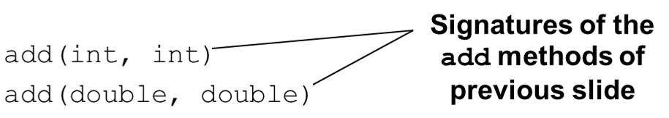
Method Signature and Binding
A method signature consists of the method’s name and the data types of the method’s parameters, in the order that they appear. The return type is not part of the signature.
The process of matching a method call with the correct method is known as binding. The compiler uses the method signature to determine which version of the overloaded method to bind the call to.

Slide 54
Rectangle Class Constructor Overload (1 of 2)
If we were to add the no-arg constructor we wrote previously to our Rectangle class in addition to the original constructor we wrote, what would happen when we execute the following calls?
Rectangle box1 = new Rectangle();
Rectangle box2 = new Rectangle(5.0, 10.0);

Slide 55
Rectangle Class Constructor Overload (2 of 2)
If we were to add the no-arg constructor we wrote previously to our Rectangle class in addition to the original constructor we wrote, what would happen when we execute the following calls?
Rectangle box1 = new Rectangle();
Rectangle box2 = new Rectangle(5.0, 10.0);
The first call would use the no-arg constructor and box1 would have a length of 1.0 and width of 1.0.
The second call would use the original constructor and box2 would have a length of 5.0 and a width of 10.0.

Slide 56
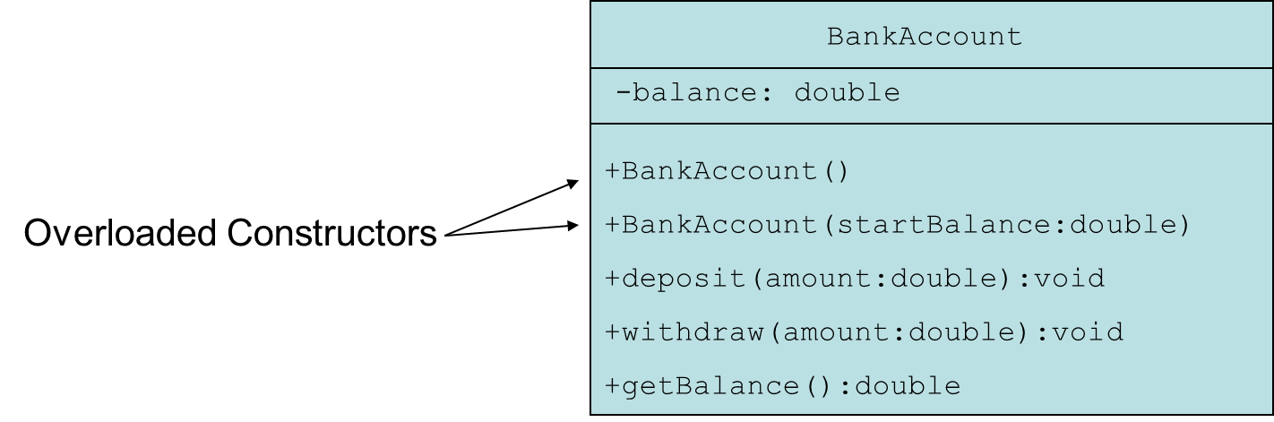
The BankAccount Class Example
BankAccount.java
AccountTest.java
Notes:
The U M L class diagram is depicted as a table with a single column, without a header, and three rows. The class name, bank account, is present in the first row. The fields listed in the second row is negative balance colon double. The methods listed in the third row are as follows. + Bank Account left parenthesis right parenthesis, + Bank Account left parenthesis start Balance colon double right parenthesis, + deposit left parenthesis amount colon double right parenthesis colon void, + withdraw left parenthesis amount colon double right parenthesis colon void, + get Balance left parenthesis right parenthesis colon double. + Bank Account left parenthesis right parenthesis, + Bank Account left parenthesis start Balance colon double right parenthesis are labeled, overload constructors.

Slide 57
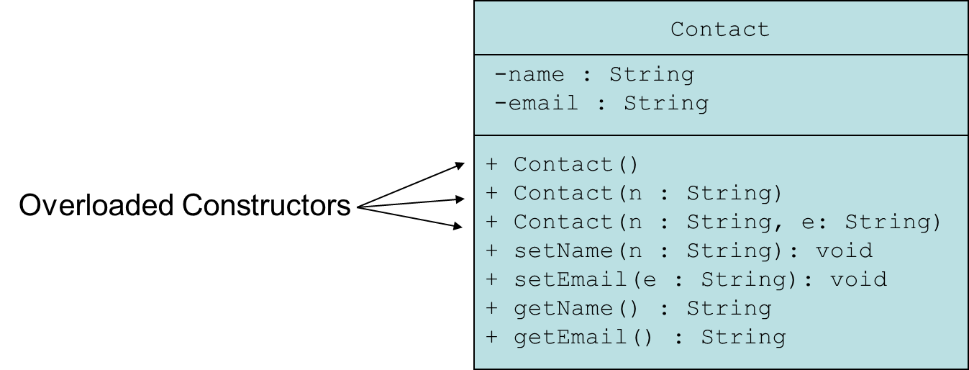
The Contact Class Example (1 of 4)
Contact.java
ContactTest.java
Notes:
The U M L class diagram is depicted as a table with a single column, without a header, and three rows. The class name, contact, is present in the first row. The fields listed in the second row are negative name colon string and negative email colon string. The methods listed in the third row are as follows. + Contact left parenthesis right parenthesis, + contact left parenthesis n colon string right parenthesis, + contact left parenthesis n colon string, e colon sting right parenthesis, + set Name left parenthesis n colon string right parenthesis colon void, + set Email left parenthesis e colon string right parenthesis colon void, + get Name left parenthesis right parenthesis colon String, + get Email left parenthesis right parenthesis colon String. + Contact left parenthesis right parenthesis, + contact left parenthesis n colon string right parenthesis, + contact left parenthesis n colon string, e colon sting right parenthesis are labeled, overload constructors.

Slide 58
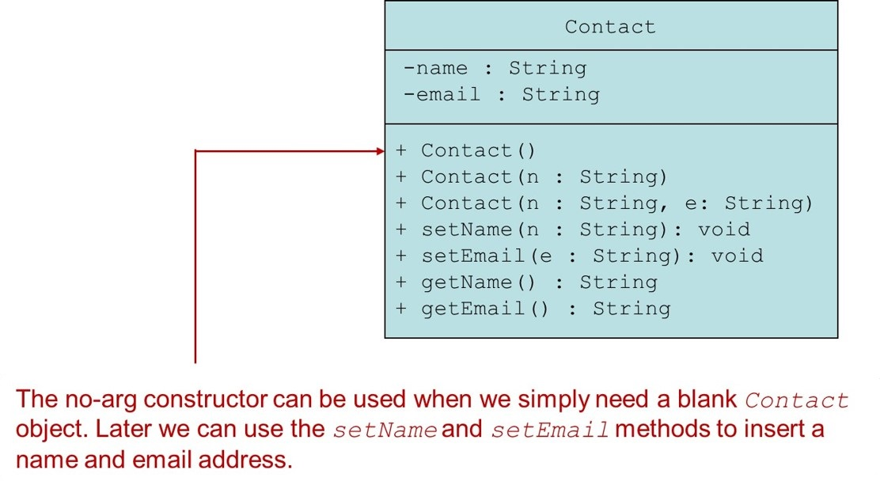
The Contact Class Example (2 of 4)
Contact.java
ContactTest.java
Notes:
The U M L class diagram is depicted as a table with a single column, without a header, and three rows. The class name, contact, is present in the first row. The fields listed in the second row are negative name colon string and negative email colon string. The methods listed in the third row are as follows. + Contact left parenthesis right parenthesis, + contact left parenthesis n colon string right parenthesis, + contact left parenthesis n colon string, e colon sting right parenthesis, + set Name left parenthesis n colon string right parenthesis colon void, + set Email left parenthesis e colon string right parenthesis colon void, + get Name left parenthesis right parenthesis colon String, + get Email left parenthesis right parenthesis colon String. + Contact left parenthesis right parenthesis is labeled, the no a r g constructor can be used when we simply need a blank contact object. Later we can use the set Name and set Email methods to insert a name and email address.

Slide 59
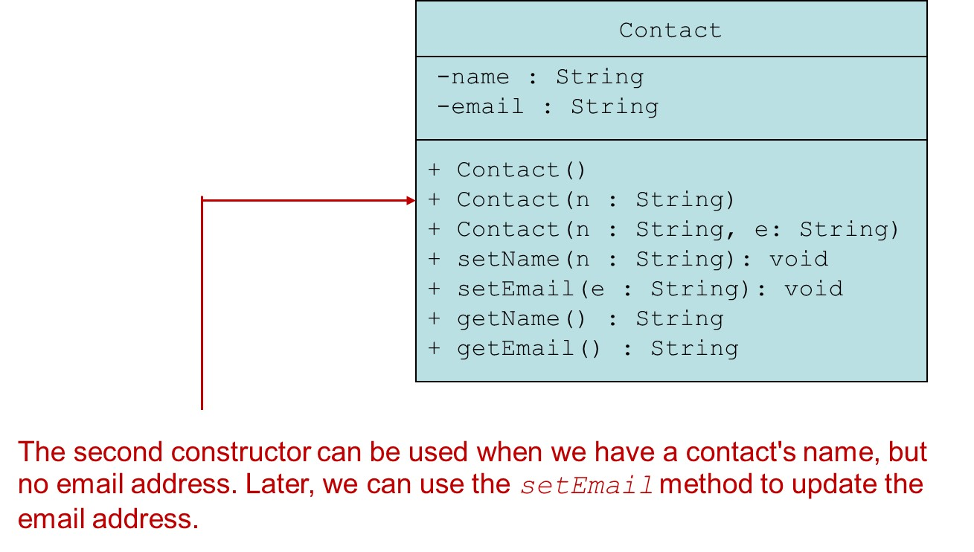
The Contact Class Example (3 of 4)
Contact.java
ContactTest.java
Notes:
The U M L class diagram is depicted as a table with a single column, without a header, and three rows. The class name, contact, is present in the first row. The fields listed in the second row are negative name colon string and negative email colon string. The methods listed in the third row are as follows. + Contact left parenthesis right parenthesis, + contact left parenthesis n colon string right parenthesis, + contact left parenthesis n colon string, e colon sting right parenthesis, + set Name left parenthesis n colon string right parenthesis colon void, + set Email left parenthesis e colon string right parenthesis colon void, + get Name left parenthesis right parenthesis colon String, + get Email left parenthesis right parenthesis colon String. + Contact left parenthesis n colon string right parenthesis is labeled, the second constructor can be used when we have a contacts name, but no email address. Later, we can use the set Email method to update the email address.

Slide 60
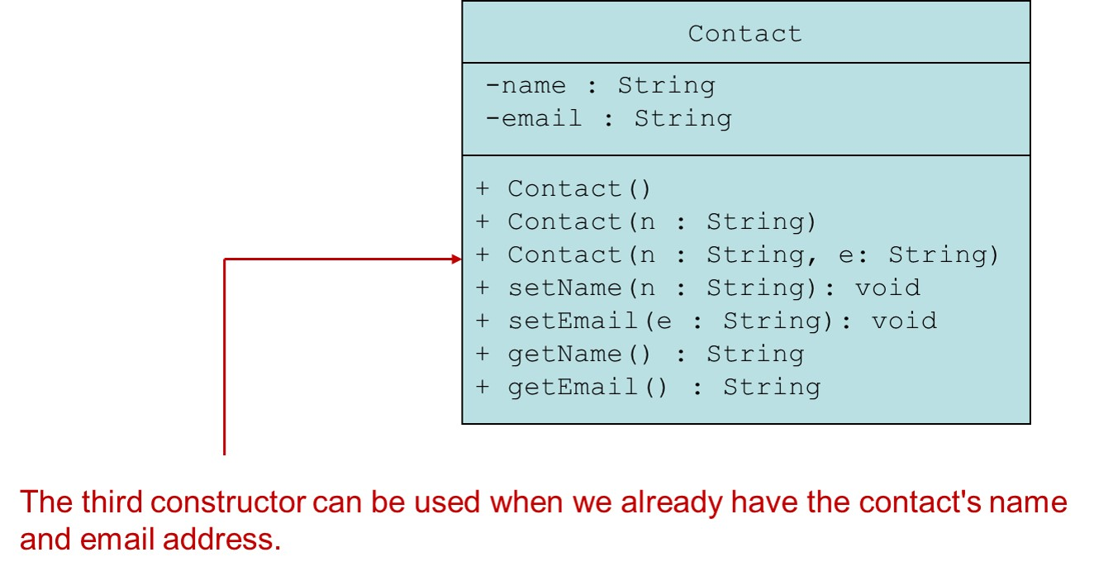
The Contact Class Example (4 of 4)
Contact.java
ContactTest.java
Notes:
The U M L class diagram is depicted as a table with a single column, without a header, and three rows. The class name, contact, is present in the first row. The fields listed in the second row are negative name colon string and negative email colon string. The methods listed in the third row are as follows. + Contact left parenthesis right parenthesis, + contact left parenthesis n colon string right parenthesis, + contact left parenthesis n colon string, e colon sting right parenthesis, + set Name left parenthesis n colon string right parenthesis colon void, + set Email left parenthesis e colon string right parenthesis colon void, + get Name left parenthesis right parenthesis colon String, + get Email left parenthesis right parenthesis colon String. + contact left parenthesis n colon string, e colon sting right parenthesis is labeled, the third constructor can be used when we already have the contacts name and email address.

Slide 61
Scope of Instance Fields
Variables declared as instance fields in a class can be accessed by any instance method in the same class as the field.
If an instance field is declared with the public access specifier, it can also be accessed by code outside the class, as long as an instance of the class exists.

Slide 62
Shadowing
A parameter variable is, in effect, a local variable.
Within a method, variable names must be unique.
A method may have a local variable with the same name as an instance field.
This is called shadowing.
The local variable will hide the value of the instance field.
Shadowing is discouraged and local variable names should not be the same as instance field names.

Slide 63
Packages and import Statements
Classes in the Java A P I are organized into packages.
Explicit and Wildcard import statements
Explicit imports name a specific class
import java.util.Scanner;
Wildcard imports name a package, followed by an *
import java.util.*;
The java.lang package is automatically made available to any Java class.

Slide 64
Some Java Standard Packages
A few of the standard Java packages
Package | Description
java.io | Provides classes that perform various types of input and output.
java.lang | Provides general classes for the Java language. This package is automatically imported.
java.net | Provides classes for network communications.
java.security | Provides classes that implement security features.
java.sql | Provides classes for accessing databases using structured query language.
java.text | Provides various classes for formatting text.
java.util | Provides various utility classes.

Slide 65
Object Oriented Design Finding Classes and Their Responsibilities (1 of 2)
Finding the classes
Get written description of the problem domain
Identify all nouns, each is a potential class
Refine list to include only classes relevant to the problem
Identify the responsibilities
Things a class is responsible for knowing
Things a class is responsible for doing
Refine list to include only classes relevant to the problem

Slide 66
Object Oriented Design Finding Classes and Their Responsibilities (2 of 2)
Identify the responsibilities
Things a class is responsible for knowing
Things a class is responsible for doing
Refine list to include only classes relevant to the problem

Slide 67

Copyright
This work is protected by United States copyright laws and is provided solely for the use of instructors in teaching their courses and assessing student learning. Dissemination or sale of any part of this work (including on the World Wide Web) will destroy the integrity of the work and is not permitted. The work and materials from it should never be made available to students except by instructors using the accompanying text in their classes. All recipients of this work are expected to abide by these restrictions and to honor the intended pedagogical purposes and the needs of other instructors who rely on these materials.

