Slide 1
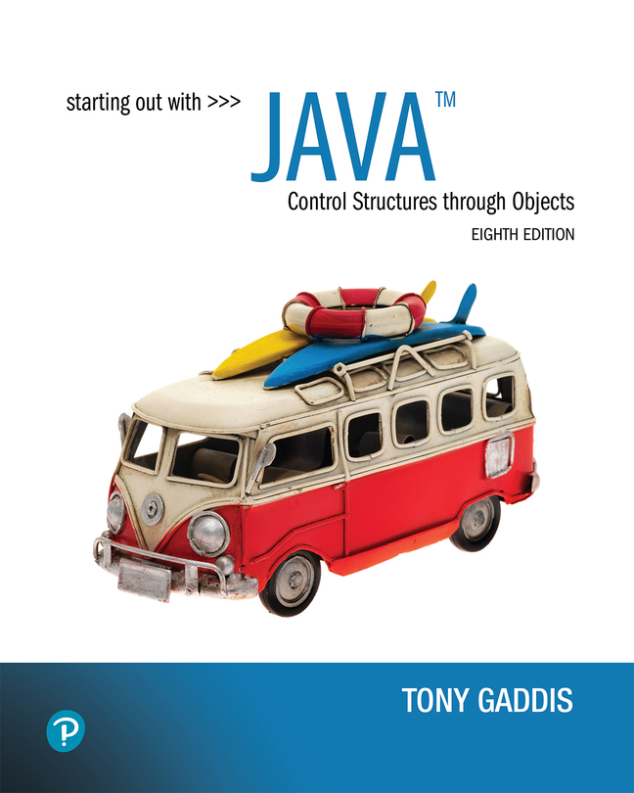

Starting Out with Java Control Structures Through Objects
Eighth Edition
Chapter 7
Arrays and the ArrayList Class
Copyright © 2022 Pearson Education, Inc. All Rights Reserved
Notes:
If this PowerPoint presentation contains mathematical equations, you may need to check that your computer has the following installed:
1) MathType Plugin
2) Math Player (free versions available)
3) NVDA Reader (free versions available)

Slide 2
Chapter Topics (1 of 2)
Chapter 7 discusses the following main topics:
Introduction to Arrays
Processing Array Contents
Passing Arrays as Arguments to Methods
Some Useful Array Algorithms and Operations
Returning Arrays from Methods
String Arrays
Arrays of Objects

Slide 3
Chapter Topics (2 of 2)
Chapter 7 discusses the following main topics:
The Sequential Search Algorithm
Parallel Arrays
Two-Dimensional Arraysa
Arrays with Three or More Dimensions
The Selection Sort and the Binary Search
Command-Line Arguments
The ArrayList Class

Slide 4
Introduction to Arrays
Primitive variables are designed to hold only one value at a time.
Arrays allow us to create a collection of like values that are indexed.
An array can store any type of data but only one type of data at a time.
An array is a list of data elements.

Slide 5
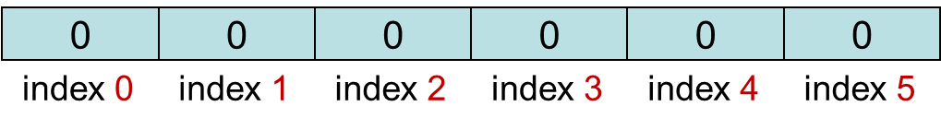
Creating Arrays (1 of 3)
An array is an object so it needs an object reference.
// Declare a reference to an array that will hold integers.
int[] numbers;
The next step creates the array and assigns its address to the numbers variable.
// Create a new array that will hold 6 integers.
numbers = new int[6];
Array element values are initialized to 0. Array indexes always start at 0.

Slide 6
Creating Arrays (2 of 3)
It is possible to declare an array reference and create it in the same statement.
int[] numbers = new int[6];
Arrays may be of any type.
float[] temperatures = new float[100];
char[] letters = new char[41];
long[] units = new long[50];
double[] sizes = new double[1200];

Slide 7
Creating Arrays (3 of 3)
The array size must be a non-negative number.
It may be a literal value, a constant, or variable.
final int ARRAY_SIZE = 6;
int[] numbers = new int[ARRAY_SIZE];
Once created, an array size is fixed and cannot be changed.

Slide 8
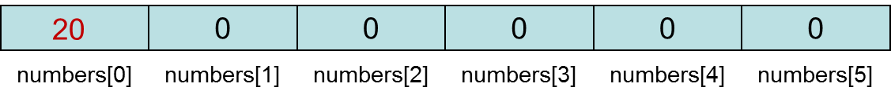
Accessing the Elements of an Array
An array is accessed by:
the reference name
a subscript that identifies which element in the array to access.
numbers[0] = 20; //pronounced "numbers sub zero"

Slide 9
Inputting and Outputting Array Elements
Array elements can be treated as any other variable.
They are simply accessed by the same name and a subscript.
See example: ArrayDemo1.java
Array subscripts can be accessed using variables (such as for loop counters).
See example: ArrayDemo2.java

Slide 10
Bounds Checking
Array indexes always start at zero and continue to (array length - 1).
int values = new int[10];
This array would have indexes 0 through 9.
See example: InvalidSubscript.java
In for loops, it is typical to use i, j, and k as counting variables.
It might help to think of i as representing the word index.

Slide 11
Array Length (1 of 2)
Arrays are objects and provide a public field named length that is a constant that can be tested.
double[] temperatures = new double[25];
The length of this array is 25.
The length of an array can be obtained via its length constant.
int size = temperatures.length;
The variable size will contain 25.

Slide 12
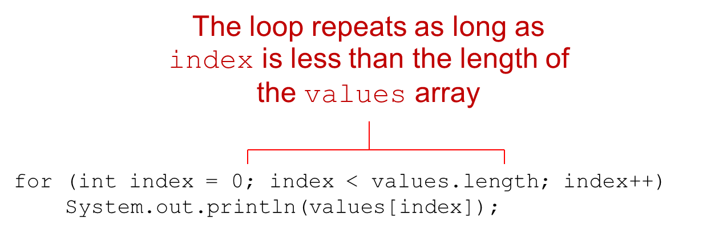
Array Length (2 of 2)
For example, the following loop steps through the values array, and displays the contents of each element:
Notes:
The code has 2 lines. Line 1. for left parenthesis i n t index = 0 semicolon index left angle bracket values period length semicolon index plus plus right parenthesis. Line 2. Indent once. System period out period print l n left parenthesis values left bracket index right bracket right parenthesis semicolon. The first line of the code is labeled, the loop repeats as long as index is less than the length of the values array.

Slide 13
Off-by-One Errors
It is very easy to be off-by-one when accessing arrays.
// This code has an off-by-one error.
int[] numbers = new int[100];
for (int i = 1; i <= 100; i++)
numbers[i] = 99;
Here, the equal sign allows the loop to continue on to index 100, where 99 is the last index in the array.
This code would throw an ArrayIndexOutOfBoundsException.

Slide 14
Array Initialization
When relatively few items need to be initialized, an initialization list can be used to initialize the array.
int[]days = {31, 28, 31, 30, 31, 30, 31, 31, 30, 31, 30, 31};
The numbers in the list are stored in the array in order:
days[0] is assigned 31,
days[1] is assigned 28,
days[2] is assigned 31,
days[3] is assigned 30,
etc.
See example: ArrayInitialization.java

Slide 15
Alternate Array Declaration
Previously we showed arrays being declared:
int[] numbers;
However, the brackets can also go here:
int numbers[];
These are equivalent but the first style is typical.
Multiple arrays can be declared on the same line.
int[] numbers, codes, scores;
With the alternate notation each variable must have brackets.
int numbers[], codes[], scores;
The scores variable in this instance is simply an int variable.

Slide 16
Processing Array Contents (1 of 2)
Processing data in an array is the same as any other variable.
grossPay = hours[3] * payRate;
Pre and post increment works the same:
int[] score = {7, 8, 9, 10, 11};
++score[2]; // Pre-increment operation
score[4]++; // Post-increment operation
See example: PayArray.java

Slide 17
Processing Array Contents (2 of 2)
Array elements can be used in relational operations:
if(cost[20] < cost[0])
{
//statements
}
They can be used as loop conditions:
while(value[count] != 0)
{
//statements
}

Slide 18
The Enhanced for Loop (1 of 2)
Simplified array processing (read only)
Always goes through all elements
General format:
for(datatype elementVariable : array)
statement;

Slide 19
The Enhanced for Loop (2 of 2)
Example:
int[] numbers = {3, 6, 9};
For(int val : numbers)
{
System.out.println("The next value is " + val);
}

Slide 20
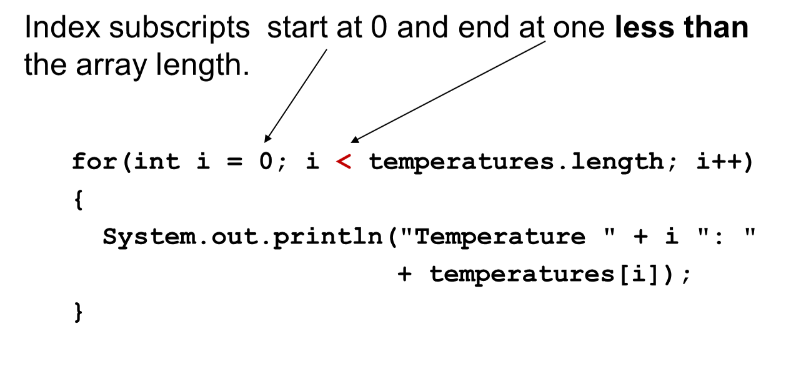
Array Size (1 of 2)
The length constant can be used in a loop to provide automatic bounding.
Notes:
The code has three lines. Line 1. for left parenthesis i n t i = 0 semicolon i left angle bracket temperatures period length semicolon i plus plus right parenthesis. Line 2. Left brace. Line 3. Indent once, System period out period print l n left parenthesis double quote temperature double quote plus i double quote colon double quote plus temperatures left bracket i right bracket right parenthesis semicolon. Line 4. Right brace. 0 and left angle bracket in line 1 is labeled, index subscripts start at 0 and end at one less than array length.

Slide 21
Array Size (2 of 2)
You can let the user specify the size of an array:
int numTests;
int[] tests;
Scanner keyboard = new Scanner(System.in);
System.out.print("How many tests do you have? ");
numTests = keyboard.nextInt();
tests = new int[numTests];
See example: DisplayTestScores.java

Slide 22
Reassigning Array References (1 of 3)
An array reference can be assigned to another array of the same type.
// Create an array referenced by the numbers variable.
int[] numbers = new int[10];
// Reassign numbers to a new array.
numbers = new int[5];
If the first (10 element) array no longer has a reference to it, it will be garbage collected.

Slide 23
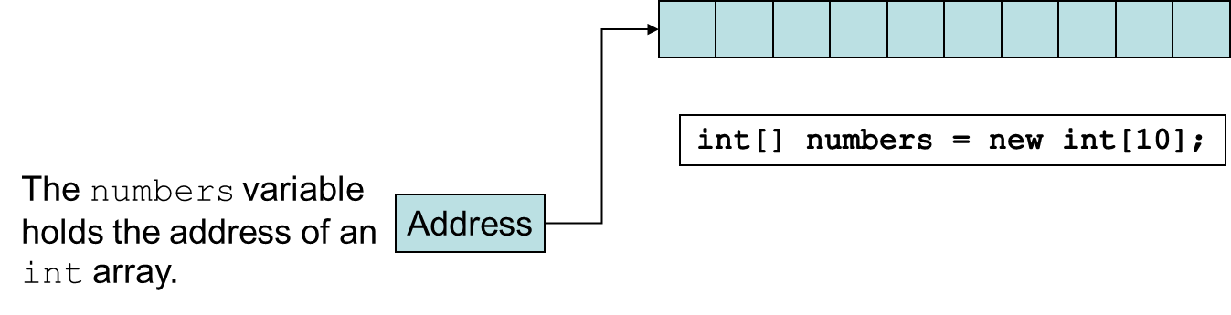
Reassigning Array References (2 of 3)
Notes:
The grid cells are labeled, address. The numbers variable holds the address of an integer array.

Slide 24
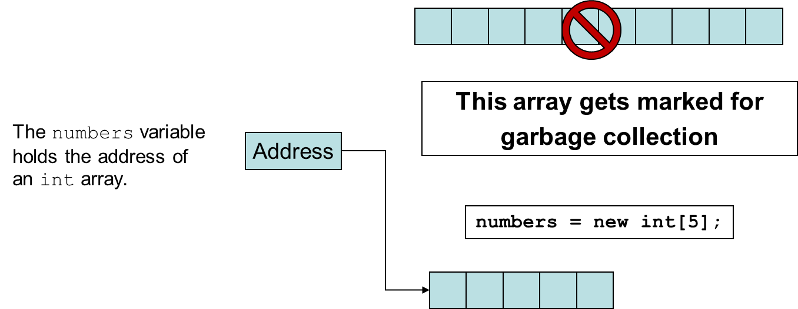
Reassigning Array References (3 of 3)
Notes:
The first array represented by an empty 1 by 10 grid is labeled, this array gets marked for garbage collection. The second array titled, numbers = new i n t left bracket 5 right bracket semicolon, represented by 1 by 5 grid. The array is labeled, address, the numbers variable holds the address of an integer array.

Slide 25
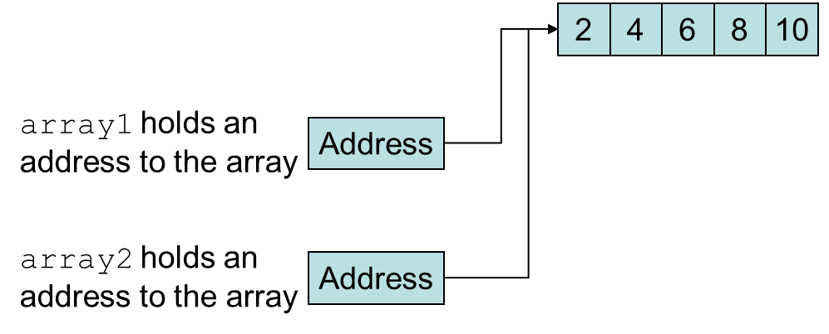
Copying Arrays (1 of 2)
This is not the way to copy an array.
int[] array1 = { 2, 4, 6, 8, 10 };
int[] array2 = array1; // This does not copy array1.
Example: SameArray.java

Slide 26
Copying Arrays (2 of 2)
You cannot copy an array by merely assigning one reference variable to another.
You need to copy the individual elements of one array to another.
int[] firstArray = {5, 10, 15, 20, 25 };
int[] secondArray = new int[5];
for (int i = 0; i < firstArray.length; i++)
secondArray[i] = firstArray[i];
This code copies each element of firstArray to the corresponding element of secondArray.

Slide 27
Passing Array Elements to a Method
When a single element of an array is passed to a method it is handled like any other variable.
See example: PassElements.java
More often you will want to write methods to process array data by passing the entire array, not just one element at a time.

Slide 28
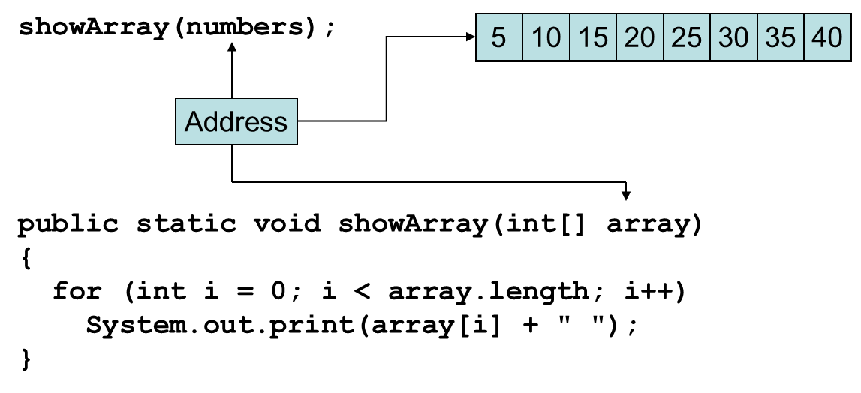
Passing Arrays as Arguments
Arrays are objects.
Their references can be passed to methods like any other object reference variable.
Example: PassArray.java
Notes:
The grid cells are labeled, address. The address is labeled, show array left parenthesis numbers right parenthesis semicolon. The computer code for address has 5 lines. Line 1. public static void show array left parenthesis I n t left bracket right bracket array right parenthesis. Line 2. Left brace. Line 3. Indent once. for left parenthesis I n t I = 0 semicolon i left angle bracket array. length semicolon i plus plus right parenthesis. Line 4. Indent twice. System period out period print left parenthesis array left bracket i right bracket plus double quote double quote right parenthesis semicolon. Line. Right brace.

Slide 29
Comparing Arrays
The == operator determines only whether array references point to the same array object.
int[] firstArray = { 5, 10, 15, 20, 25 };
int[] secondArray = { 5, 10, 15, 20, 25 };
if (firstArray == secondArray) // This is a mistake.
System.out.println("The arrays are the same.");
else
System.out.println("The arrays are not the same.");

Slide 30
Comparing Arrays: Example
int[] firstArray = { 2, 4, 6, 8, 10 };
int[] secondArray = { 2, 4, 6, 8, 10 };
boolean arraysEqual = true;
int i = 0;
// First determine whether the arrays are the same size.
if (firstArray.length != secondArray.length)
arraysEqual = false;
// Next determine whether the elements contain the same data.
while (arraysEqual && i < firstArray.length)
{
if (firstArray[i] != secondArray[i])
arraysEqual = false;
i++;
}
if (arraysEqual)
System.out.println("The arrays are equal.");
else
System.out.println("The arrays are not equal.");

Slide 31
Useful Array Operations (1 of 3)
Finding the Highest Value
int [] numbers = new int[50];
int highest = numbers[0];
for (int i = 1; i < numbers.length; i++)
{
if (numbers[i] > highest)
highest = numbers[i];
}

Slide 32
Useful Array Operations (2 of 3)
Finding the Lowest Value
int lowest = numbers[0];
for (int i = 1; i < numbers.length; i++)
{
if (numbers[i] < lowest)
lowest = numbers[i];
}

Slide 33
Useful Array Operations (3 of 3)
Summing Array Elements:
int total = 0; // Initialize accumulator
for (int i = 0; i < units.length; i++)
total += units[i];
Averaging Array Elements:
double total = 0; // Initialize accumulator
double average; // Will hold the average
for (int i = 0; i < scores.length; i++)
total += scores[i];
average = total / scores.length;
Example: SalesData.java, Sales.java

Slide 34
Partially Filled Arrays
Typically, if the amount of data that an array must hold is unknown:
size the array to the largest expected number of elements.
use a counting variable to keep track of how much valid data is in the array.
…
int[] array = new int[100];
int count = 0;
…
System.out.print("Enter a number or −1 to quit: ");
number = keyboard.nextInt();
while (number != −1 && count <= 99)
{
array[count] = number;
count++;
System.out.print("Enter a number or −1 to quit: ");
number = keyboard.nextInt();
}
…
input, number and keyboard were previously declared, and keyboard references a Scanner object

Slide 35
Arrays and Files (1 of 3)
Saving the contents of an array to a file:
int[] numbers = {10, 20, 30, 40, 50};
PrintWriter outputFile = new PrintWriter("Values.txt");
for (int i = 0; i < numbers.length; i++)
outputFile.println(numbers[i]);
outputFile.close();

Slide 36
Arrays and Files (2 of 3)
Using try-with-resources:
int[] numbers = {10, 20, 30, 40, 50};
try (PrintWriter outputFile = new PrintWriter("Values.txt"))
{
for (int i = 0; i < numbers.length; i++)
outputFile.println(numbers[i]);
}

Slide 37
Arrays and Files (3 of 3)
Reading the contents of a file into an array:
final int SIZE = 5; // Assuming we know the size
int[] numbers = new int[SIZE];
int i = 0;
try (Scanner inputFile = new Scanner(new File("Values.txt")))
{
while (inputFile.hasNext() && i < numbers.length)
{
numbers[i] = inputFile.nextInt();
i++;
}
}

Slide 38
Returning an Array Reference
A method can return a reference to an array.
The return type of the method must be declared as an array of the right type.
public static double[] getArray()
{
double[] array = { 1.2, 2.3, 4.5, 6.7, 8.9 };
return array;
}
The getArray method is a public static method that returns an array of doubles.
See example: ReturnArray.java

Slide 39
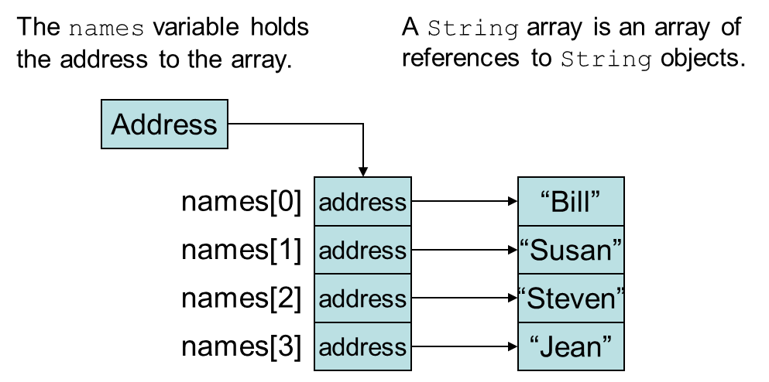
String Arrays (1 of 3)
Arrays are not limited to primitive data.
An array of String objects can be created:
String[] names = { "Bill", "Susan", "Steven", "Jean" };
Example: MonthDays.java
Notes:
The names variable holds the address to the array. A string array is an array of references to string objects. The string names are as follows. Names left bracket 0 right bracket, Bill. Names left bracket 1 right bracket, Susan. Names left bracket 2 right bracket, Steven. Names left bracket 3 right bracket, Jean.

Slide 40
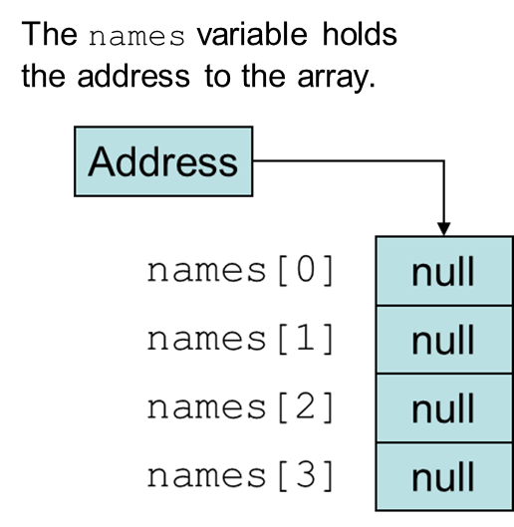
String Arrays (2 of 3)
If an initialization list is not provided, the new keyword must be used to create the array:
String[] names = new String[4];
Notes:
The grid cells from top are labeled, names left bracket 0 right bracket through names left bracket 3 right bracket. The names variable holds the address to the array.

Slide 41
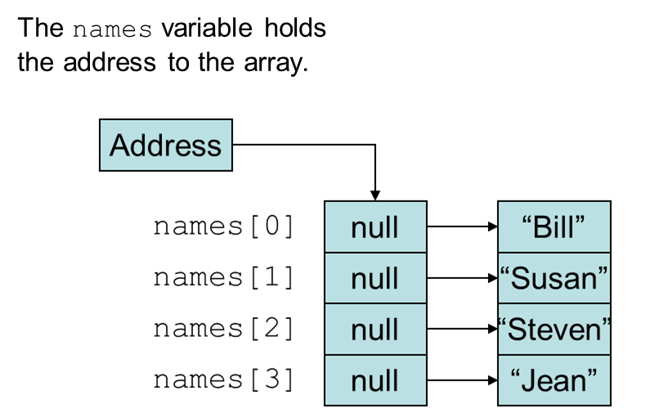
String Arrays (3 of 3)
When an array is created in this manner, each element of the array must be initialized.
names[0] = "Bill";
names[1] = "Susan";
names[2] = "Steven";
names[3] = "Jean";
Notes:
The grid cells from top are labeled, names left bracket 0 right bracket through names left bracket 3 right bracket. The names variable holds the address to the array. The string names for the null values are as follows. Names left bracket 0 right bracket, Bill. Names left bracket 1 right bracket, Susan. Names left bracket 2 right bracket, Steven. Names left bracket 3 right bracket, Jean.

Slide 42
Calling String Methods On Array Elements
String objects have several methods, including:
toUpperCase
compareTo
equals
charAt
Each element of a String array is a String object.
Methods can be used by using the array name and index as before.
System.out.println(names[0].toUpperCase());
char letter = names[3].charAt(0);

Slide 43
The length Field & The length Method
Arrays have a final field named length.
String objects have a method named length.
To display the length of each string held in a String array:
for (int i = 0; i < names.length; i++)
System.out.println(names[i].length());
An array’s length is a field
You do not write a set of parentheses after its name.
A String’s length is a method
You do write the parentheses after the name of the String class’s length method.

Slide 44
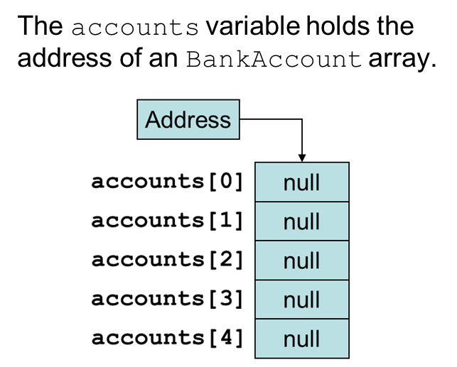
Arrays of Objects (1 of 2)
Because Strings are objects, we know that arrays can contain objects.
BankAccount[] accounts = new BankAccount[5];
The array is an array of references to BankAccount objects.
Notes:
The grid cells from top are labeled, accounts left bracket 0 right bracket through accounts left bracket 4 right bracket. The accounts variable holds the address of an bank account array.

Slide 45
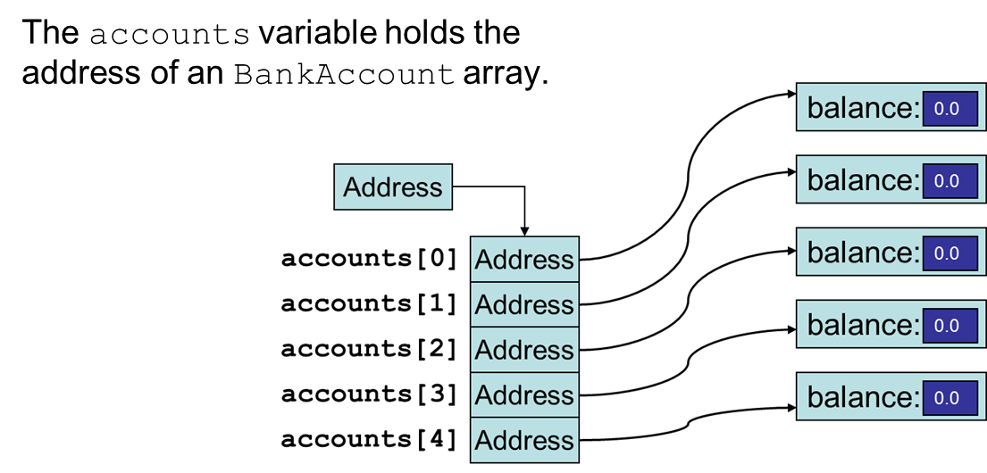
Arrays of Objects (2 of 2)
Each element needs to be initialized.
for (int i = 0; i < accounts.length; i++)
accounts[i] = new BankAccount();
See example: ObjectArray.java
Notes:
The grid cells from top are labeled, accounts left bracket 0 right bracket through accounts left bracket 4 right bracket. The accounts variable holds the address of an bank account array. The array values are as follows. Account left bracket 0 right bracket, balance 0.0. Accounts left bracket 1 right bracket, balance 0.0. Accounts left bracket 2 right bracket, balance 0.0. Accounts left bracket 3 right bracket, balance 0.0. Accounts left bracket 4 right bracket, balance 0.0.

Slide 46
The Sequential Search Algorithm
A search algorithm is a method of locating a specific item in a larger collection of data.
The sequential search algorithm uses a loop to:
sequentially step through an array,
compare each element with the search value, and
stop when
the value is found or
the end of the array is encountered.
See example: SearchArray.java

Slide 47
Two-Dimensional Arrays (1 of 2)
A two-dimensional array is an array of arrays.
It can be thought of as having rows and columns.
Blank | column 0 | column 1 | column 2 | column 3
row 0 | Blank | Blank | Blank | Blank
row 1 | Blank | Blank | Blank | Blank
row 2 | Blank | Blank | Blank | Blank
row 3 | Blank | Blank | Blank | Blank

Slide 48
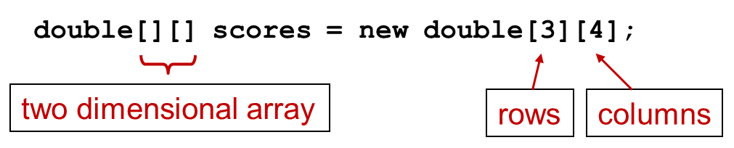
Two-Dimensional Arrays (2 of 2)
Declaring a two-dimensional array requires two sets of brackets and two size declarators
The first one is for the number of rows
The second one is for the number of columns.
The two sets of brackets in the data type indicate that the scores variable will reference a two-dimensional array.
Notice that each size declarator is enclosed in its own set of brackets.
Notes:
Double left bracket right bracket left bracket right bracket scores = new double left bracket 3 right bracket left bracket 4 right bracket semicolon. Two sets of left bracket right bracket on the left are together labeled two dimensional arrays. Left bracket 3 right bracket is labeled, rows. Left bracket 4 right bracket is labeled, columns.

Slide 49
Accessing Two-Dimensional Array Elements (1 of 5)
When processing the data in a two-dimensional array, each element has two subscripts:
one for its row and
another for its column.

Slide 50
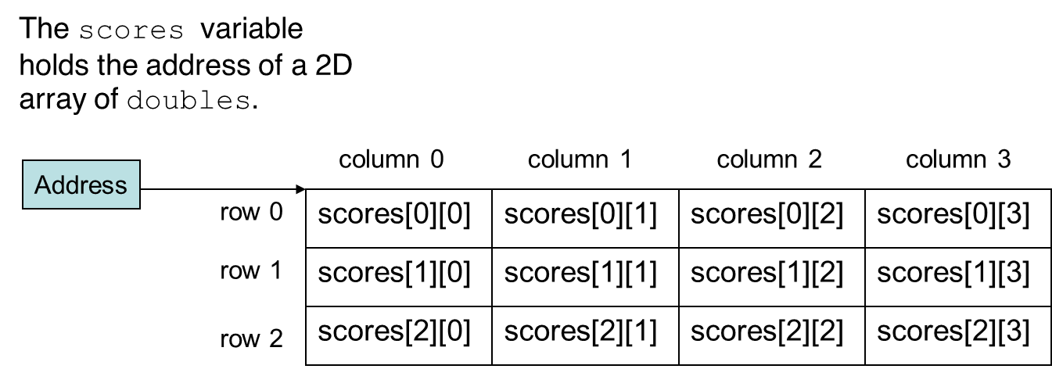
Accessing Two-Dimensional Array Elements (2 of 5)
Notes:
The test scores from the array are as follows. Row 0. Column 0, scores left bracket 0 right bracket left bracket0right bracket. Column 1, scores left bracket 0 right bracket left bracket 1 right bracket. Column 2, scores left bracket 0 right bracket left bracket 2 right bracket. Column 3, scores left bracket 0 right bracket left bracket 3 right bracket. Row 1. Column 0, scores left bracket 1 right bracket left bracket0right bracket. Column 1, scores left bracket 1 right bracket left bracket 1 right bracket. Column 2, scores left bracket 1 right bracket left bracket 2 right bracket. Column 3, scores left bracket 1 right bracket left bracket 3 right bracket. Row 2. Column 0, scores left bracket 2 right bracket left bracket 0 right bracket. Column 1, scores left bracket 2 right bracket left bracket 1 right bracket. Column 2, scores left bracket 2 right bracket left bracket 2 right bracket. Column 3, scores left bracket 2 right bracket left bracket 3 right bracket. The scores variable holds the address of a 2 D array of doubles.

Slide 51
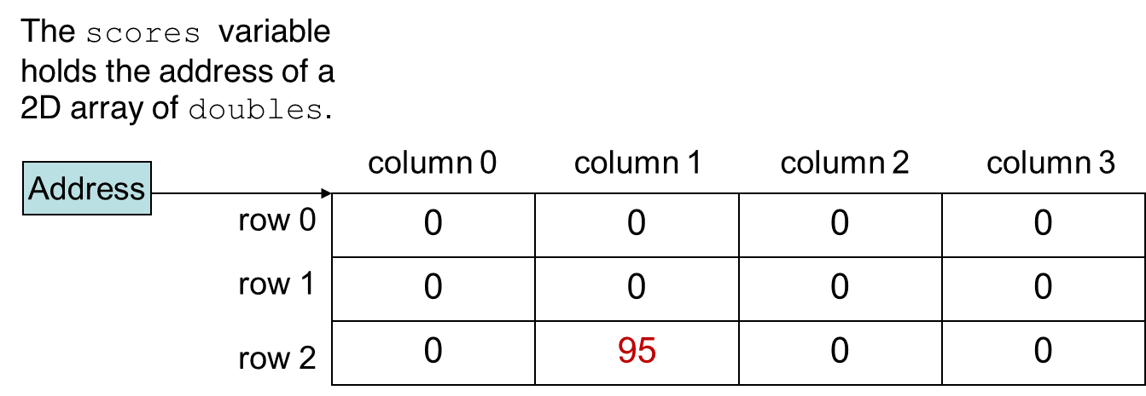
Accessing Two-Dimensional Array Elements (3 of 5)
Accessing one of the elements in a two-dimensional array requires the use of both subscripts.
scores[2][1] = 95;
Notes:
The test scores from the array are as follows. Row 0. Column 0, 0. Column 1, 0. Column 2, 0. Column 3, 0. Row 1. Column 0, 0. Column 1, 0. Column 2, 0. Column 3, 0. Row 2. Column 0, 0. Column 1, 95. Column 2, 0. Column 3, 0. The scores variable holds the address of a 2 D array of doubles.

Slide 52
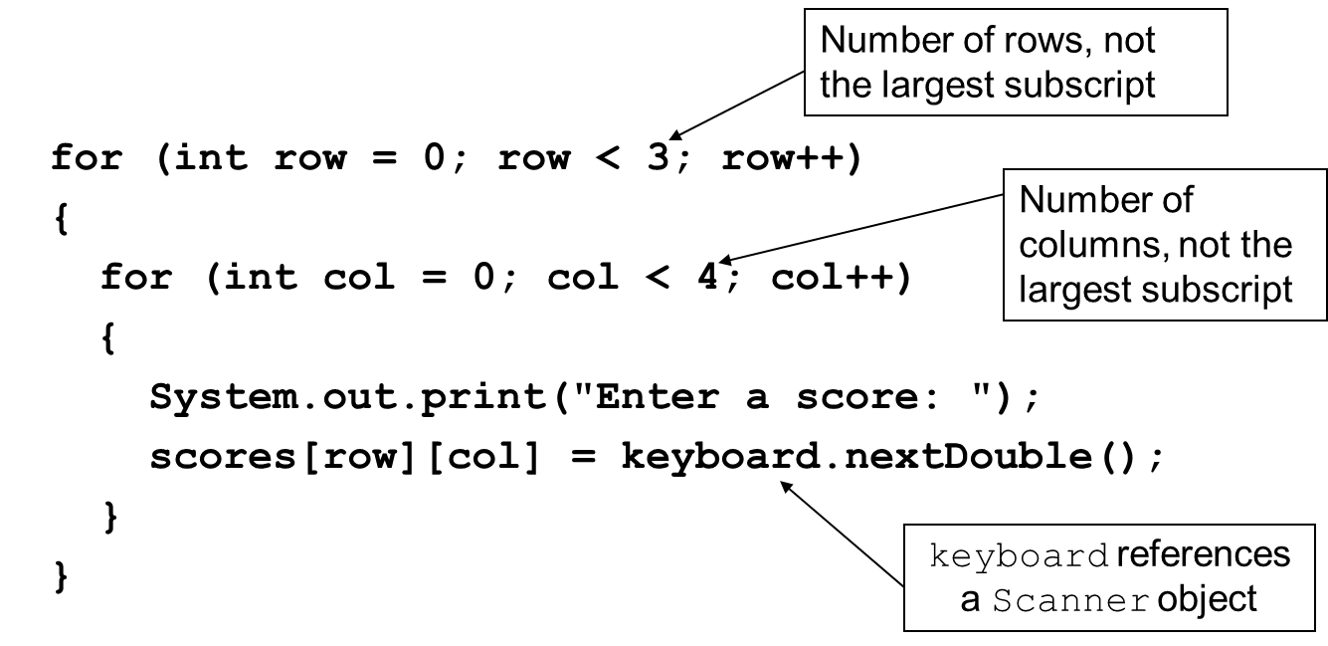
Accessing Two-Dimensional Array Elements (4 of 5)
Programs that process two-dimensional arrays can do so with nested loops.
To fill the scores array:
Notes:
The program has 8 lines. Line 1. for left parenthesis i n t row = 0 semicolon row left angle bracket 3 semicolon row plus plus right parenthesis. Line 2. Left brace. Line 3. Indent once. for left parenthesis i n t c o l = 0 semicolon c o l left angle bracket 4 semicolon c o l plus plus right parenthesis. Line 4. Indent once. Left brace. Line 5. Indent twice. System period out period print left parenthesis double quote Enter a score colon double quote right parenthesis semicolon. Line 6. Ident twice. scores left bracket row right bracket left bracket c o l right bracket = keyboard period next Double left parenthesis right parenthesis semicolon. Line 7. Indent once, right brace. Line 8. Right brace. 3 in line 1 is labeled, number of rows, not the largest subscript. 4 in the line 3 is labeled, number of columns, not the largest subscript. Keyboards in the line 6 is labeled, keyboard references a scanner object.

Slide 53
Accessing Two-Dimensional Array Elements (5 of 5)
To print out the scores array:
for (int row = 0; row < 3; row++)
{
for (int col = 0; col < 4; col++)
{
System.out.println(scores[row][col]);
}
}
See example: CorpSales.java

Slide 54
Initializing a Two-Dimensional Array (1 of 2)
Initializing a two-dimensional array requires enclosing each row’s initialization list in its own set of braces.
int[][] numbers = { {1, 2, 3}, {4, 5, 6}, {7, 8, 9} };
Java automatically creates the array and fills its elements with the initialization values.
row 0
row 1
row 2
Declares an array with three rows and three columns.

Slide 55
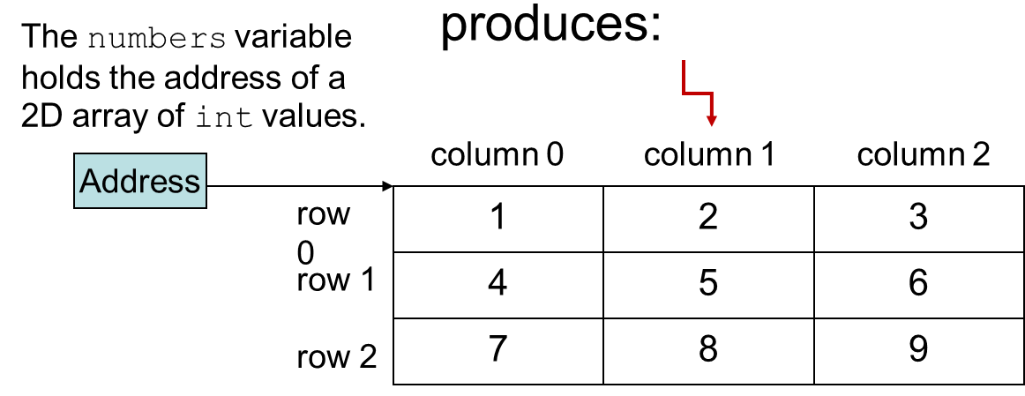
Initializing a Two-Dimensional Array (2 of 2)
int[][] numbers = {{1, 2, 3},
{4, 5, 6},
{7, 8, 9}};
Notes:
The test scores from the array are as follows. Row 0. Column 0, 1. Column 1, 2. Column 2, 3. Row 1. Column 0, 4. Column 1, 5. Column 2, 6. Row 2. Column 0, 7. Column 1, 8. Column 2, 9. The numbers variable holds the address of a 2 D array of integer values. Column 1 is labeled, produces.

Slide 56
The length Field (1 of 2)
Two-dimensional arrays are arrays of one-dimensional arrays.
The length field of the array gives the number of rows in the array.
Each row has a length constant tells how many columns is in that row.
Each row can have a different number of columns.

Slide 57
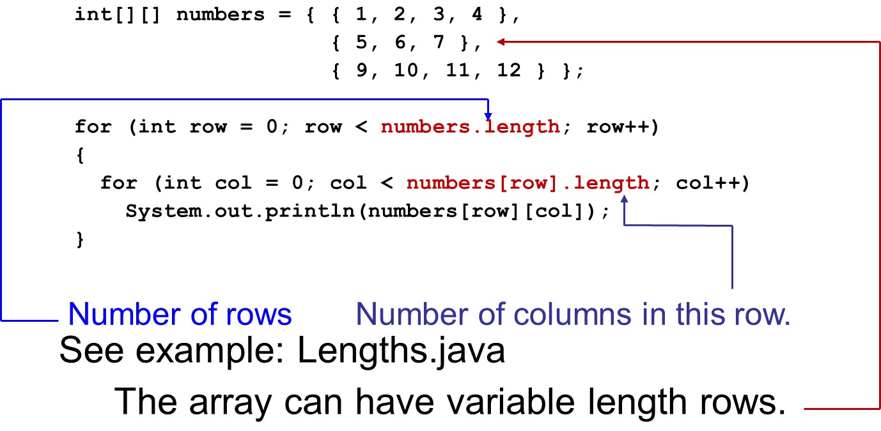
The length Field (2 of 2)
To access the length fields of the array:
Notes:
The examples is as follows. The computer has 8 lines. Line 1. i n t left bracket right bracket left bracket right bracket numbers = left brace left brace 1, 2, 3 right bracket comma. Line 2. Indent once, left brace 4, 5, 6 right brace comma. Line 3. Indent once, left brace 7, 8, 9 right brace right brace semicolon. Line 4. for left parenthesis i n t row = 0 semicolon row left angle bracket numbers period length semicolon row plus plus right parenthesis. Line 5. right brace. Line 6. Indent once. for left parenthesis i n t c o l = 0 semicolon c o l left angle bracket numbers left bracket row right bracket period length semicolon c o l plus plus right parenthesis. Line 7. Indent twice. System period out period. print l n left parenthesis numbers left bracket row right bracket left bracket c o l right bracket right parenthesis semicolon. Line 8. right brace. Length in line 4 is labeled, number of rows. Length in line 5 is labeled, number of columns in this row. Left brace 4, 5, 6 right brace is labeled, the array can have variable length rows.

Slide 58
Summing The Elements of a Two-Dimensional Array
int[][] numbers = { { 1, 2, 3, 4 },
{5, 6, 7, 8},
{9, 10, 11, 12} };
int total;
total = 0;
for (int row = 0; row < numbers.length; row++)
{
for (int col = 0; col < numbers[row].length; col++)
total += numbers[row][col];
}
System.out.println("The total is " + total);

Slide 59
Summing The Rows of a Two-Dimensional Array
int[][] numbers = {{ 1, 2, 3, 4},
{5, 6, 7, 8},
{9, 10, 11, 12}};
int total;
for (int row = 0; row < numbers.length; row++)
{
total = 0;
for (int col = 0; col < numbers[row].length; col++)
total += numbers[row][col];
System.out.println("Total of row "
+ row + " is " + total);
}

Slide 60
Summing The Columns of a Two-Dimensional Array
int[][] numbers = {{1, 2, 3, 4},
{5, 6, 7, 8},
{9, 10, 11, 12}};
int total;
for (int col = 0; col < numbers[0].length; col++)
{
total = 0;
for (int row = 0; row < numbers.length; row++)
total += numbers[row][col];
System.out.println("Total of column "
+ col + " is " + total);
}

Slide 61
Passing and Returning Two-Dimensional Array References
There is no difference between passing a single or two-dimensional array as an argument to a method.
The method must accept a two-dimensional array as a parameter.
See example: Pass2Darray.java

Slide 62
Ragged Arrays
When the rows of a two-dimensional array are of different lengths, the array is known as a ragged array.
You can create a ragged array by creating a two-dimensional array with a specific number of rows, but no columns.
int [][] ragged = new int [4][];
Then create the individual rows.
ragged[0] = new int [3];
ragged[1] = new int [4];
ragged[2] = new int [5];
ragged[3] = new int [6];

Slide 63
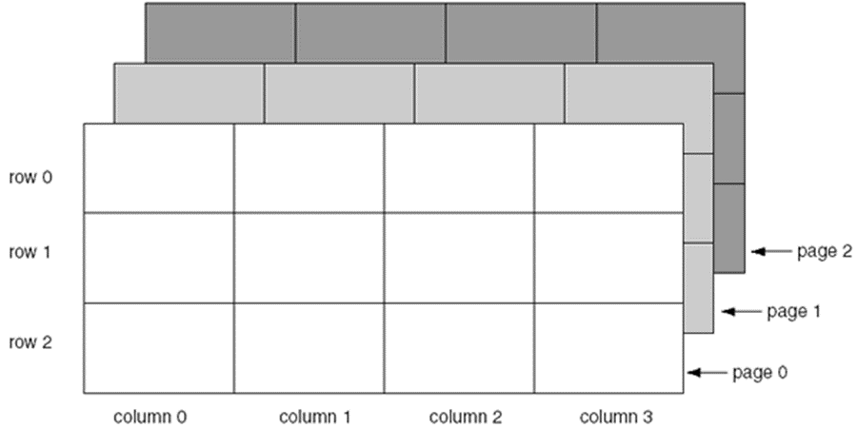
More Than Two Dimensions
Java does not limit the number of dimensions that an array may be.
More than three dimensions is hard to visualize, but can be useful in some programming problems.

Slide 64
Selection Sort
In a selection sort:
The smallest value in the array is located and moved to element 0.
Then the next smallest value is located and moved to element 1.
This process continues until all of the elements have been placed in their proper order.
See example: SelectionSortDemo.java

Slide 65
Binary Search
A binary search:
requires an array sorted in ascending order.
starts with the element in the middle of the array.
If that element is the desired value, the search is over.
Otherwise, the value in the middle element is either greater or less than the desired value
If it is greater than the desired value, search in the first half of the array.
Otherwise, search the last half of the array.
Repeat as needed while adjusting start and end points of the search.
See example: BinarySearchDemo.java

Slide 66
Command-Line Arguments (1 of 2)
A Java program can receive arguments from the operating system command-line.
The main method has a header that looks like this:
public static void main(String[] args)
The main method receives a String array as a parameter.
The array that is passed into the args parameter comes from the operating system command-line.

Slide 67
Command-Line Arguments (2 of 2)
To run the example:
java CommandLine How does this work?
args[0] is assigned "How"
args[0] is assigned "does"
args[0] is assigned "this"
args[0] is assigned "work?"
Example: CommandLine.java
It is not required that the name of main’s parameter array be args.

Slide 68
Variable-Length Argument Lists
Special type parameter – vararg…
Vararg parameters are actually arrays
Examples: VarArgsDemo1.java, VarargsDemo2.java
public static int sum(int... numbers)
{
int total = 0; // Accumulator
// Add all the values in the numbers array.
for (int val : numbers)
total += val;
// Return the total.
return total;
}

Slide 69
The ArrayList Class
Similar to an array, an ArrayList allows object storage
Unlike an array, an ArrayList object:
Automatically expands when a new item is added
Automatically shrinks when items are removed
Requires:
import java.util.ArrayList;

Slide 70
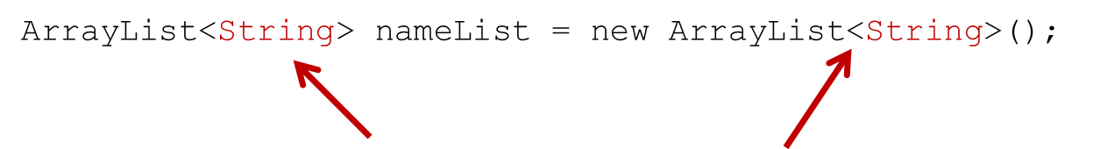
Creating an ArrayList
Notice the word String written inside angled brackets <>
This specifies that the ArrayList can hold String objects.
If we try to store any other type of object in this ArrayList, an error will occur.

Slide 71
Using an ArrayList (1 of 9)
To populate the ArrayList, use the add method:
nameList.add("James");
nameList.add("Catherine");
To get the current size, call the size method
nameList.size(); // returns 2

Slide 72
Using an ArrayList (2 of 9)
To access items in an ArrayList, use the get method
nameList.get(1);
In this statement 1 is the index of the item to get.
Example: ArrayListDemo1.java

Slide 73
Using an ArrayList (3 of 9)
The ArrayList class's toString method returns a string representing all items in the ArrayList
System.out.println(nameList);
This statement yields :
[ James, Catherine ]
The ArrayList class's remove method removes designated item from the ArrayList
nameList.remove(1);
This statement removes the second item.
See example: ArrayListDemo3.java

Slide 74
Using an ArrayList (4 of 9)
The ArrayList class's add method with one argument adds new items to the end of the ArrayList
To insert items at a location of choice, use the add method with two arguments:
nameList.add(1, "Mary");
This statement inserts the String "Mary" at index 1
To replace an existing item, use the set method:
nameList.set(1, "Sabrina");
This statement replaces “Mary” with “Sabrina”
See example: ArrayListDemo5.java

Slide 75
Using an ArrayList (5 of 9)
An ArrayList has a capacity, which is the number of items it can hold without increasing its size.
The default capacity of an ArrayList is 10 items.
To designate a different capacity, use a parameterized constructor:
ArrayList<String> list = new ArrayList<String>(100);

Slide 76
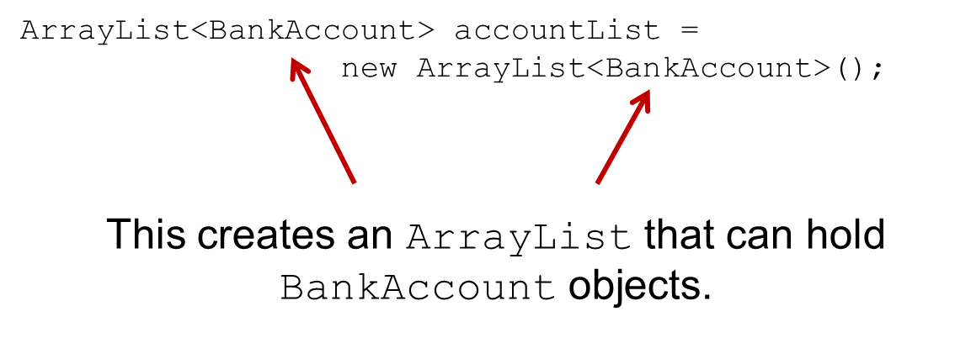
Using an ArrayList (6 of 9)
You can store any type of object in an ArrayList
Notes:
The code is as follows. Array List left angle bracket Account right angle bracket account List = new Array List left angle bracket Bank Account right angle bracket left parenthesis right parenthesis semicolon. Arrows points to the Bank Account.

Slide 77
Using an ArrayList (7 of 9)
// Create an ArrayList to hold BankAccount objects. ArrayList<BankAccount> list = new ArrayList<BankAccount>(); // Add three BankAccount objects to the ArrayList. list.add(new BankAccount(100.0)); list.add(new BankAccount(500.0)); list.add(new BankAccount(1500.0)); // Display each item. for (int index = 0; index < list.size(); index++) { BankAccount account = list.get(index); System.out.println("Account at index " + index + "\nBalance: " + account.getBalance()); }
See: ArrayListDemo6.java

Slide 78
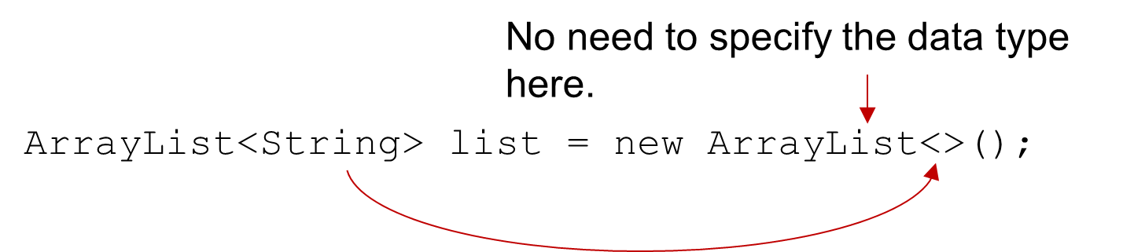
Using an ArrayList (8 of 9)
The diamond operator
Beginning in Java 7, you can use the <> operator for simpler ArrayList declarations:
Java infers the type of the ArrayList object from the variable declaration.
Notes:
The code is as follows. Array List left angle bracket String right angle bracket list = new Array List left angle bracket right angle bracket left parenthesis right parenthesis semicolon. Array List is labeled, No need to specify the data type here. An arrow extends from left angle bracket String right angle bracket to left angle bracket right angle bracket.

Slide 79
Using an ArrayList (9 of 9)
Declaring an ArrayList with var
In Java 10 and later you can use var to declare an ArrayList:
var nameList = new ArrayList<String>();
Java infers the type of the nameList variable from the initialization value.

Slide 80

Copyright
This work is protected by United States copyright laws and is provided solely for the use of instructors in teaching their courses and assessing student learning. Dissemination or sale of any part of this work (including on the World Wide Web) will destroy the integrity of the work and is not permitted. The work and materials from it should never be made available to students except by instructors using the accompanying text in their classes. All recipients of this work are expected to abide by these restrictions and to honor the intended pedagogical purposes and the needs of other instructors who rely on these materials.

