Slide 1
Scientific Motivation
Nuclear Gluonometry
Slides from J. Maxwell (JLab)

Slide 2
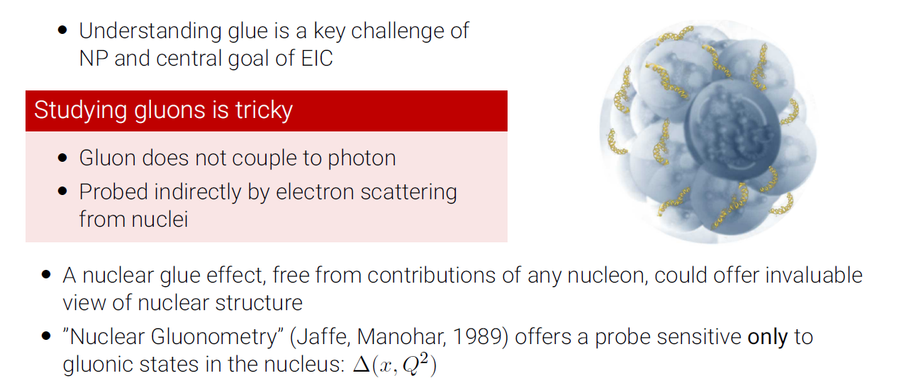
Gluon Structure of Nuclei
Slides from J. Maxwell (JLab)
Notes:
30-35 mW is the power to the optical pumping region. Accounting for the loss of transmission, ~60 mW may be needed, which can be easily achieved with solid-state laser.

Slide 3
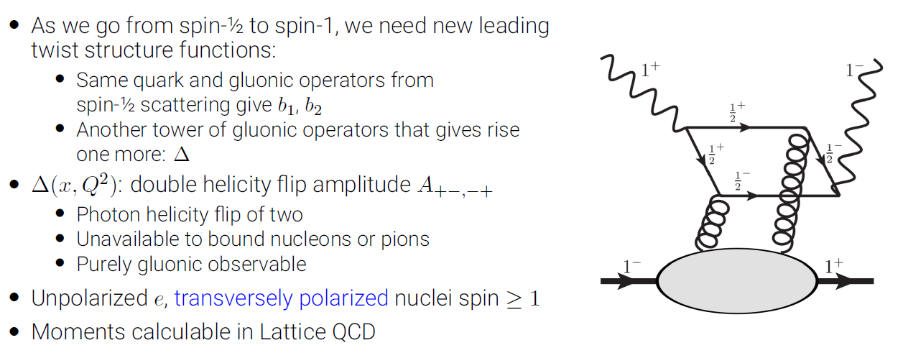
Double Helicity-Flip Structure Function

Slide 4
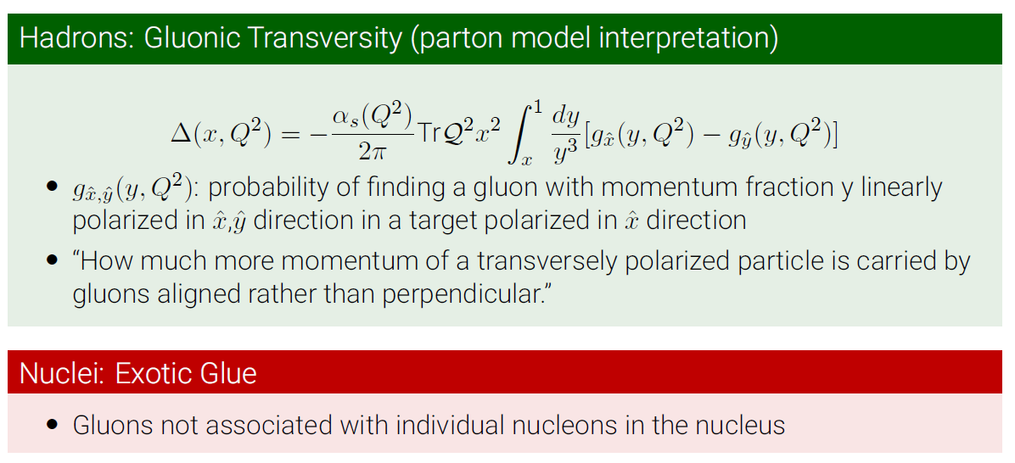
Double Helicity-Flip Structure Function

Slide 5
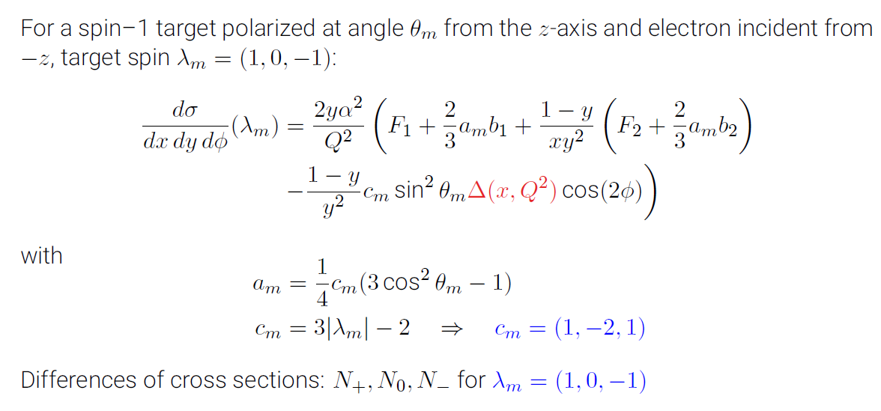
Differential Cross Secion
Notes:
30-35 mW is the power to the optical pumping region. Accounting for the loss of transmission, ~60 mW may be needed, which can be easily achieved with solid-state laser.

Slide 6
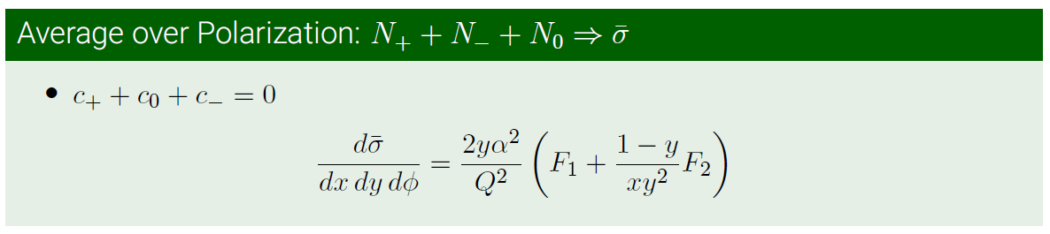
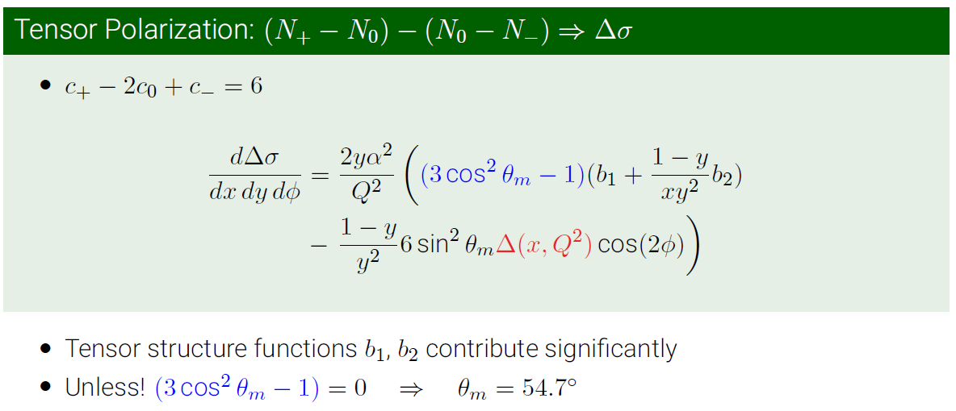
Measurement
Notes:
30-35 mW is the power to the optical pumping region. Accounting for the loss of transmission, ~60 mW may be needed, which can be easily achieved with solid-state laser.

Slide 7
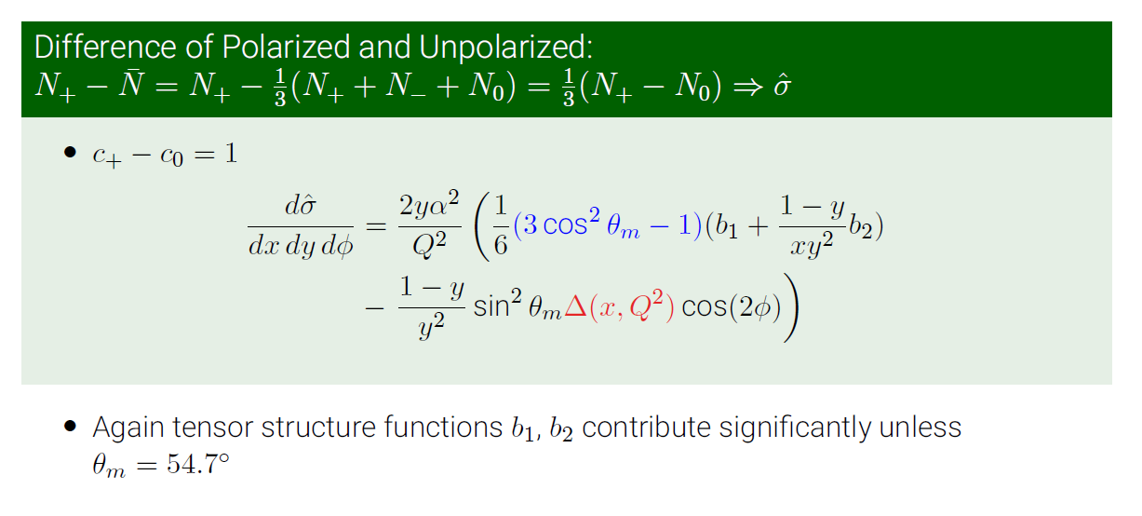
Measurement
Notes:
30-35 mW is the power to the optical pumping region. Accounting for the loss of transmission, ~60 mW may be needed, which can be easily achieved with solid-state laser.

Slide 8
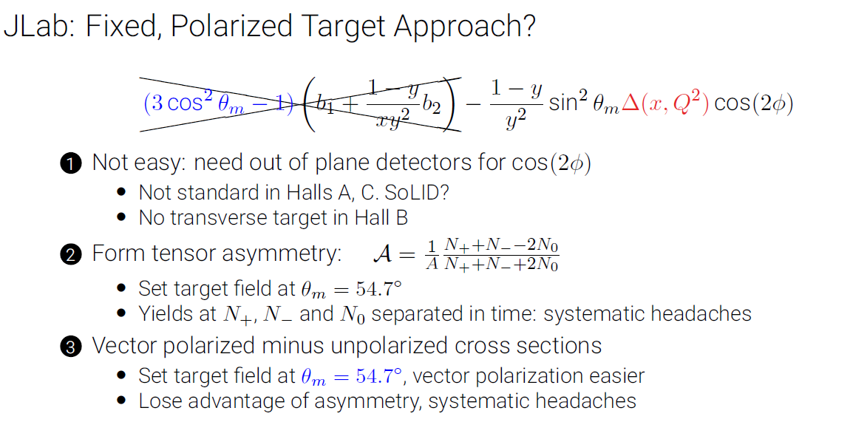
Experimental Approach

Slide 9
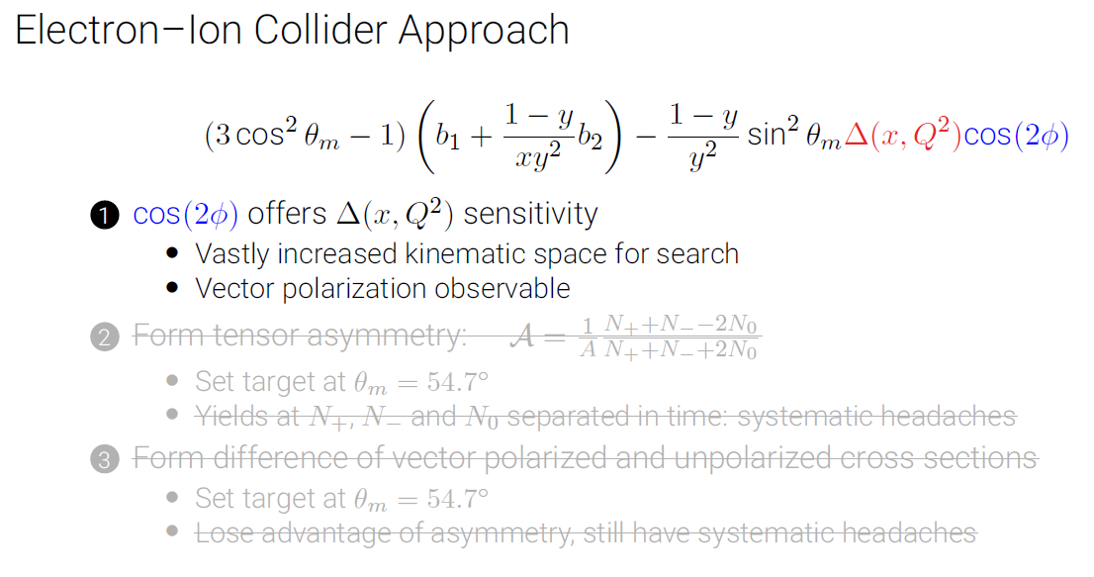
Experimental Approach

Slide 10
Scientific Motivation
Polarized EMC Effects
Slides from I. Cloet (Argonne)

Slide 11
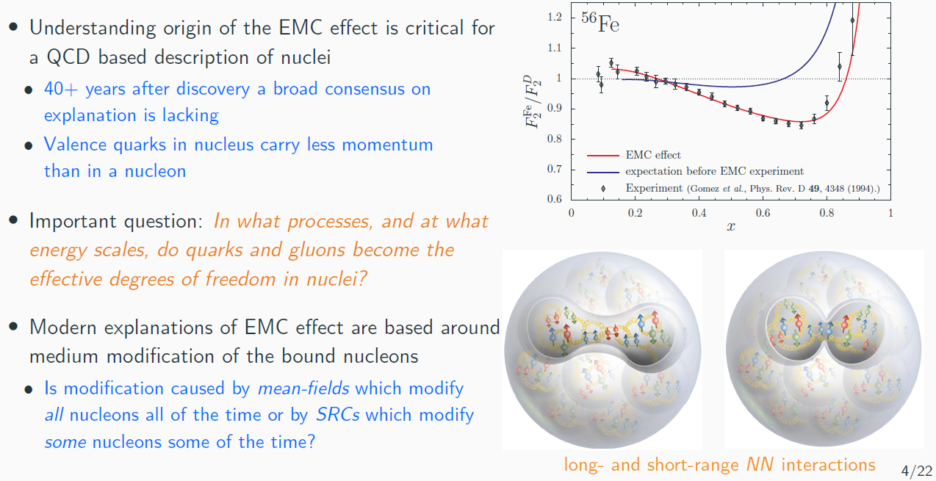
EMC Effect

Slide 12
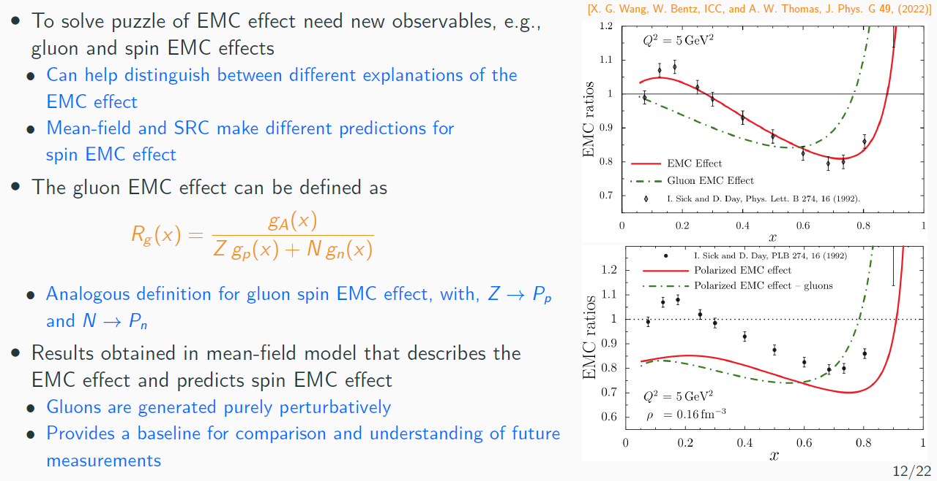
Spin and Gluon EMC Effect

Slide 13
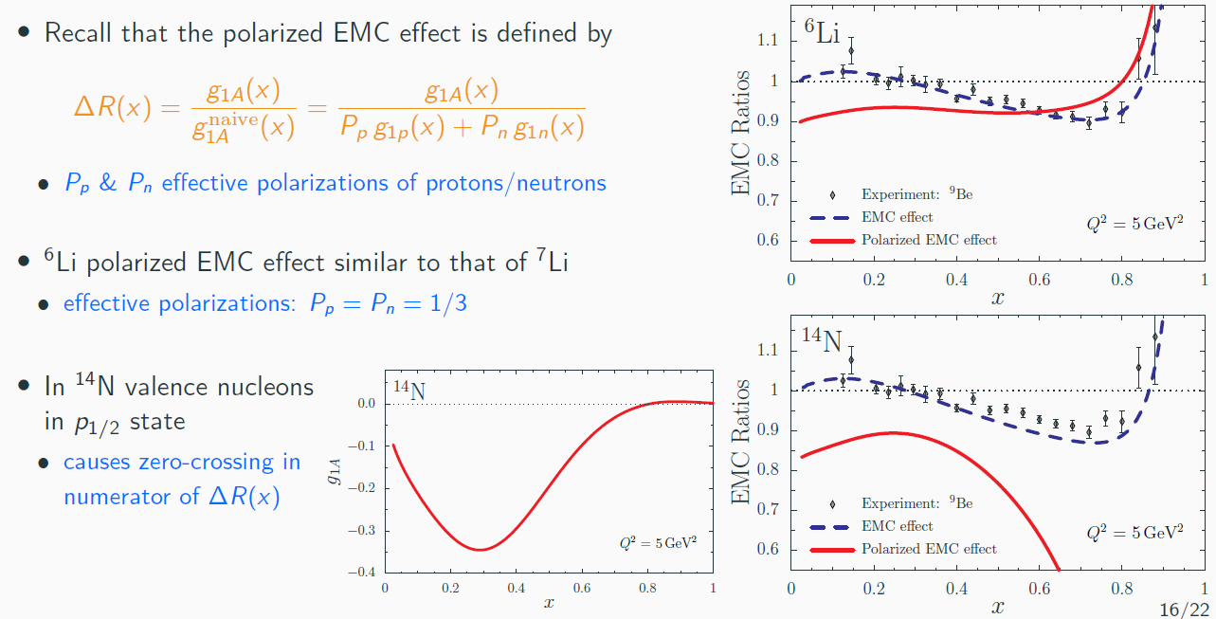
Polarized EMC Effect for Spin-1 Nuclei

Slide 14
Scientific Motivation
New Ideas?

Slide 15
New Ideas

Slide 16
Technical Challenges

Slide 17
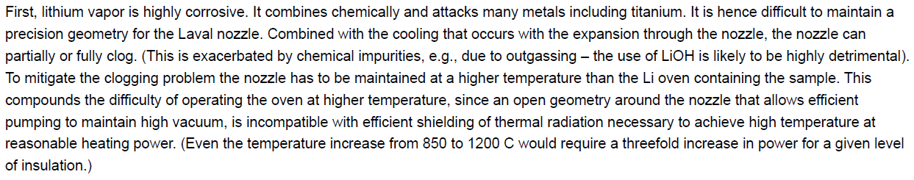
From Reviewers

Slide 18
From Reviewers

Slide 19
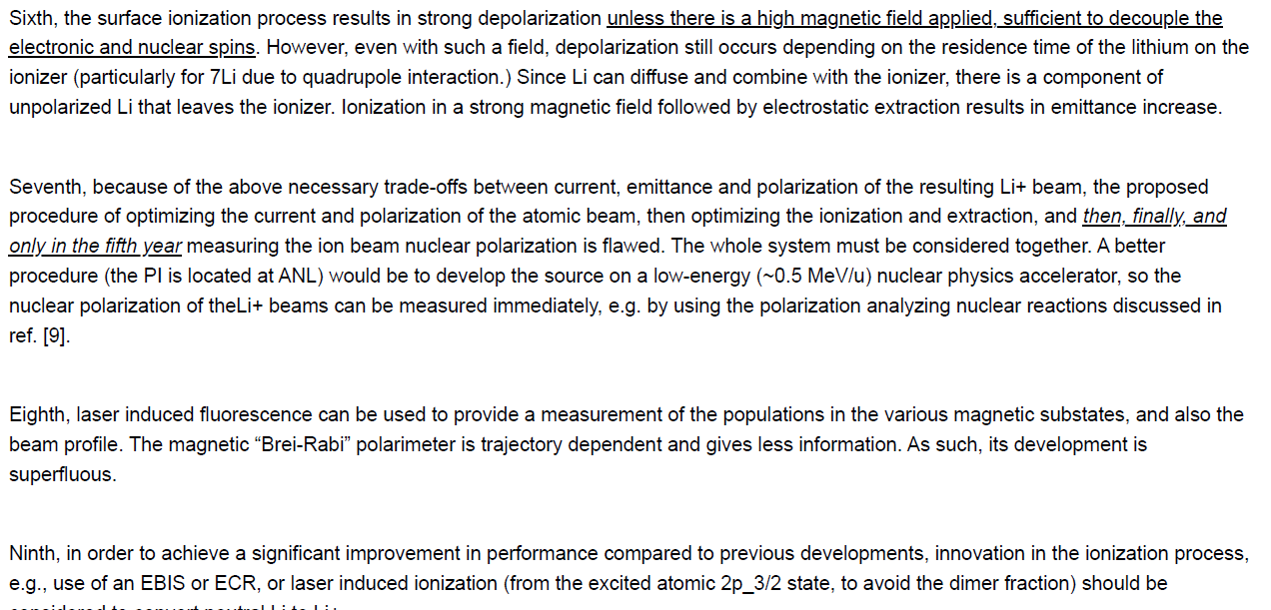
From Reviewers

Slide 20
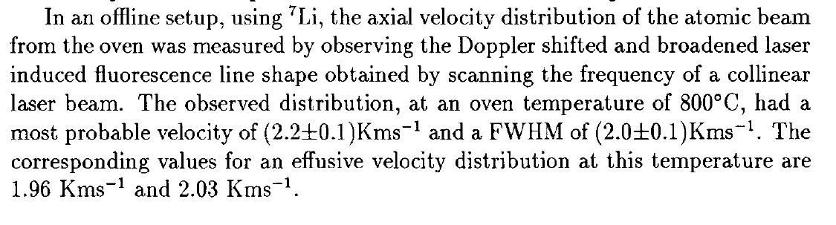
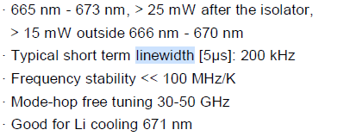
Doppler Broadening
150 kHz
E. G. Meyers, A. J. Mendez, B. G. Schmidt, et al., AIP Conference Proceedings 293, 214 (1993)
Toptica DL pro Laser Specs

Slide 21
Other Challenges
Within the scope of a 2-year proposal
Specifications
~uA, 10^13 – 10^14 atom/s (need a more careful estimate)
Emittance to EBIS (look into technical notes): 10 mm in diameter, transportation in 2~3 meters
Polarization > 90%

Slide 22
Work Plans

Slide 23
Resources
Needed
Special chamber for transverse cooling
Optics
Need to check the coating
One additional high power laser (500 mW) ~ 60k~80k
Get a quote from Toptica
Transverse cooling
Optical pumping
Existing 25 mW can be used for diagnostics

Slide 24
Timelines
Beam profile study (~1 year effort)
Laser diagnostics for divergence, speed, …
Laser beam in 90 and 45 degrees (need a chamber with the windows)
Coarse wavemeter for laser frequency control (17k), cavity (3~4k), single-frequency laser (existing one)
Setup from Peter
Design of the system (in parallel with beam profile study)
Transverse cooling region (modularized), magnetic gradient field for focusing (modularized, ~10 G/cm), optical pumping region, polarization measurement region
Magnet designs and building (engineering efforts)
Set up the laser and optics (~10k) for optical pumping
New oven designed with stainless steel, old oven would still work for the testing
Study of transverse cooling

Slide 25
Timelines
Based on profile study - requirement for transverse cooling
Building and installing transverse cooling
Modularized transverse cooling chamber to be inserted between optical pumping and oven
Modularized magnetic gradient field chamber for focusing
Polarization and polarimeter
Installing the optics for optical pumping and laser induced fluorescence
Polarize the lithium atom beam and measure the polarization

Slide 26
Deliverables and Milestones
2-year proposal
Deliverables
Polarized lithium-7 atom beam
With targeted intensity 10^12~10^13, and measurement with laser induced fluorescence
With divergence determined, and transverse cooling studied for the future beam profile tuning
With polarization Pz and Pzz > 90%, with laser induced fluorescence measurement
Guide field: ~10 Gaus, solenoid
Next-gen oven baseline design (for sustainable running)
Transport simulation towards the injection to EBIS

Slide 27
Deliverables and Milestones
2-year proposal
Risks and mitigations
Transverse cooling
Traditional approach: magnetic lensing
Milestones

Slide 28
Budget for NOFO (Draft)
Personnel per year
PI (Chao Peng): 0.3 FTE (adjustable)
Postdoc: 1.0 FTE
Engineering support (Thomas O’Connor): 0.2 FTE (adjustable)
May need some adjustment to include equipment cost
UKY (travel and efforts, $20~30k/year)

Slide 29
Budget for NOFO (Draft)
Equipment – $145k (2 years)
High power (500 mW) laser: $80k
Wavemeter: $17k
Cavity: $5k
Optics: $10k
Chambers cost (transverse cooling): $28k = $4k chamber + $10k mirrors + $8k windows + $6k optical mechanics
Magnets: $5k

Slide 30
Budget for NOFO (Draft)
Material & Supplies - $20~30k (2 years)
Vacuum components (chambers, valves, windows, flanges, gaskets)
Electro-optic modulators (EOMs), acousto-optic modulators (AOMs)
Lithium supplies
Optical components
Travel - $11k/year
4 domestic trips per year
To BNL/SBU, and meeting with collaborators

Slide 31
Important points
Emphasize the modularity
Oven
Transverse Cooling (insertable)
Transverse Focusing (optional, insertable)
Laser diagnostics for beam profile (insertable)
Optical pumping
Polarimetry

Slide 32
Work Plans (Before the NOFO Decision)
Laser diagnostics (laser + optics)
Frequency scan to get profile (camera + window)
Velocity distribution needs information regarding resonance de-tuning
Doppler broadening ~10 MHz (need wavemeter)
Technical details (talk to Peter)
MEP postdoc could work on this
Might need EOMs/AOMs (need cost estimates)
Optical pumping
Magnets design
Nozzles (once the basic laser diagnostics ready)
Test different nozzles

Slide 33
Work Plans (If Not Getting the NOFO)
Laser splitting for polarization and polarimetry
Optical pumping
Laser induced fluorescence
Will know if the laser power limits the polarization after the work
Might need a booster

Slide 34
Work Plans (If Not Getting the NOFO)
Milestones
Measure the beam intensity distribution – 6 months + 3 months (if no wavemeter)
Might encounter power limits on the profile measurement (needs increase the laser power)
With divergence determined, and transverse cooling studied for the future beam profile tuning: because of no laser and chamber (cost more than 100k)
Beam profiling with wire-scan
Could study with the traditional method: magnetic lensing
Polarization and Polarimeter

