Slide 1
SmartGuide: A smart campus guide using BLE based indoor localization
Rida Mahmood (2016-CE-54)
Tooba Naseer (2016-CE-72)
Rabeya Hamood (2016-CE-81)
Ayesha Jabbar (2016-CS-159)

Slide 2
Demonstartion Presentation
Supervisor
Dr. Sheikh Faisal Rasheed
Co-Advisor
Dr. Beenish Ayesha Akram
Computer Science and Engineering Department, UET Lahore.

Slide 3
Introduction
Overview
Predict room level location using BLE beacons.
RSSI fingerprinting technique.
Information of current and its nearby locations on user’s mobile app.
To provide guided tour of the indoor building (CSE Dept of UET).

Slide 4
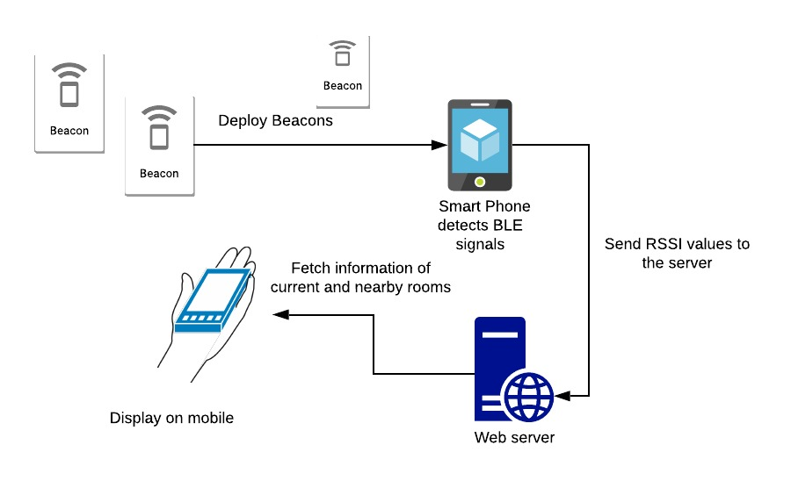
Introduction(Contd.)

Slide 5
Problem Statement
Whenever a visitor goes to university campus or visits a new place, he does not know about the specifications of that area i.e. what happens in that specific room or what courses have been taught in a particular and its nearby labs. So, we are developing a system which assists them in determining the textual and pictorial information of a particular area and its nearby locations. For this purpose, we first find the indoor location of a user by using BLE beacons and FP values, and then provide information to him automatically on his android application.

Slide 6

Goal
Our goal is to provide ease and guidance to users regarding current and nearby locations automatically via installed application on device by estimating his indoor location. The guidance involves the textual and pictorial information.

Slide 7
Scope of the Project
Data(FP) collection
Trained model using Machine Learning Algorithms
Smart Guided Tour
Android Application
Indoor location is CSE Department, UET Lhr.

Slide 8
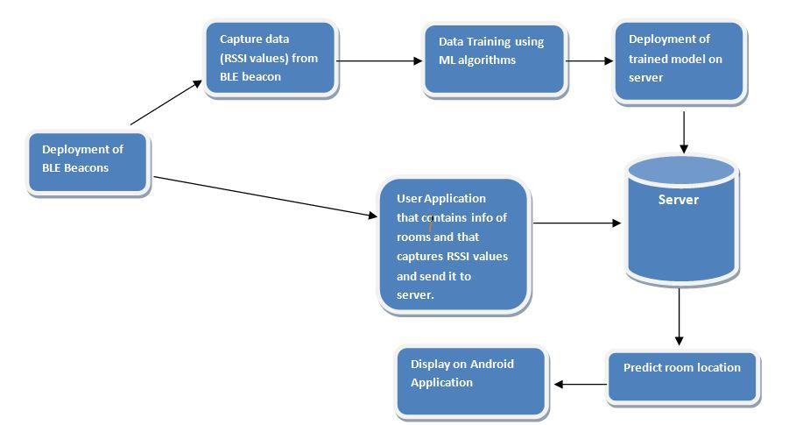
Proposed System

Slide 9
Completed Modules
Dummy application
Collect information of experimental area
Data Capturing application
Frontend of Admin and User Android application
Admin Backend(60%)
Data(FP) collection
Prepare dataset on MATLAB
Train model

Slide 10
Dummy Application
Firstly, we gather sample datasets from Internet and choose Flower dataset.
Apply Logistic regression algorithm for the training of dataset.
Develop an Android application to get predictions from the trained model.

Slide 11
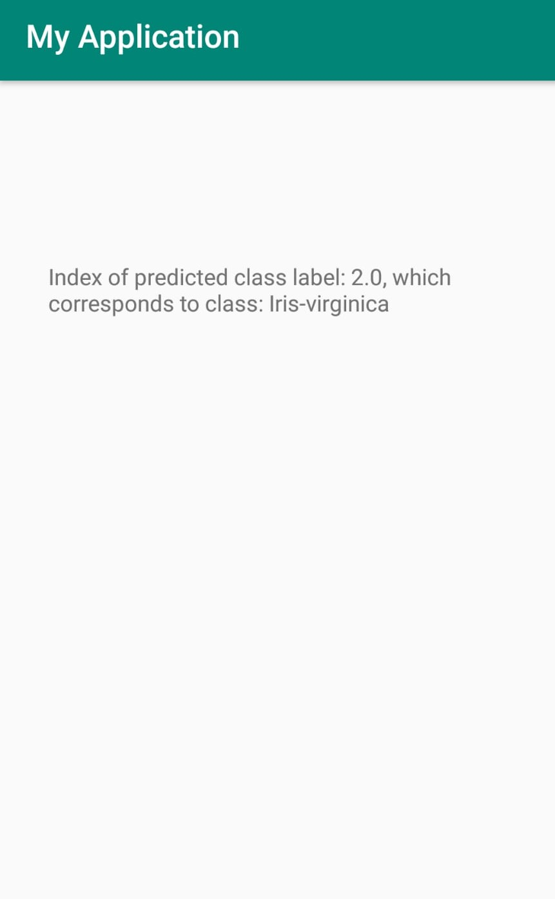

Slide 12
Collect Information of Experimental Area
Our experimental area is CSE Department, UET Lahore.
We collect information of all rooms and save them in audios, pictorial and textual formats.

Slide 13
Data Capturing application
Develop data capturing application for the collection of BLE beacons fingerprints.
This app scans the RSSI values of nearby BLE devices based on following parameters:
Number of iterations
Delay between iterations
Room number

Slide 14
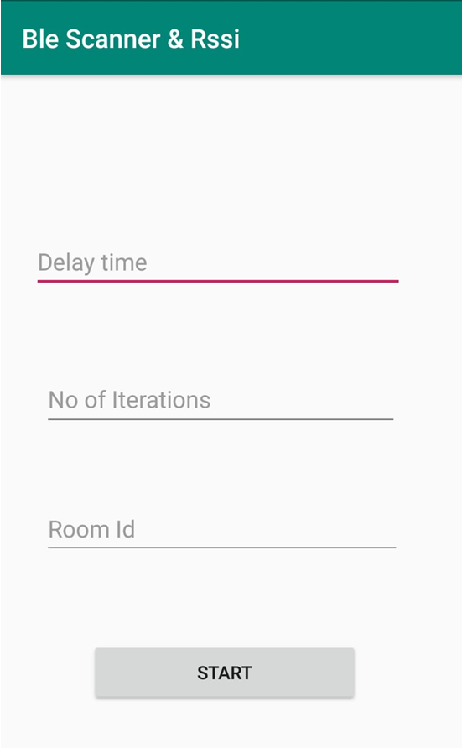
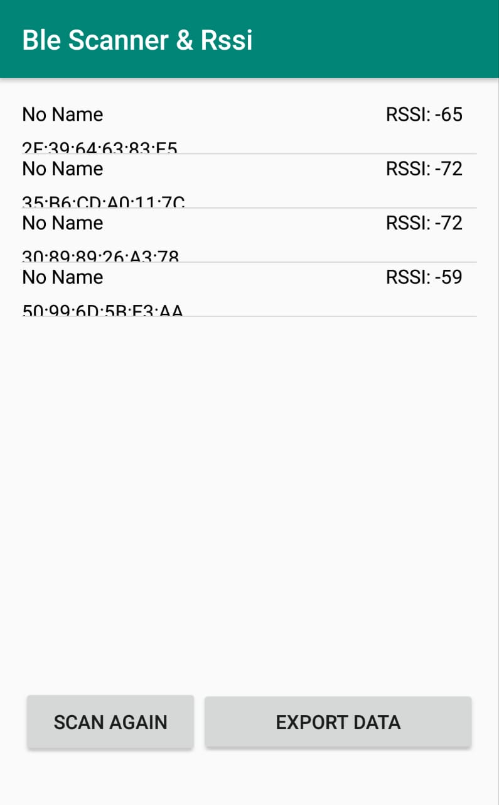
Data Capturing application

Slide 15
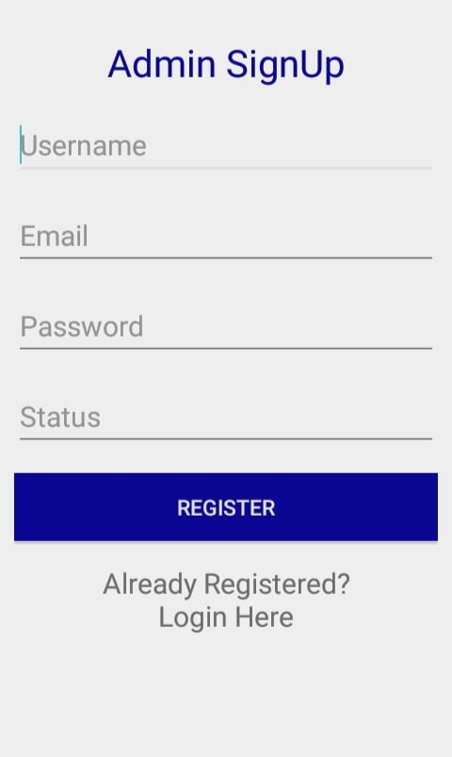
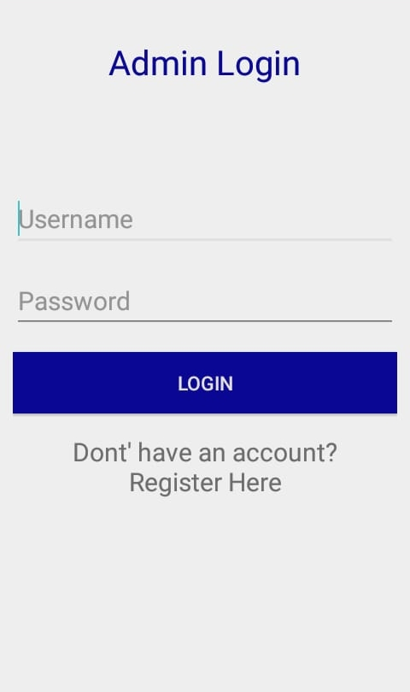
Admin Frontend

Slide 16
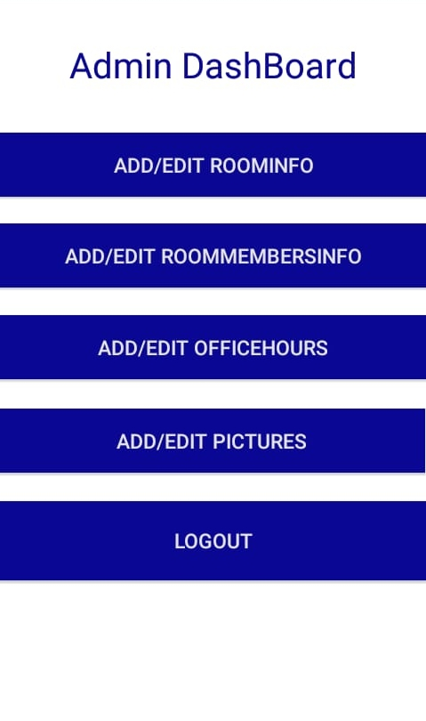
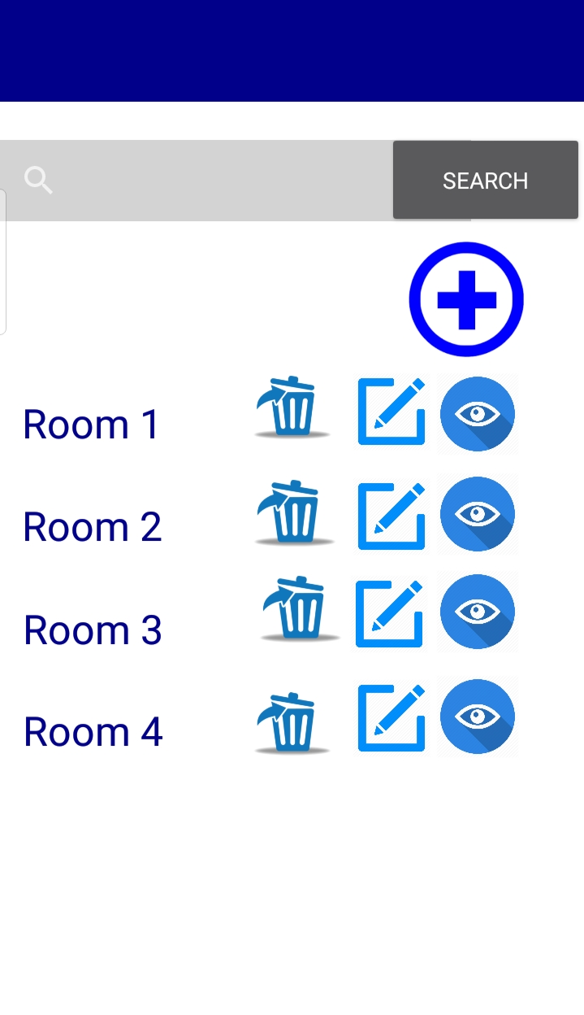
Admin Frontend

Slide 17
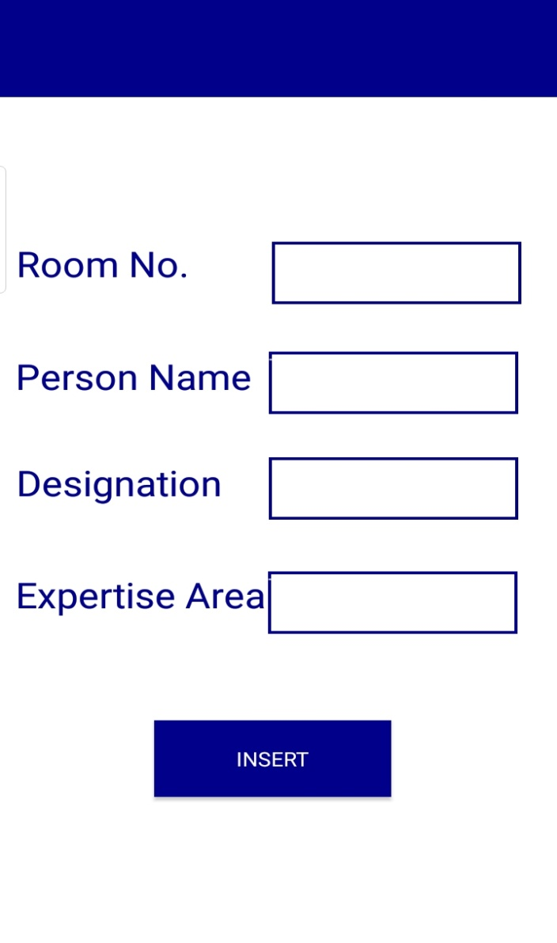
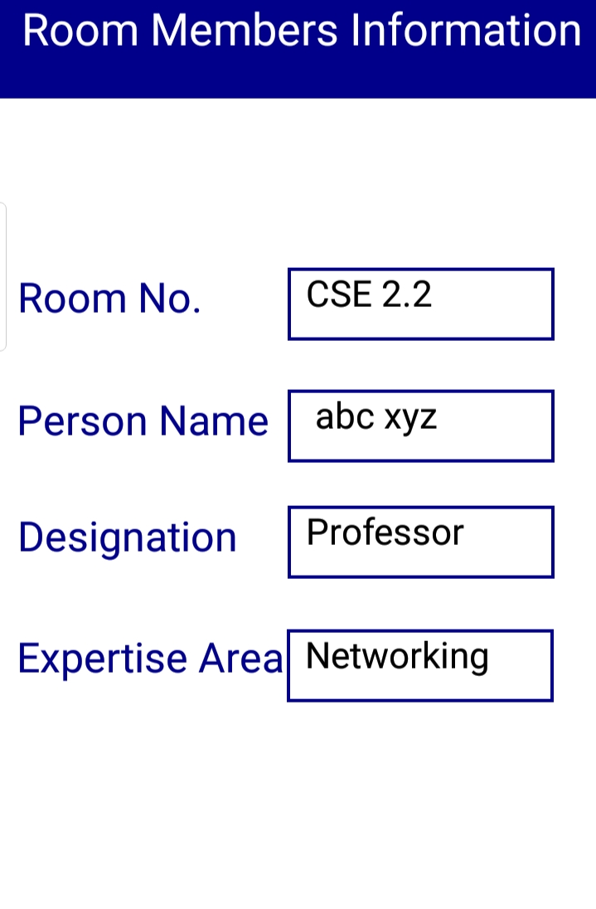
Admin Frontend

Slide 18
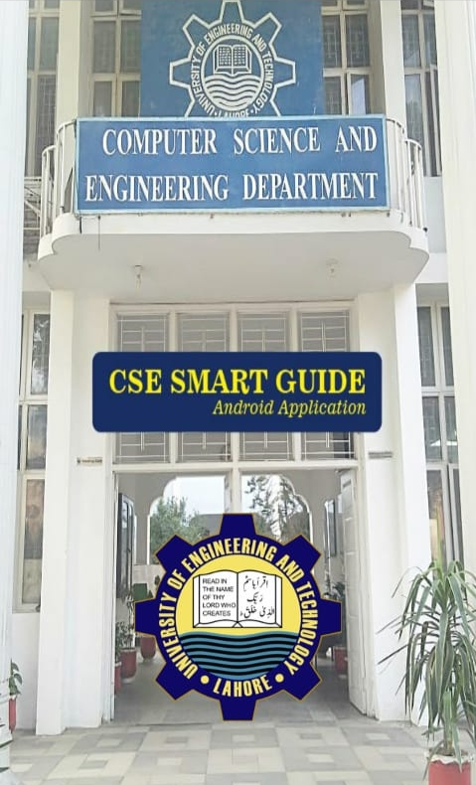
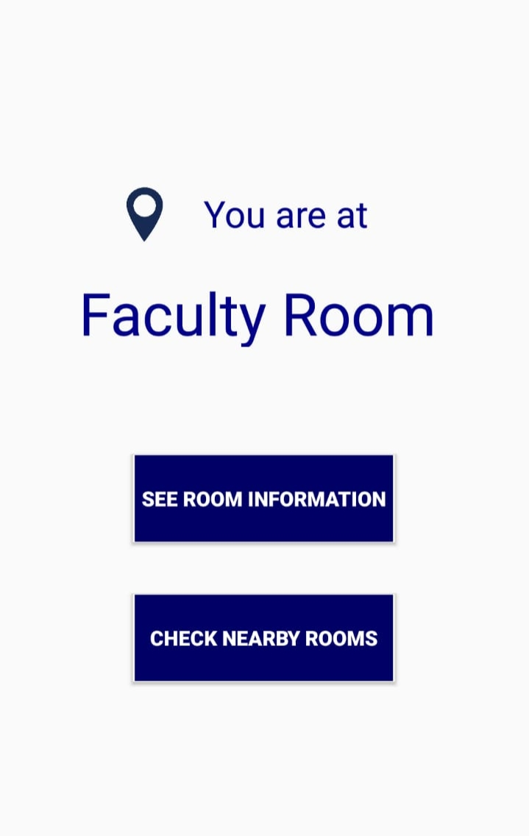
User Frontend

Slide 19
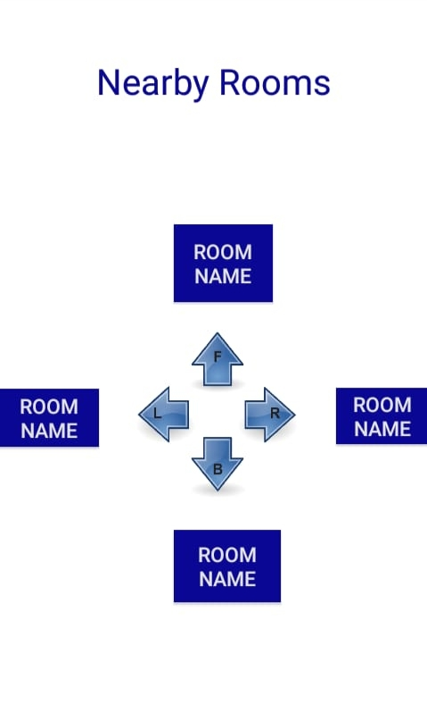
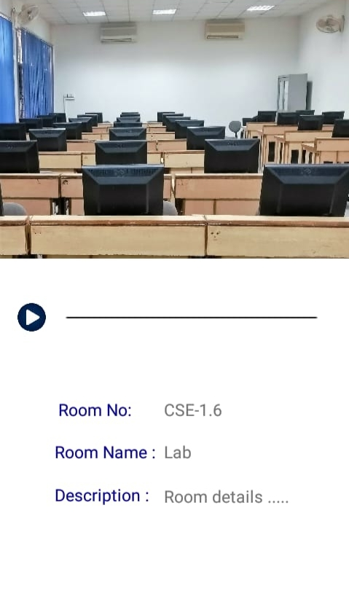
User Frontend

Slide 20
Admin Backend
Completed Functionalities(60%)
SignUp/ Login
Admin can upload audios and pictures of rooms in database(MySQL)
Admin can add room information, office hours and staff information in database
Data updating and deleting(In process)

Slide 21
Data(FP) Collection
Deploy 2 beacons in CSE 1.6 (partitioning it into 2 rooms) to capture data.
Collect 25 samples of 2 BLE beacons

Slide 22
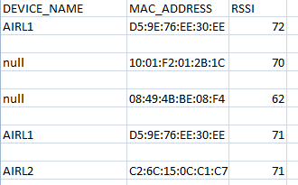

Samples

Slide 23
Prepare Dataset
Discard RSSI values of BLE devices other than beacons.
Merge all csv files containing samples of different locations and time into one csv file.

Slide 24
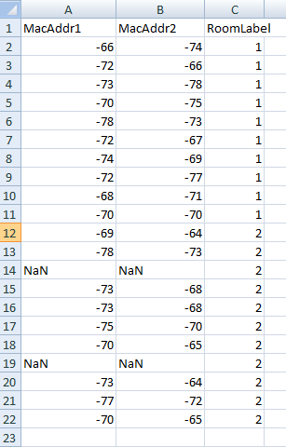
Prepared Dataset

Slide 25
Model Training(In process)
Model training using python libraries in Anaconda by applying knn and logistic regression algorithms.

Slide 26
Timeline Of our Project

Slide 27
Thank You!

