Slide 1
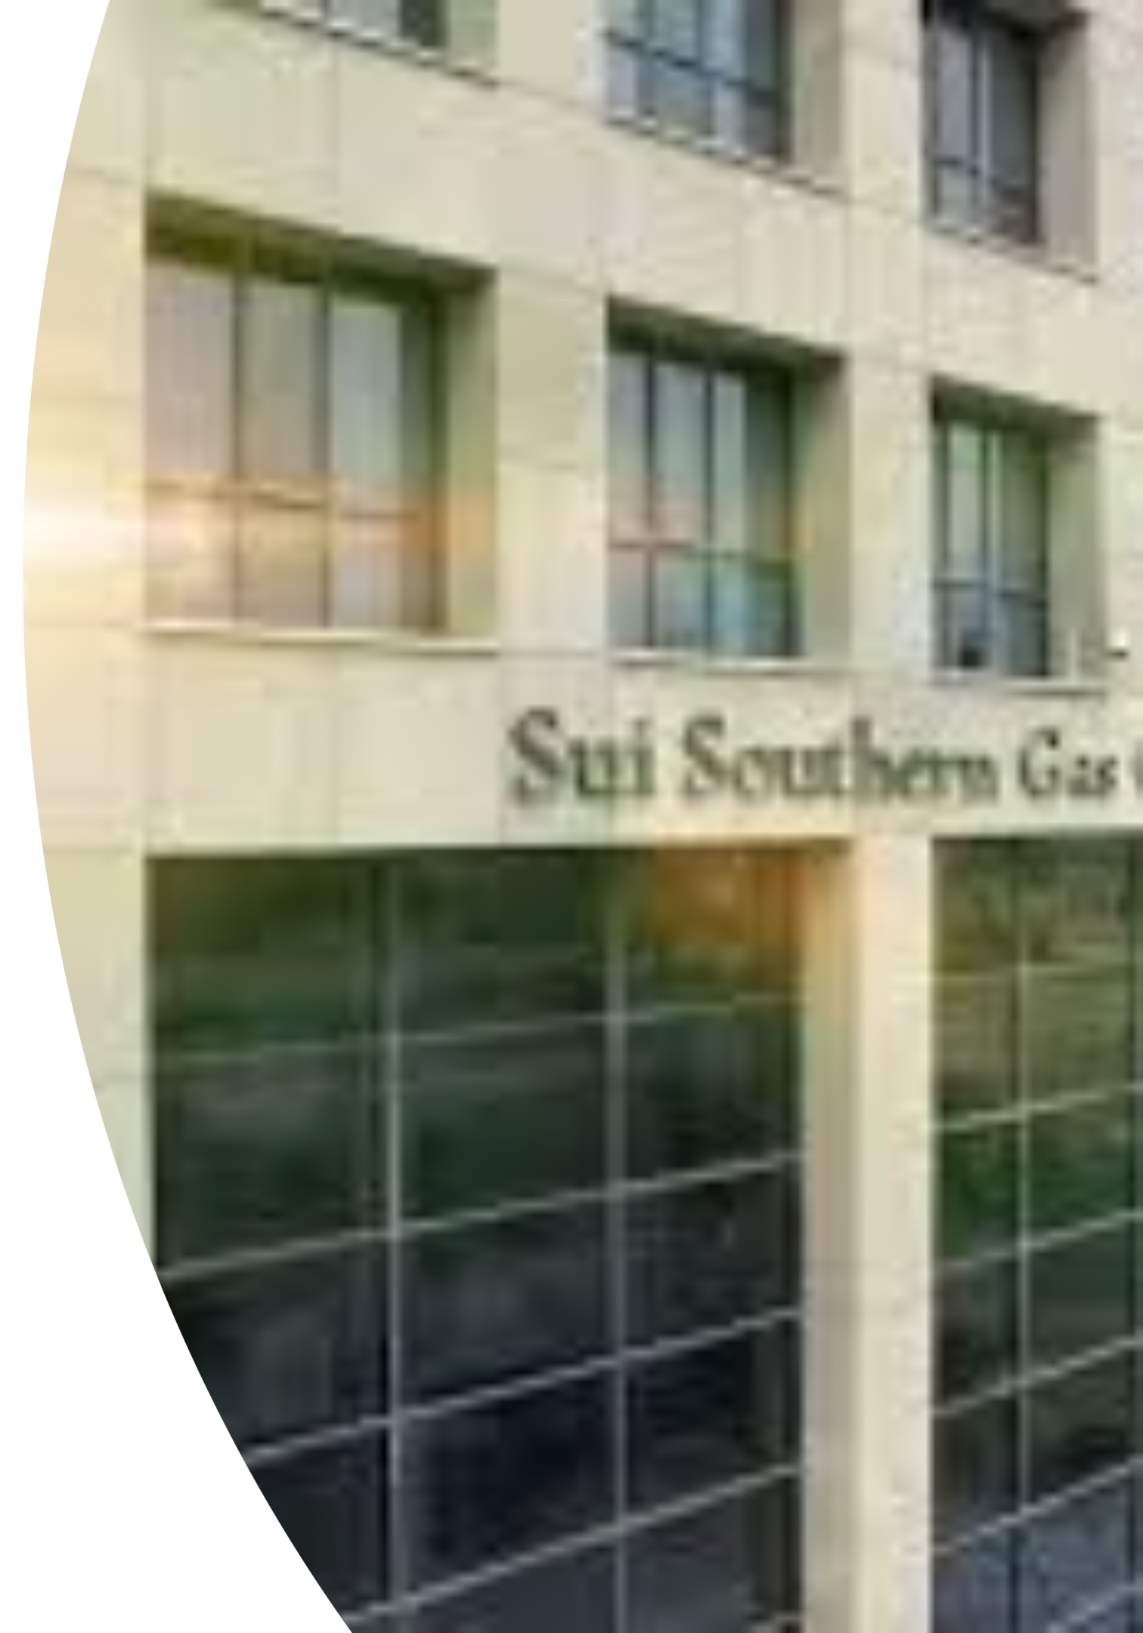
Technology Strategy Report
AI-Powered Forecasting & Automation for SSGC
Transforming Pakistan's largest gas utility through intelligent automation and predictive analytics

Slide 2

Company Overview
Sui Southern Gas Company (SSGC) is Pakistan's largest state-owned utility, responsible for natural gas transmission and distribution across Sindh and Balochistan. Despite advanced SCADA monitoring capabilities, critical operations still rely on manual data collection, introducing inefficiencies and delays.
2
Core Challenge: Converting operational data into actionable insights through AI-powered forecasting and automation.
Provinces Served
Sindh & Balochistan
3
Key Sectors
Residential, Commercial, Industrial

Slide 3


Current State Analysis
Strengths
SCADA-based real-time monitoring
Sole gas provider with stable revenue
Experienced technical workforce
Government backing and support
Weaknesses
Manual data collection processes
No predictive analytics capability
Dependence on senior staff
Limited AI/analytics expertise

Slide 4
Strategic Opportunities & Threats
Opportunities
Threats
IoT Integration
Cybersecurity Risks
Automate data collection across network
Exposure to hacking and data breaches
Predictive Tools
Optimize supply chain performance
Employee Resistance
Unfamiliarity with automation
Digital Dashboards
Real-time monitoring and alerts
Vendor Dependency
Workforce Upskilling
Reliance on third-party maintenance
Training in analytics and automation
Transition Challenges
Data loss or compatibility issues

Slide 5
Proposed Technology Solution
Hybrid Automation & AI-Based Forecasting System
Gas Flow Forecasting
Inventory Planning
Predict inflow/outflow patterns using historical SCADA data and machine learning models
Optimize gas supply scheduling based on demand predictions and seasonal trends
Predictive Maintenance
Automated Dashboards
Minimize equipment failures through AI-driven maintenance scheduling algorithms
Real-time SCADA integration with automated reporting and Excel generation

Slide 6

Strategic Impact
Operational Efficiency
Automation reduces manual workload and improves real-time visibility across the network
Cost Reduction
Predictive maintenance minimizes breakdowns and optimizes repair schedules
Data-Driven Decisions
Forecasting enables proactive planning and faster response to anomalies
Service Reliability
Accurate demand prediction ensures consistent gas supply to all sectors

Slide 7
Implementation Roadmap
Short-Term (0–6 Months)
1
Digitize manual data-entry processes
Conduct AI and analytics training workshops
2
Mid-Term (6–18 Months)
Build initial dashboards with real-time metrics
Fully integrate AI forecasting into SCADA
Begin pilot forecasting models
Deploy predictive maintenance engine
Implement smart alerts for anomalies
Long-Term (18–36 Months)
3
Launch automated reporting system
Expand forecasting to seasonal trends
Integrate IoT sensors for remote monitoring
Automate field operations via mobile capture
Achieve fully self-adjusting hybrid system

Slide 8
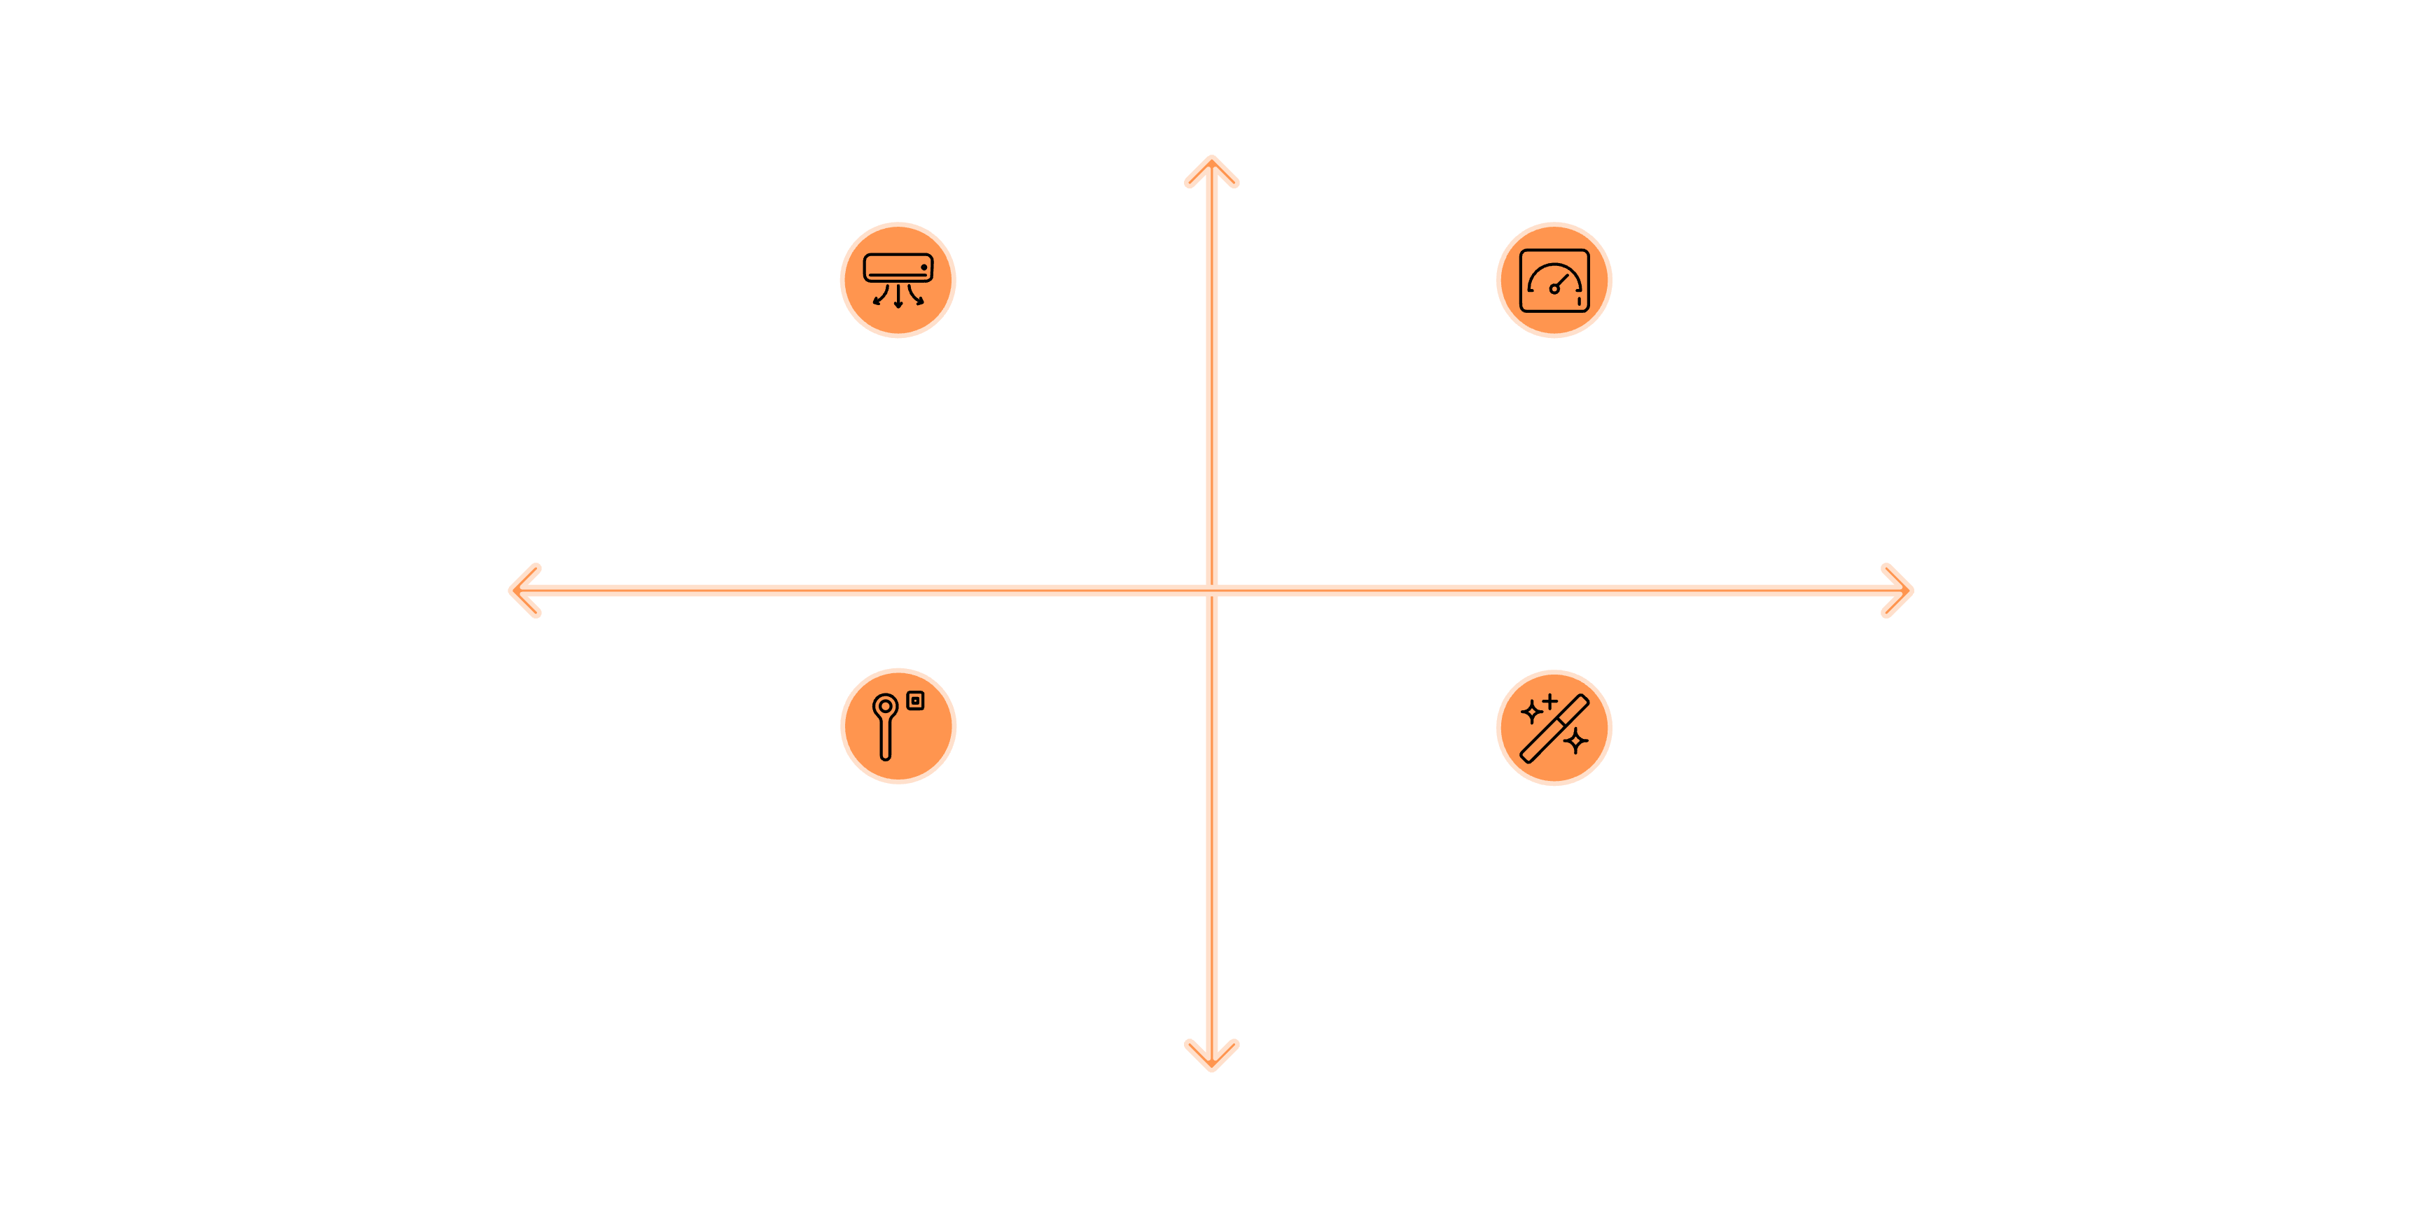
Technology Portfolio & Maturity
High Importance
AI Forecasting Models
Automated Dashboards
Low Maturity
High Maturity
Predictive Maintenance
Emerging Capabilities
Low Importance

Slide 9
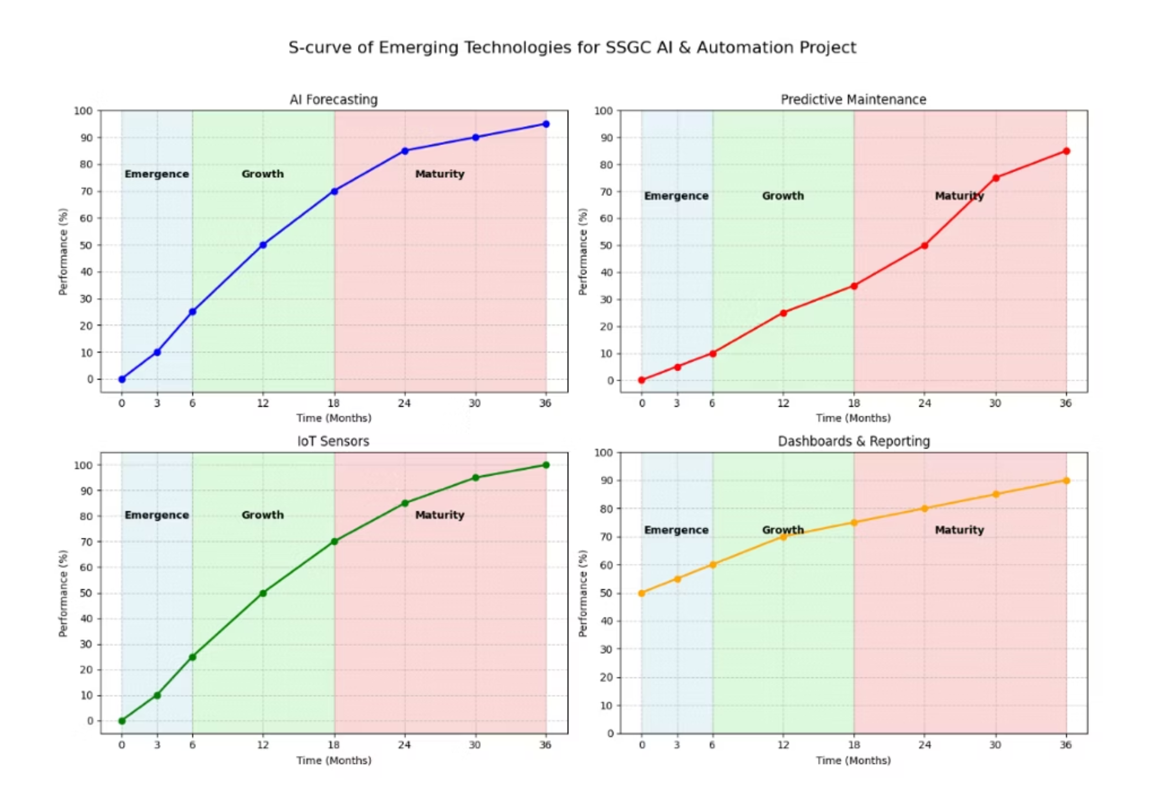
Technology S-Curve Analysis

Slide 10


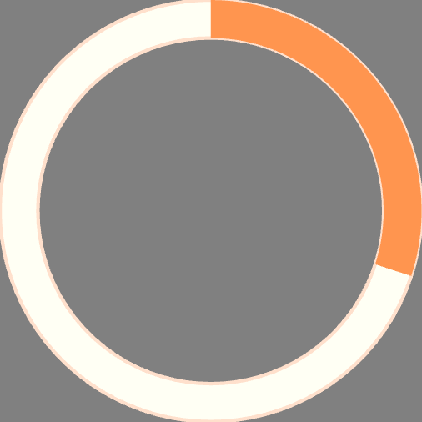

Expected Outcomes & KPIs
60%
85%
Reduction in Manual Work
Forecasting Accuracy
Decreased data entry workload
Improved prediction reliability
30%
95%
Fewer Failures
System Uptime
Reduction in unplanned maintenance
Increased network reliability
Financial Impact
Service Quality
Digital Adoption
10–15% reduction in operational costs and 20% decrease in resource wastage
50–70% faster reporting and 40–50% quicker fault response times
80% staff trained on AI tools with 70%+ organizational adoption rate

Slide 11

Risk Management & Ethics
Cybersecurity
Implement robust security protocols to protect AI-driven systems from threats and breaches
Workforce Transition
Focus on upskilling rather than replacement; address resistance through training and transparency
Data Integrity
Ensure accuracy in predictive algorithms and maintain strict confidentiality of operational data
IP Protection
Secure proprietary AI algorithms, dashboards, and maintain data ownership agreements with vendors

Slide 12
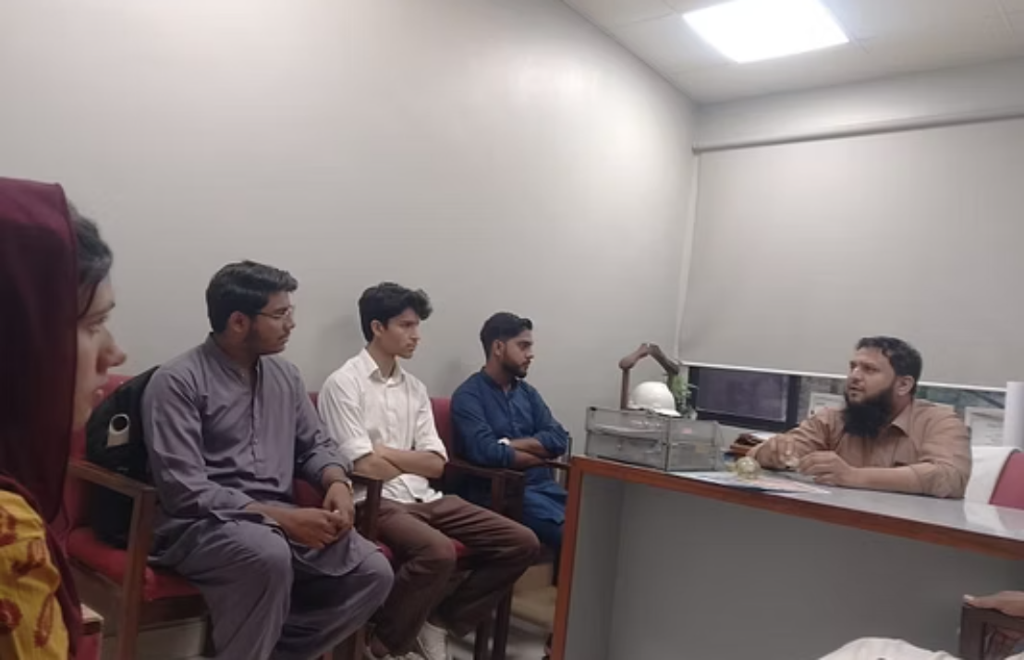
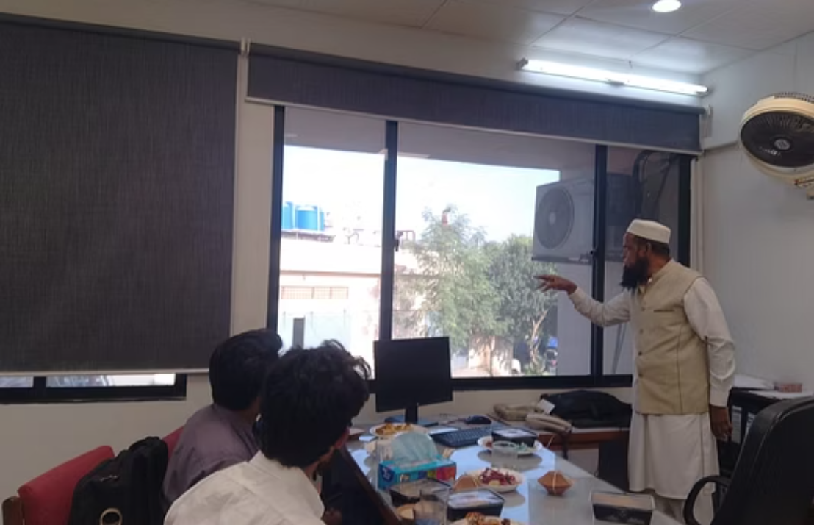
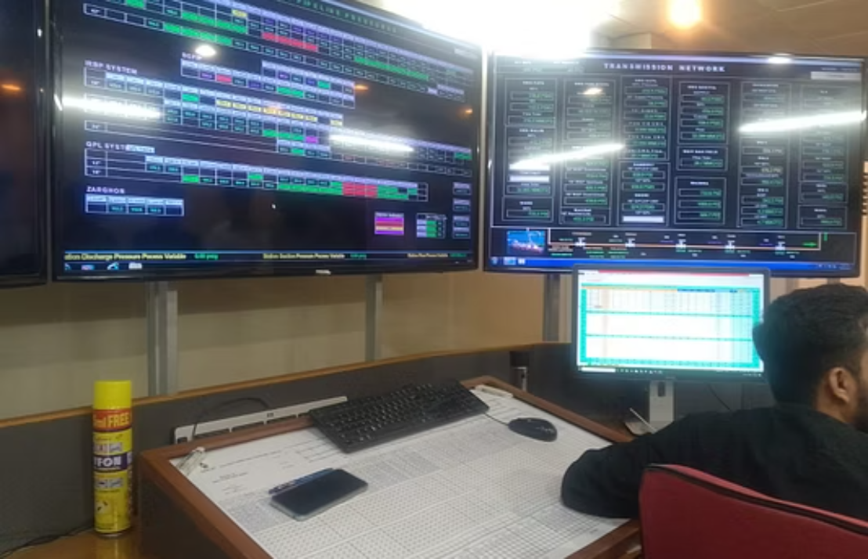
SSGC Site Visit & Stakeholder Meeting
As part of our initial engagement phase, a comprehensive site visit was conducted at SSGC facilities. This visit facilitated direct collaboration with key personnel, allowing our team to gain deeper insights into existing operational workflows and infrastructure.
These crucial stakeholder engagement and requirements gathering sessions were instrumental in validating our preliminary assessments and ensuring precise alignment on the strategic objectives for the upcoming AI-powered forecasting and automation initiative.

