Slide 1
Arduino Based Home Energy Measurement https://github.com/Tooblippe/Energy_Logger
tobie.nortje@navitas.co.za

Slide 2
Background
This is my attempt to build a small home based energy logger.
It is not unique but has an RF12 on board so it can integrate with other systems, and it logs data to an OpenLog unit
This makes changing SD cards and logging a breeze
It is based on OpenEnergyMonitor
Many of these projects have been done all around the world
I think what makes this one unique is the fact that the sensor unit (the arduino with the CT) has a RF12 radio built in and also an Openlog unit from Sparkfun
The OpenLog unit is connected to the UART of the sensor unit. Full control off the Openlog can be obtained via the remote unit connected via RF12 radio
This means that the sensor unit can keep on logging to the Openlog. You can remotely initiate a session with the Openlog from the base station, and make changes to the settings, before putting it back in logging mode

Slide 3
Some facts
Small home built energy logger
Based on Atmel ATMega 328 chip and arduino compatible
Based on the OpenEnergyMonitor project
Measure current only, Voltage assumed constant
RF12 radio installed, this makes the system very expandable
OpenLog from sparkfun installed
Voltage assumed constant and only RMS current measured using Emon.cc library from the OpenEnergyLogger project

Slide 4
Device Setup
Plot LifeGraph
PC
Python Script
Log CSV Power Data to file
CT
Log to Pachube
Arduino
Remote Unit
Arduino
Sensor Unit
RF12 Radio
Sends commands
Receive power data
RF Link
RF12 Radio
Send power info
Receive Commands
OpenLog
Logs power info
Can be remote controlled

Slide 5
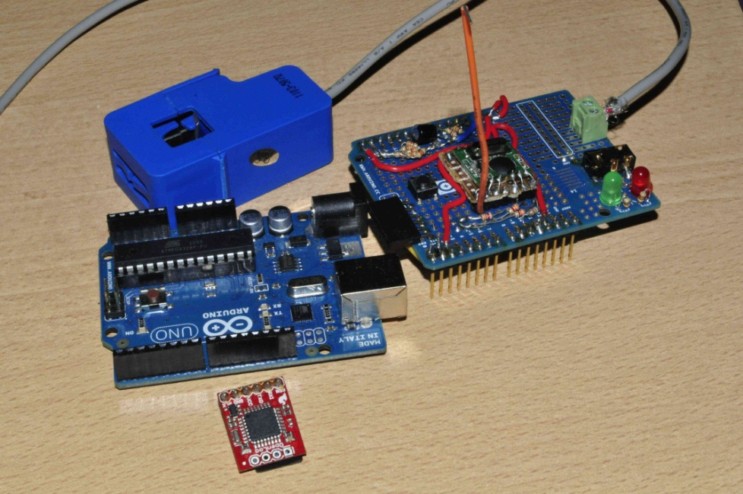
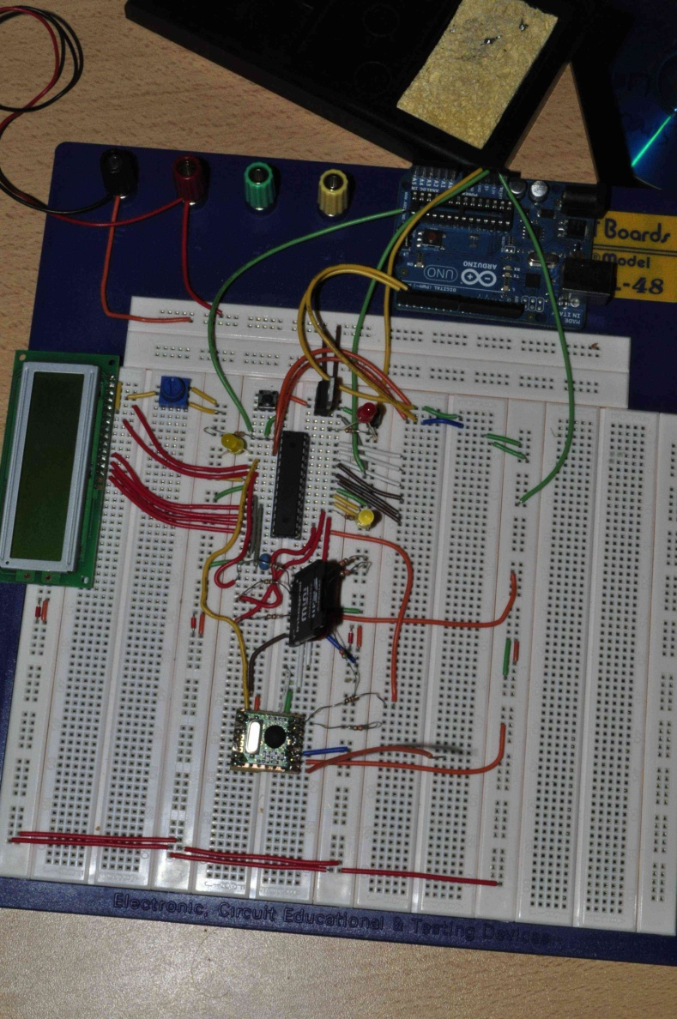
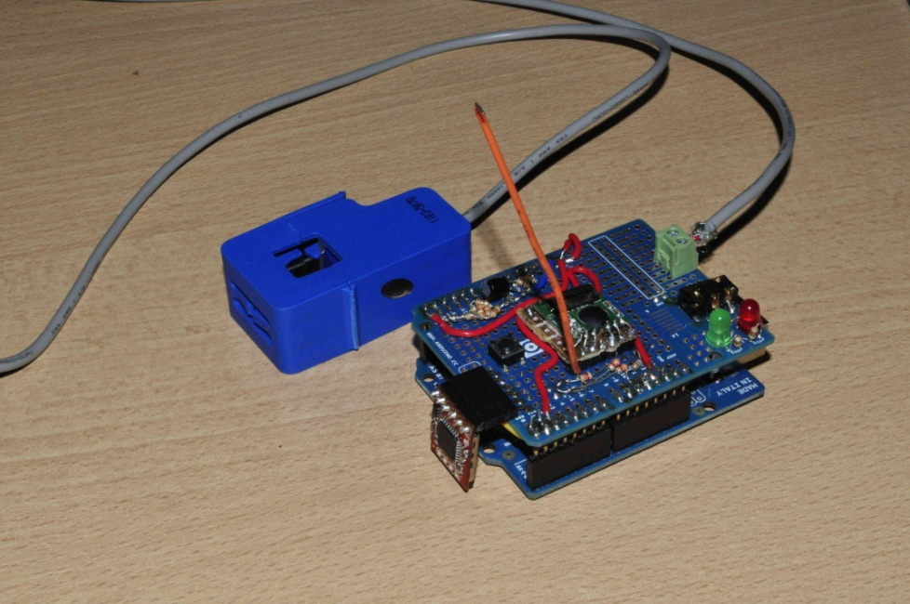
Some photos
CT
arduino
Radio and CT shield
OpenLog
arduino
SD Card
RF12
Remote Unit– rx info, logging
Sensor Unit – CT and logging

Slide 6
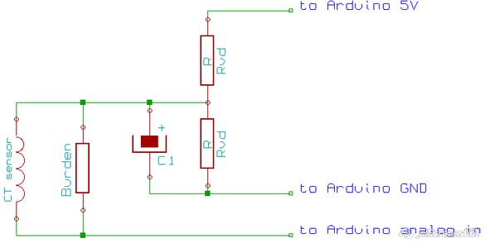
Connecting the CT
Use bias resistor s to bias CT voltage around 2.5V, since the controller cannot read the negative portion of the current wave
We would have to filter out this DC voltage later on with a digital high pass filter – refer to code in emon.cc
The CT sensor produces a current that is proportional to the instantaneous current flowing in the mains wire by:
Isens = CTturnsRatio x Iinst
The resistor in parallel with the CT sensor is called a burden resistor and converts the current Isens into a voltage:
VsensI = Burden Resistance x Isens
The two Rvd resistors from a voltage divider that outputs a voltage at half the Arduino supply voltage of 5V. This voltage biases the AC voltage produced by the CT sensor and burden resistor by 2.5V, needed because the Arduino analog input channel requires a positive voltage.
Voltage at analog input = Bias Voltage + VsensI
The capacitor C1 stabilizes the DC bias as this can often be a source of considerable noise.
Suitable sizes for resistors Rvd are 10 to 100k. Higher resistance lowers energy consumption but also increases noise.
A suitable value for C1 is 10uF.
Source - http://openenergymonitor.org/emon/node/59

Slide 7
Measuring Power
variable deceleration and setup
void loop()
{
for n=0 to numberOfSamples
{
read in voltage and current sample
remove voltage and current sample offset with digital high pass filter
correct current phase displacement with linear interpolation caused by: ADC multiplexing,
inherent CT and power adapter phase displacements.
accumulate squares of voltage and current for rms calculation
accumulate product of voltage and current for real power calculation
}
calculate values for real power, apparent power, power factor, rms voltage, rms current from accumulators
apply voltage and current calibration coefficients.
print values to USB serial
reset accumulators.
}
http://openenergymonitor.org/emon/

Slide 8
Measurement of home hot water energy
Tobie.nortje@navitas.co.za

Slide 9
Specific Day measurement
Baby Bath
Dad – Shower,Mom - Bath
Daddy Bath
Mom, shower
Dishes
Dishes
Dishes
Get some more logged data at https://github.com/Tooblippe/Energy_Logger/tree/master/loggeddata

Slide 10
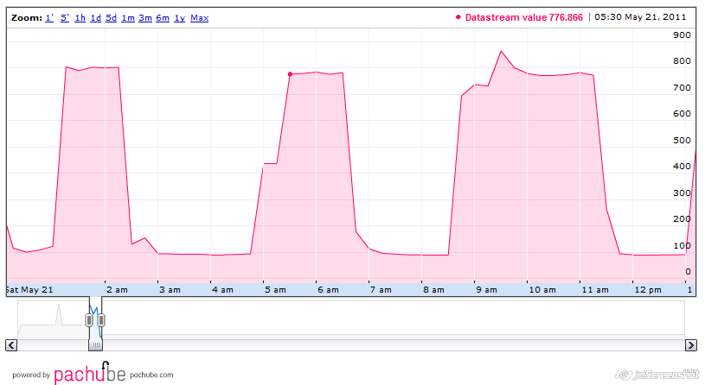
Logging data to Pachube with Python
Log your realtime data to the cloud using Pachube and Python
Dowload eeml - https://github.com/petervizi/python-eeml/tree/207ef35b9c0dd64851249b83d91b5e0506c5ebbd
CODE Example
import eeml import serial # parameters API_KEY = 'YOUR PERSONAL API KEY' API_URL = 'YOUR PERSONAL API URL, LIKE /api/1275.xml' serial = serial.Serial('/dev/ttyUSB0', 9600) readings = serial.readline().strip().split(' ') # the readings are separated by spaces pac = eeml.Pachube(API_URL, API_KEY) pac.update([eeml.Data(0, readings[0], unit=eeml.Celsius()), eeml.Data(1, readings[1], unit=eeml.RH())]) pac.put()

Slide 11
Project Info
GIT -https://github.com/Tooblippe/Energy_Logger
GIT Wiki - https://github.com/Tooblippe/Energy_Logger#readme
Sparkfun – www.sparkfun.com
Arduino – www.arduino.cc
OpenEnergyMonitor - http://openenergymonitor.org/emon/
My RF12 data hub - https://github.com/Tooblippe/Energy_Logger/wiki/The-RF12-Radio
RF12 Radio on its carrier - http://www.flickr.com/photos/tooblippe/5665521708/

Slide 12
More about me
www.navitas.co.za/tobienortje

Slide 13
Project licence
Free as in really free... give us a mention and we are happy, but you don't have to.

Slide 14
OpenEnergyMonitor info
OpenEnergyMonitor is copyright © 2009,2010,2011 the OpenEnergyMonitor researchers (see developers), and other contributors.
Principal author:
Trystan Lea
Ogoronwy, Llanfrothen, Gwynedd, North Wales, UK, LL48 6DJ
e-mail - trystan.lea@googlemail.com
OpenEnergyMonitor is free; you can redistribute it and/or modify it under the terms of the GNU General Public Licence as published by the Free Software Foundation; either Version 3 of the Licence, or (at your option) any later version.
OpenEnergyMonitor is distributed in the hope that it will be useful, but WITHOUT ANY WARRANTY; without even the implied warranty of MERCHANTABILITY or FITNESS FOR A PARTICULAR PURPOSE. See the GNU General Public Licence for more details.
For this purpose the words "software" and "library" in the GNU General Public Licence are taken to mean any and all computer programs computer files images data results documents and all other copyright information available from the OpenEnergyMonitor project.
The copyright covers the neologism "OpenEnergyMonitor" in upper, lower, or any mix of cases in any typeface, also covered by the GPL. Anyone can use them freely in any way they choose, but they may not be registered as trademarks or restricted in any other way.
You can read the GNU General Public Licence here. This page you are reading now introduces the licence for the entire OpenEnergyMonitor project; that licence applies to all of it; if the links to the licence do not work, write to the Free Software Foundation, Inc., 51 Franklin Street, 5th Floor, Boston, MA 02110 , or see
http://www.gnu.org/copyleft/gpl.html
Hardware designs (schematics and CAD) files are licensed under the Creative Commons Attribution-ShareAlike 3.0 Unported License and follow the terms of the OSHW (Open-source hardware) Statement of Principles 1.0.
All documentation on OpenEnergyMonitor is subject to GNU Free Documentation License
Overview of open-source licenses by Adafruit http://www.adafruit.com/blog/2009/03/28/open-source-hardware-overview-slides/

