Slide 1
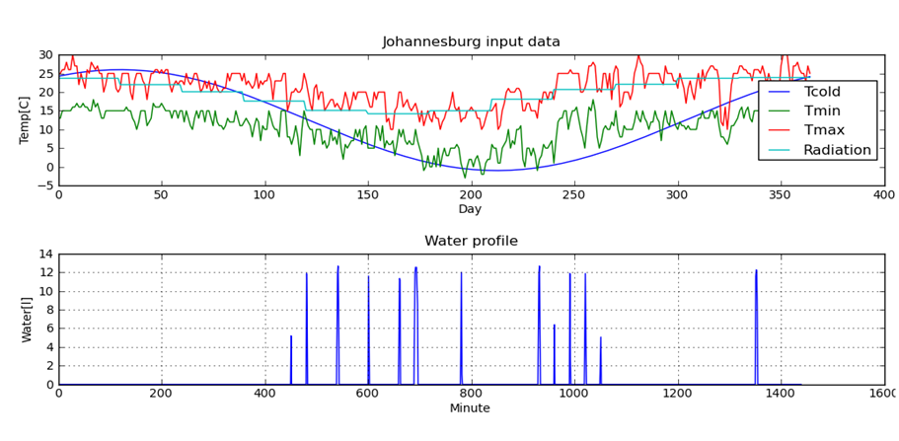
Thermodynamic Model Development Solving 1minutely model over 365 days
- Q_{tanklosses}
+Q_{geyser}
Storage
tank
Q_{stored}
+Q_{in}
+Q_{swh}
+Q_{heatpump}
- Q_{pipelosses}
- Q_{out}

