Slide 1
Case Studies
A selection of tailored solutions

Slide 2
About me
A selection of tailored solutions

Slide 3
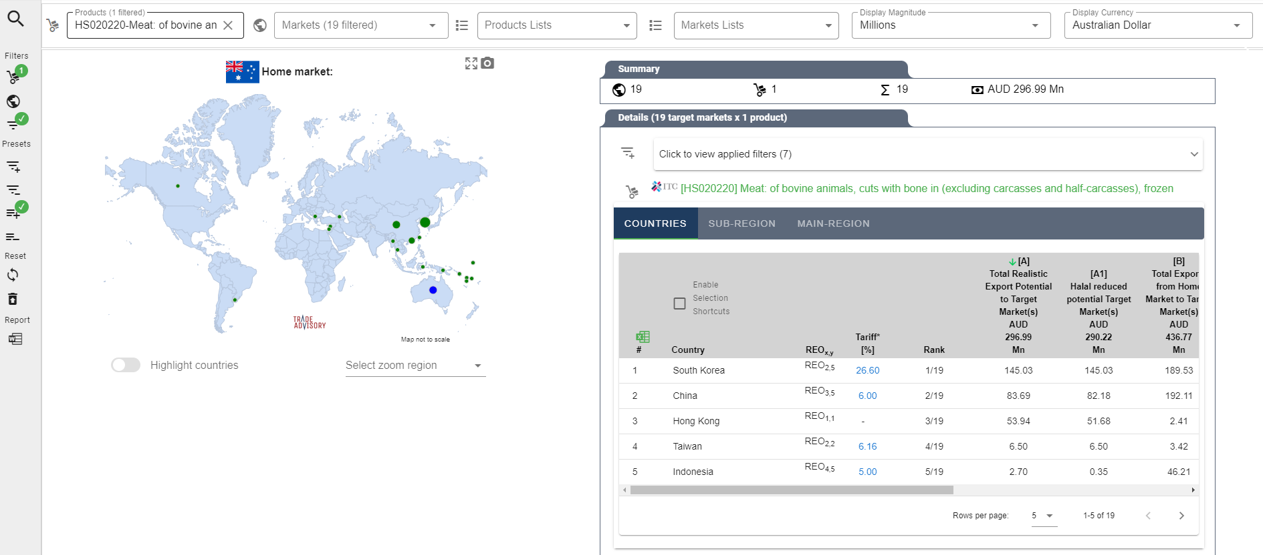
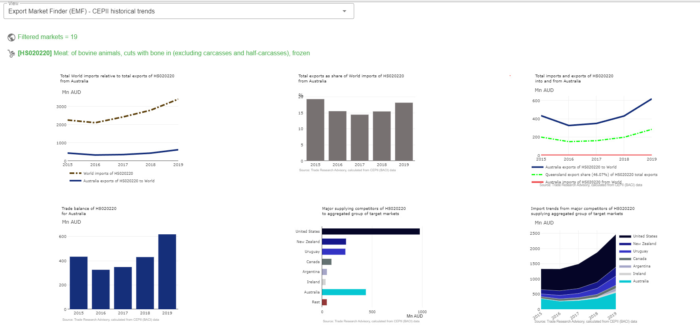
Case Study | International trade application

Slide 4
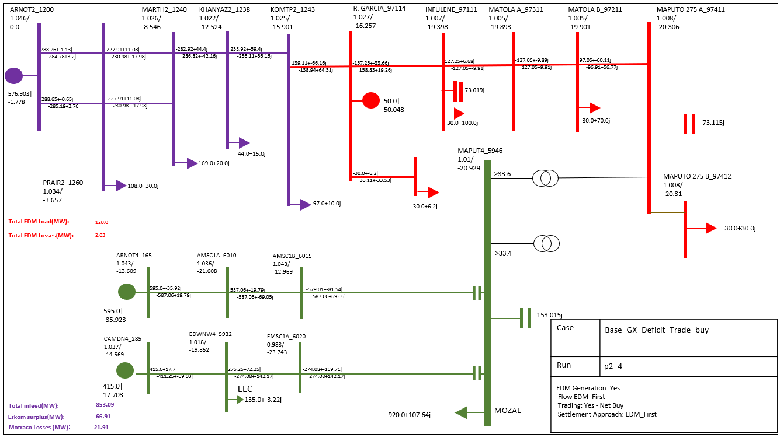
Case Study | Tailored electrical engineering

Slide 5
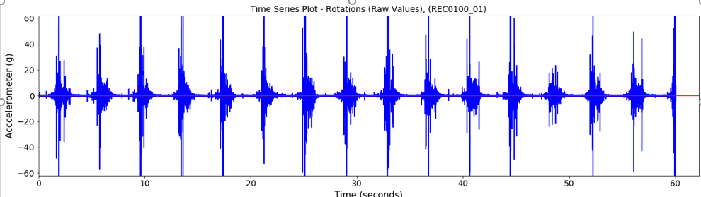
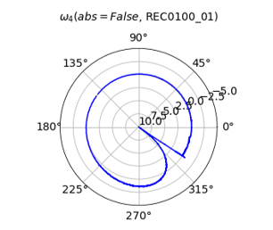
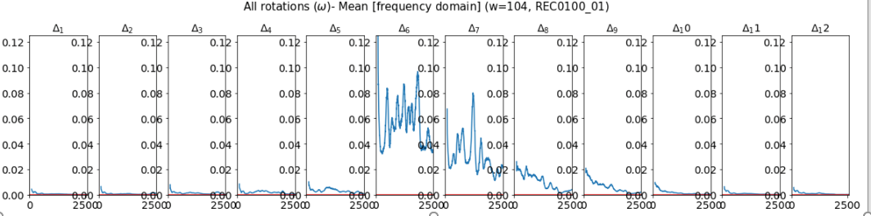
Case Study | Industrial Scientific Analysis
Time series
Rotational energy
Frequency domain

Slide 6
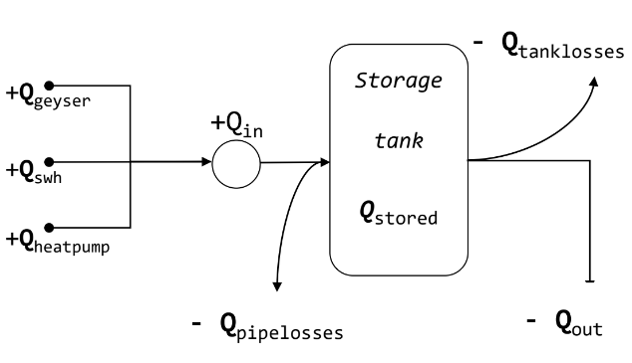
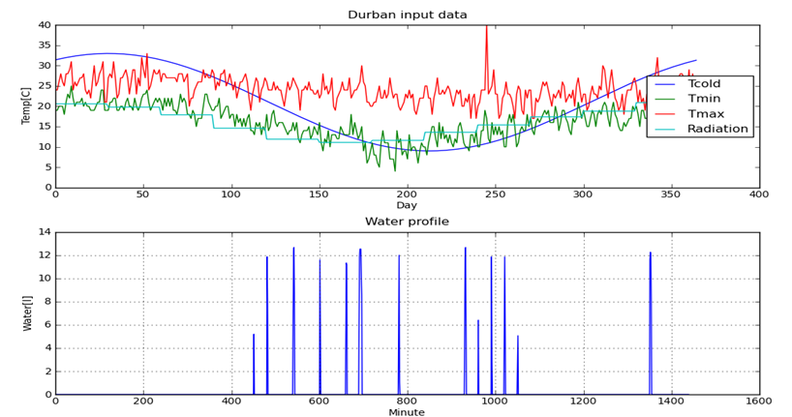
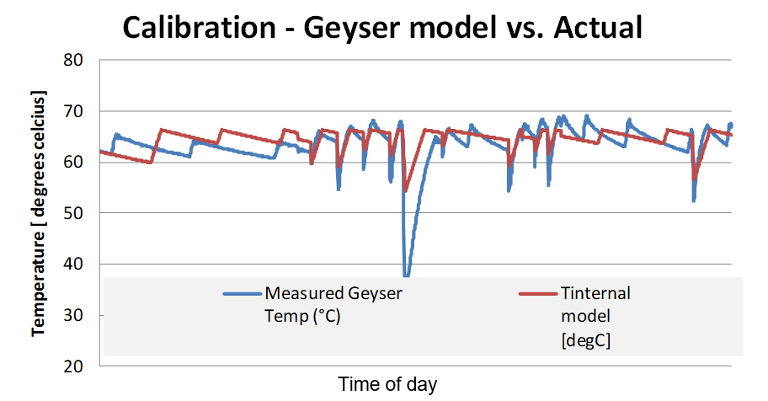
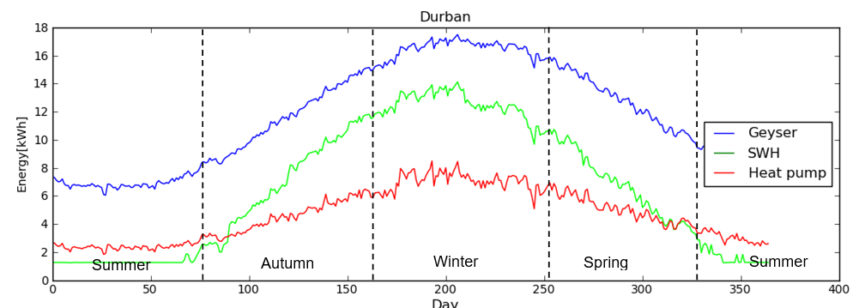
Case Study | Water heating research
Model
Results
Calibration
Results

Slide 7
Case Study | Fourier transforms in industry

Slide 8
Case Study | Automated graphics generation

Slide 9
Case Study | Social post automation

Slide 10
Case Study | Specialized mailing lists

Slide 11
Case Study | Tailor made analysis tools

Slide 12
Case Study | Engineering automation

Slide 13
Case Study | Large data sets analysis

Slide 14
Case Study | Automated presentations

Slide 15
Case Study | Automated PDF reports

